Slide 1
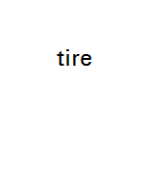
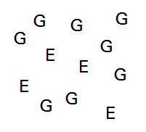
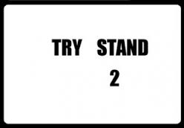
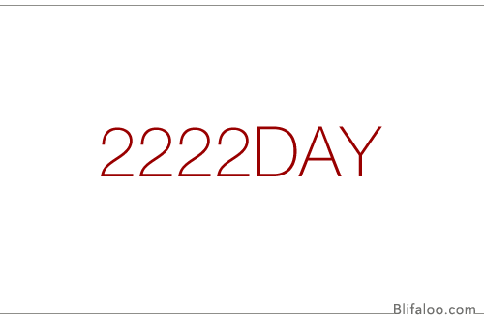
PWALKARK
MEREPEAT
GIVE GET
GIVE GET
GIVE GET
GIVE GET
NOONT
S
E
M I T
Ever
Ever
Ever
Ever
T
O
W
N
TI
ME

Slide 2
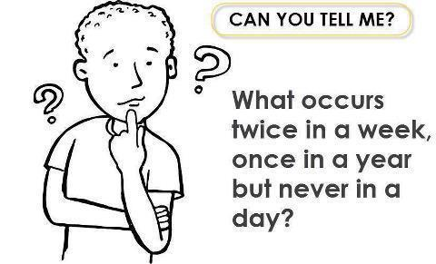

Slide 7
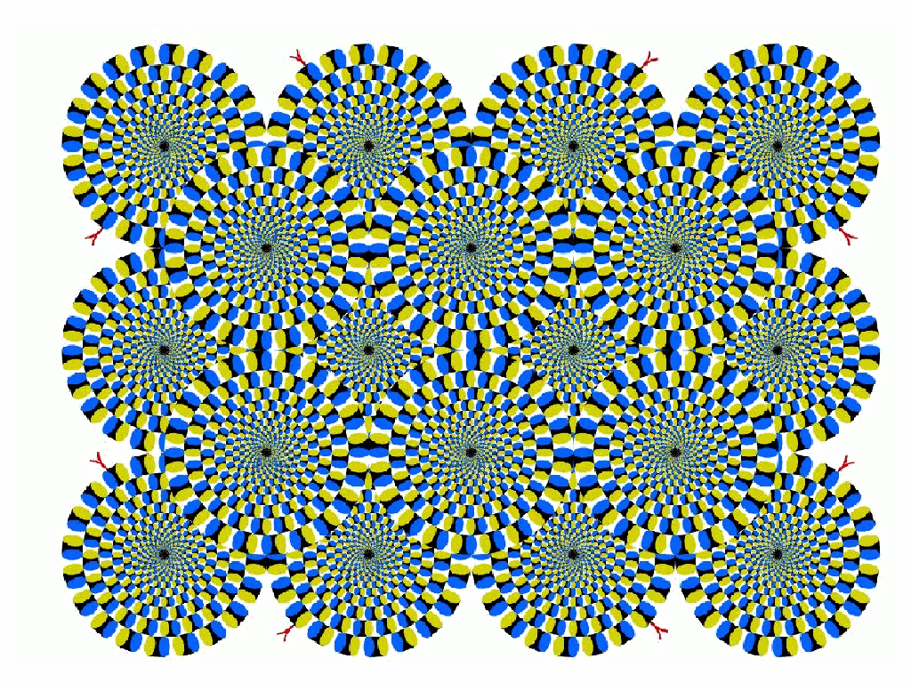

Slide 8
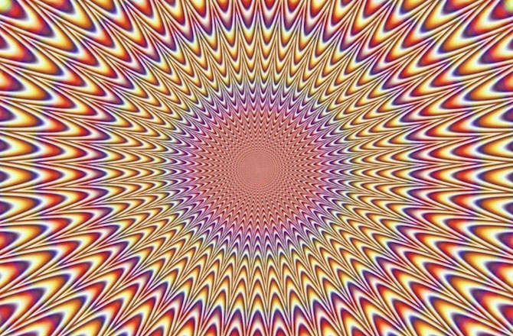

Slide 11
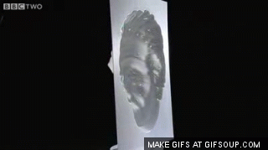

Slide 14
