Slide 1
My Opinion

Slide 2
What is opinion?
Opinion = What do you think?

Slide 4
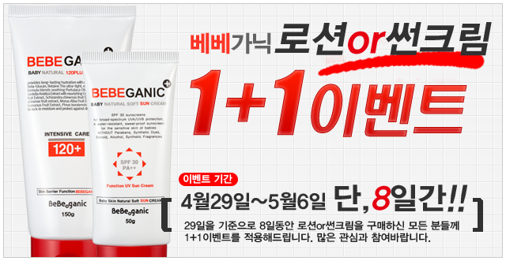
1 + 1 = 2

Slide 5
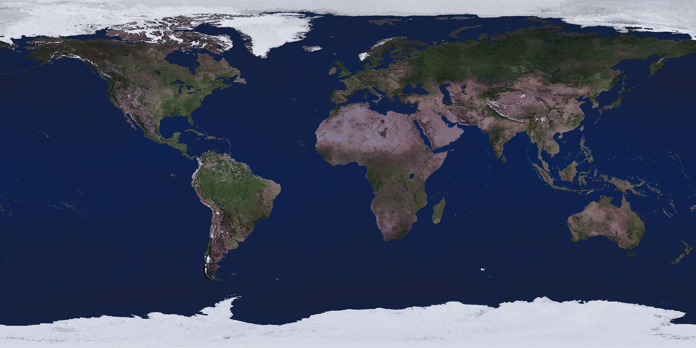
The earth is round.

Slide 6
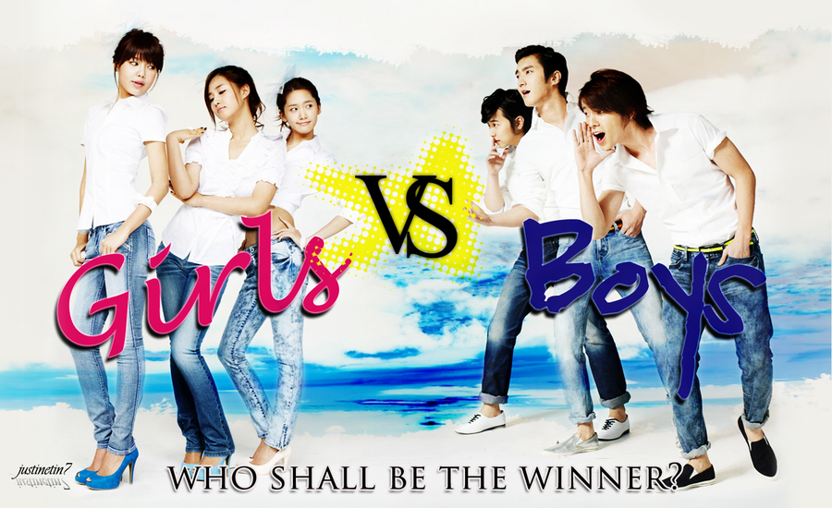
Girls are smarter than boys.

Slide 7
The pyramids are very old.

Slide 8
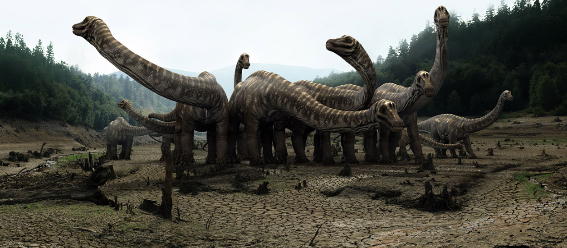
Dinosaurs lived in large groups.

Slide 9
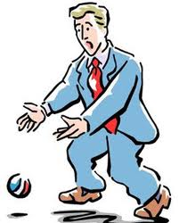
If I drop a ball, it will fall to the floor.

Slide 10
Blue whales are the largest animals to ever live.

Slide 11
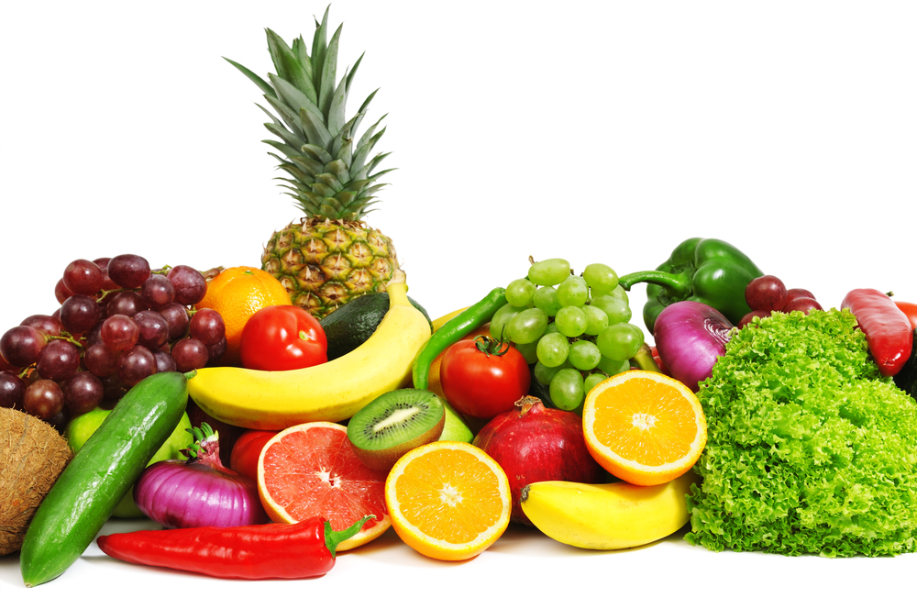
Eating healthy makes you feel happier.

Slide 12
What is your opinion of the following pictures?

Slide 13
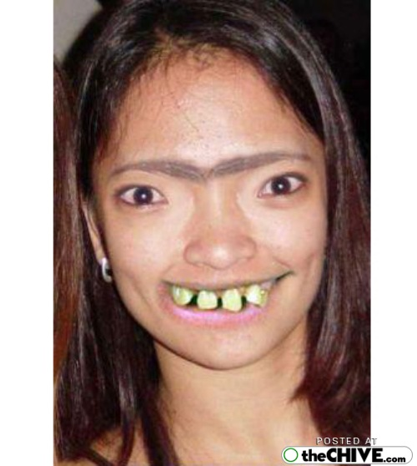

Slide 14
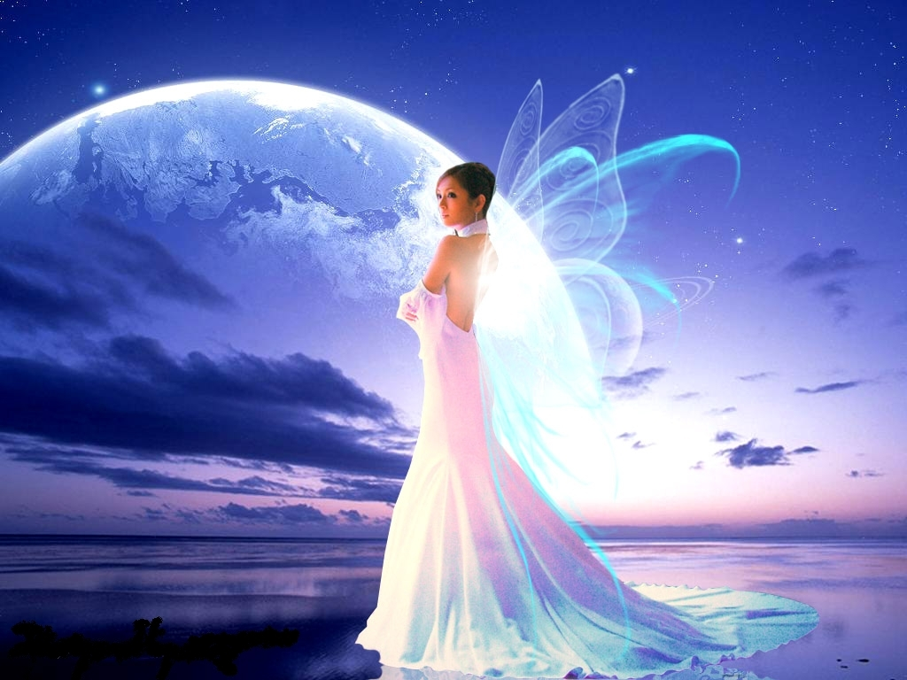

Slide 15
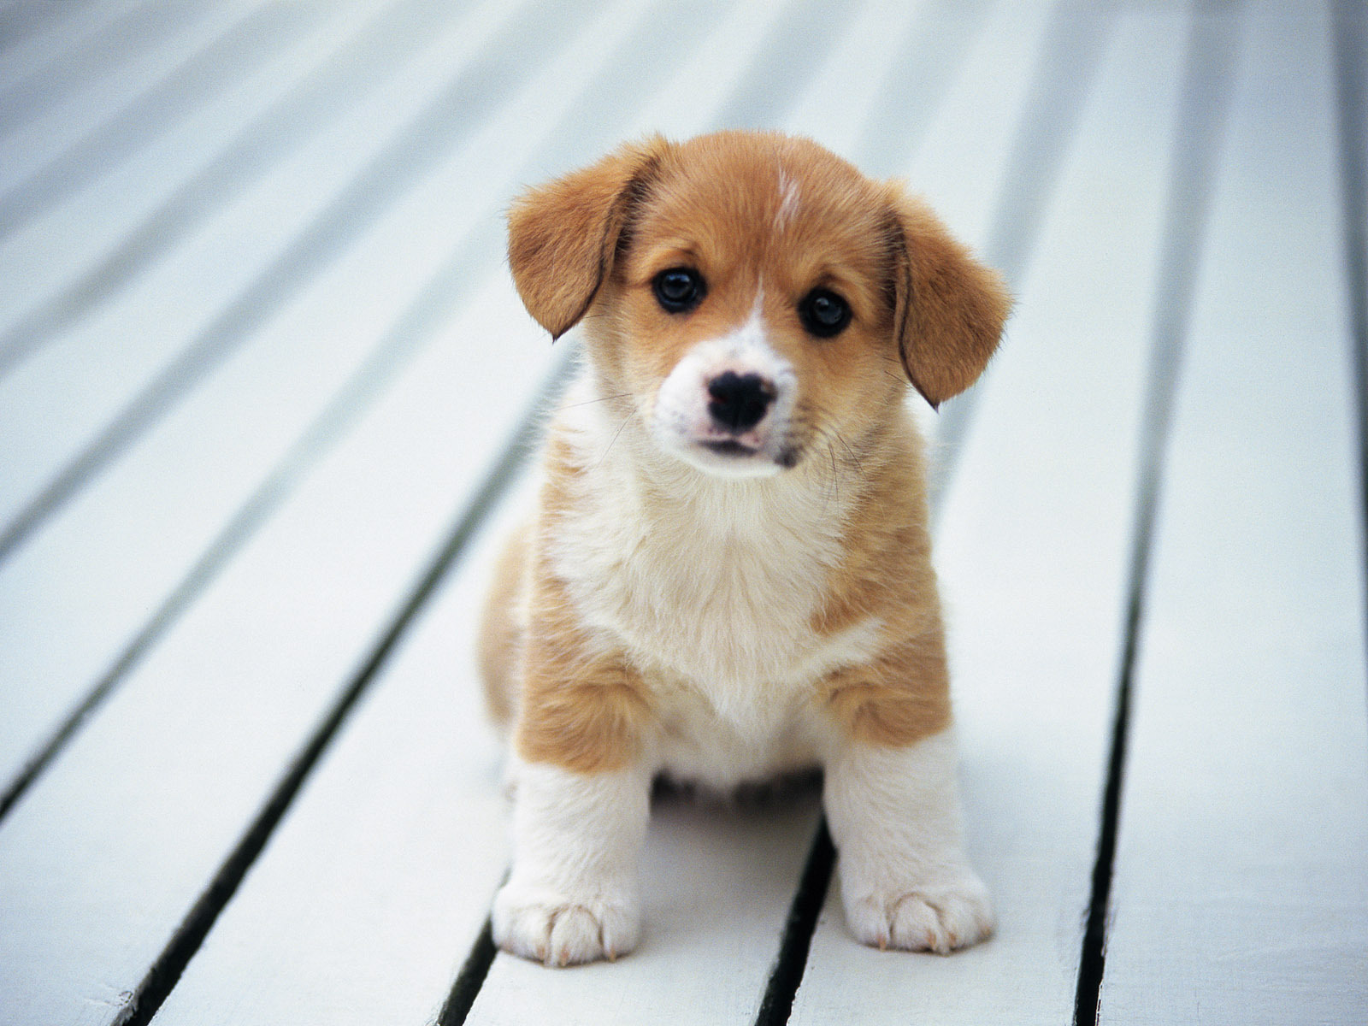

Slide 16
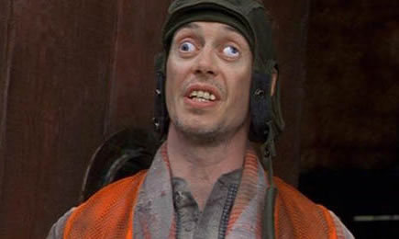

Slide 17
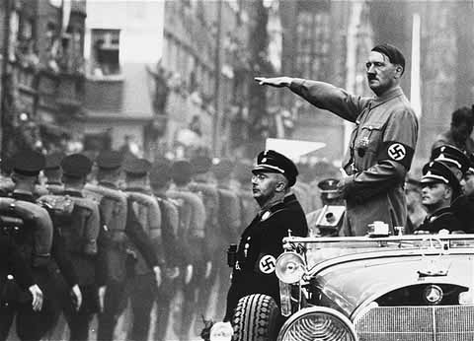

Slide 18
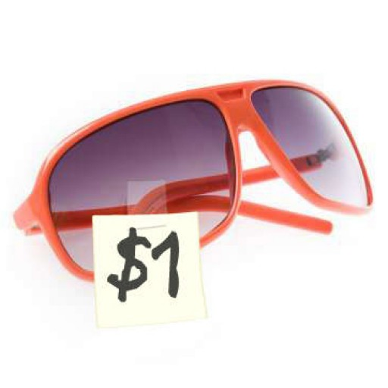

Slide 19
List of opinions:
Ugly
Beautiful
Cute
Crazy
Bad
cheap

Slide 20
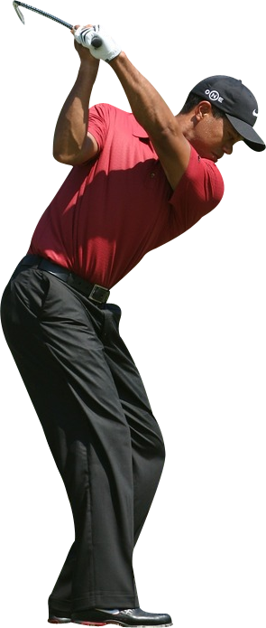
I think ________.
I think it’s ugly.
I think she’s cute.
I think he’s a good golfer.

Slide 21
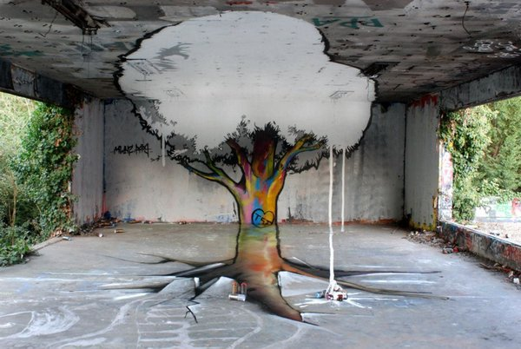

Slide 22
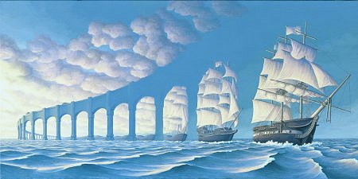

Slide 23
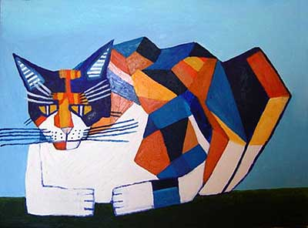

Slide 24
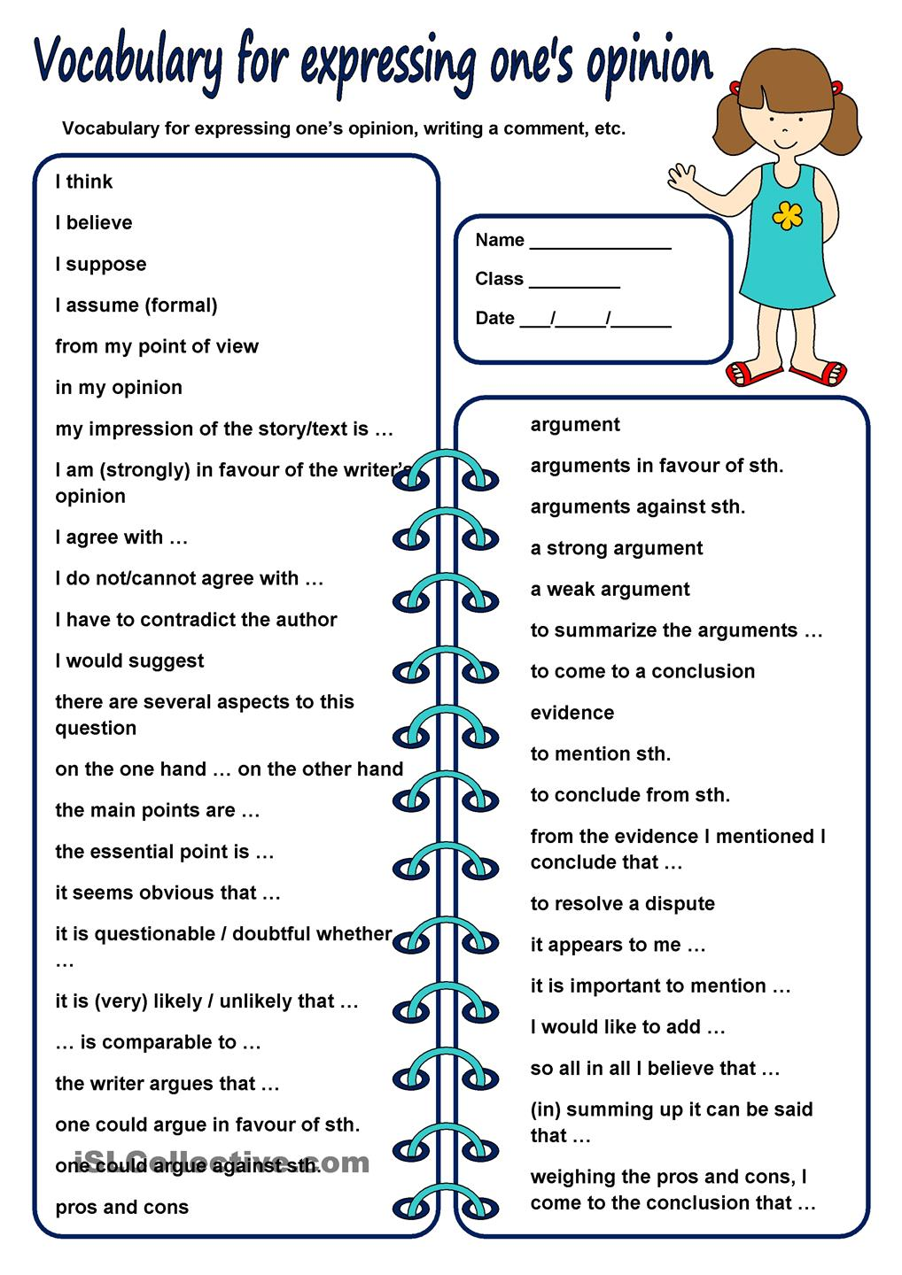

Slide 25
I think…

Slide 26
What’s the best place to live?

Slide 27
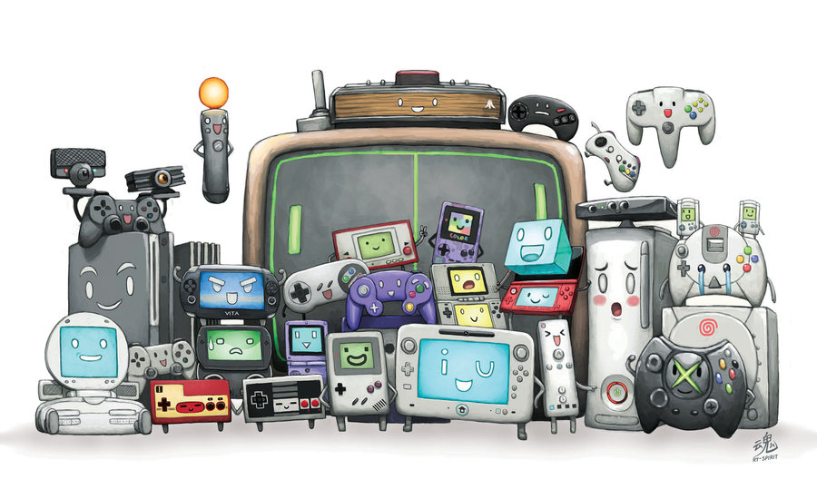
What’s the best video game?

Slide 28
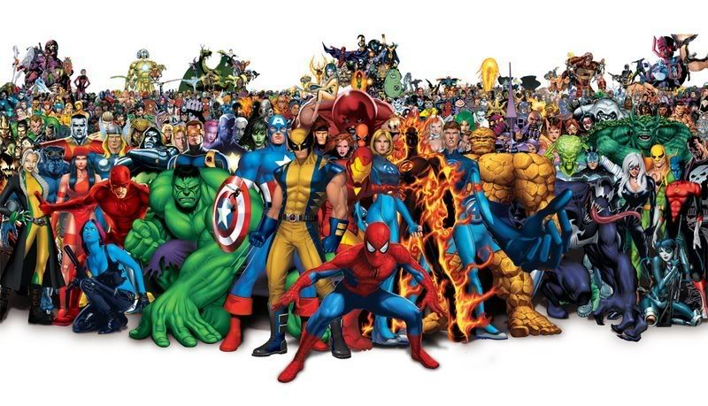
Who is the worst superhero?

Slide 29
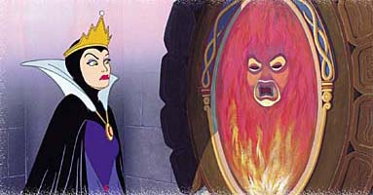
Who is the most beautiful girl?

Slide 30
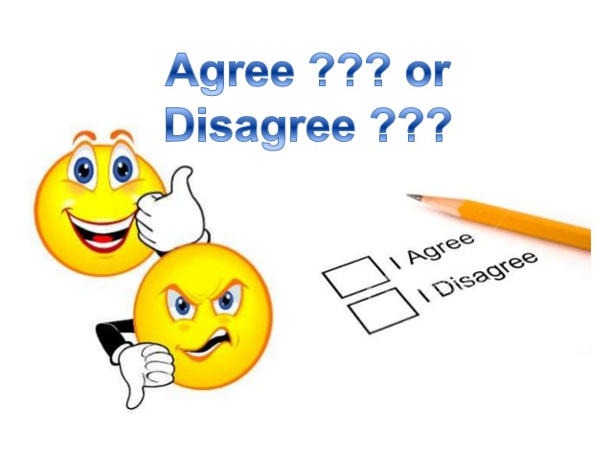
Agree / Disagree

Slide 31
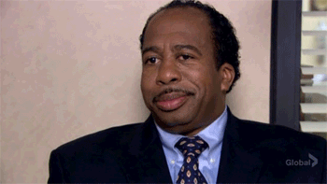
Agree =
동의하다

Slide 32
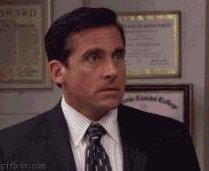
Disagree =
맞지 않다

Slide 33
Agree / Disagree

Slide 34
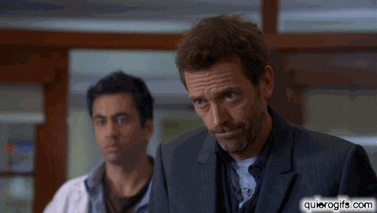
Agree / Disagree

Slide 35
Agree:
I second that idea.
I agree with you.
I’m for the idea.

Slide 36
Disagree:
I object to that idea.
I’m opposed to the idea.
I’m against the idea.

Slide 37
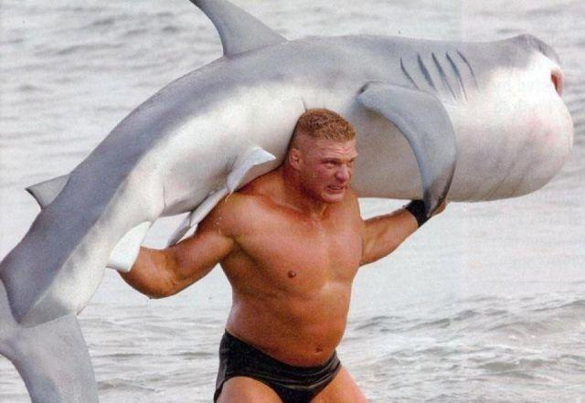
He is a strong man.

Slide 38
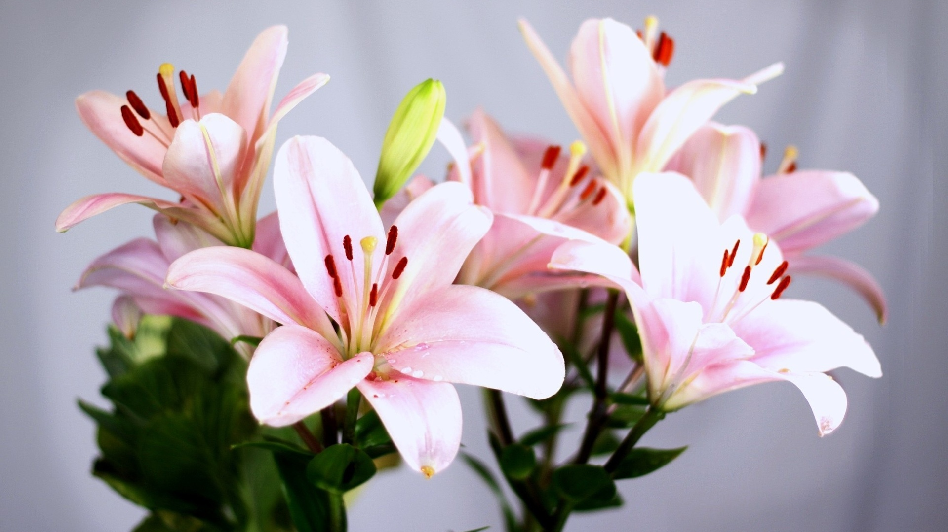
Lilies are the most beautiful flower.

Slide 39
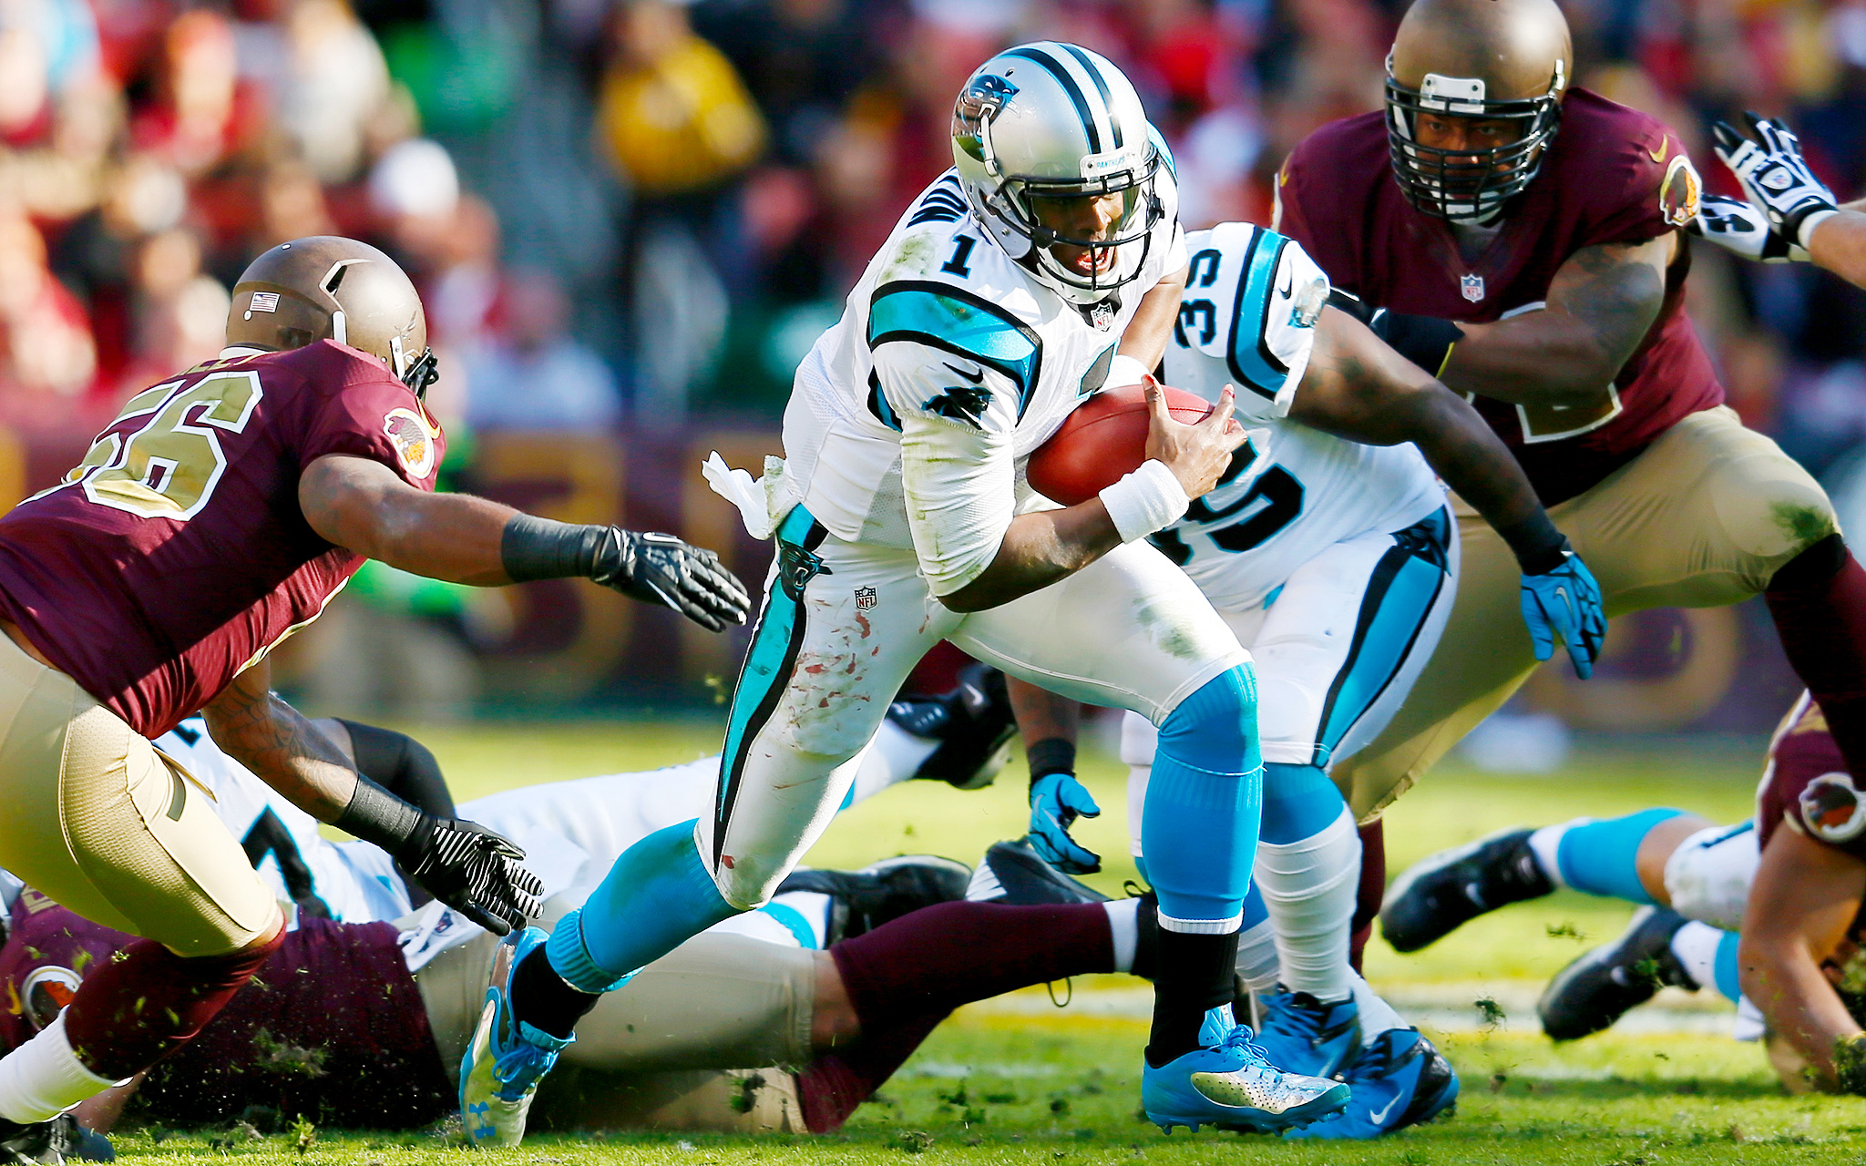
American Football is the best sport.

Slide 40
Agree

Slide 41
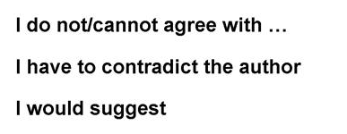
Disagree

Slide 42
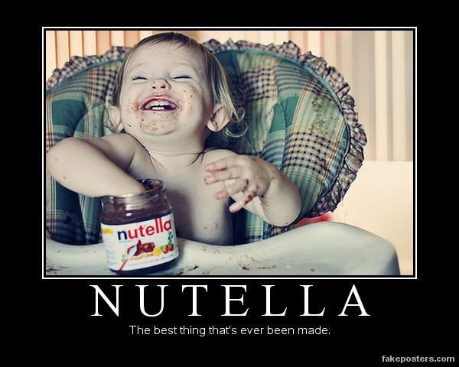

Slide 43
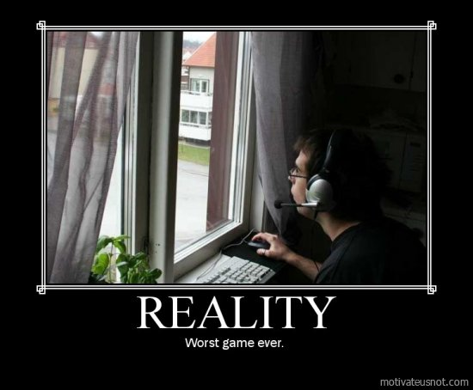

Slide 45
Debate
Each side take one side of an argument.

Slide 46
Alcohol should be illegal.
Agree / Disagree

Slide 47
High school students should wear uniforms.

Slide 48
Junk food should be illegal in public schools.

