Slide 1
Write on the card:
Something you like to do.
Pink
Something you don’t like to do?
Yellow

Slide 2
Would you rather

Slide 3
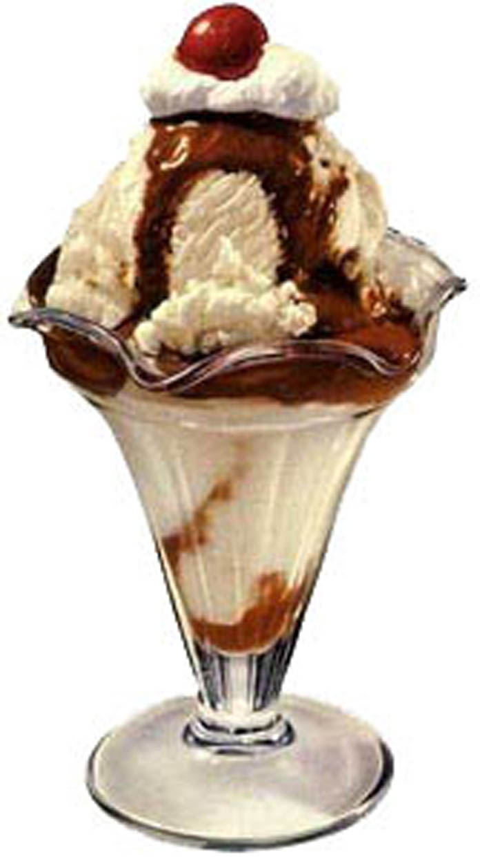
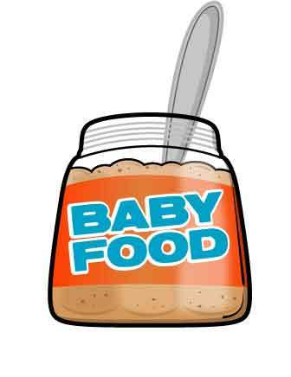
Choice
Do you want Ice Cream OR Baby food?

Slide 4
I want
I want __________.
I want to ___________.
NOUN
VERB

Slide 5
Both / Neither
2 things = both
0 things = neither

Slide 6
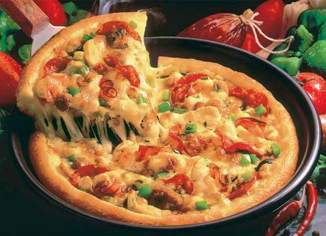
Choice
Do you want Ice Cream OR Pizza?

Slide 7
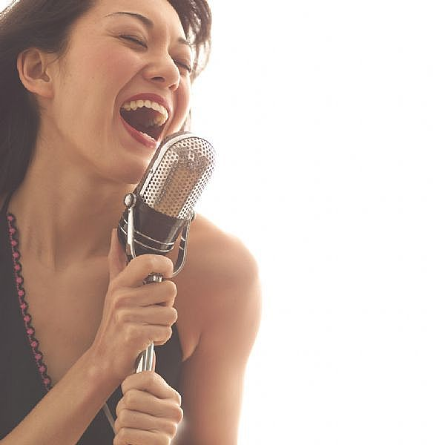
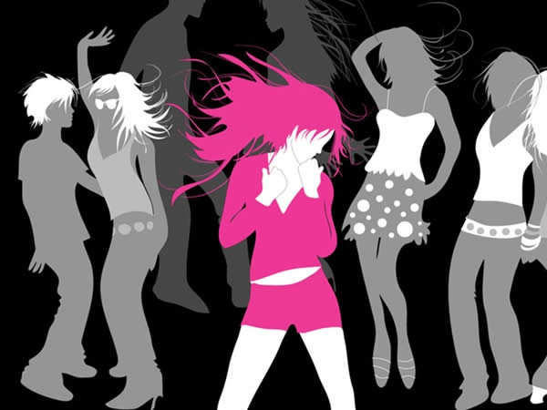
Would you rather ...
Dance
OR
Sing

Slide 8
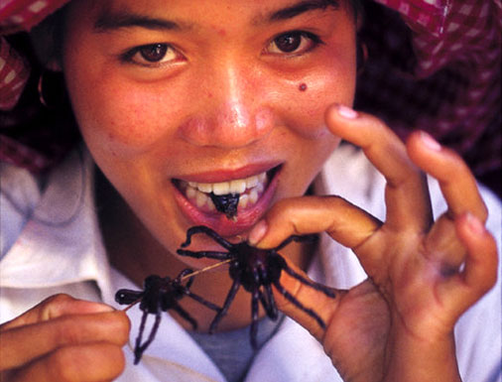
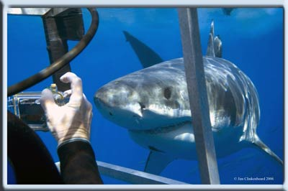
Would you rather ...
Eat an insect
OR
Swim with sharks?

Slide 9
I’d rather...
VERB
I would rather ___________.

Slide 10
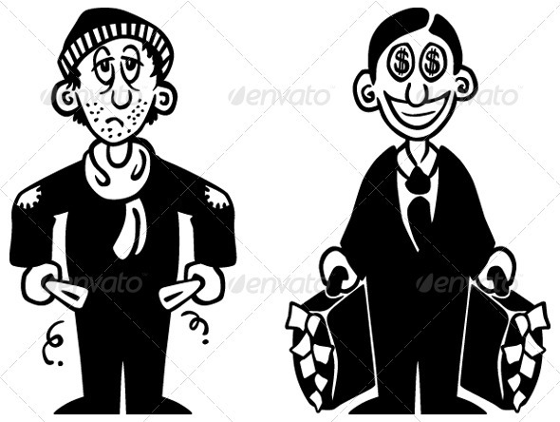
Rather / Than
Be rich Be poor
I’d rather _____________ than ___________.

Slide 11
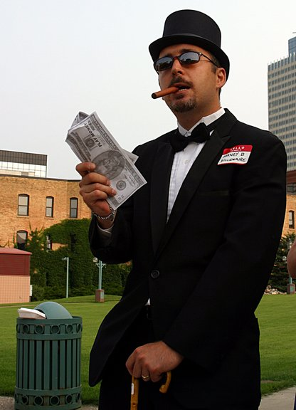
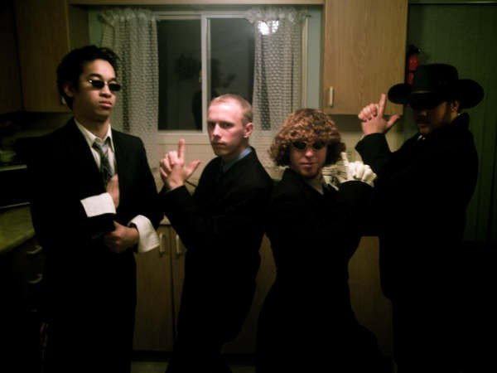
Would you rather ...
Be rich and alone
OR
Be poor but have
many friends

Slide 12
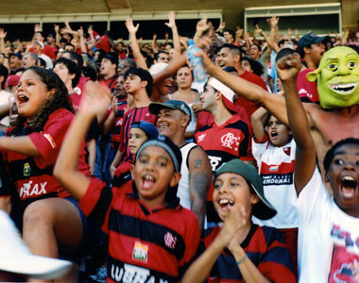
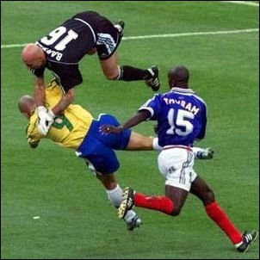
Would you rather ...
Watch soccer
OR
Play
soccer

Slide 13
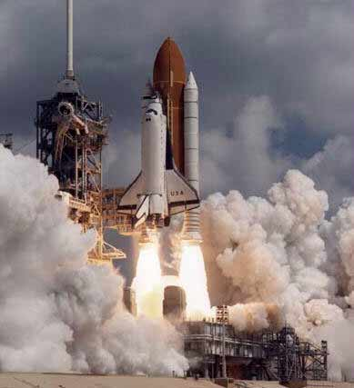
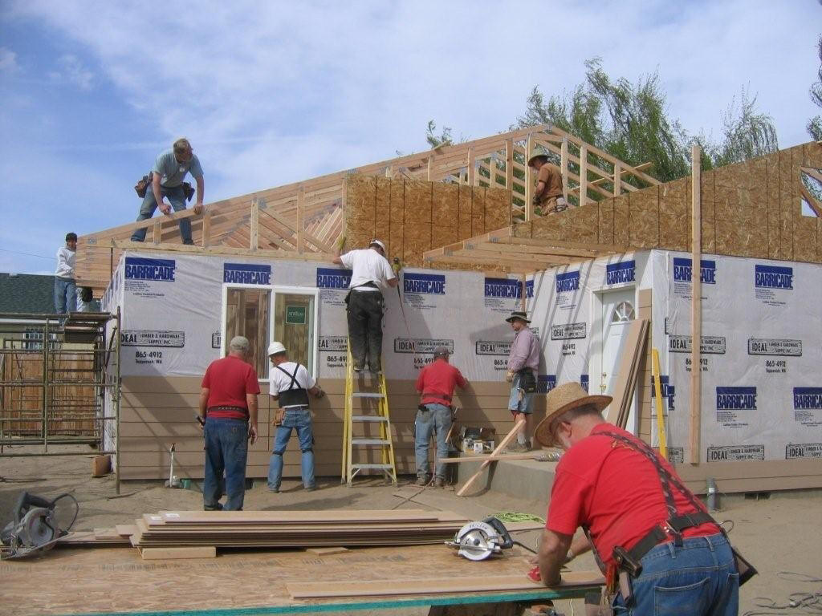
Would you rather ...
Fly to the moon
OR
Build your own house

Slide 14
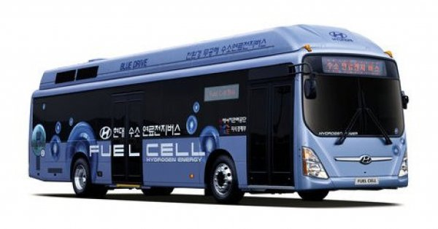
Would you rather ...
Take a bus
OR
Take a train

Slide 15
I prefer...
VERB or Noun
I prefer ___________.
I would prefer ___________.
VERB or Noun

Slide 16
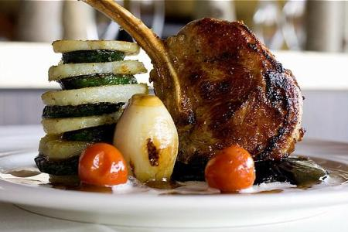
Do you like...
Home cooking
OR
Restaurant food

Slide 17
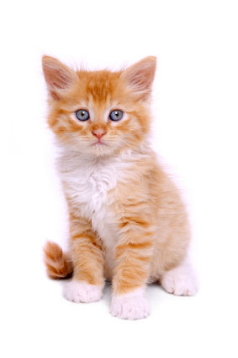
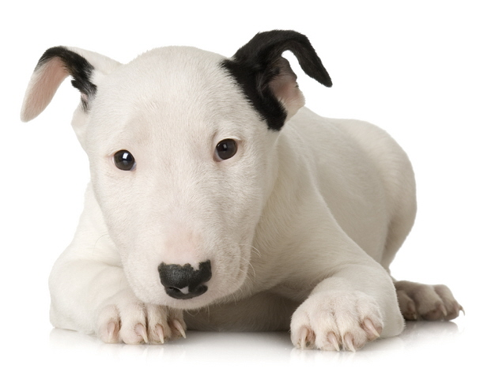
Do you like .....
Cats
OR
Dogs

Slide 18
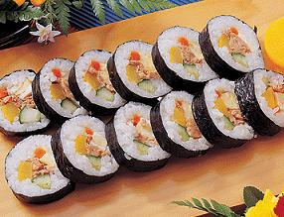
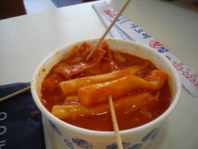
Do you want...
Kimbap
OR
Ddeokbokki

Slide 19
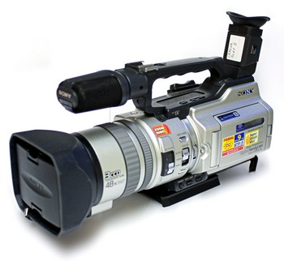
Would you rather ...
Read a book
OR
Watch a movie

Slide 20
Cards:
Answer, “Would you rather….”

Slide 21
Make Your Own Question:
Would you rather __________ or _________?
Do you want ___________ or ___________?
Do you like ___________ or ____________?

Slide 22
Ask 9 students:
Name | ______________ | ______________

Slide 23
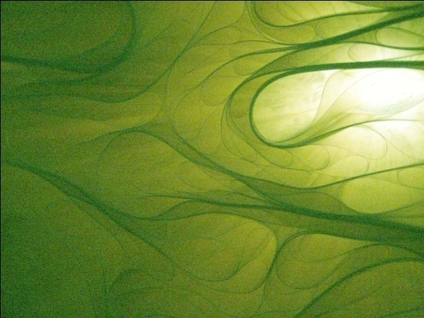
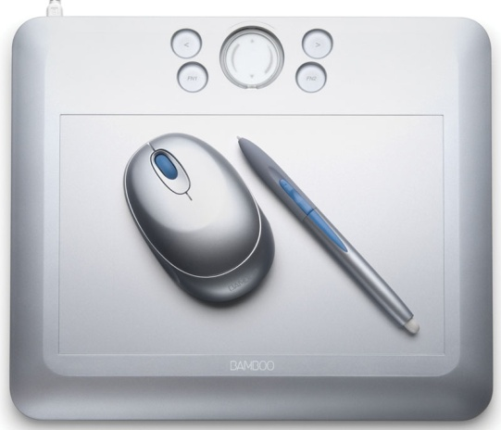
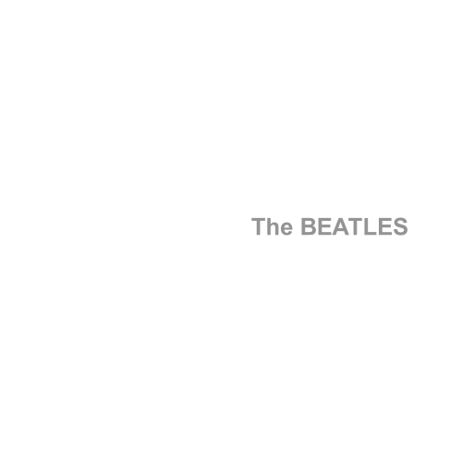
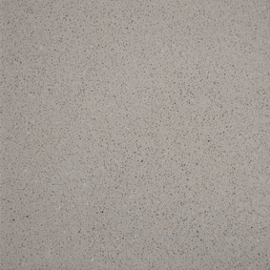
What is your favourite color?

Slide 24
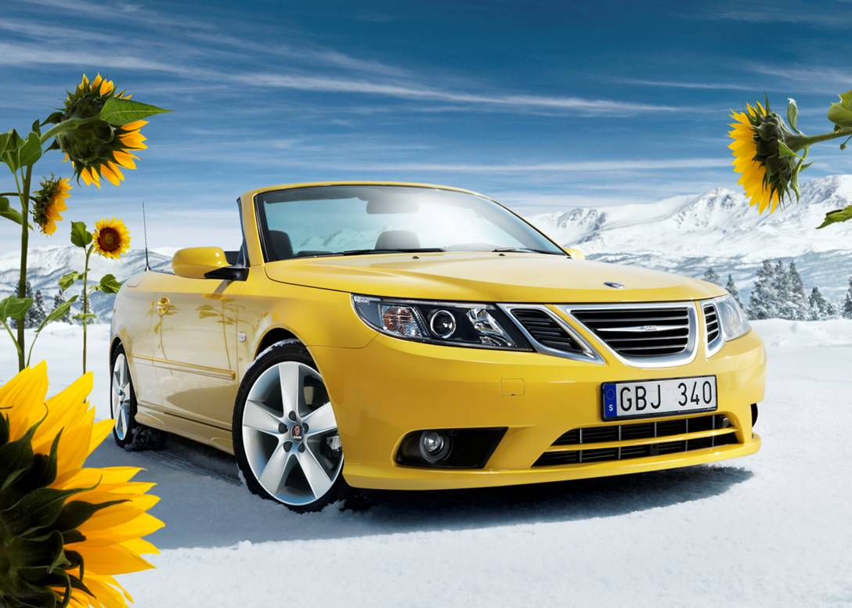
Yellow
Happiness
Wisdom
Imagination
“sunny personality”
Coward (easily scared)

Slide 25
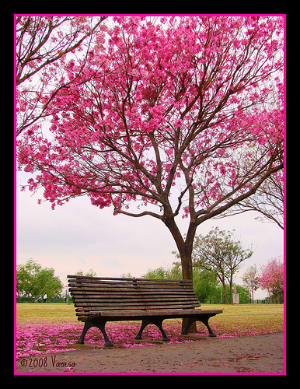
Pink
Love
Affection
Motherly
Wants protection
Sheltered life
Delicate and fragile

Slide 26
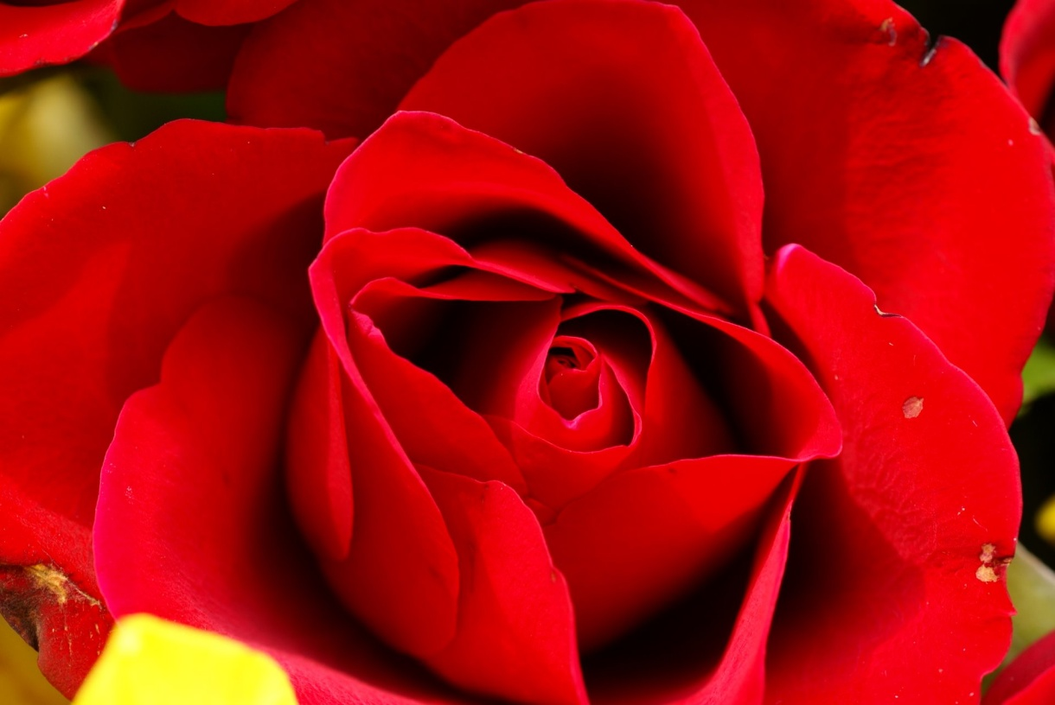
Red
Health and vitality
Passion – Love and Anger
Outgoing
Ambitious

Slide 27
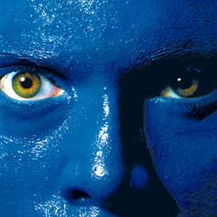
Blue
Calm
Compassionate
Sensitive
Patient
Wisdom

Slide 28
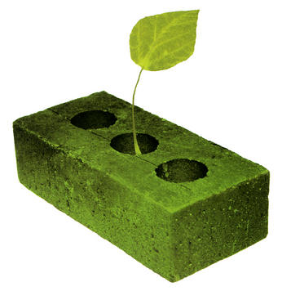
Green
Harmony
Hope
Renewal
Peaceful
Social

Slide 29
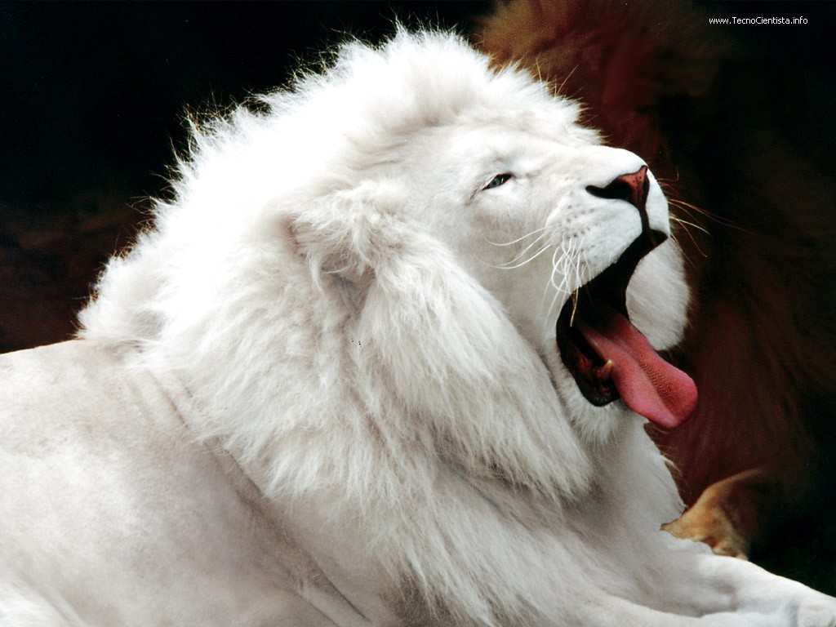
White
Pure
Clean
Innocent
Naive

Slide 30
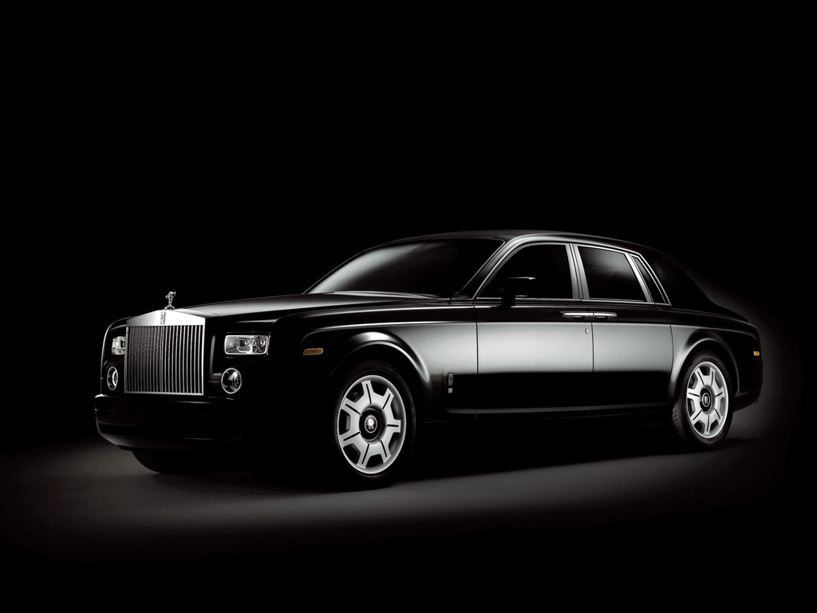
Black
Conservative
Serious
Mysterious
Evil

Slide 31
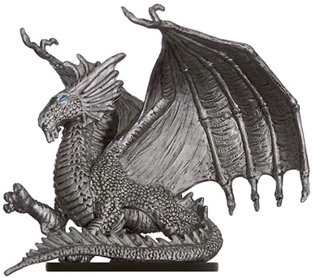
Silver
Cool
Playful
Modern
Have expensive things

Slide 32
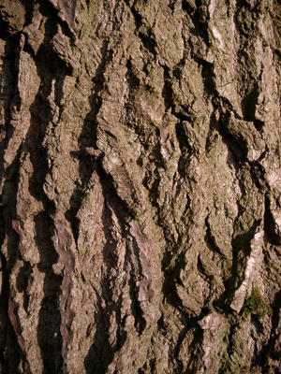
Brown
Nature
Down to earth **
Friendly
Responsible
Inflexible

Slide 33
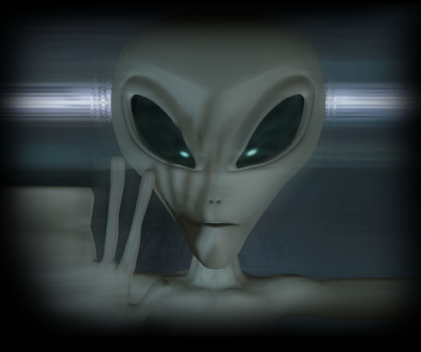
Grey
Neutral
Conservative
Cautious
Work too much

Slide 34
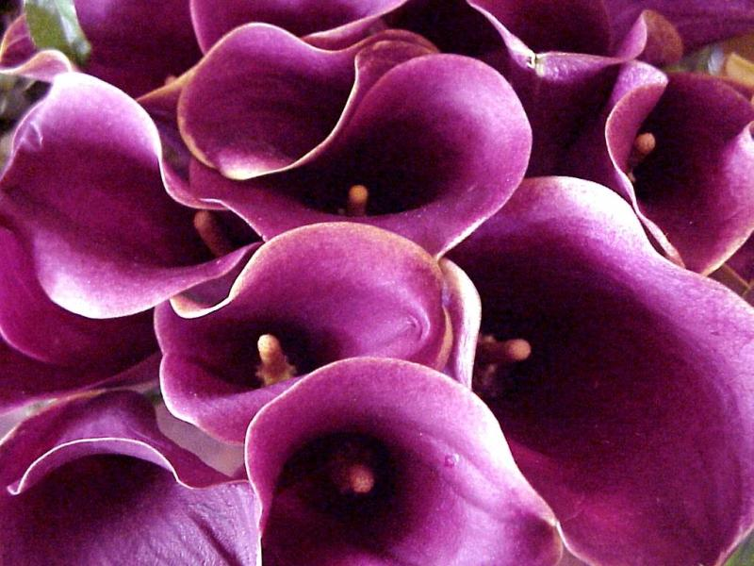
Purple
Royalty (dignified)
Artistic
Unique
Spiritual

Slide 35
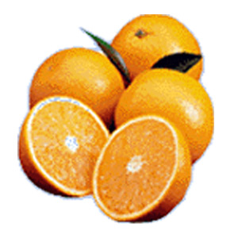
Orange
Like luxury
Energy
Popular / Social
Curiosity

Slide 36
What are your favorite 3 animals?

Slide 37
What are your favorite 3 animals?
What your friends think about you.
What you think of yourself
What you want to be

