Slide 1
Compare and Contrast

Slide 2
Comparatives
Superhero duel

Slide 3
What are comparatives?
Show the differences

Slide 4
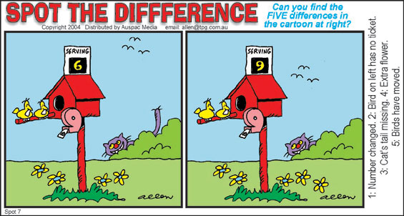
d

Slide 5
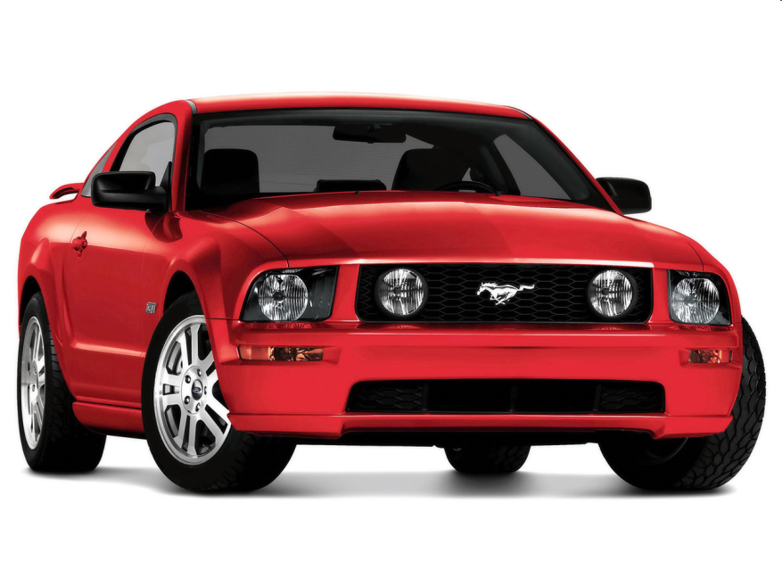
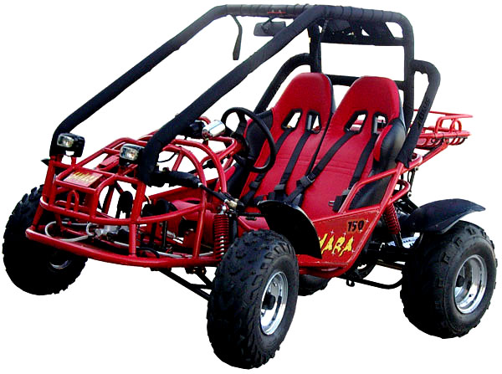
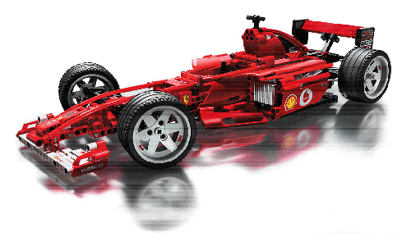
Comparatives / Superlatives
Fast
Faster
Fastest

Slide 6
Smart
Smarter
Smartest

Slide 7
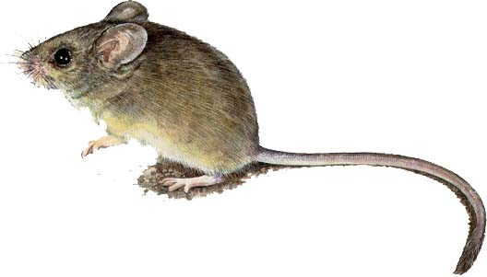
Small
Smaller
Smallest

Slide 8
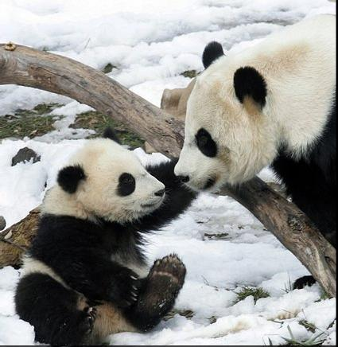
Cute
Cuter
Cutest

Slide 9
Thin
Thinner
Thinnest

Slide 10
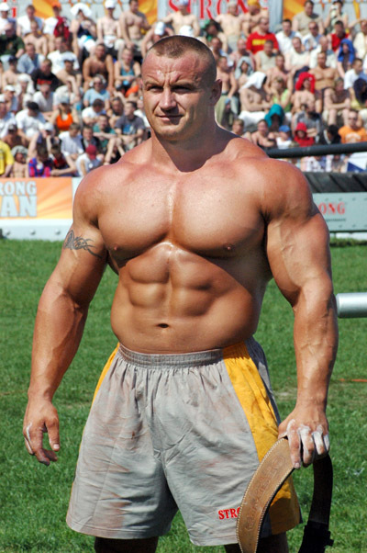
Strong
Stronger
Strongest

Slide 11
Sexier
Sexiest
Sexy

Slide 12
Happy
Happier
Happiest

Slide 13
Intelligence
Smarter
Smartest

Slide 14
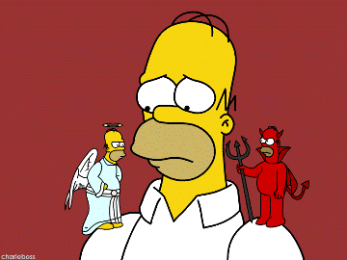
Strange Comparatives (morallity)
Good
Bad
Better
Best
Worse
Worst

Slide 15
Strange Comparatives (attractiveness)
More beautiful Most beautiful
More handsome Most handsome
Less beautiful Least Beautiful
Less Handsome Least Handsome

Slide 16
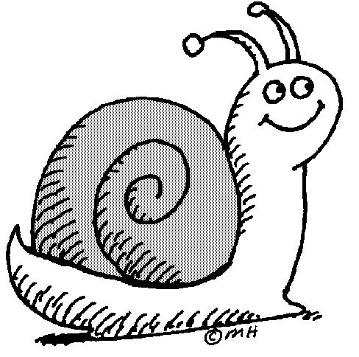
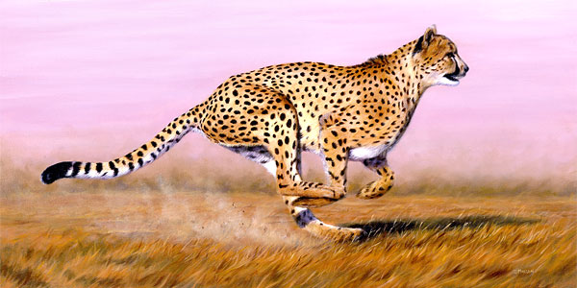
Compare these:
Snail, cheetah

Slide 17
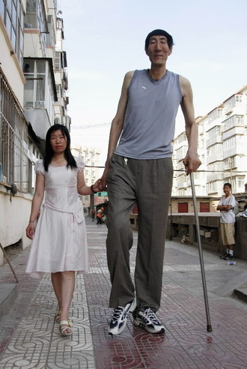
Compare these:

Slide 19
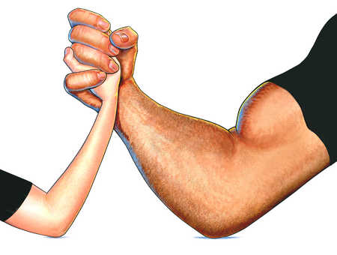

Slide 20
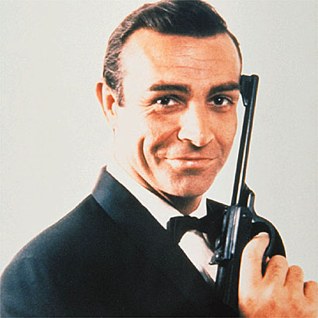
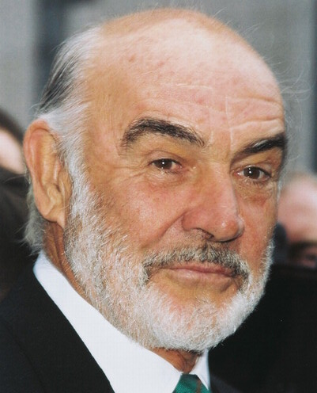

Slide 21
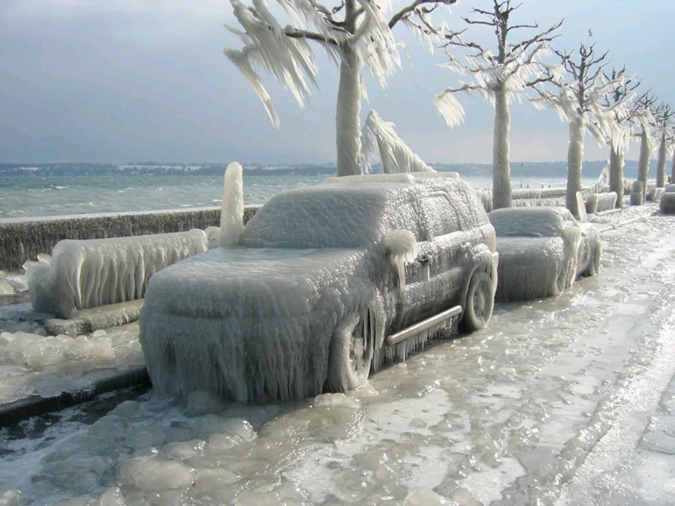

Slide 22
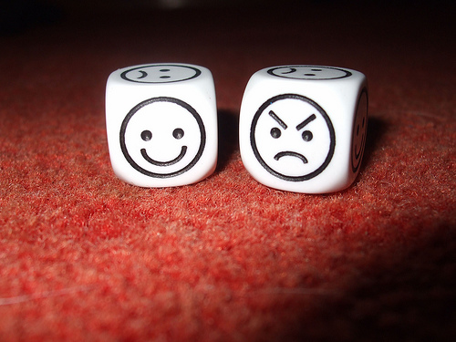

Slide 23
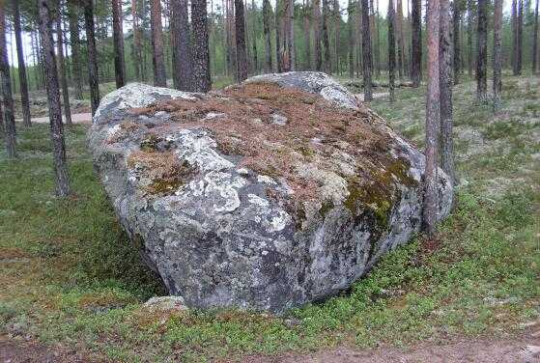
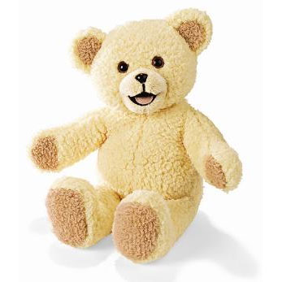

Slide 24
Game
Fast, Faster
Speed
Power
Size
Intelligence
Strong, Stronger
Big, Bigger
Smart, Smarter

Slide 25
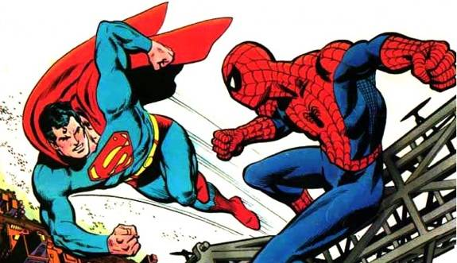
Hero vs Hero

Slide 26
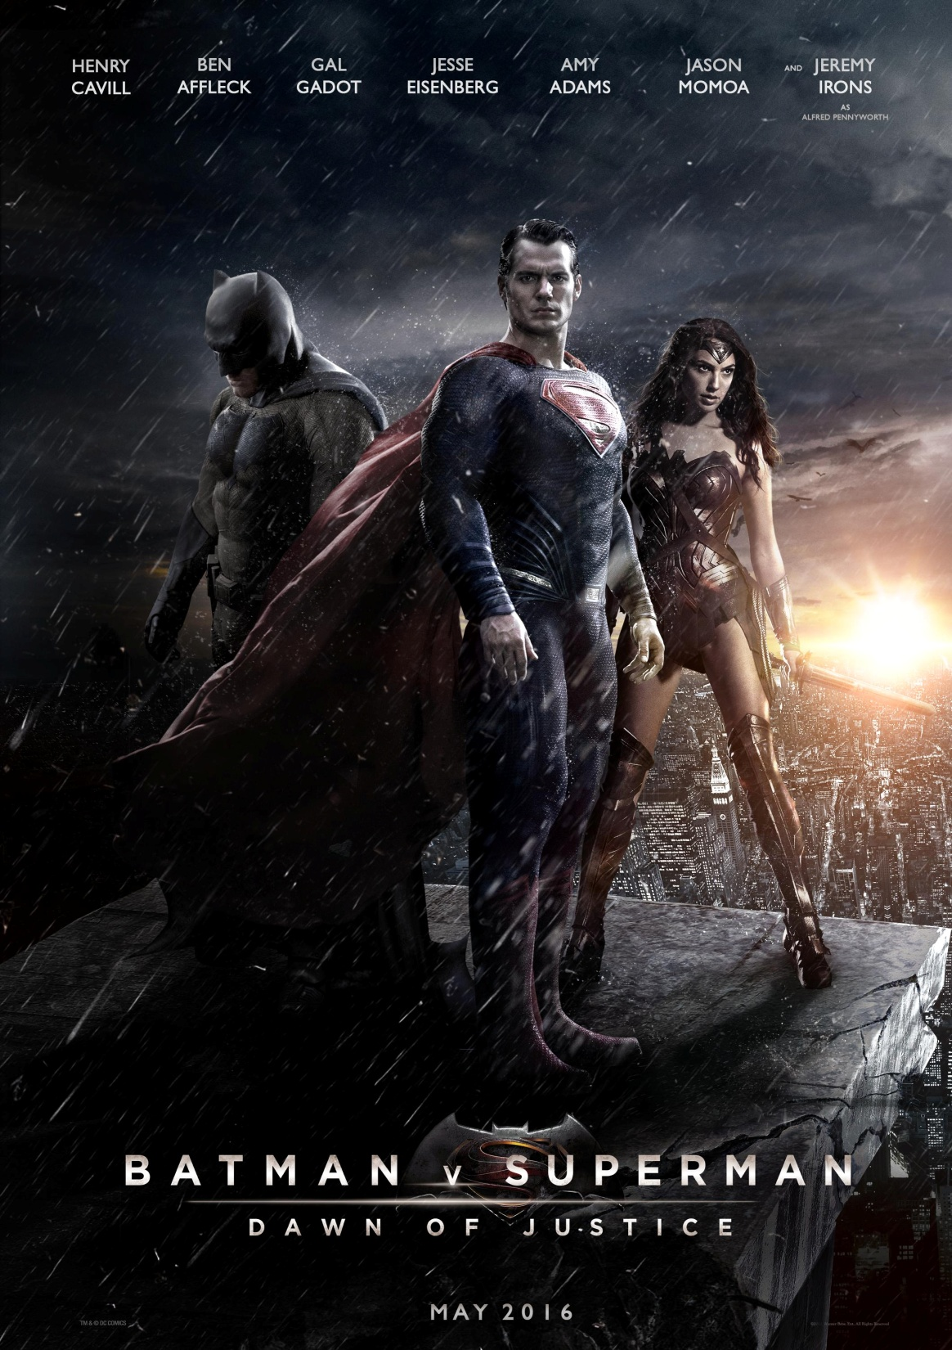

Slide 27
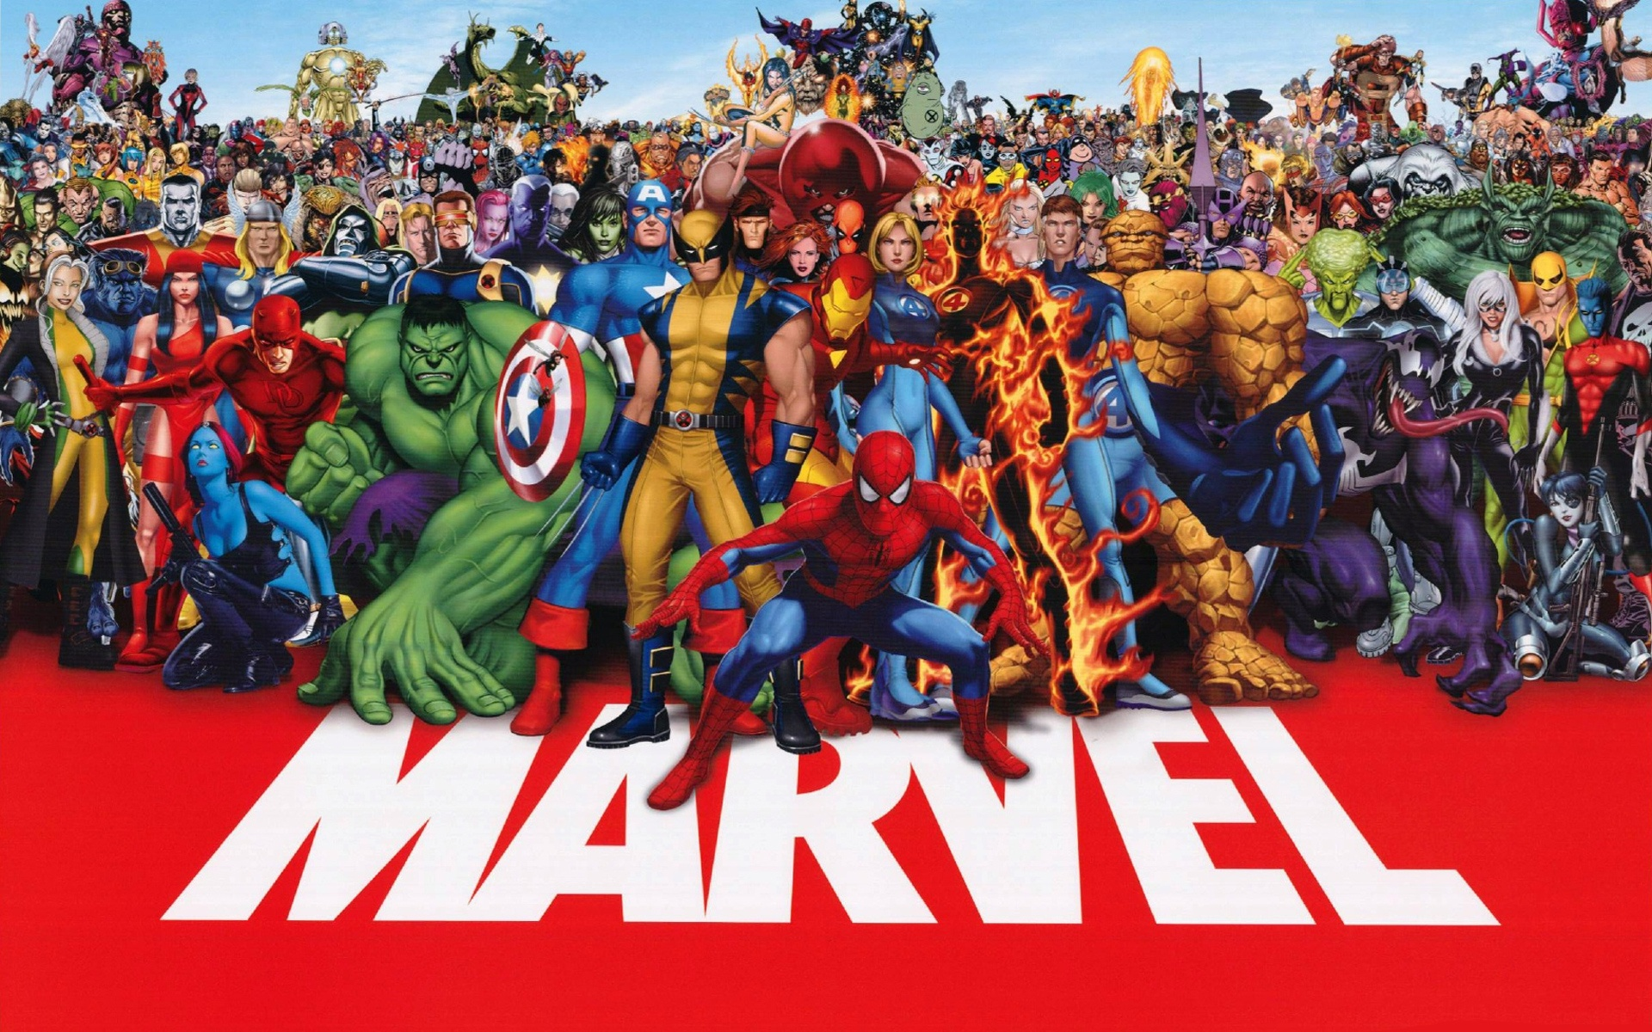

Slide 28
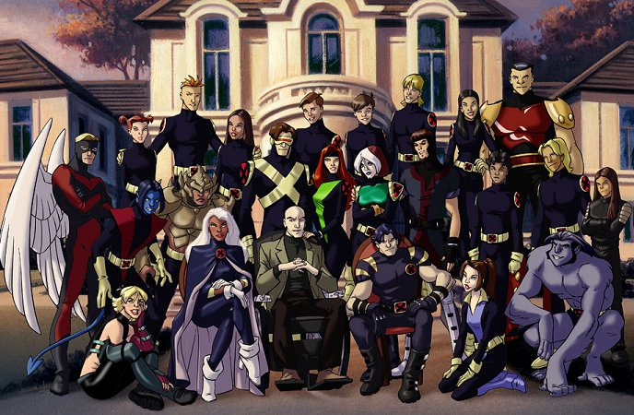

Slide 29
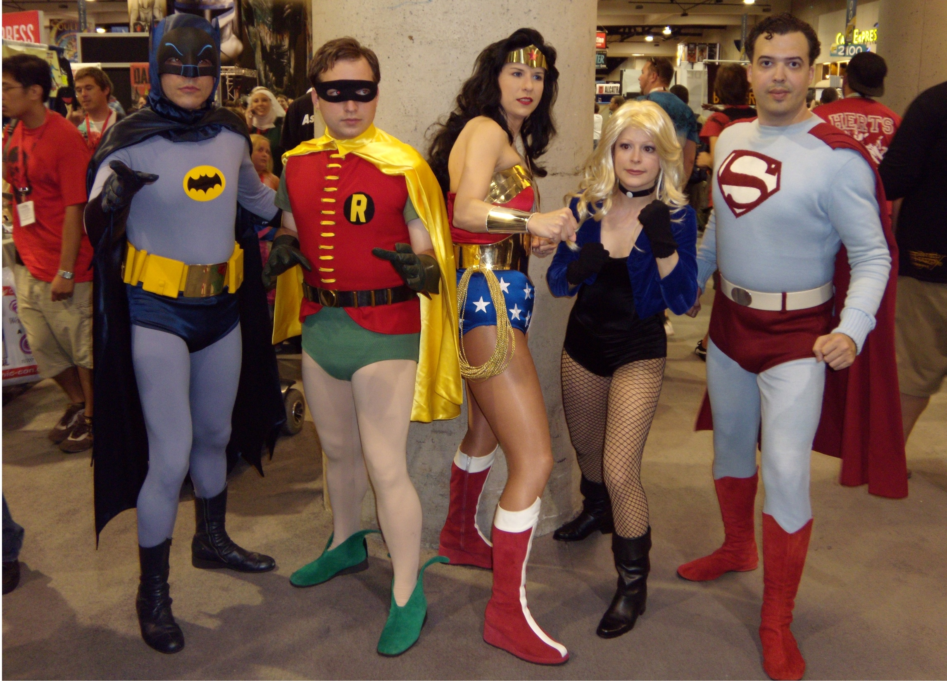

Slide 30
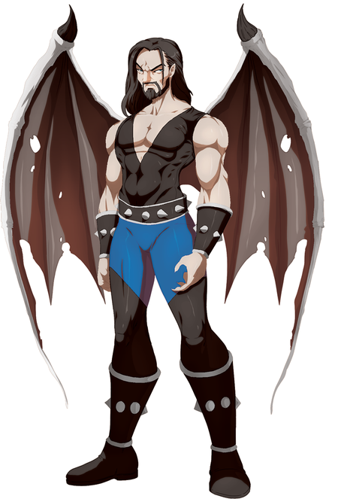
Pteroman
(100 points total)
Size: 15 Power: 25
Speed: 10 Morality: 36
Intelligence: 10
Attractiveness: 4

Slide 31
Rules
Two heroes will battle.
Roll the dice
1 = size 2 = Power 3 = Speed,
4 = Morality 5 = Intelligence 6 = Attractiveness
Flip a coin
Heads = more Tails = Less
Whoever wins must use a comparative sentence.
Last One Alive Will Win

Slide 32
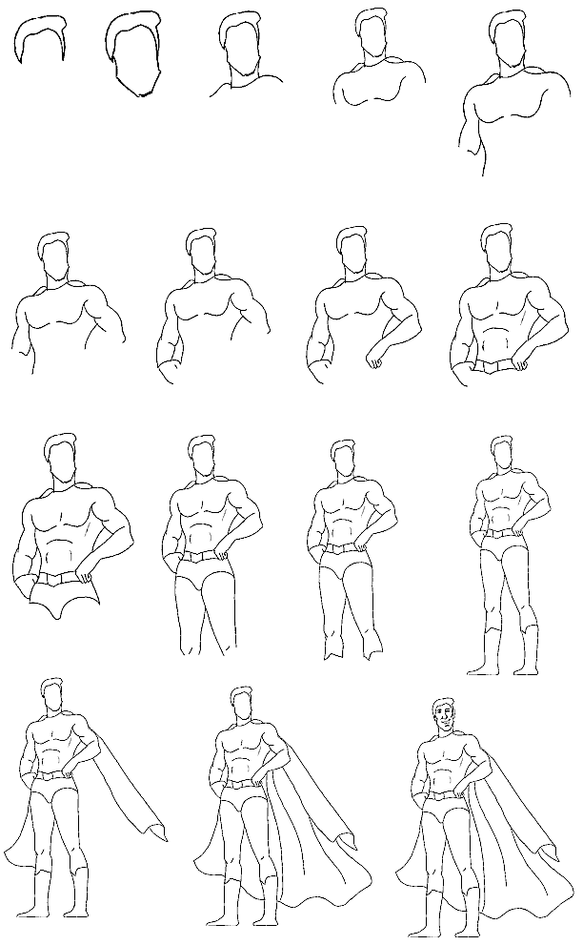
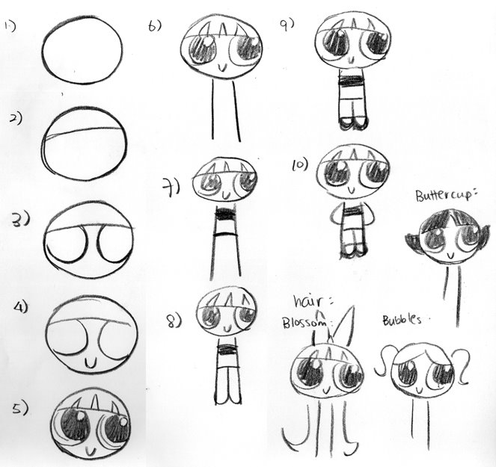

Slide 33
Superhero Name: _____________
(100 points total)
Size: Power:
Speed: Morality:
Intelligence:
Attractiveness:

Slide 34
Superlatives
Olympics / Class superlatives

Slide 35
Class Superlatives
Write your name on a card.
Pass the card around.
Everyone write a superlative about that student.

Slide 36
Daedeok Olympics

Slide 37
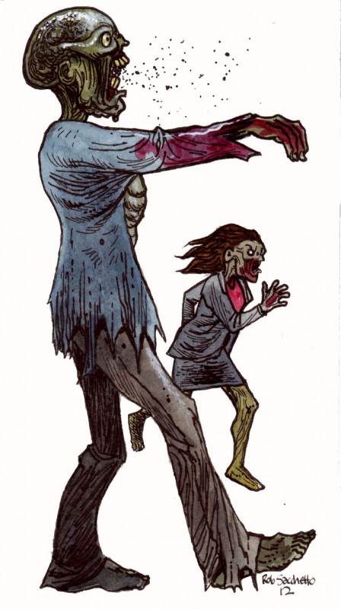
Event 1 (strongest zombie)

Slide 38
Event 2 (fastest speaking)

Slide 40
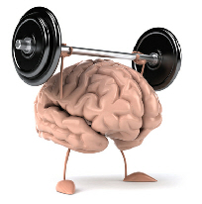
Event 3 (smartest)

Slide 42
Event 4 (fastest writing)

Slide 43
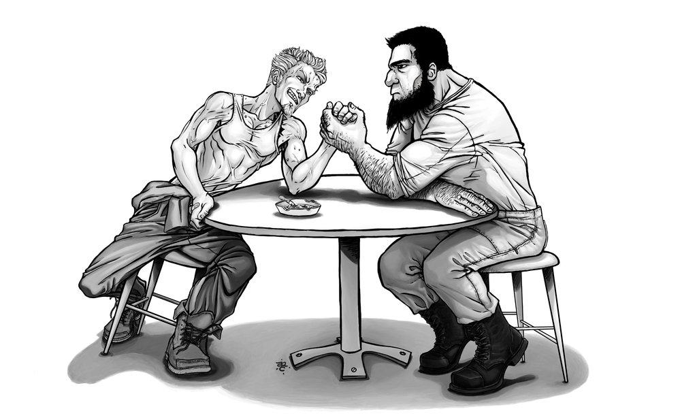
Event 5 (strongest 2)

Slide 44
Contrasting

Slide 45
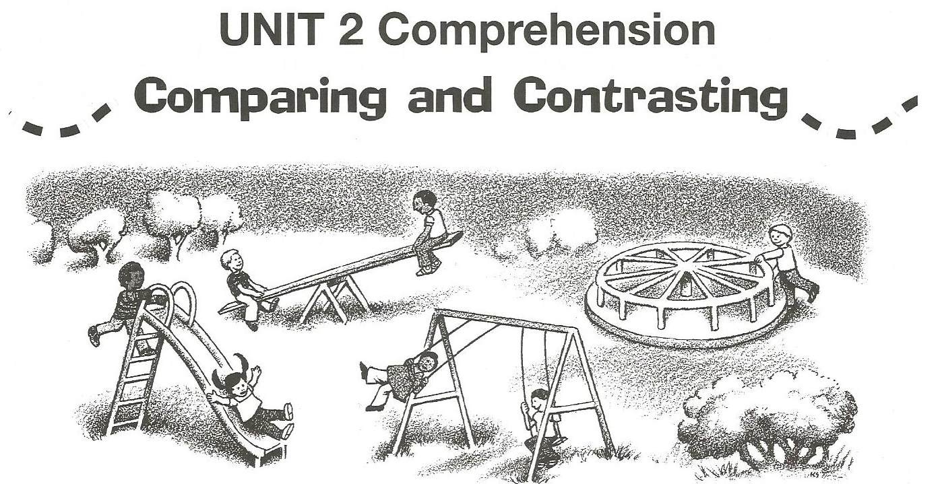
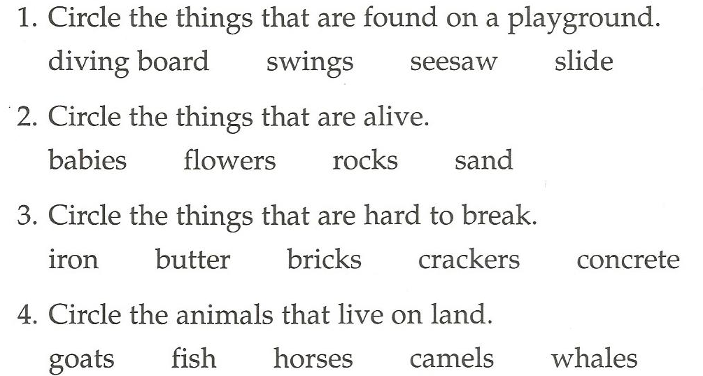

Slide 46
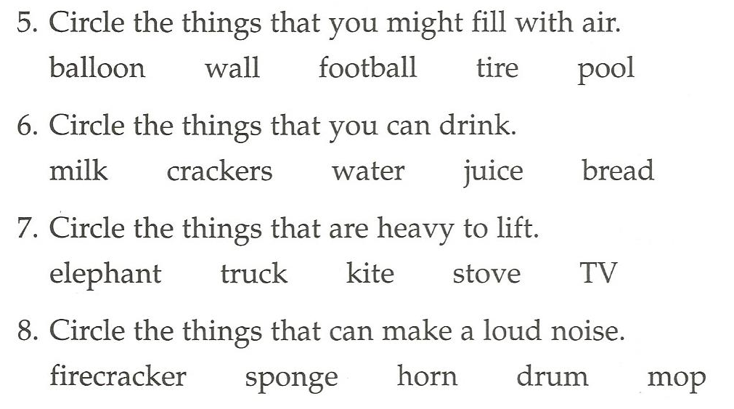

Slide 48
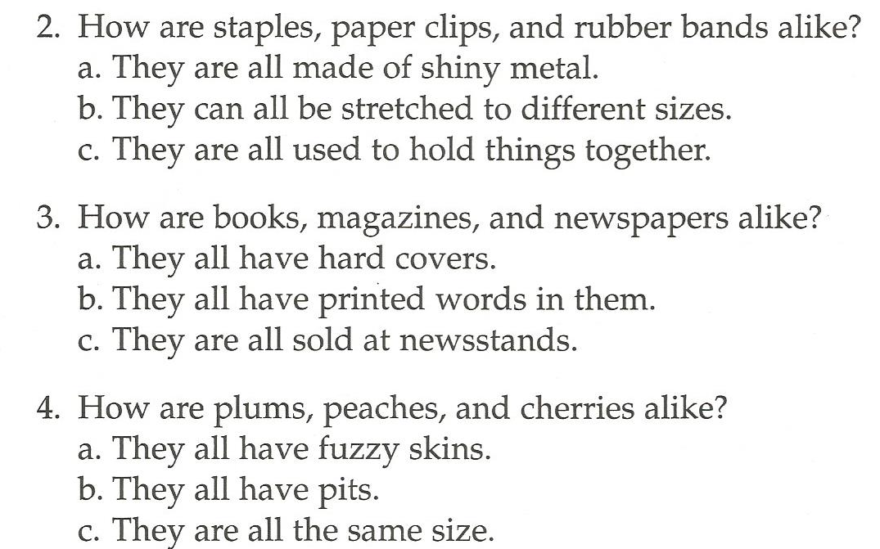

Slide 50
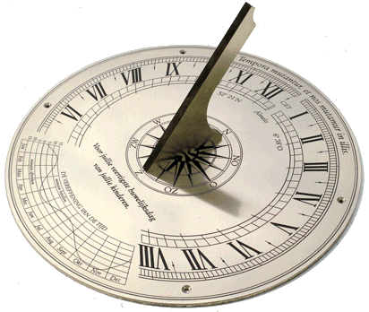
How are they the same?

Slide 51
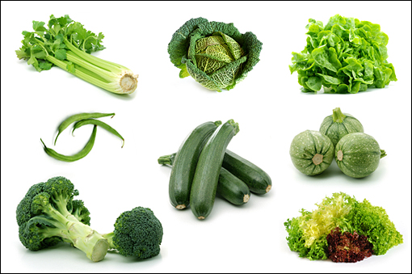
How are they different?

Slide 52
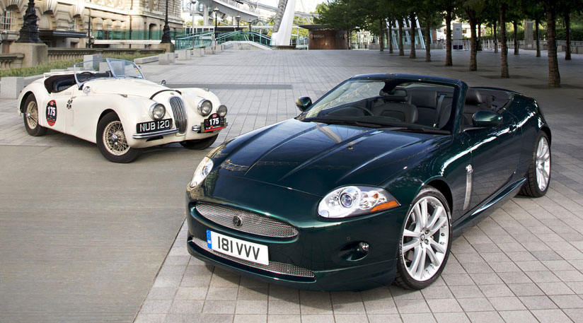
How are they the same / different?

Slide 53
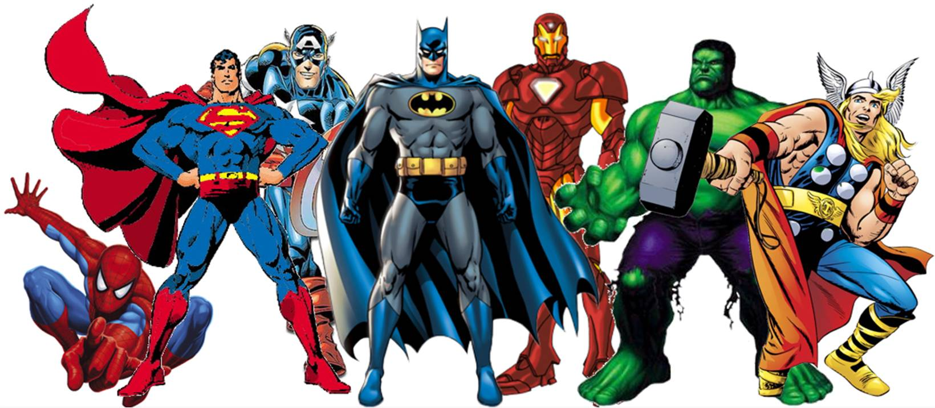
Which one is best?

Slide 54
Which one is worst?

Slide 55
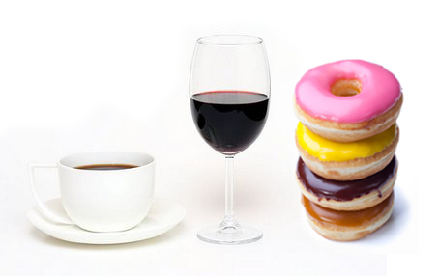
Which is most dangerous?

Slide 56
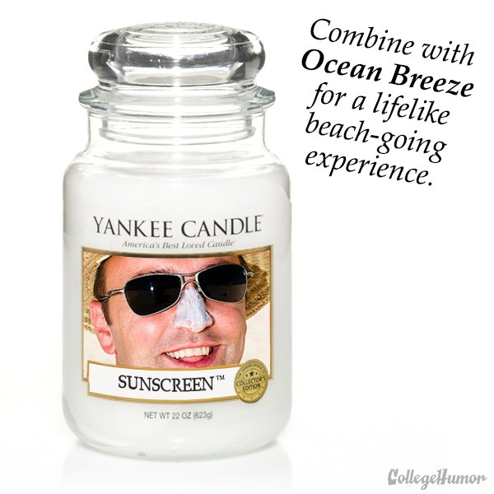
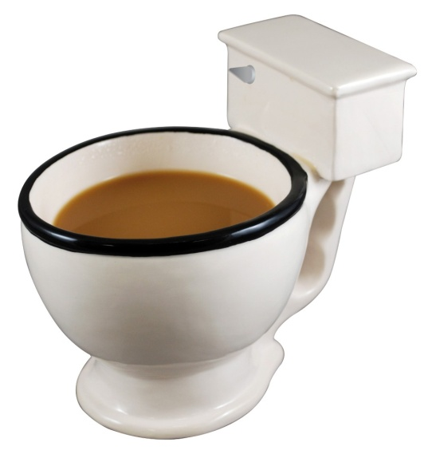
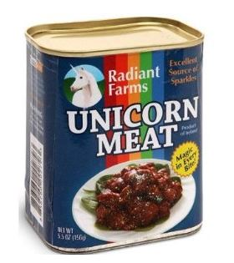
Which would you give as a gift?

Slide 57
How to play:
Take two cards:
Roll the dice
1 – Which is more dangerous?
2 – Which is better to give to as a gift, why?
3 – Which is worse and why?
4 – Which is better and why?
5 – How are they the same?
6 – How are they different?
If it’s a good explanation… you get a point.
Vote

