Slide 1
What did you do last weekend?
And next weekend…

Slide 2
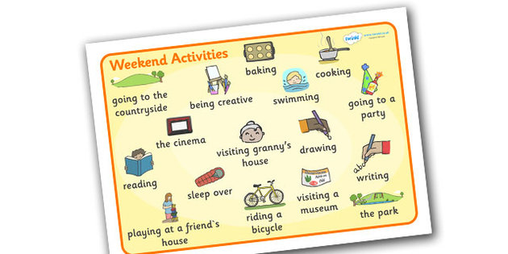
What did you do last weekend?

Slide 3
What will you do next weekend?

Slide 4
What are some fun things to do on the weekend?

Slide 5
Verb Tense
Past
Present
Future
Yesterday
Last _______
Today
Nowadays
Tomorrow
Next ___________

Slide 6
Past Present Future
Regular Verbs
played
play
will play
listened
listen
will listen
tried
try
will try
used
use
will use
asked
ask
will ask
helped
help
will help
watched
watch
will watch
walked
walk
will walk
stayed
stay
will stay
cycled
cycle
will cycle

Slide 7
Past Present Future
Irregular Verbs
read
read
will read
was
am
will be
bought
buy
will buy
ate
eat
will eat
went
go
will go
took
take
will take
wrote
write
will write
made
make
will make
saw
see
will see
did
do
will do

Slide 8
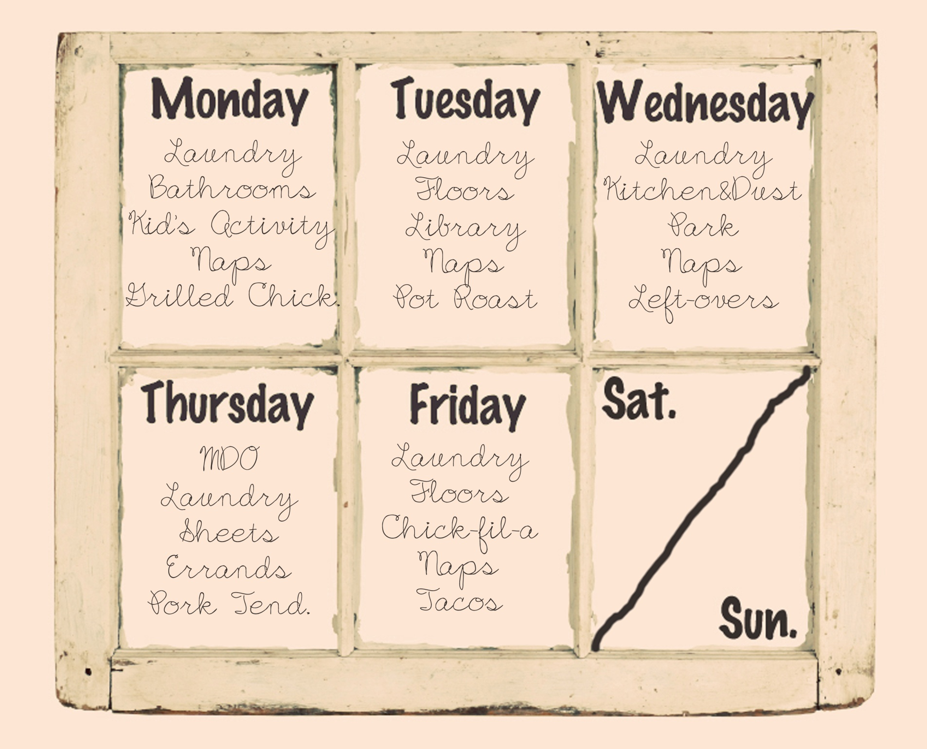
Schedule

Slide 9
On / At
At (time)
On (day)
In (year)

Slide 10
When is Christmas?

Slide 11
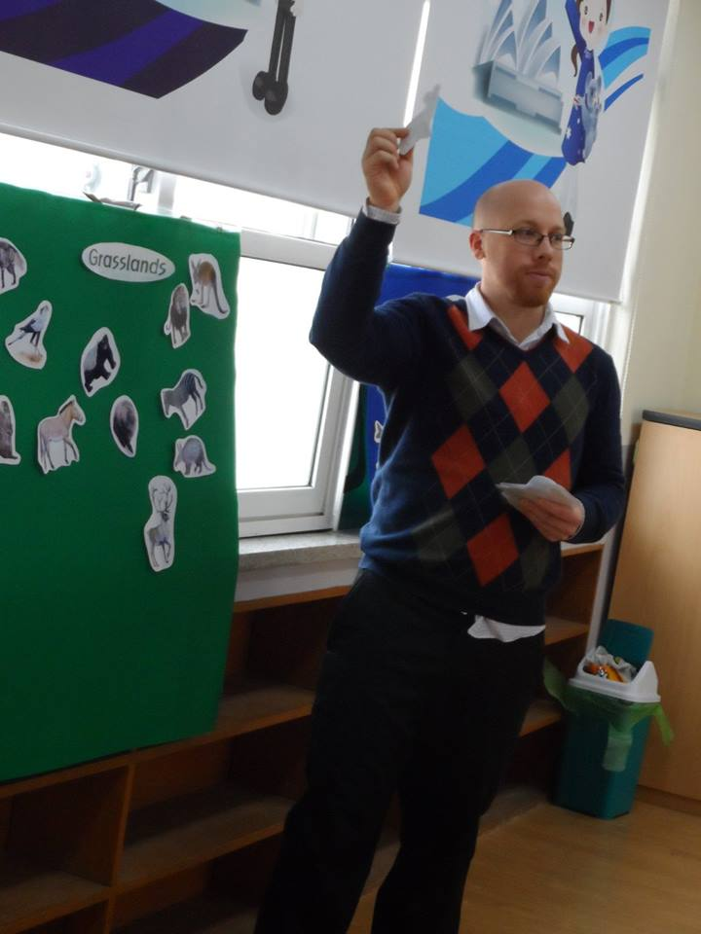
When do you have English Class with Mr. S?

Slide 12
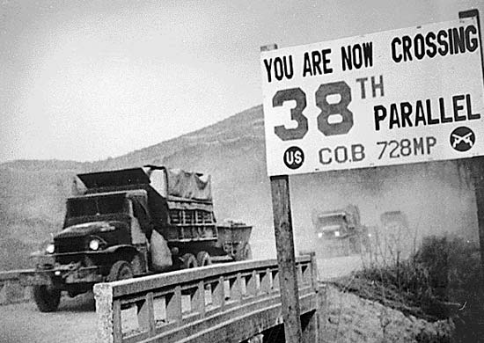
When did the Korean war “end”?

Slide 13
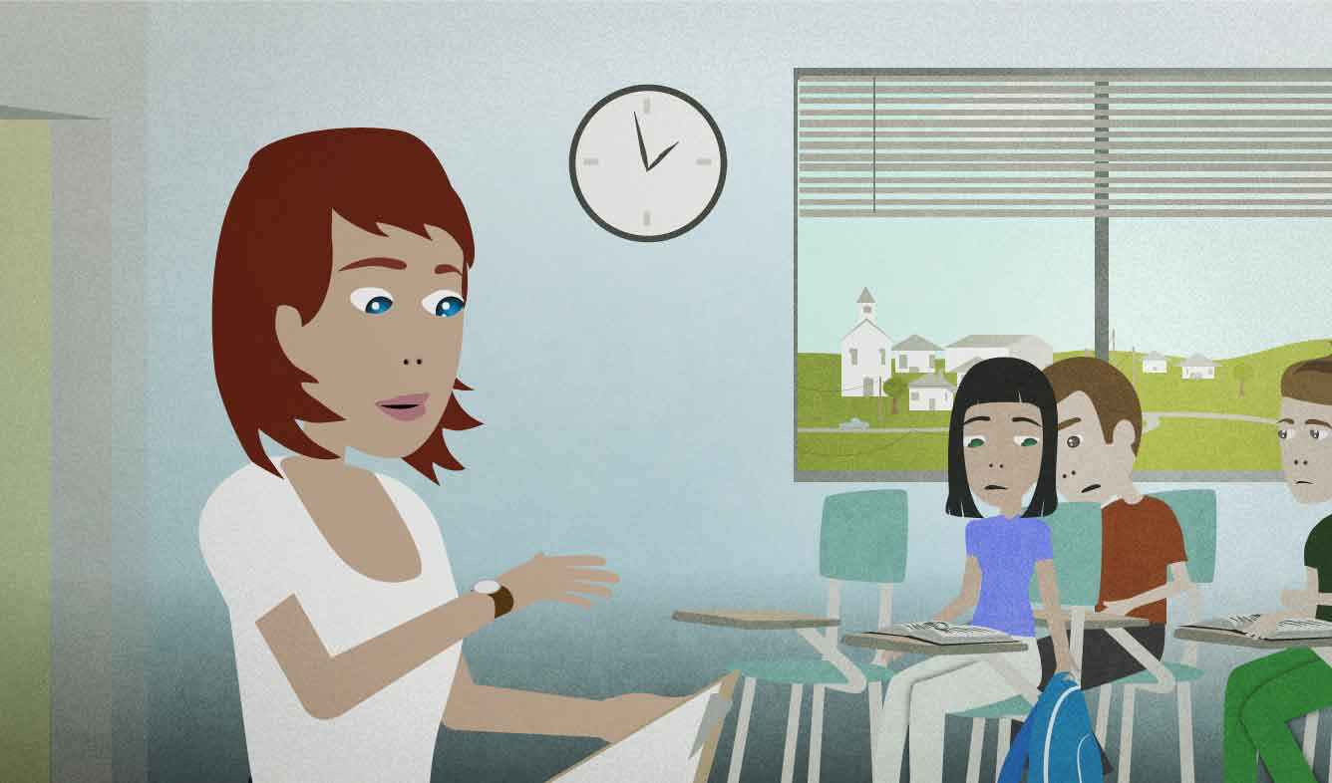
When is class finished?

Slide 14
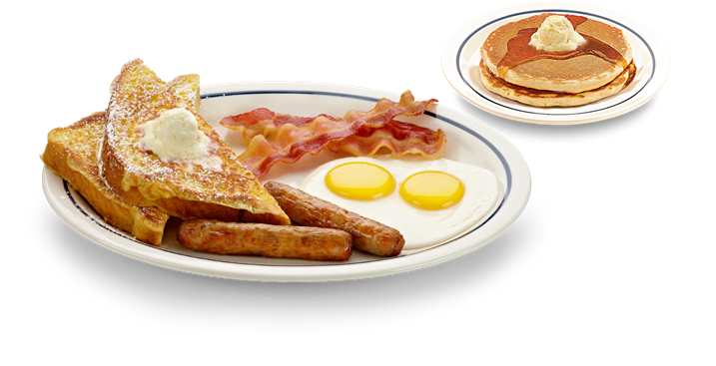
When do you eat breakfast?

Slide 15
When is your birthday?

Slide 16
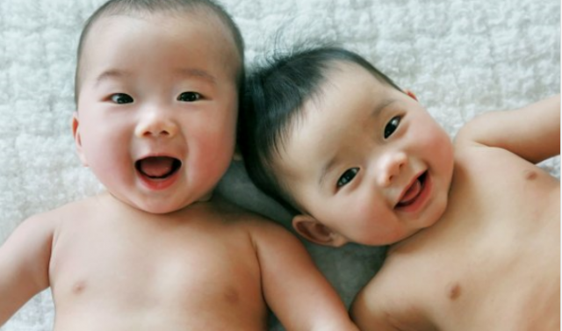
When were you born?

Slide 18
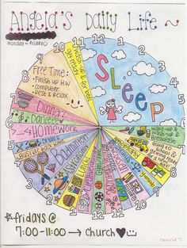

Slide 19
Mr.S’ Schedule:
 | Mon | Tue | Wed | Thu | Fri | Sat
9:00 - 9:40 |  | 6-5 | 5-4 | 4-1 | 3학년 | Going Abroad
9:50 - 10:30 | 6-1 | 6-6 | 5-5 | 4-2 | 3학년 | Going Abroad
10:40 - 11:20 | 6-3 | 6-7 | 5-3 | 4-3 | 4-6 | Going Abroad
11:30 - 12:10 | 6-4 | 5-6 | 5-2 | 4-4 | 4-5 | Going Abroad
Lunch
1:10 - 1:50 | 6-2 | 5-7 | 5-1
2:00 – 3:50 |  |  | volleyball
3:00 - 3:50 | EBS |  | volleyball |  | EBS
Dinner
7:00 - 7:50 | Daedeok | Daedeok
8:00 - 8:50 | Daedeok | Daedeok

Slide 20
Celebrity Schedule
Who is your favorite celebrity
What do they do during the week?
Make a weekly schedule for them.

Slide 21
Celebrity Name: _______________
Monday
Tuesday
Wednesday
Thursday
Friday
Saturday
Sunday

