Slide 1
What do you want to do today?

Slide 2
What do you want to do?
I want to (verb)…

Slide 3
Suggestions
Let’s, Should

Slide 4
Let’s …

Slide 5
What do you want to do today?

Slide 6
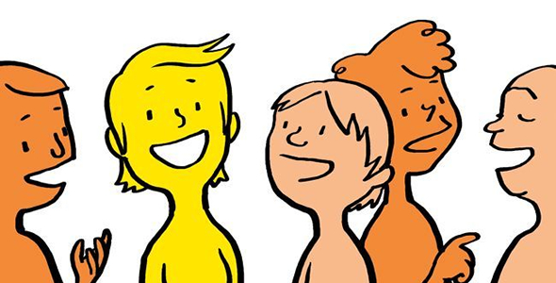
What do you want to do today?

Slide 7
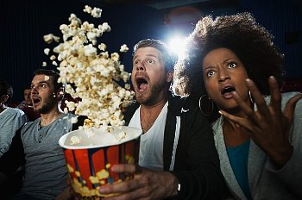
What do you want to do today?

Slide 8
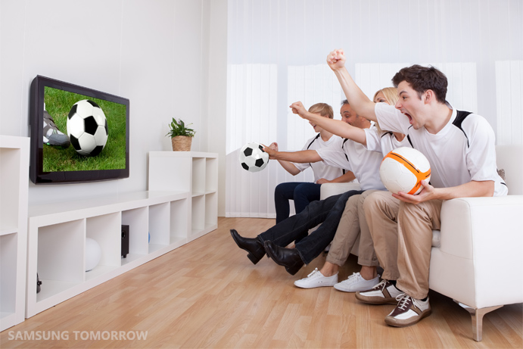
What do you want to do today?

Slide 9
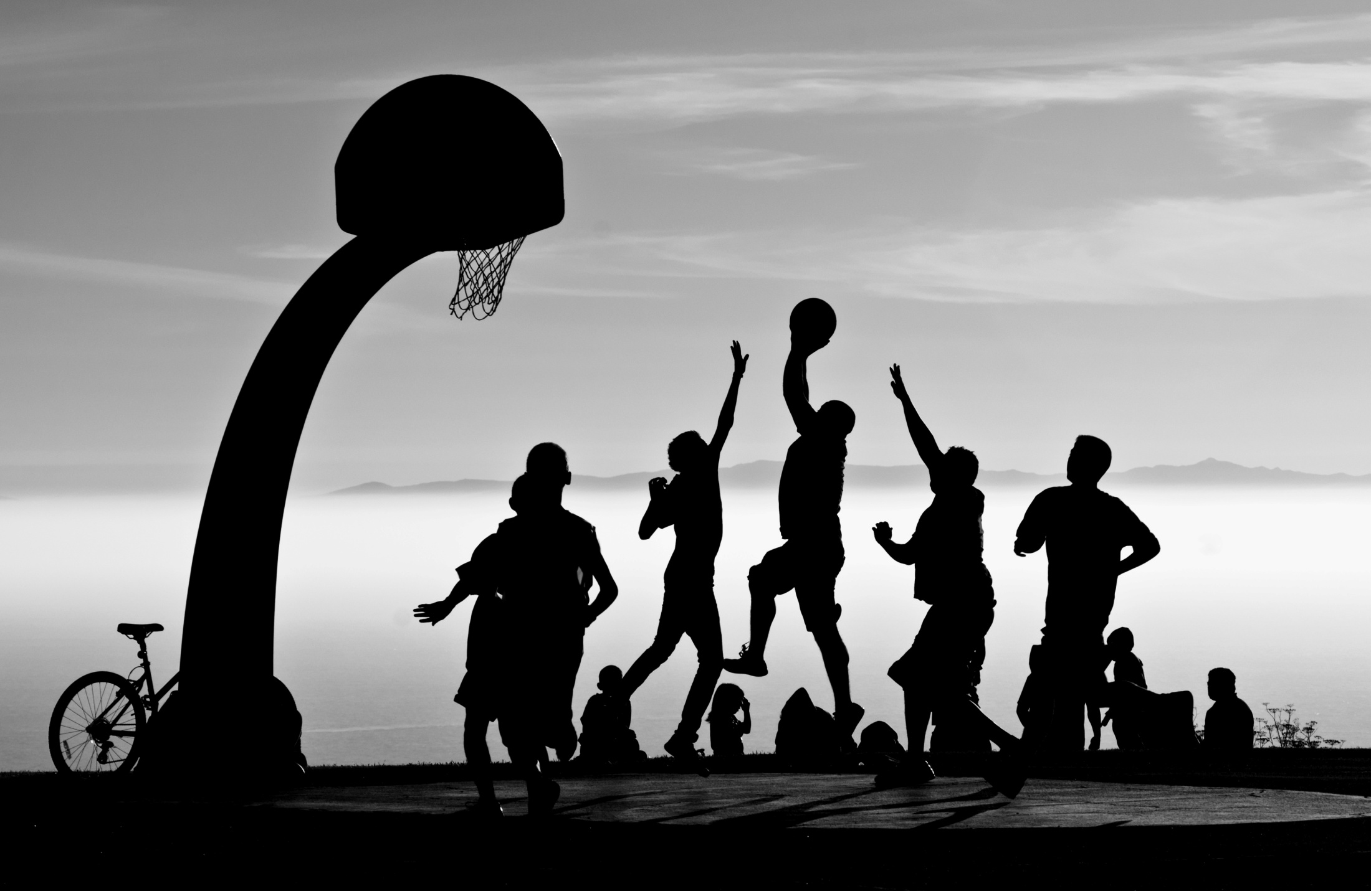
What do you want to do today?

Slide 10
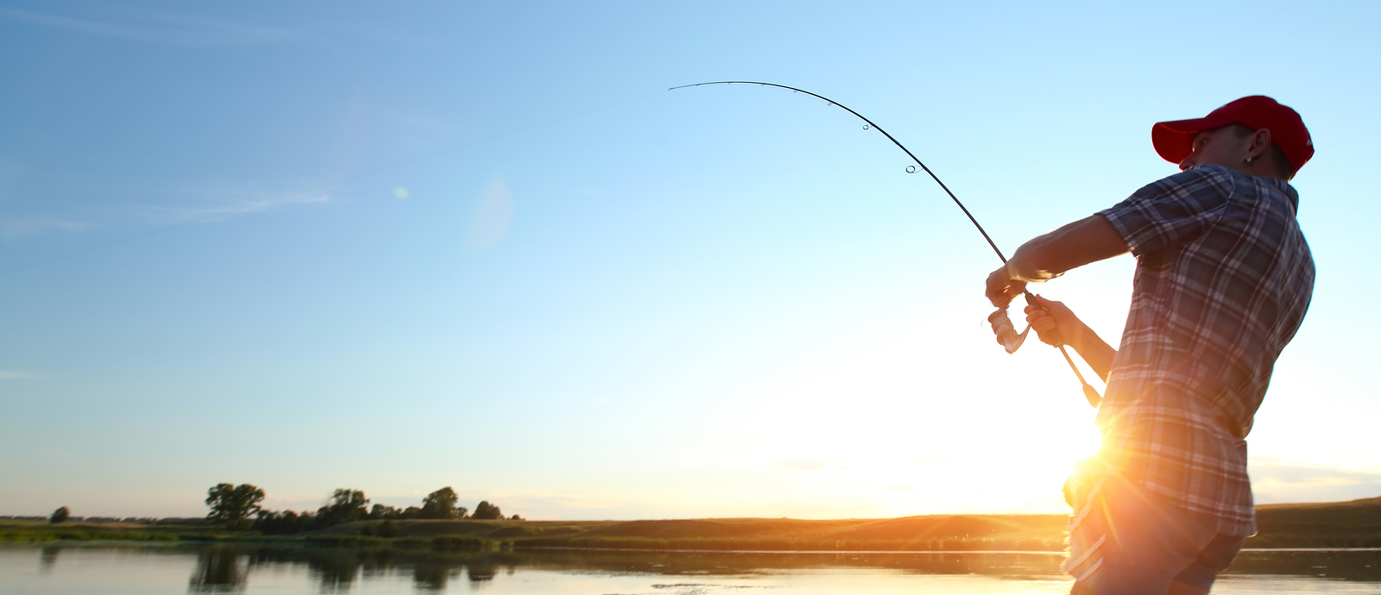
What do you want to do today?

Slide 11
What do you want to do today?

Slide 12
We should…

Slide 13
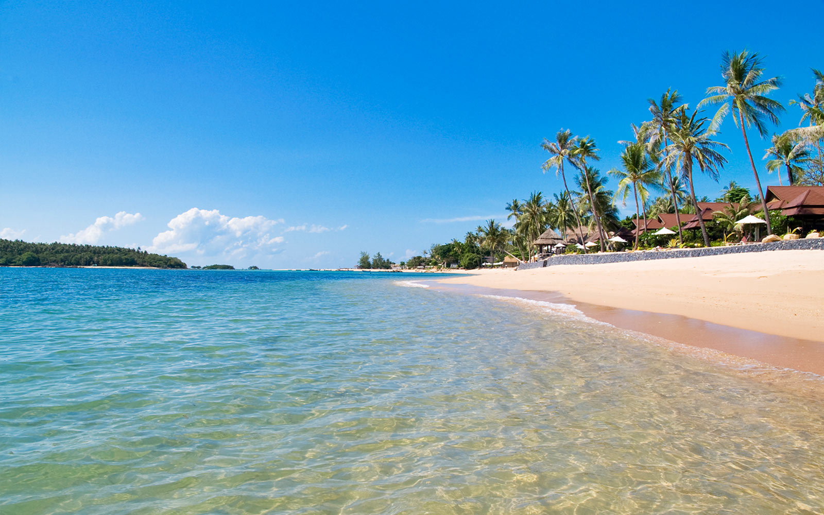
We should…

Slide 14
We should…

Slide 15
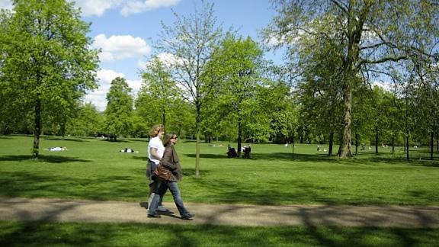
We should…

Slide 16
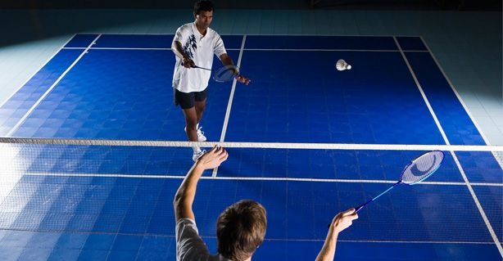
We should…

Slide 17
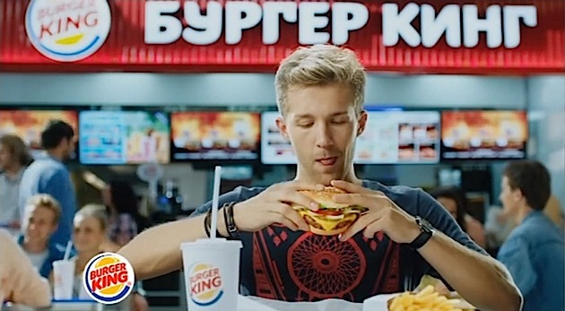
We should…

Slide 18
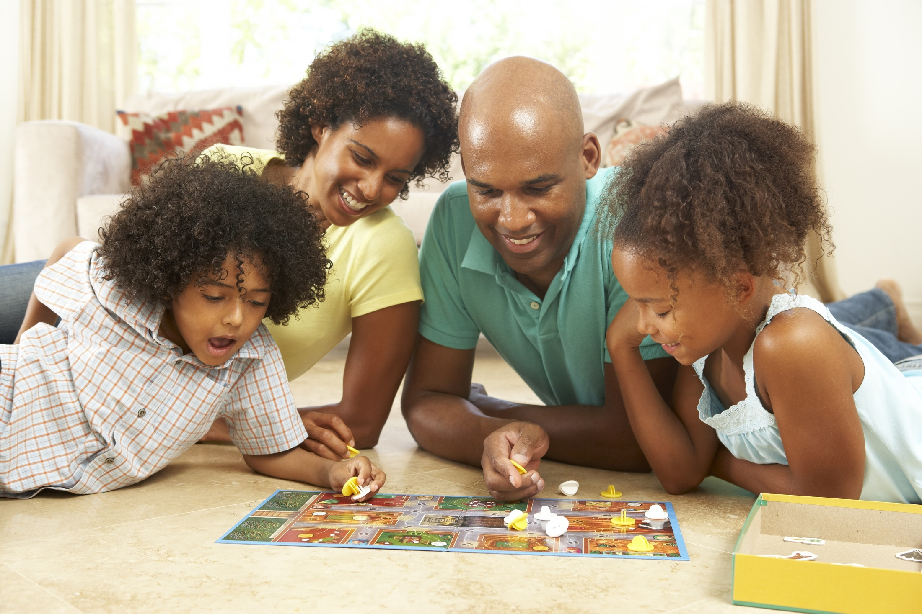
We should…

Slide 19
The Lost Homework
Goal: Find your homework
Rules: Make suggestions and find out what happens.

Slide 20
Suggestion Bingo
Write what you want to do
Randomly ask for suggestions

Slide 21
What do you want to do this weekend?

