Slide 1
Events on a Calendar
ordinals

Slide 2
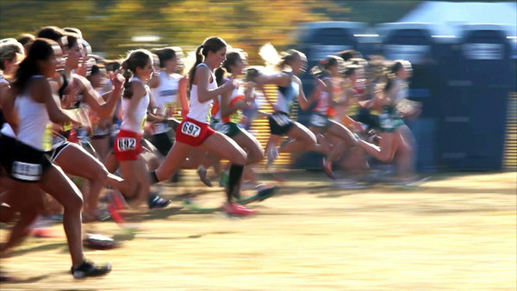
Ordinal Numbers
Order

Slide 3
Order:
1st
2nd
3rd
4th
5th
6th
21st
22nd
23rd
24th
100th
234th

Slide 4
Order:
1st =
2^{nd =}
3^{rd =}
4^{th =}
5^{th =}
6th =
First
Second
Third
Fourth
Fifth
Sixth
21^{st =}
22^{nd =}
23^{rd =}
24^{th =}
100^{th =}
234th =
Twenty-first
Twenty-second
Twenty-third
Twenty-fourth
One Hundredth
Two hundred and thirty-fourth

Slide 5
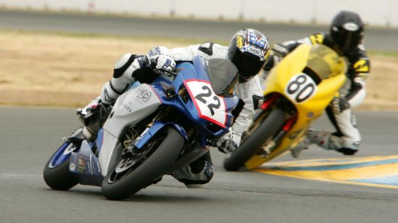
Who is in first?

Slide 6
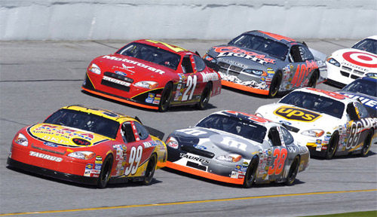
What position is he in?

Slide 7
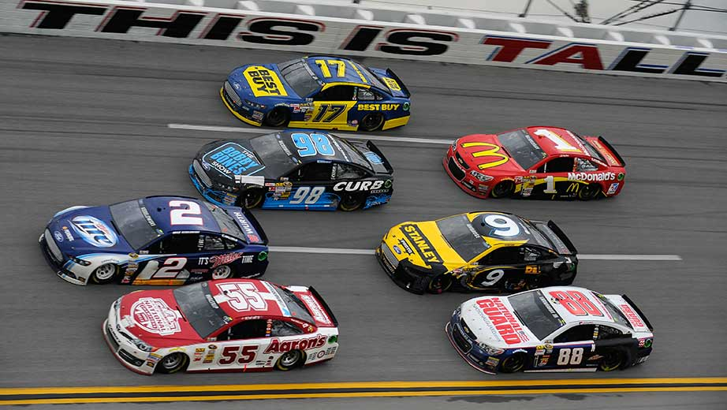
What position is he in?

Slide 8
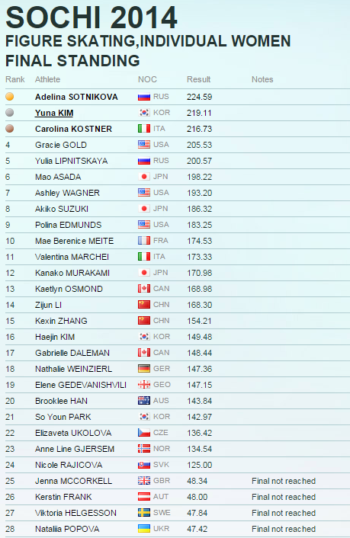
Who finished first?

Slide 9
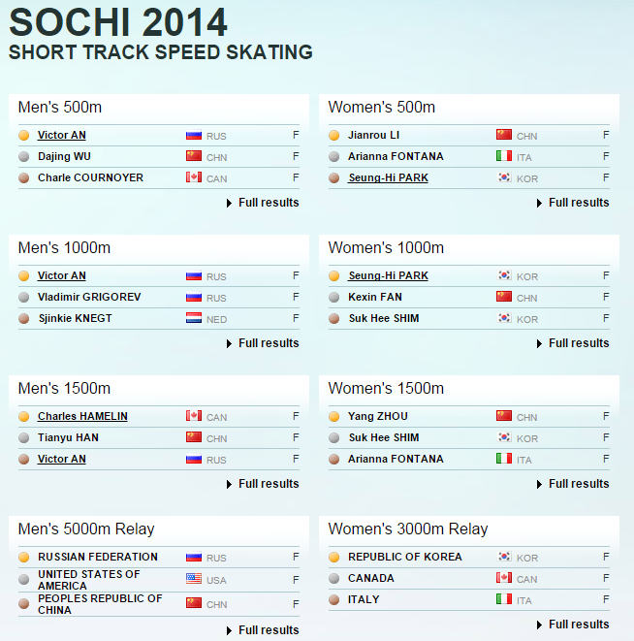

Slide 10
Betting Game
Who will finish first?

Slide 11
Betting Game Rules
You start with $10.
You can bet as much money as you want on as many players as you want.
If you are right, you win money
2 players = 1:1
3 players = 1:2
4 players = 1:3

Slide 12
Betting Game
https://www.youtube.com/watch?v=2QFXP8BxMME

Slide 13
Midgets vs Camel
https://www.youtube.com/watch?v=X8KdawFd874

Slide 14
Man vs Giraffe vs Zebra
https://www.youtube.com/watch?v=Y5QwYJoLUfE

Slide 15
Backwards Race – Man vs Car
https://www.youtube.com/watch?v=0olAvlNsWZI

Slide 16
Man vs Ostrich
https://www.youtube.com/watch?v=2WcMRpozO4s

Slide 17
Veyron vs Jet
https://www.youtube.com/watch?v=7NZ9X9A2efA

Slide 18
Usain Bolt vs Bus
https://www.youtube.com/watch?v=OHwU5Krd8l0

Slide 19
Mascot Race
https://www.youtube.com/watch?v=eCvrnn6Hi10

Slide 20
On the Calendar
We use ordinal numbers…
When is New Year’s Day?
What day is it today?

Slide 21
Canadian Holidays

Slide 22
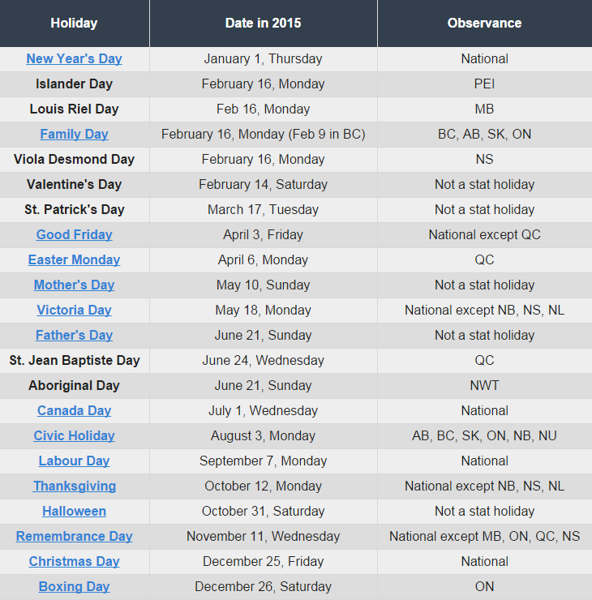
Holiday List

Slide 23
Holiday Calendar
Ask, “When is ____________?”
Answer, “It’s on ____(ordinals)____.”
Write it on your calendar.

