Slide 1
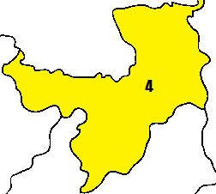
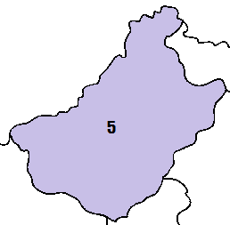
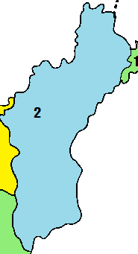
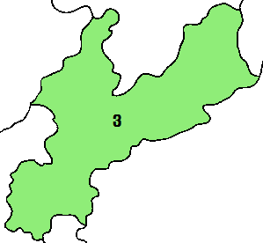
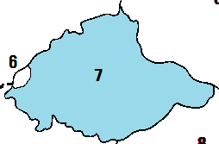
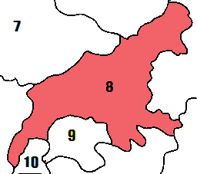
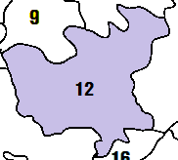
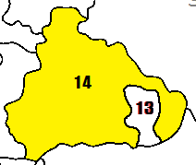
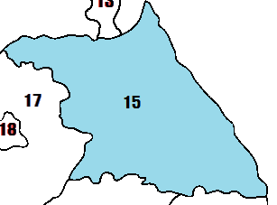
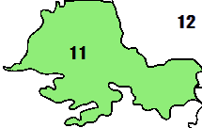
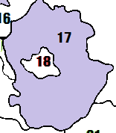
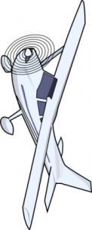
Nanjin
Hamgyeong (North)
Hamgyeong (South)
Yanggang
Changgang
Sinuiju
Pyeongan (North)
2
3
Pyeongan
(South)
Pyeongyang
Nampo
Hwanghae
(South)
Hwanghae
(North)
Gangwon
(North)
Gangwon
(South)
Kaesong
Gyeonggi
Seoul
Incheon
Ulleung
Daejeon
Daegu
Airplane
Airplane
Airplane
Airplane
Airplane

Slide 2
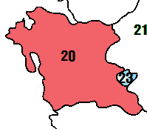
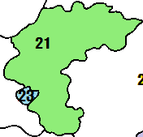
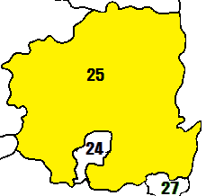
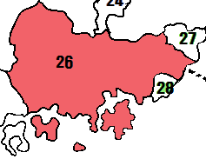
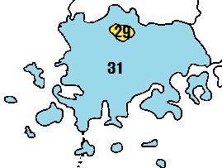
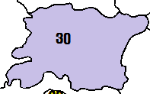
Ulsan
Chungcheong
(South)
Chungcheong
(North)
Busan
Gwangju
Jeju
Gyeongsang
(North)
Gyeongsang
(South)
Dokdo
Jeolla
(South)
Jeolla
(North)
China
Kumgang
East China Sea
33
East Sea
East Sea
East Sea
Yellow Sea
Yellow Sea
Yellow Sea
East China Sea
Airplane
Airplane
Airplane
Airplane
Airplane

Slide 3
China

