Slide 1
Planning a Vacation

Slide 2
What are some fun places to visit?

Slide 3
Why would you go there?

Slide 4
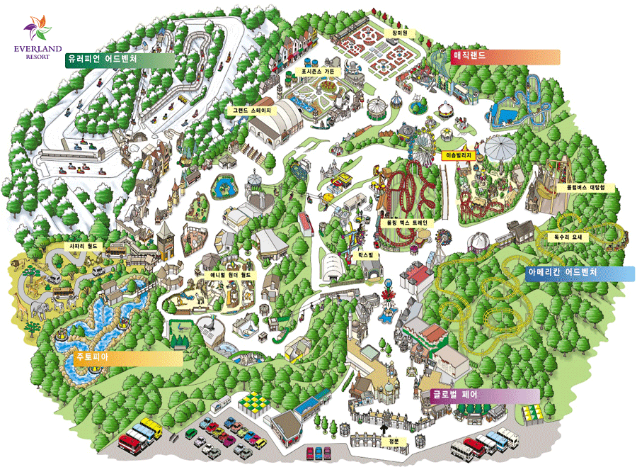
Why would you go there?

Slide 5
Why would you go there?

Slide 6
Why would you go there?

Slide 7
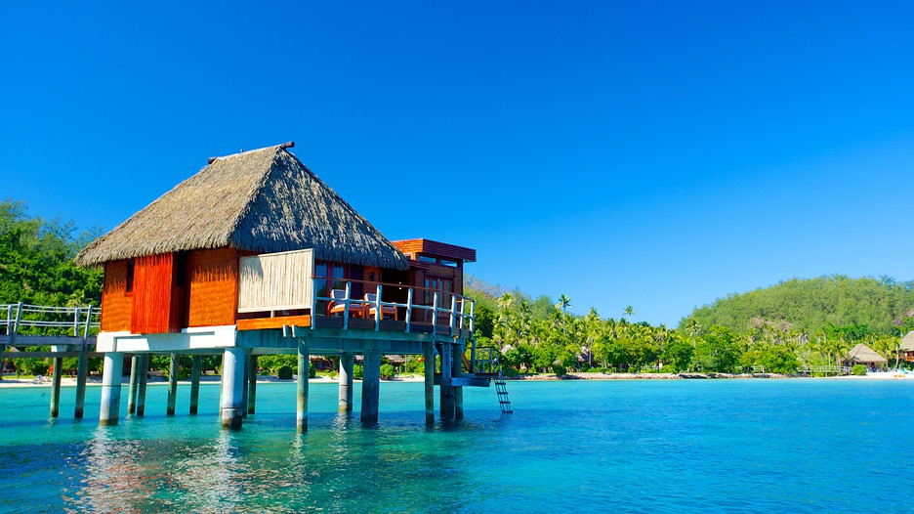
Why would you go there?

Slide 8
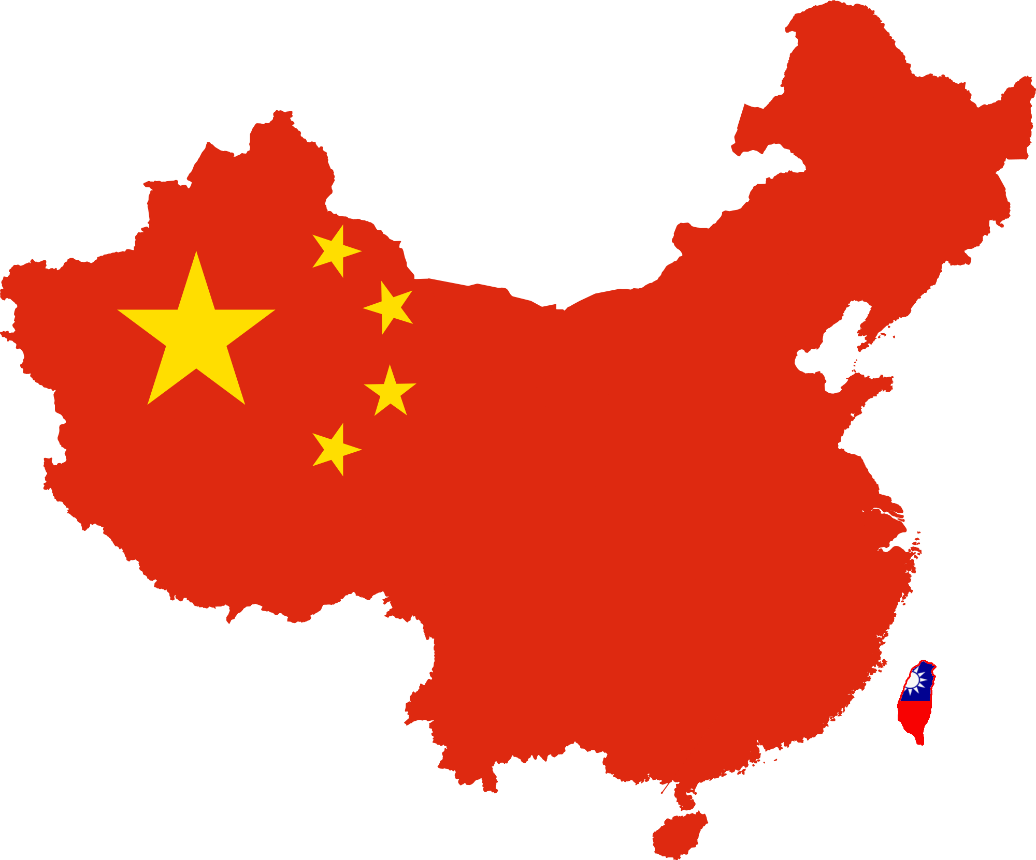
Why would you go there?

Slide 9
Why would you go there?

Slide 10
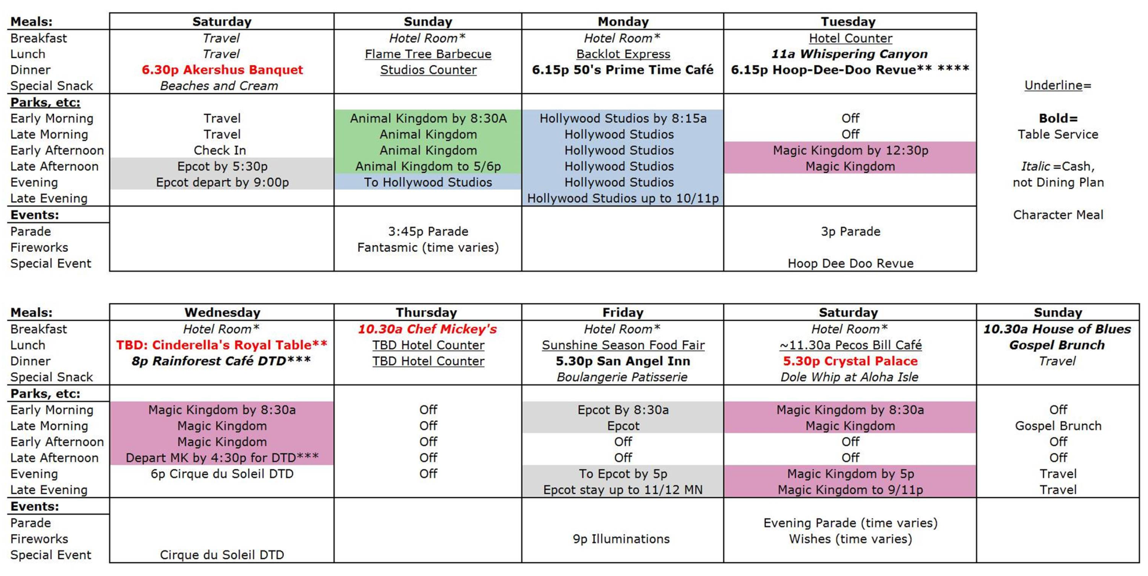
Itinerary =
What will you do and when.

Slide 12
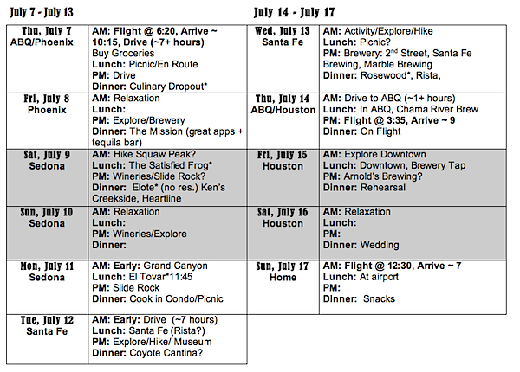

Slide 13
Korea Vacation Itinerary

Slide 14
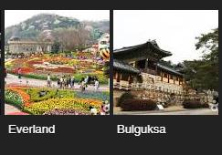

Slide 15
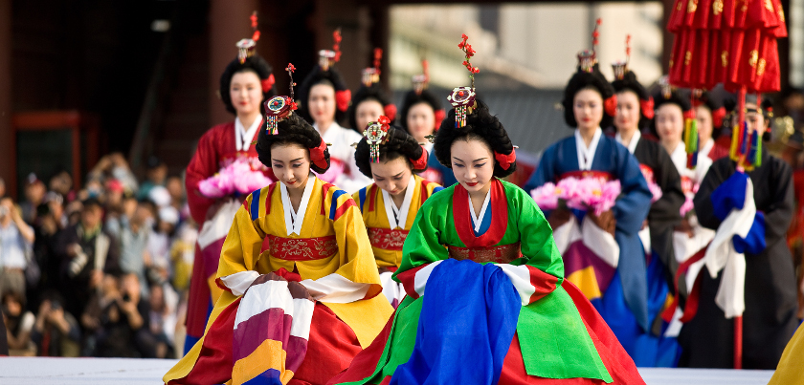

Slide 16
Itinerary for ______________
Friday
Saturday
Sunday
Monday

Slide 17
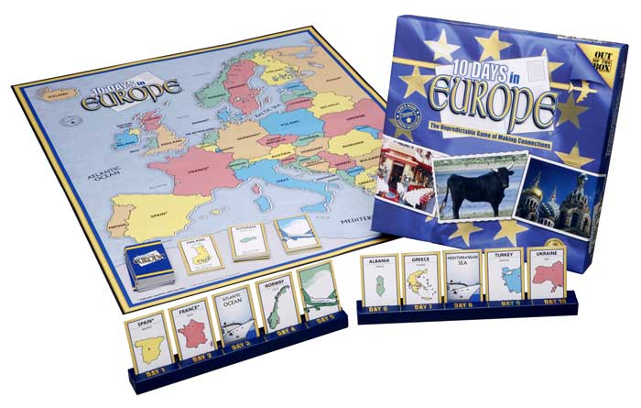
Game

Slide 18
7 Days in Korea
Make an itinerary…
Game Board
48 County Tiles
19 Transportation Tiles
4 Tile holders
Rules

Slide 19
Setting Up
Put the game board in the center of the table.
Each player gets one card holder.
Place all county and transportation tiles face down next to the board and shuffle.

Slide 20
Getting Started
Players fill their card holders without taking turns.
One at a time
In any open slot
Can not move the cards now.
Stack the remaining cards (facedown) to make a draw pile
Select a player to take the first turn…

Slide 21
Player’s Turn
Choose one of the following:
Change position of a card
Take one of the three up cards
Take one card from the random pile.

Slide 22
Winner
The first player with 8 days connected is the winner.

