Slide 1
Feelings

Slide 2
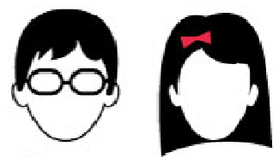
satisfied relieved excited relaxed happy
scared worried confused disappointed nervous
ashamed embarrassed angry upset frustrated
Curious bored confident peaceful surprised

