Slide 1
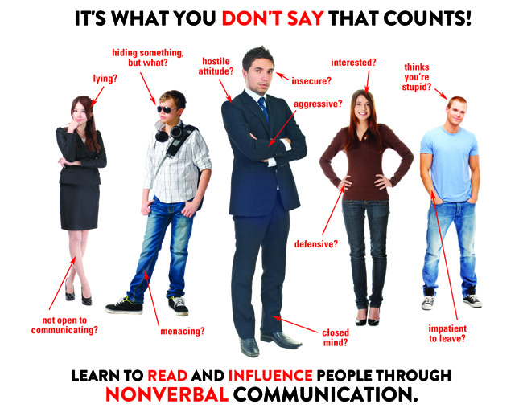

Slide 2
Language is more than what we say. It is also how we act.
Communication is based on:
55% facial expression
38% Tonality
7% Words

Slide 3
Which Student is Listening?

Slide 4
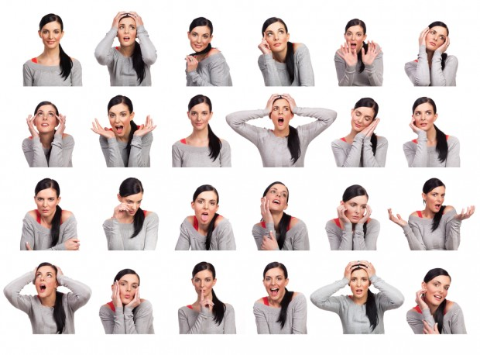

Slide 5
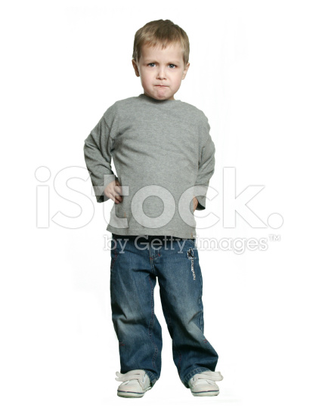
How is he feeling? How do you know?

Slide 6
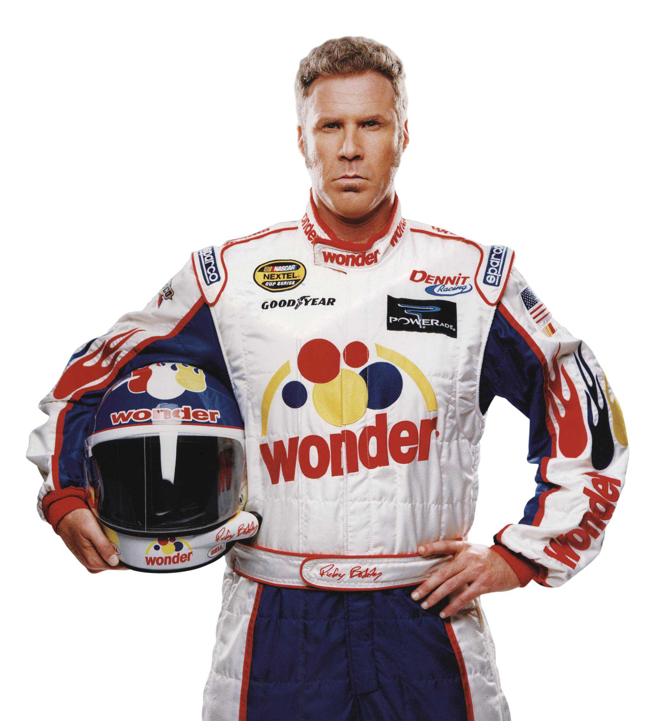
Ricky Bobby
https://www.youtube.com/watch?v=M8PP3QU7wjI.

Slide 7
3 Main Parts of Body Language:
Facial Expression (face)
Posture (body)
Gesture (moving)

Slide 8
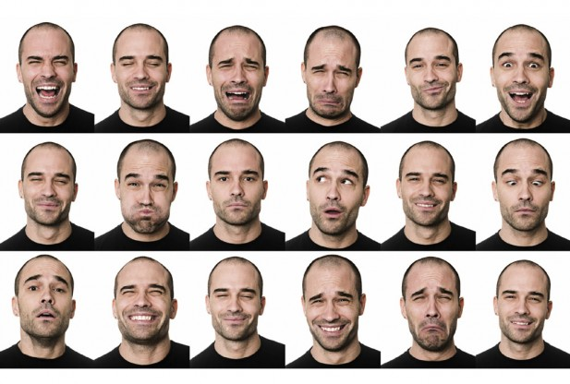
Facial Expressions

Slide 9
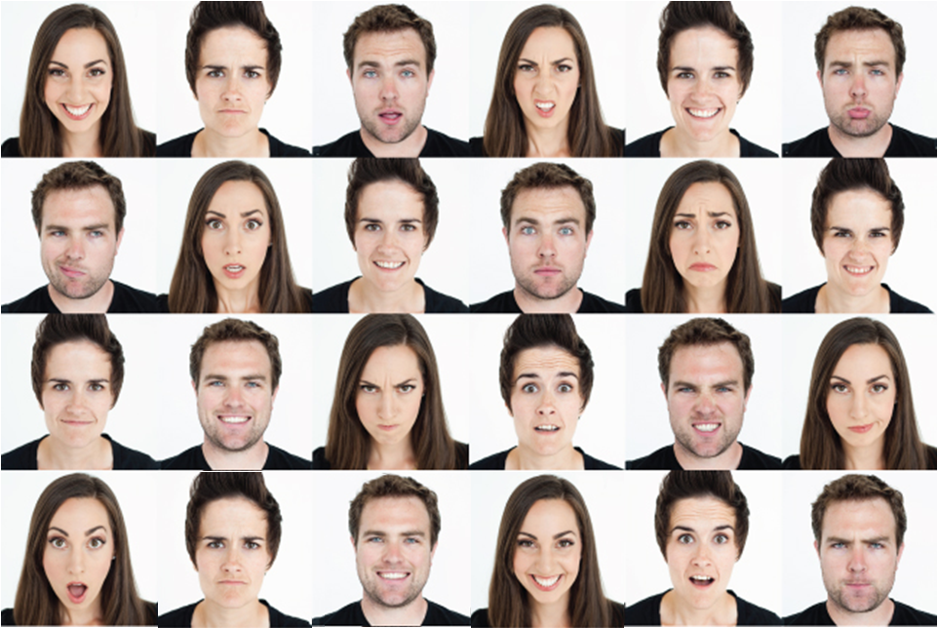
Find the 3 matching facial expressions

Slide 10
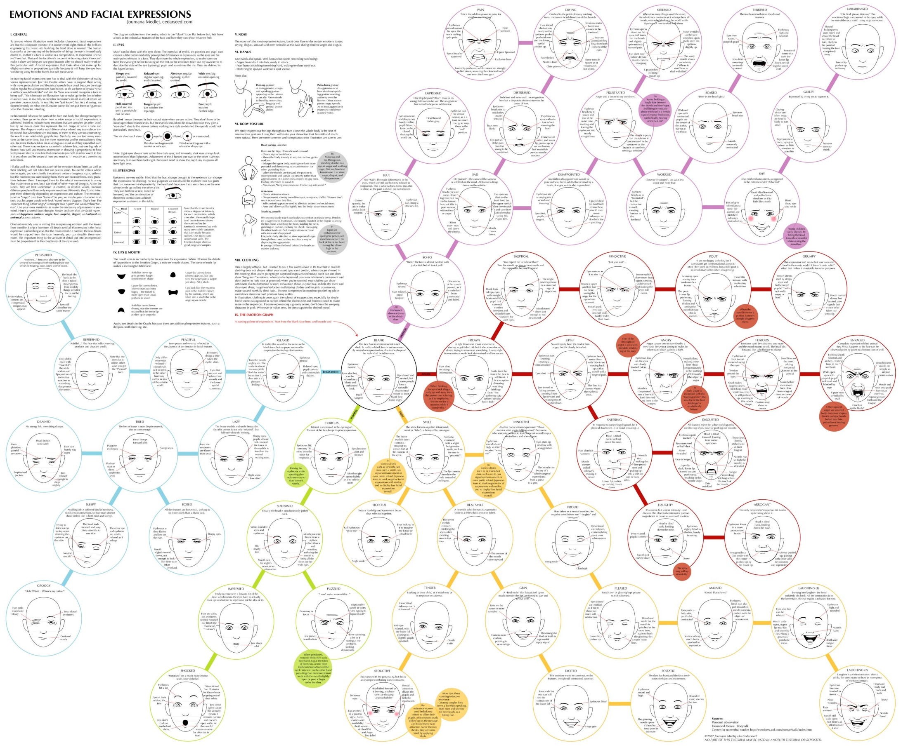

Slide 11
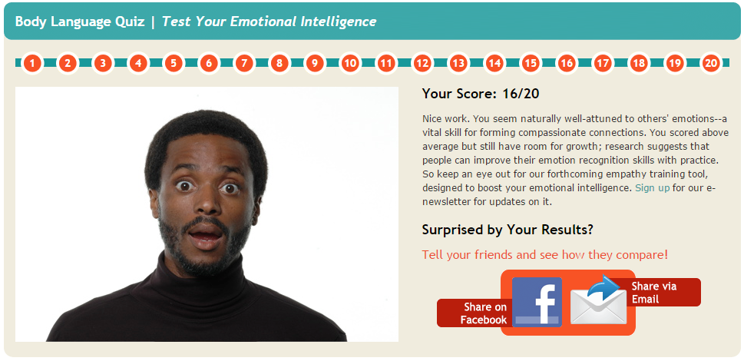
EQ Test
http://greatergood.berkeley.edu/ei_quiz/#1

Slide 12
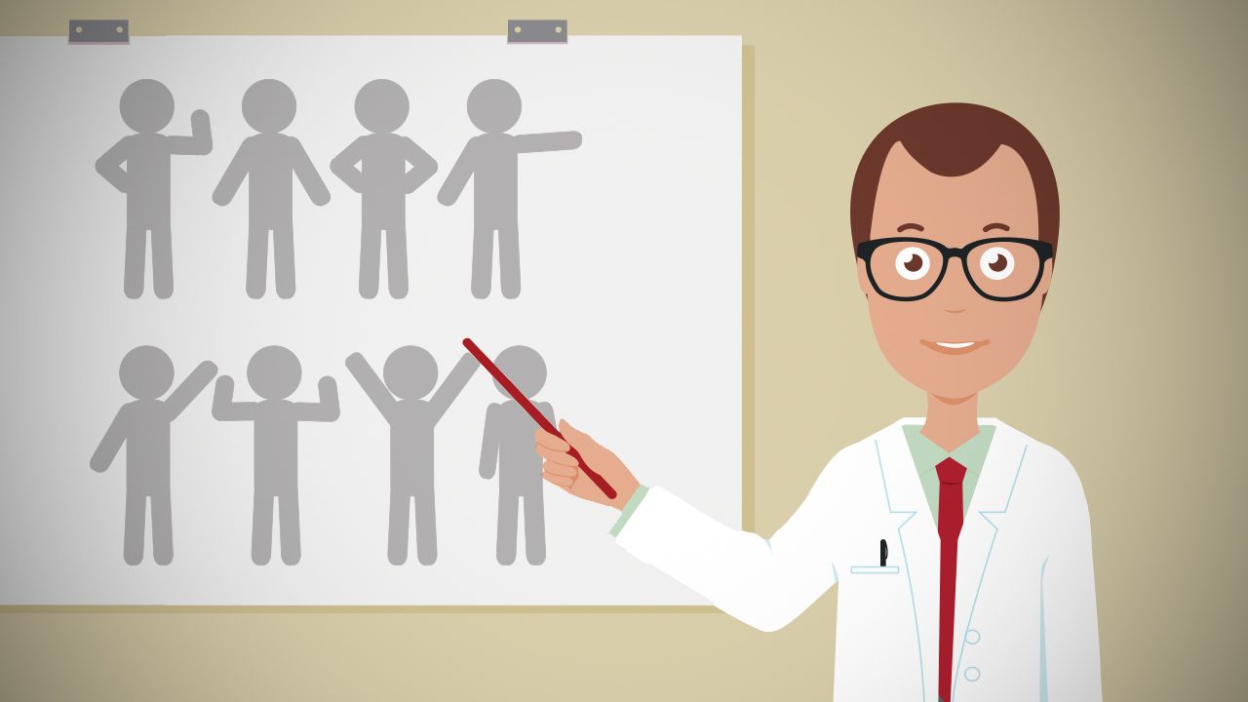
Posture

Slide 13
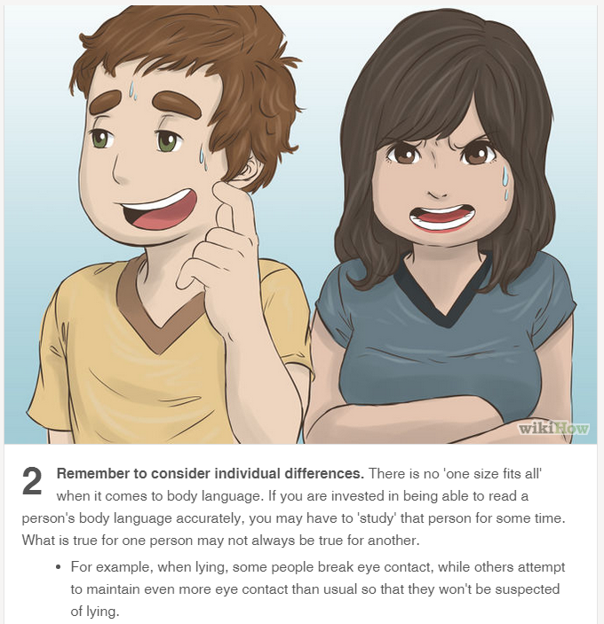

Slide 14
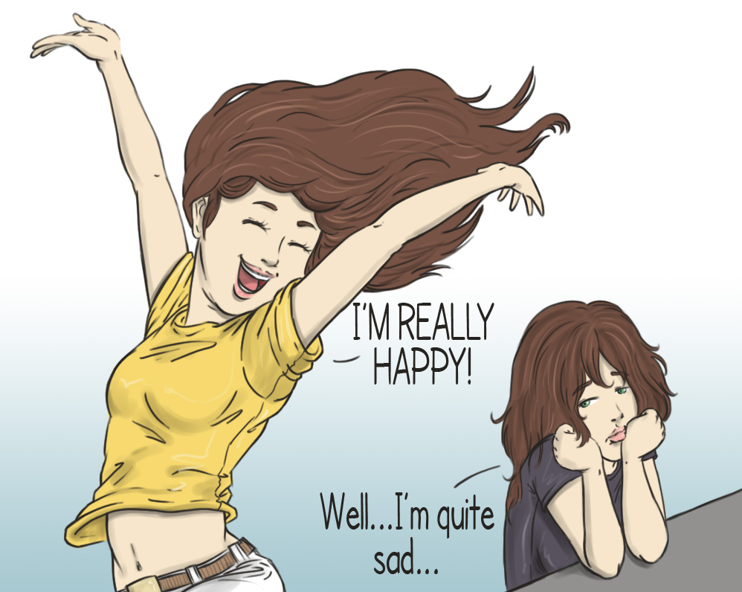

Slide 15
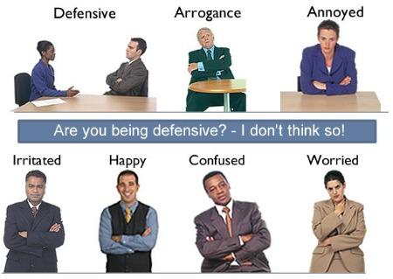

Slide 16
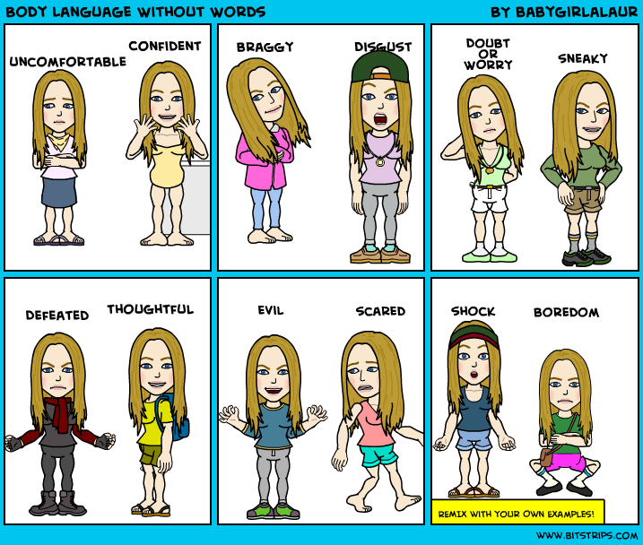

Slide 17
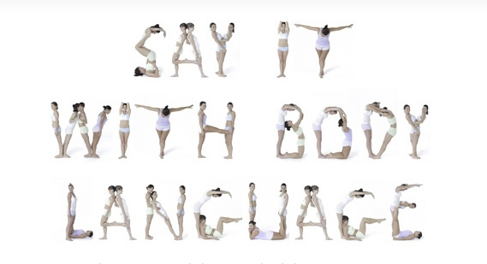

Slide 18
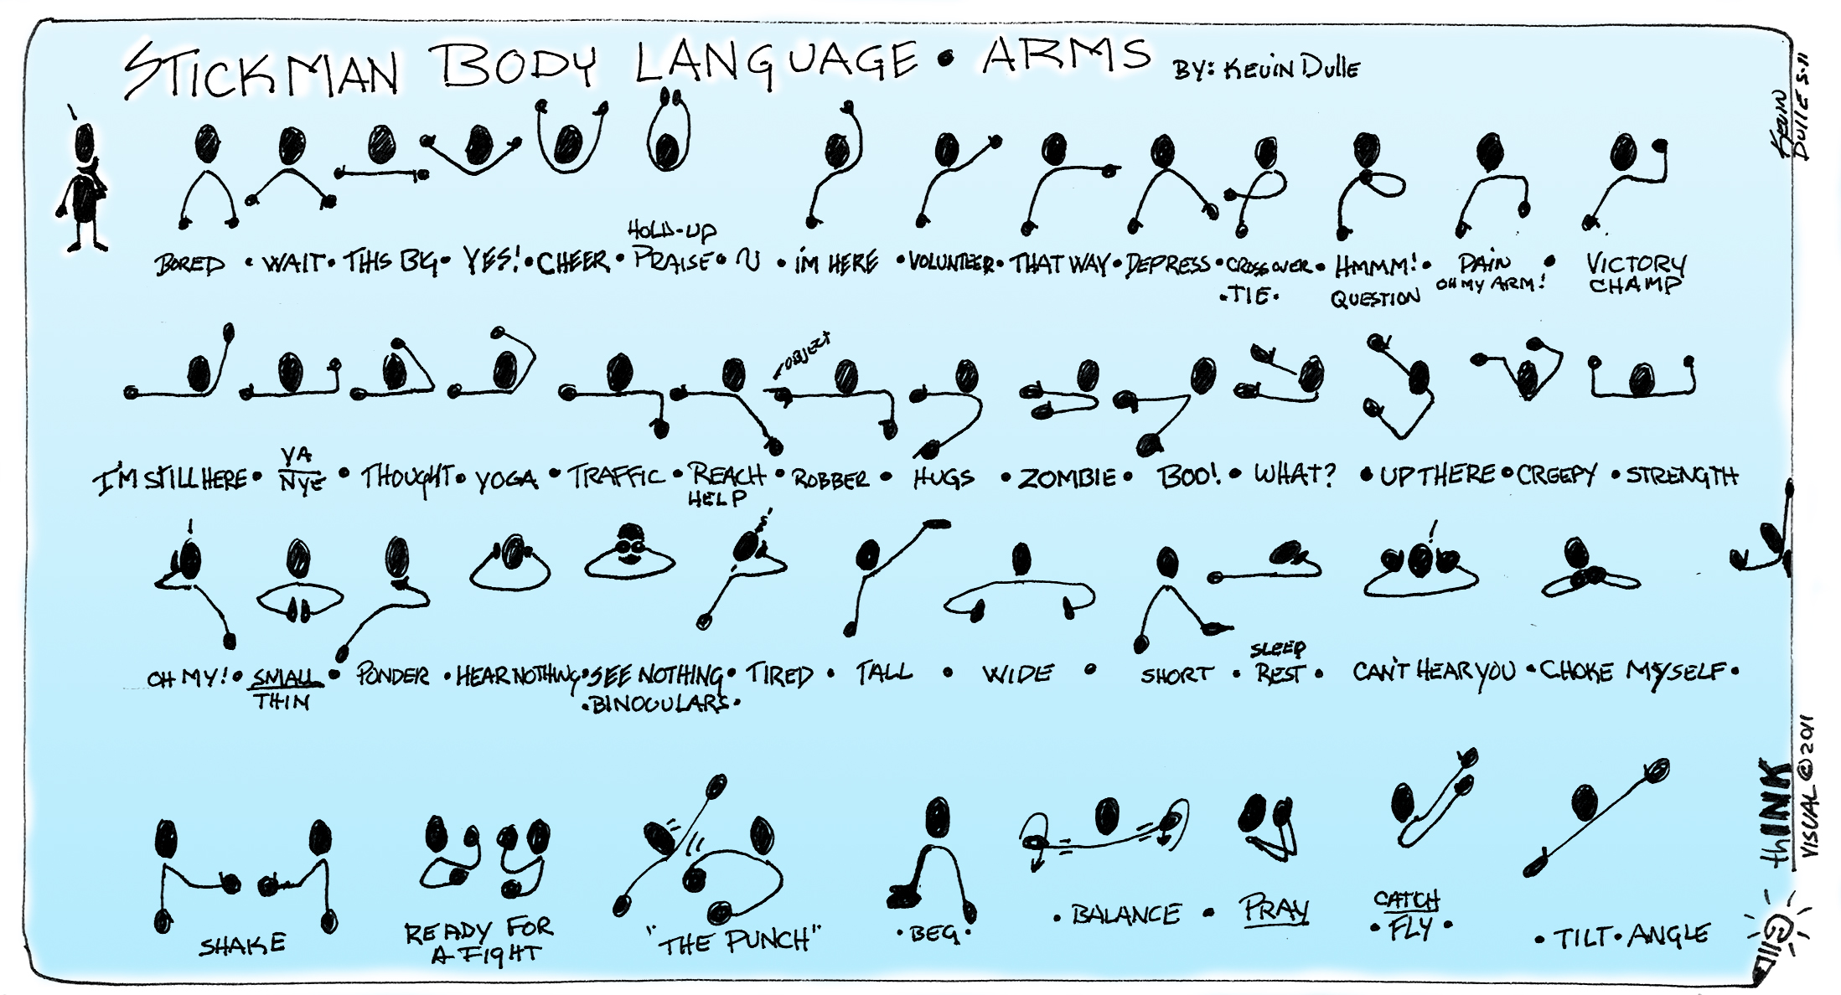
Stickman Race

Slide 19
7 Ways to make people instantly like you…

Slide 21
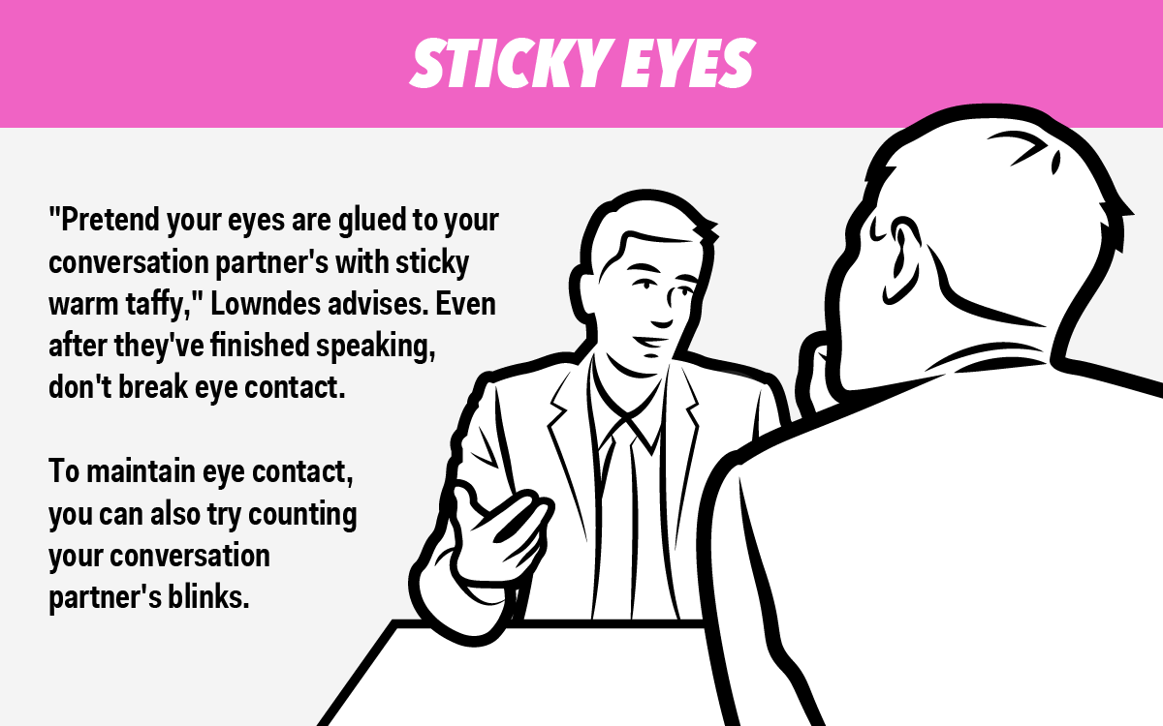

Slide 23
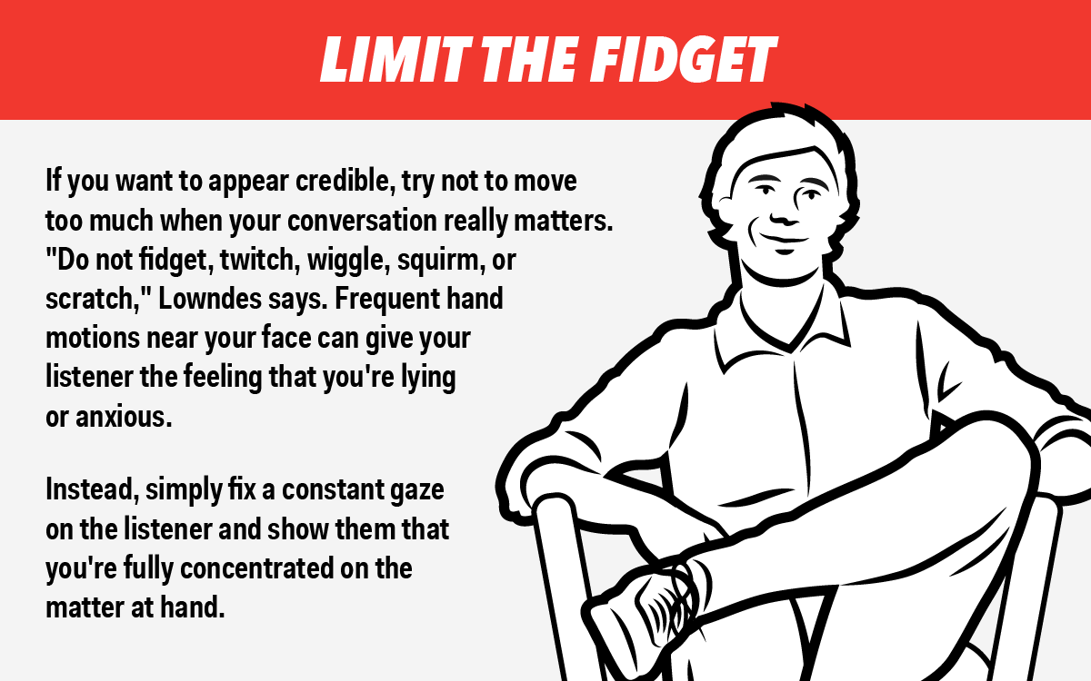

Slide 24
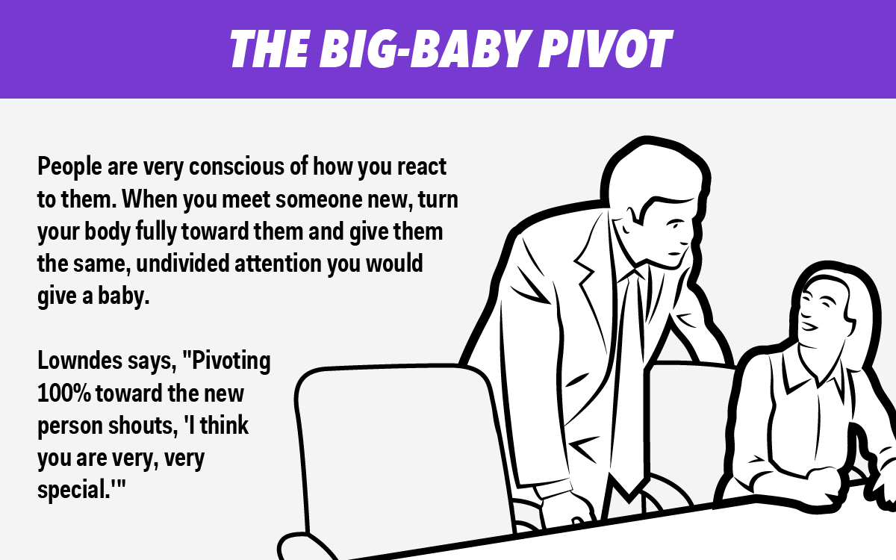

Slide 27
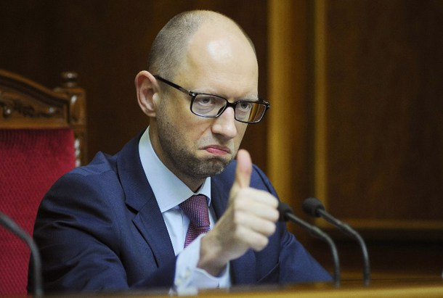
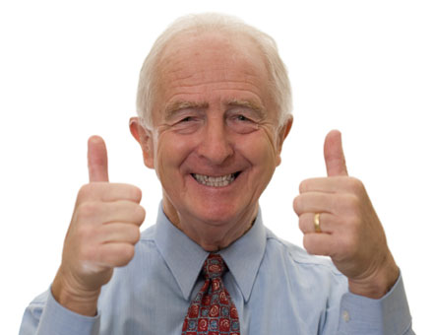
Gestures
Different between countries.

Slide 28
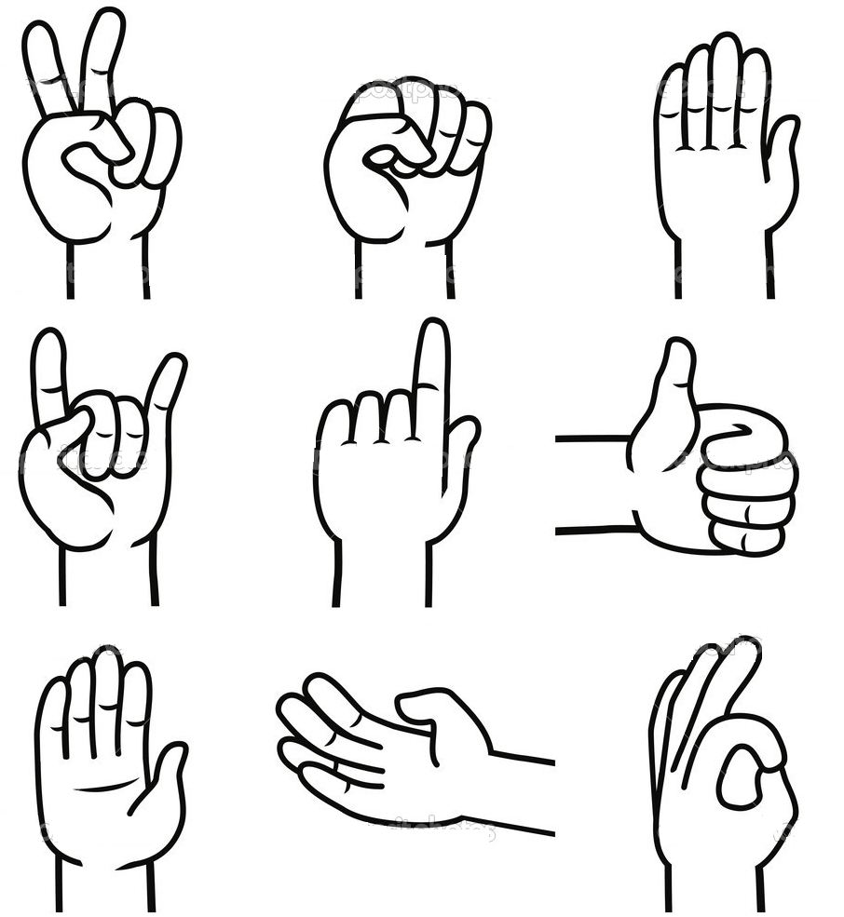

Slide 29
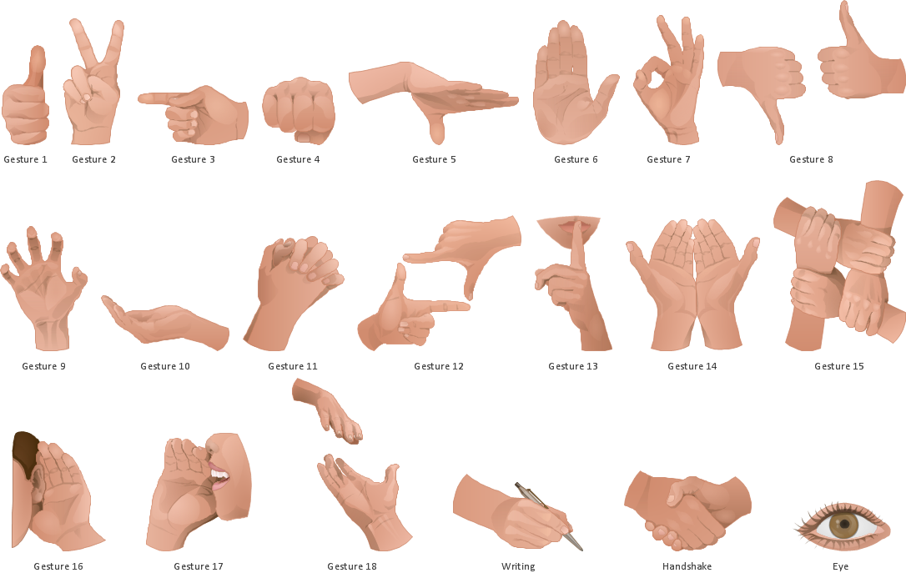
How do you Gesture…

Slide 30
Come here

Slide 31
I can’t hear you.

Slide 32
Give me money.

Slide 33
I love you.

Slide 34
I forgot.

Slide 35
What time is it?

Slide 36
Why?

Slide 37
Charades
Take a clue
Only use body language

Slide 38
Resources
https://www.youtube.com/watch?v=vicuZS0ChYQ

Slide 39
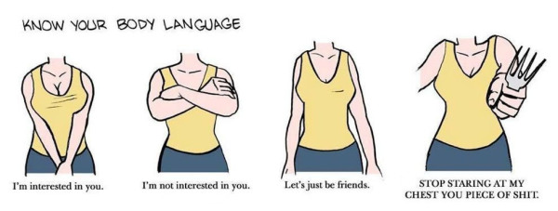
How do you know if someone likes you?

Slide 40
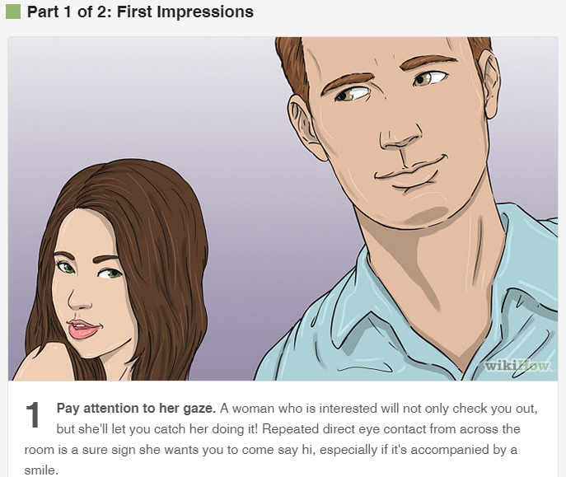

Slide 41
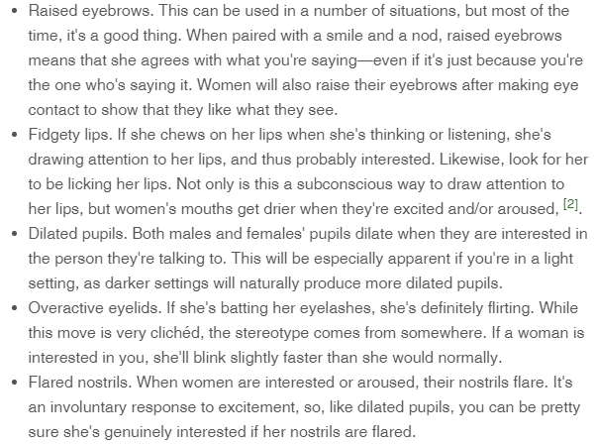
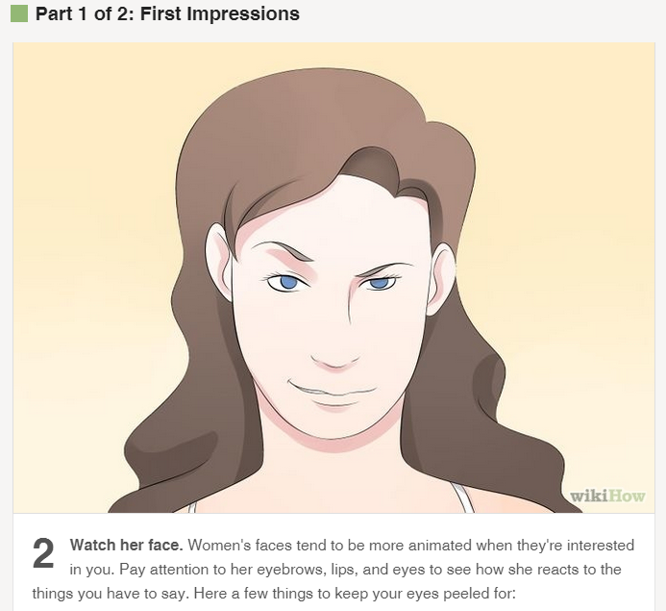

Slide 42
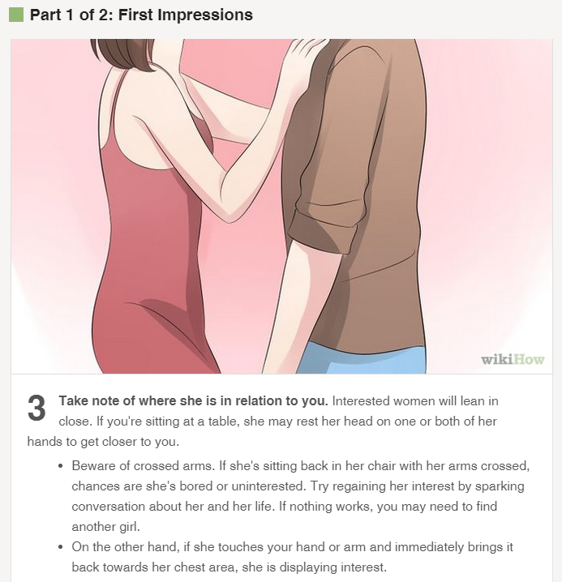

Slide 43
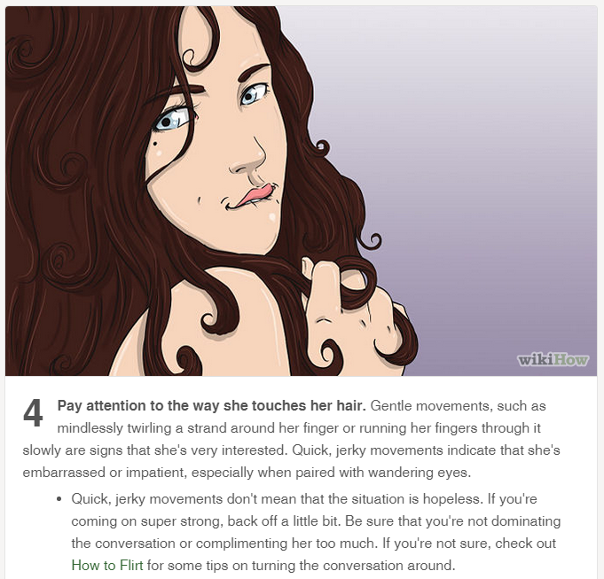

Slide 44
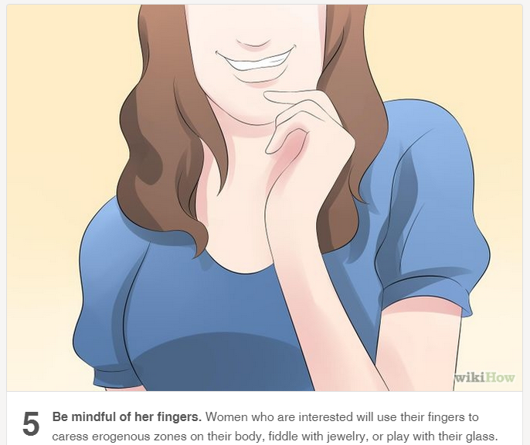
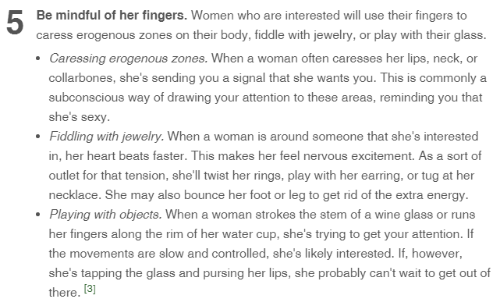

Slide 45
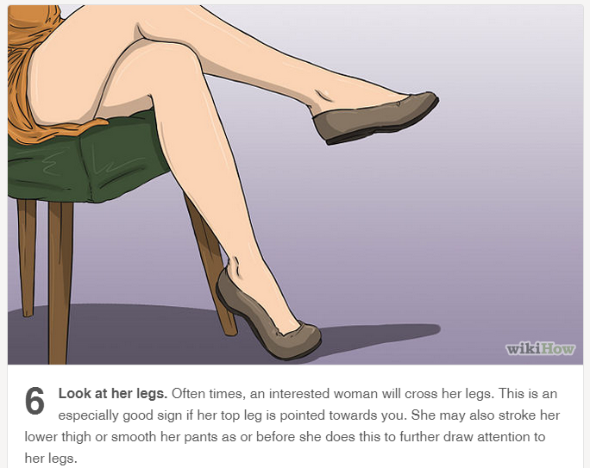

Slide 46
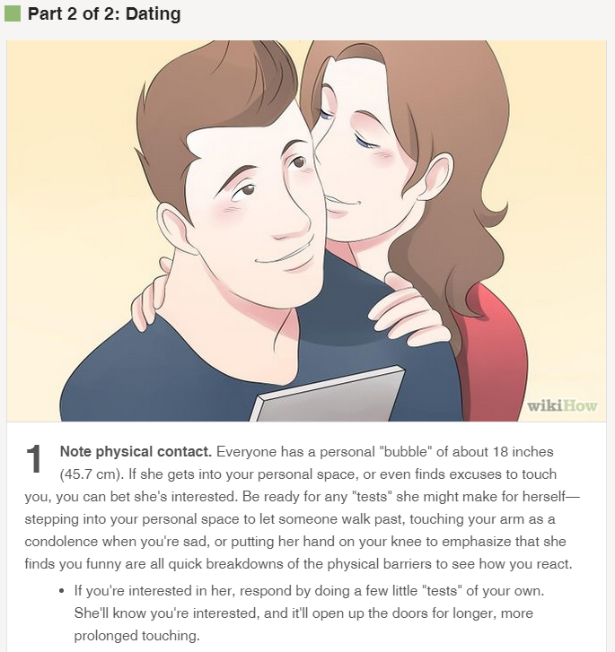

Slide 47
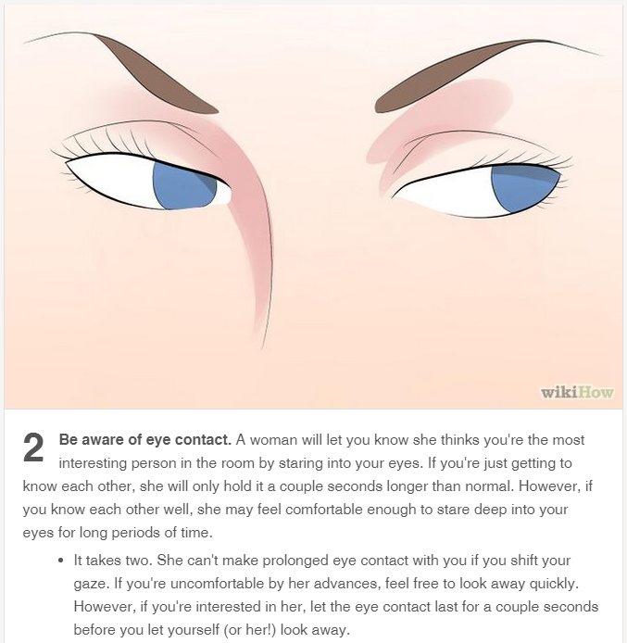

Slide 48
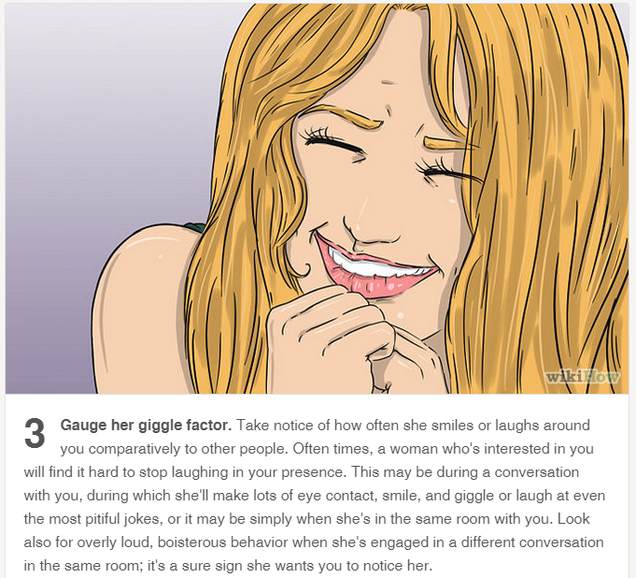

Slide 49
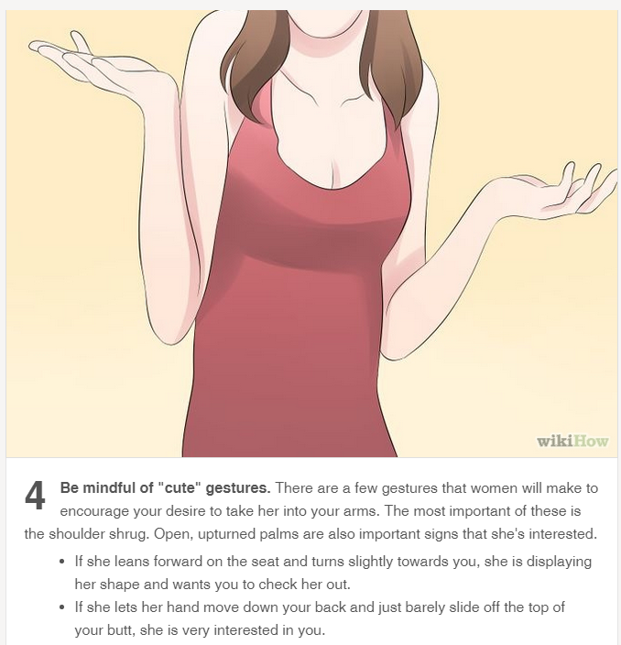

Slide 50
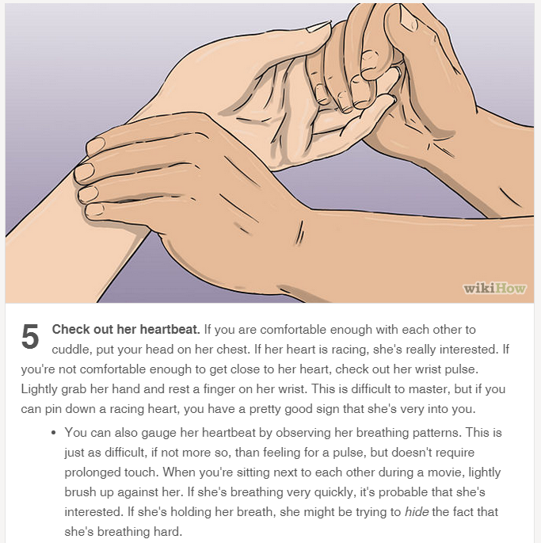

Slide 51
