Slide 1
Objects in the House

Slide 2
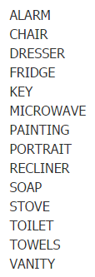
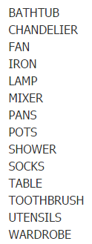
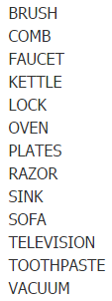

Slide 3
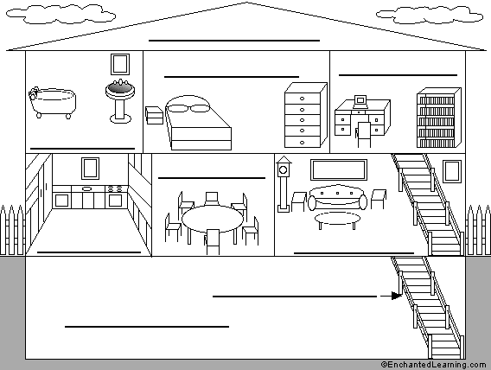
Rooms in a House
Attic
Bedroom
Office
Bathroom
Dining room
Kitchen
Living room
Stairs
Basement

Slide 4
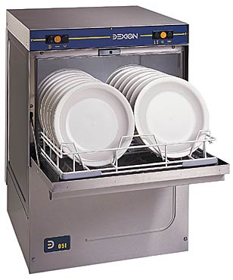
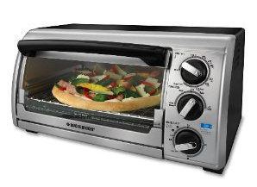
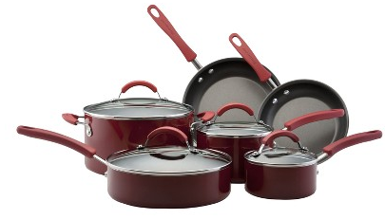
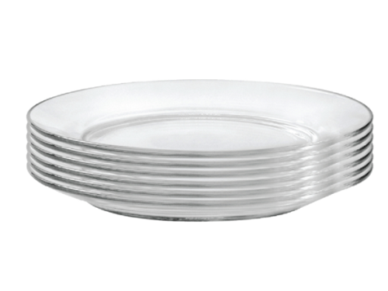
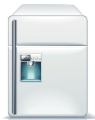
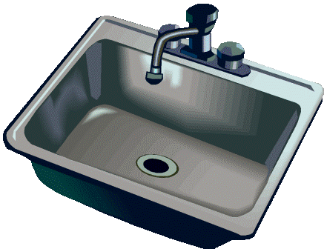
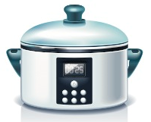

Slide 5
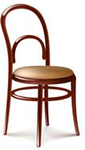
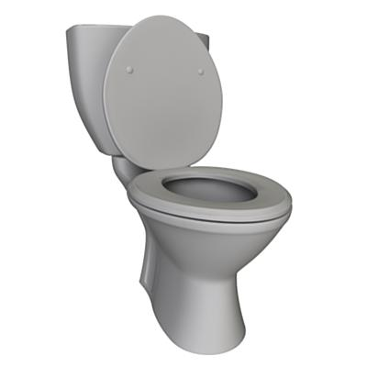
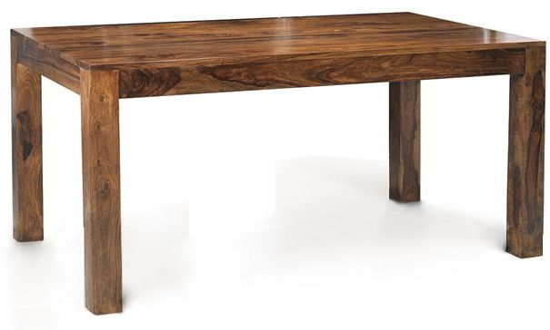
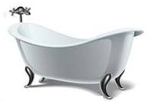
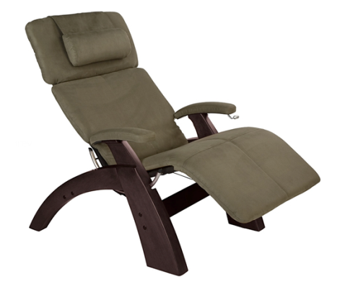

Slide 6
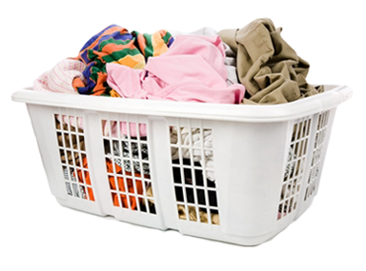
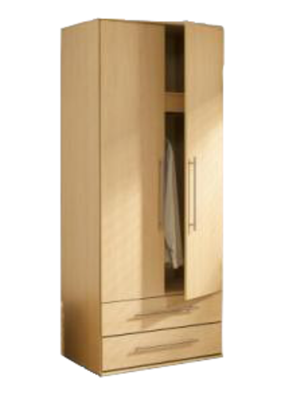
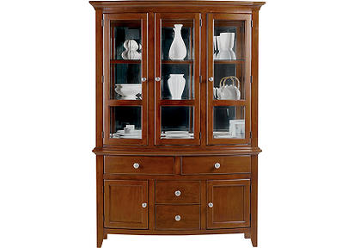
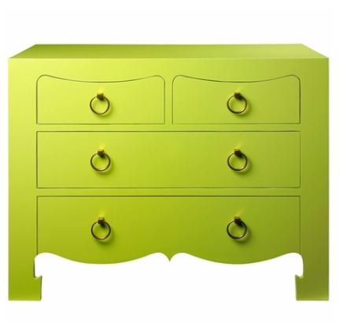

Slide 7
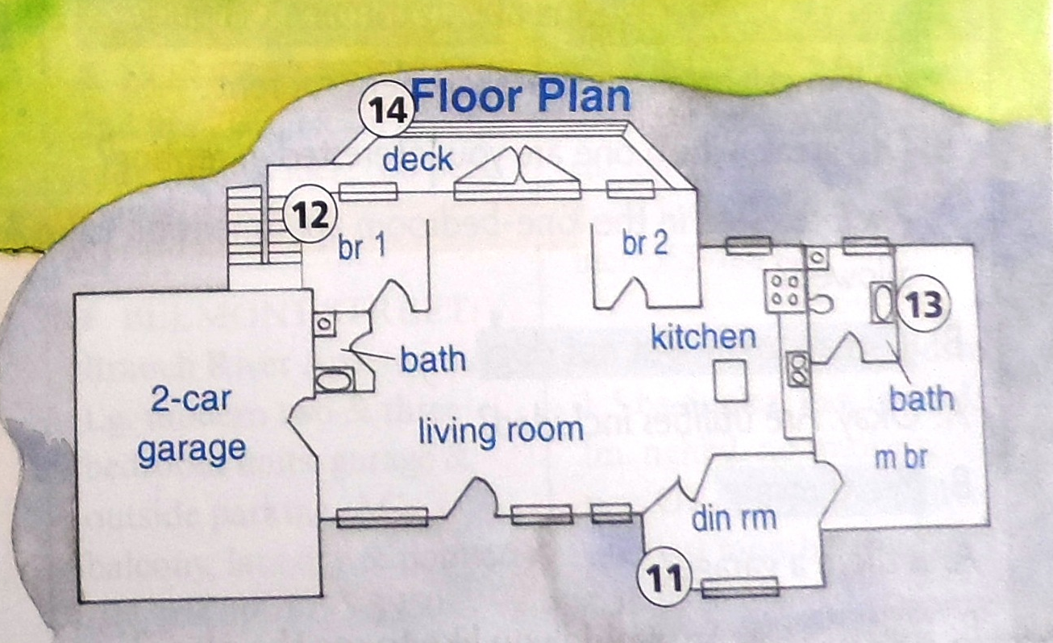
Match the item with the room.

Slide 8
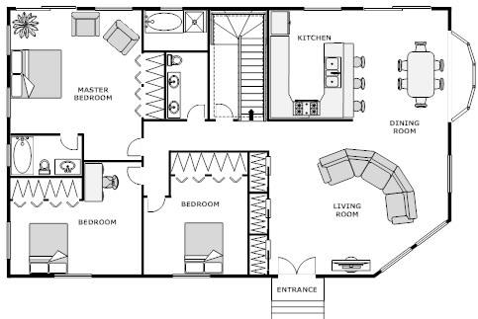
Blueprint

Slide 9
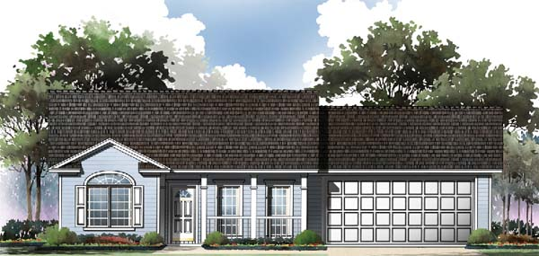
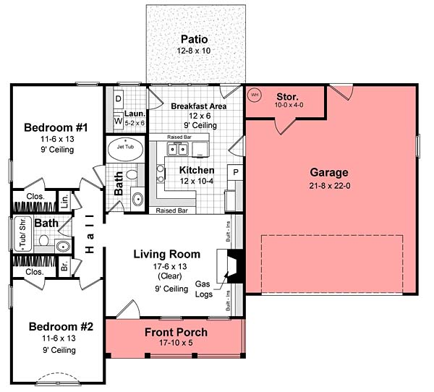
Blueprint

Slide 10
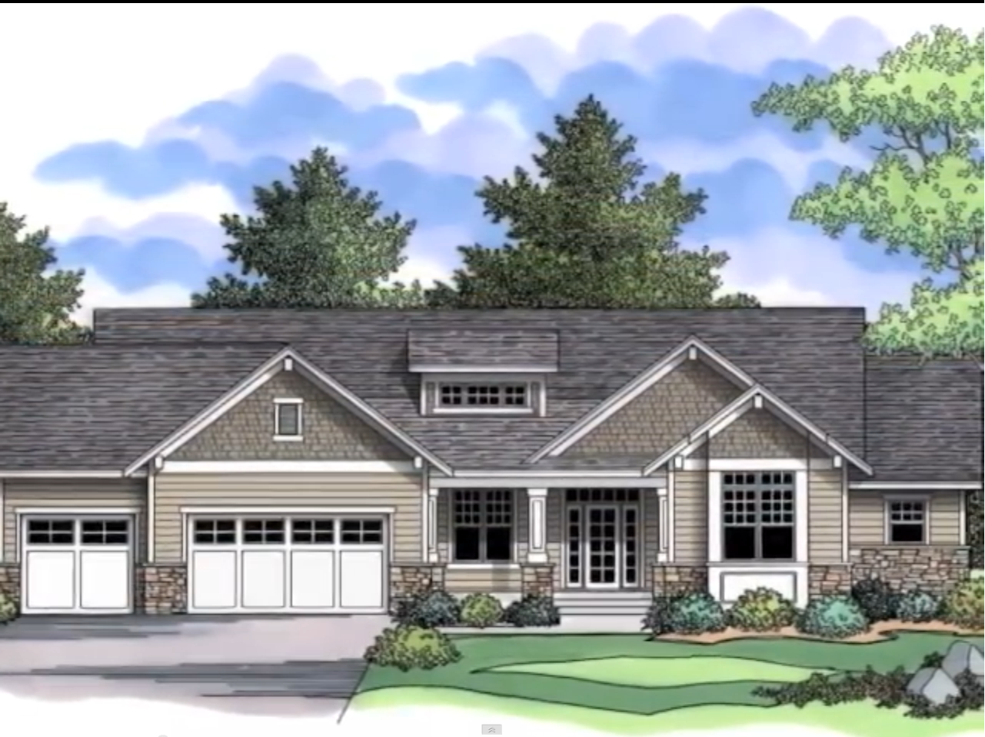

Slide 11
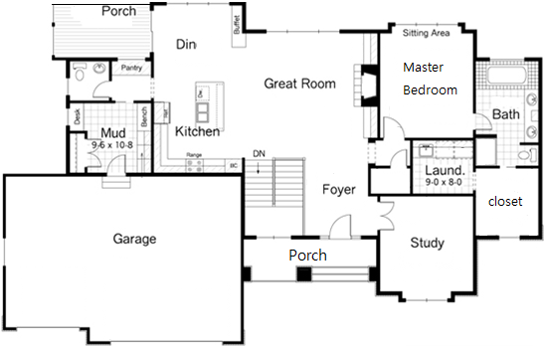

Slide 12
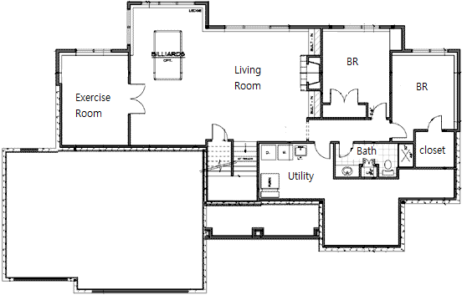

Slide 14
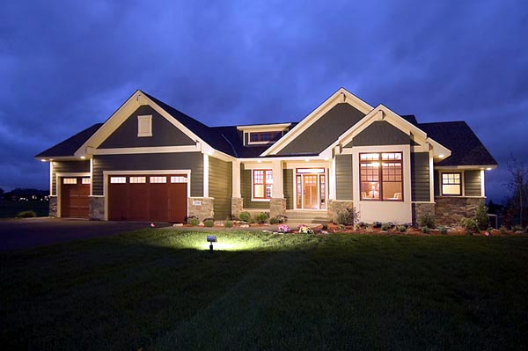
How many bed rooms?
How many bathrooms?
What is the FOYER?

Slide 15
What is in the Living Room?
What room can be changed to a 4th bedroom?

Slide 16
Put a dot where you think the picture was taken.

Slide 17
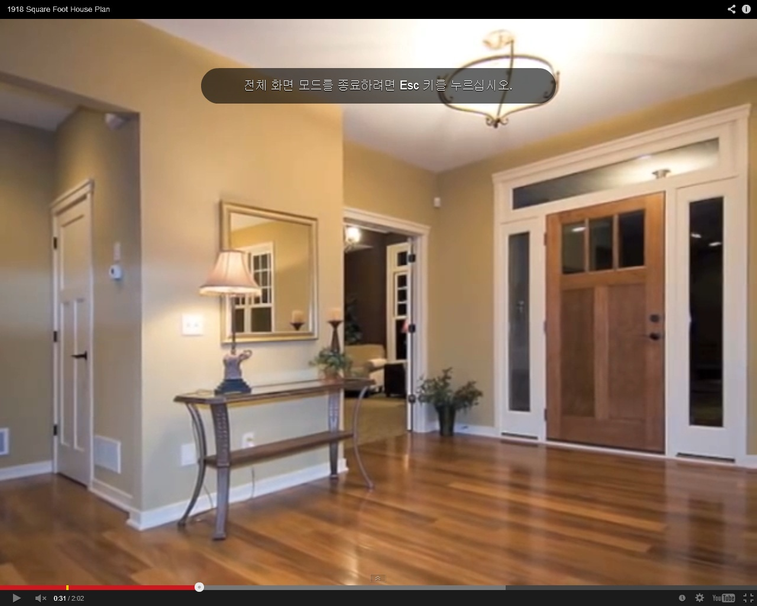
Blue Dot

Slide 18
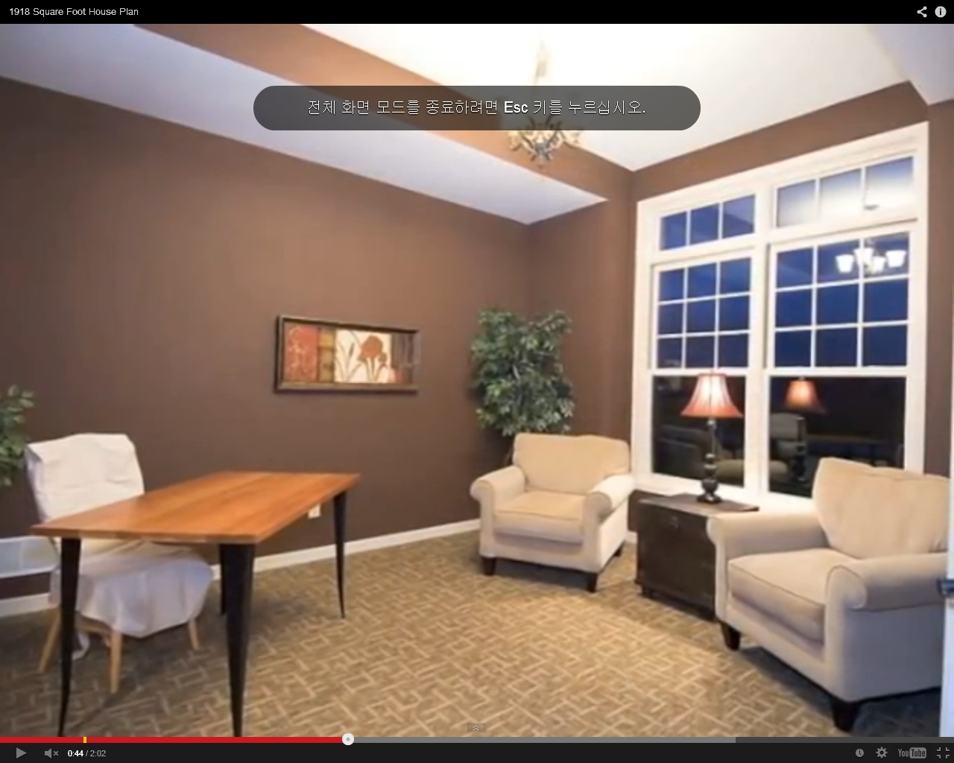
Red Dot

Slide 19
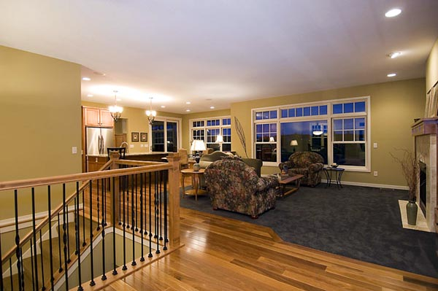
Purple Dot

Slide 20
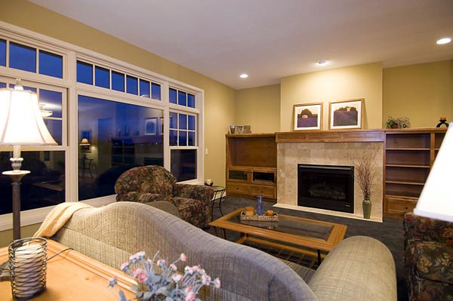
Green Dot

Slide 21
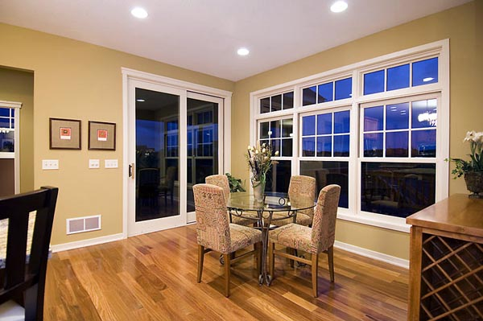
Orange Dot

Slide 22
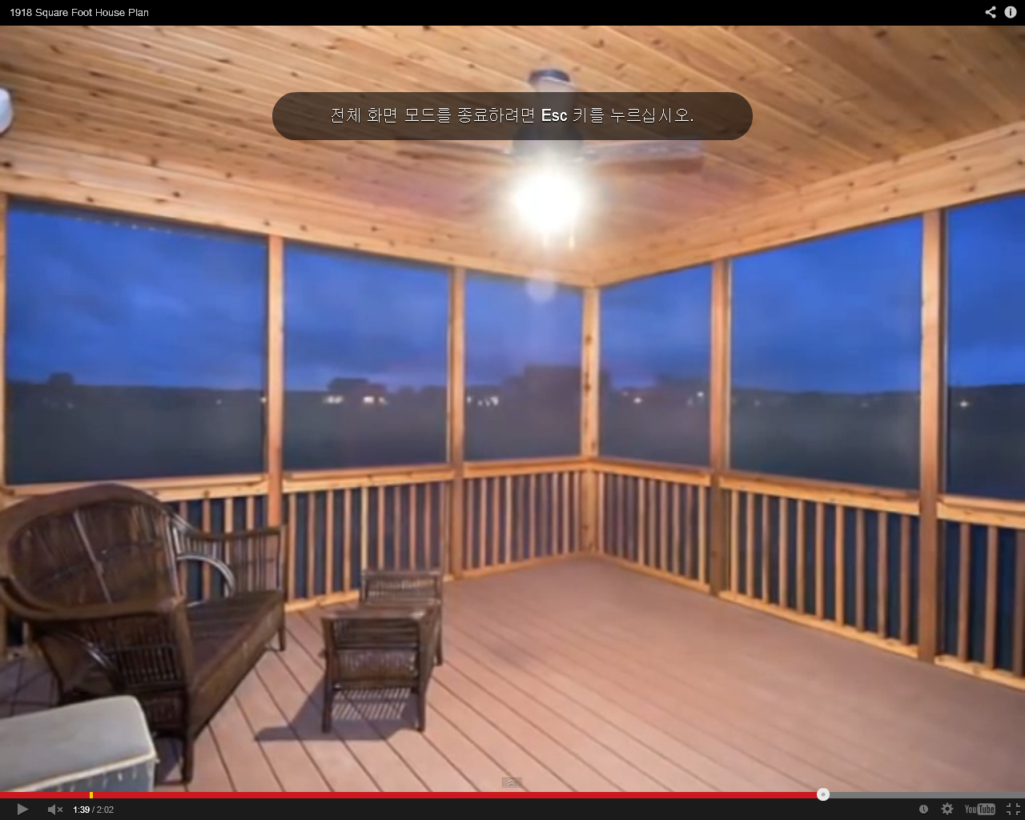
Black Dot

Slide 23
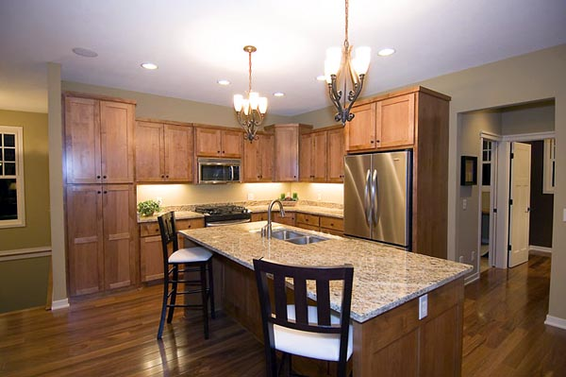
Yellow Dot

Slide 25
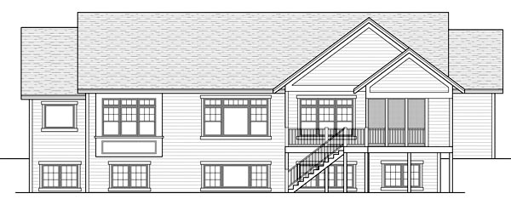
http://www.coolhouseplans.com/details.html?pid=chp-47121

Slide 26
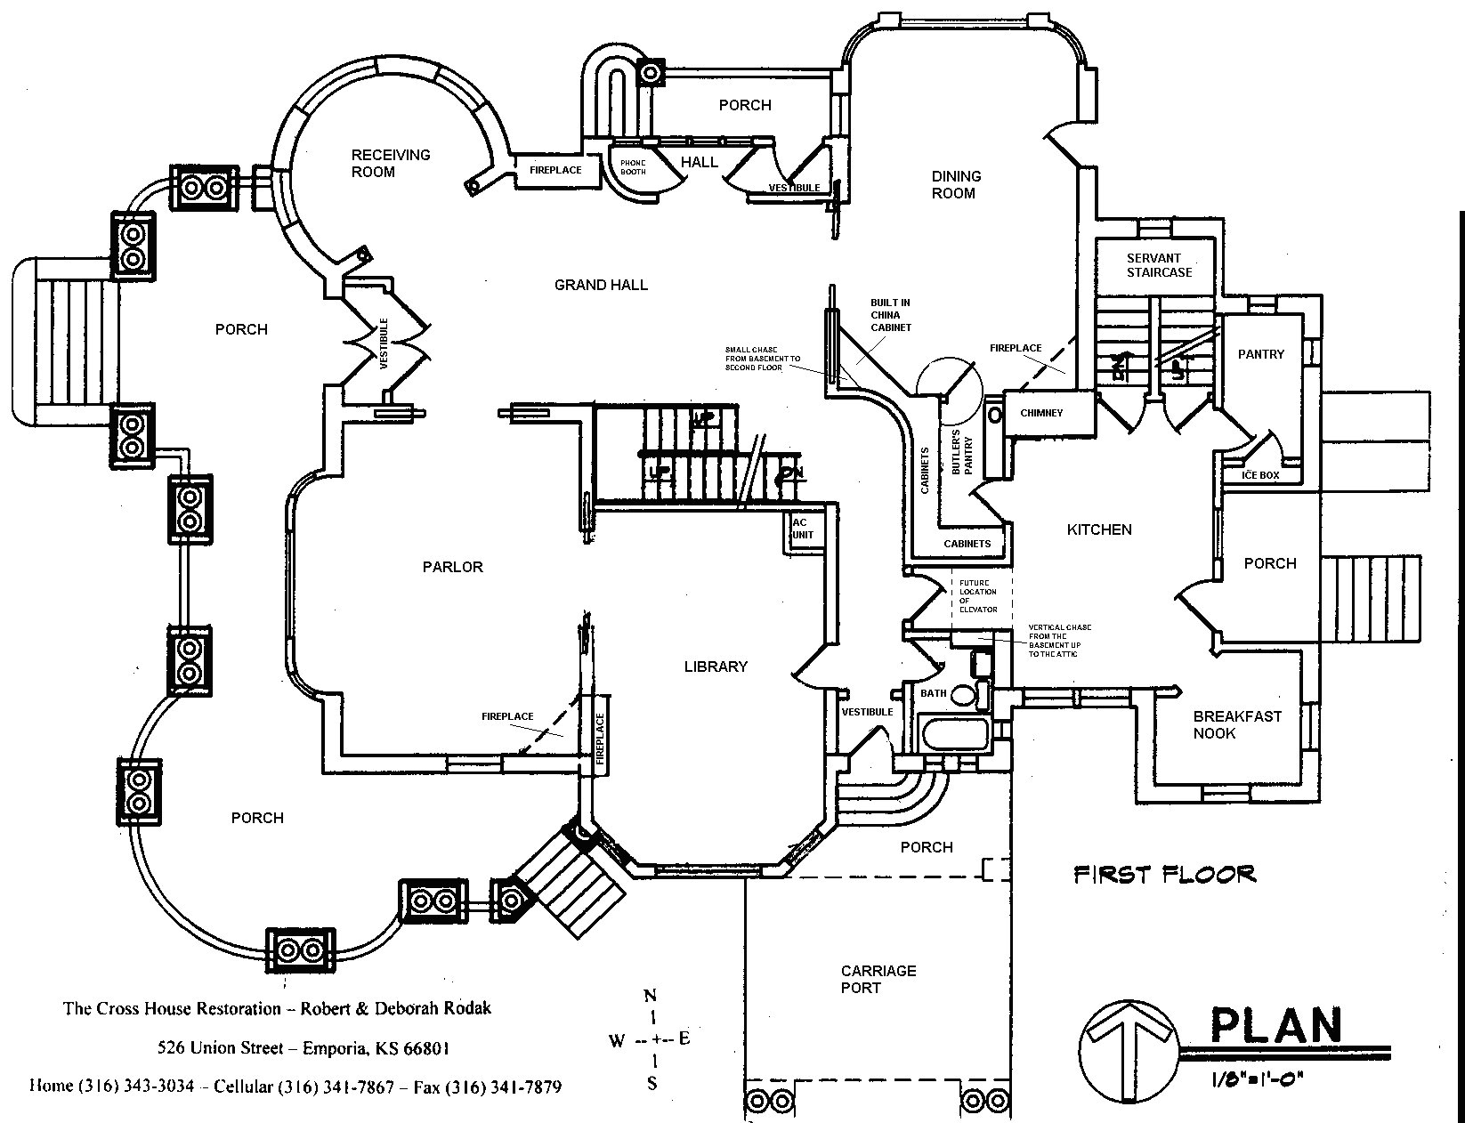
Draw your DREAM HOUSE:

Slide 27
Michael wants a house with:
4 bedrooms
A large living room

Slide 28
Jessica wants a house with:
Only 1 bedroom
An office

Slide 29
Lloyd wants a house with:
A place to play games
A nice kitchen

Slide 30
Sally wants a house with:
At least 2 bedrooms
2 bathrooms

Slide 31
Gina wants a house with:
A porch
A kitchen
A living room

Slide 32
Ted wants a house with:
A room to play games
The living room is the biggest room
One or two bedrooms
One bathroom

Slide 33
Gary wants a house with:
Two floors
Master Bedroom upstairs
A laundry room

Slide 34
Celina wants a house with:
Two bedrooms in the basement
A dining room attached to the kitchen
A porch behind the house

Slide 35
Helen wants a house with:
Master bedroom is the largest room.
A unique room.
A large foyer.

