Slide 1
Classroom Objects

Slide 2
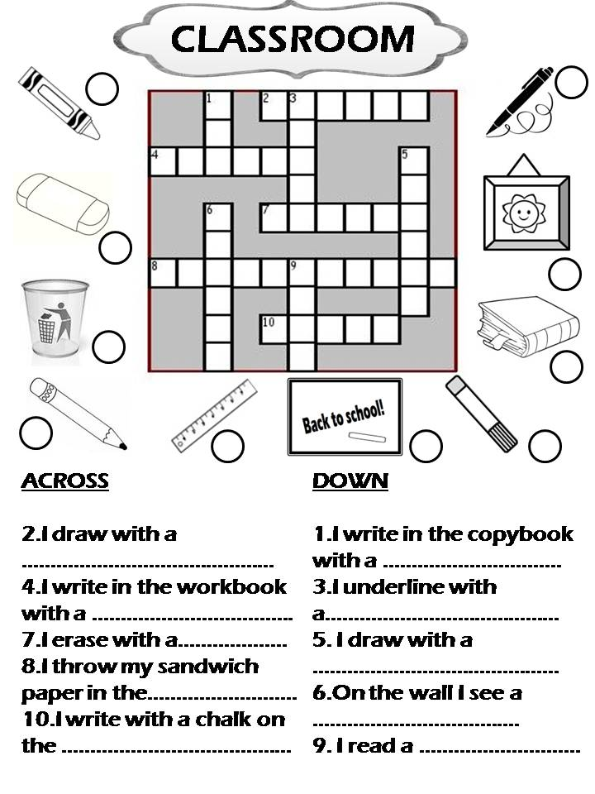
Crossword
Use the pictures to solve the crossword.

Slide 3
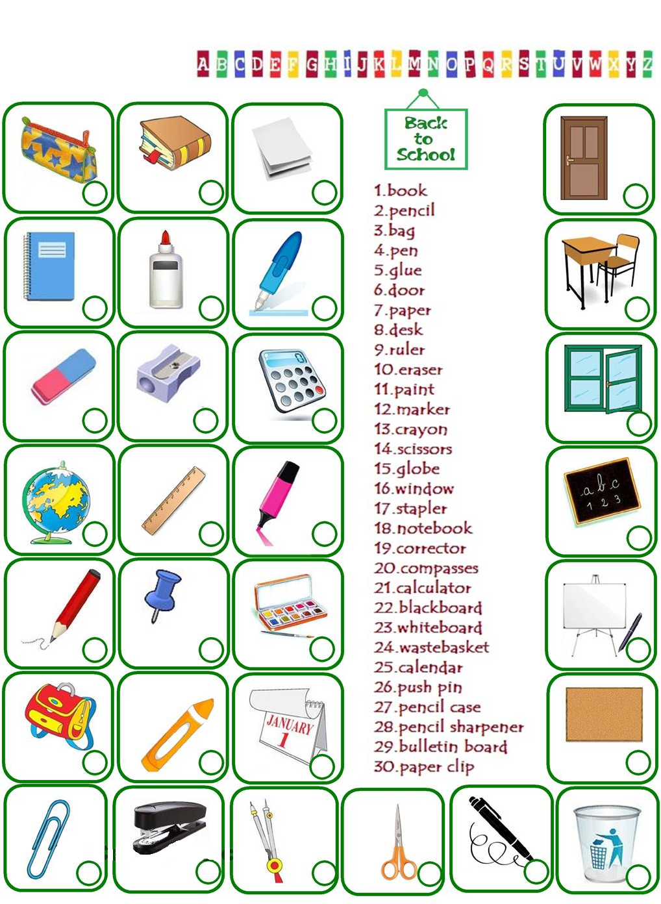
Match the items
Write the correct number

Slide 4
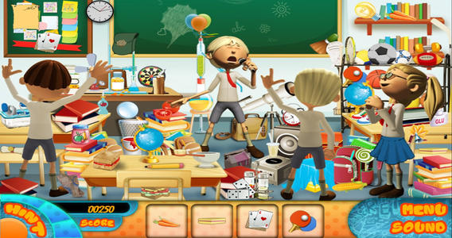

Slide 5
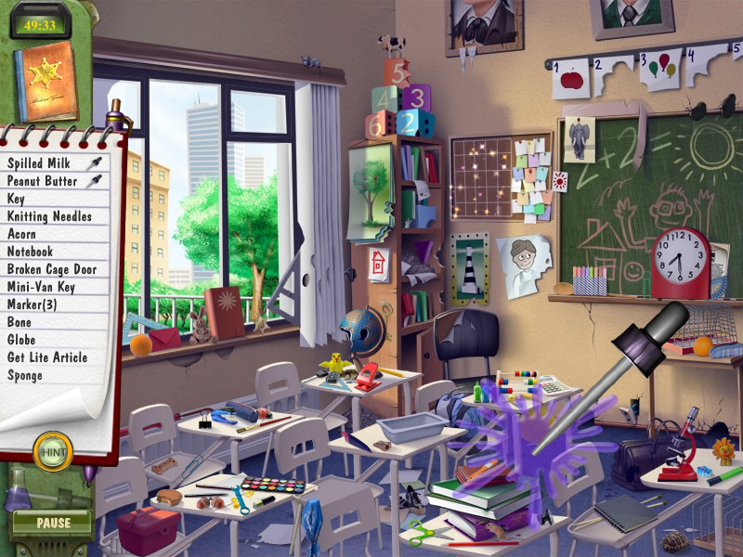

Slide 6
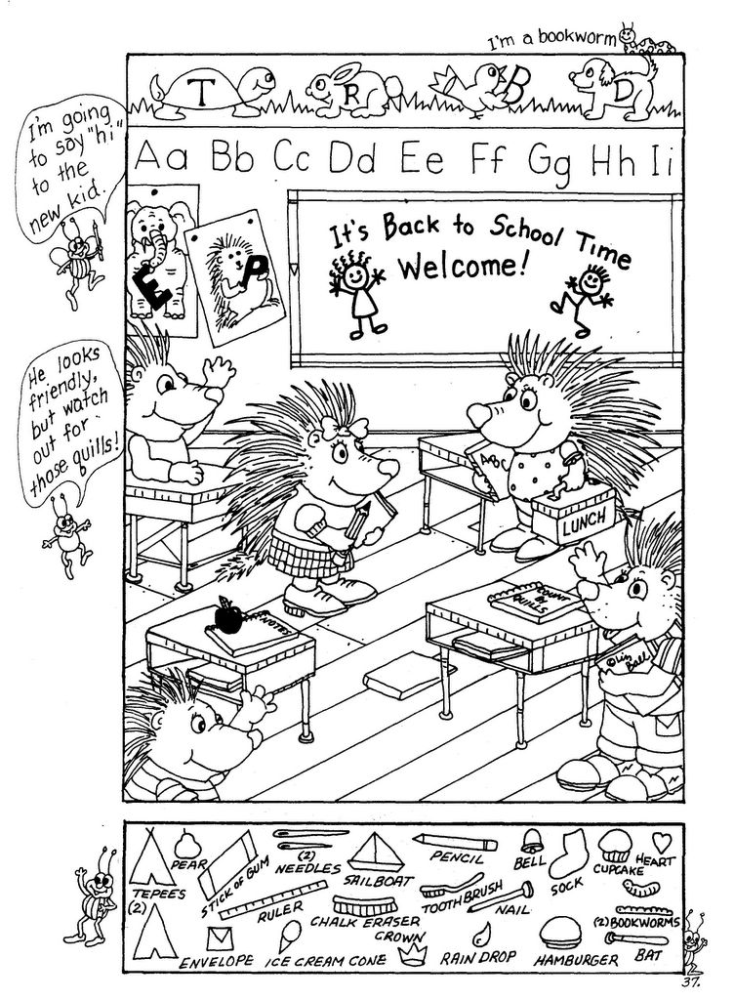

Slide 7
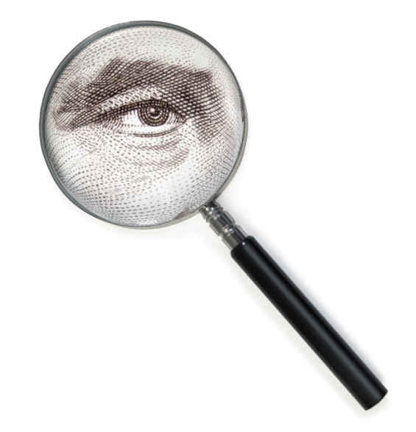
I Spy with my little eye, something that is _______.

Slide 8
Move the Objects Game
One team waits in the hall (no looking)
The other teams each put one thing in the box.
The first team comes back in and tries to find what is missing.
1 point for each object

Slide 9
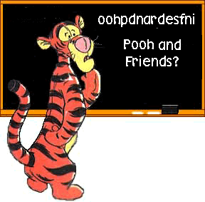
Unscramble and Draw
Unscramble the picture and then draw it.
First person finished is the winner.
Must be able to see the picture.

Slide 10
NEP
CNEPLI
SKOBO
RTELSAP
CRISSSSO
REPRESHAN
LDCARNEA
ORACULLATC
RRTEINP
PLMADORW
OPTCERJOR
MASPOSC

Slide 11
PEN
PENCIL
BOOKS
STAPLER
SCISSORS
SHARPENER
CALENDAR
CALCULATOR
PRINTER
HIGHLIGHTER
PROJECTOR
COMPASS

Slide 12
