Slide 1
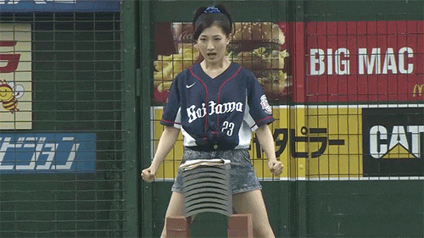
Have You Ever…?

Slide 2
Start by writing:
Yellow Paper – Something happy that happened to you.
Blue Paper – Something sad that happened to you.

Slide 3
Have you ever…?
What does it mean?
Why would you use it?

Slide 4
Have you ever…?
I have.
I have not.
Yes, ______________________.
No, _______________________.

Slide 5
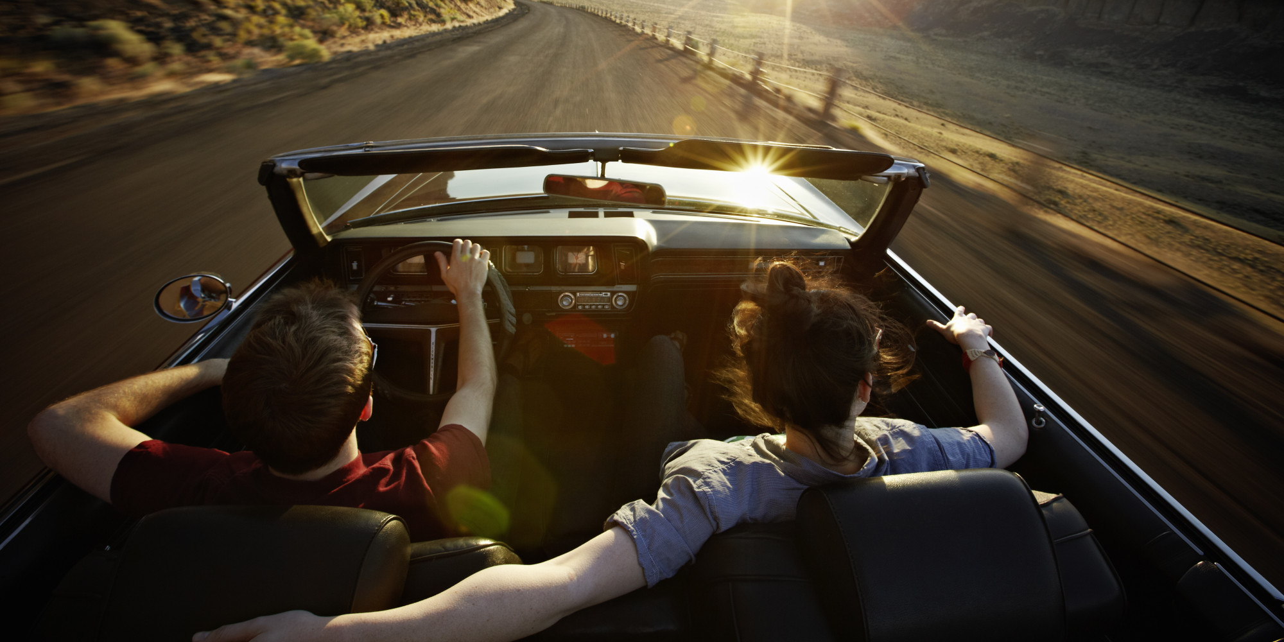
Have you ever driven a car?

Slide 6
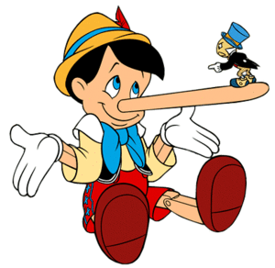
Have you ever lied to your mother?

Slide 7
Have you ever studied math?

Slide 8
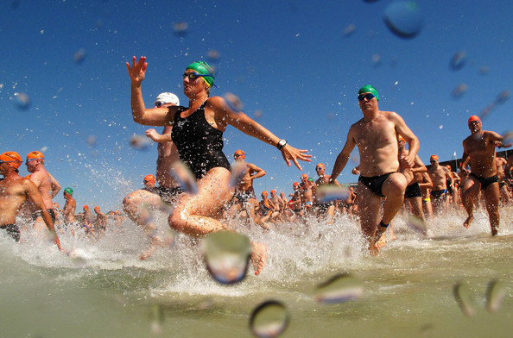
Have you ever swam in the ocean?

Slide 9
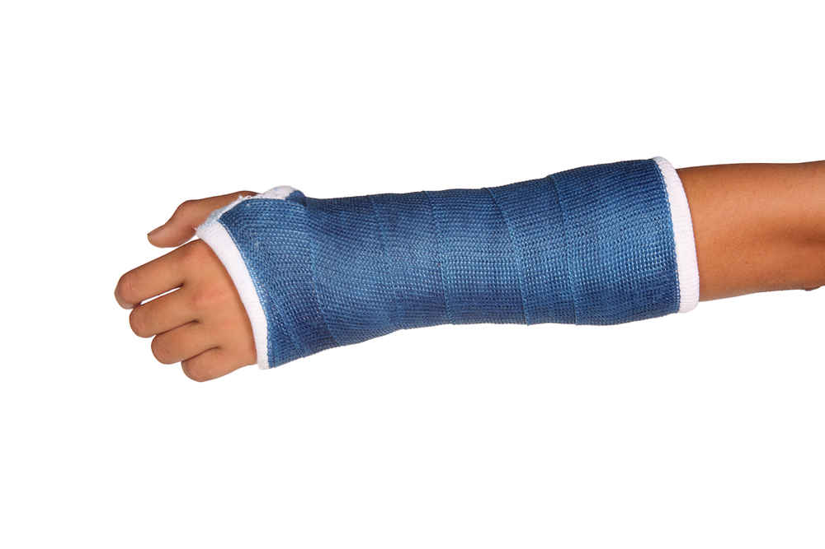
Have you ever broke your arm?

Slide 10
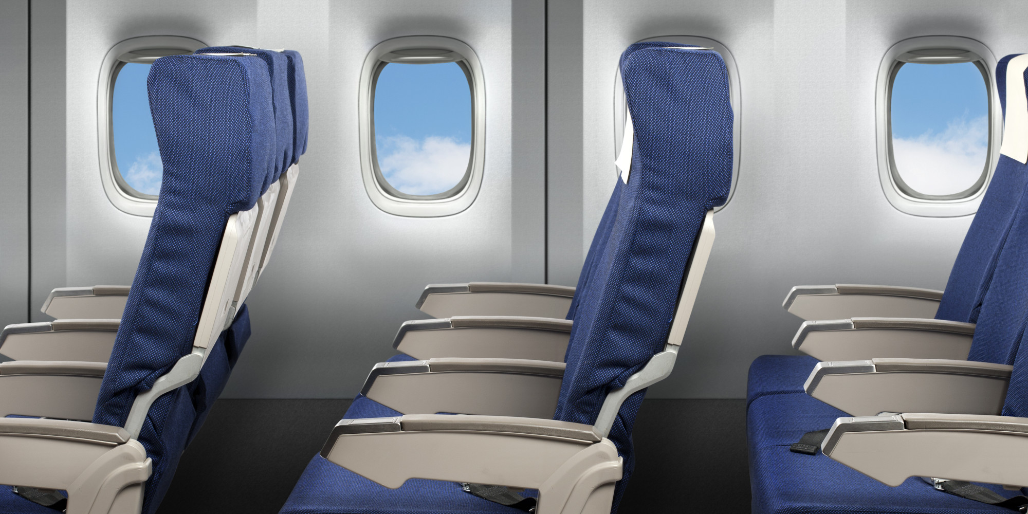
Have you ever been on an airplane?

Slide 11
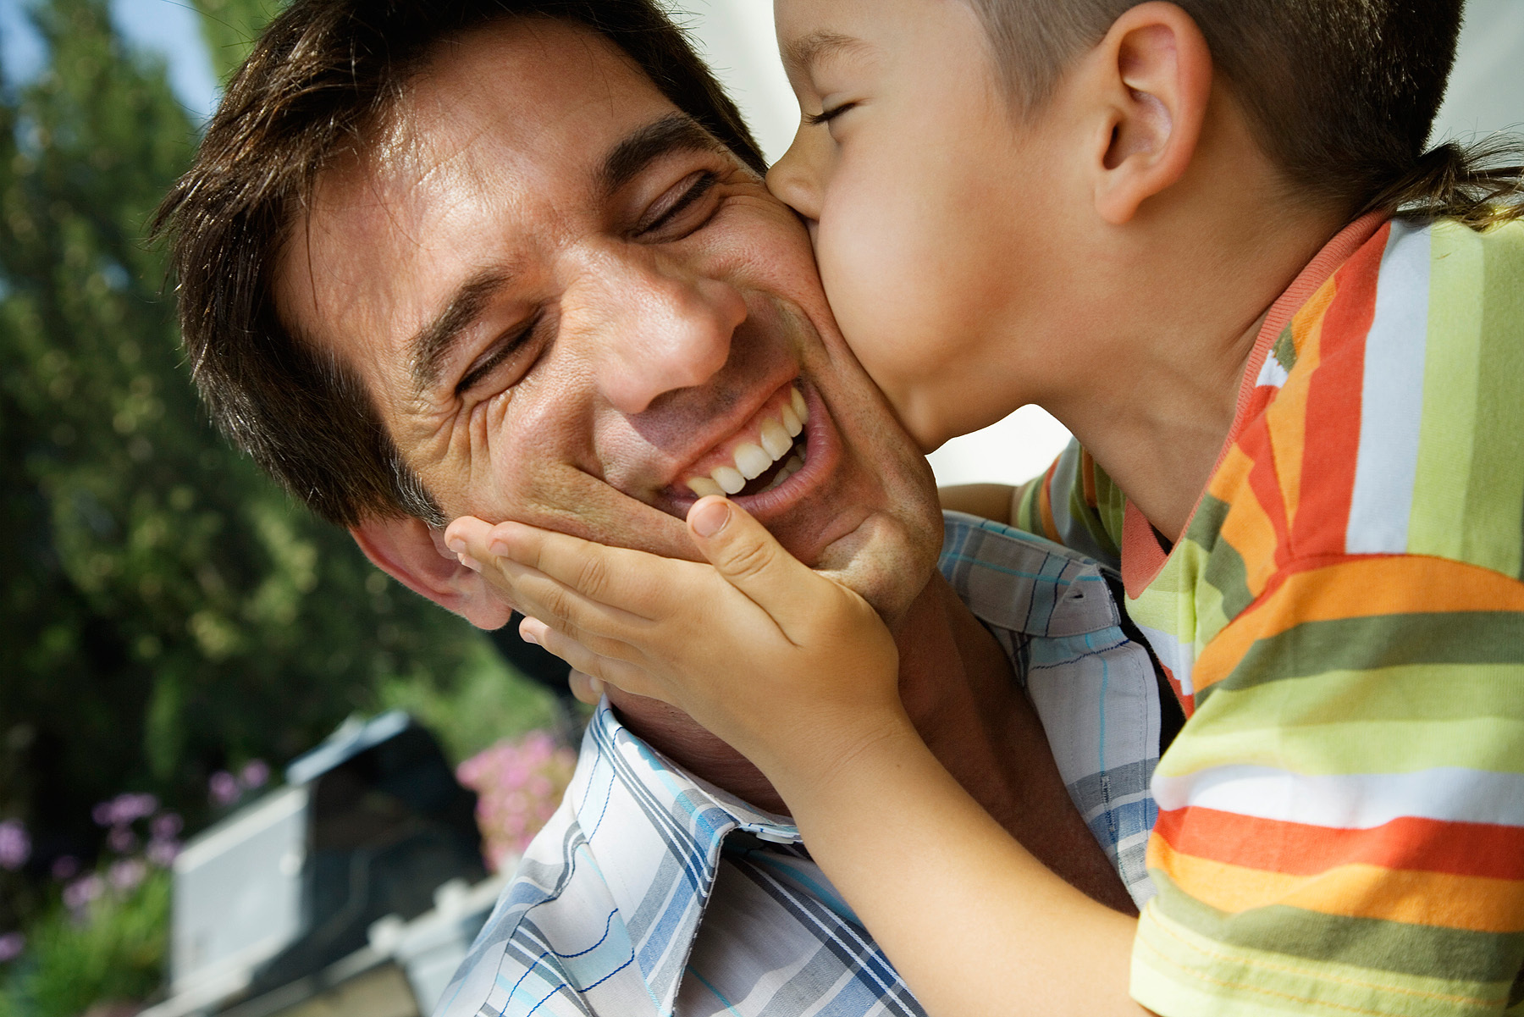
Have you ever kissed your father?

Slide 12
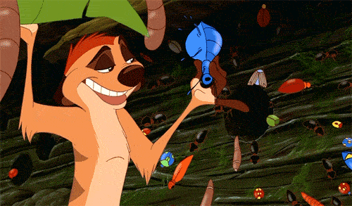
Have you ever eaten an insect?

Slide 13
Have you ever been in a fight?

Slide 14
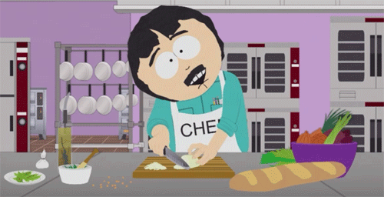
Have you ever cooked dinner?

Slide 15
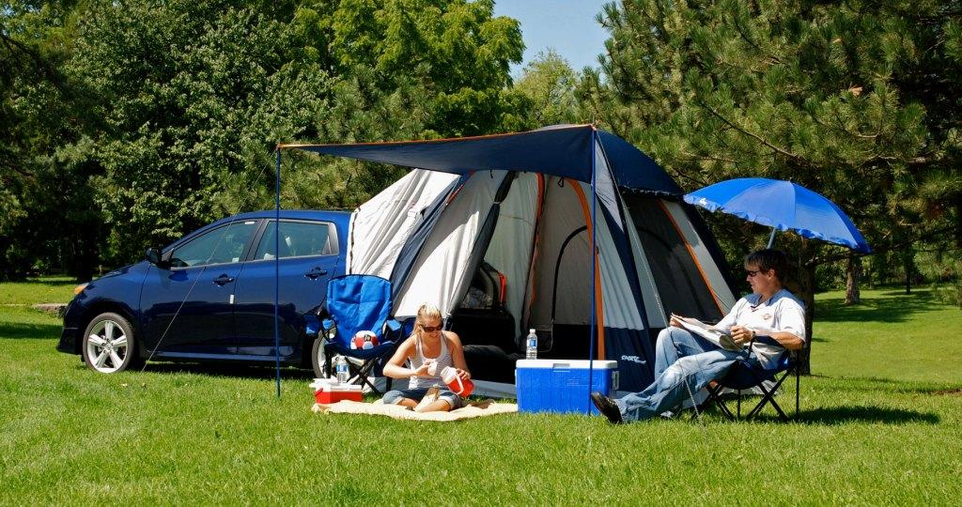
Have you ever slept in a tent?

Slide 16
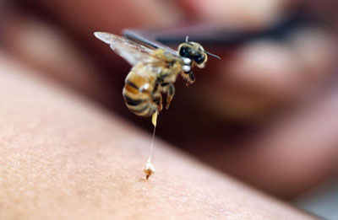
Have you ever been stung by a bee?

Slide 17
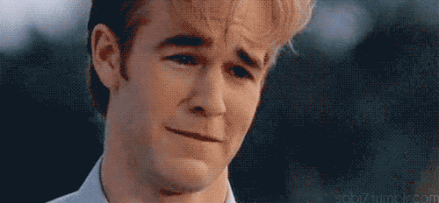
Have you ever made someone cry?

Slide 18
Have you ever lost your phone?

Slide 19
Present Perfect Tense
I have….

Slide 21
verb | past tense | past participle
ask | asked | asked
clean | cleaned | cleaned
climb | climbed | climbed
cook | cooked | cooked
finish | finished | finished
fix | fixed | fixed
frighten | frightened | frightened
help | helped | helped
jump | jumped | jumped
kick | kicked | kicked
look | looked | looked
move | moved | moved
open | opened | opened
play | played | played
pretend | pretended | pretended
remember | remembered | remembered
show | showed | showed
start | started | started
talk | talked | talked
walk | walked | walked
watch | watched | watched
work | worked | worked

Slide 23
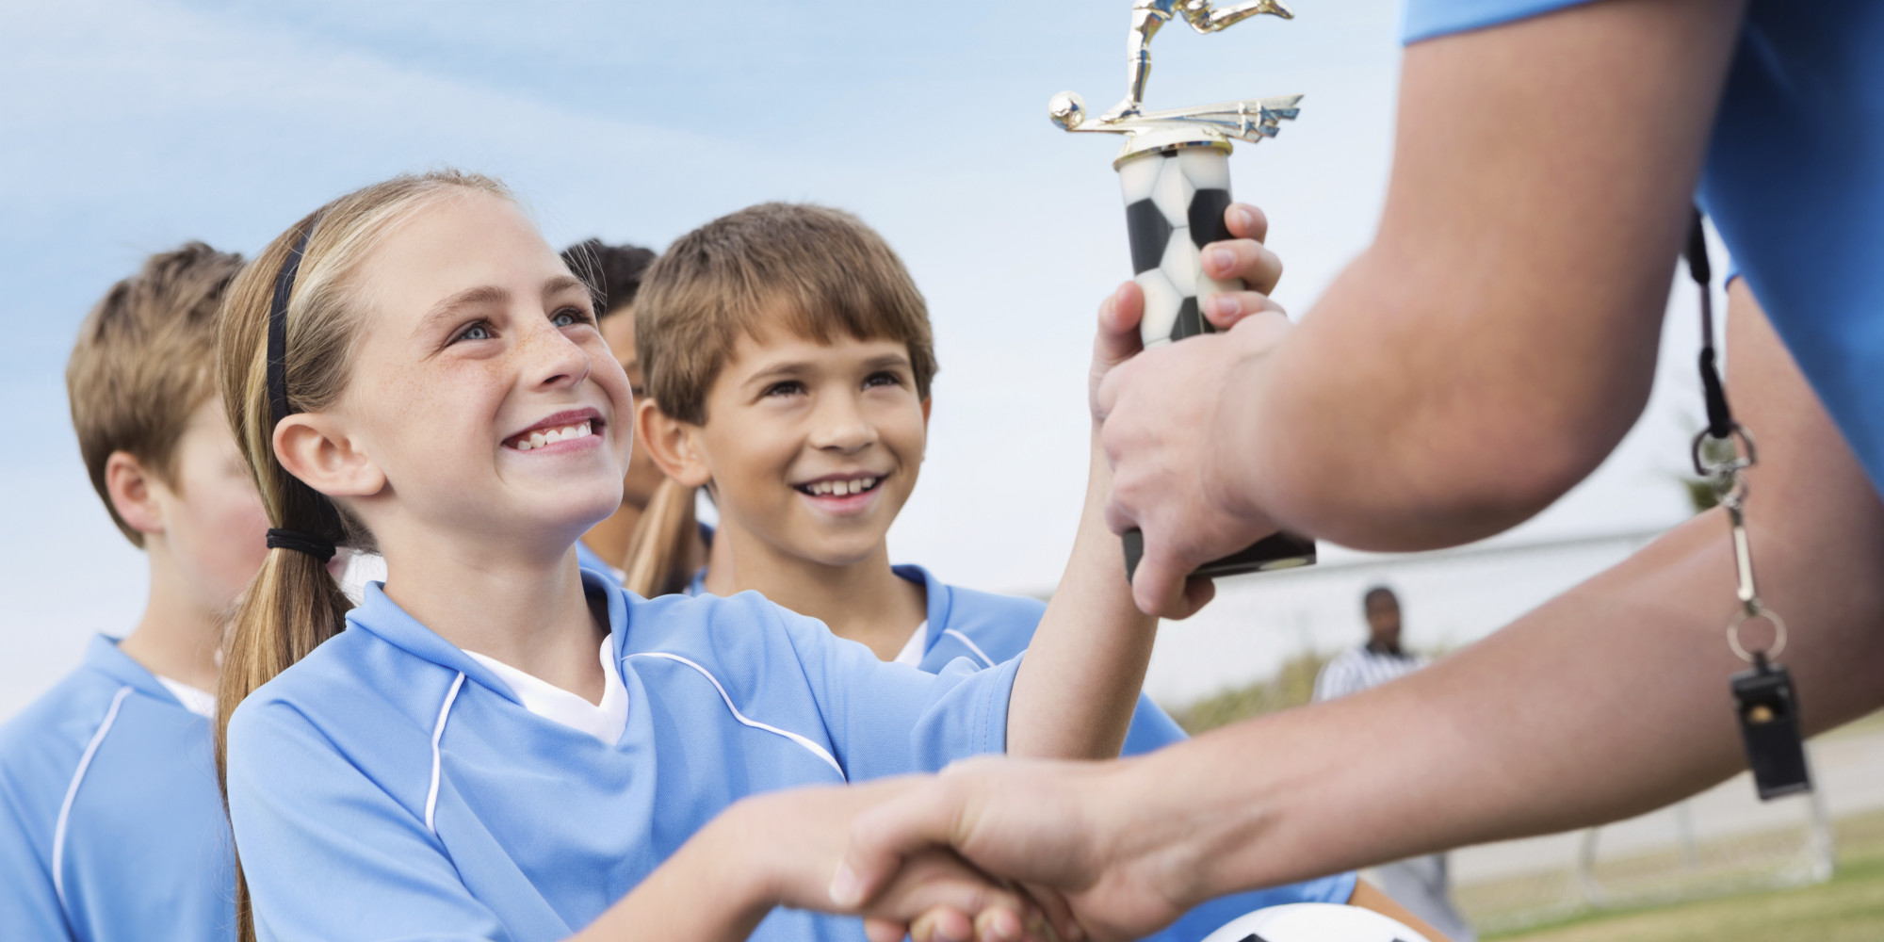
I win a trophy.
I have won a trophy.

Slide 24
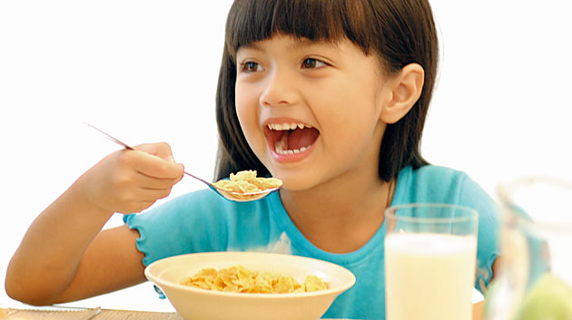
I have eaten breakfast.

Slide 25
I have been to the zoo.

Slide 26
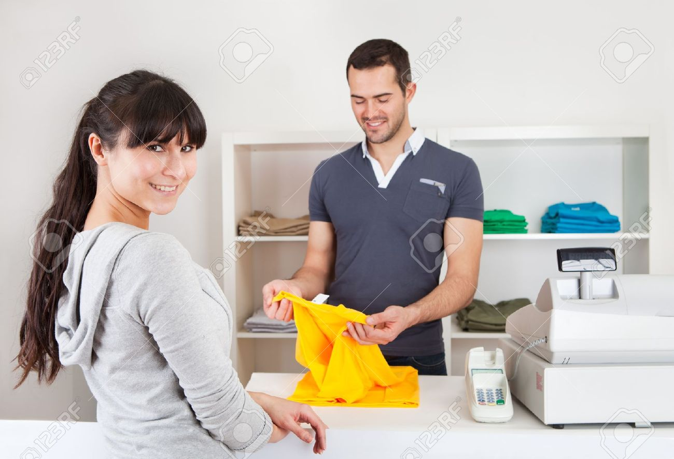
I have bought clothes.

Slide 27
I have travelled to another country.

Slide 28
I haven’t travelled to another country.

Slide 29
I’ve never – The Sitting Game
Everyone must stand up at the back of class.
Make a present perfect sentence.
Must be something that you didn’t do.
If someone else has done it, but you have not, you can sit down.

Slide 30
Dare
Challenge someone to do something.

Slide 31
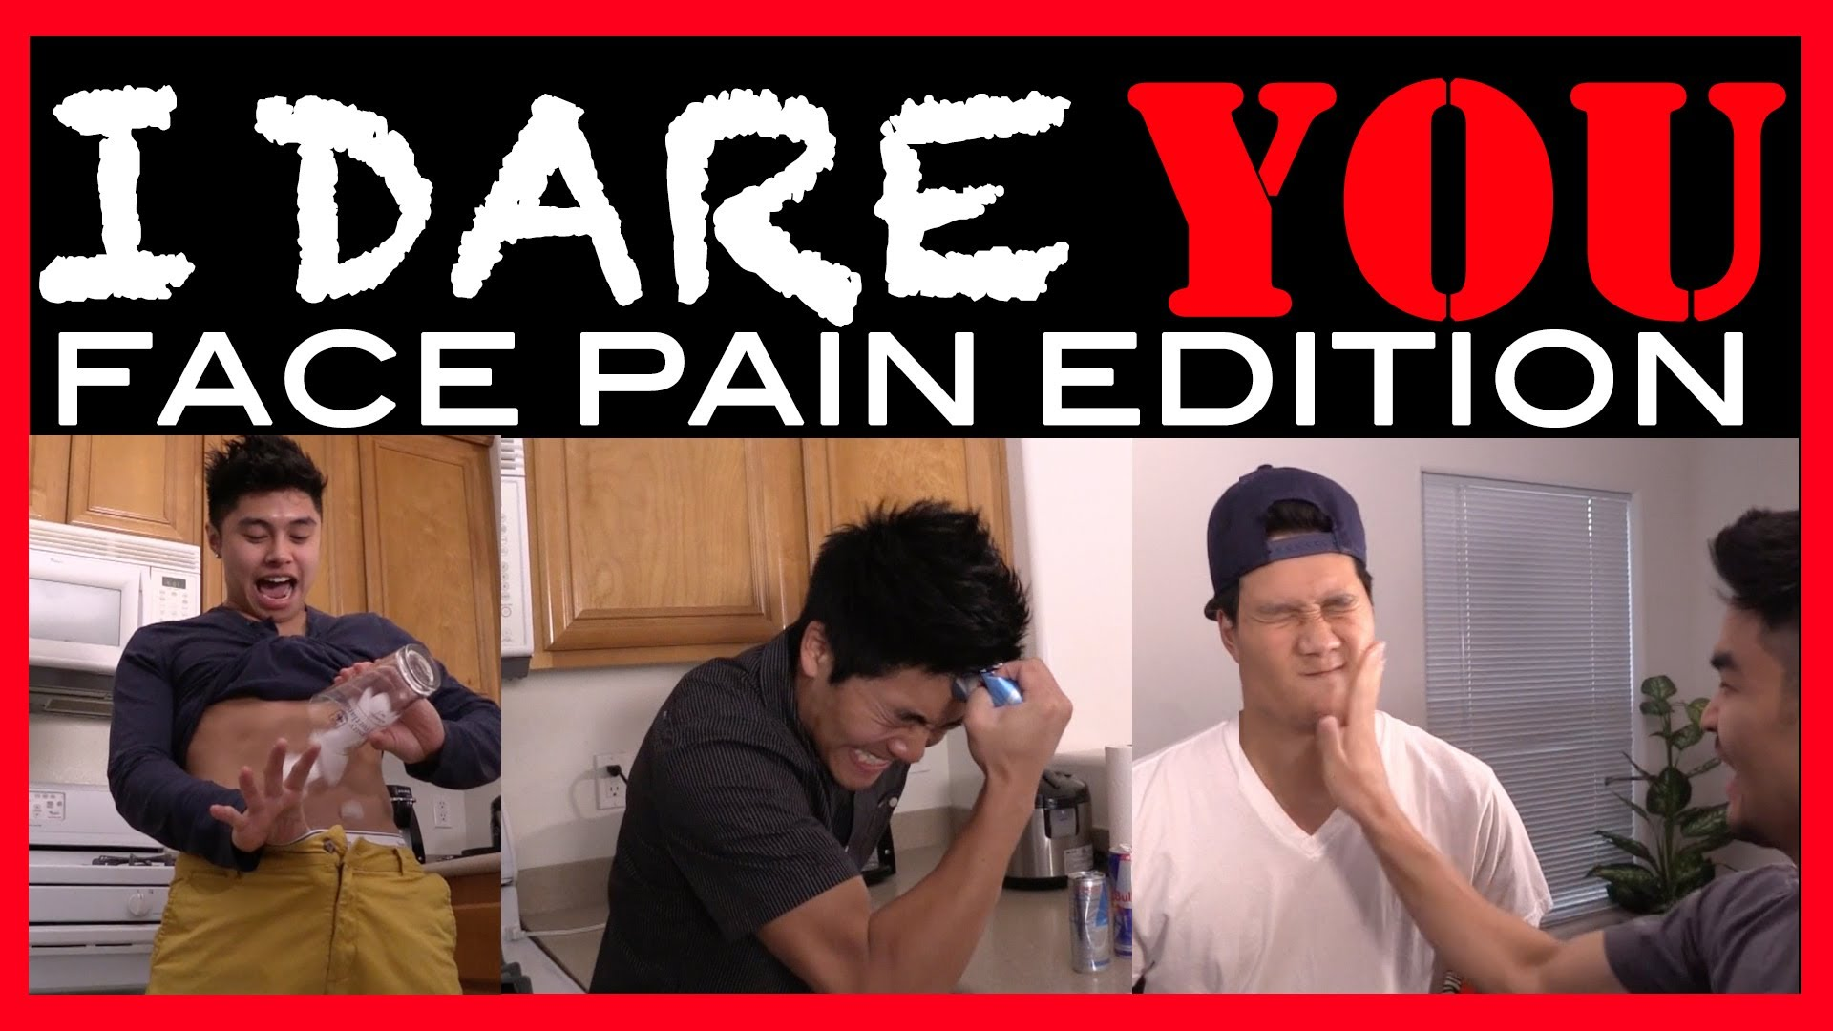
Dare

Slide 32
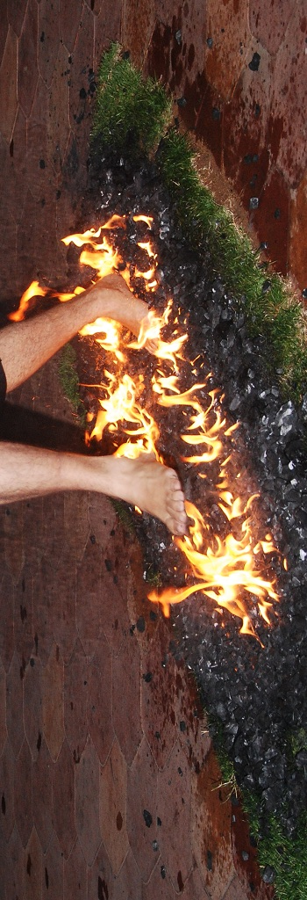
I dare you to…

Slide 33
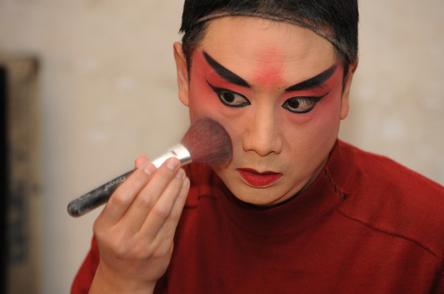
I dare you to….

Slide 34
Travis Pastrana
https://www.youtube.com/watch?v=L5N7R9Wbe_E

Slide 35
Fear Factor
https://www.youtube.com/watch?v=aw_bmpgfZK4

Slide 36
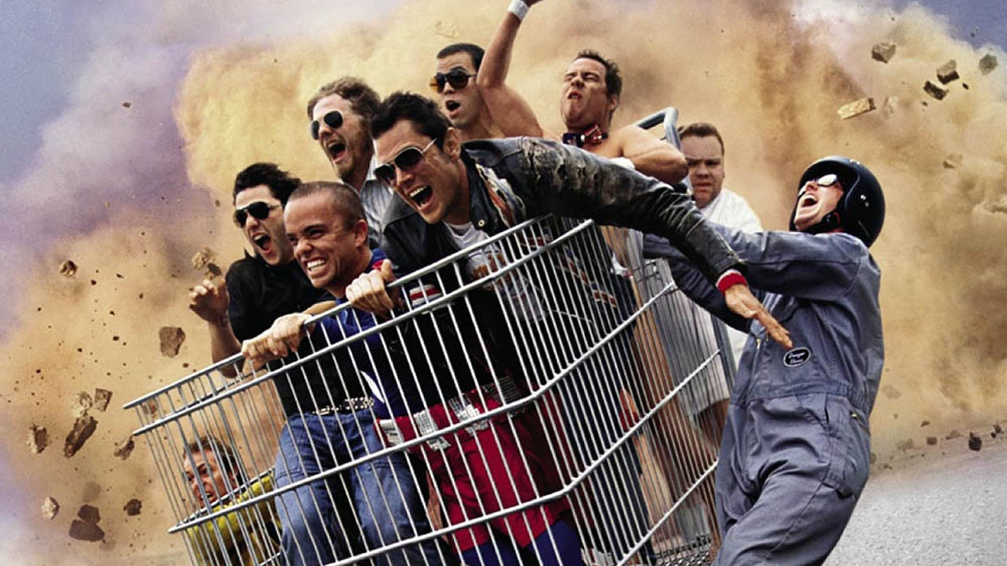
Jackass
https://www.youtube.com/watch?v=3_3VrHLuqG4

Slide 37
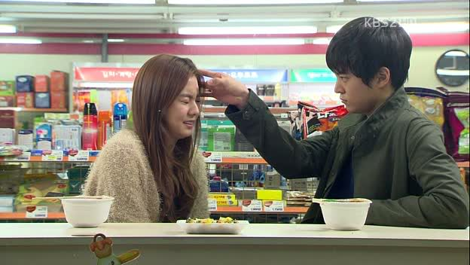
Truth or Dare
One student comes to the front.
Another student asks, “Truth or Dare?”
Truth – Ask, “Have you ever…”
Dare – Say, “I dare you to…”

Slide 38
Two truths one lie and other games:
http://www.teach-this.com/resources/grammar/present-perfect

