Slide 1
The Lunch Menu

Slide 2
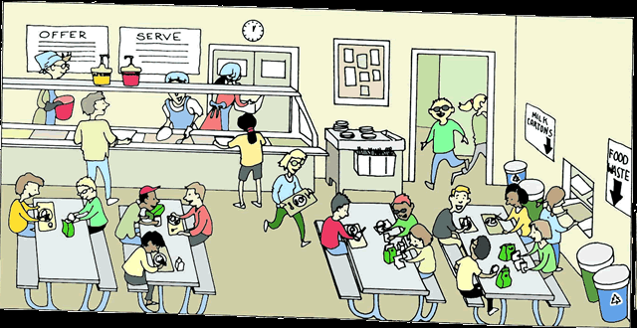
Cafeteria
Where do you eat lunch?

Slide 3
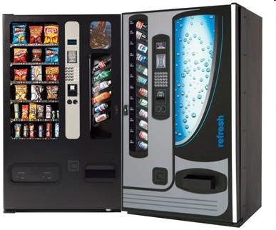
Vending Machine

Slide 4
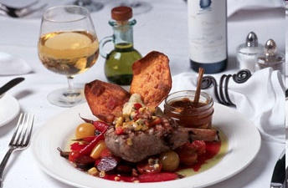
Have a good lunch!
맛있게 드세요
Bon Appetite

Slide 5
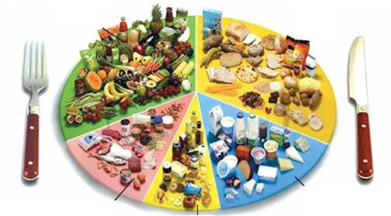
6 food groups

Slide 6
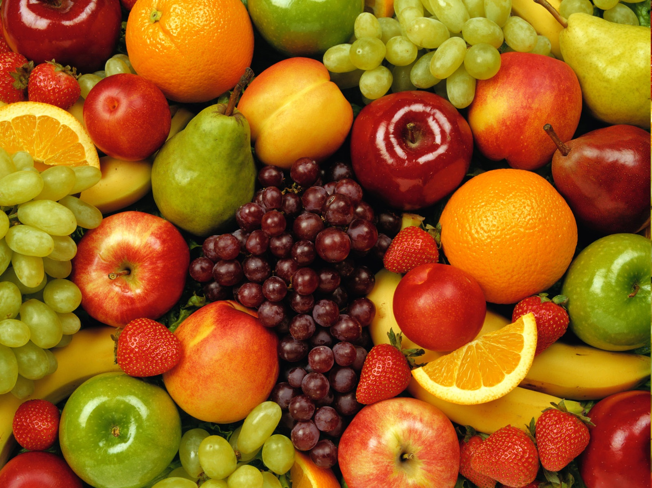
Group 1:

Slide 7
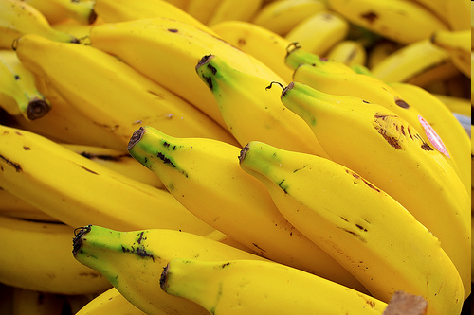
Group 1: Fruits

Slide 8
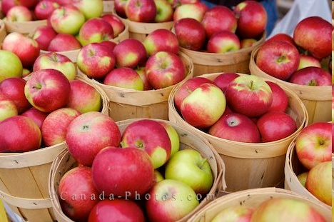

Slide 9
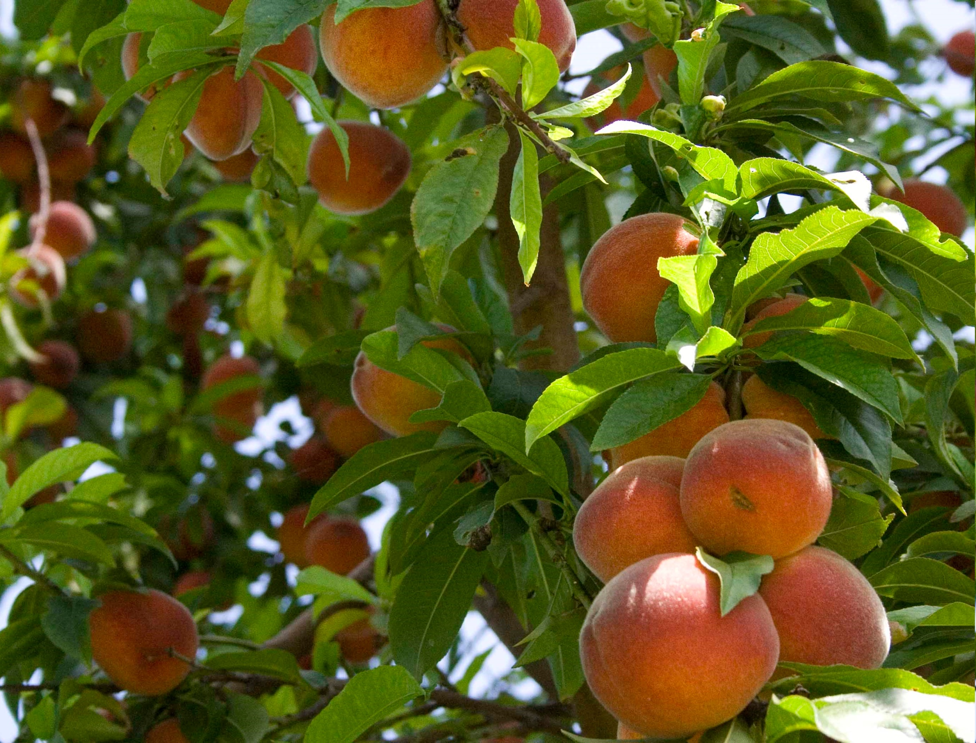

Slide 10
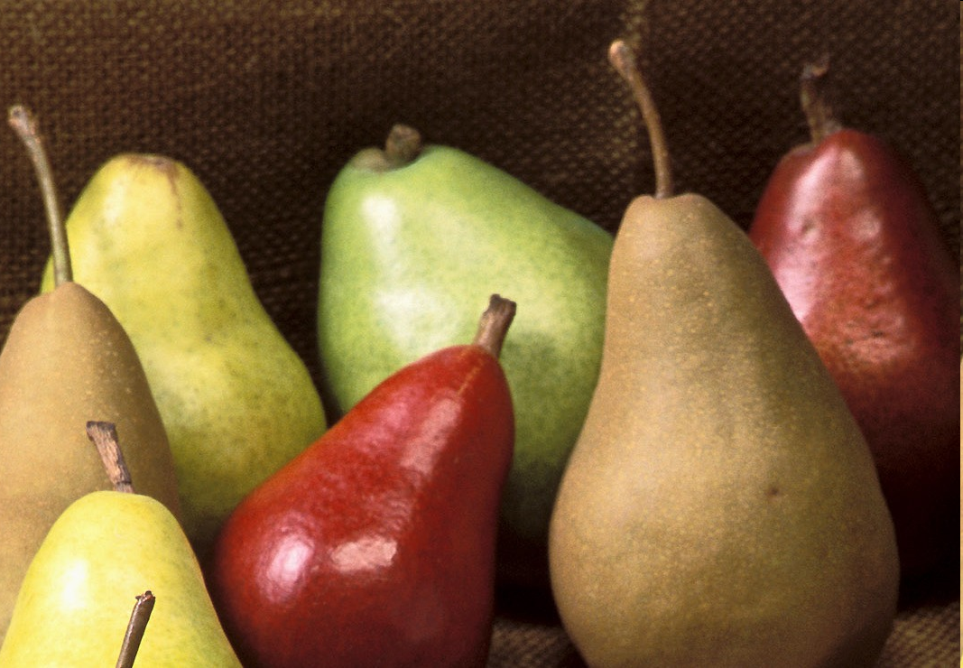

Slide 11
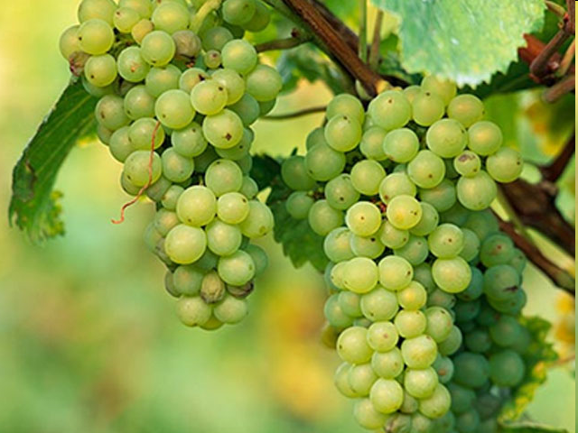

Slide 12
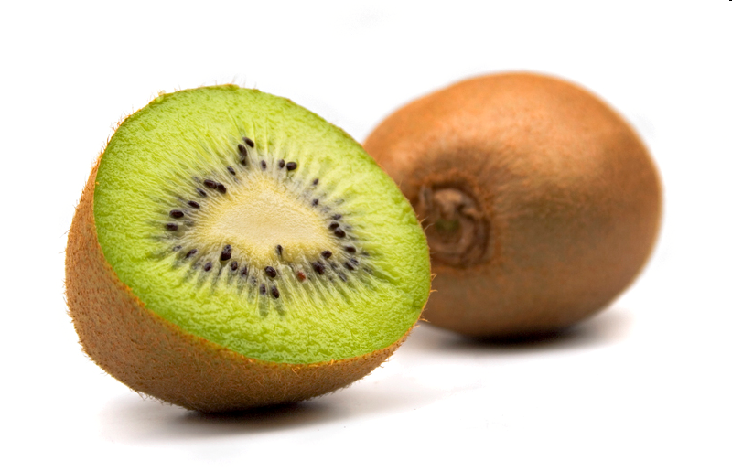

Slide 13
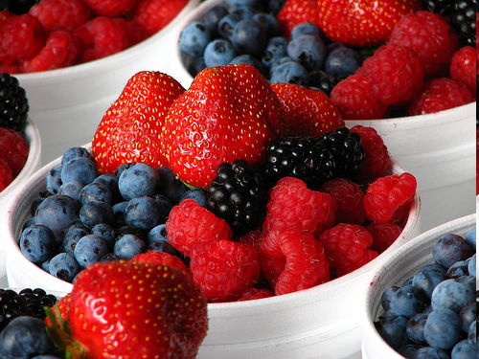

Slide 14
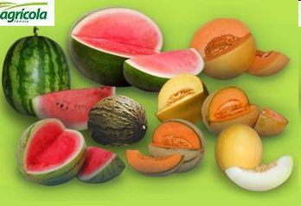

Slide 15
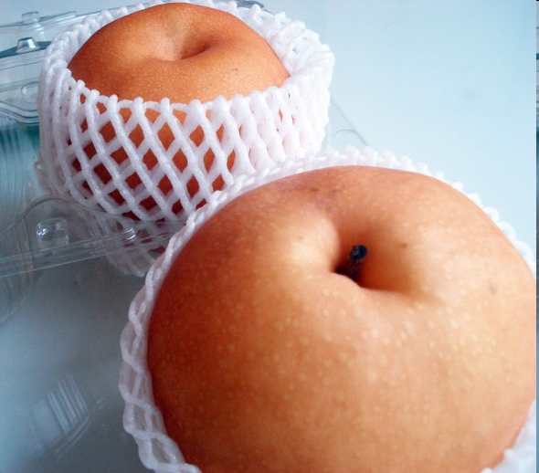

Slide 16
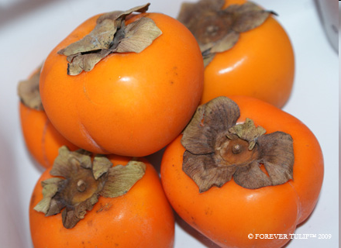

Slide 17
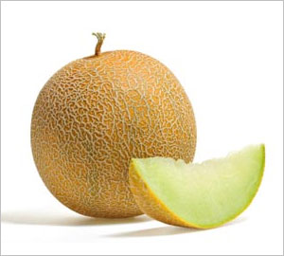

Slide 18
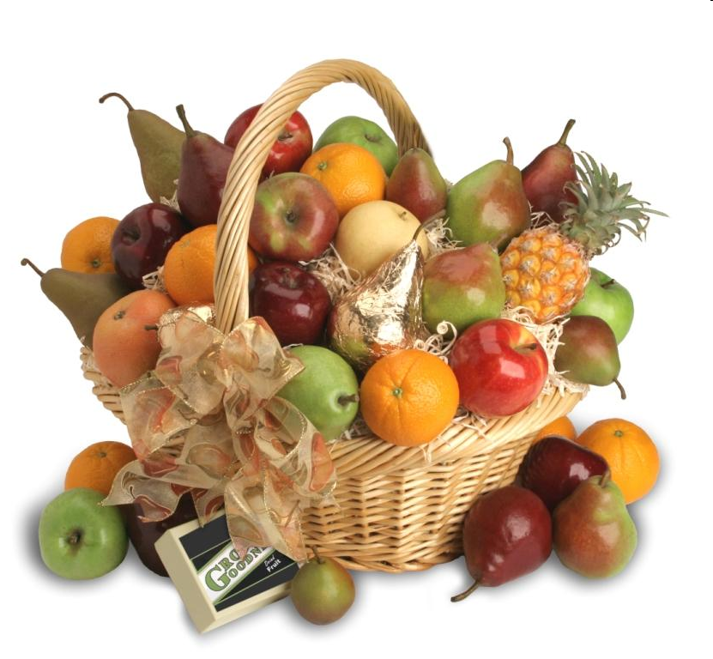

Slide 19
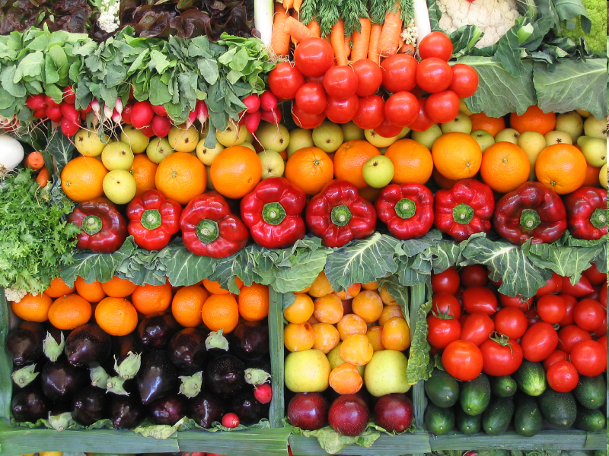
Group 2:

Slide 20

Group 2: Vegetables

Slide 21
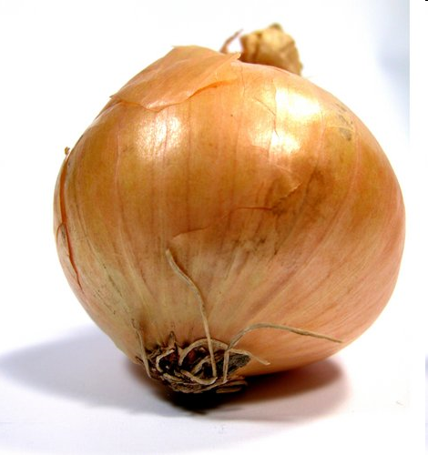

Slide 22
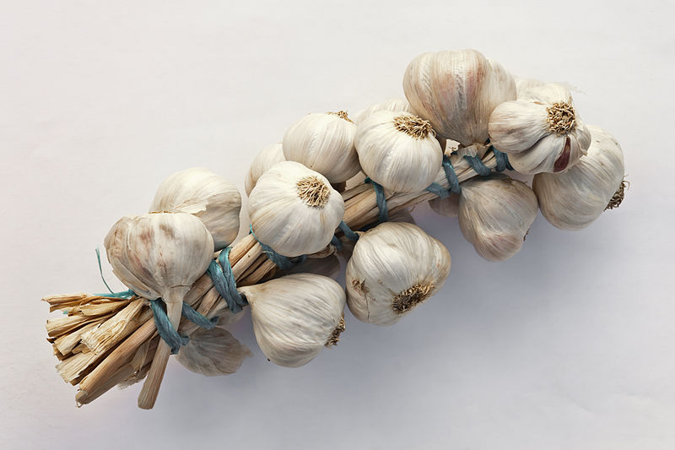

Slide 23
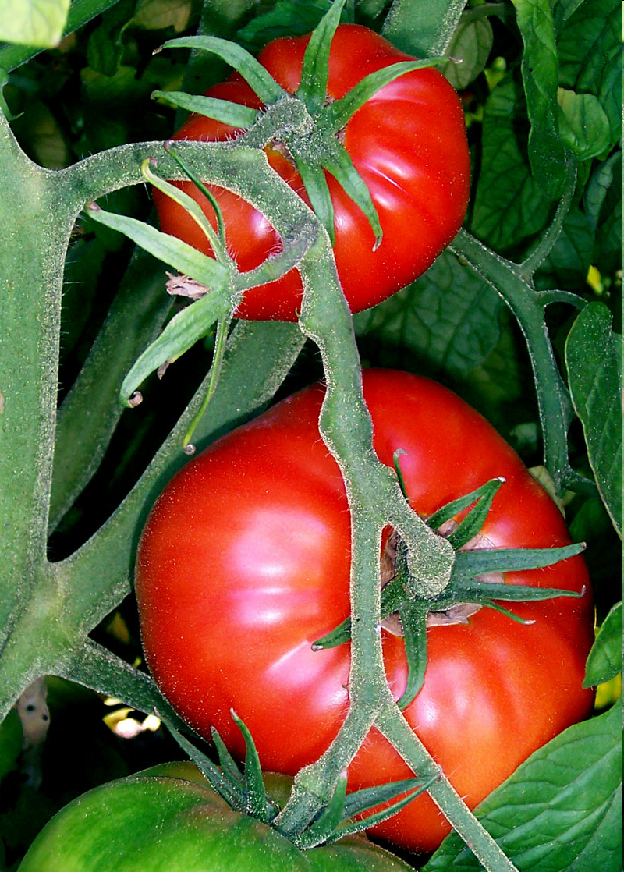
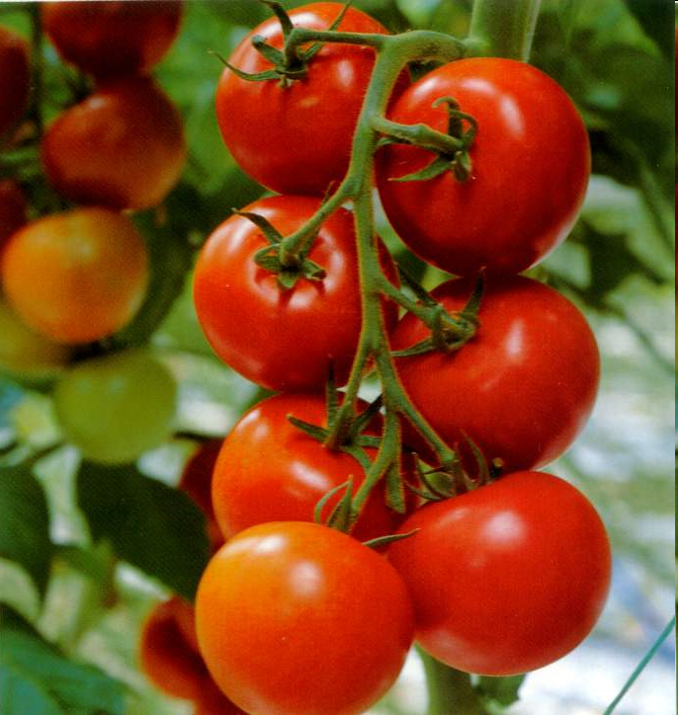

Slide 24
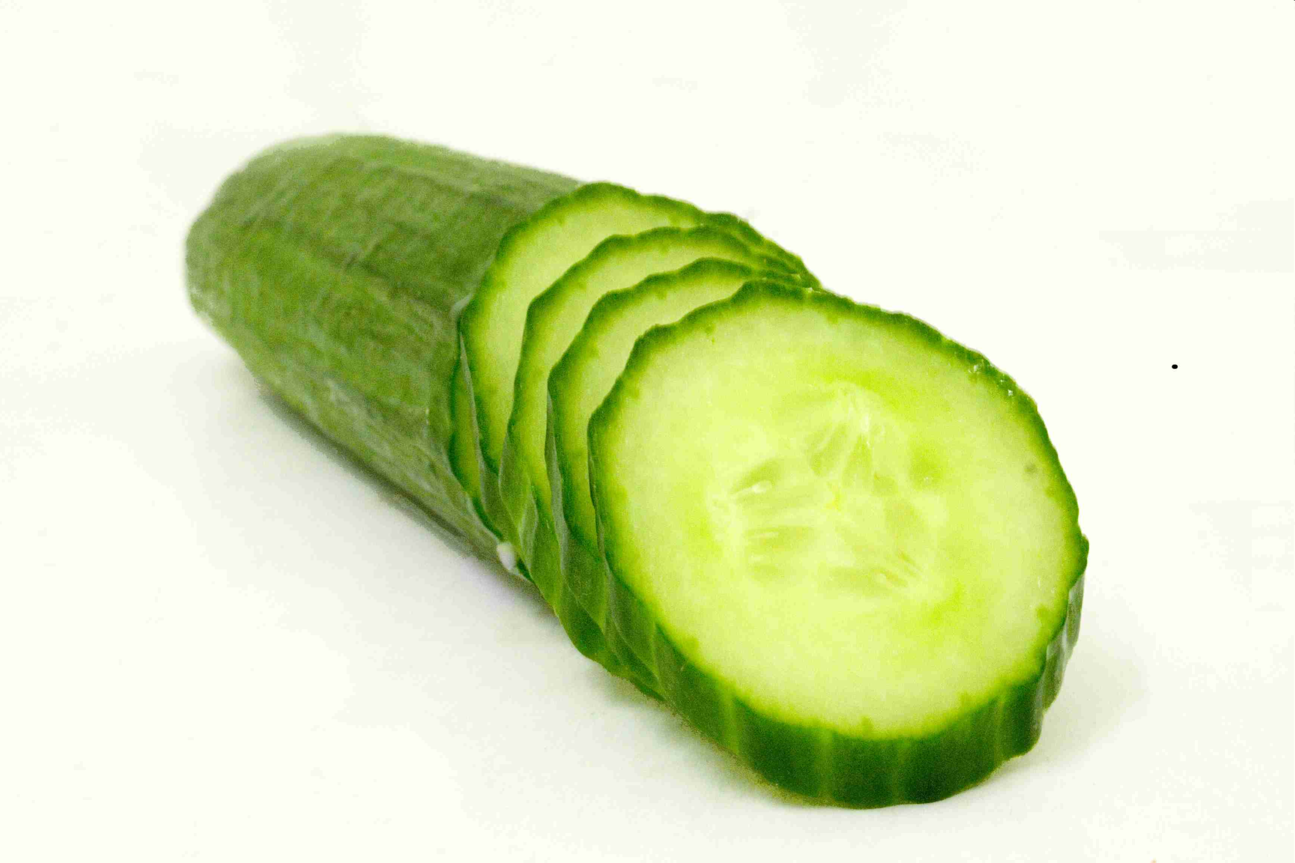

Slide 25
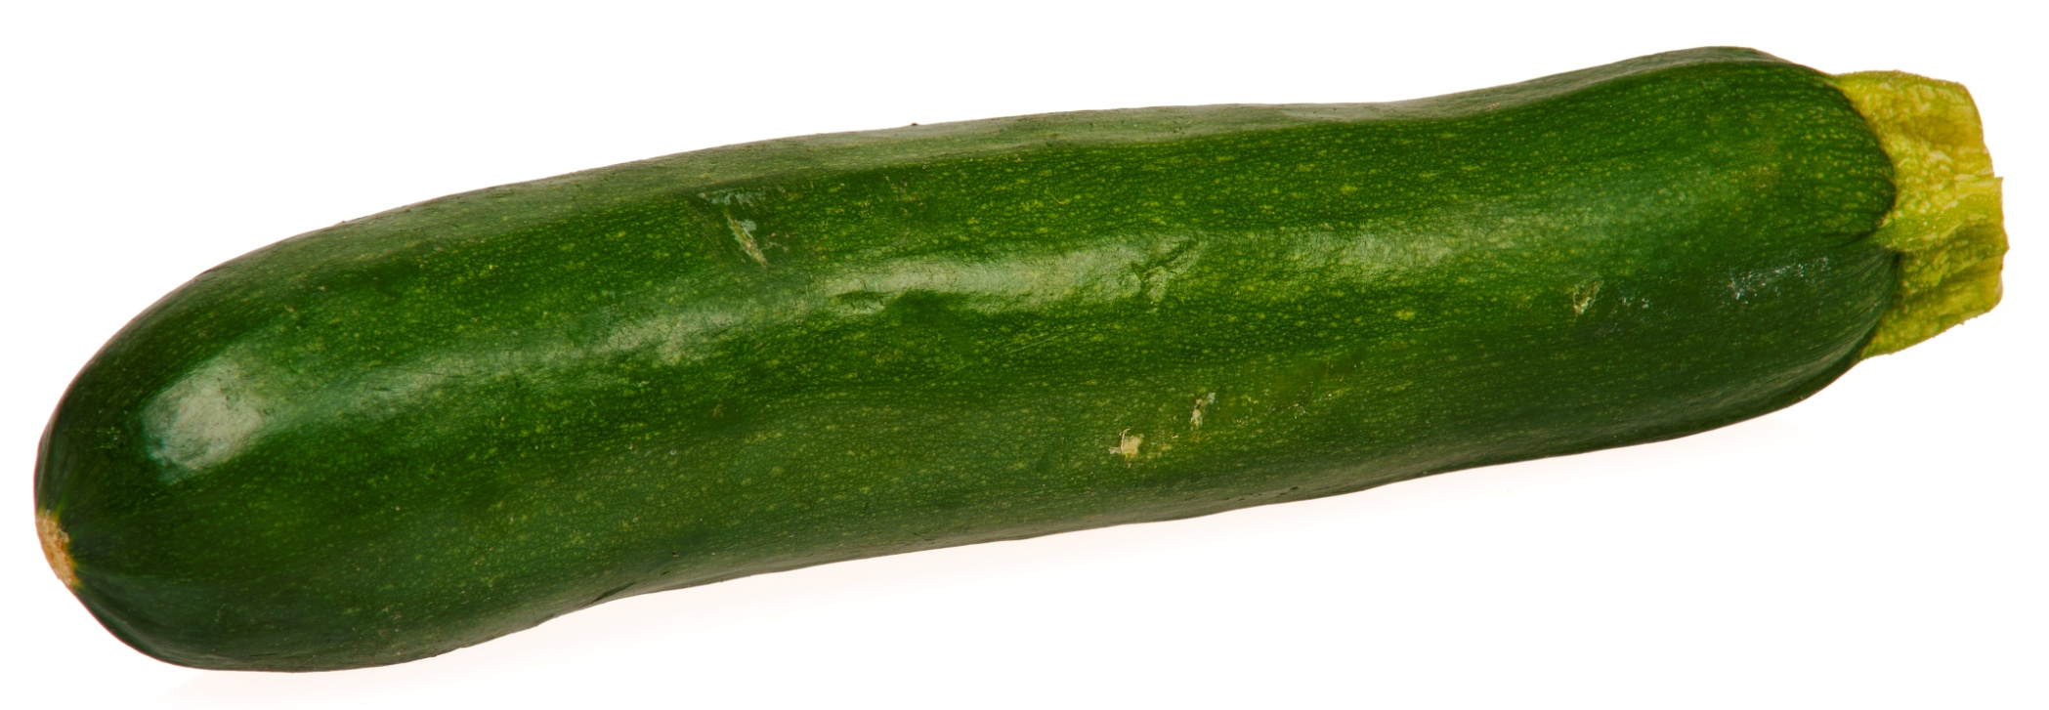
Zucchini

Slide 26
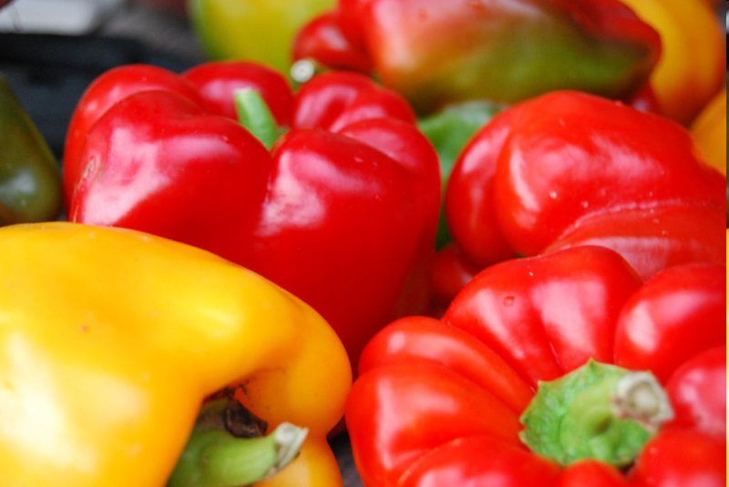

Slide 27
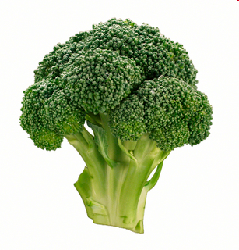

Slide 28
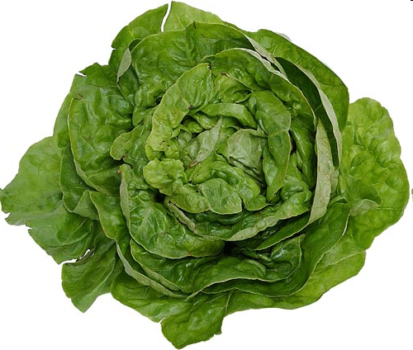

Slide 29
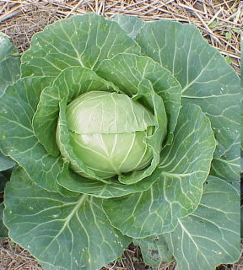

Slide 30
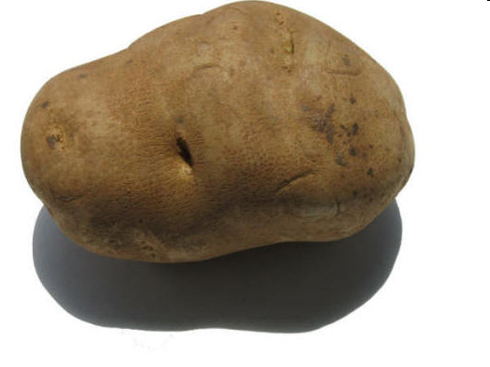
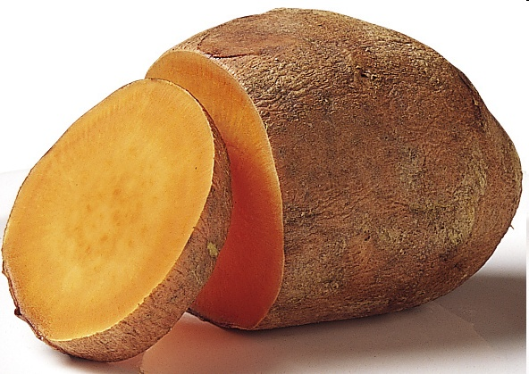

Slide 31
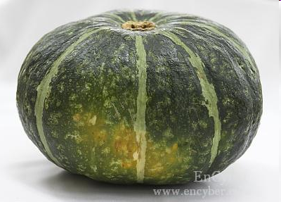

Slide 32
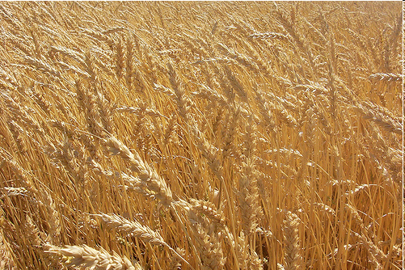
Group 3:

Slide 33
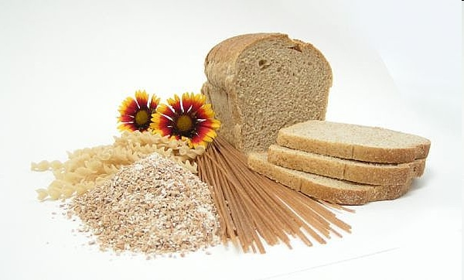
Group 3: Grains, Cereal

Slide 34
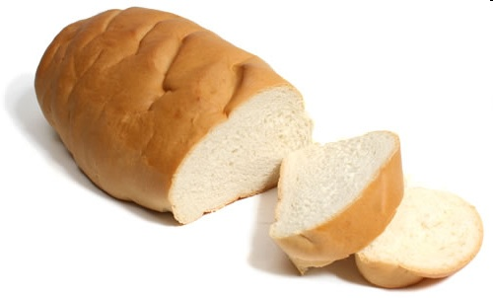

Slide 35
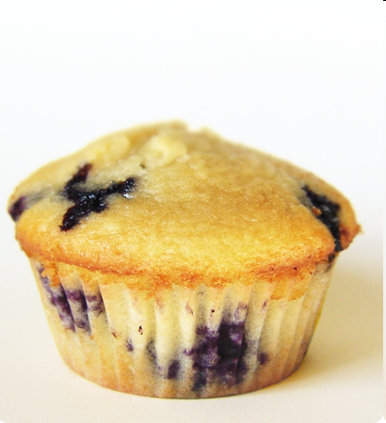

Slide 36
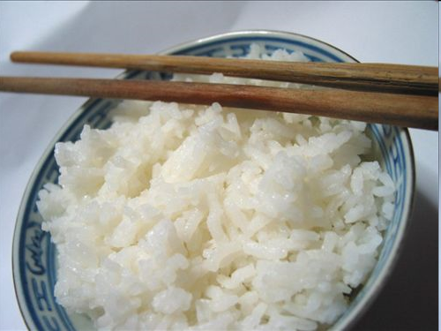

Slide 37
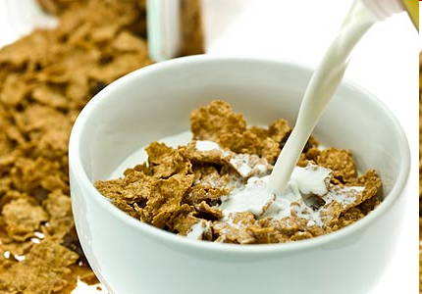

Slide 38
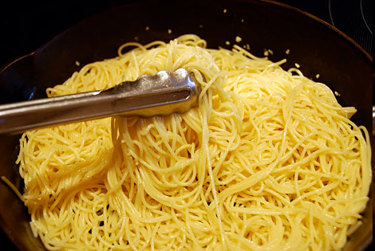
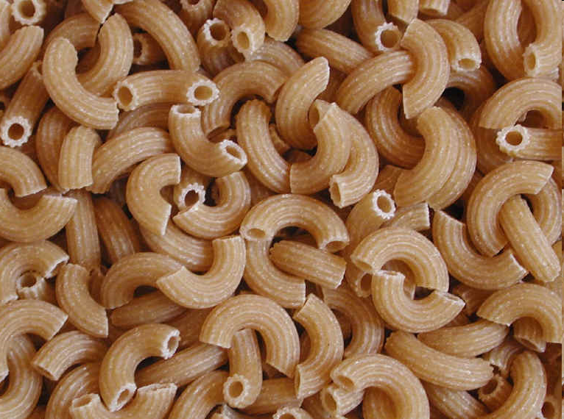

Slide 39
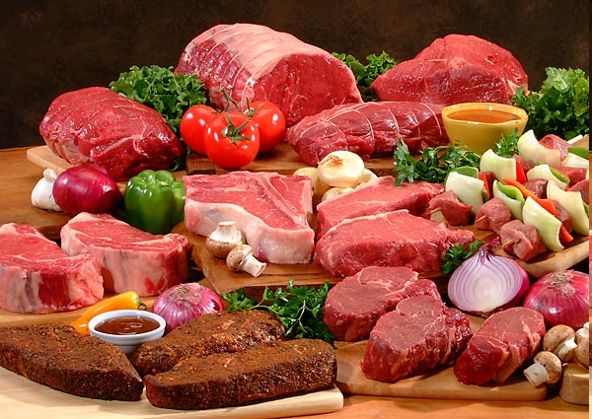
Group 4:

Slide 40
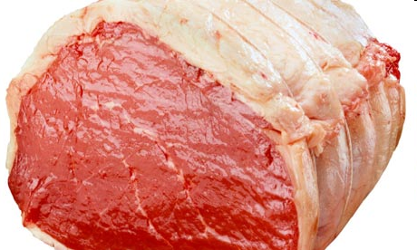
Group 4: meat, fish, eggs

Slide 41
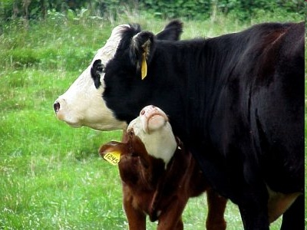

Slide 42


Slide 43
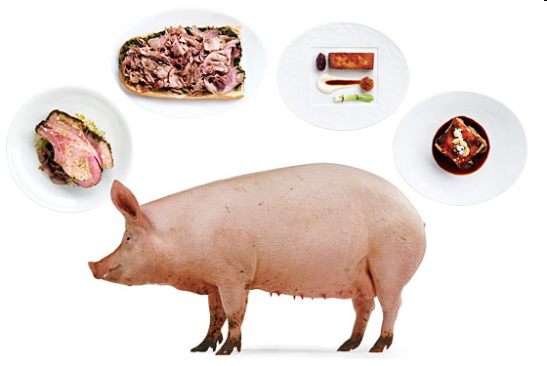

Slide 44
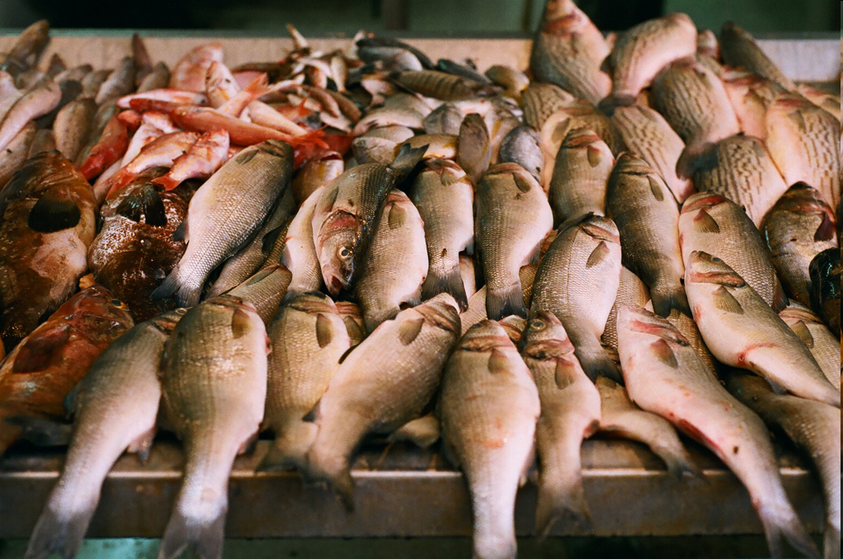

Slide 45
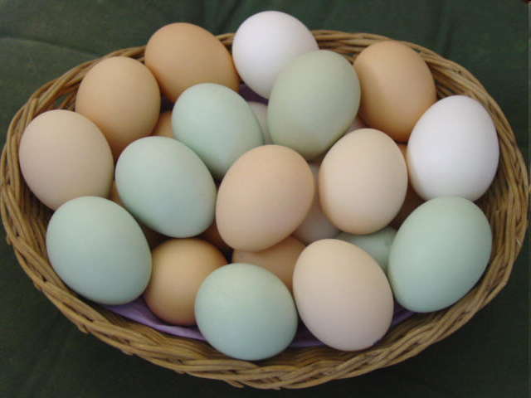

Slide 46
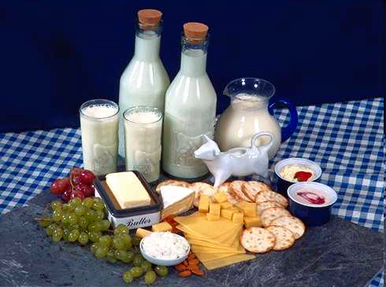
Group 5:

Slide 47

Group 5: Milk Products

Slide 48
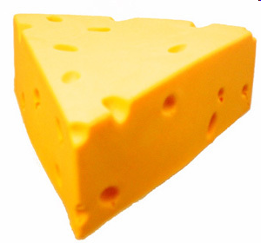

Slide 49
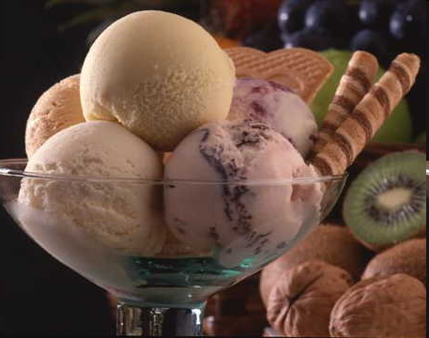

Slide 50
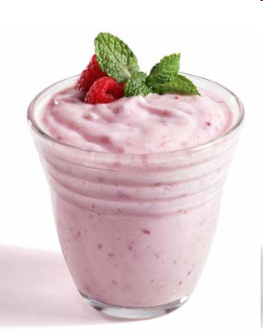

Slide 51
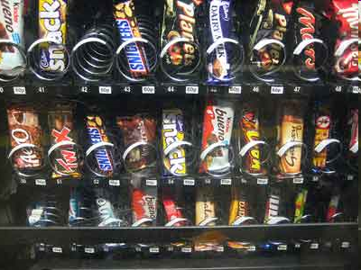
Group 6:

Slide 52

Group 6: Junk food

Slide 53


Slide 54


Slide 55


Slide 56


Slide 57


Slide 58


Slide 59


Slide 60


Slide 61


Slide 62


Slide 63

What food group?

Slide 64


Slide 65


Slide 66


Slide 67


Slide 68


Slide 69


Slide 70


Slide 71


Slide 72


Slide 73


Slide 74


Slide 75
Food Group Blitz:
Put the pictures in the correct food groups,
Then unscramble the letters to find the secret message.

Slide 76
Unscramble
Food Groups
  ___ ___ ___ ___ ___ ___ ___ ___ ___ ___
  ___ ___ ___ ___ ___ ___ ___ ___

Slide 77

What is your favorite dinner?

Slide 78
Food Group Battle
Take turns naming a food from the food group.
If you can’t think of a new food in 10 seconds, you are out.

