Slide 1
Sugar

Slide 2
What is your favorite snack?

Slide 3
Why do we need / want it?

Slide 4
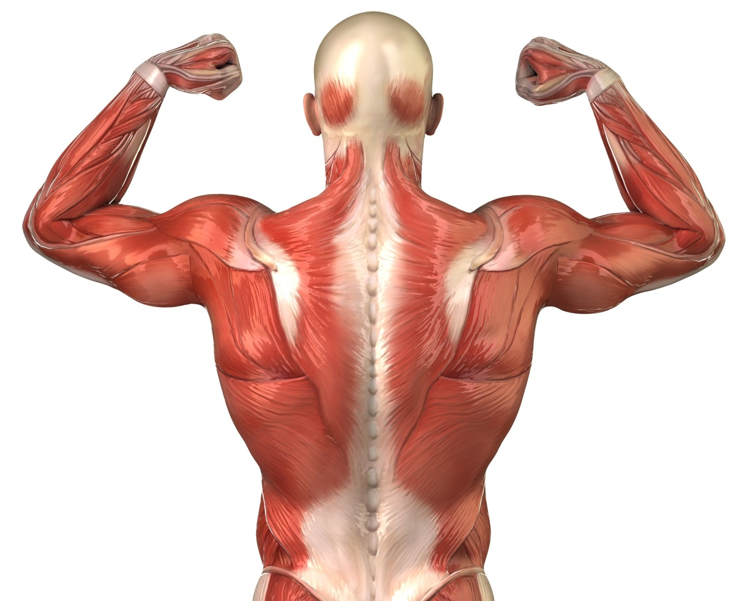
Why do we need / want it?

Slide 5
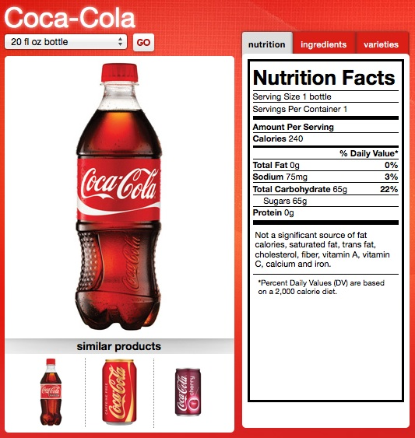
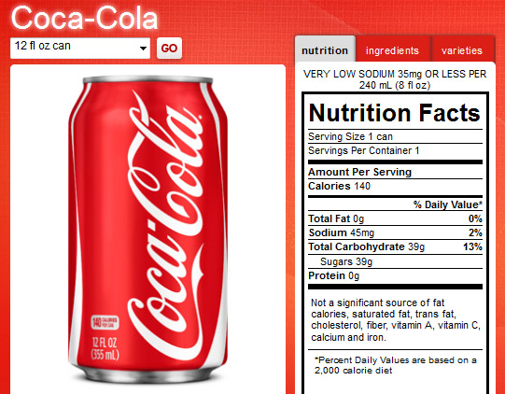
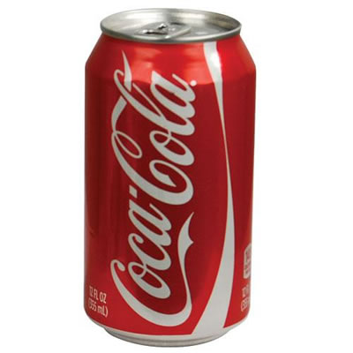
How much is too much?
The American Heart Association says:
Men: 150 calories per day
(37.5 grams or 9 teaspoons).
Women: 100 calories per day
(25 grams or 6 teaspoons).
1 can of soda =
140 calories from sugar
39 grams of sugar

Slide 6
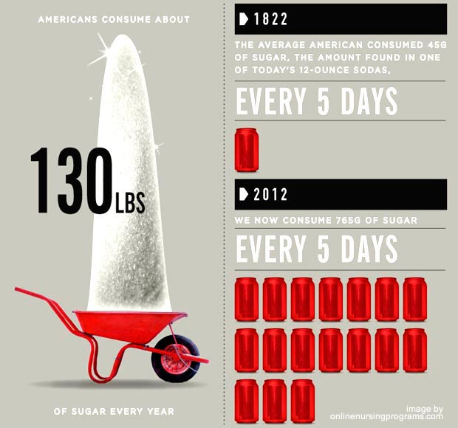
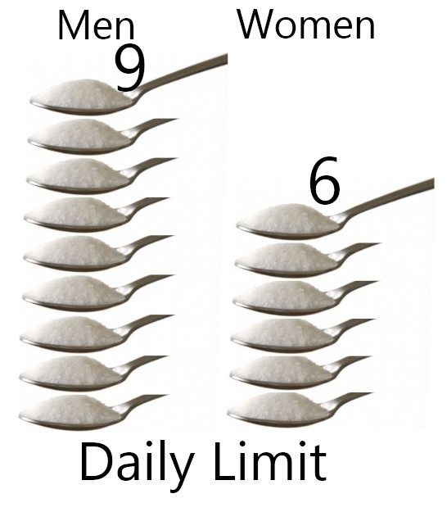
How much is that?
59kg

Slide 7
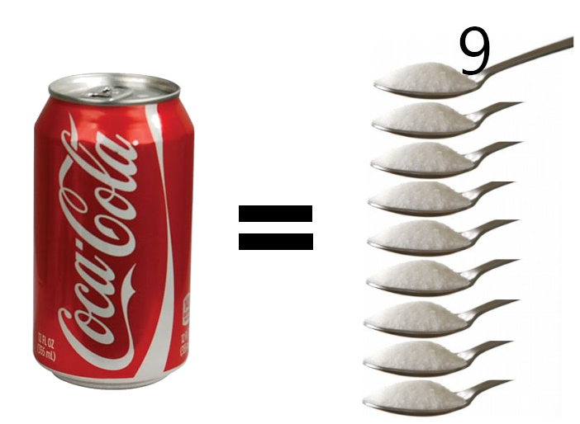
Measuring Sugar

Slide 8
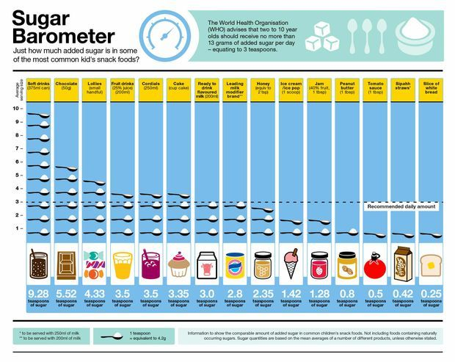

Slide 10
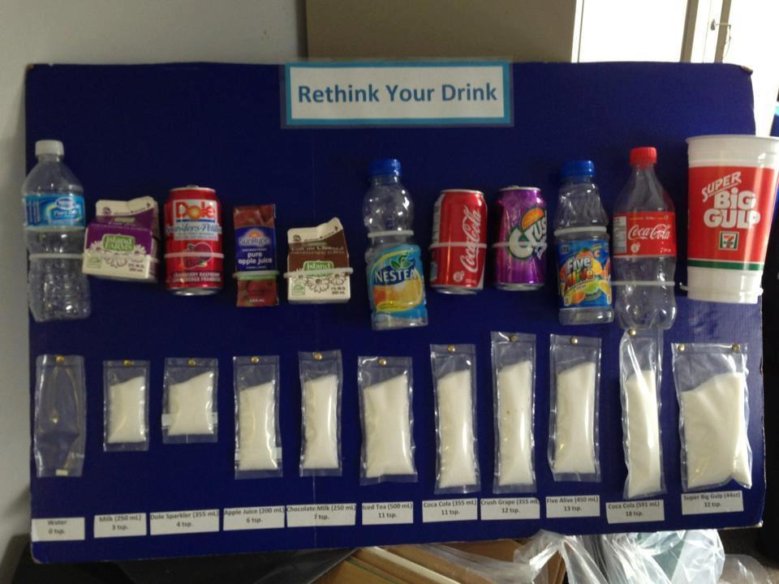
Measuring Sugar

Slide 11
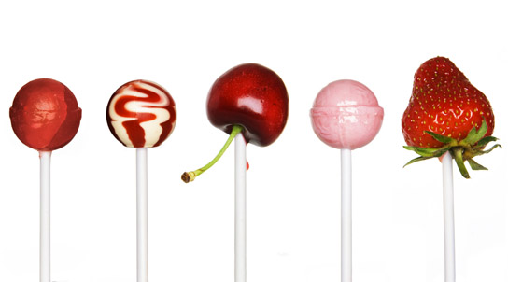
Natural vs Added Sugar

Slide 12
Natural vs Added Sugar

Slide 13
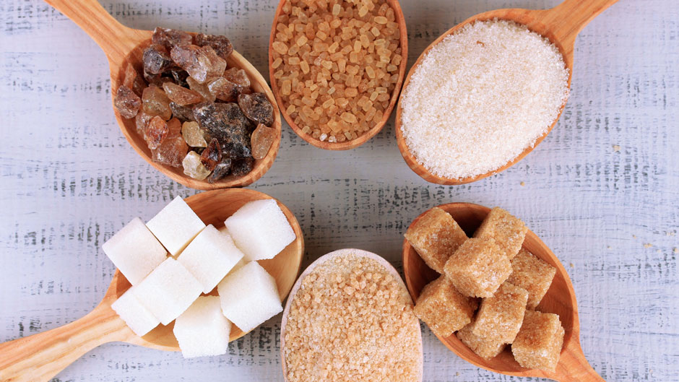
Is sugar really sugar?

Slide 14
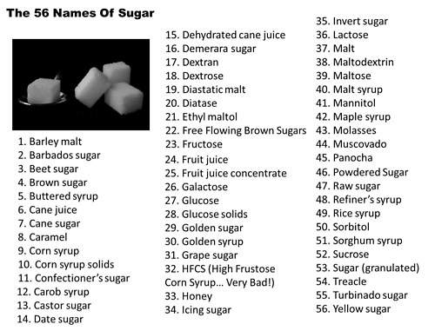

Slide 15
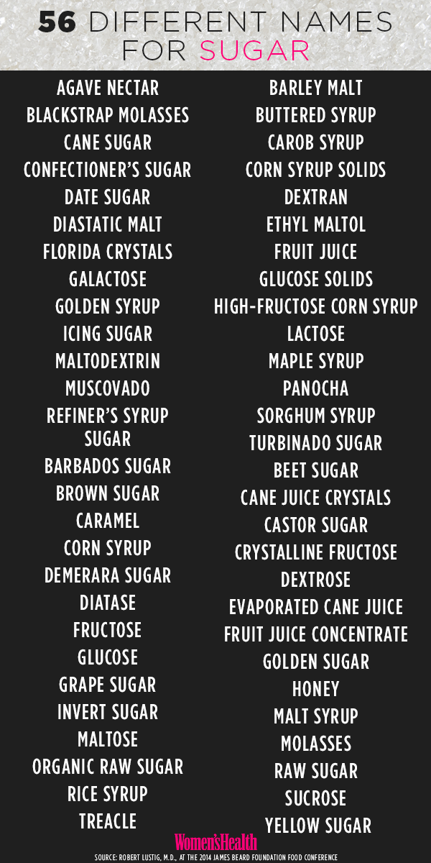
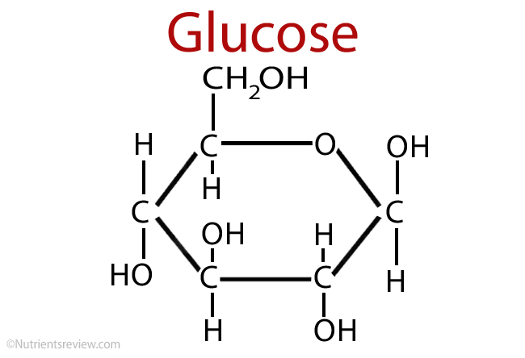

Slide 17
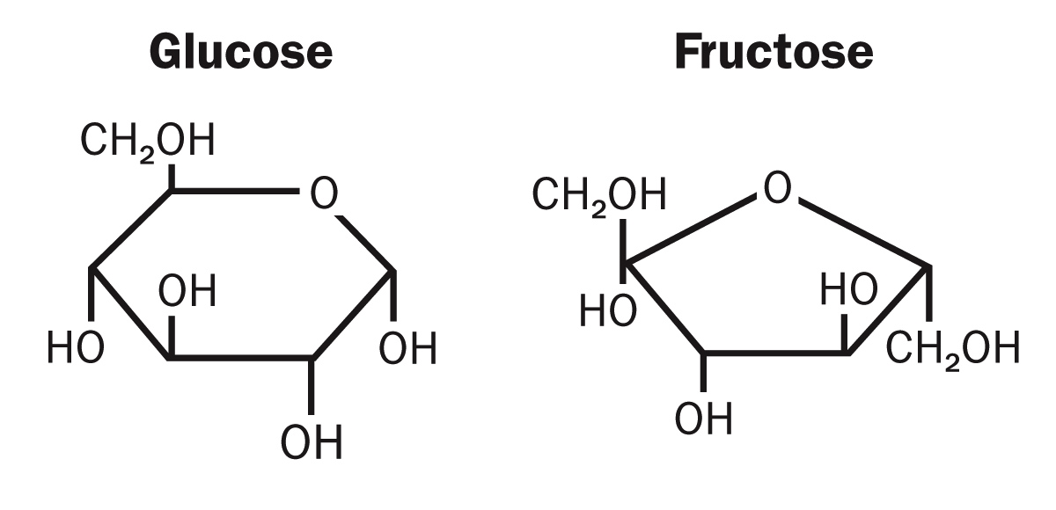

Slide 18
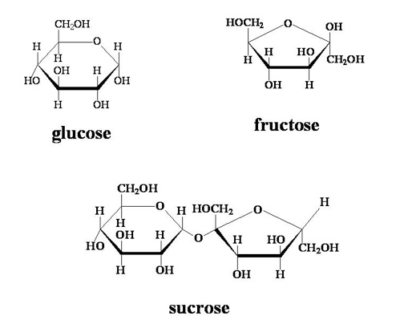

Slide 19
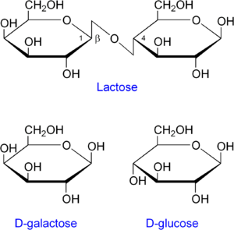

Slide 20
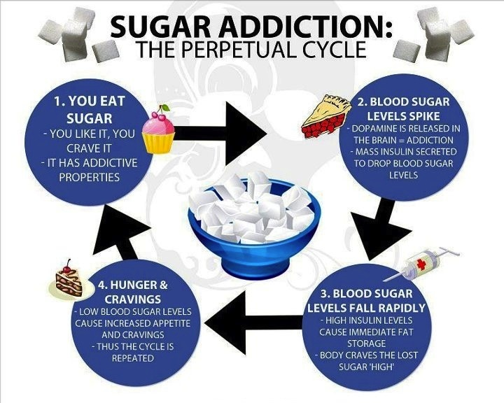

Slide 21
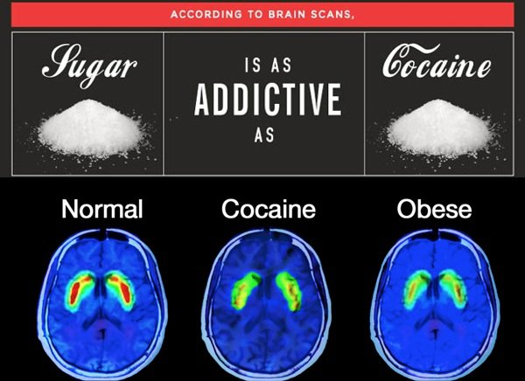

Slide 22
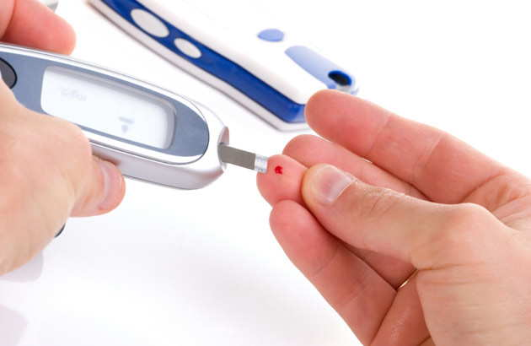
What does sugar do to our bodies?

Slide 23
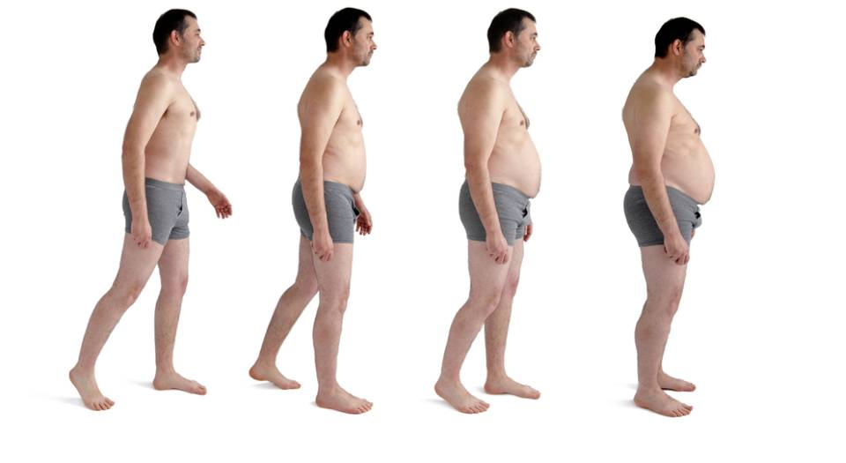
What does sugar do to our bodies?

Slide 24
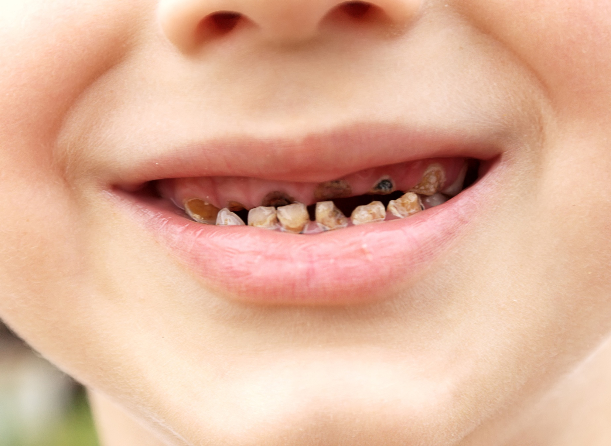
What does sugar do to our bodies?

Slide 25
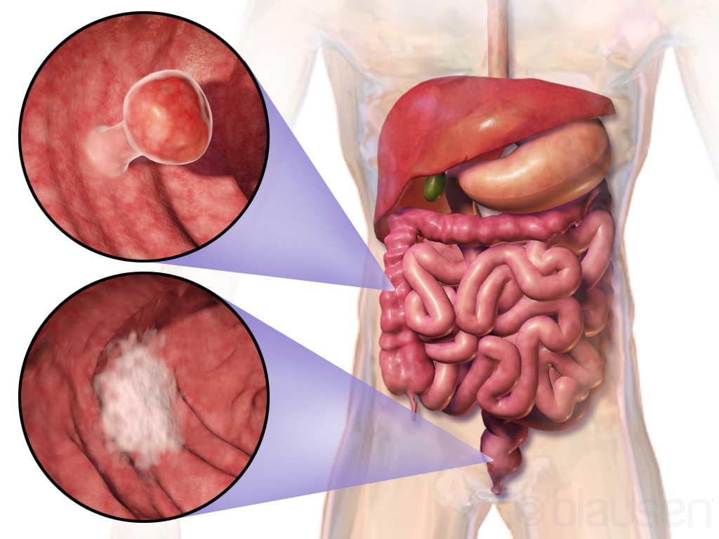
What does sugar do to our bodies?

Slide 26
What does sugar do to our bodies?

Slide 27
What does sugar do to our bodies?

Slide 28
What does sugar do to our bodies?

Slide 29
What does sugar do to our bodies?

Slide 31
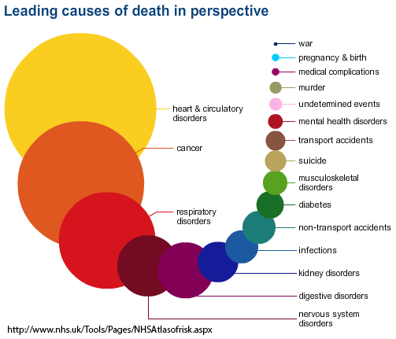

Slide 33
Fed Up
https://www.facebook.com/FedUpMovie?fref=nf
https://www.youtube.com/watch?v=4kieTRLt8ks

Slide 34
Ingredients
What is it made from?

Slide 35
Big Mac Meal Ingredients

Slide 36
Big Mac Meal Ingredients:
Fruit Vegetables Grains
Meat Milk Junk Food

Slide 37
Farting

Slide 38
Burping

Slide 39
What foods make you fart / burp?

Slide 40
Fart Foods (game)
Put recipe cards in the middle
You may move one space each turn (or stay)
Take one of the ingredient cards
When you make a recipe, go home and complete the recipe
Use the air pump according to the card.
You may trade ingredients

