Slide 1
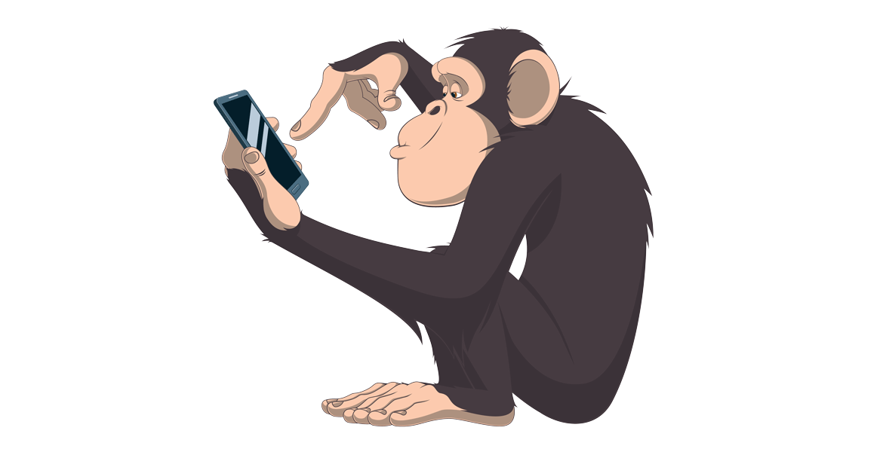
Chimp Memory Test
How well can you do?

Slide 2
1
2
3

Slide 3
1
3
2

Slide 4
2
8
5

Slide 5
1
3
4
2

Slide 6
2
5
1
3
4

Slide 7
1
2
3
6
5
4

Slide 8
5
4
2
1
6
3
7

Slide 9
5
3
8
1
7
2
6
4

Slide 10
5
4
7
6
2
8
3
9
1

Slide 11
5
3
8
7
1
6
9
2
4

Slide 12
5
2
9
8
7
6
3
1
4

Slide 13
5
4
7
6
2
8
3
9
1

Slide 14
5
9
8
7
1
4
6
3
2

Slide 15
5
8
2
7
4
9
6
1
3

Slide 16
5
4
3
6
1
8
9
7
2

Slide 17
Now Watch a Chimp
https://www.youtube.com/watch?v=qyJomdyjyvM

