Slide 1
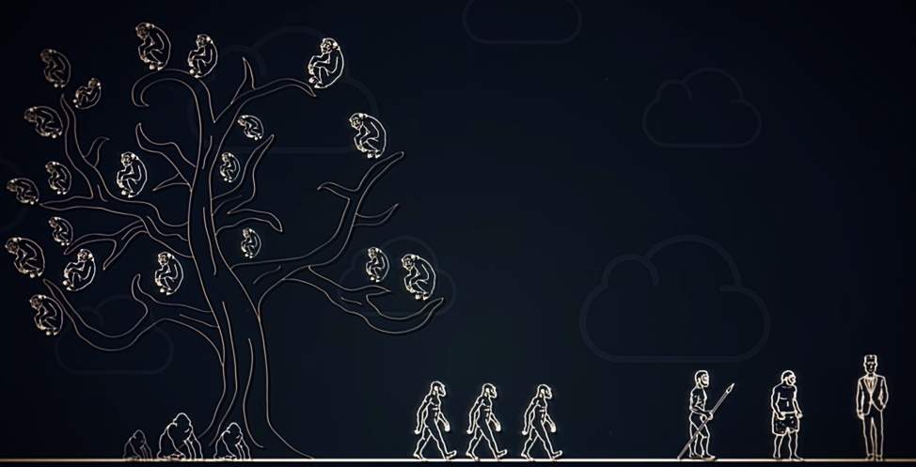
Cognitive Tradeoff
Hypothesis

Slide 2
Cognition (Cognitive)
Acquiring knowledge through thought, experience, and the senses.

Slide 3
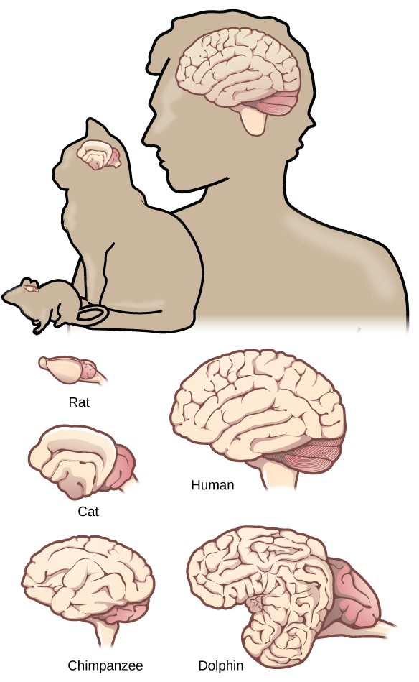
Brain Size

Slide 4
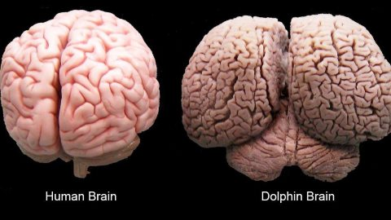
Largest Brain?
Sperm Whale – 8kg
Orca – 5.4 to 6.8kg
Elephant – 5kg
Bottlenose dolphin – 1.5 to 1.7kg
Human – 1.3 to 1.4kg

Slide 5
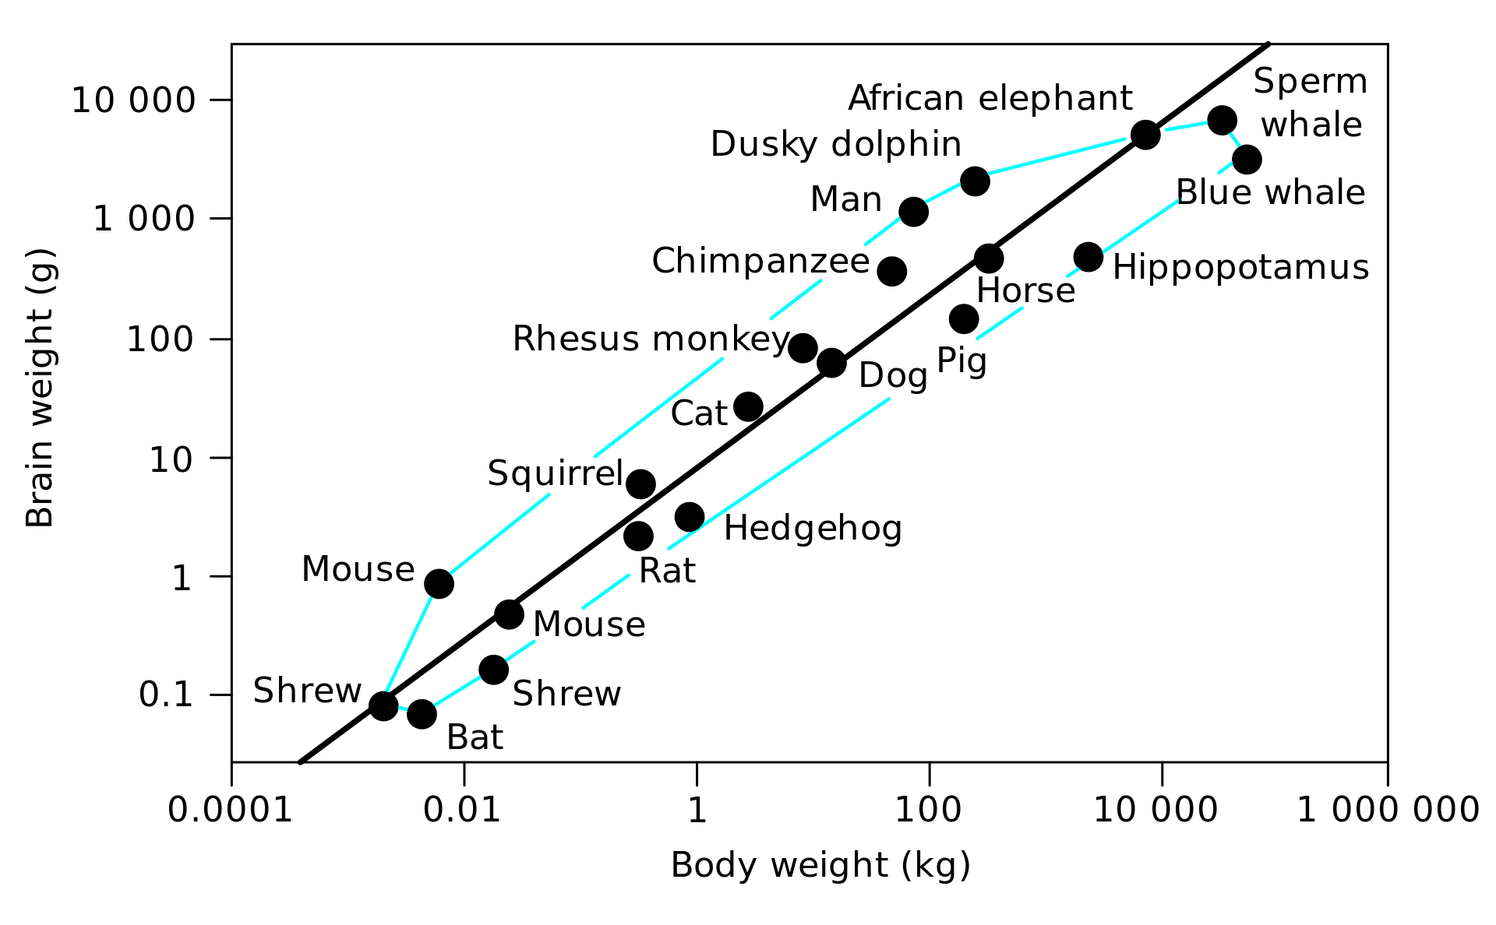
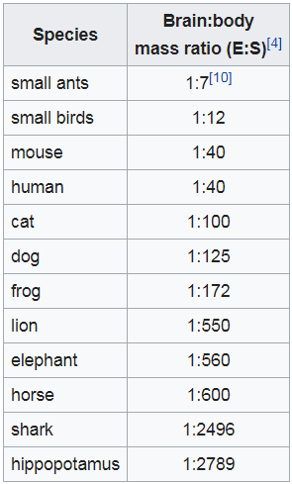
Brain to Body Ratio

Slide 6
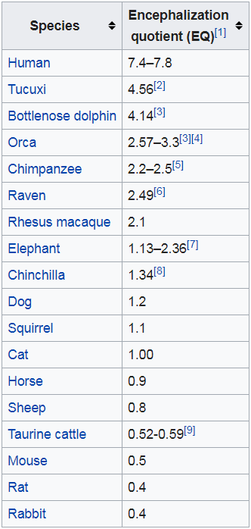
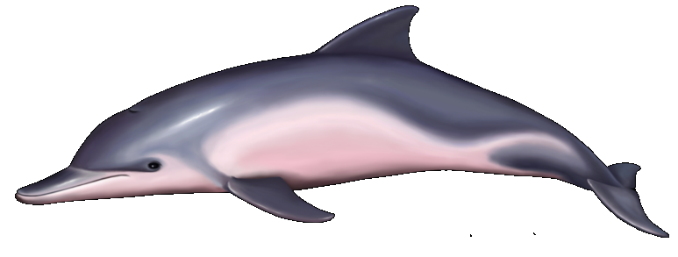
Brain Power (encephalization)
How much better than expected
Brain size for the body size.

Slide 7
Who is the Smartest?

Slide 8
Energy Cost of Big Brains

Slide 9
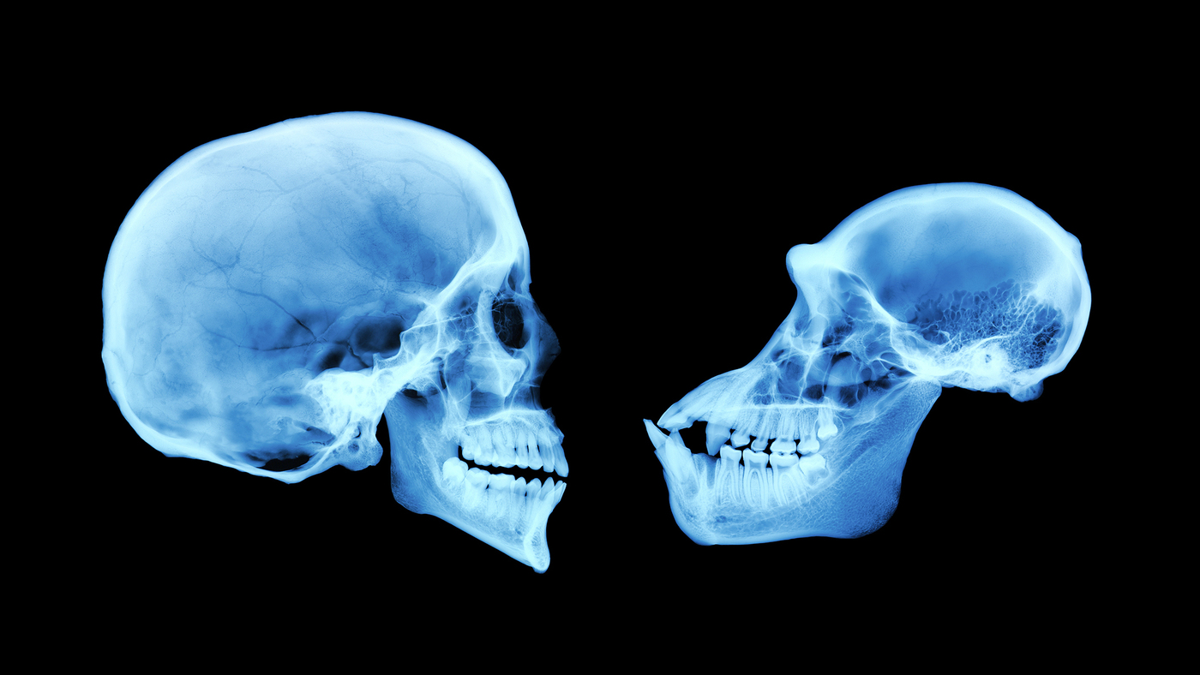
Cognitive Tradeoff Hypothesis
What did we trade for our cognition?

Slide 10
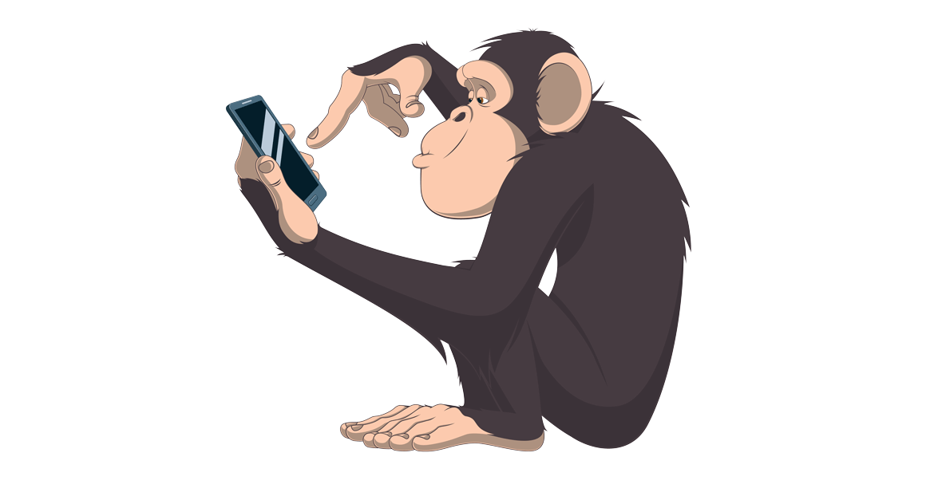
Chimp Memory Test
How well can you do?

Slide 11
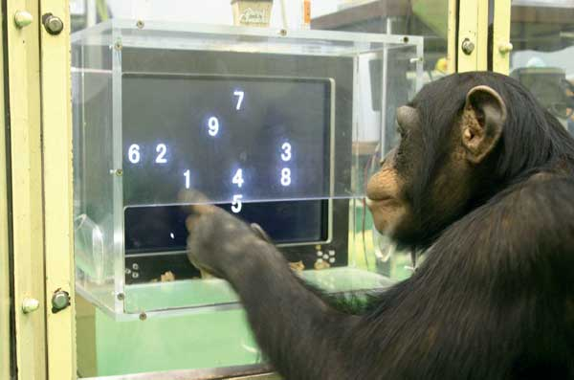
Working Memory
https://www.youtube.com/watch?v=zsXP8qeFF6A

Slide 12
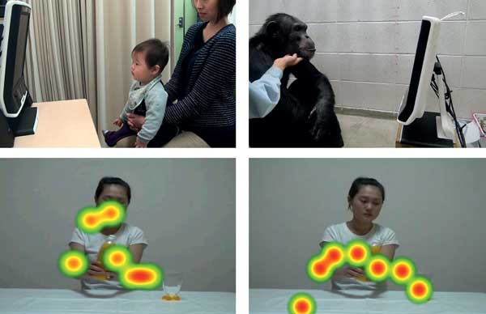
Eye-Tracking

Slide 13
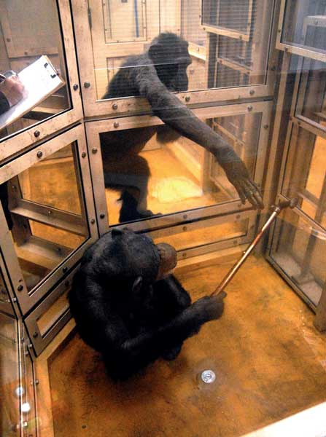
Altruism

Slide 14
266kg
300kg

Slide 15
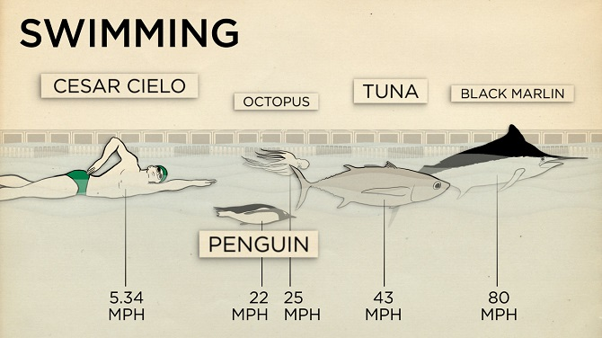
8.6
KPH
35
KPH
40
KPH
69
KPH
129
KPH

Slide 16
8.96m
15m

Slide 17
44
KPH
48
KPH
63.5
KPH
69
KPH
88
KPH
98
KPH

Slide 18
Some scientists believe that we traded physical abilities for language.

Slide 19
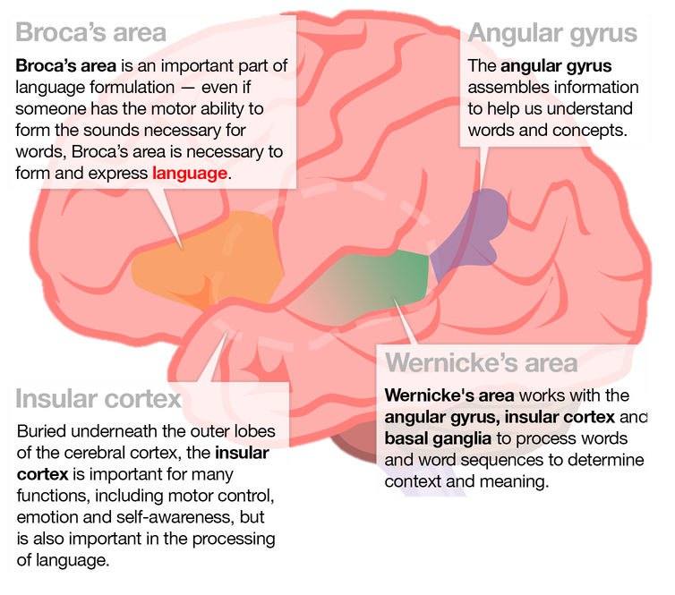

Slide 20
Communication vs Language

Slide 21
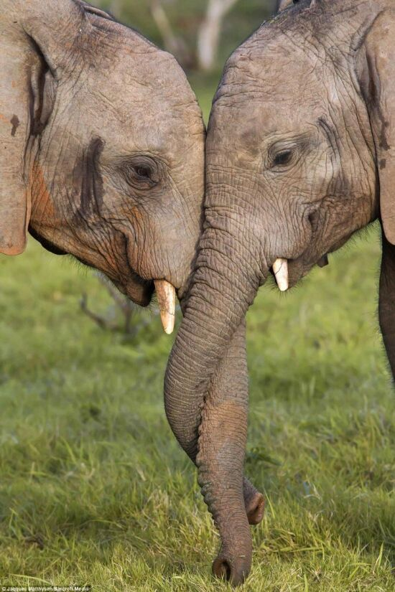
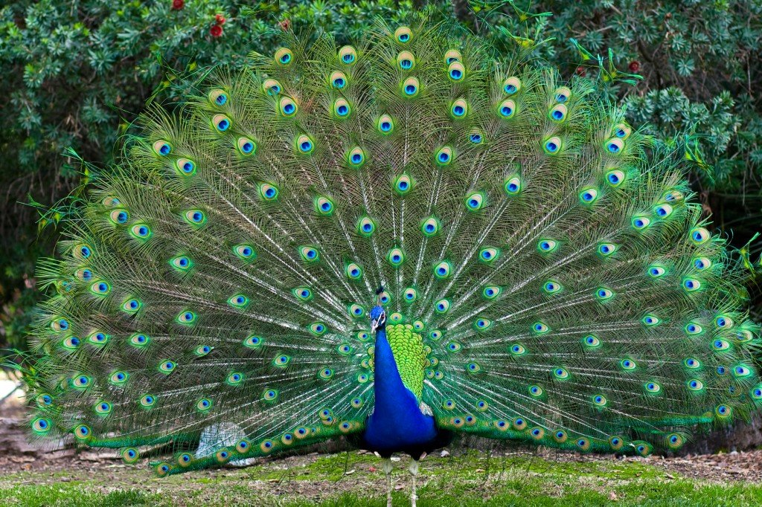
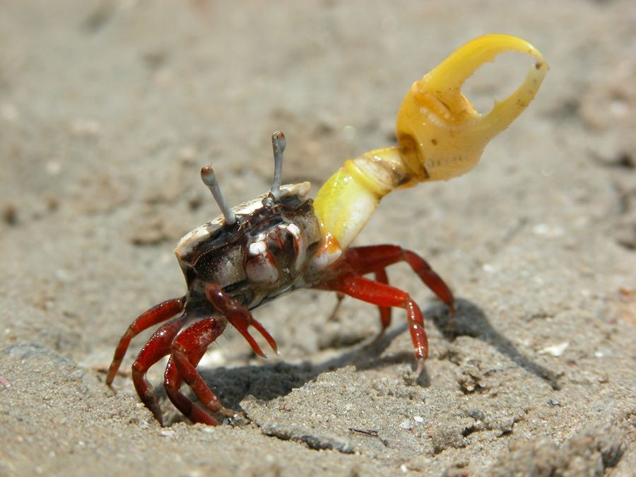
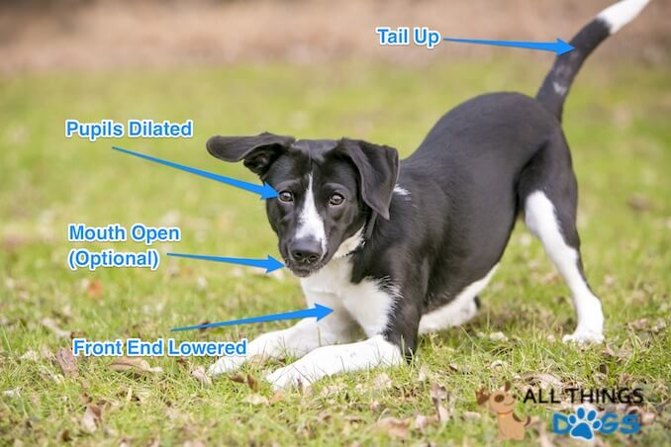
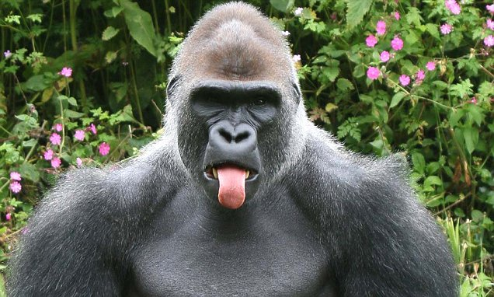
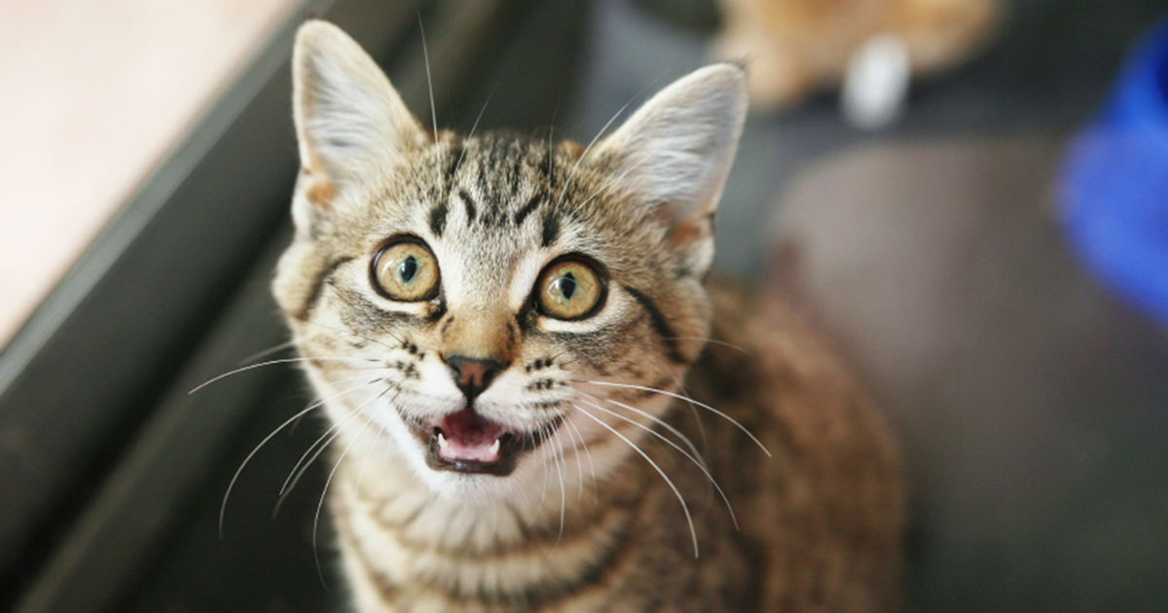
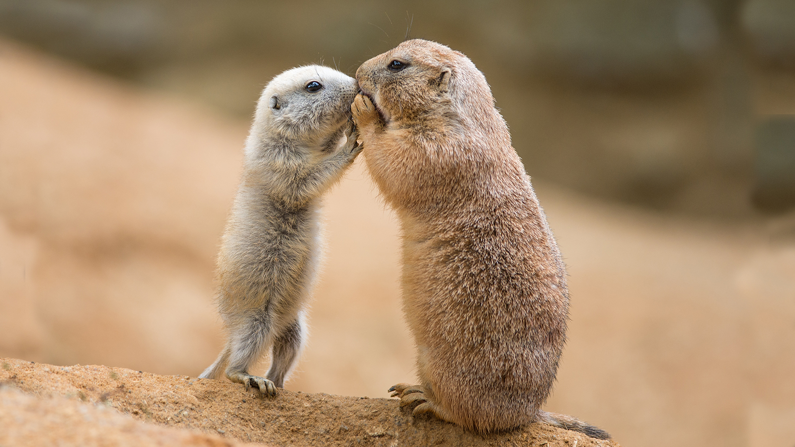
Types of Communication
Verbal
Speaking
Calls and Alarms
Written
Body Gestures
Dancing
Touching hands
Licking teeth
Chemical (pheromones)
Electrical

Slide 22
Why?
Warning
Growling
Alarm
Prairie Dog calls
Comfort
Purring
Description
Information over space
Scent marking
Information over time
Teaching how to hunt
Abstract Communication
Story Telling
https://www.youtube.com/watch?v=TRqE43vj_Qc

Slide 23
Features of a Language
Displacement
Arbitrariness
Productivity (creativity ‚open-endedness)
Cultural transmission
Duality
Prevarication
Reflexiveness
Learnability
Specialization
Vocal-auditory channel use
http://www.anglozof.com/linguistics/features.htm

Slide 24
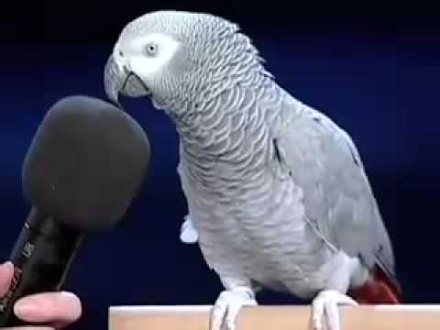
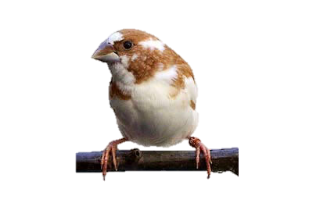
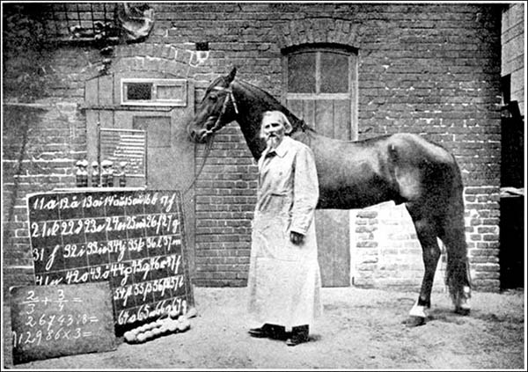
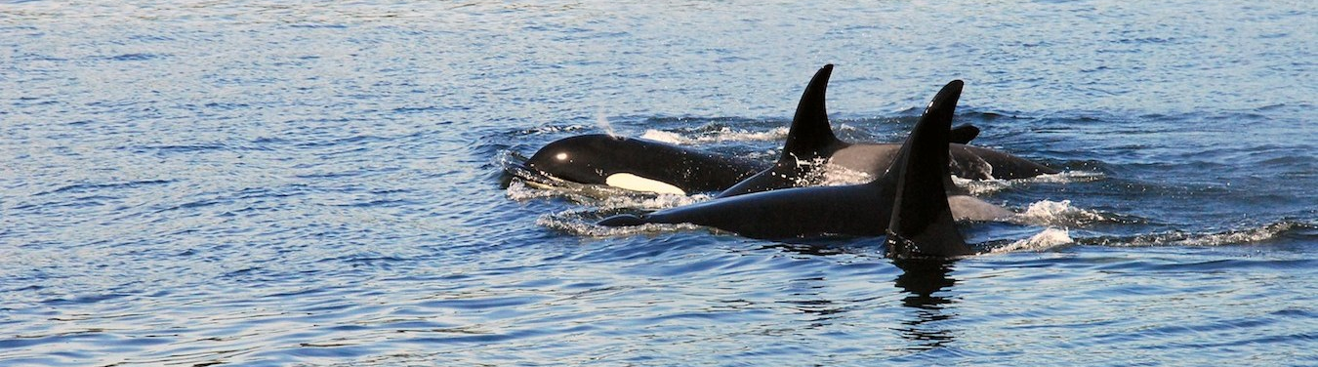
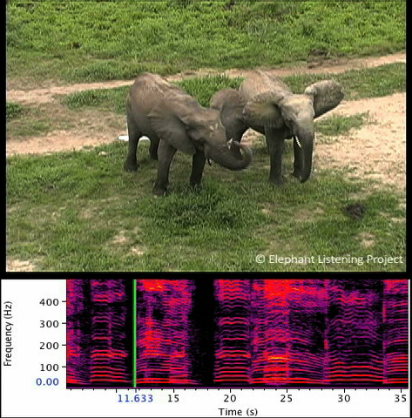
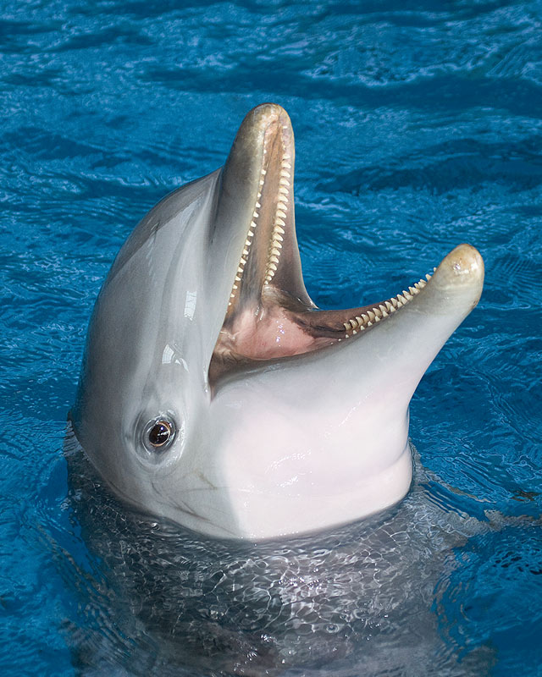
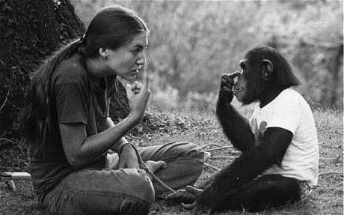
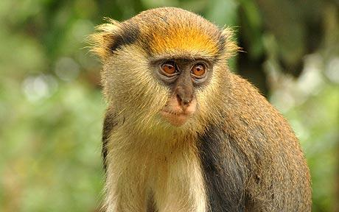
Animals with Language?
Syntax
https://www.youtube.com/watch?v=CQ5dRyyHwfM
Prepositions
Conjunctions
Demonstratives
Locatives
Suffixes

Slide 25
So, what is unique about human language?
Writing

