Slide 1
Schedule

Slide 2
Dates and Times
On, at, in…

Slide 3
Years
1983 =
2017 =
1503 =
2007 =
nineteen eighty-three.
Twenty seventeen.
fifteen “O” three.
two thousand and seven.

Slide 4
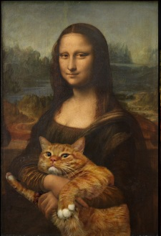
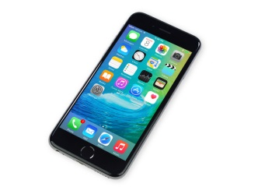
Years
In 1983, I was born.
Donald Trump became president in 2017.
Leonardo DaVinci started painting the Mona Lisa in 1503.
The first i-Phone was released in 2007.

Slide 5
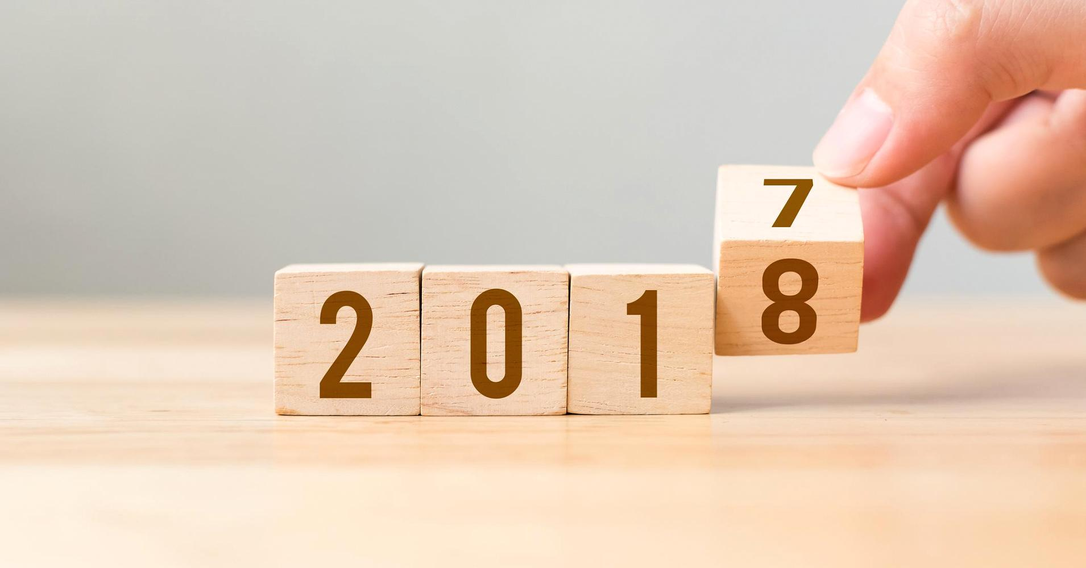
Years

Slide 9
Months
The Pyeongchang Olympics were held in February.
The next Star Wars movie will be released in May.
The Korean Armistice Agreement (한국휴전협정) was signed in July, 1953.

Slide 10
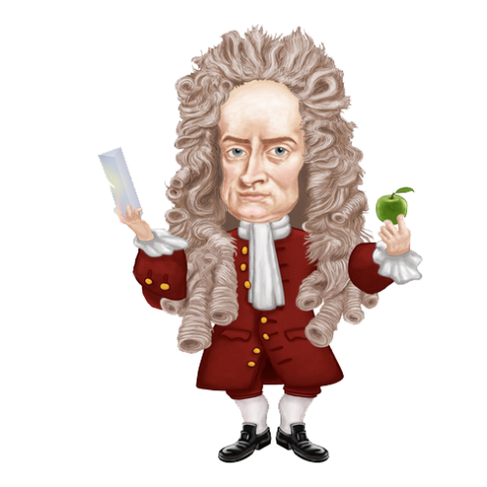
Day
On December 25th, we celebrate Christmas.
Isaac Newton was born on January 14th, 1643.
The official end to World War 2 was on September 2nd, 1945.

Slide 11
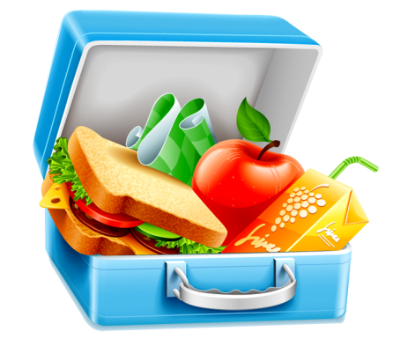
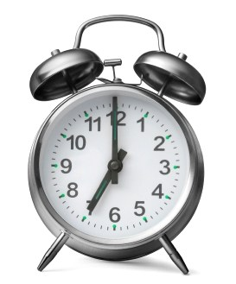
Time
We will meet for lunch at 11:30.
Remember, you need to wake up at 7am.
World War 1 ended on November 11th, 1918 at 11am.

Slide 12
When did I make this ppt?
Years =
Months =
Days =
Time =
in
in
on
at

Slide 13
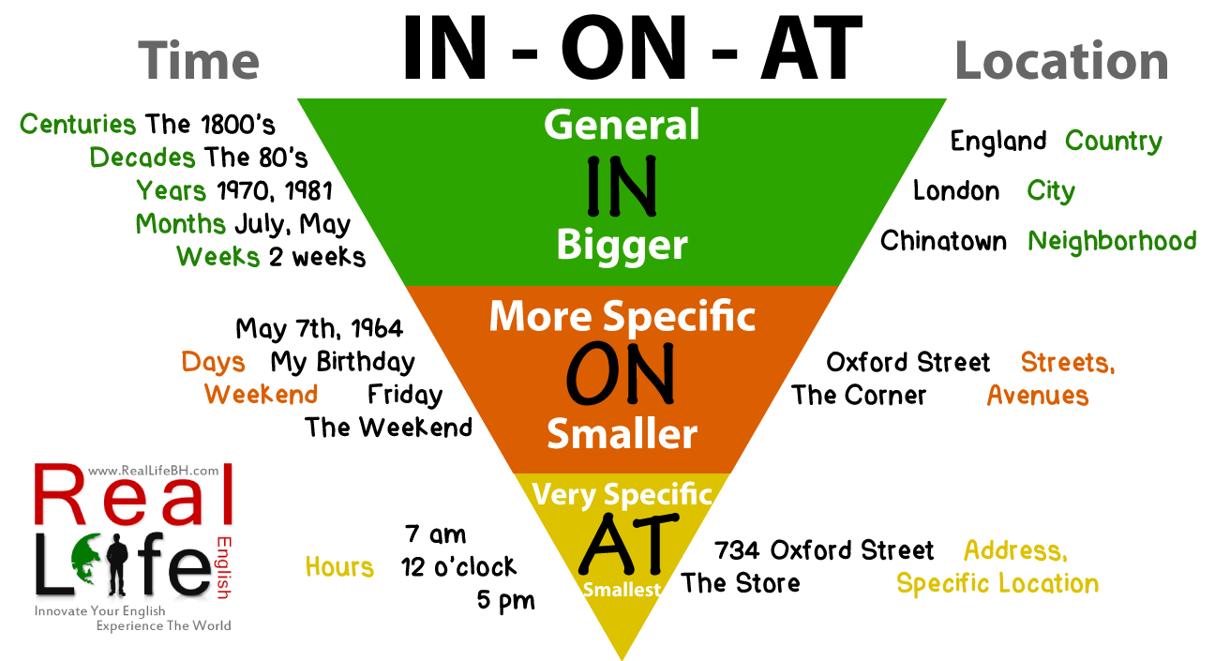

Slide 14
When is Valentines day?
Valentine's day is on February 14th.

Slide 15
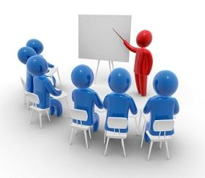
When does class start?
Class starts at __:__.

Slide 16
When did you wake up?
I woke up at __:__.

Slide 17
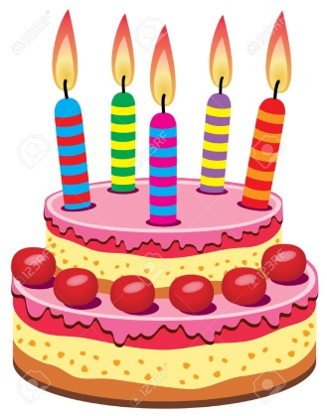
When is your birthday?
My birthday is on _______ ___.

Slide 18
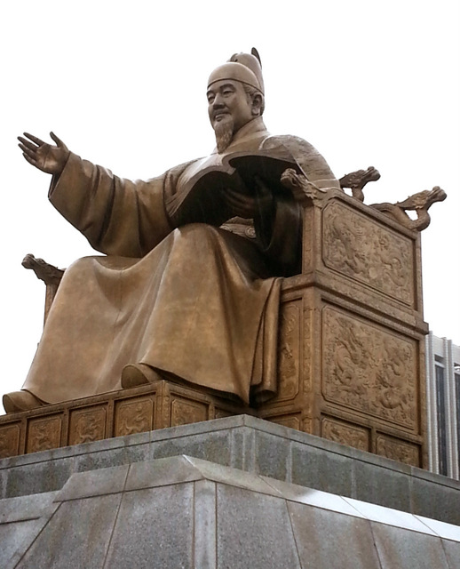
When was King Sejong born?
(He was born in 1397)
(He was born on May 15th, 1397)

Slide 19
Going to…

Slide 20
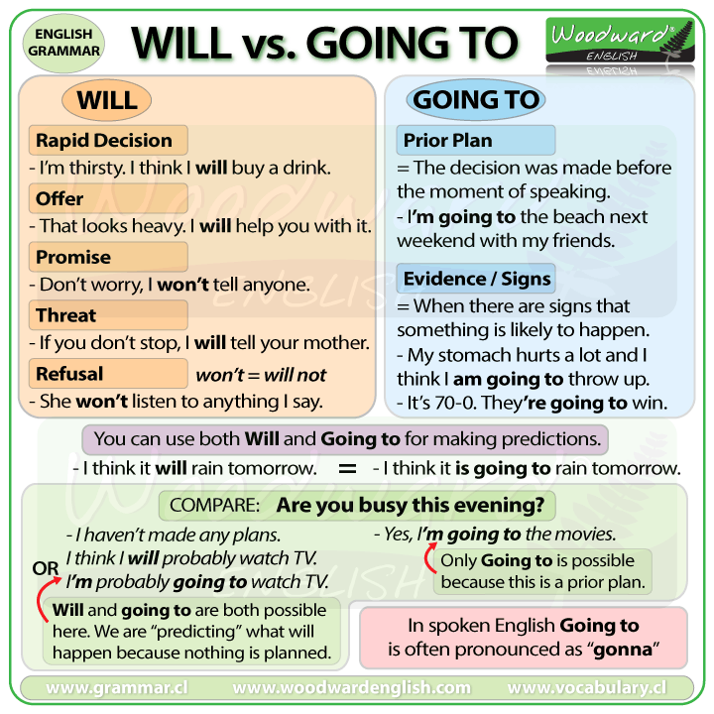
Will = Going to

Slide 21
I am going to (verb) _____.
Watch a movie
I am going to watch a movie.
Eat at Burger King
I am going to eat at Burger King.
Go to the park
I am going to go to the park

Slide 22
Let’s Practice
Make a sentence

Slide 23
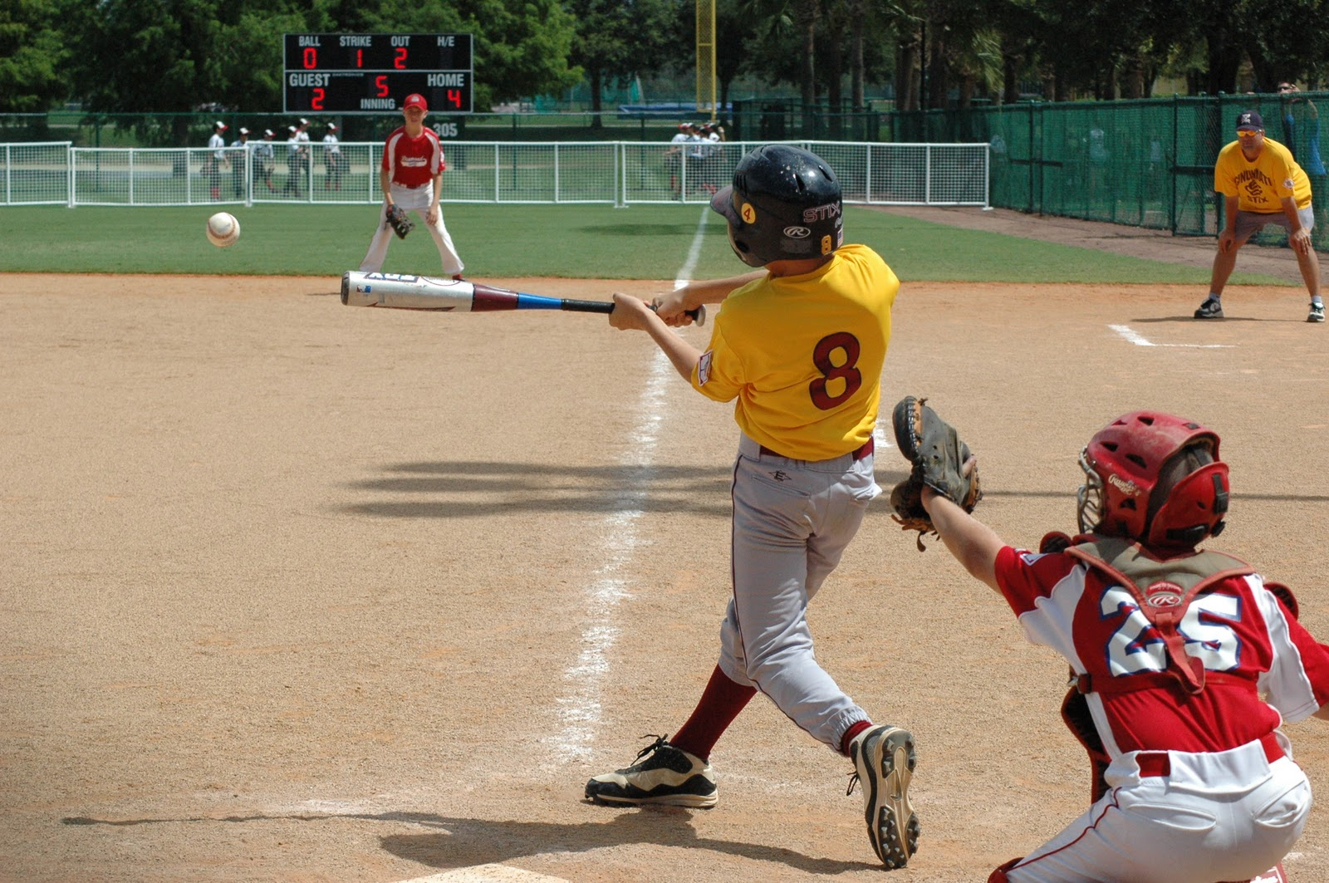
I am going to play baseball.

Slide 24
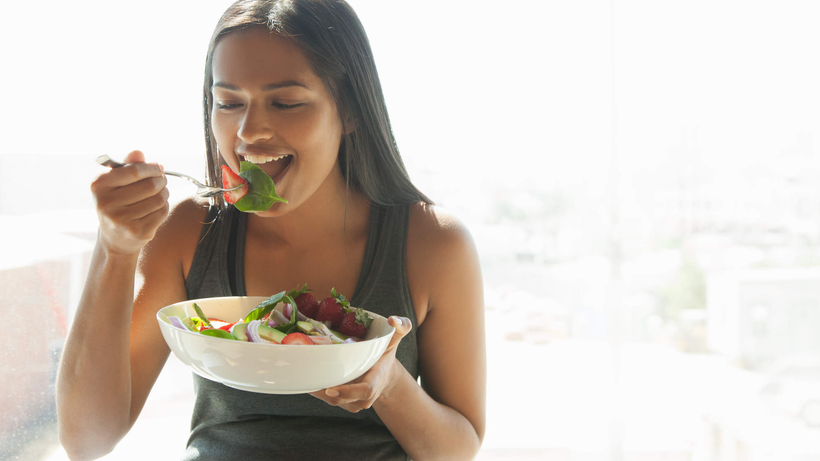
I am going to eat a salad.

Slide 25
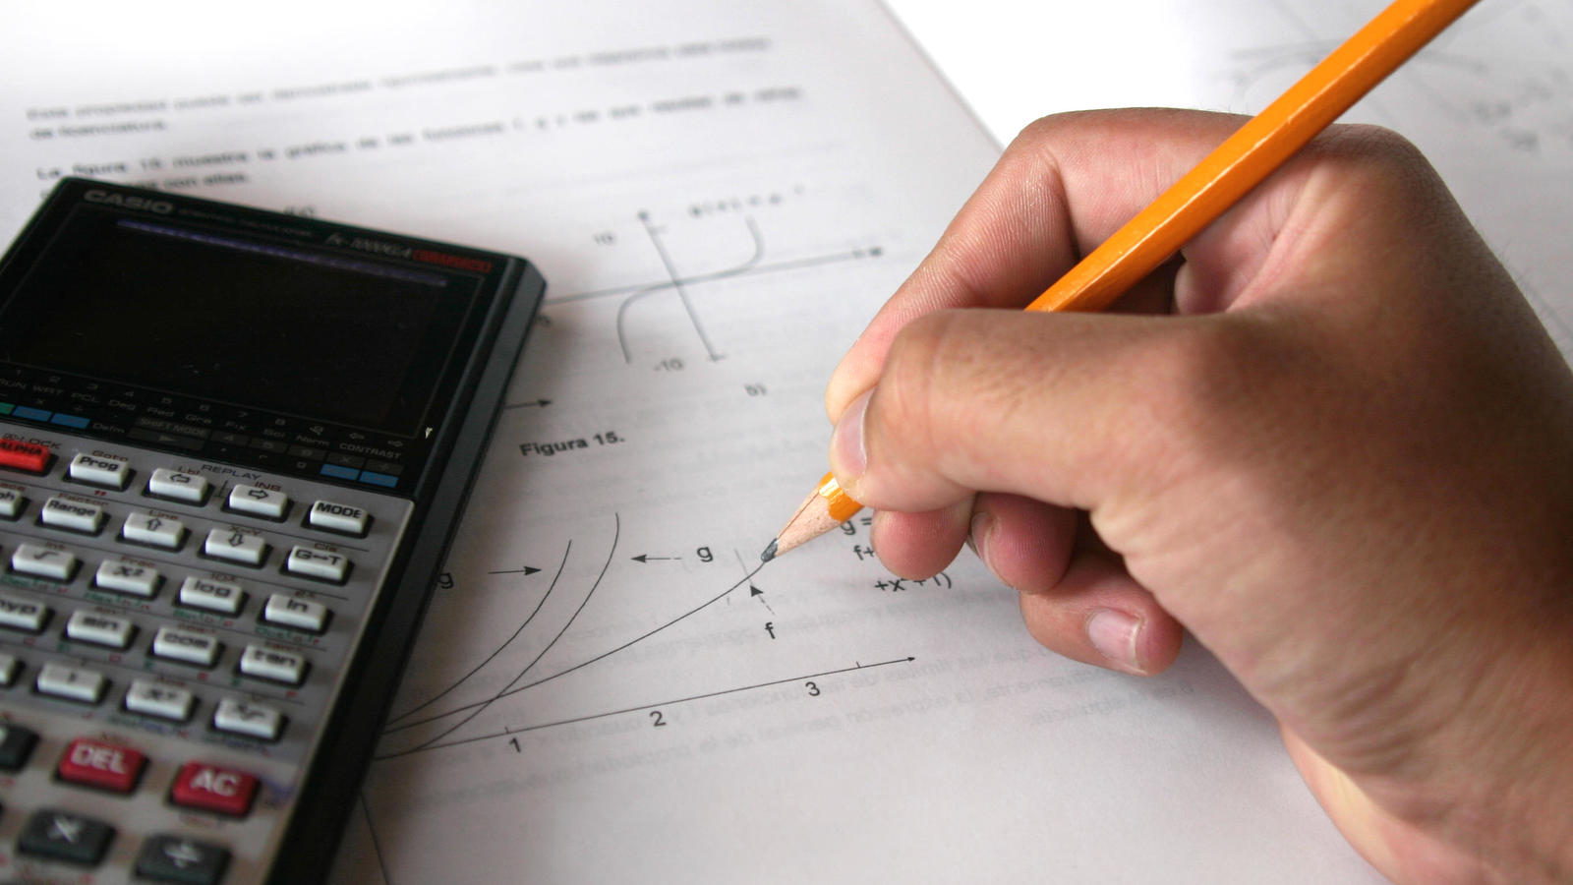
I am going to study math.

Slide 26
I am going to go shopping.

Slide 27
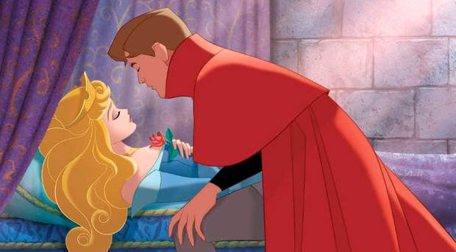
I’m going to kiss her.

Slide 28
I am going to visit my grandmother.

Slide 29
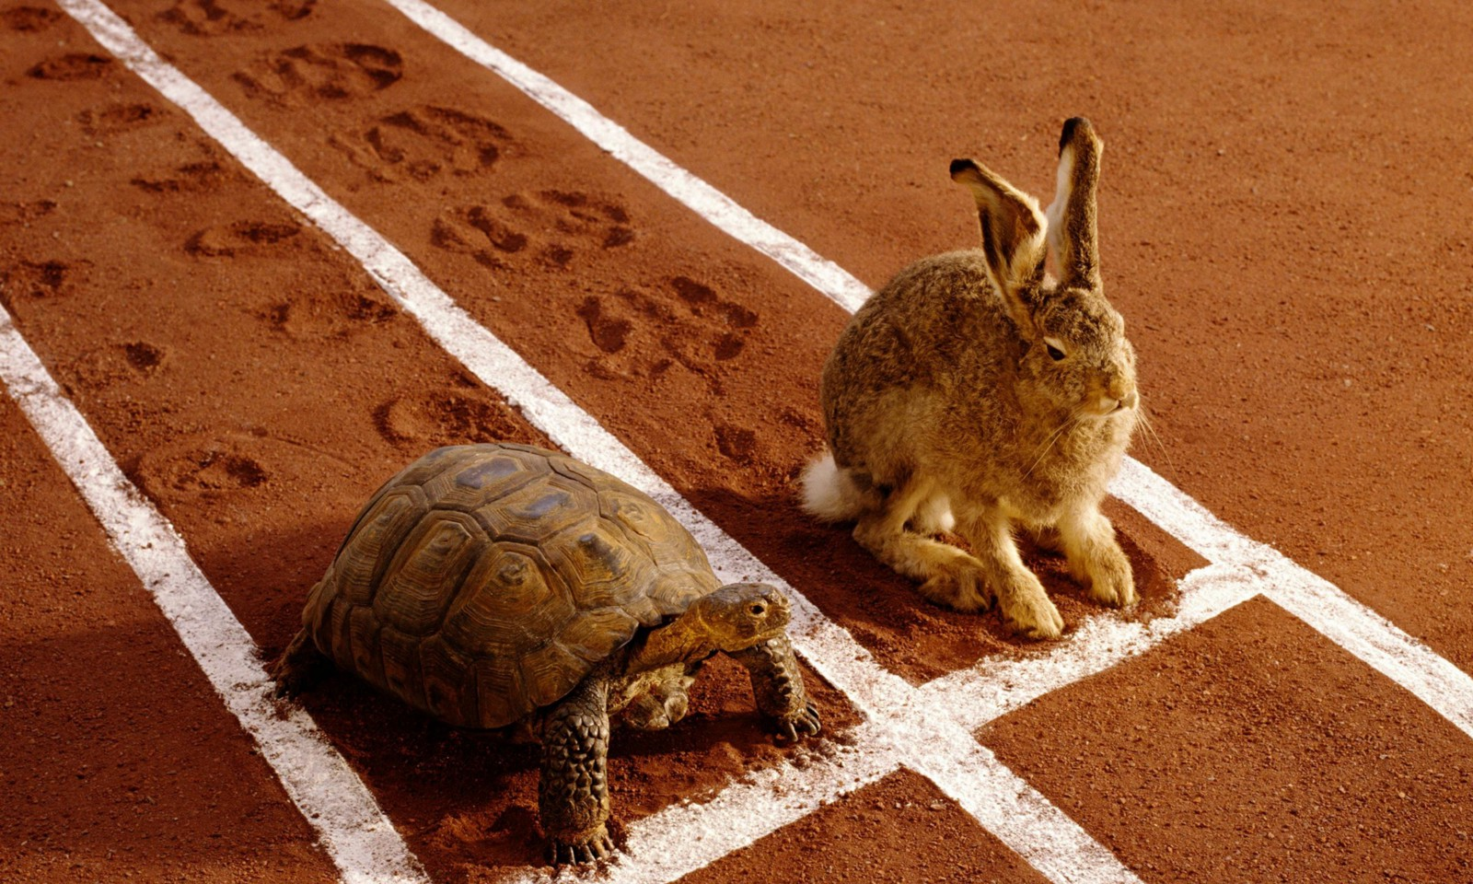
I am going to win.

Slide 30
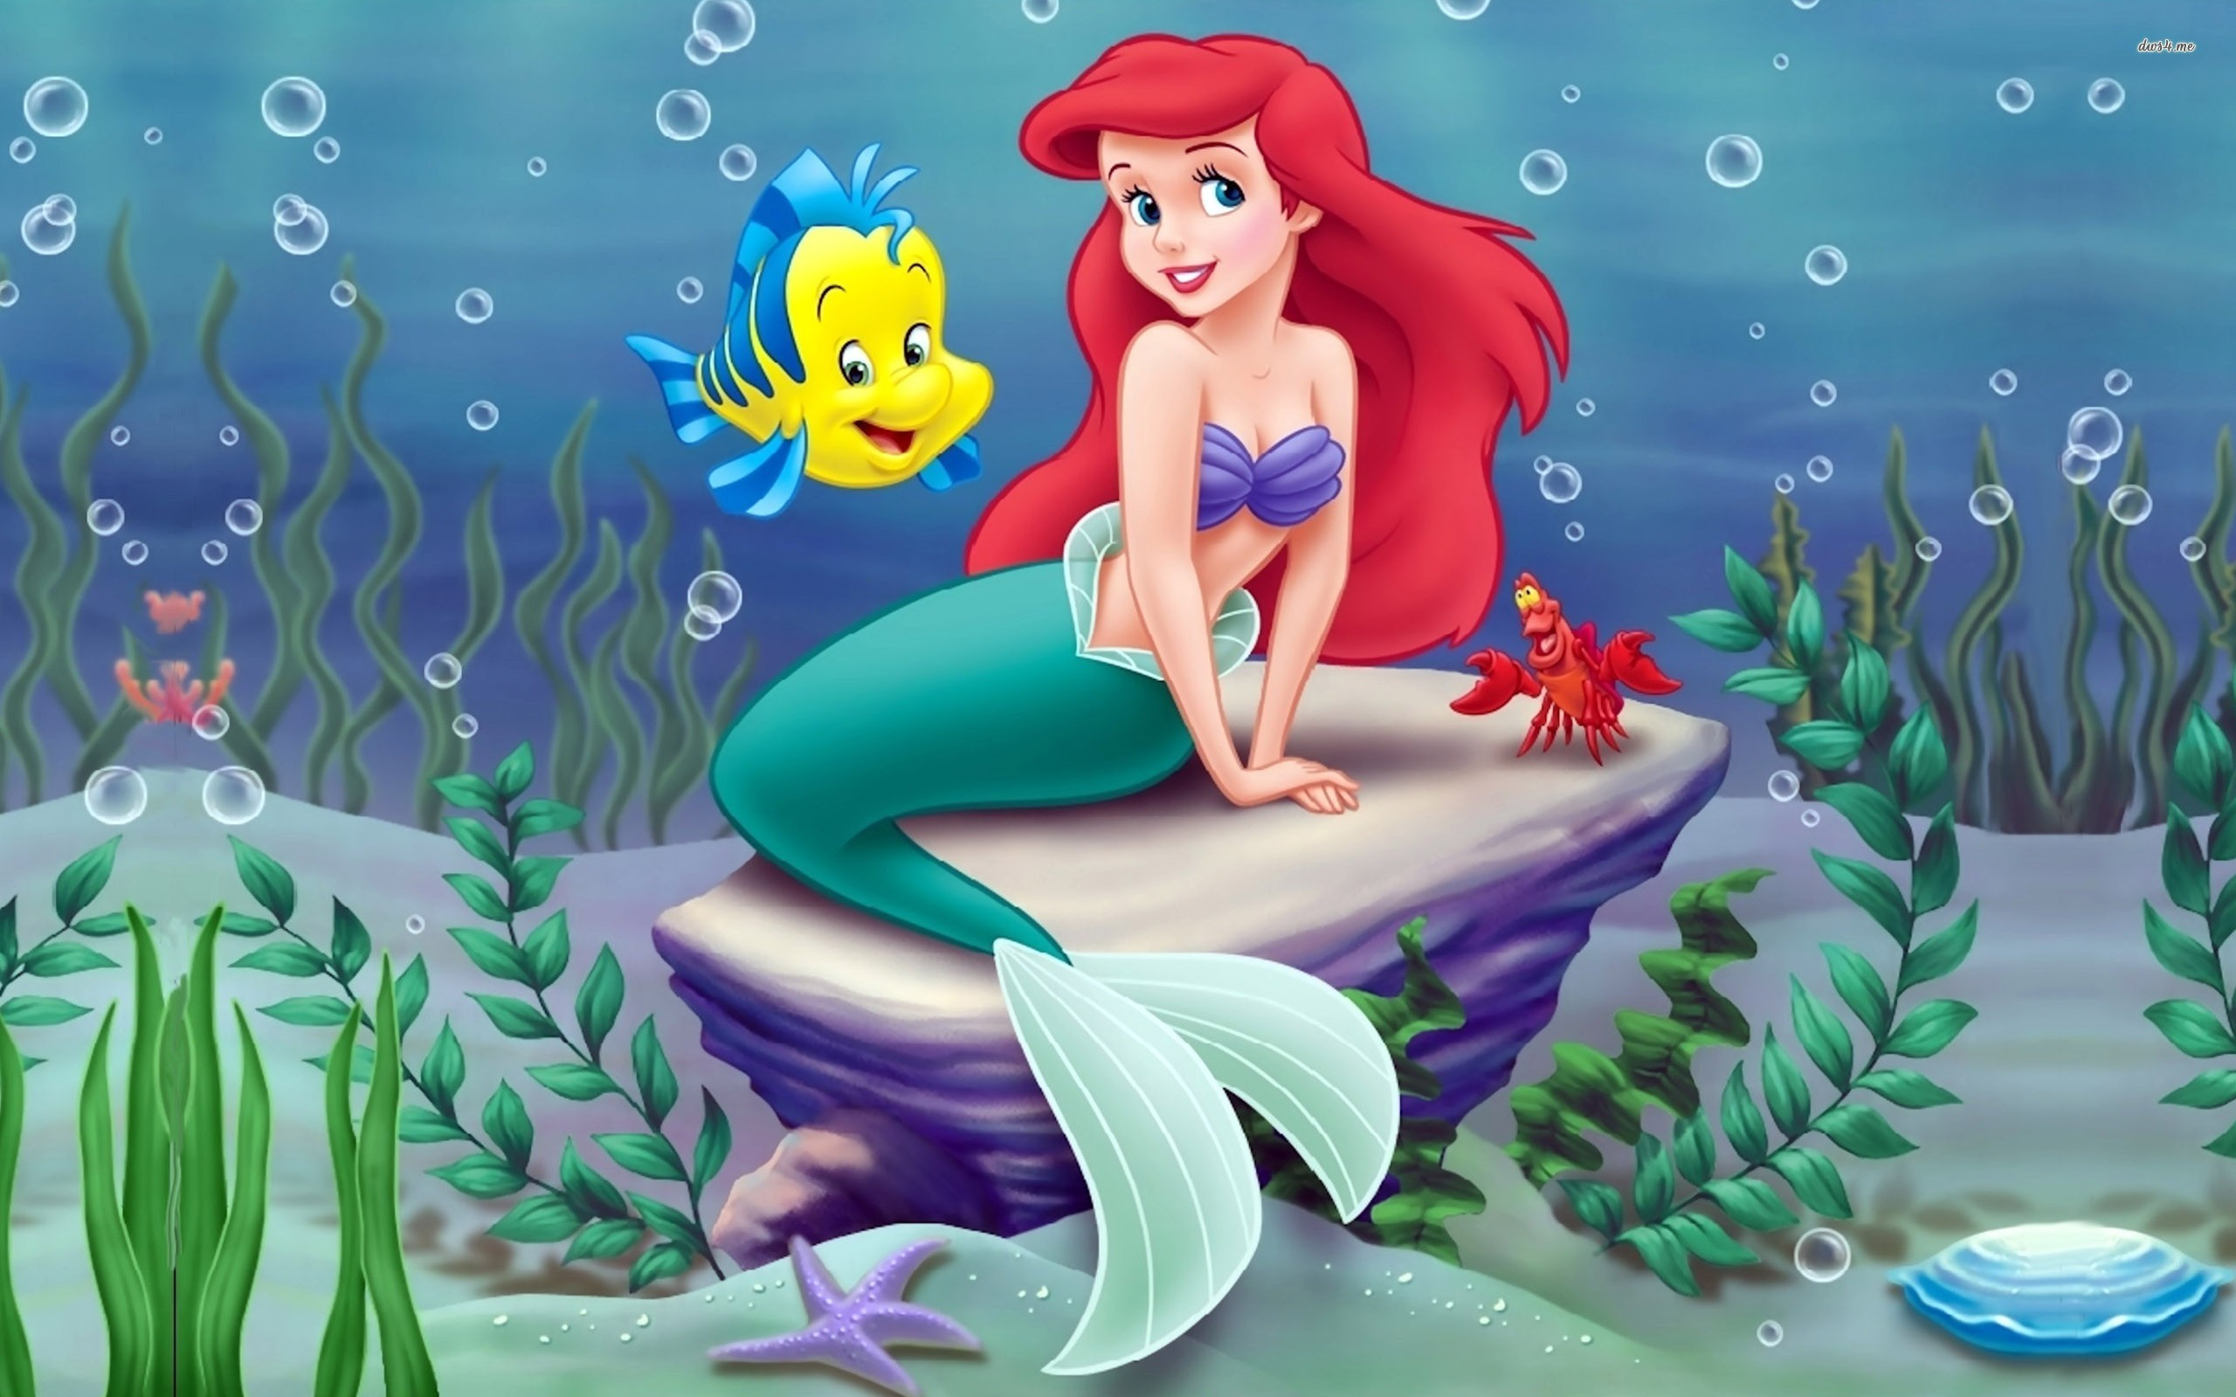
I’m going to become a human.

Slide 31
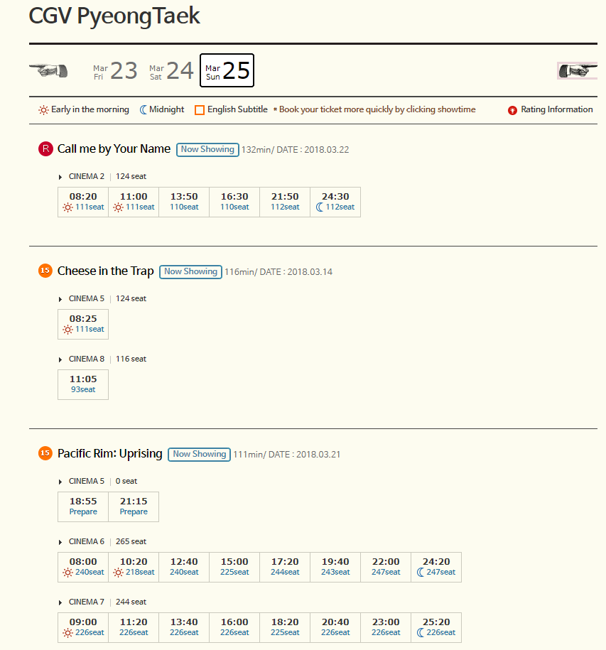
I am going to watch Pacific Rim at 3:00pm .

Slide 32
I’m going to graduate in 2021.

Slide 33
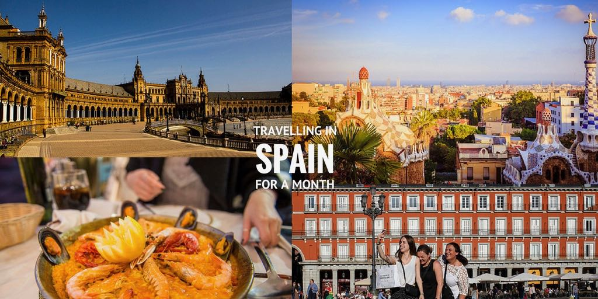
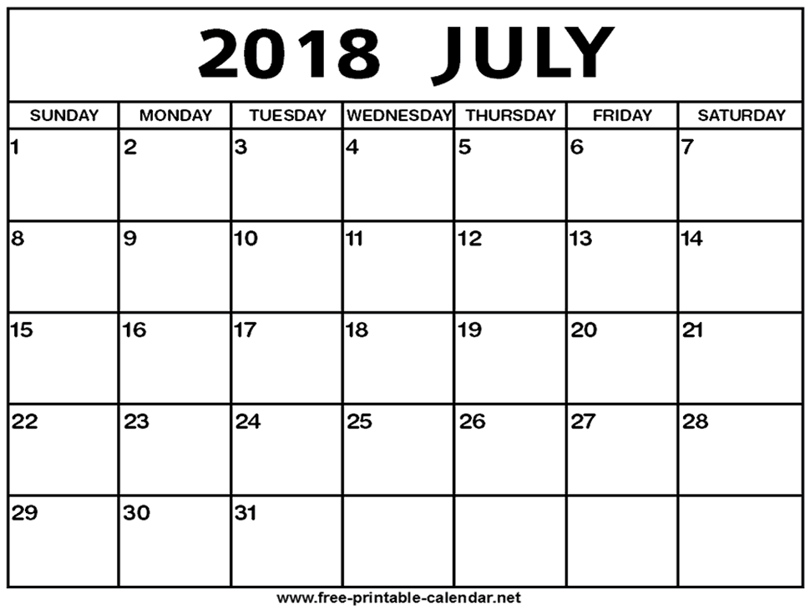
I’m going to go to Spain in July.

Slide 34
Chuseok is going to be on September 23rd this year.

Slide 35
Future Plans
Write 5 sentences about your future plans.
Use the date and time that it will happen.
I’m going to ______ on (date) at (time).
*It doesn’t need to be a real sentence*

Slide 36
Future Plans
I’m going to bake a cake on April 18, 2019 at 3:00pm.
I’m going to eat fish on January 14th, 2023 at 3:00.
I’m going to go swimming on Monday April 29th at 8:00.
I’m going to go to Everland on August 18th, 2019 at 12:00.

Slide 37
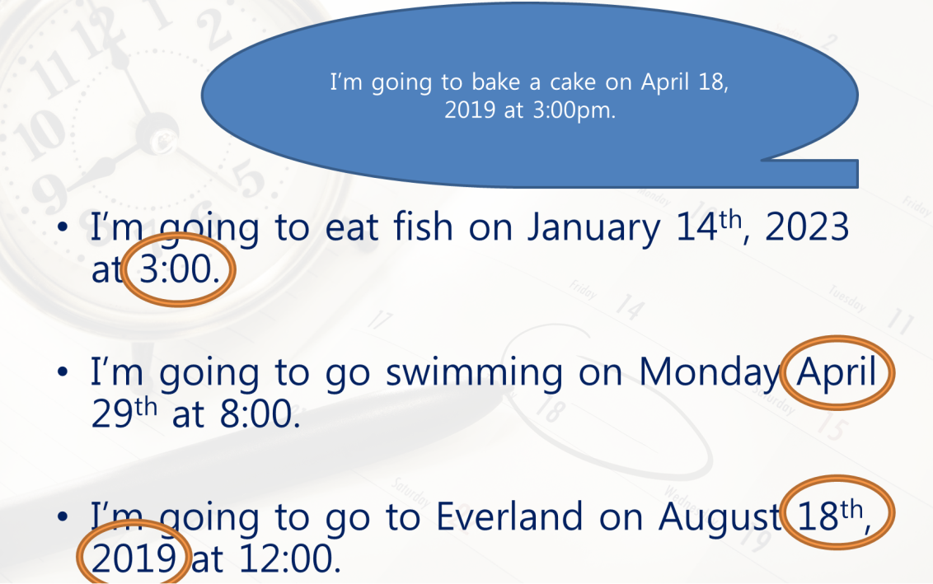
Future Plans
One student will read a sentence.
Can not get points
You get points for matching
Year = 1 point
Month = 2 points
Day = 3 points
Time = 5 points
Future plan = 3 points
5
2
3
1

