Slide 1
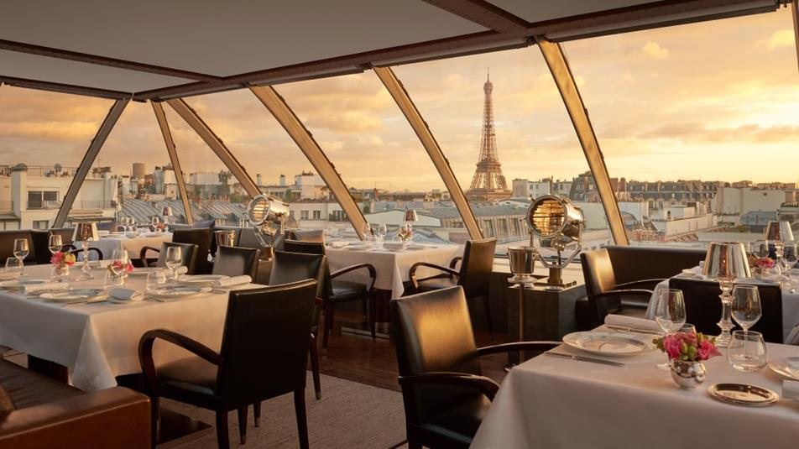
Restaurant

Slide 2
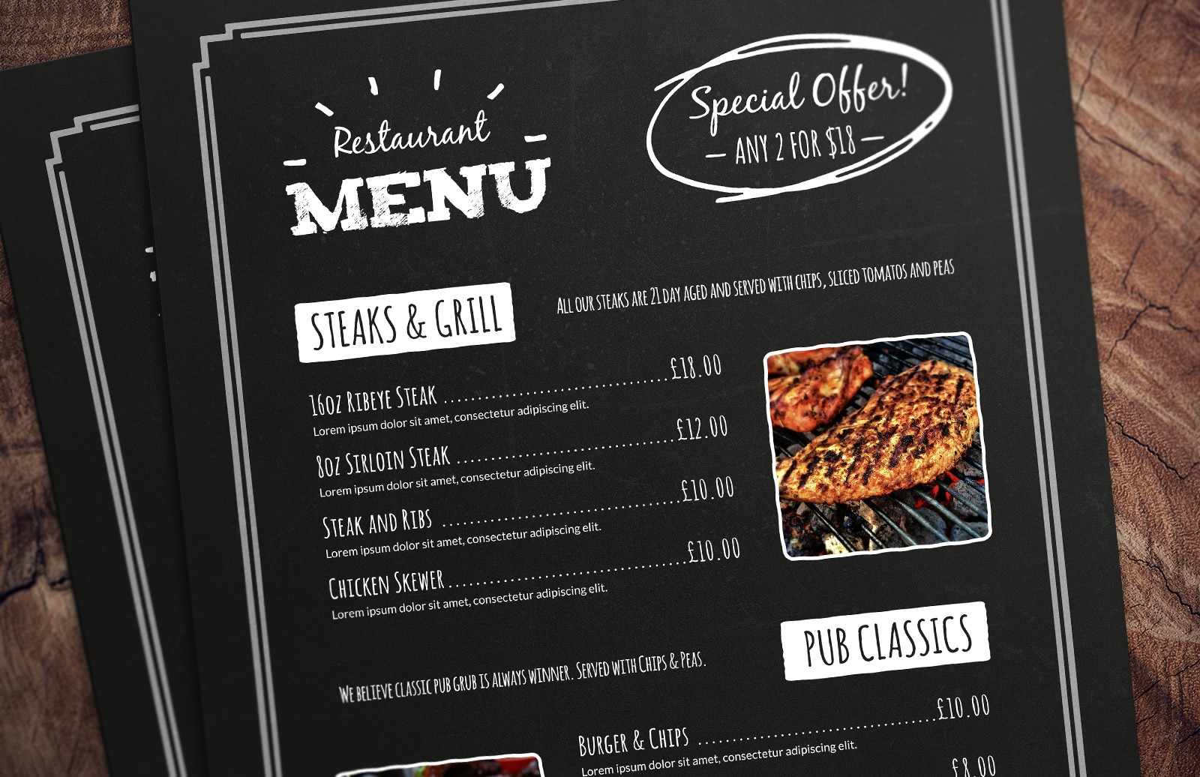

Slide 3
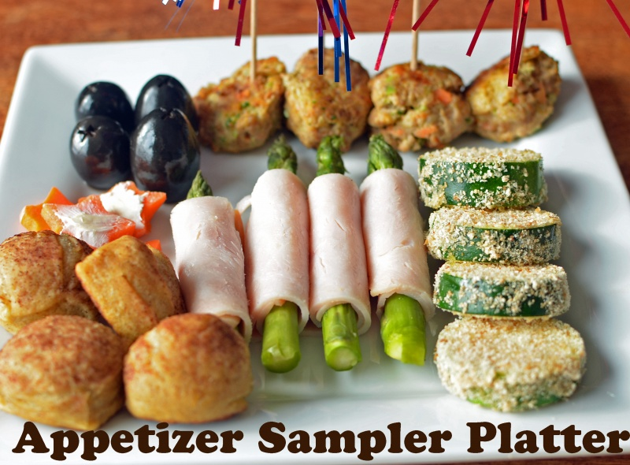
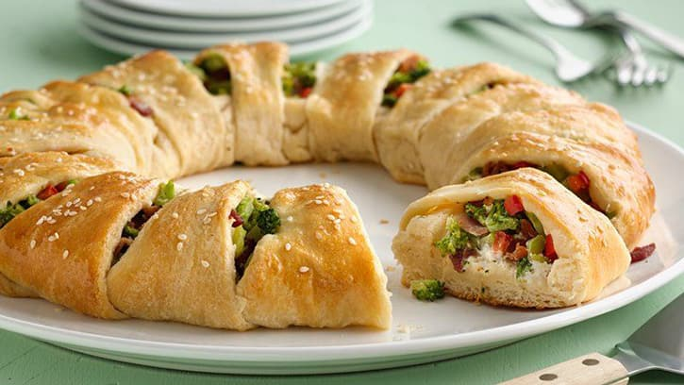
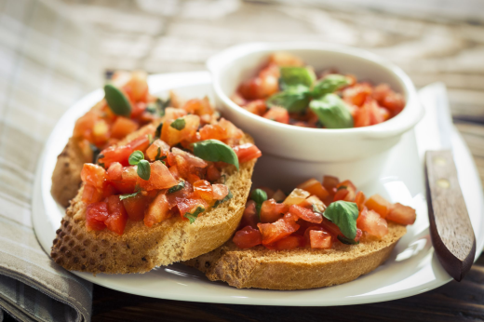
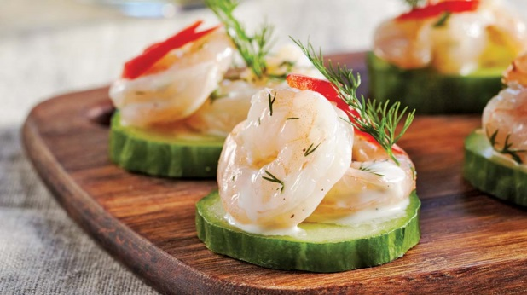
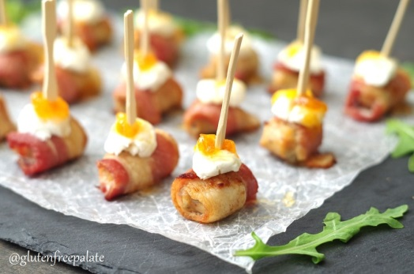
Appetizer (Starter)
A small amount of food
It will make you hungrier for the main dish
Appetizer Platter
(A platter is a lot of different foods on one plate)

Slide 4
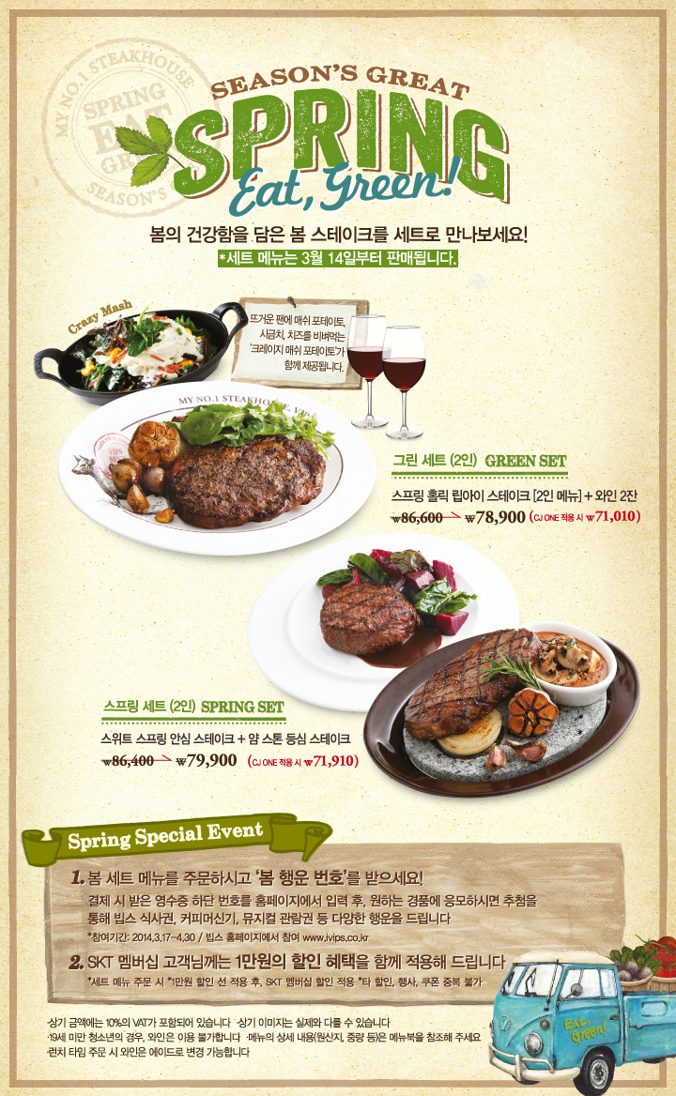
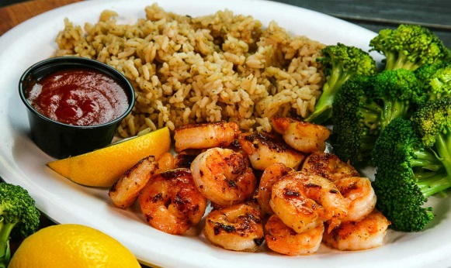
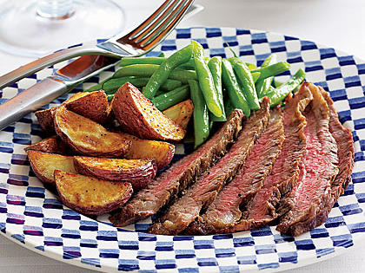
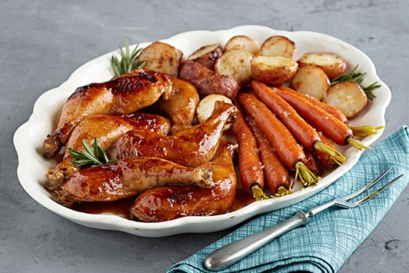
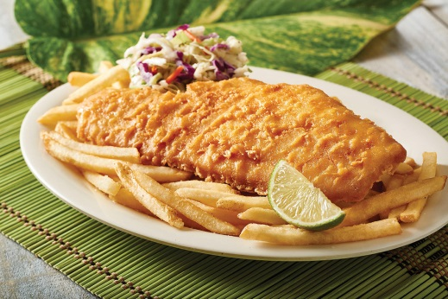
Entrée (Main Course, Main Dish)
This is the main part of the meal.
In North America, this is usually meat, vegetables, potato (rice).
Dish
Meal
Course
Set (세트)

Slide 5
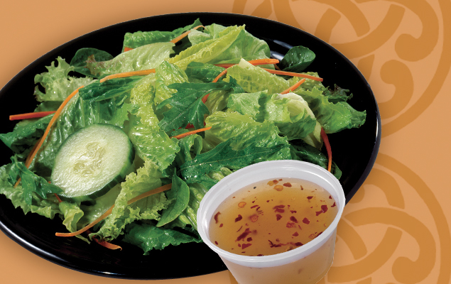
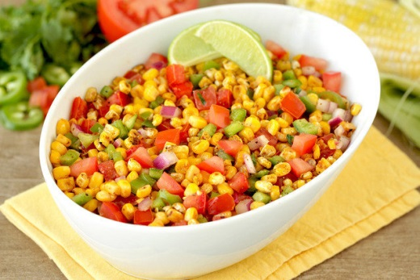
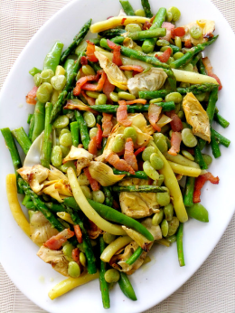
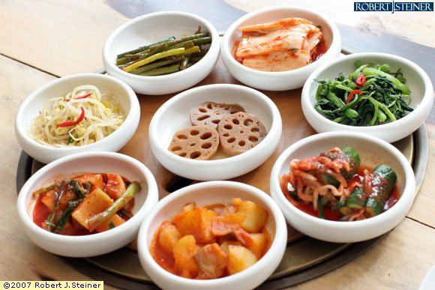
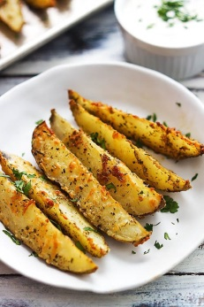
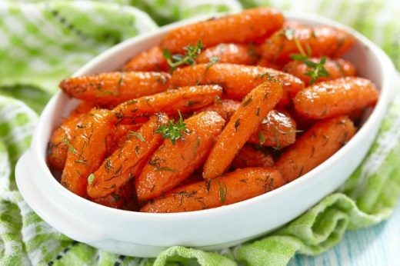
Sides (Side Dish, Side Order)
On the side
(you can also order part of the main dish to be separate – usually the sauce)
Something you can add to your meal.
Usually served to the ‘side’ of the main dish.

Slide 6
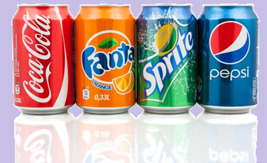
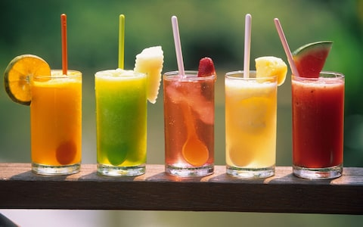
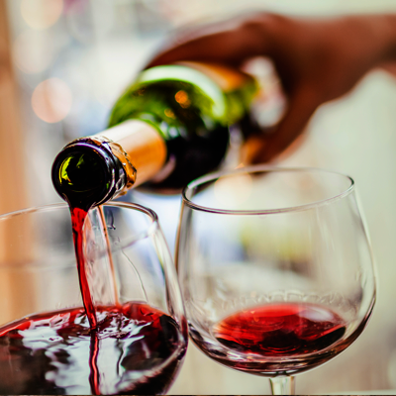
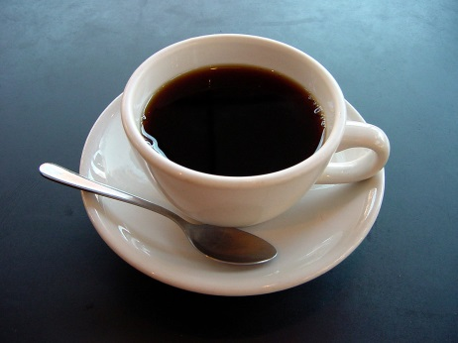
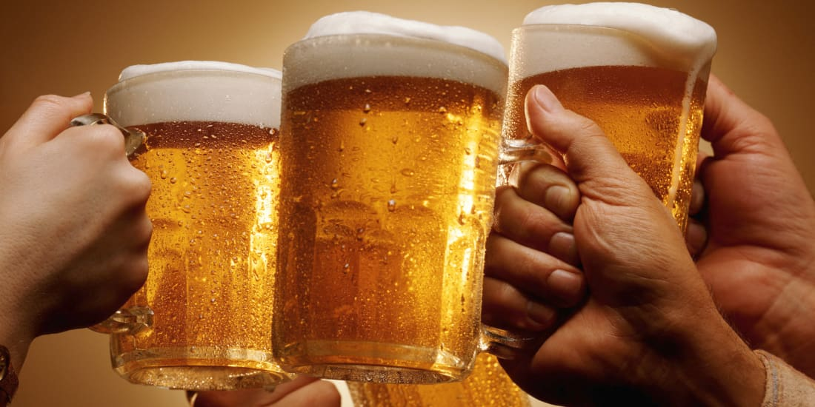
Beverages (Drinks)
Water is usually free, but these are other options.
Soft Drinks
Soda
Cola
Pop

Slide 7
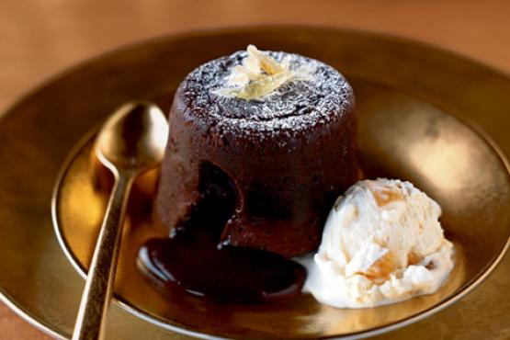
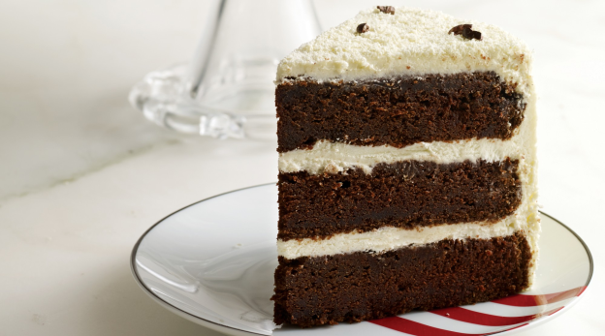
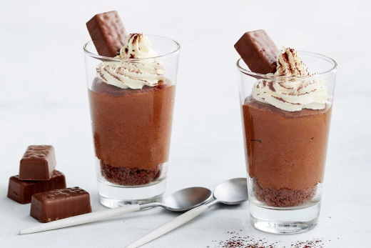
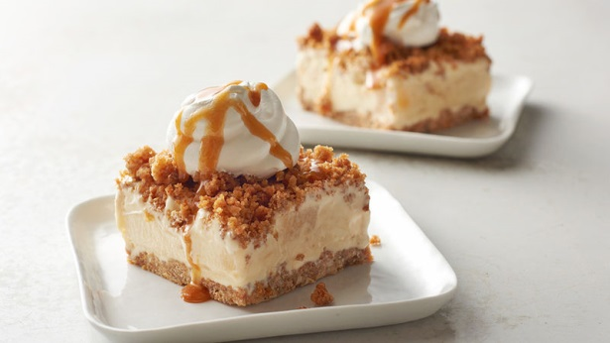
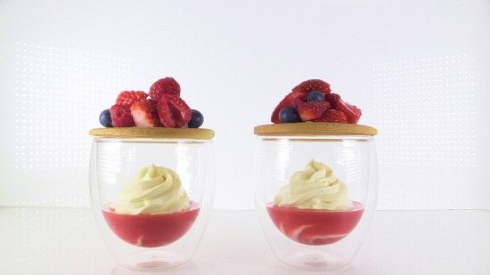
Dessert
A la mode
(with ice cream)
After your meal is finished.
Sometimes a restaurant has a second menu for desserts.

Slide 8
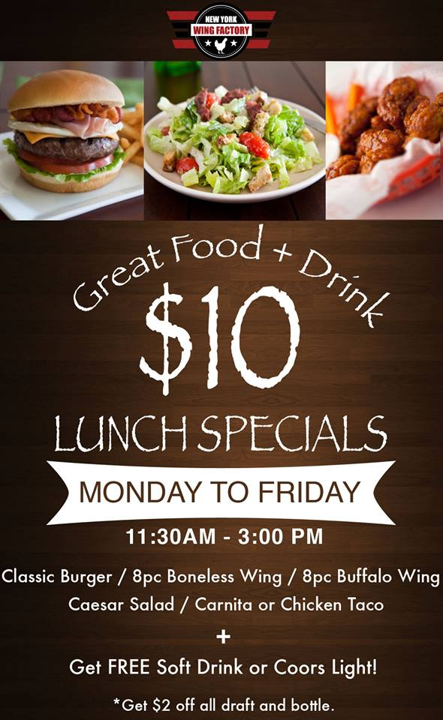
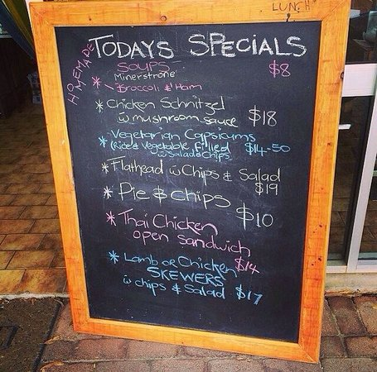
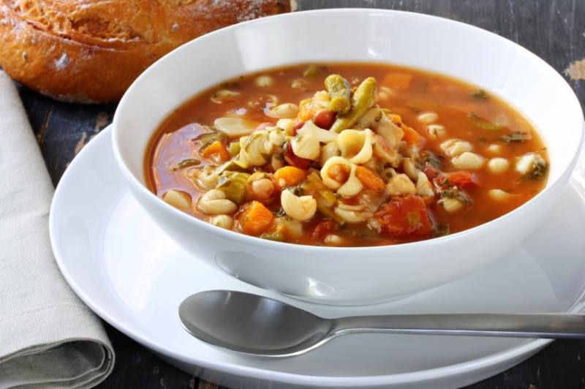
Specials
Lunch Specials
Today’s Specials
Soup of the day (de jour)

Slide 9
Cooking Vocabulary
How was it made?

Slide 10
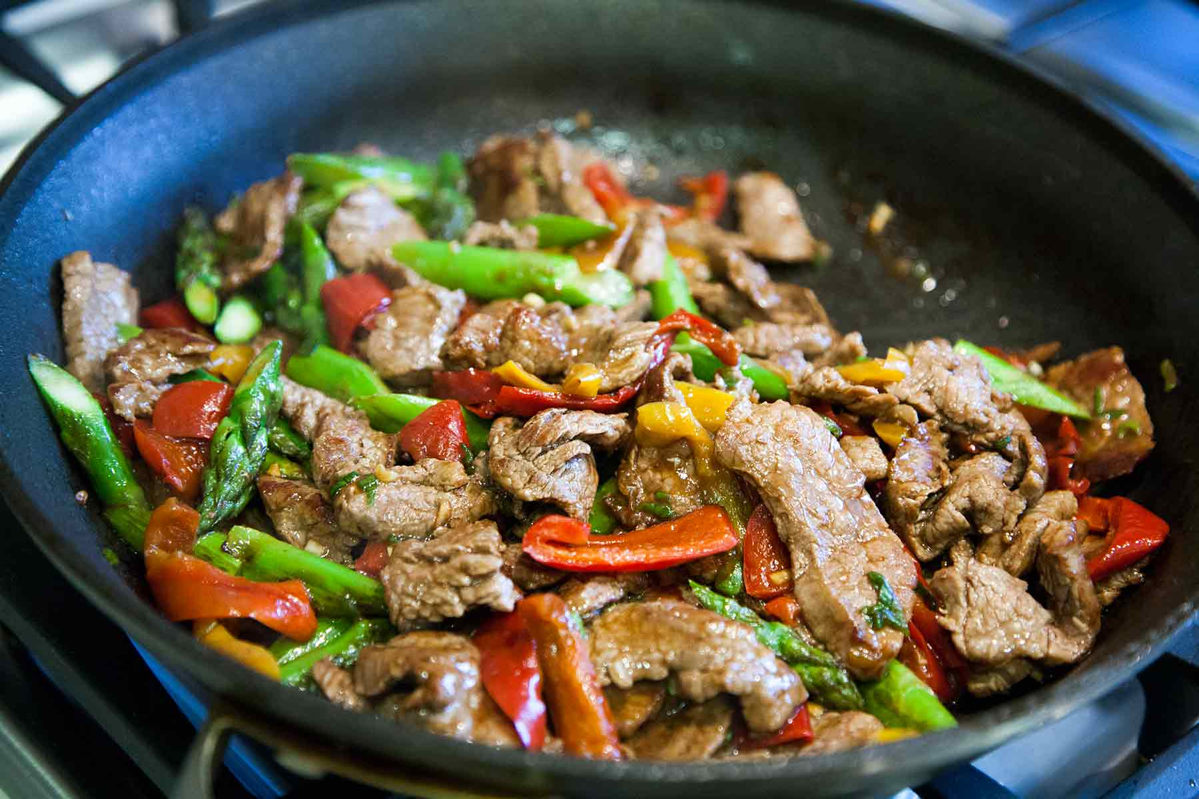
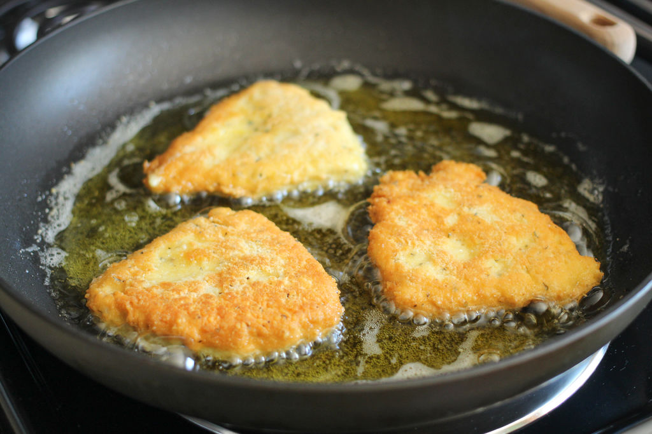
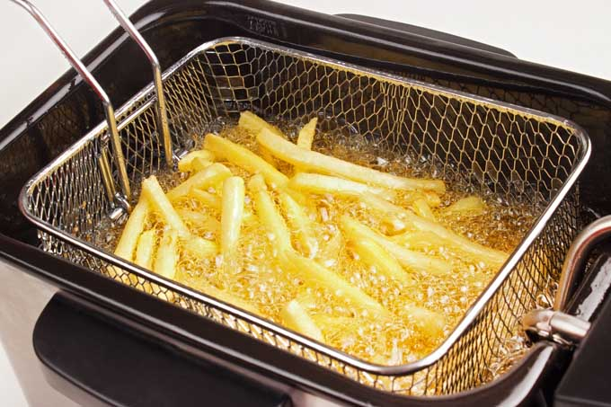
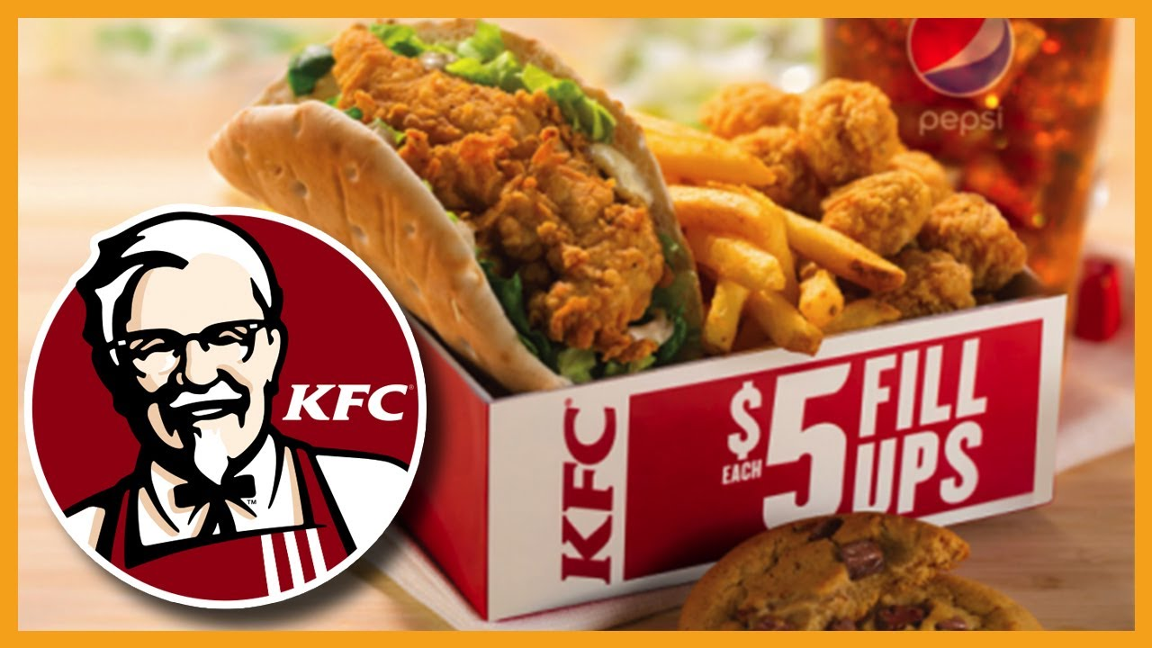
Fried (battered)
Deep fried
Pan fried
Stir-fried

Slide 11
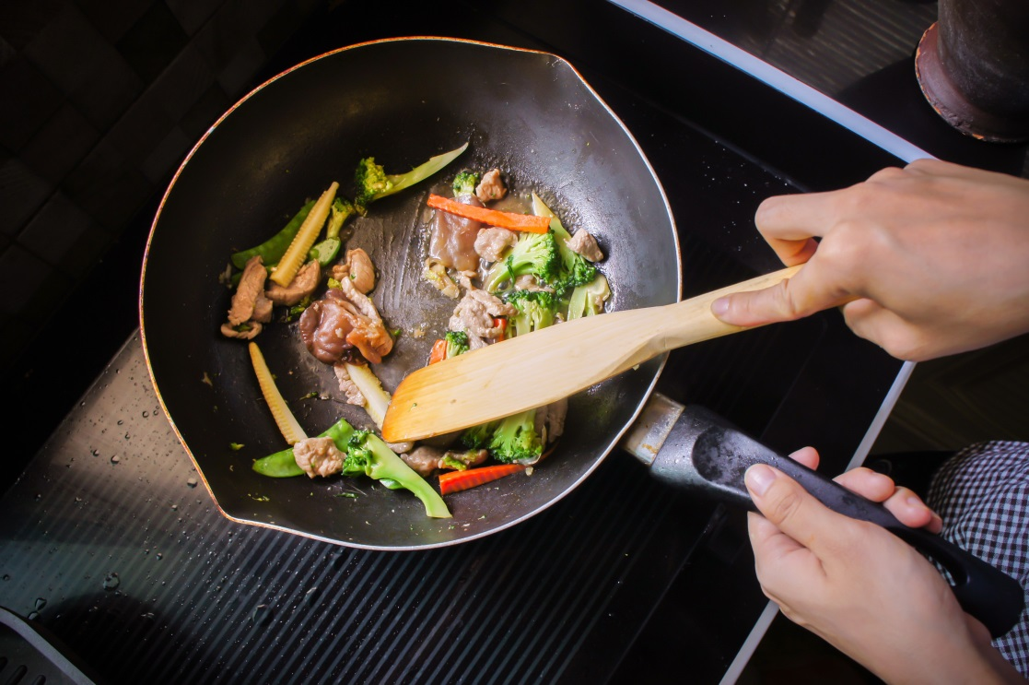
Sautéed
Cooked in a pan
Pan-fried

Slide 12
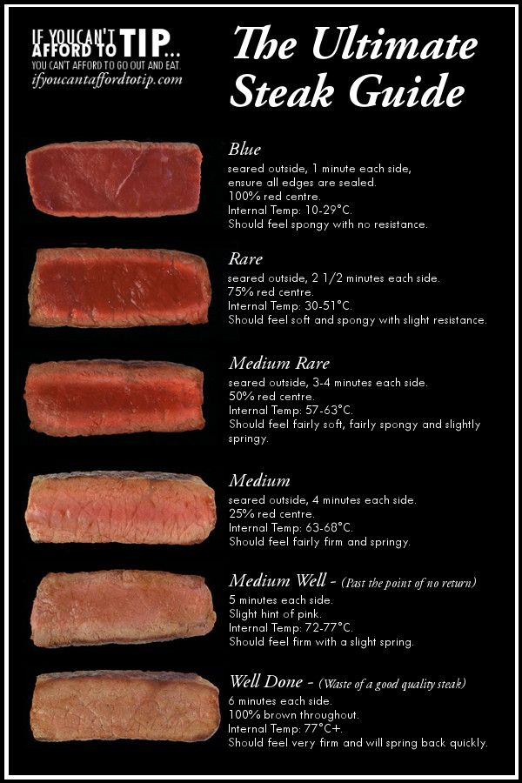
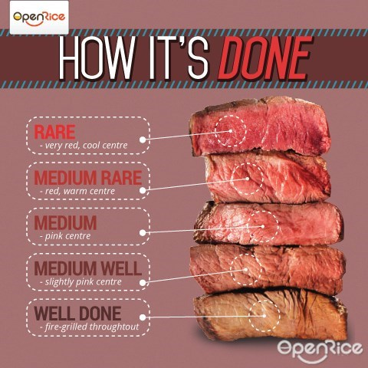
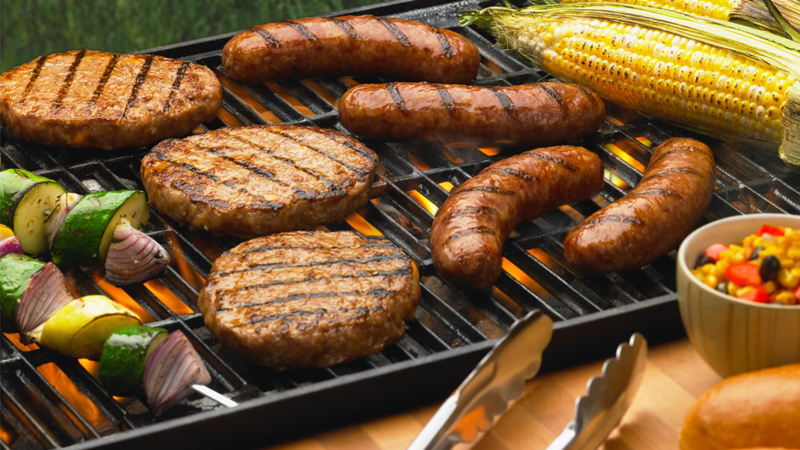
Grilled
Over fire
On a grill, bbq
Rare, medium, well-done, blue

Slide 13
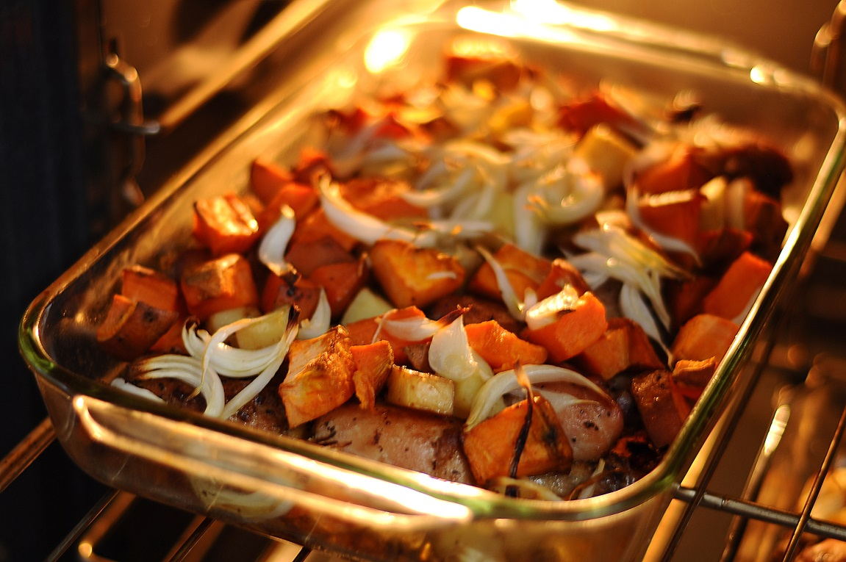
Roasted
Cook with high temperature.

Slide 14
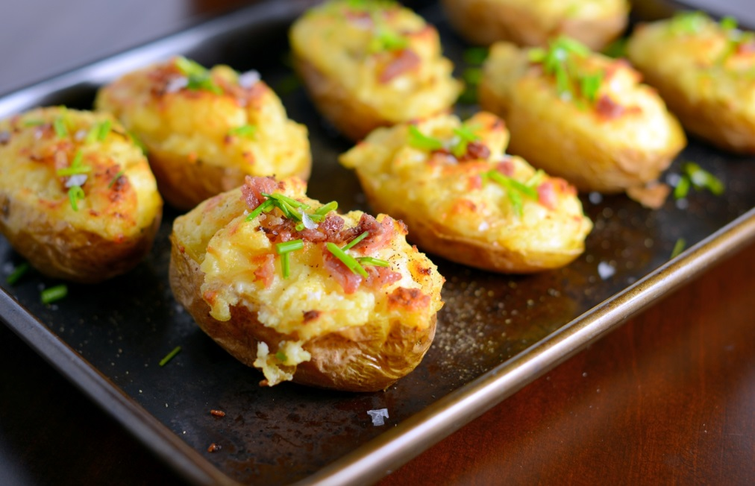
Baked
In an oven
Heat from top and bottom

Slide 15
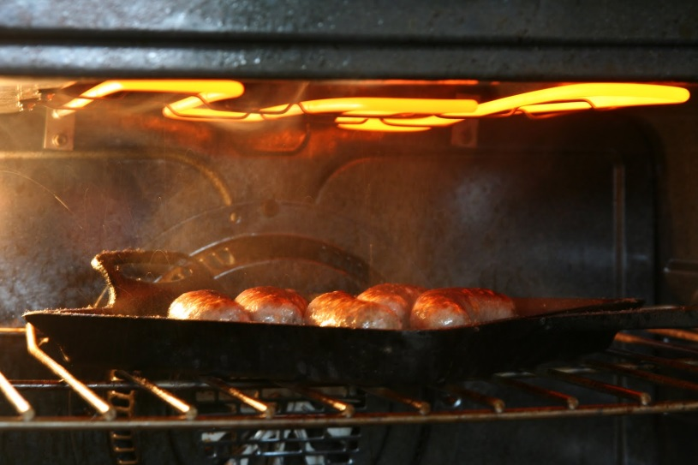
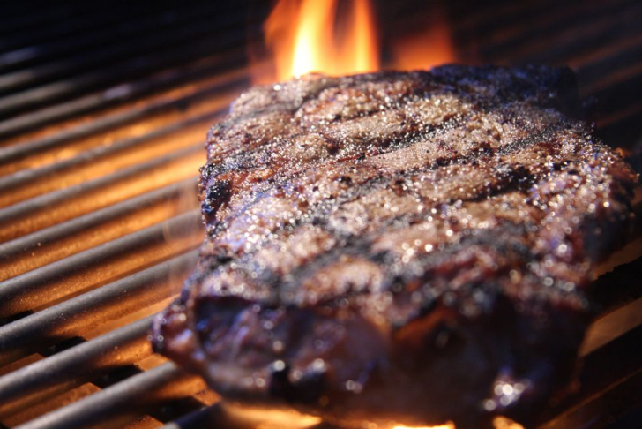
Broiled
Heat from the top in an oven
Heat from under on a stove or grill

Slide 16
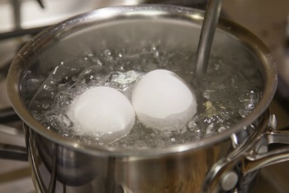
Boiled
In hot water

Slide 17
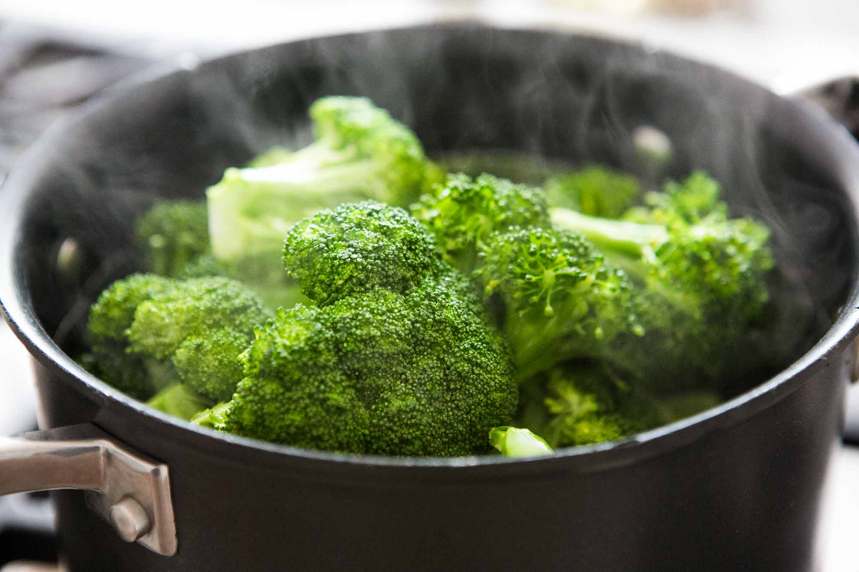
Steamed
Water is boiled below it.

Slide 18
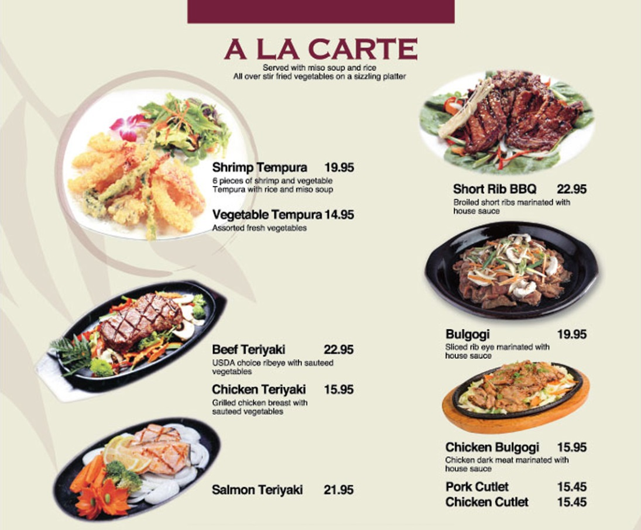
A la carte
With meat

Slide 19
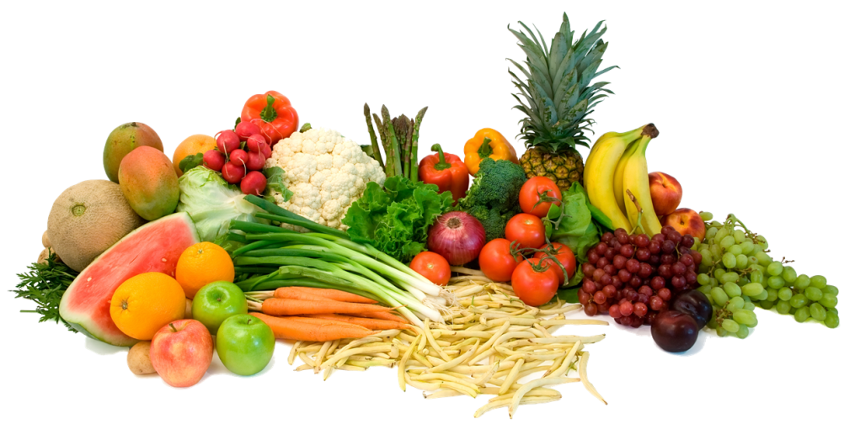
Vegetarian / Vegan
Vegetarian = no meat (sometimes milk, eggs)
Vegan = no animal products (no milk, eggs, honey)

Slide 20
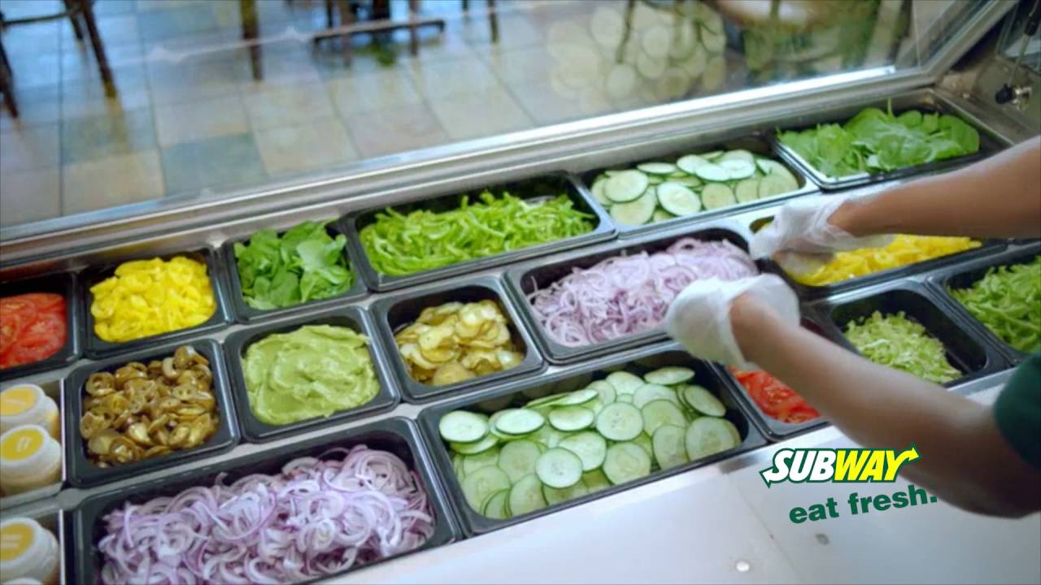
Toppings
Something that goes on the food.
Pizza, hamburger, etc.

Slide 21
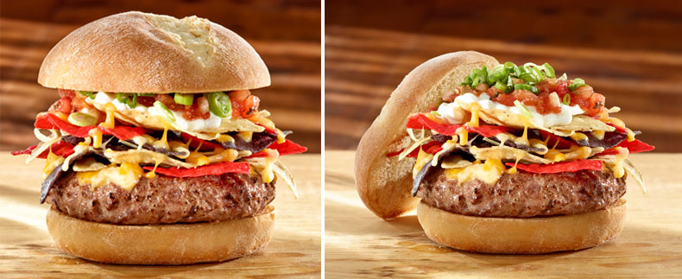
The Works
All toppings possible
“Give me the works.”

Slide 22
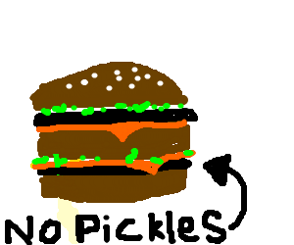
Hold the…
Don’t use this topping.
“Hold the pickle, please”

Slide 24
Host / Hostess

Slide 25
Hello, how can I help you?
Hi. Can we have a table for two?
Sure, can you wait here?

Slide 26
Your table is ready.
Please come with me.
Smith, party of 2!

Slide 27
Can I help you?
Are you ready to order?
Yes, please.
Can you give me a minute, please?

Slide 28
What would you like today?
What can I get you today?
May I take your order?
I’d like to have the ____________.

Slide 29
Would you like a _______?
beverage
appetizer
Yes, I’d like ______.
No, thank you.

Slide 30
Recommend
(권하다)
What do you recommend?

Slide 31
How would you like your _____?
Rare, medium, well-done.
Baked, grilled, fried.

Slide 32
Here you are.
Thank you.

Slide 33
Is everything ok?
Yes, it’s great.
Could I have _____?

Slide 34
Can I get you anything else?
Yes please, can I see the dessert menu?
No thanks, can I have the bill?

Slide 36
Paying the Bill
Tips / Gratuity
Western culture
About 10 – 20%
Tip the tax
Give extra money for good service.

Slide 37
Paying the Bill
How would you like to pay?
Cash
Debit
Credit card

Slide 38
Paying the Bill
Would you like a receipt?
It’s on the house

Slide 39
Restaurant Etiquette
https://www.youtube.com/watch?v=FDGGv7z5r2c
Or
https://www.youtube.com/watch?v=bROOWTpyTlg

Slide 40
Role Play
We need a host / hostess
We need some waiters / waitresses
Customers have a challenge

Slide 41
Role Play
One person is vegetarian
One is lactose intolerant
One is a child
One person only has $10
Eat something with chicken
Ordering from the lunch menu

Slide 42
Role Play
The host will seat the customers.
Groups of 4 or 5
The waiter must take the order of the customers.
Menus
Make a receipt
The host will also add the totals.
$100 budget per table.

Slide 43
Winners
Waiter
The highest tip.
Customers
The group closest to $100 (not including tip)

