Slide 1
Big Numbers

Slide 2
Review: Years
1992 –
1709 –
2018 -
Nineteen ninety-two
Seventeen “O” nine
Twenty eighteen

Slide 3
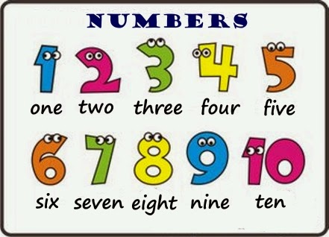
One to Ten

Slide 4
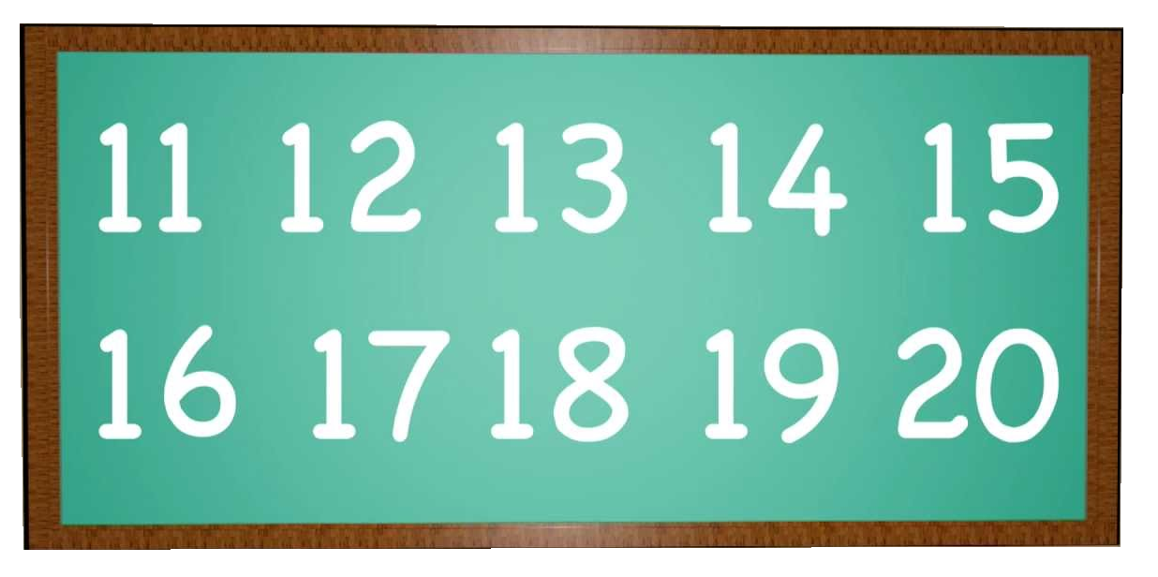
Teens

Slide 5
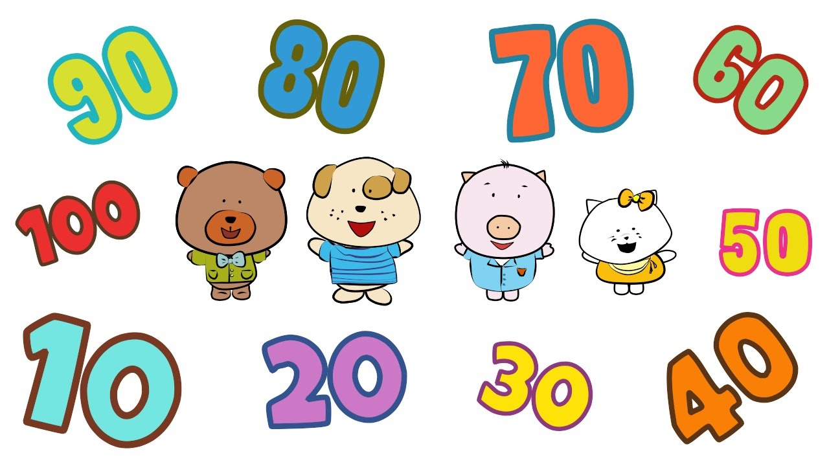

Slide 6
Tens

Slide 7
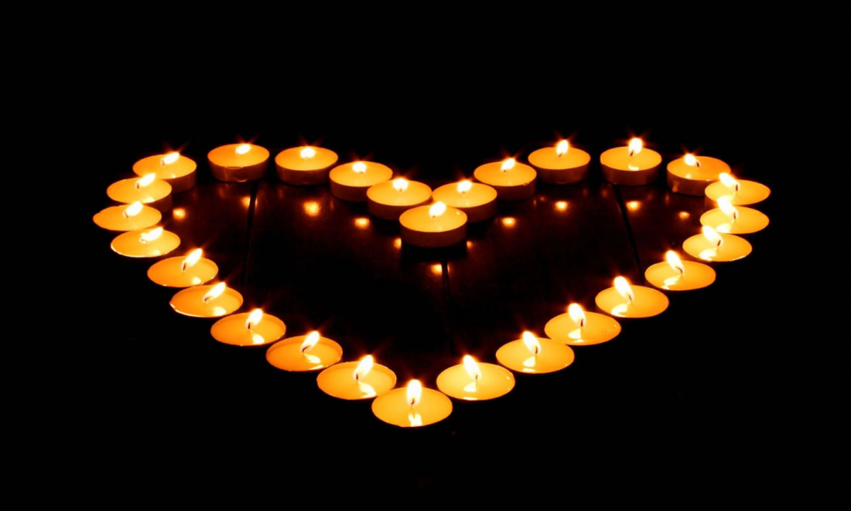
20 +
21 =
22 =
36 =
81 =
79 =
Twenty-one
Twenty-two
Thirty-six
Eighty-one
Seventy-nine

Slide 8
Hundreds

Slide 9
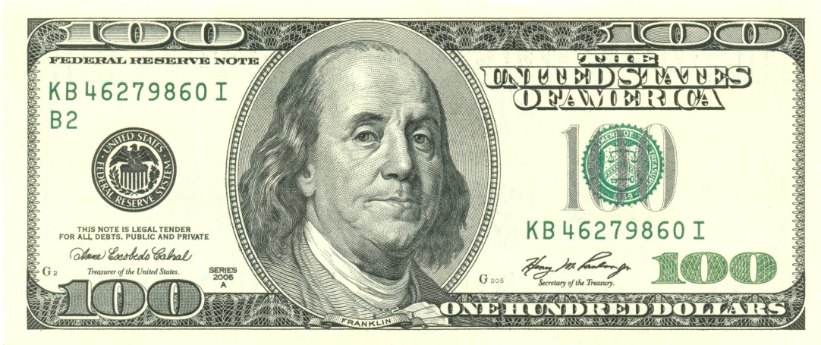
100
One hundred
Two hundred, three hundred…

Slide 10
100 and…
101 = one hundred and one
205 = two hundred and five
653 = six hundred and fifty-three

Slide 11
Try these
Three hundred and forty-five
Eight hundred and seventy-two
Nine hundred and eleven
Seven hundred and seventy – seven
345 =
872 =
911 =
777 =

Slide 12
Thousands

Slide 13
Thousands
Try writing with a comma every 3 numbers…
Read the number before the comma, then the number after (following the ‘hundreds’ rules)
1,234

Slide 14
Thousands
Try writing with a comma every 3 numbers…
The comma is “Thousand”
1,234

Slide 15
Bigger

Slide 16
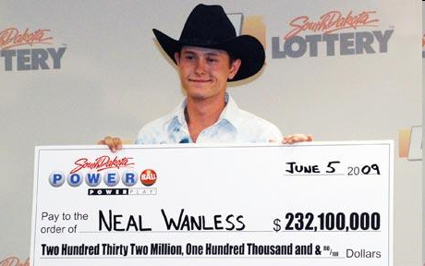
Bigger…
1,000 =
10,000 =
100,000 =
1,000,000 =
One thousand
Ten thousand
One hundred thousand
One Million

Slide 17
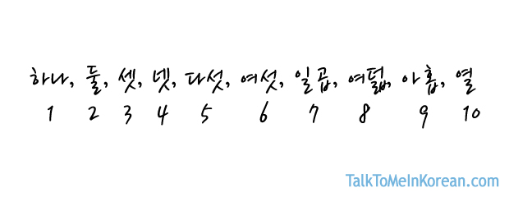
Bigger…
만원 =
억 =
조 =
Ten thousand won
100,000,000
100000000
One hundred million
1,000,000,000,000
One Trillion

Slide 18
987,654,321

Slide 19
Ordinals
1st = First
2nd = Second
3rd = Third
4th = Fourth
5th = Fifth
21st = Twenty-first
25th = Twenty-fifth

Slide 20
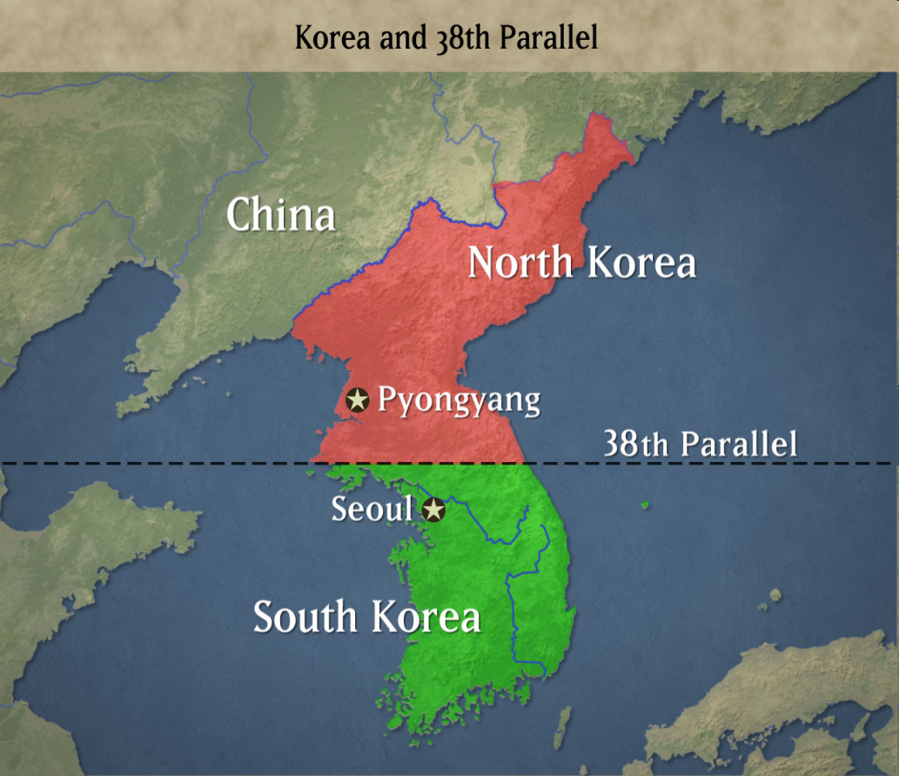
Ordinals
63rd =
38th =
51st =
Sixty-third
Thirty-eighth
Fifty-first

Slide 21
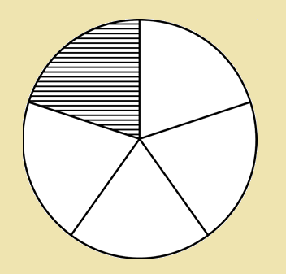
Fractions
1 / 5 = one fifth
1/10 =
1 / 55 =
2/3 =
One tenth
One fifty-fifth
Two thirds

Slide 22
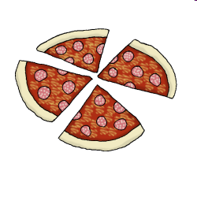
Fractions
½ =
¼ =
¾ =
Half
Quarter
3 Quarters

Slide 23
6 1/3
18 3/7

Slide 24
Decimals
0.1 = zero point one
0.10 =
7.3429 =
Zero point one zero
Seven point three four two nine

Slide 25
55.5
12.25

Slide 26
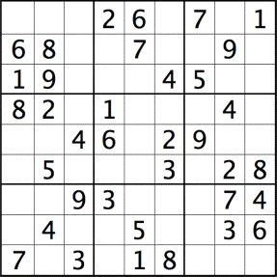
Sudoku

Slide 27
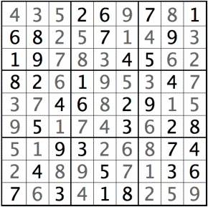

Slide 28
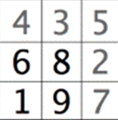
Write the numbers from 1-9:
In each square
In each row
In each column

Slide 29
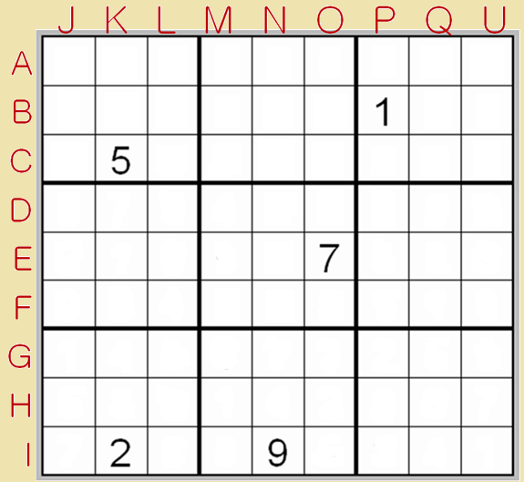
A: Three hundred ninety-one million, two hundred eighty-six thousand, five hundred and seventy four.
F: (One-hundred seven million, one-hundred sixty-nine thousand, eight-hundred and fifty-seven) x nine.
G: One fifth of (seven-hundred forty-eight million, three hundred sixty-six thousand, two-hundred and ninety).
J: (Two-hundred twenty-two million, two-hundred twenty-two thousand, two hundred and twenty-two) + (one-hundred twenty-four million, six-hundred six thousand, nine-hundred and thirty-five).
M: Half of (four-hundred seventy-four million, nine-hundred ninety-one thousand, two-hundred and thirty six).
Q: (One billion) minus (two-hundred seventy-six million, eighteen thousand, four-hundred and thirty-six).

Slide 30
3
A: Three hundred ninety-one million, two hundred eighty-six thousand, five hundred and seventy four.
F: (One-hundred seven million, one-hundred sixty-nine thousand, eight-hundred and fifty-seven) x nine.
G: One fifth of (seven-hundred forty-eight million, three hundred sixty-six thousand, two-hundred and ninety).
J: (Two-hundred twenty-two million, two-hundred twenty-two thousand, two hundred and twenty-two) + (one-hundred twenty-four million, six-hundred six thousand, nine-hundred and thirty-five).
M: Half of (four-hundred seventy-four million, nine-hundred ninety-one thousand, two-hundred and thirty six).
Q: (One billion) minus (two-hundred seventy-six million, eighteen thousand, four-hundred and thirty-six).
9
1
2
8
6
5
7
4
4
3
2
6
7
3
8
4
9
2
9
8
9
6
4
5
2
8
7
1
3
1
4
9
6
7
3
2
5
8
5
1
6
7
8
4

Slide 31
3
A: Three hundred ninety-one million, two hundred eighty-six thousand, five hundred and seventy four.
F: (One-hundred seven million, one-hundred sixty-nine thousand, eight-hundred and fifty-seven) x nine.
G: One fifth of (seven-hundred forty-eight million, three hundred sixty-six thousand, two-hundred and ninety).
J: (Two-hundred twenty-two million, two-hundred twenty-two thousand, two hundred and twenty-two) + (one-hundred twenty-four million, six-hundred six thousand, nine-hundred and thirty-five).
M: Half of (four-hundred seventy-four million, nine-hundred ninety-one thousand, two-hundred and thirty six).
Q: (One billion) minus (two-hundred seventy-six million, eighteen thousand, four-hundred and thirty-six).
9
1
2
8
6
5
7
4
4
8
7
3
5
9
2
6
6
2
7
1
4
8
3
9
8
7
5
4
3
1
6
9
2
2
1
3
9
6
4
8
5
9
6
4
5
2
8
7
1
3
1
4
9
6
7
3
2
5
8
5
3
8
1
4
2
9
6
7
7
6
8
5
3
4
1

Slide 32
Guesstimate
Guess the number

Slide 33
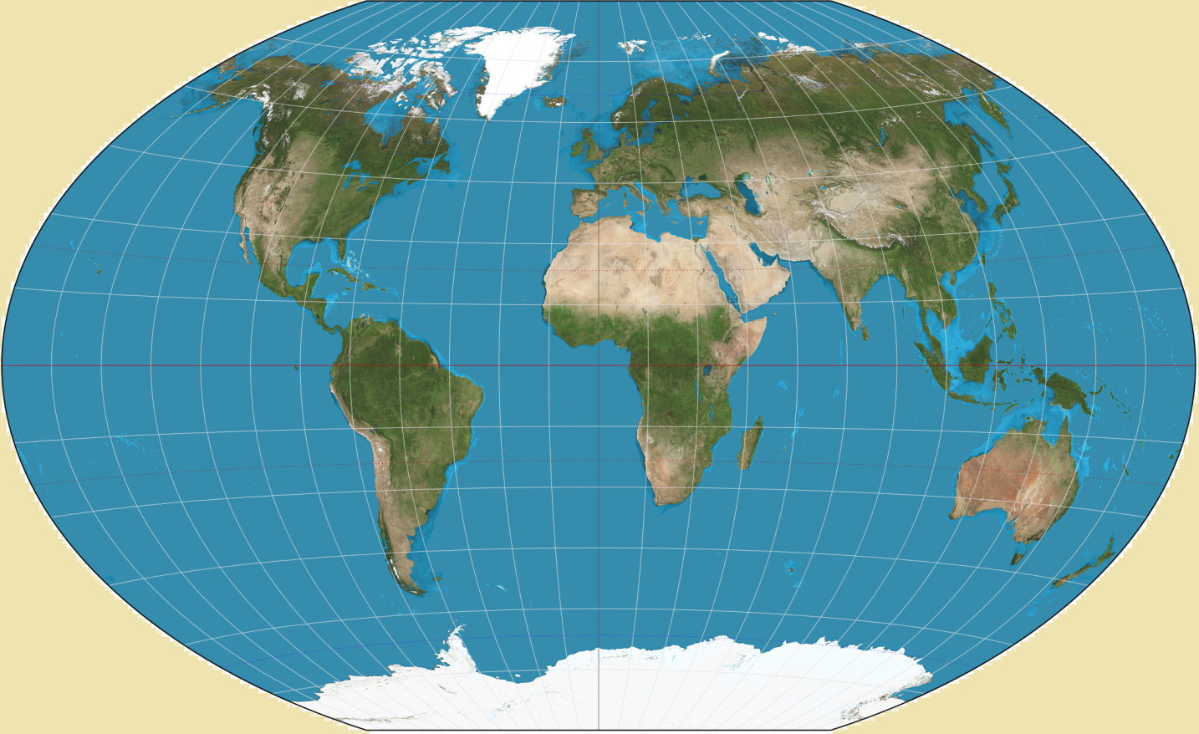
How many countries are there in the world?
195

Slide 34
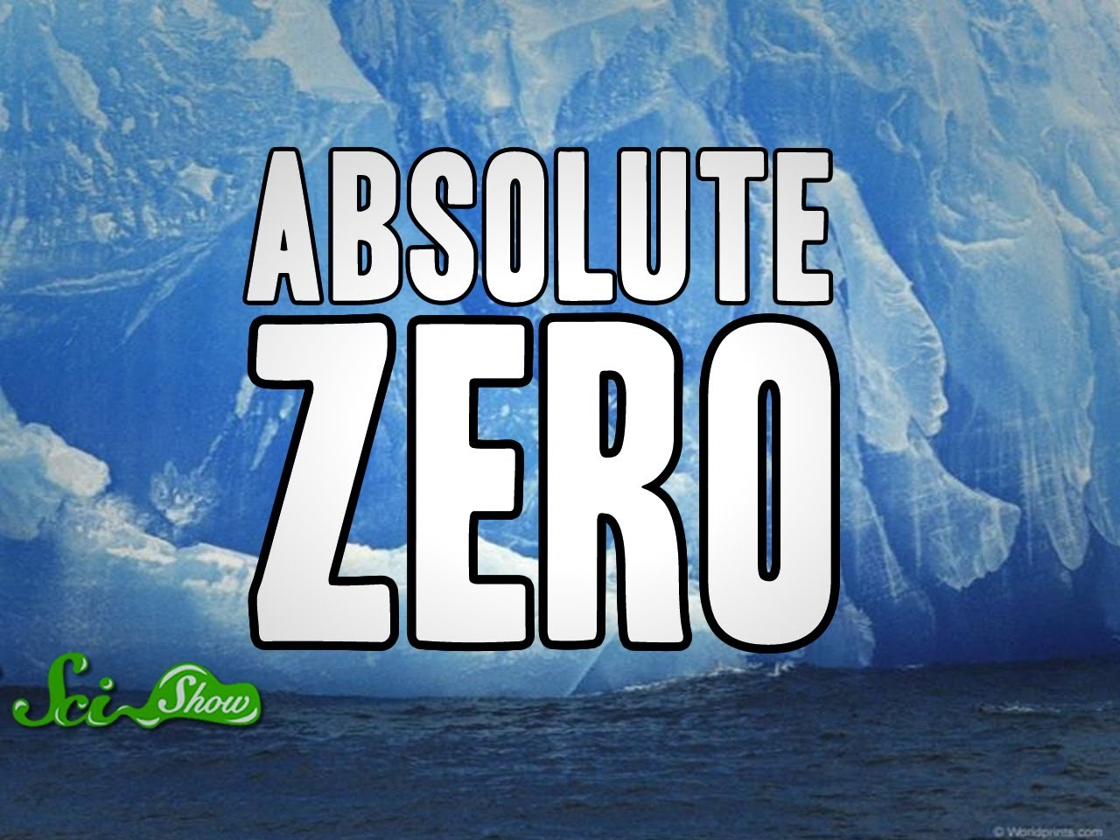
What is 0 Kelvin in Celsius?
-273.15C

Slide 35
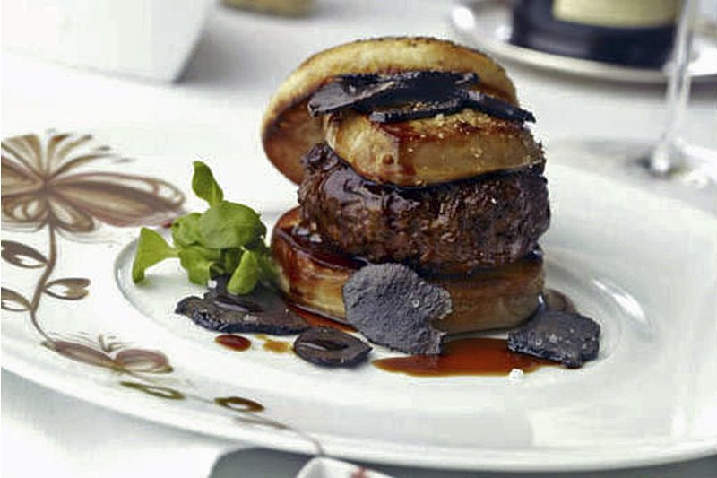
How much is the most expensive hamburger?
$5,000

Slide 36
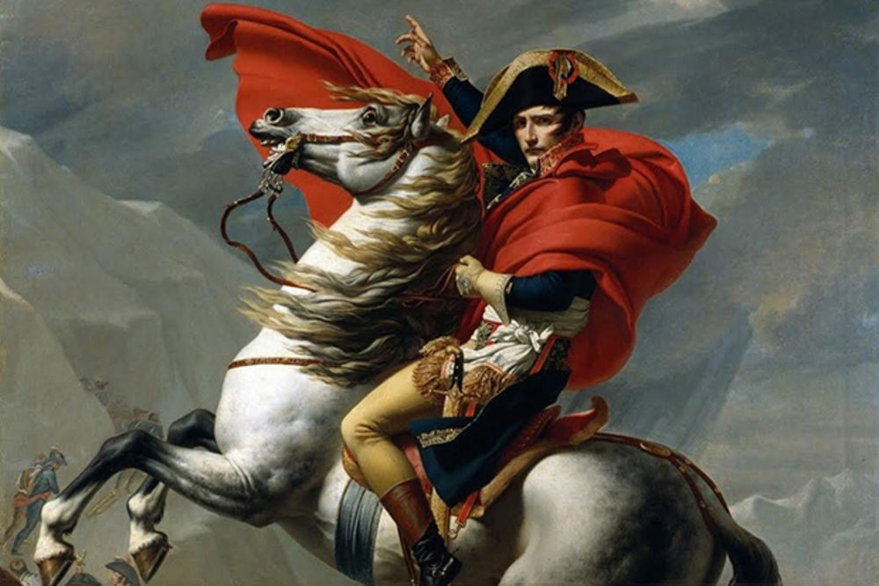
When did Napoleon die?
1821

Slide 37
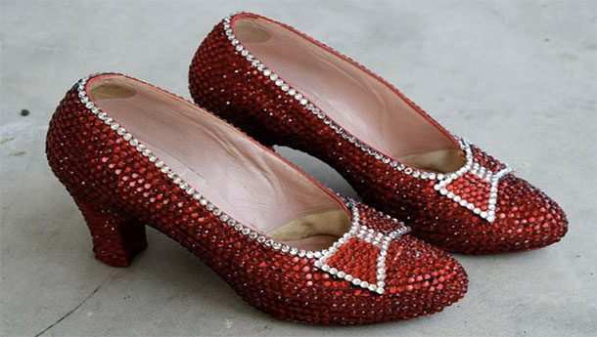
How much is it (dollars)?
3 million dollars

Slide 38
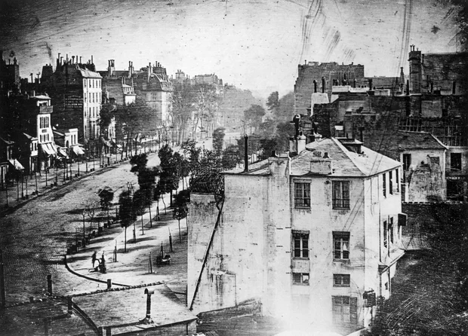
What year was this picture taken?
1838

Slide 39
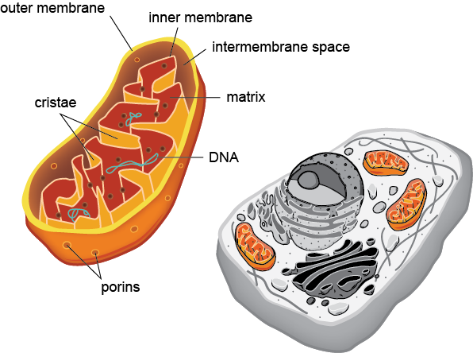
How long is a mitochondria (in meters)?
~0.000002m

Slide 40
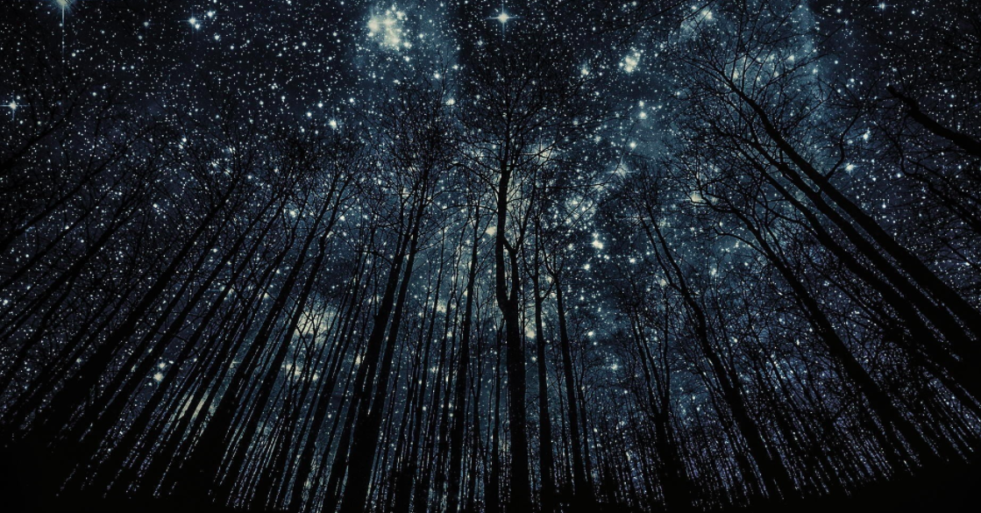
How many stars can you see at night?
9,096

Slide 41
How many people are in the world?
http://www.worldometers.info/

