Slide 1
Scanning
Fleche

Slide 2
Main Information:
Who wrote it (author)?
What is it (title)?
What is it about (topic)?
Who is it for (intended audience)?

Slide 3
Author?

Slide 4
Title?

Slide 5
Topic?

Slide 6
Intended Audience?
Students who want to study in Malaysia.

Slide 7
Thesis
Thesis = Topic + Opinion + Reasons

Slide 8
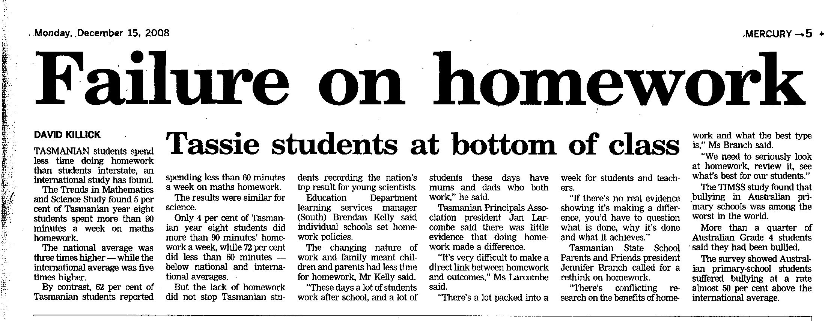
Thesis
Homework doesn’t matter.

Slide 9
Scanning
Don’t look at the common words.
Find the words to help you understand the overall meaning.
Look for the most important words.
Main words and Key words

Slide 10
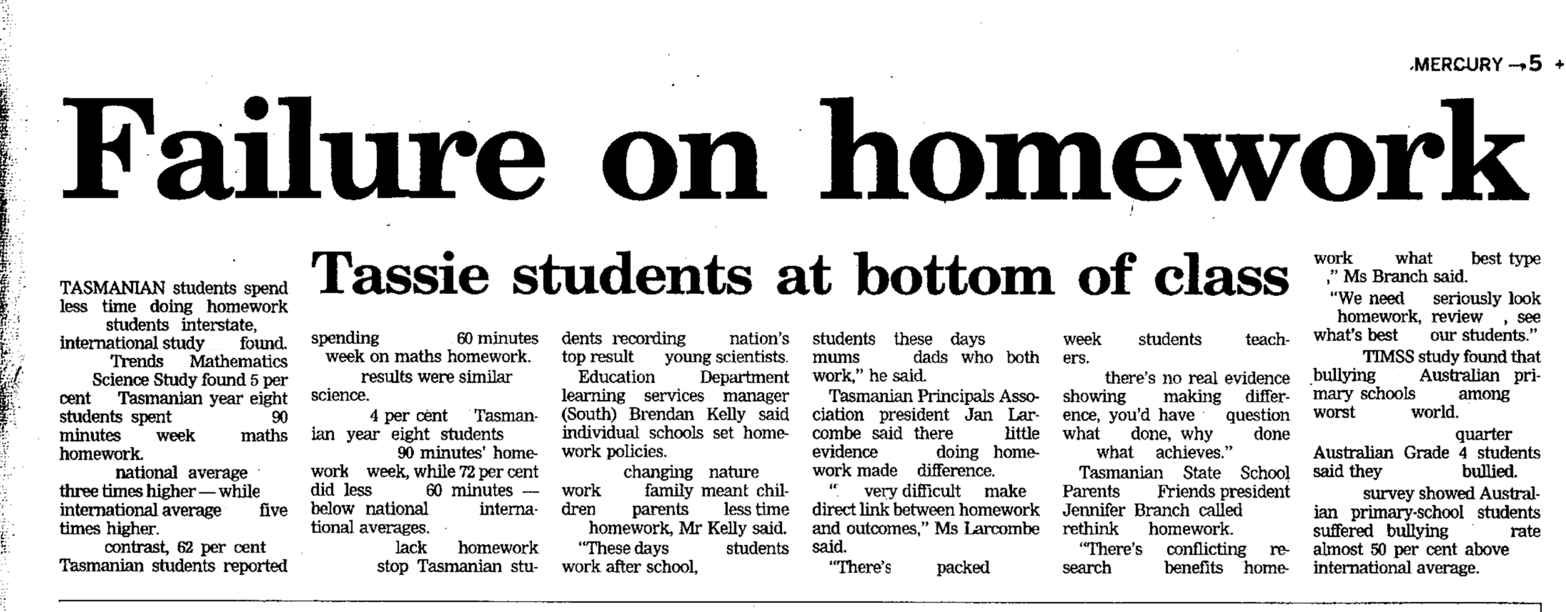
Scanning (short words, conjunctions)

Slide 11
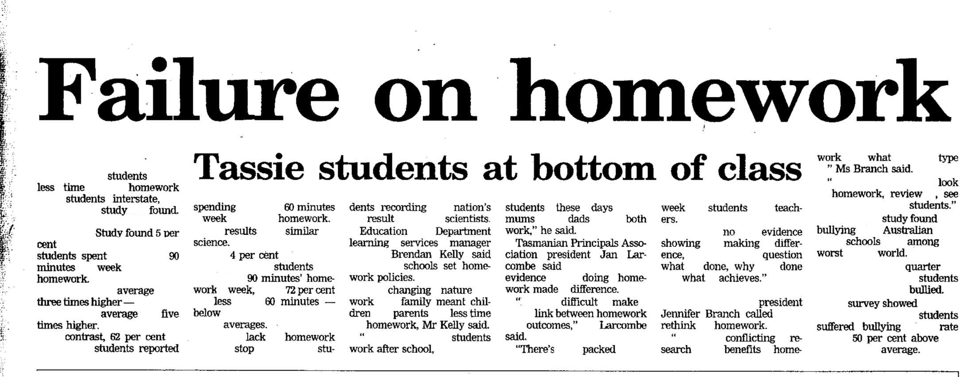
Scanning (Adverbs / Adjectives*)

Slide 12
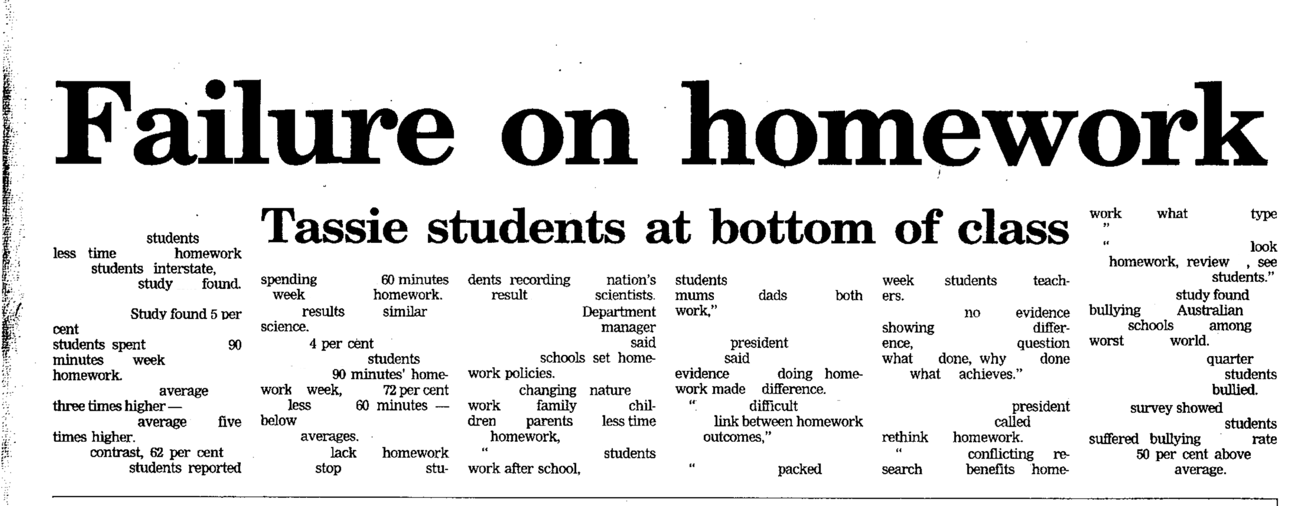
Scanning (specifics – names, dates)

Slide 13
Main Ideas
Each paragraph should have a main idea.
All of the main ideas should relate to the thesis.

Slide 14
Main Ideas
Students do less homework
Bullying almost worst in the world.
Top result for young scientists.
Lower than average.
Doing homework doesn’t make a big difference.
Rethink homework.
Few students do >90min. Of homework
Children and parents have less time

Slide 15
Keywords
They can help you find the main idea.
They are about the main idea.
Sometimes repeated

Slide 16
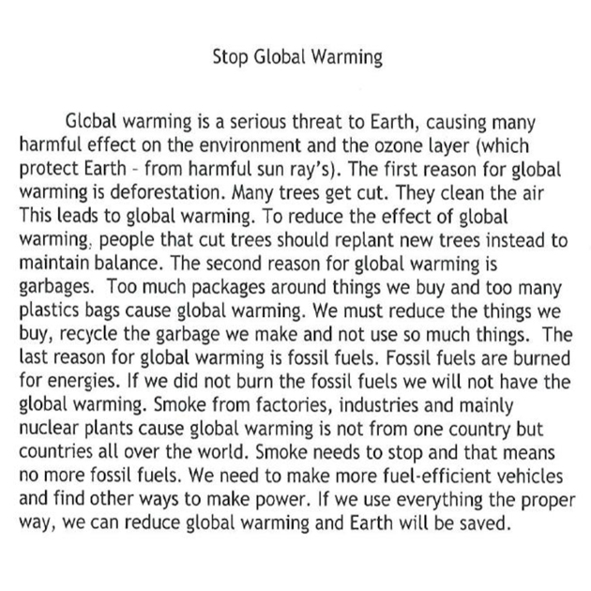
Key Words

Slide 17
Analyze
Are there any words or concepts that you don’t understand?
Use a dictionary / encyclopedia to find more information.

Slide 18
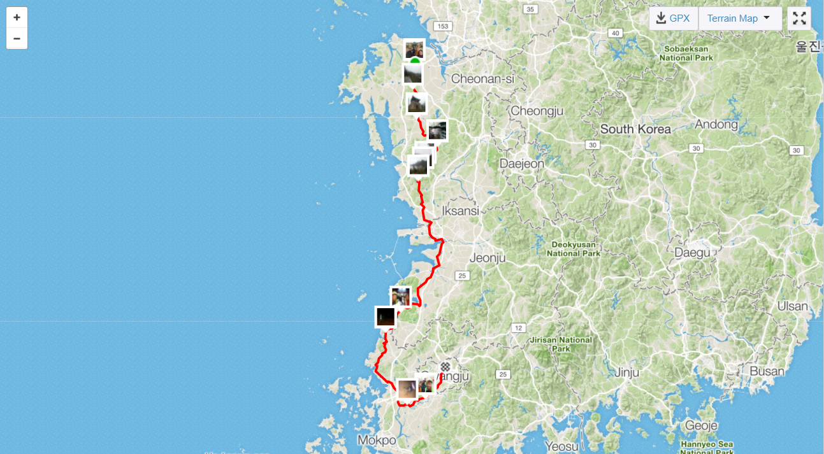
Fleche Report
Find the information and scan…

Slide 19
Main Information:
Mr.S
Author:
Title:
Topic:
Audience:
Team “Mixed Nuts” – Fleche 2018
Cycling (Fleche)
Friends and family
Skip to Questions

Slide 20
Fleche is a French word that means arrow. Every year in Korea, there is a cycling event called Fleche. Teams start from all over the country and meet in Gwangju 24 hours later. Each team needs to cycle more than 360km. This is the story of our team, Mixed Nuts. This year started in the rain. We had some mechanical issues before we got to the first check point. There were some interesting roads on this ride. There were many problems but our whole team completed the ride.

Slide 21
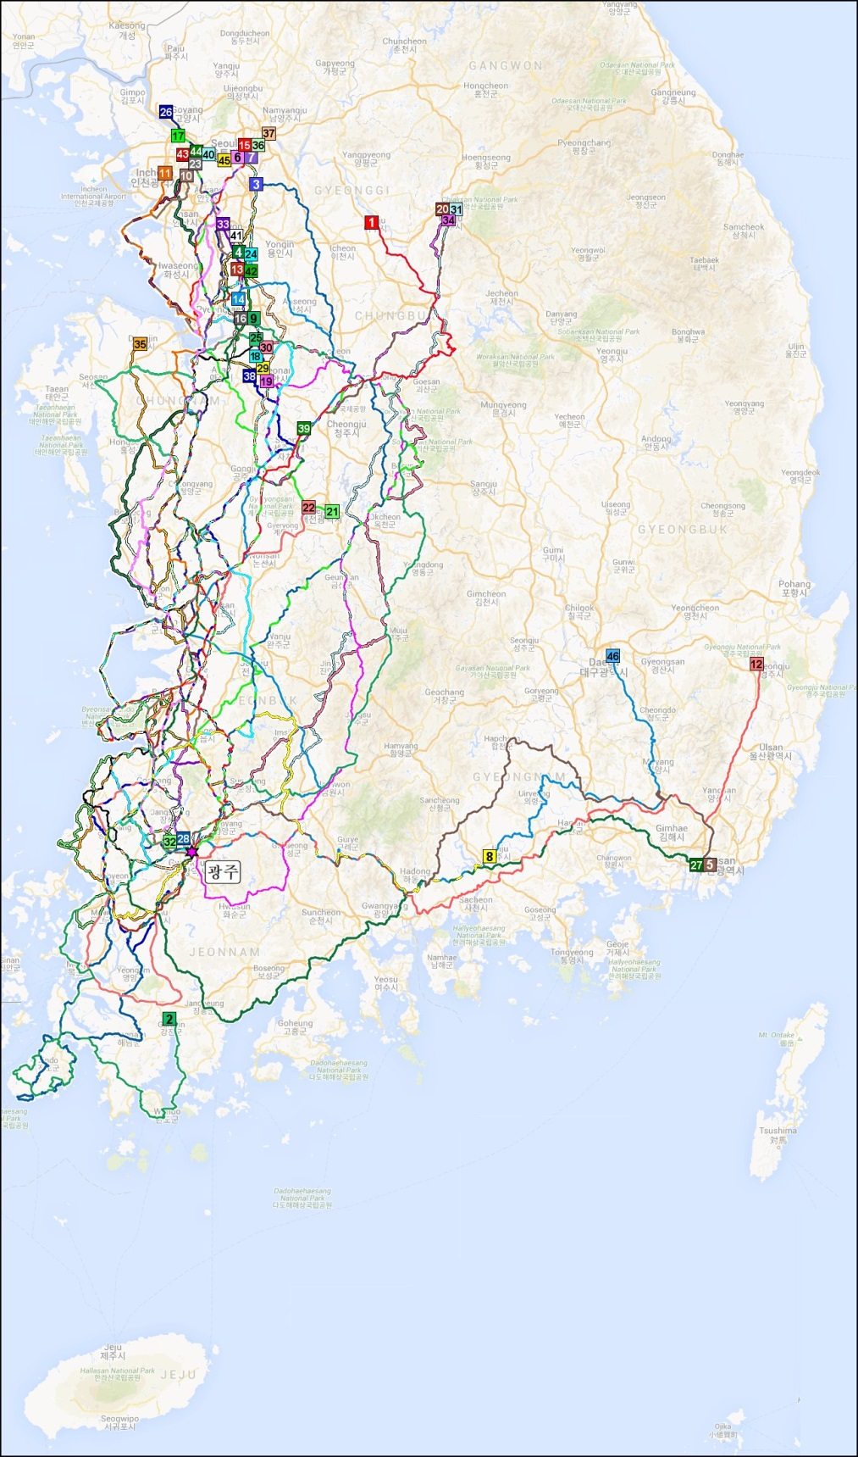

Slide 22
This year’s Fleche had some bad weather. We left Dangjin, our starting location, in the rain. There was more rain farther South. About 5kms into the ride we had our first issue. A headlight fell off Darnell’s bike and broke. Luckily he had a spare light. A little farther down the road we made a left turn. The GPS file I made said that it was a road but it looked like a park. Amazingly, it turned into a cute little road. The road was pretty but rough and my bike got a flat tire. My teammates helped me to replace the tube. We had to be careful because there was a lot of dirt on the tire.

Slide 23
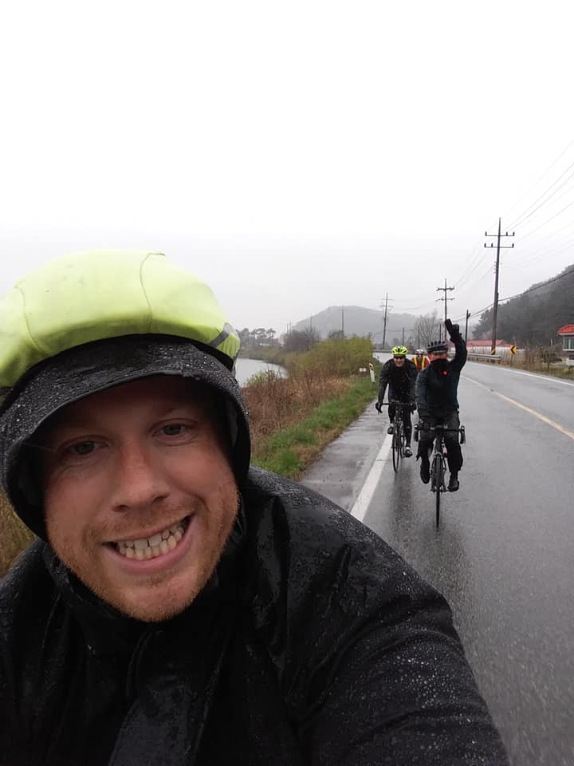
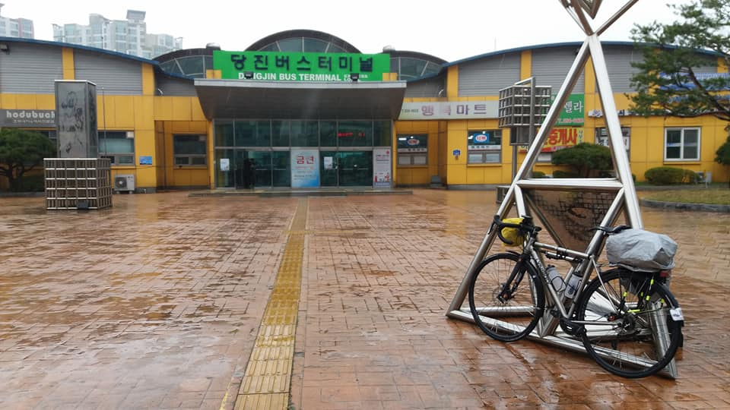

Slide 24
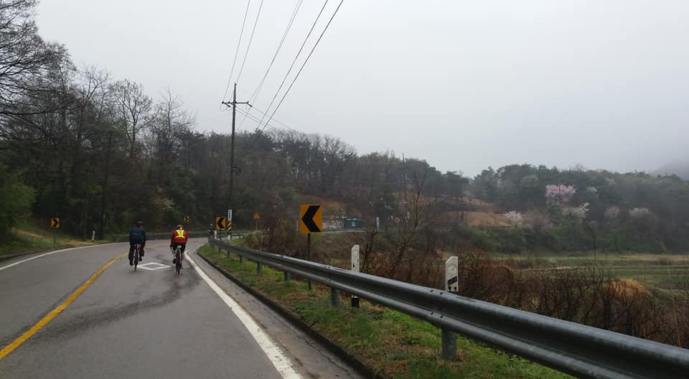

Slide 25
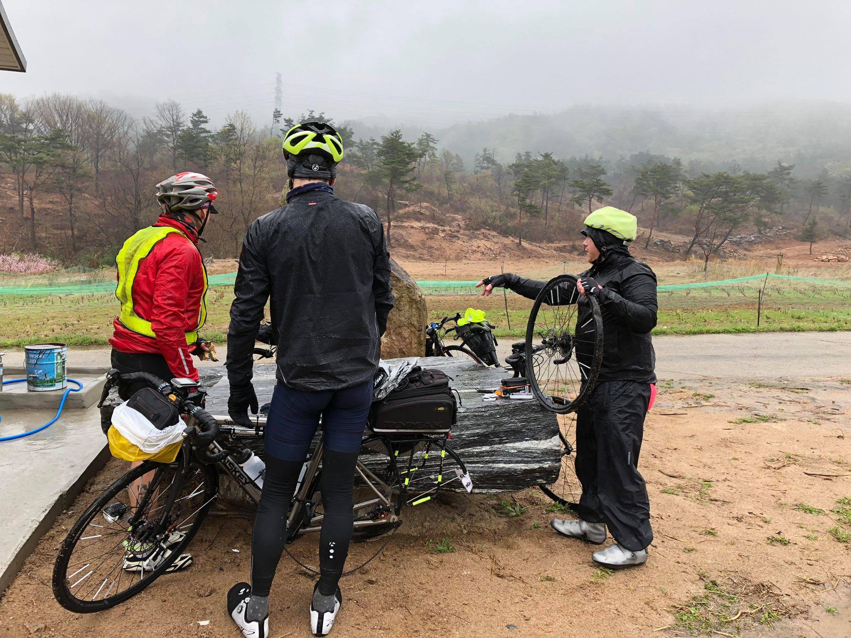

Slide 26
We started cycling again and I noticed there was a problem. The tire felt bumpy. I talked about it with my team and we thought that maybe the new tube was twisted. It would take a long time to fix, so we just kept going. My tire would feel bumpy for the next 300km. While we were changing the tire Jake started getting very cold. He was shivering and the other guys were also cold. The temperature was around 8C. I had packed a lot to stay comfortable, but my teammates didn’t bring as much. So, at the first control point, Jake bought some leggings and construction gloves to wear. He said he felt a lot warmer. While we were at the control point, the rain stopped. The roads were still wet, but we started to dry off.

Slide 27
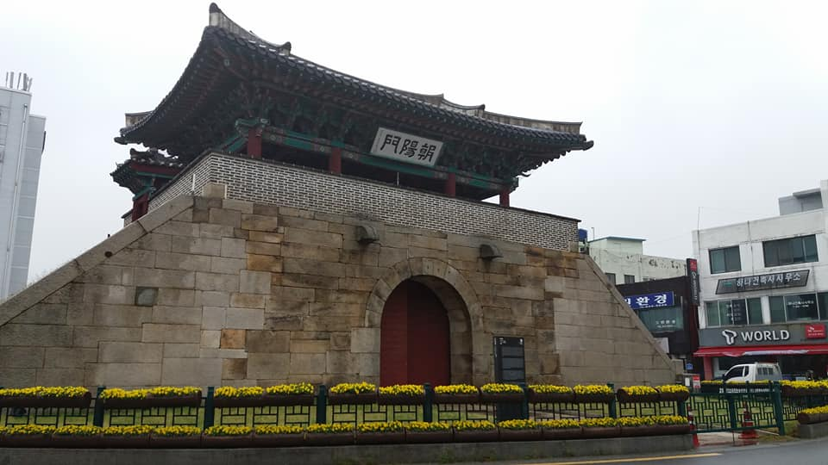

Slide 28
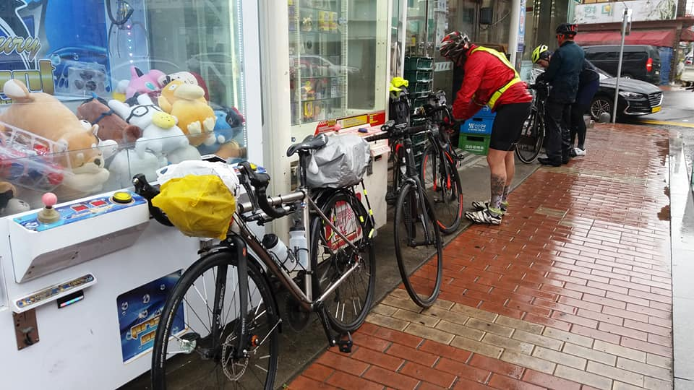

Slide 29
The route was beautiful. The morning mist from the rain also provided a wonderful landscape. The road beside Boryeong Lake was amazing. The view was a little boring near Gunsan, but farther south, there were some nice areas. I hope to go there during daylight some time.

Slide 30
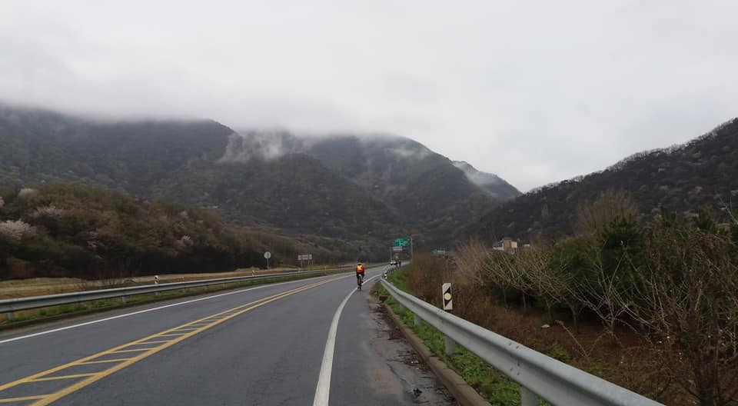
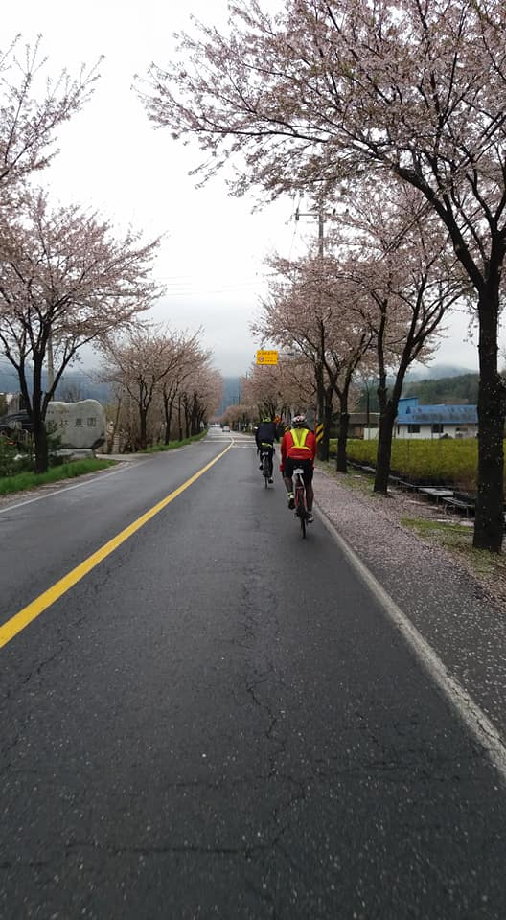

Slide 31
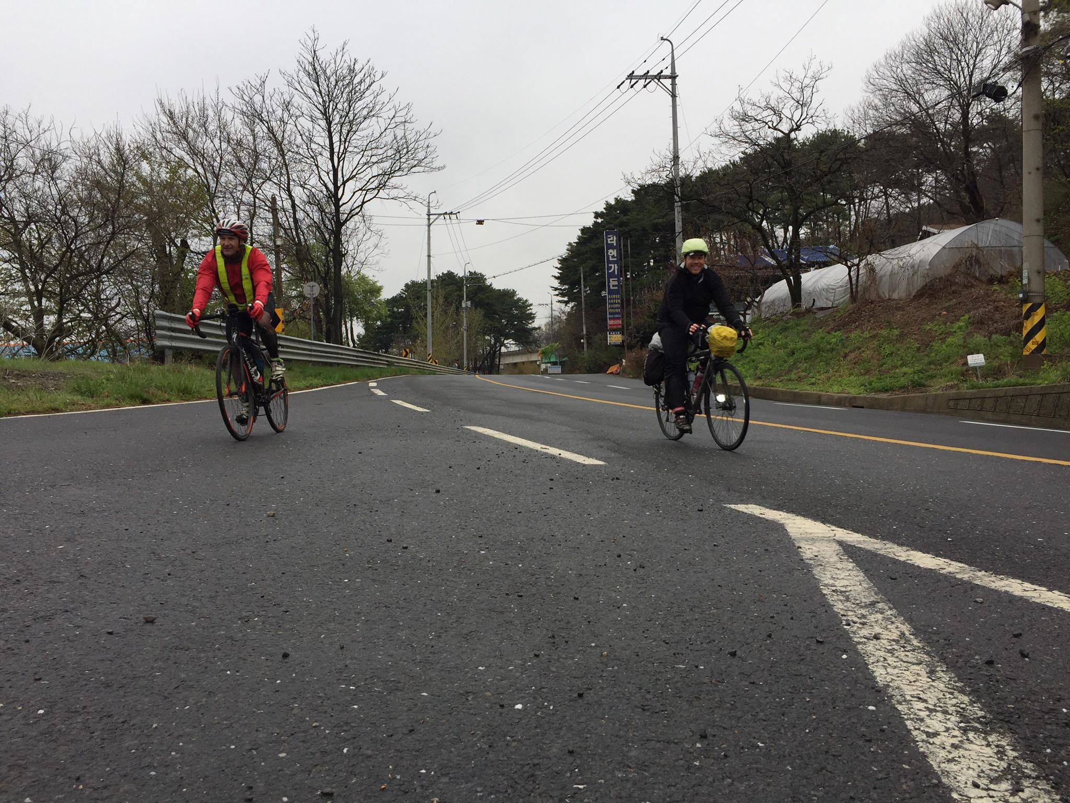

Slide 32
After the rain stopped, the wind started. Luckily, it was a tailwind. It was a fairly strong tailwind too. Usually at this time of year, the wind is coming from the opposite direction. It made things a lot easier for us but was very difficult for teams coming from the south. Our course was also pretty flat, which made things easier. The only thing holding our team back was my slow pace. The other guys on my team were much stronger than I was. But what I lost in physical ability, I made up for by having the only correct route on my Garmin. This combination did provide some laughs during the night. Sometimes the guys would ride ahead, which is fine, but they missed the turns. I think they did 10km of extra cycling because of this.

Slide 33
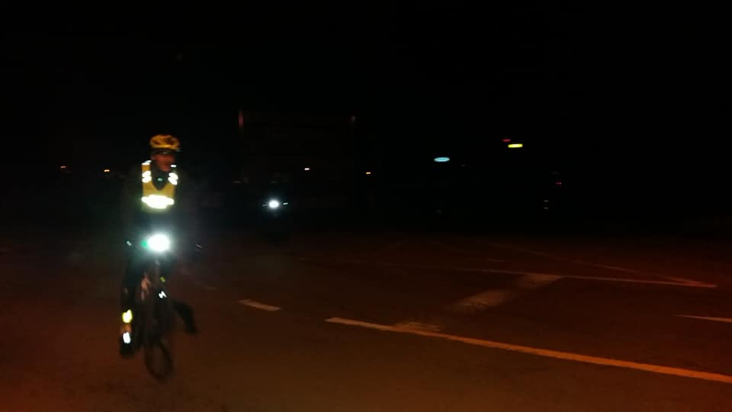
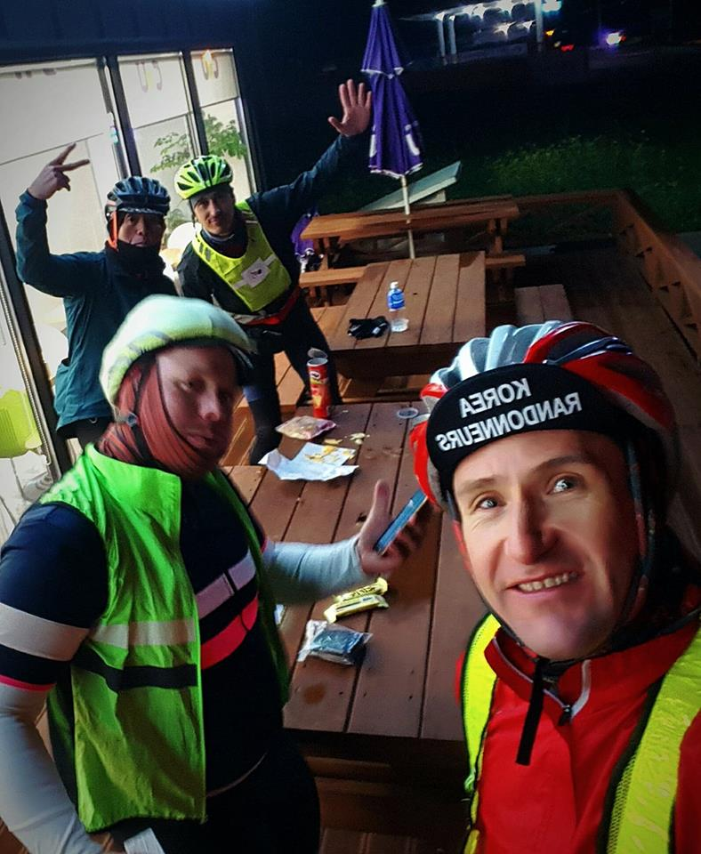

Slide 34
The last 30km before the 22hr control were interesting. First, Jake and I had to wait for James and Darnell to come back to the route. Then, the road was very rough and dangerous. I knew that it would be a bad road until we got to the bike path. Unfortunately, I didn’t know that the bike path was under construction. The earlier rains had made the mud soft and slippery. We tried, but it was too difficult to cycle there. We needed to find another way. Jake did a great job finding a new route to Naju. But before we got there, the tire that we fixed earlier broke again. I am surprised that it lasted 300km. The tires were very muddy, so we needed to clean them before fixing. Luckily James and Darnel found a free water pipe. We cleaned it and replaced the tube. That 30km section took 2.5 hours! It should have taken less than half of that time.

Slide 35
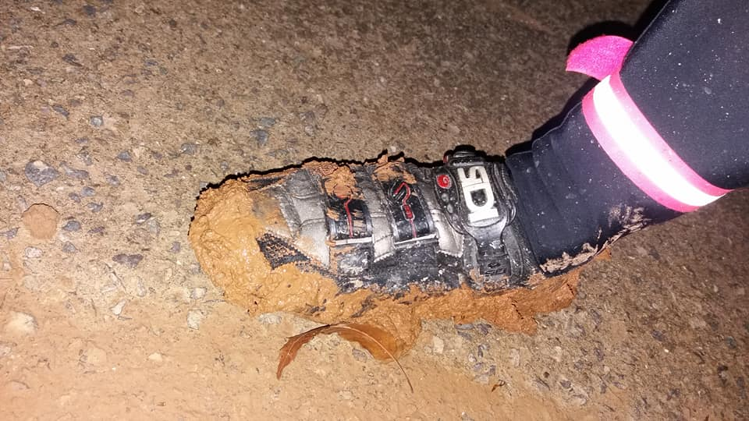

Slide 36
We took a well-deserved break at the 22hr control. According to the rules, we couldn't leave until 7am. This way all the teams will arrive in Gwangju at the same time. We rode in to Gwangju on some REAL bike paths, but we weren't finished yet. About 7km from the end, we were forced to do some last minute mechanical work to that tire. We made it to Gwangju and met with the other riders. Korea Randonneurs also provide brunch at a buffet. We ate heartily and headed home our separate ways. It was a great ride and a few good stories.

Slide 37
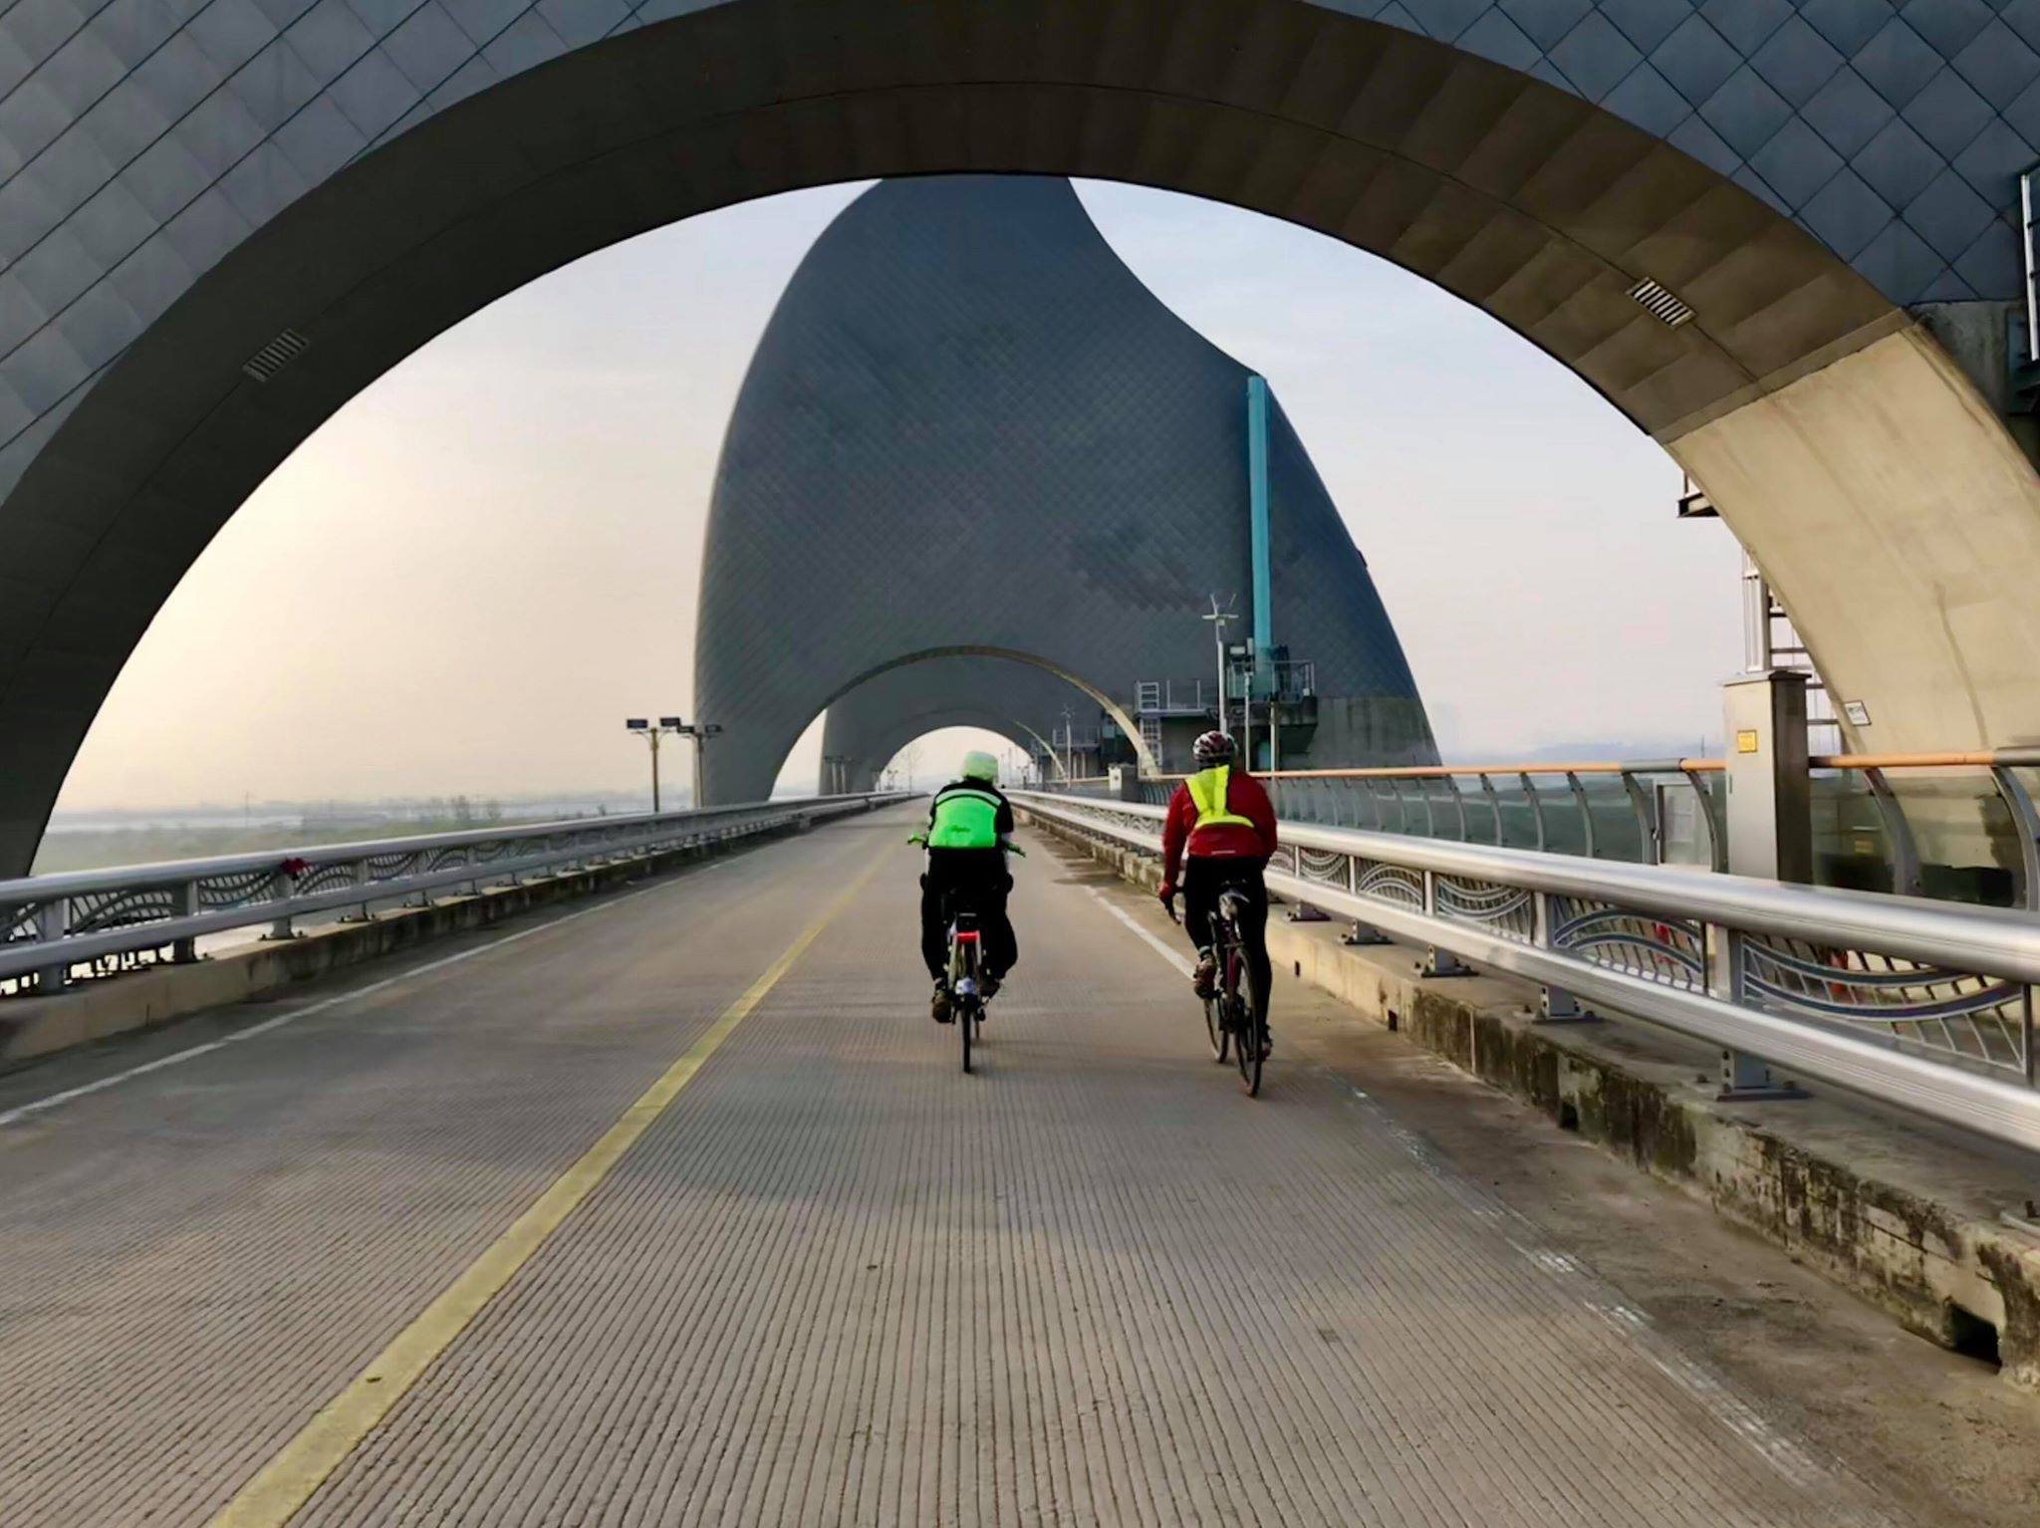

Slide 38
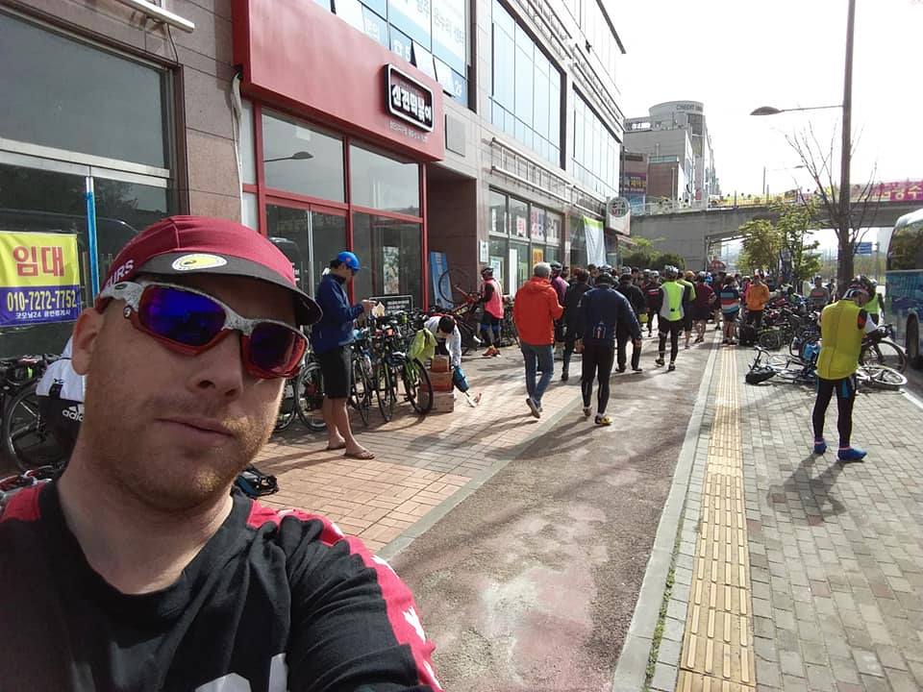
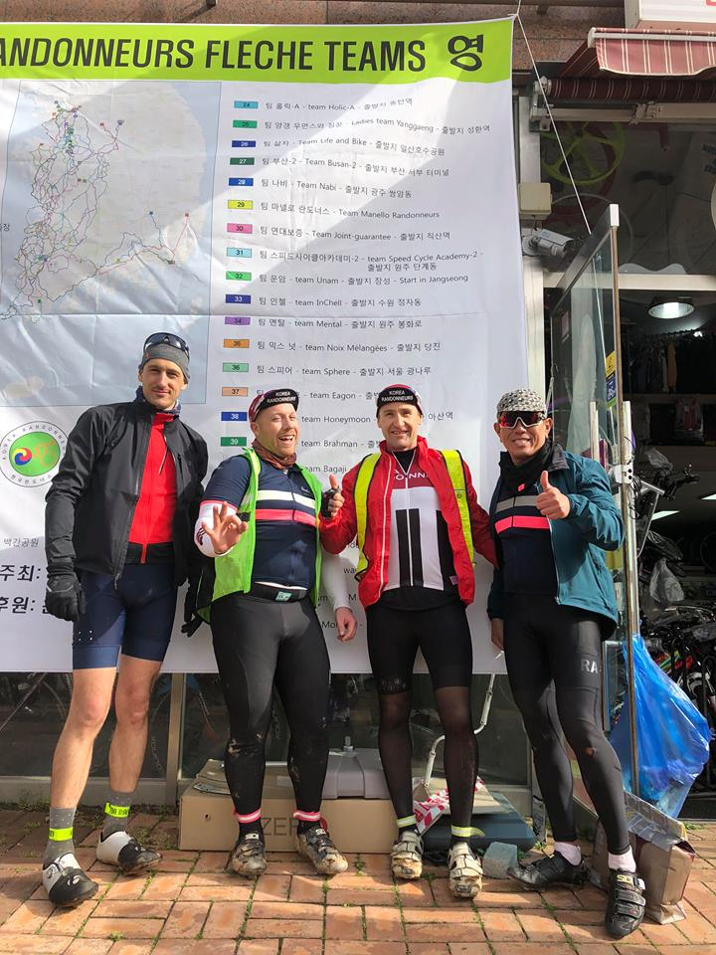

Slide 39
Thesis?
The ride was difficult.

Slide 40
What is “Fleche”?
A French word meaning “arrow” (cycling event)

Slide 41
Where did they go?
Gwangju

Slide 42
How was the weather?
Rainy, windy, cold

Slide 43
Why did James and Darnell miss the turns?
They didn’t use GPS.

Slide 44
What is a 22 hour control (why do they have it)?
Can’t leave until 7am.
All teams arrive at the same time.

Slide 45
List the “mechanical issues” they experienced:
Headlight broke
Flat tire
(Bumpy tire)
Flat tire
More work to the tire.

Slide 46
Korea Randonneurs
https://www.youtube.com/watch?v=rWI_NV7_Wts&feature=youtu.be

Slide 47
Paris – Brest - Paris
PBP

Slide 48
Paris – Brest - Paris
https://www.youtube.com/watch?v=n-o5rd-D_bE

Slide 49
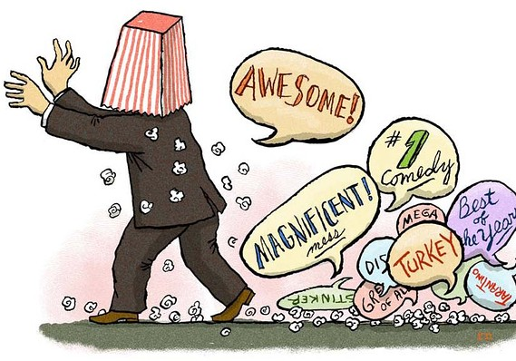
Critical Analysis
Making a critique

Slide 50
Summary
Take the passage and reduce it to about 1 paragraph if possible.
Make sure you include all of the main ideas.

Slide 51
Write an Outline
Start with the thesis and list the main ideas of each paragraph.
You can add examples

Slide 52
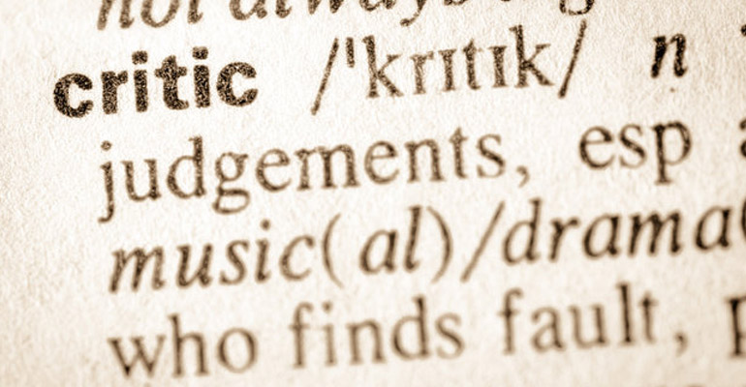

Slide 53
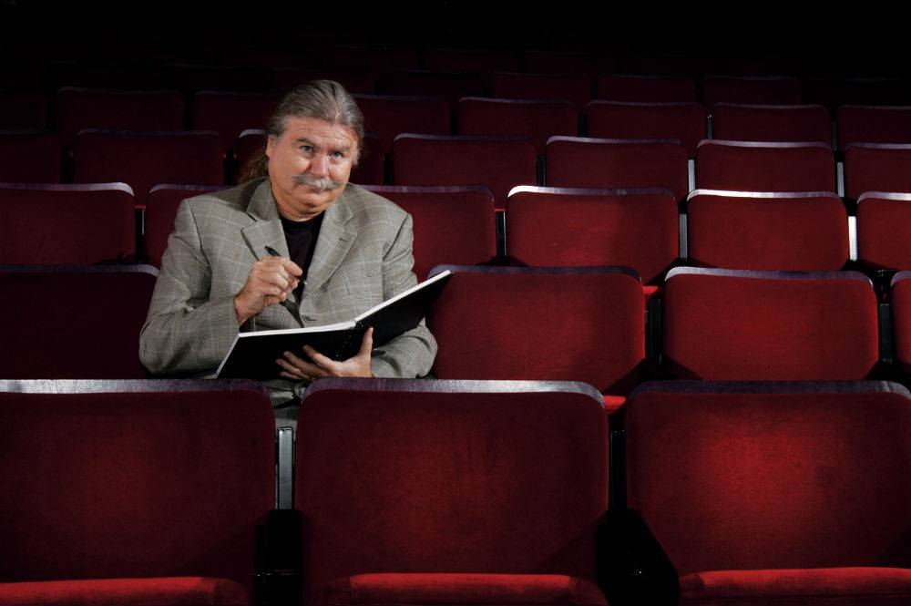
Movie Critic

Slide 54
Purpose
Why did the author write the article?
Entertainment?
Information?
Persuasion?
Tell a story?

Slide 55
Evaluate
Did the author accomplish their purpose?
Did the article make sense?
Was it easy to find the thesis? Were the main ideas about the thesis?

