Slide 1
The Process of elimination

Slide 2
Process
A series of steps or actions to achieve a goal.
A way of doing something

Slide 3
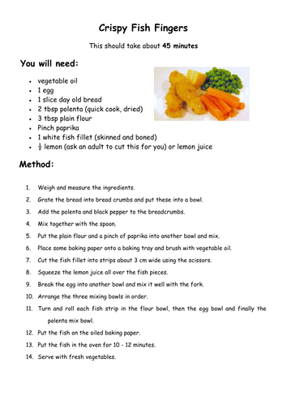
Process
Example:
A recipe

Slide 4
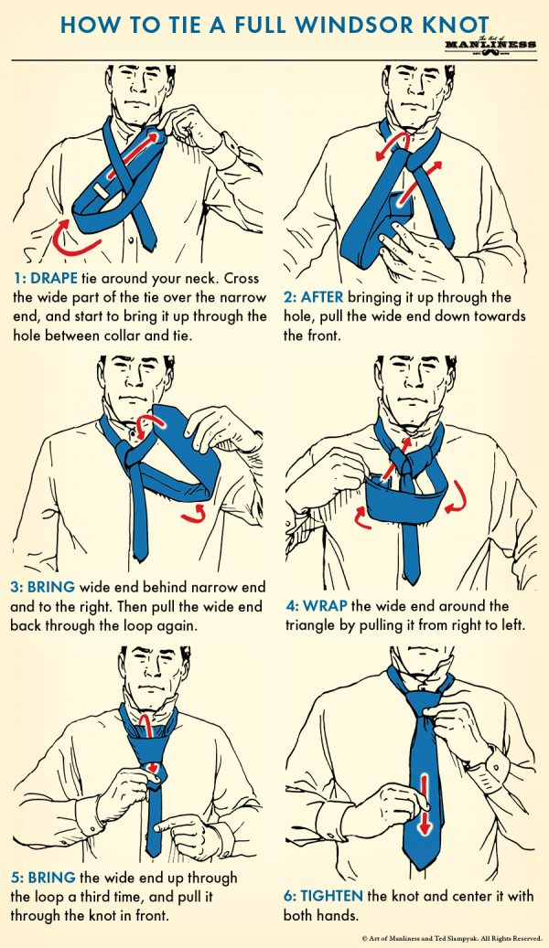
Process
Example:
How to Guide

Slide 5
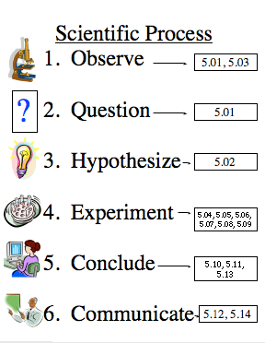
Process
Example:
The Scientific Process

Slide 6
Elimination
Removal or destruction of something

Slide 7
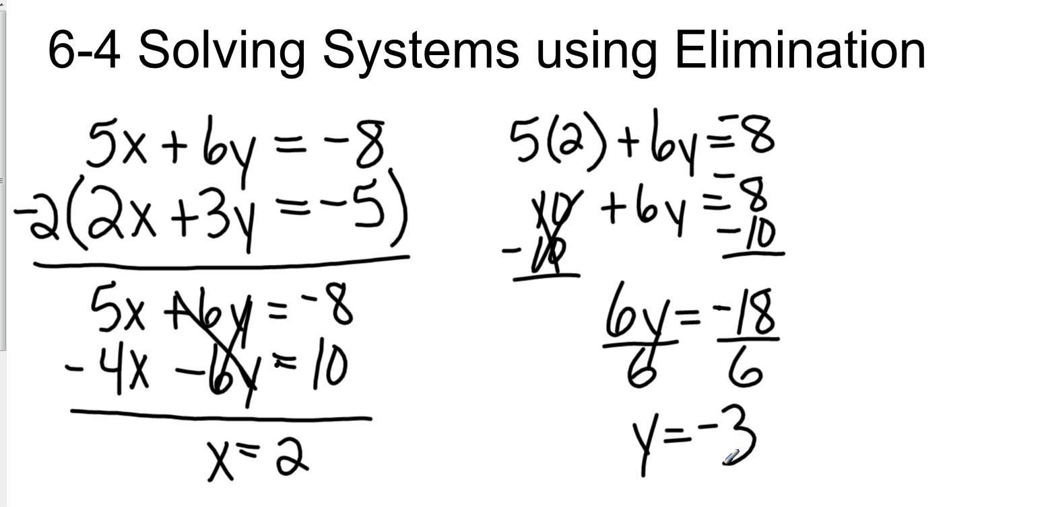
Elimination
Example:
Math

Slide 8
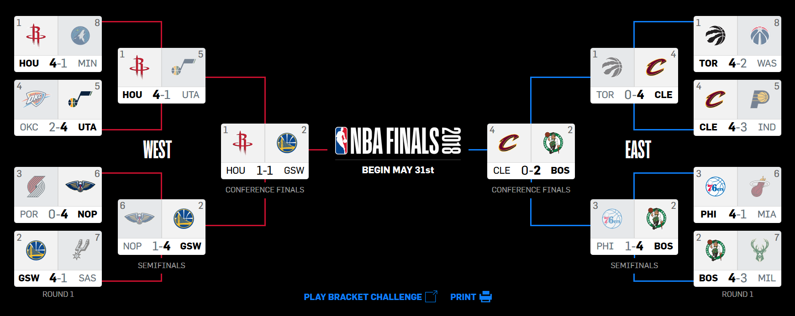
Elimination
Example:
A basketball tournament

Slide 9
The process of elimination
A way of removing bad ideas until only one good one is left.

Slide 10
The process of elimination
Create a goal
Start by brainstorming ideas
Test the ideas
Failure = eliminate
Success = don’t eliminate
Continue until only one idea is left.

Slide 11
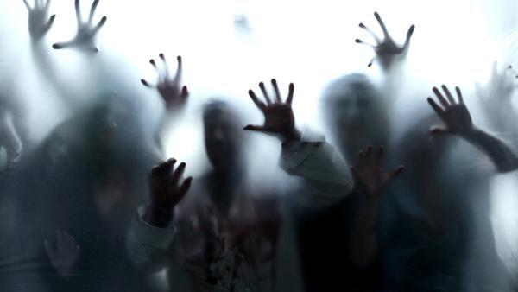
Create a Goal
We are in a building (this school) surrounded by zombies.
Our Goal: To defeat the zombies.

Slide 12
Brainstorm

Slide 13
Test #1 – Can we survive?
Eliminate the bad ideas

Slide 14
Test #2 – Will we survive for a long time?

Slide 15
Test #3 – Will the zombies go away?

Slide 16
Test #4 – Can we kill all the zombies?

Slide 17
Test #5 – can we help others

Slide 18
Test #6 – Can we save everyone?

Slide 19
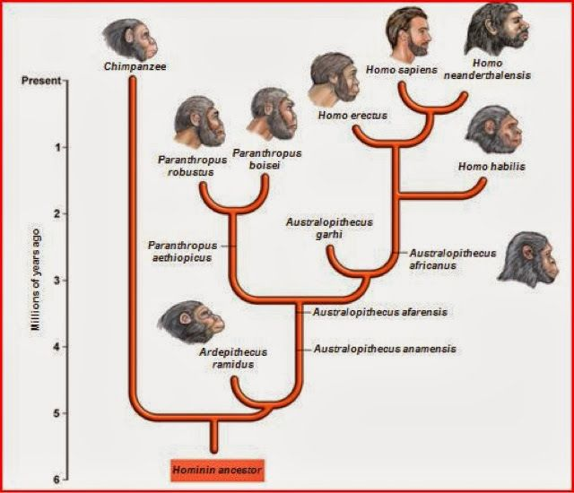
The process of elimination
In nature:
Evolution
Natural Selection

Slide 20
The Challenge
Elimination

Slide 21
The challenge
I will give a topic.
Take turns
Name an English word that goes with that topic.
Must fit the topic
Must be a new word (no other students said it)
5 second limit
Continue until someone can’t think of a word (or incorrect)
That student is eliminated

Slide 22
Category
1
2
3
4
5
6
7
8
9
10
1
6
2
7
3
8
4
9
End Game?
5
10
1
2
3
4
5
6
7
8
9
10

Slide 23
Class Subjects
Eliminate

Slide 24
Birds
Eliminate

Slide 25
Countries
Eliminate

Slide 26
Accessories
Eliminate

Slide 27
Types of clothing
Eliminate

Slide 28
Vegetables
Eliminate

Slide 29
Artists
Eliminate

Slide 30
Jobs
Eliminate

Slide 31
Colors
Eliminate

Slide 32
Holidays
Eliminate

Slide 33
Sports
Eliminate

Slide 34
Beverages
Eliminate

Slide 35
Extinct animals
Eliminate

Slide 36
Things larger than earth
Eliminate

Slide 37
Class Subjects
Eliminate

Slide 38
Stationary (school Supplies)
Eliminate

Slide 39
Furniture
Eliminate

Slide 40
Fruit
Eliminate

Slide 41
Things with wheels
Eliminate

Slide 42
Teachers at the school
Eliminate

Slide 43
Wooden things
Eliminate

Slide 44
Body parts
Eliminate

Slide 45
Languages
Eliminate

Slide 46
Korean cities
Eliminate

Slide 47
Feelings
Eliminate

Slide 48
Things in this room
Eliminate

Slide 49
Animals larger than humans
Eliminate

Slide 50
Types of transportation
Eliminate

Slide 51
Types of weather
Eliminate

Slide 52
Movie Genre
Eliminate

Slide 53
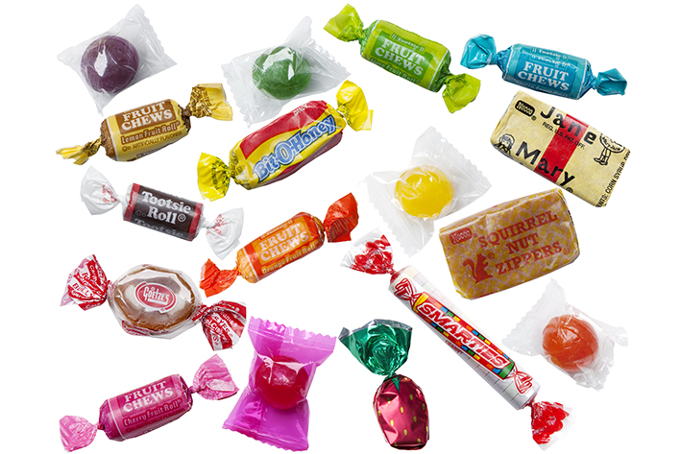
Game End

Slide 54
Group Work
Use the process of elimination
Goal = How to make the school a better place

