Slide 1
Technology
A History

Slide 2
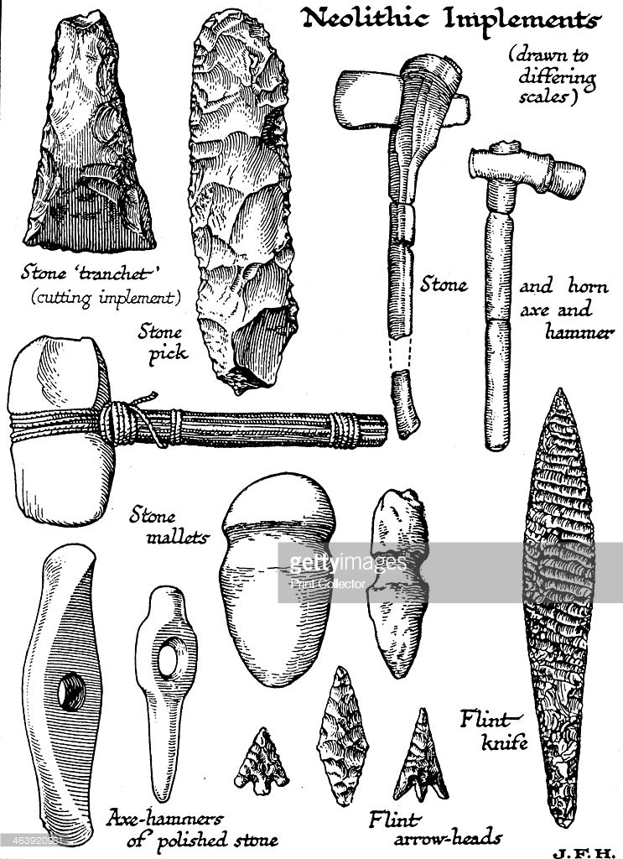
What was the first technology?

Slide 3
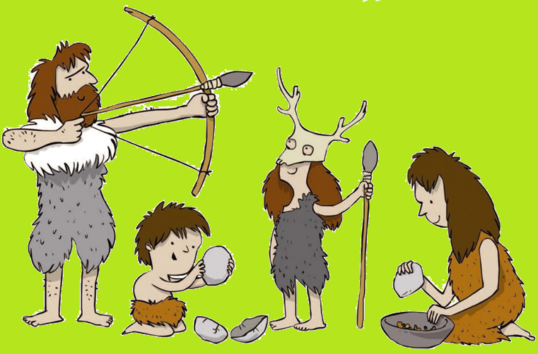
Prehistory

Slide 4
Prehistory
Stone Age, Bronze Age, Iron Age
From first stone tools to the printing press

Slide 5
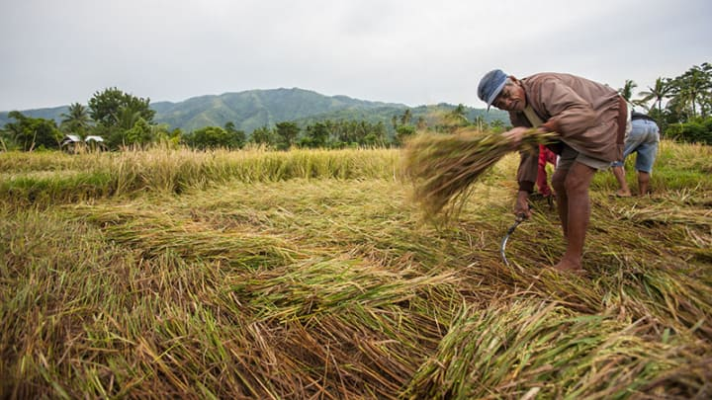
Agricultural Revolution

Slide 6
Agricultural Revolution
About 12,500 years ago
From hunters to farmers
Cities, free time

Slide 7
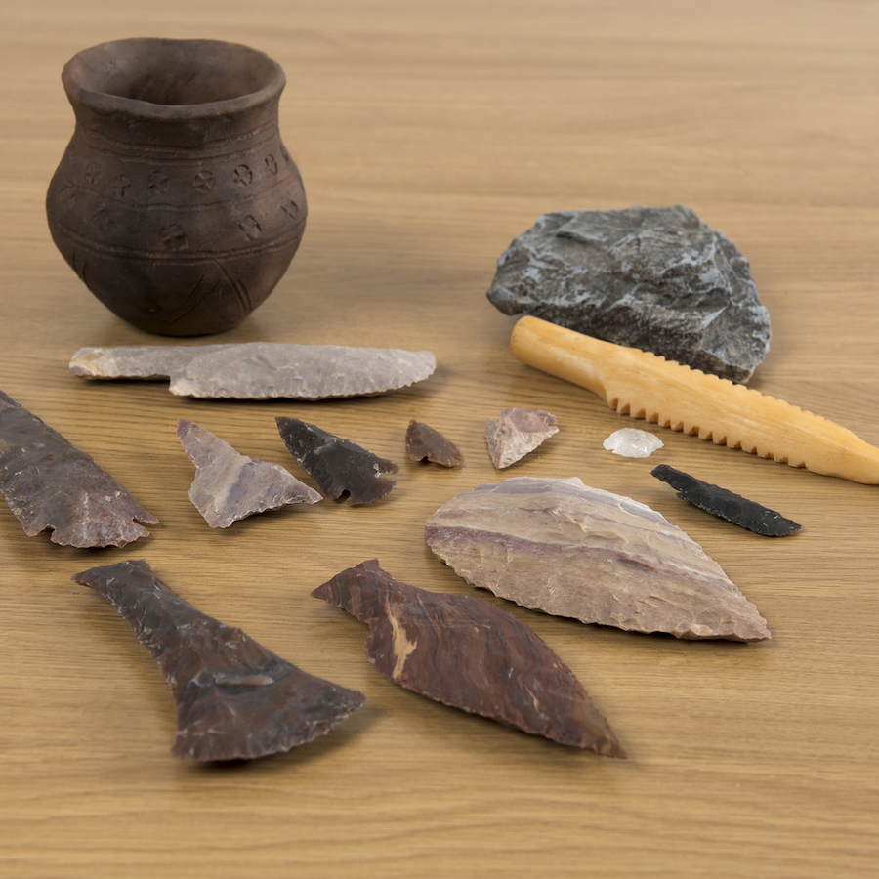
Stone Age

Slide 8
Stone Age
Start: 3,400,000 years ago
End: 8700 BCE and 2000 BCE
Basic tools

Slide 9
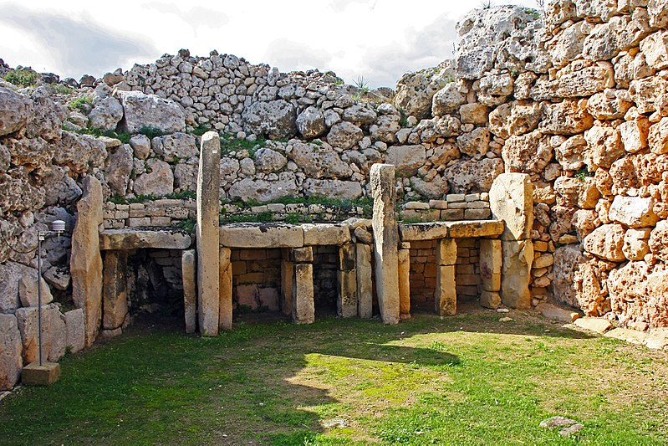
Ggantija Temples, Xaghra, Gozo

Slide 10
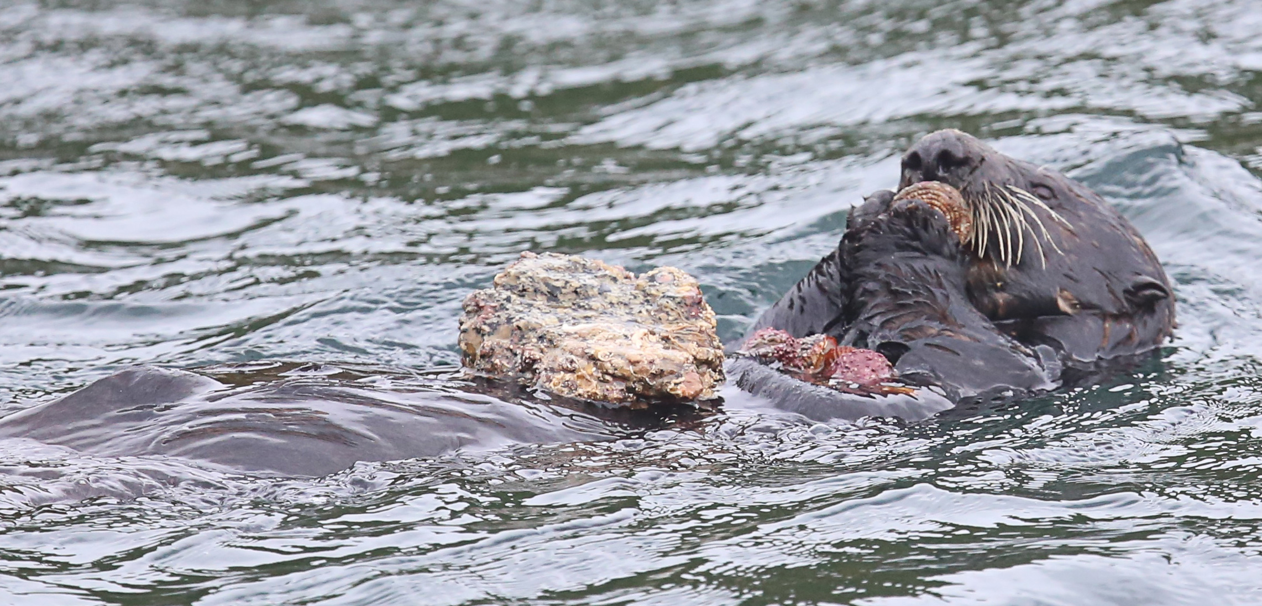

Slide 11
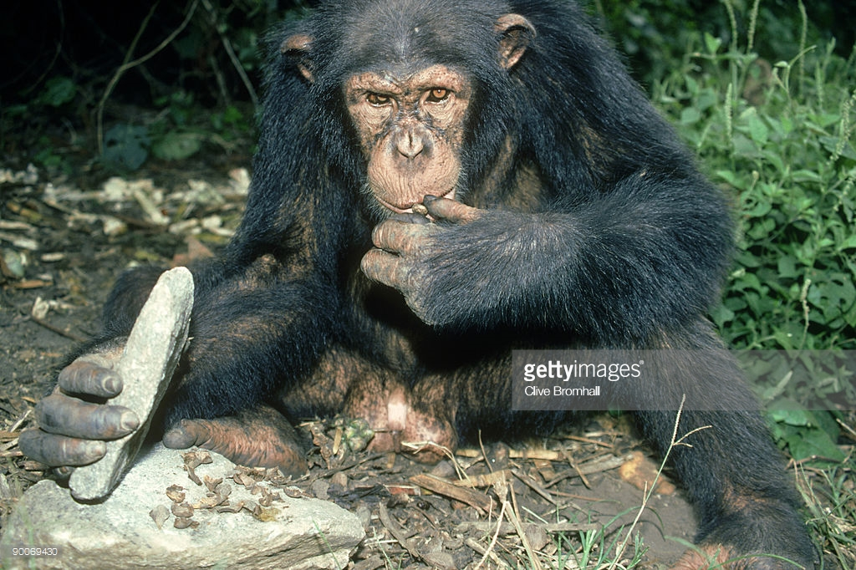

Slide 12
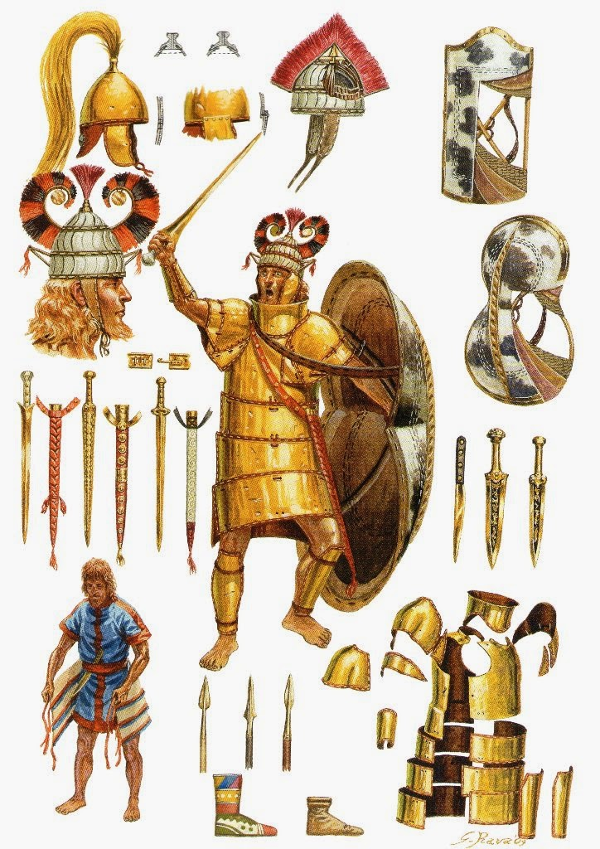
Bronze Age

Slide 13
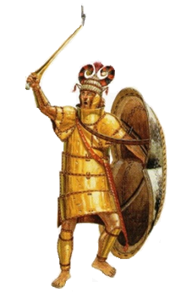
Bronze Age
Near East (c. 3300–1200 BC)
South Asia (c. 3300–1200 BC)
Europe (c. 3200–600 BC)
East Asia (c. 2000–300 BC)
Metal

Slide 14
Bronze Age
Bronze = copper + tin
First writing
Mines, organized labor

Slide 15
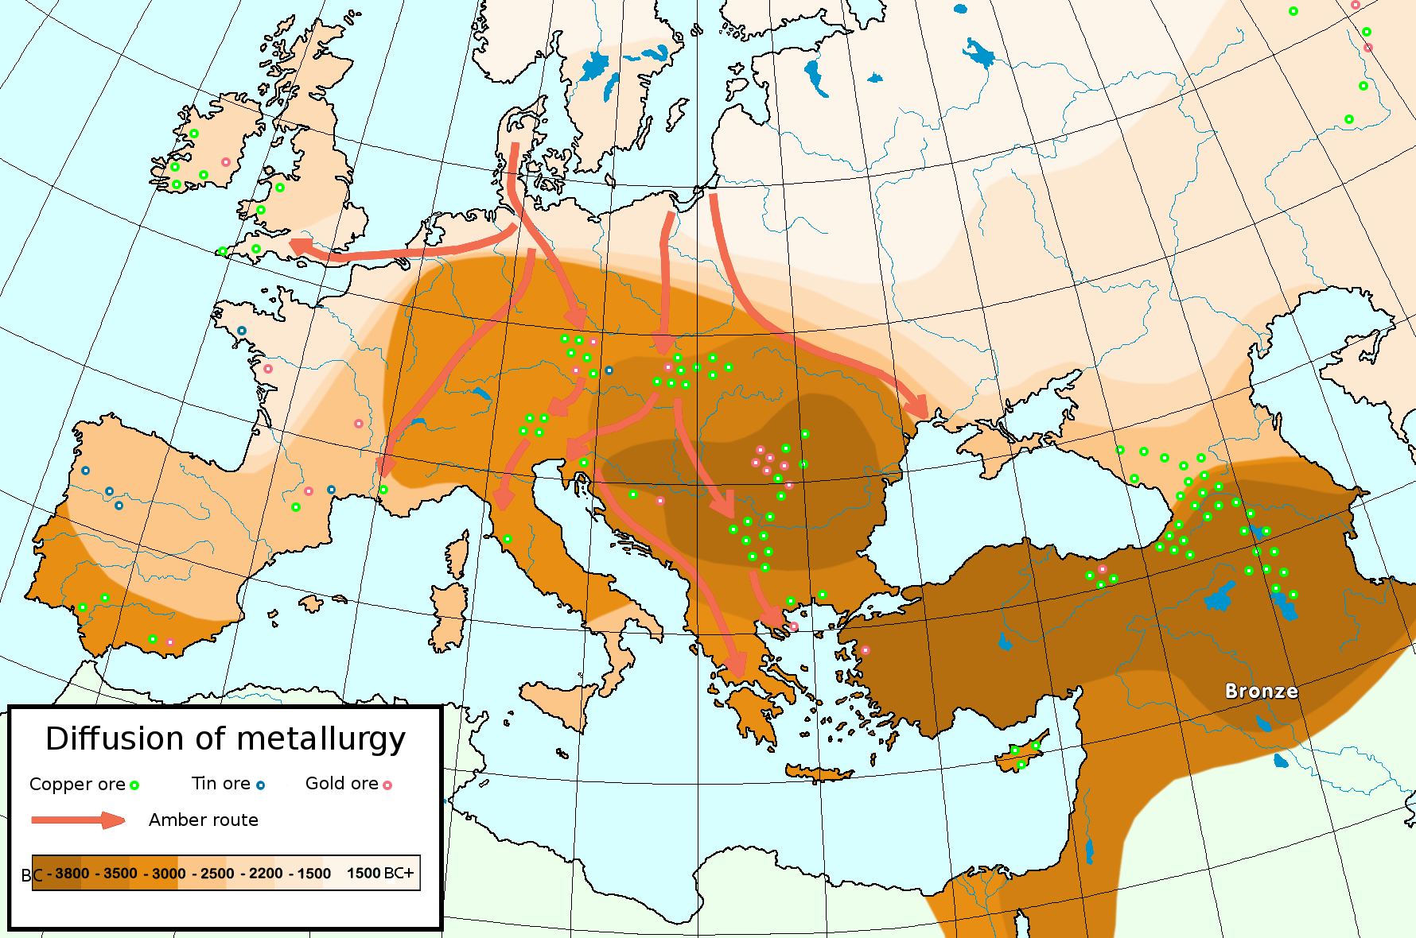

Slide 16
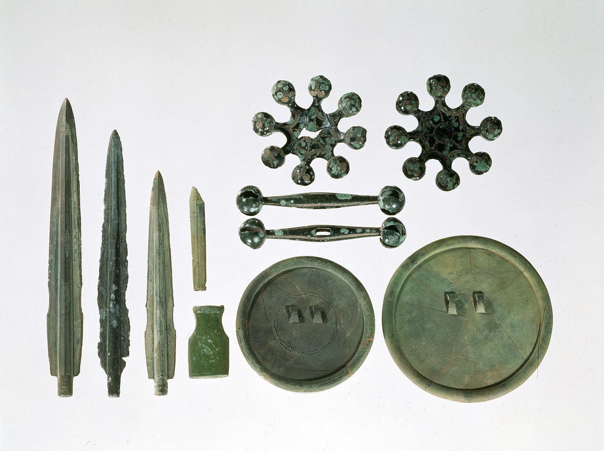

Slide 17
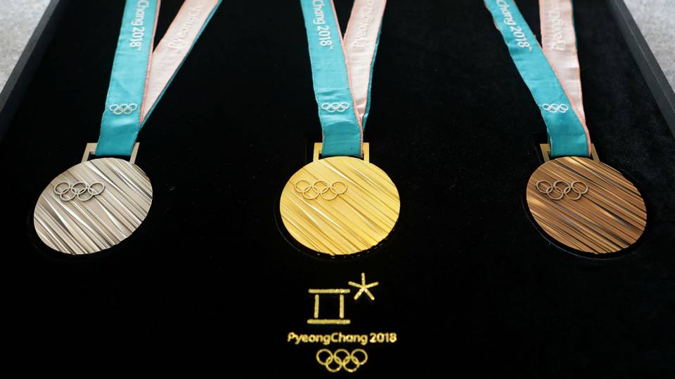

Slide 18
Iron Age

Slide 19
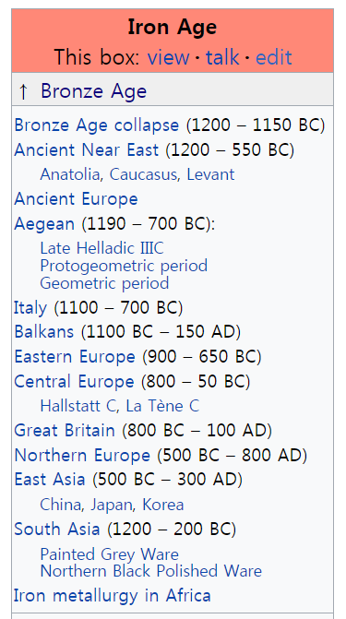
Iron Age
1200 BC to 800 BC
Ends when history begins
Iron is a very common metal
More difficult to work with

Slide 20
Iron Age
Bronze Age collapse
No more tin
Iron + Carbon (2%) = Steal
Steal is very hard

Slide 21
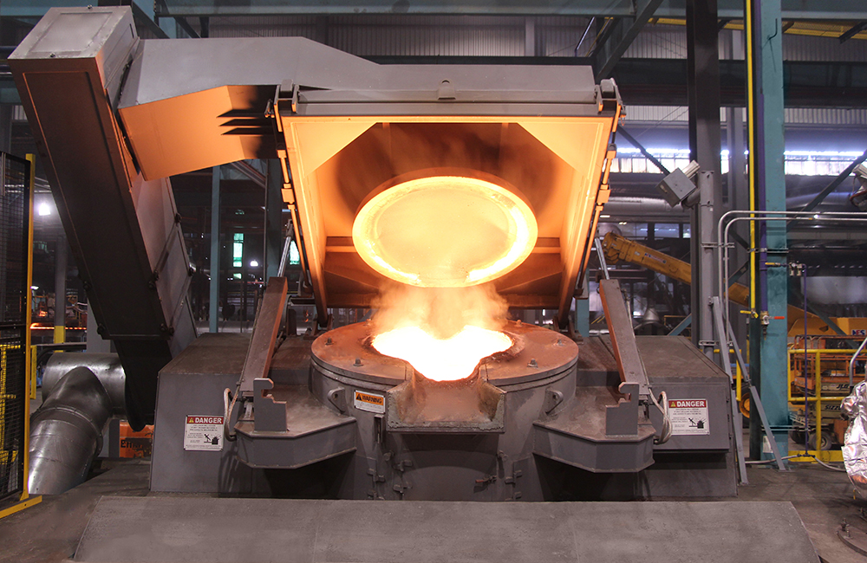

Slide 22
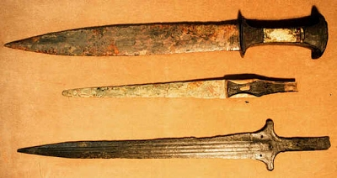

Slide 23
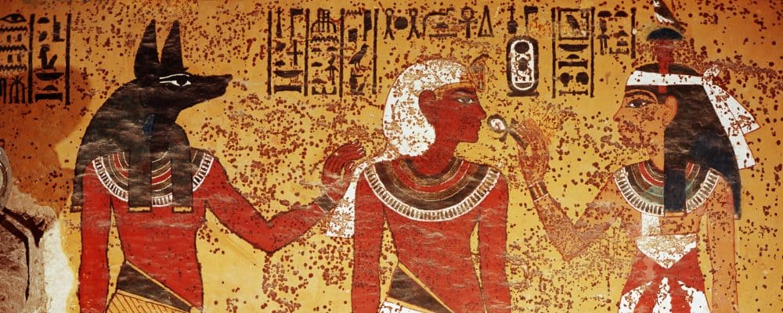
Ancient History

Slide 24
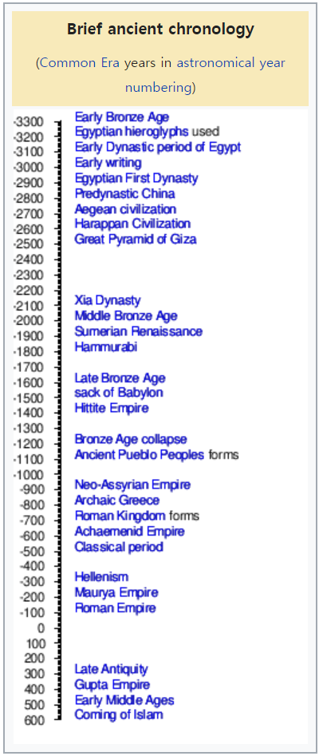
Ancient History
After printing and writing
(early as 5,000 years ago)
Before 5th or 6th century
Before writing = prehistory

Slide 25
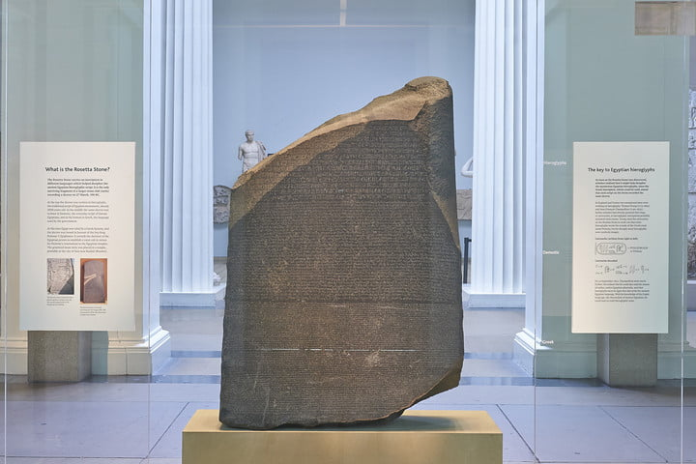
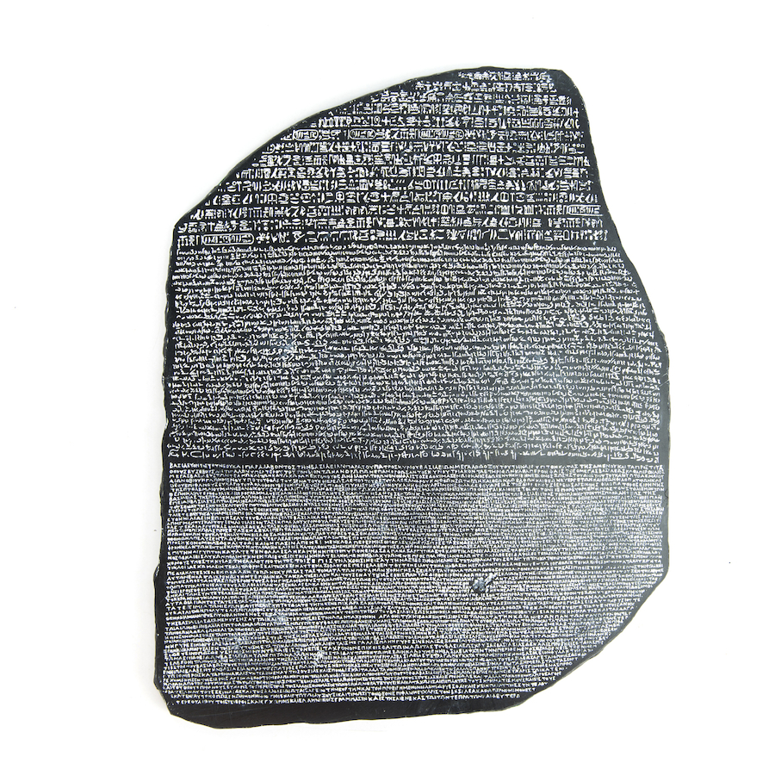

Slide 26
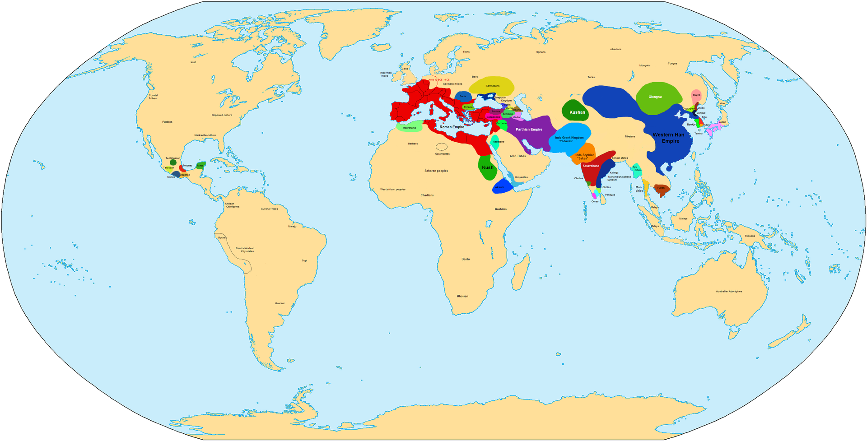
1 AD

Slide 27
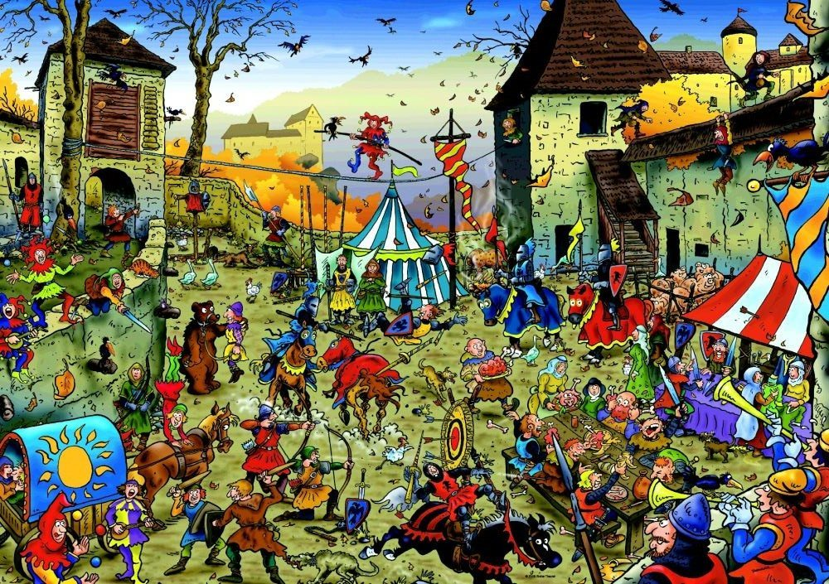
Middle Ages

Slide 28
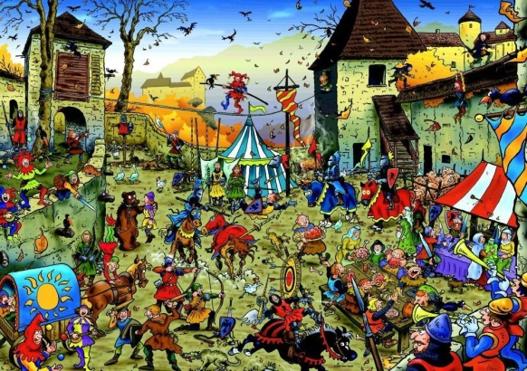
Middle Ages
5th century – 15th century
Decline of the Roman Empire
A lot of wars
The “dark age”
Church control

Slide 29
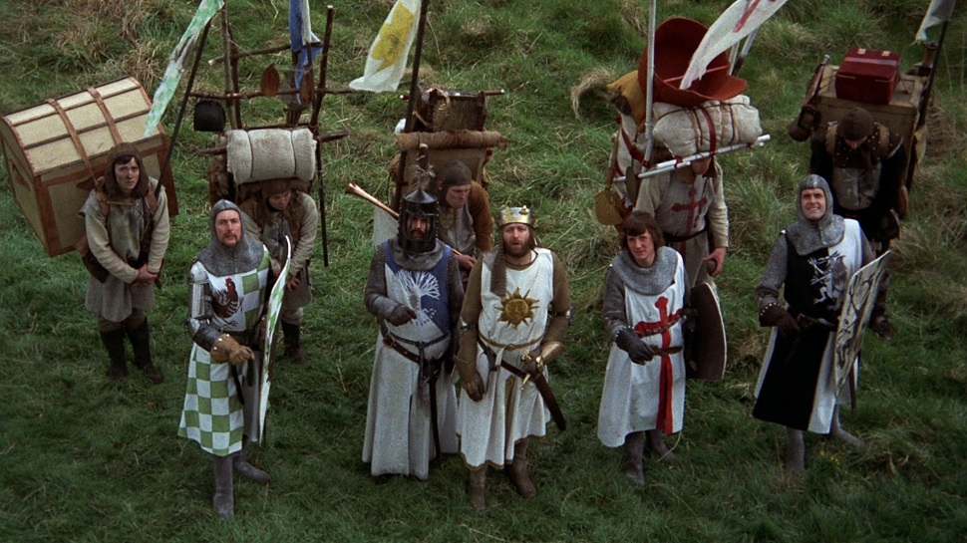

Slide 30
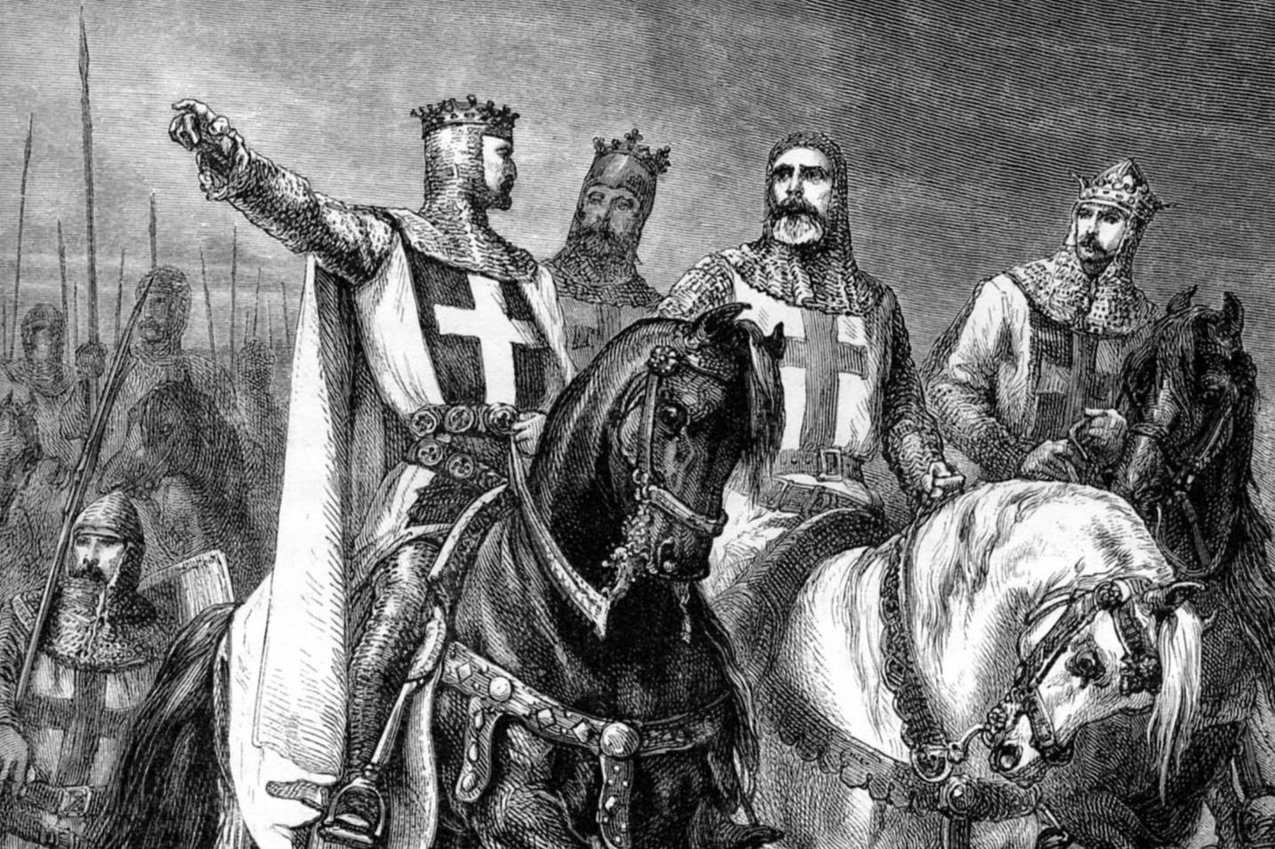
The Crusades

Slide 31
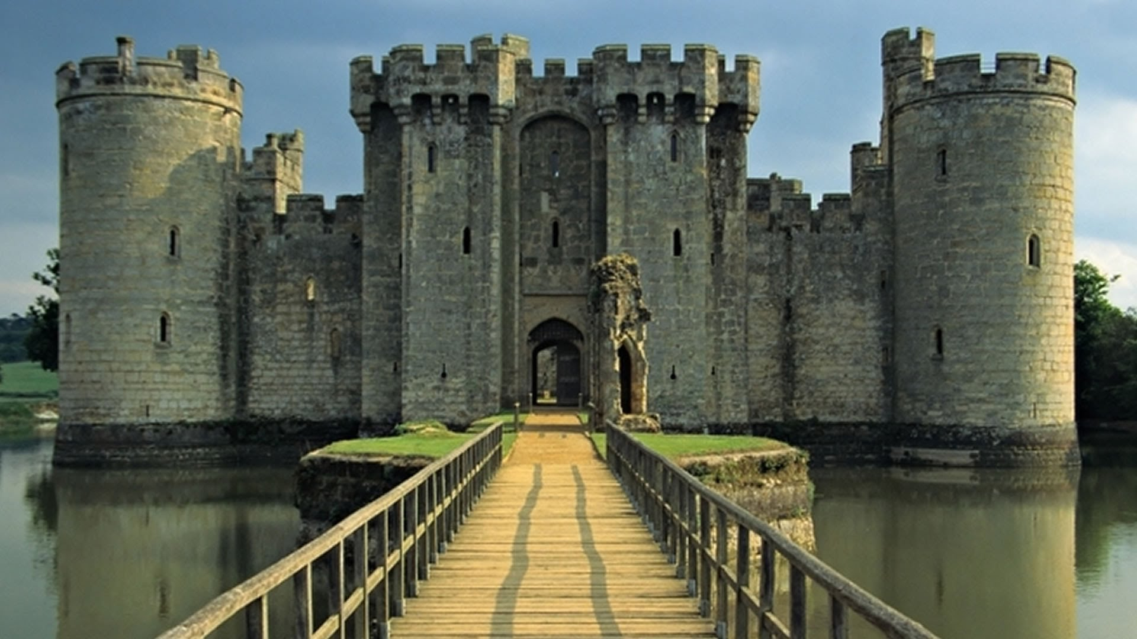

Slide 32
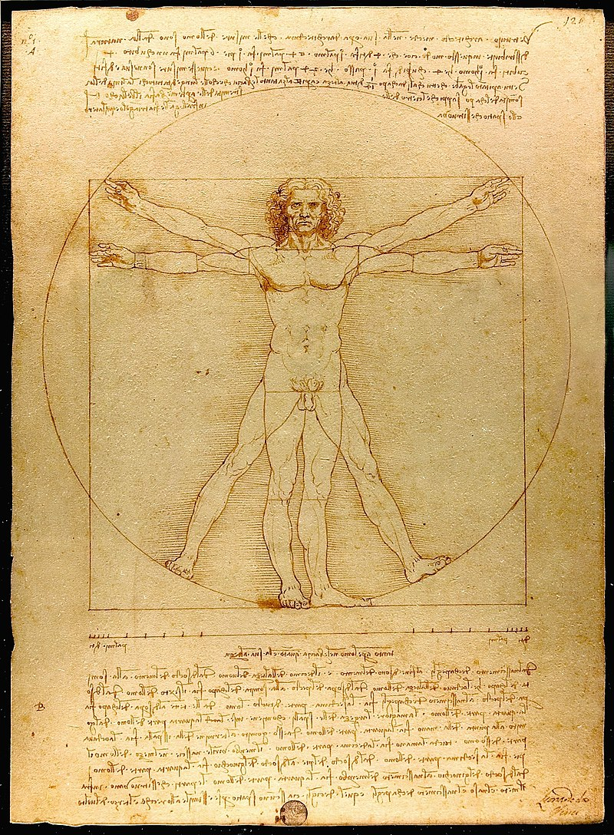
Renaissance

Slide 33
Renaissance
14th to 17th century
Humanism
Education reform
Arts, Science
Reject the Church

Slide 35
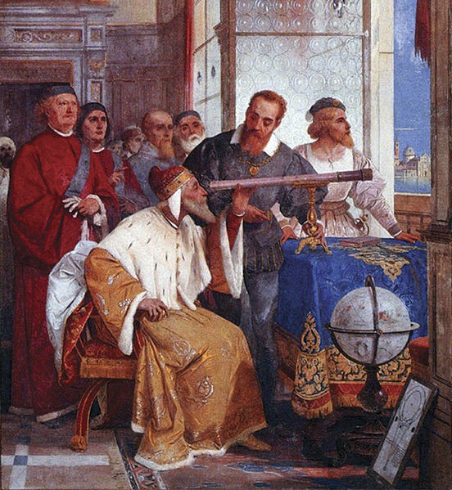
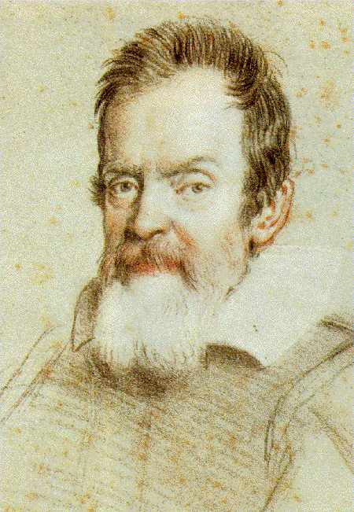
Galileo Galilei

Slide 36
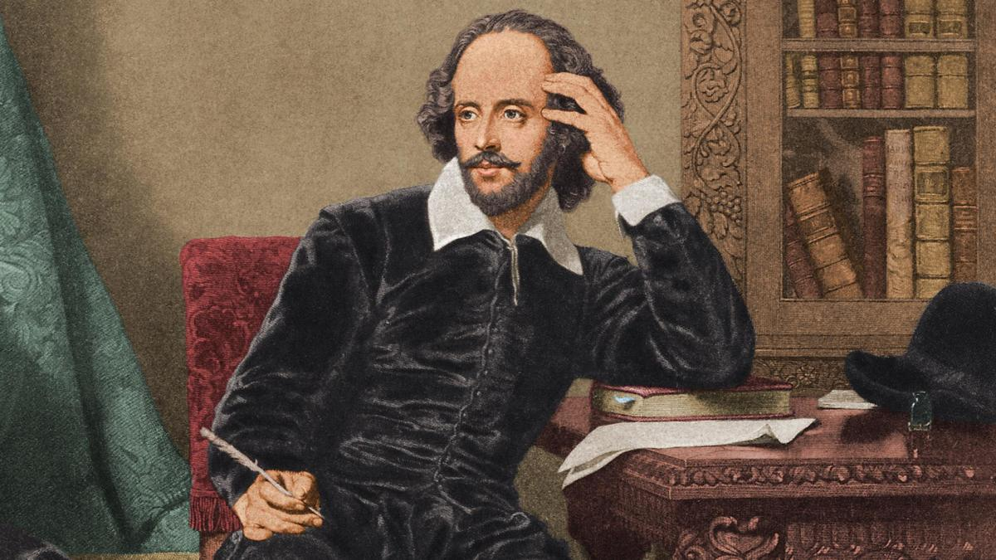
Shakespeare

Slide 37
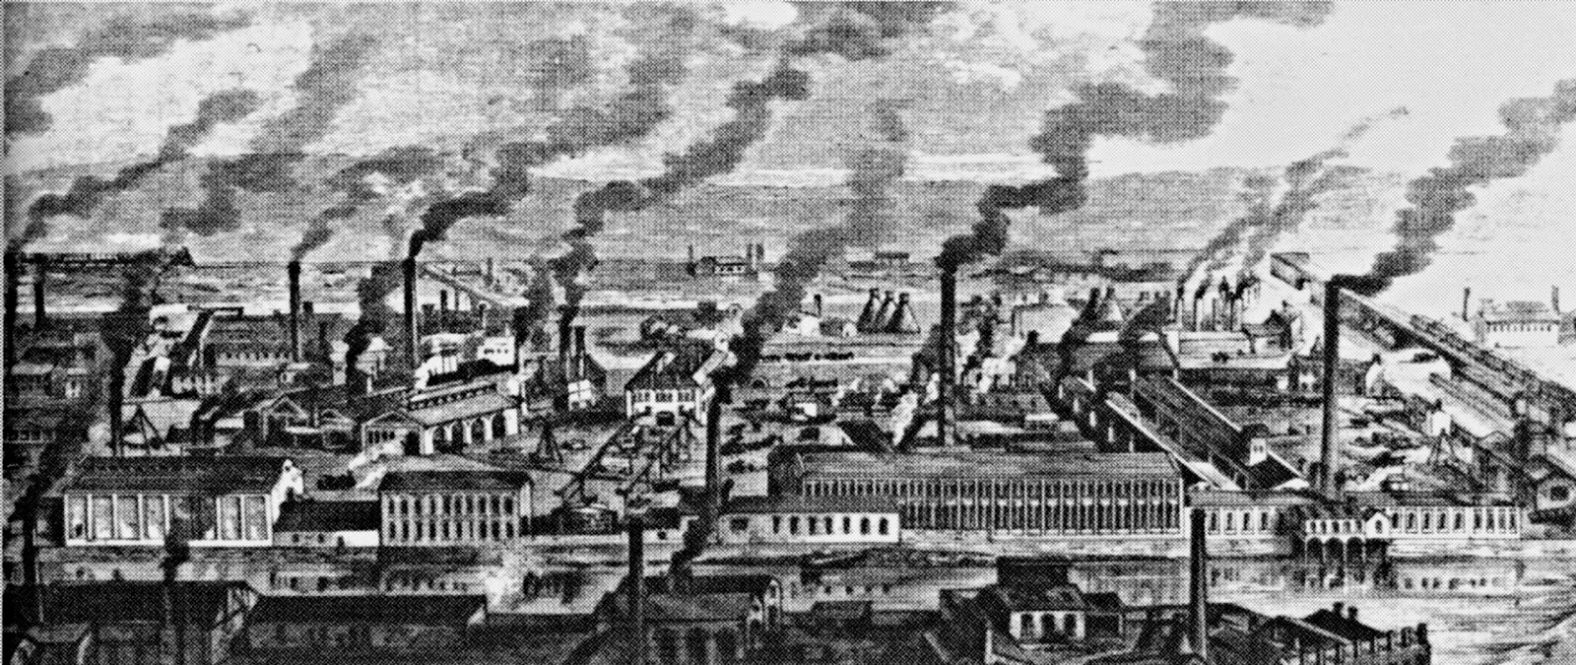
Industrial Revolution

Slide 38
Industrial Revolution
~1760 to 1840
Division of labor
Machines
Economy

Slide 39
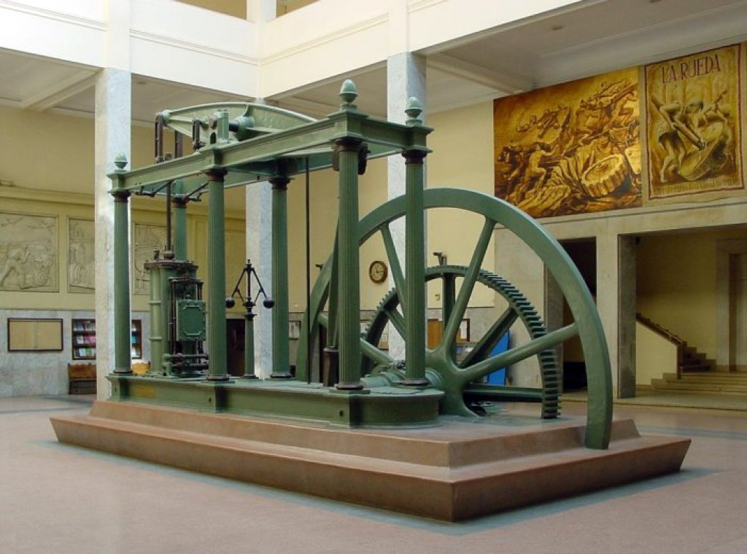

Slide 40
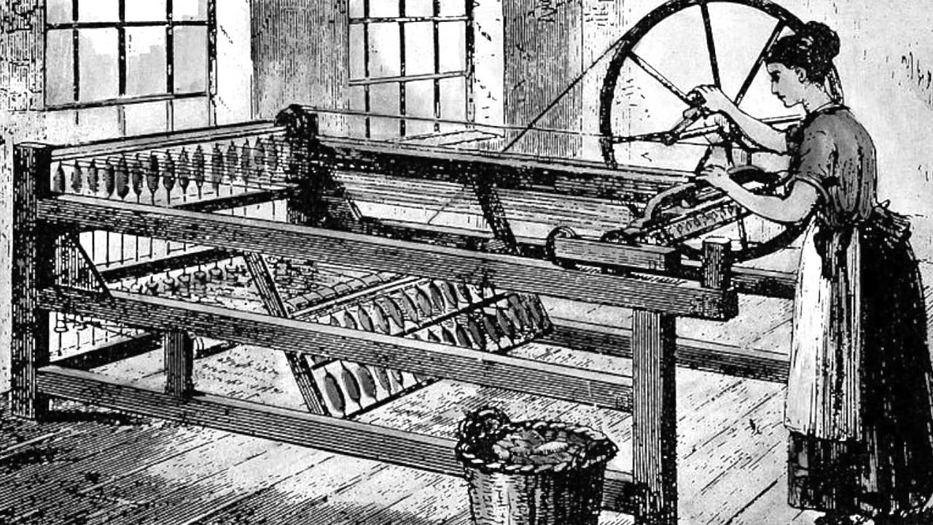

Slide 41
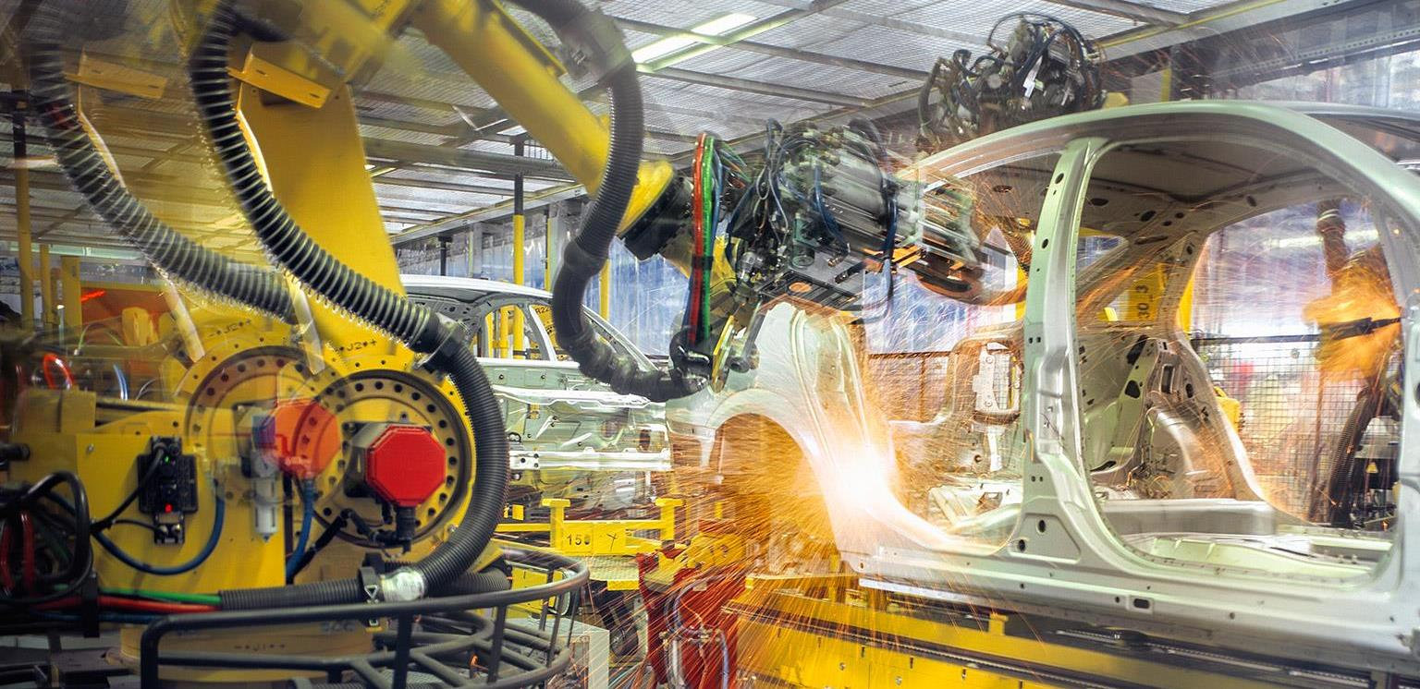

Slide 42
Atomic Age

Slide 43
Atomic Age
Since the first atomic bomb on July 16, 1945
Atomic energy
Atomic bomb

Slide 44
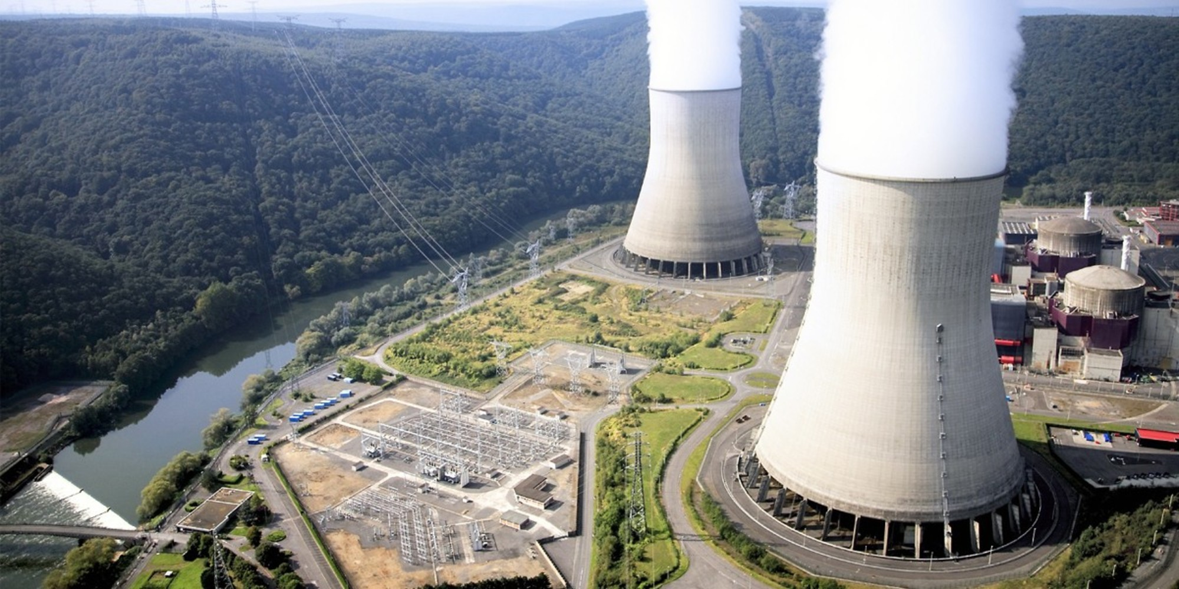

Slide 45
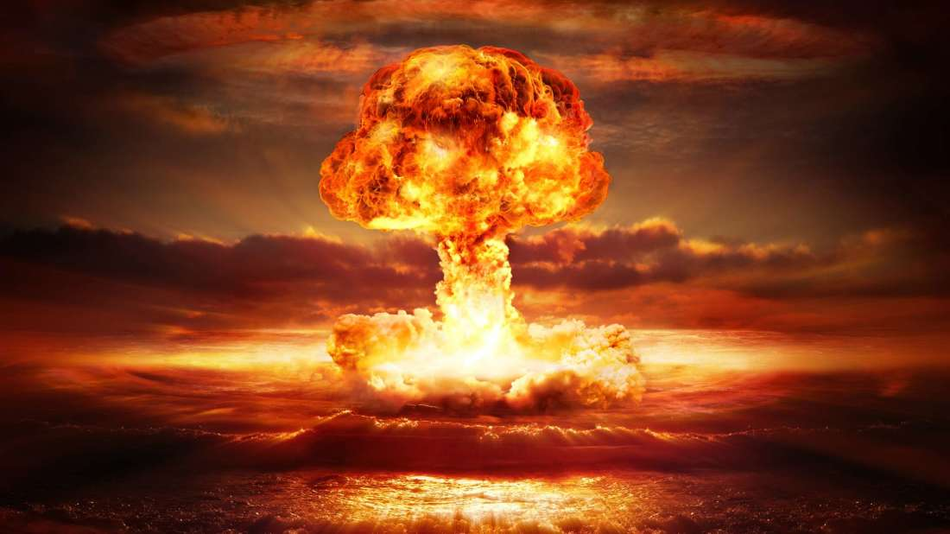

Slide 46
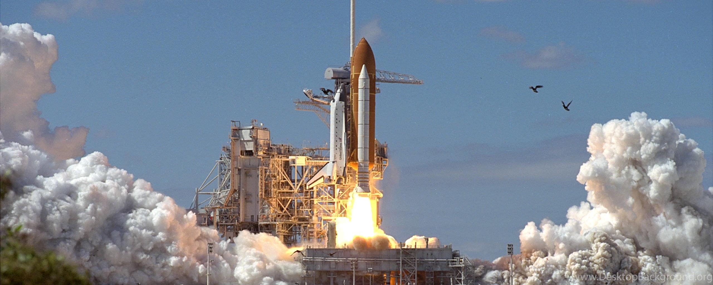
Space Age

Slide 47
Space Age
Since 1957
Sputnik
Moon landing
Mars?

Slide 48
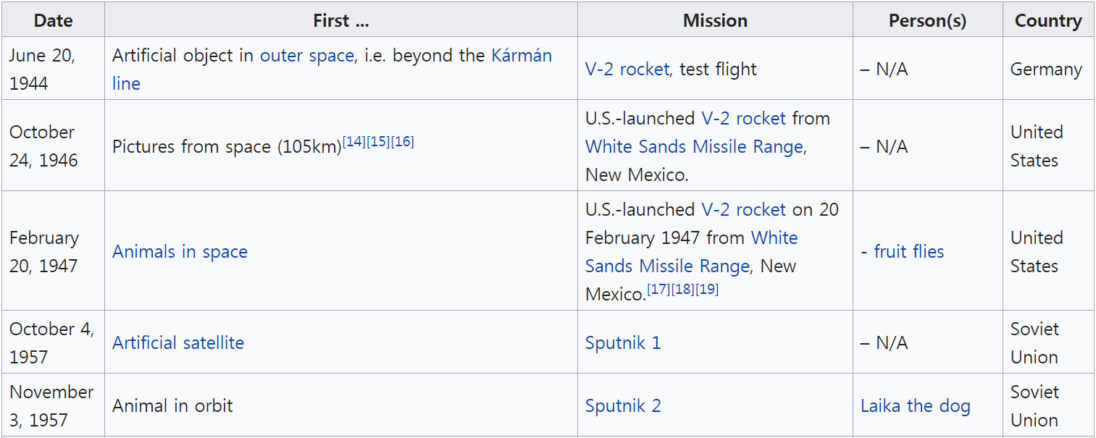

Slide 49
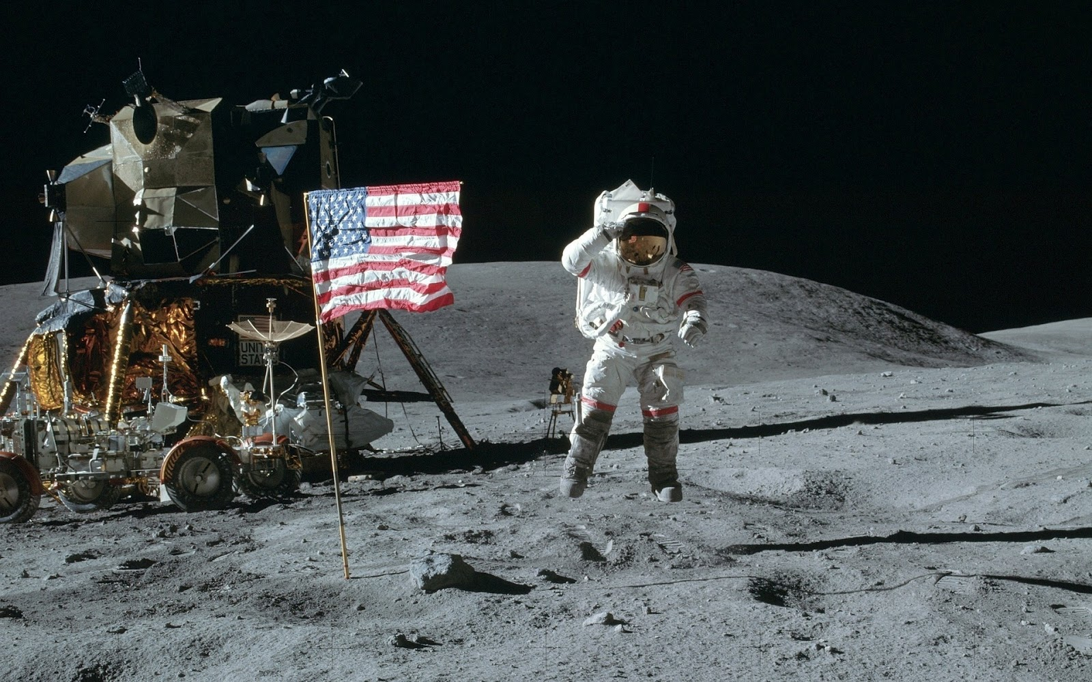

Slide 50
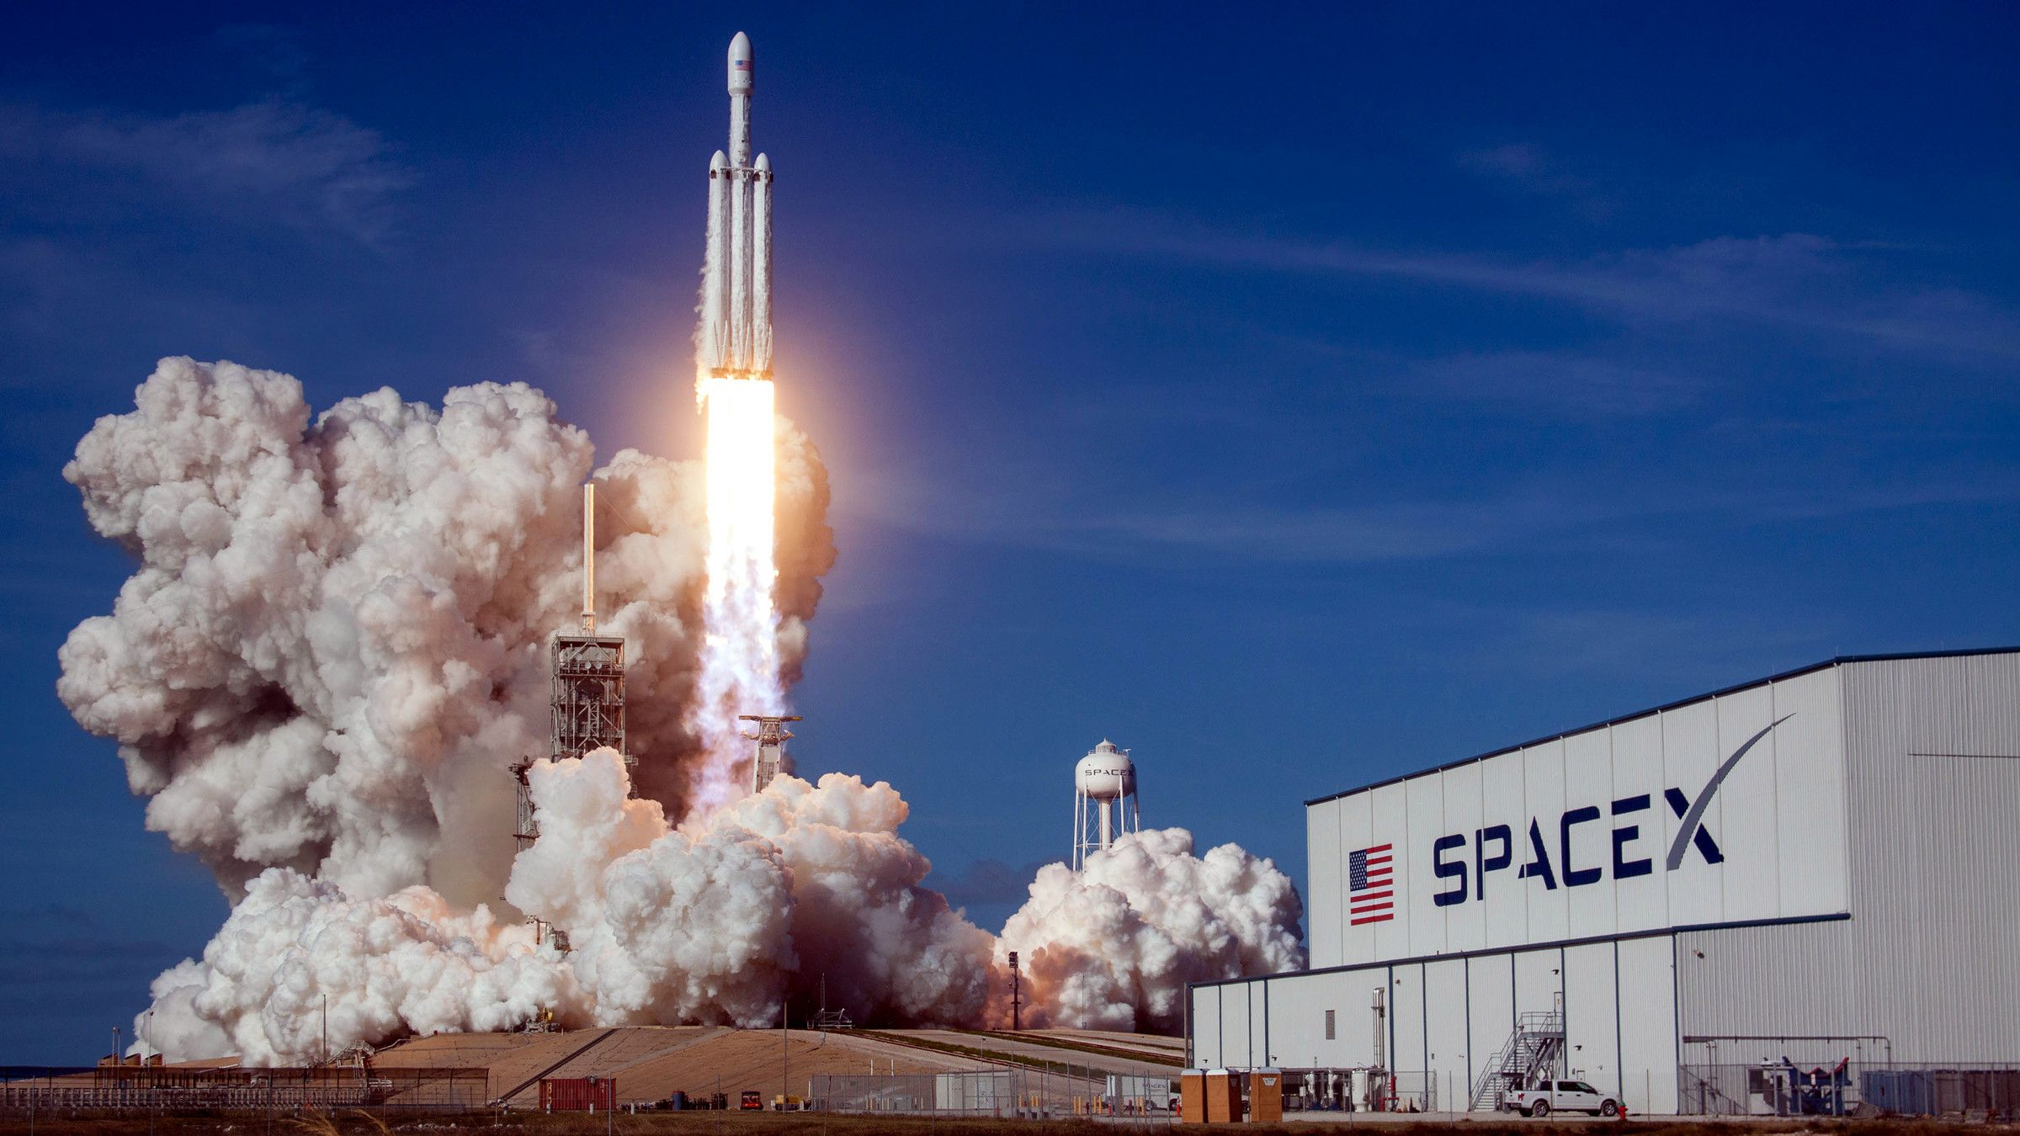

Slide 51
Digital Revolution

Slide 52
Digital Revolution
Began around 1950s to 1970s
Binary
Information exchange

Slide 53
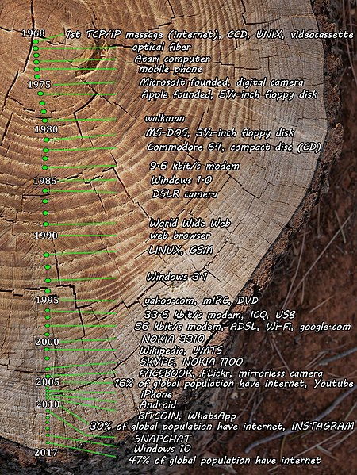

Slide 55
Information Age

Slide 56
Information Age
Since the digital revolution
New Media age
Computer age
Digital age

Slide 58
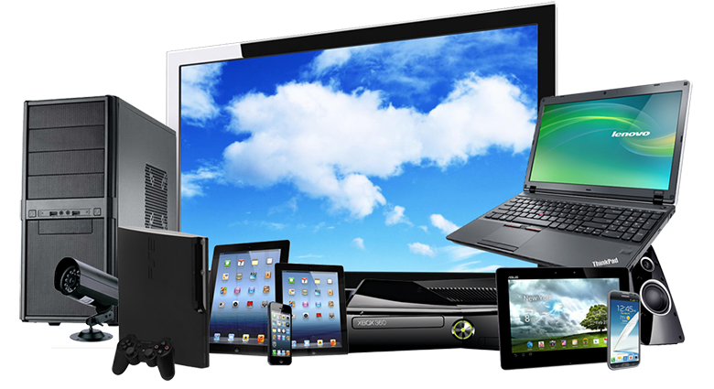

Slide 59
Which era is it?

Slide 60
12,500 BCE
0
1900
Ancient Age
- Industrial Revolution
- Agricultural Revolution
- Atomic bomb
5,000 BCE
Stone Age
4,000 BCE
1000 AD
1950 AD
Middle Ages
3,000 BCE
Atomic Age
2,000 BCE
Bronze Age
Renaissance
Space Age
1,000 BCE
Iron Age
Information Age
0
1900
Today

Slide 61
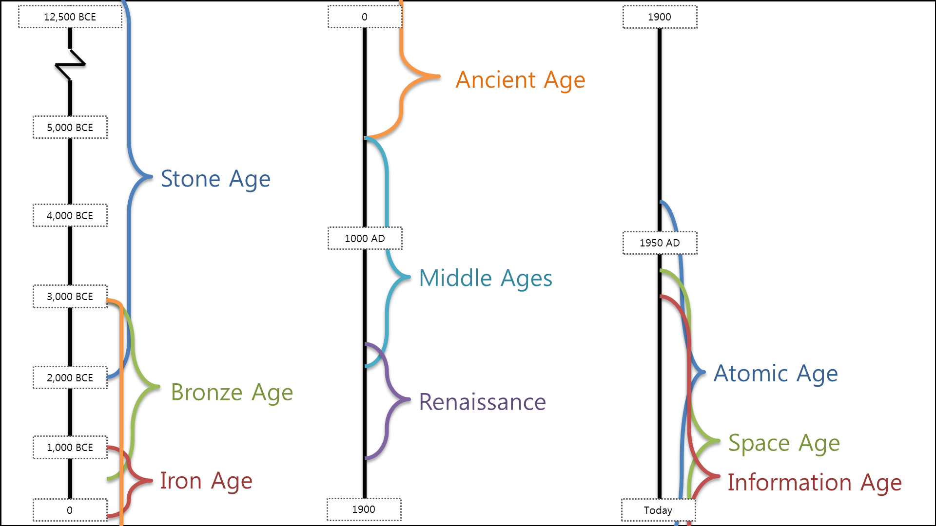
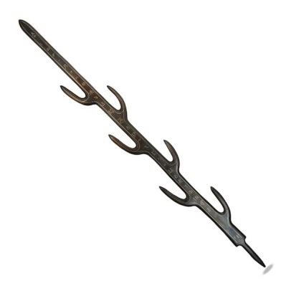
- 7 Branched sword
369 AD

Slide 62
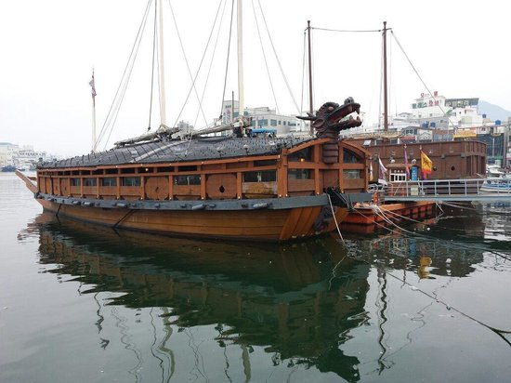
- Turtle ship
1590 AD

Slide 63
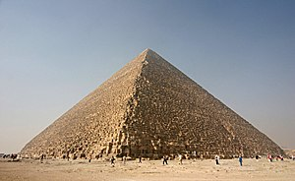
- The Great Pyramid
3,800 BC

Slide 64
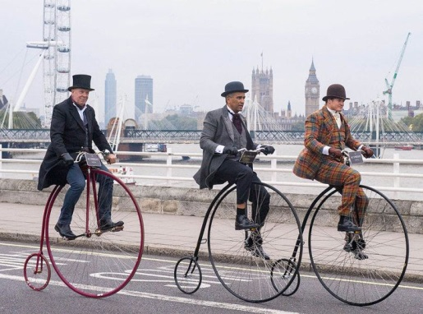
- Penny-farthing
1869 AD

Slide 65
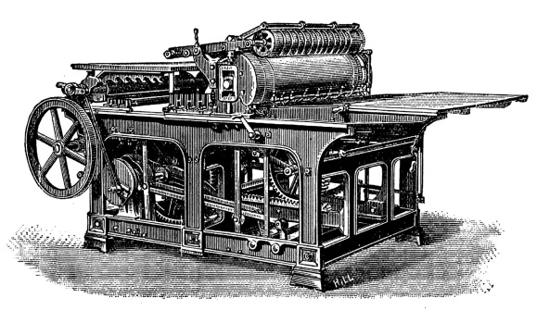
- Printing press
1440 AD

Slide 66
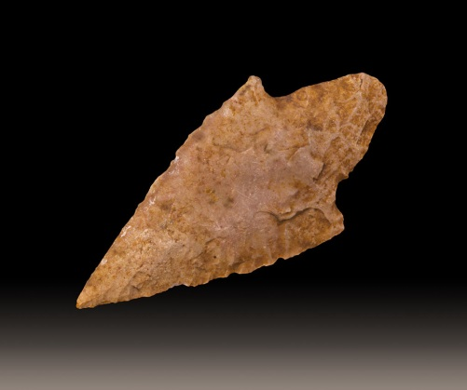
- Arrowhead
62,000 BC

Slide 67
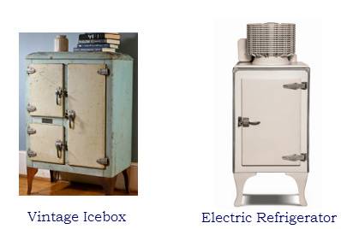
- Refrigerator
~1750 AD

Slide 68
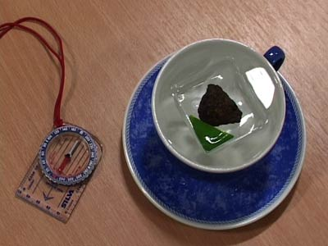
- Compass
206 BC

Slide 69
- Edison Light Bulb
1879 AD

Slide 70
- Lens
Nimrod Lens
750 BC

Slide 71
- Telephone
1876 AD

Slide 72
- Penicillin
1928 AD

Slide 73
- Concrete
6,500 BC

Slide 74
- X-ray photograph
1897 AD

Slide 75
- Camera Obscura
470 BC

Slide 76
Guess the invention
What is its function?

Slide 78
It lets you walk your fish.

Slide 80
It stops the smell of farts.

Slide 82
It helps you put on lipstick.

Slide 84
It scares away mice.

Slide 86
It cuts bananas.

Slide 88
It cooks turkeys / chickens.

Slide 90
It separates the popcorn from the kernels (seeds).

Slide 92
It helps disabled people get to their wheelchair.

Slide 94
It can turn on your kettle with your phone.

Slide 96
It can 3D print bridges.

Slide 98
It shoots around corners.

Slide 99
I have a problem
Can you invent something to help me?

Slide 100
My noodles are too hot when I eat.

Slide 102
I can’t hear my friend at the bar.

Slide 104
I fall asleep a lot on the subway.
My head always falls down.

Slide 106
I am bald.

Slide 108
Eating spaghetti is difficult.

Slide 110
I want to sleep at school.

Slide 112
I’m too busy to clean because I have to take care of my baby.

Slide 114
Someone keeps stealing my ice cream.

Slide 116
My cereal gets soggy.

Slide 118
I like to play music while I am cooking.

Slide 120
I don’t like getting sauce on my fingers when I eat chicken.

Slide 122
Someone keeps stealing my sandwiches.

Slide 124
My baby keeps escaping her bed.

Slide 126
My desk doesn’t have a cup holder.

Slide 128
I want to take picture of myself eating.

