Slide 1
Adjective Order

Slide 2
Color
Opinion / Quality
Origin
Types of Adjectives
Age
Purpose
Shape
Size
Material

Slide 3
Color
Opinion / Quality
Origin
Cotton
Pointy
Delicate
Pink
Microscopic
Chubby
Skinny
Wooden
Enormous
Slimy
Italian
Baseball
Extra-terrestrial
Ancient
Sneaky
Clear
Spooky
Gigantic
Loud
Shiny
Nasty
Pretty
Asian
Age
Purpose
Shape
Size
Material

Slide 4
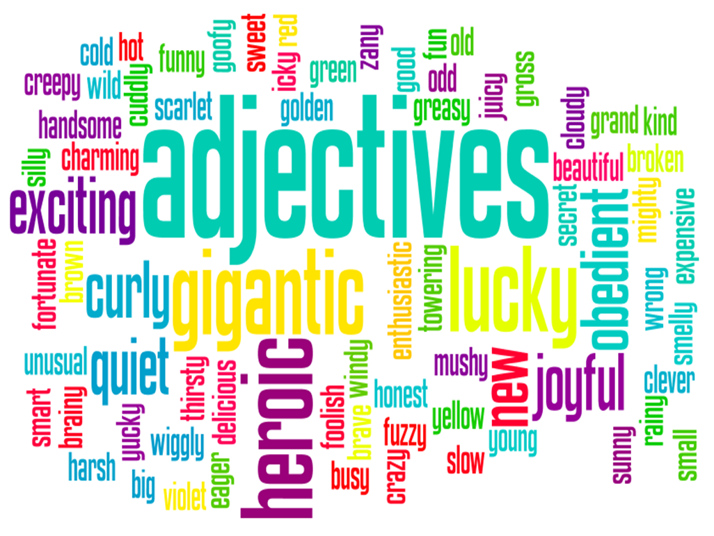
Add some more adjectives
Group Size = 4

Slide 5
Origin

Slide 6
Color

Slide 7
Opinion / Quality

Slide 8
Purpose

Slide 9
Material

Slide 10
Shape

Slide 11
Size

Slide 12
Age

Slide 13
Adjective Order

Slide 14
Adjective Order
Opinion / Quality
Size
Shape
Age
Color
Origin
Material
Purpose
Noun

Slide 15
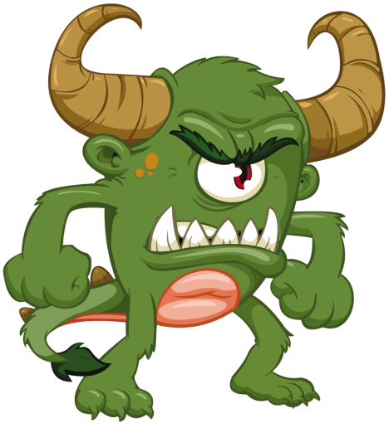
Examples
Last week I saw an amazing old stone statue.
She bought an expensive new red sports car.
It’s a spooky large green monster.

Slide 16
Same group = , and
He’s a smart and handsome young man.
They ate the yellow and blue candies.
It’s a red, white and blue flag.

Slide 17
Choose the correct sentence:
My grandmother lives in a cute pink, blue and yellow house.
My grandmother lives in a cute, pink, blue, yellow house.
My grandmother lives in a pink, blue, cute and yellow house.

Slide 18
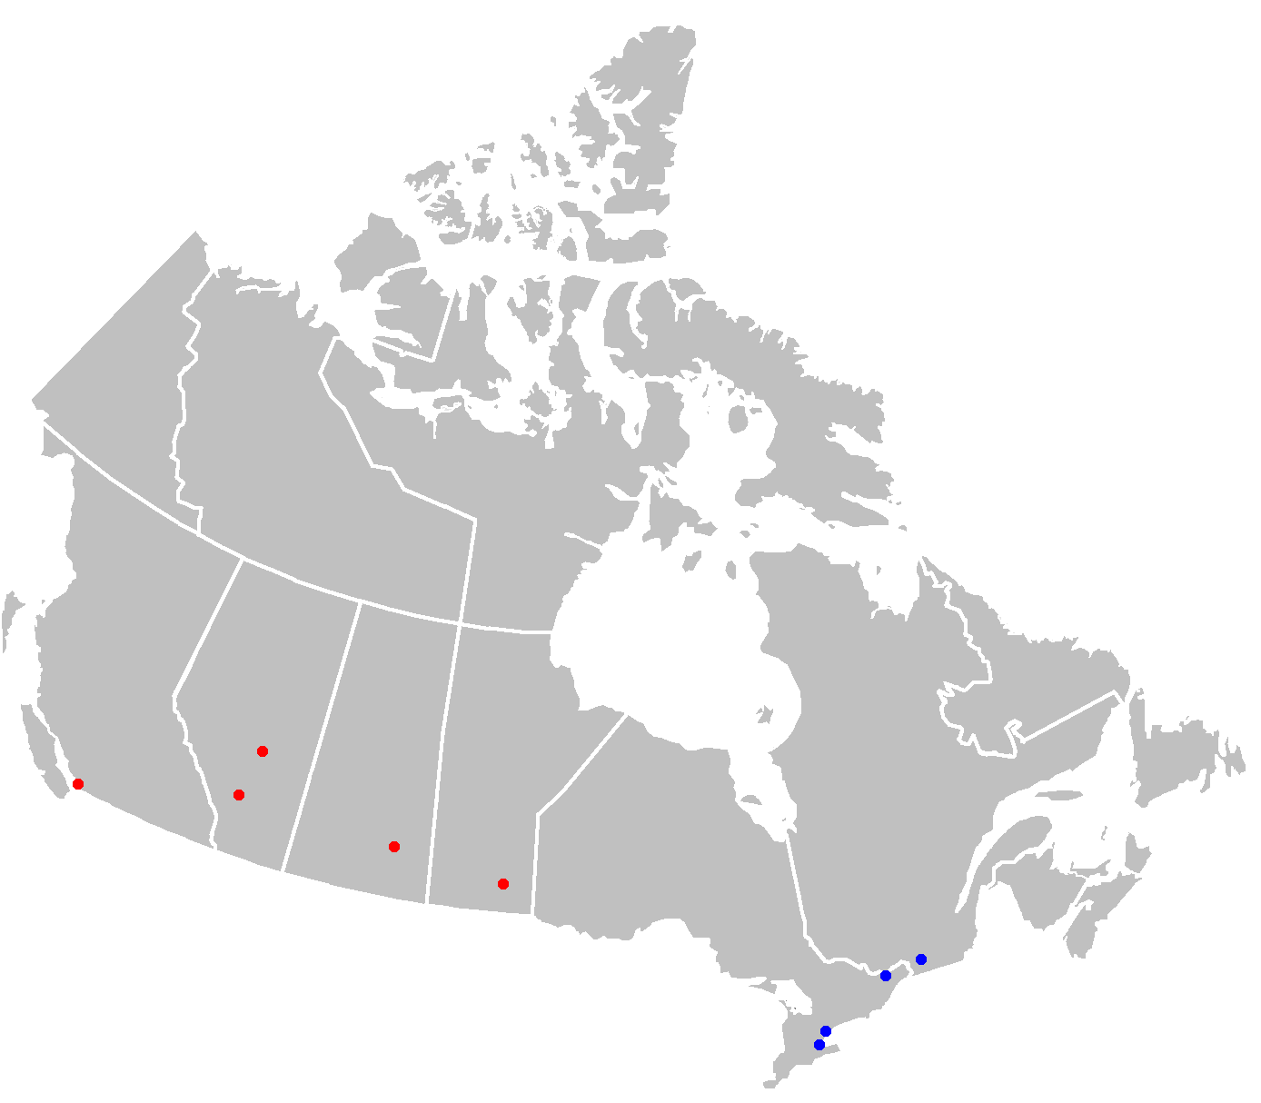
Choose the correct sentence:
Canada is a large, cold, North, American country.
Canada is a cold large North American country.
Canada is a cold North American large country.

Slide 19
Choose the correct sentence:
Soccer uses round and black white balls.
Soccer uses round, black, white, balls.
Soccer uses round black and white balls.

Slide 20
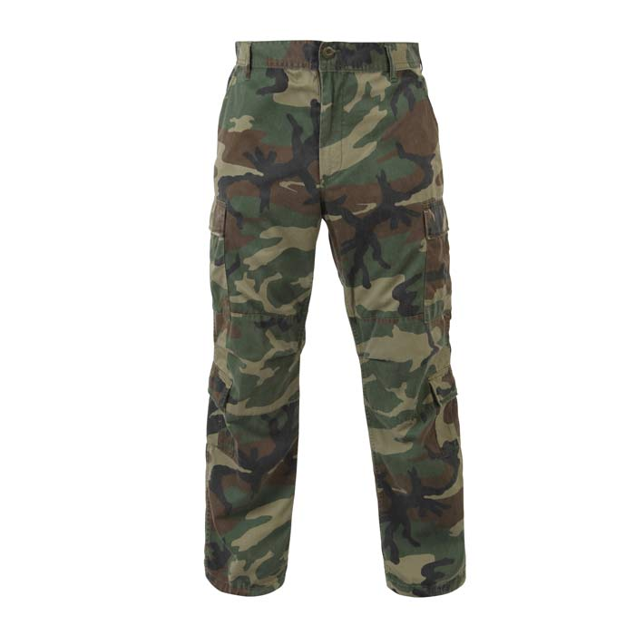
Choose the correct sentence:
Where can I buy black and green pants?
Where can I buy black, green pants?
Where can I buy pants black and green?

Slide 21
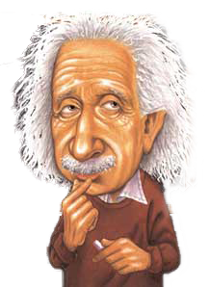
Choose the correct sentence:
Einstein was a German intelligent theoretical Physicist.
Einstein was a theoretical intelligent German Physicist.
Einstein was an intelligent German theoretical Physicist.

Slide 22
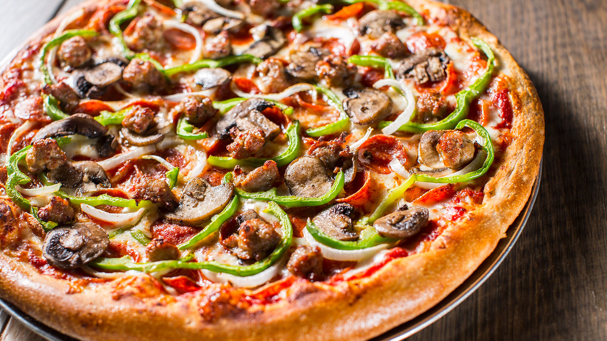
Put the sentence in the correct adjective order:
I want to eat the Italian delicious big pizza.
I want to eat the delicious big Italian pizza.

Slide 23
Put the sentence in the correct adjective order:
It was a long math boring book.
It was a boring long math book.

Slide 24
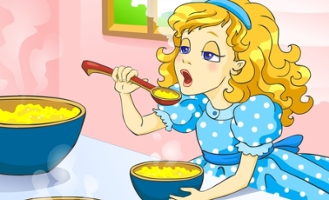
Put the sentence in the correct adjective order:
Goldilocks has long blonde curly hair.
Goldilocks has long curly blonde hair.

Slide 25
Put the sentence in the correct adjective order:
I can’t find my new round reading glasses.
I can’t find my new round reading glasses.
(round new)

Slide 26
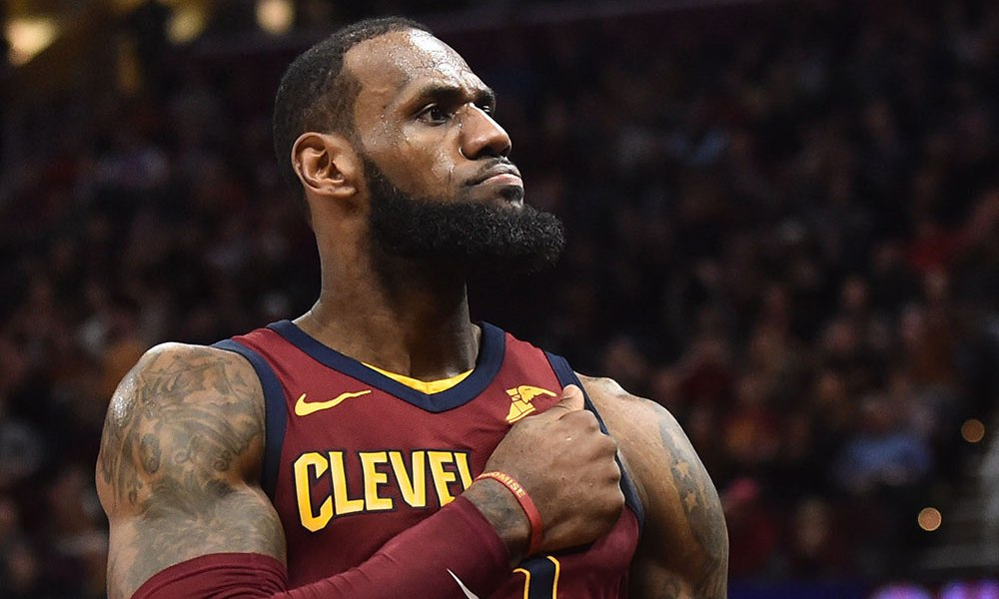
Put the sentence in the correct adjective order:
Lebron James is a basketball tall athletic player.
Lebron James is an athletic tall basketball player.

Slide 27
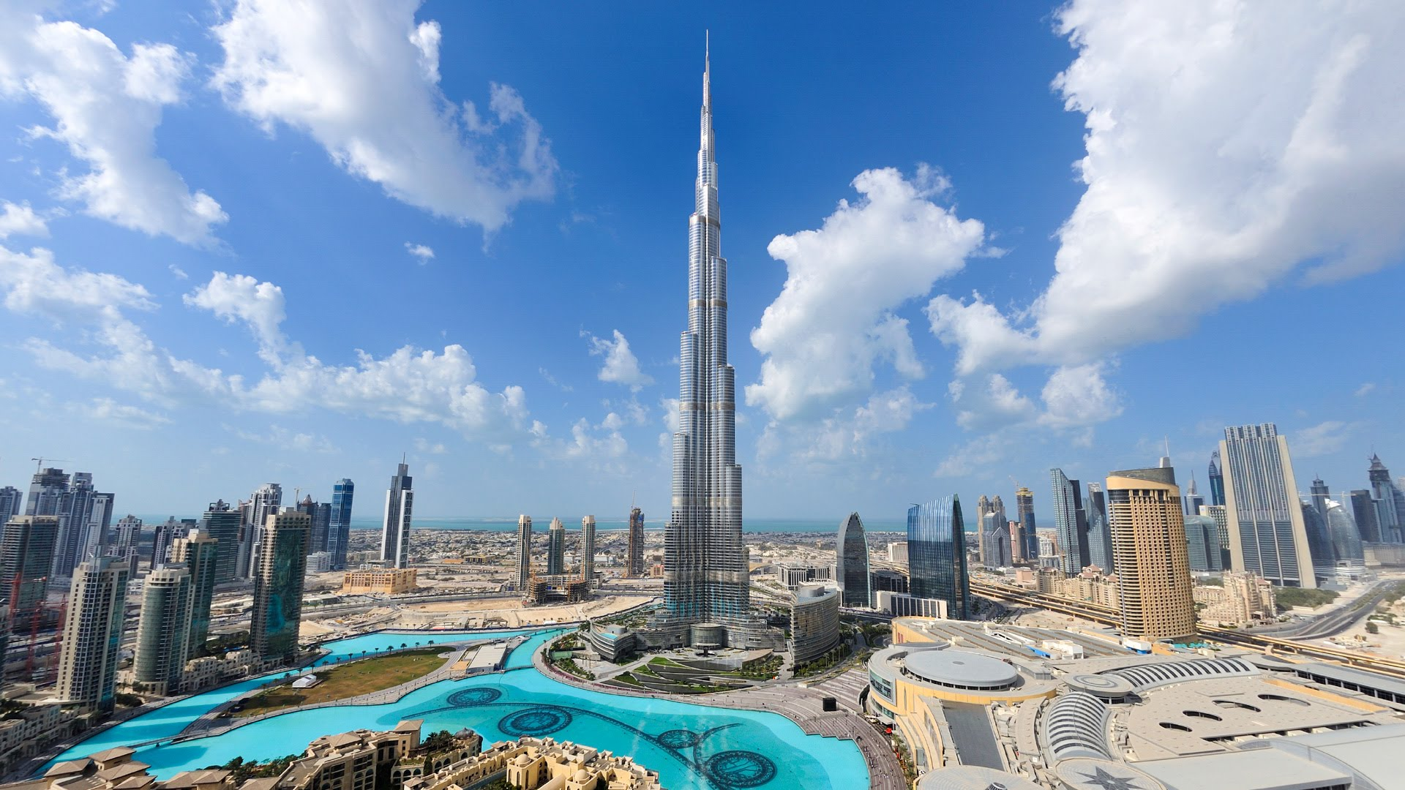
Describe this:

Slide 28
Describe this:

Slide 29
Describe this:

Slide 30
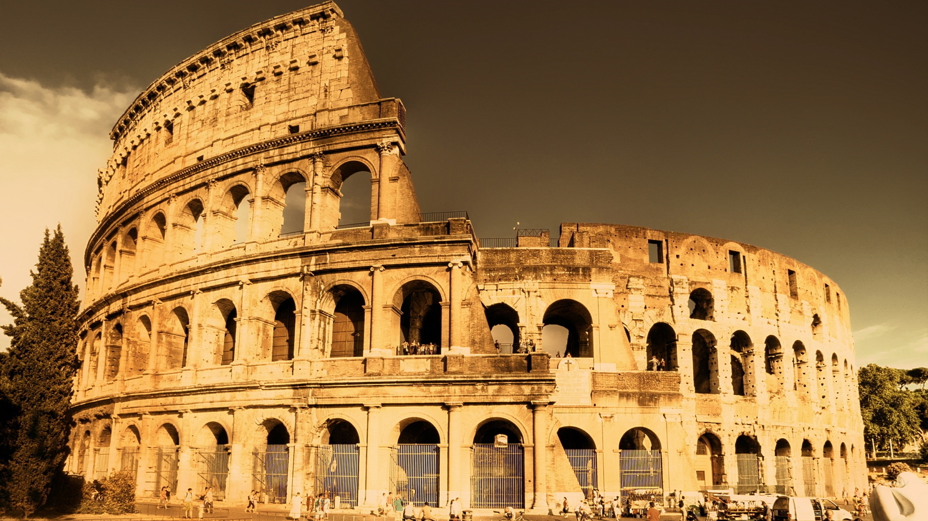
Describe this:

Slide 31
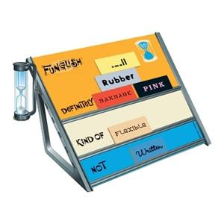
Funglish
https://www.youtube.com/watch?v=s7_XRcCKqP4

Slide 32
Rules
Team Game
The leader comes to the front.
You have 1 minute to get as many as possible.
You can’t speak or act, just use word clues.
Your team can guess.

