Slide 1
Cave Drawings

Slide 2
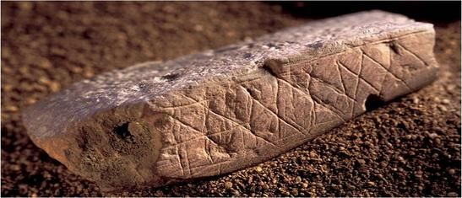
Blombos Cave Engravings (70,000 BC)

Slide 3
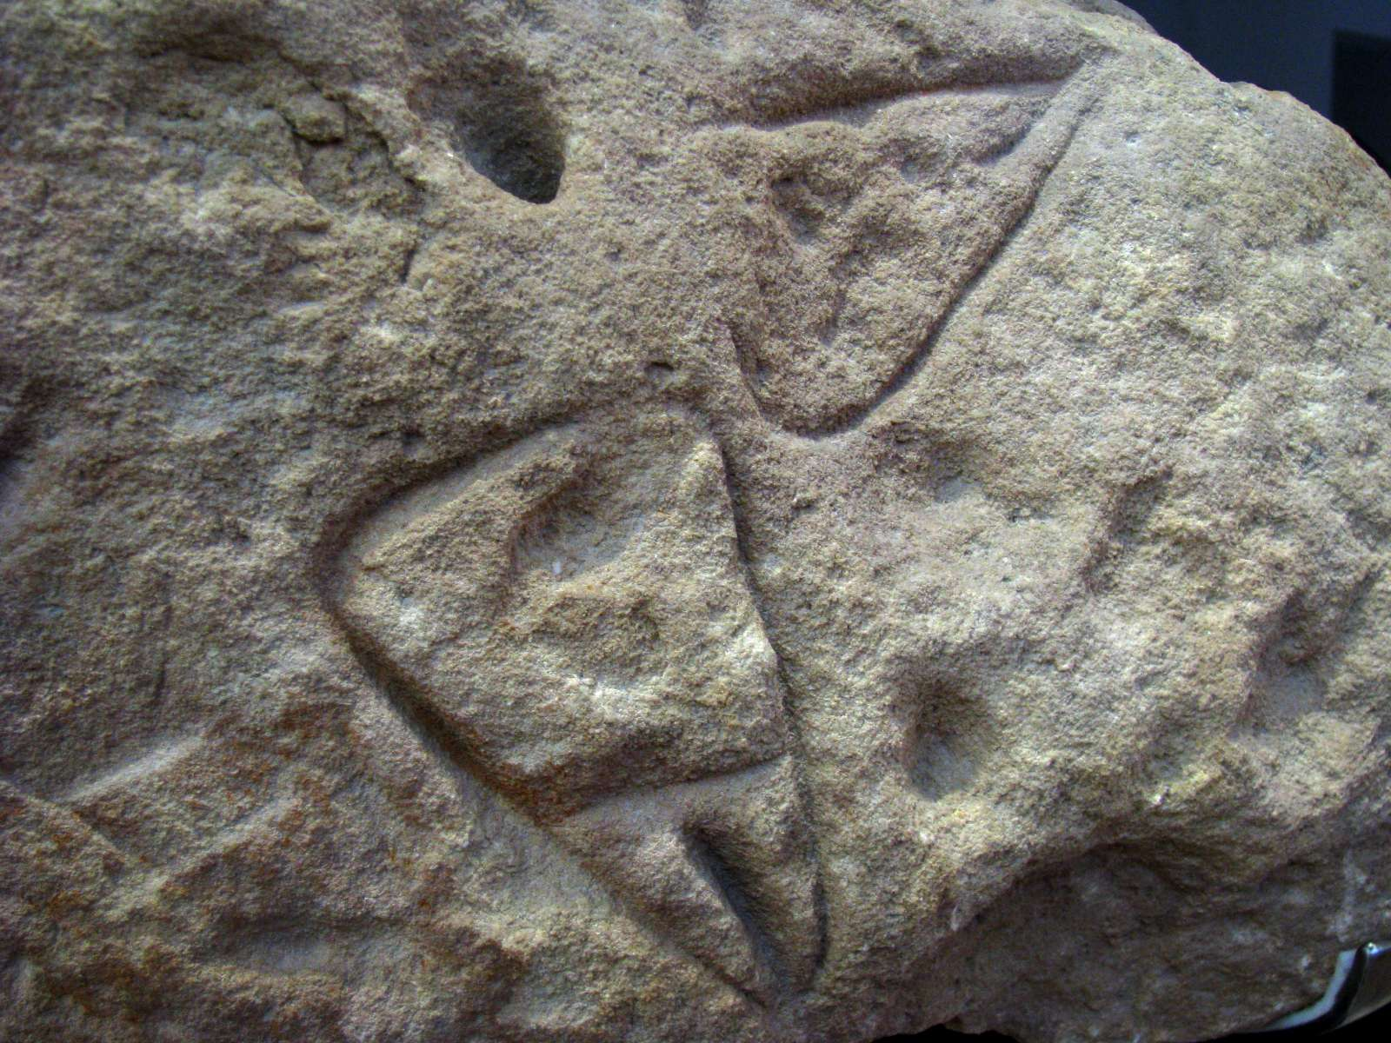
La Ferrassie Cave Petroglyphs (60,000 BC)

Slide 4
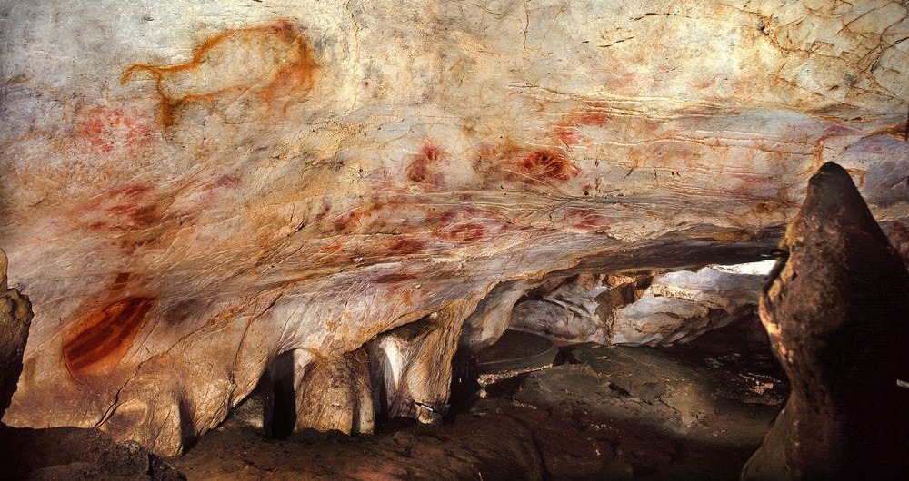
El Castillo Cave Paintings (39,000 BC)

Slide 5
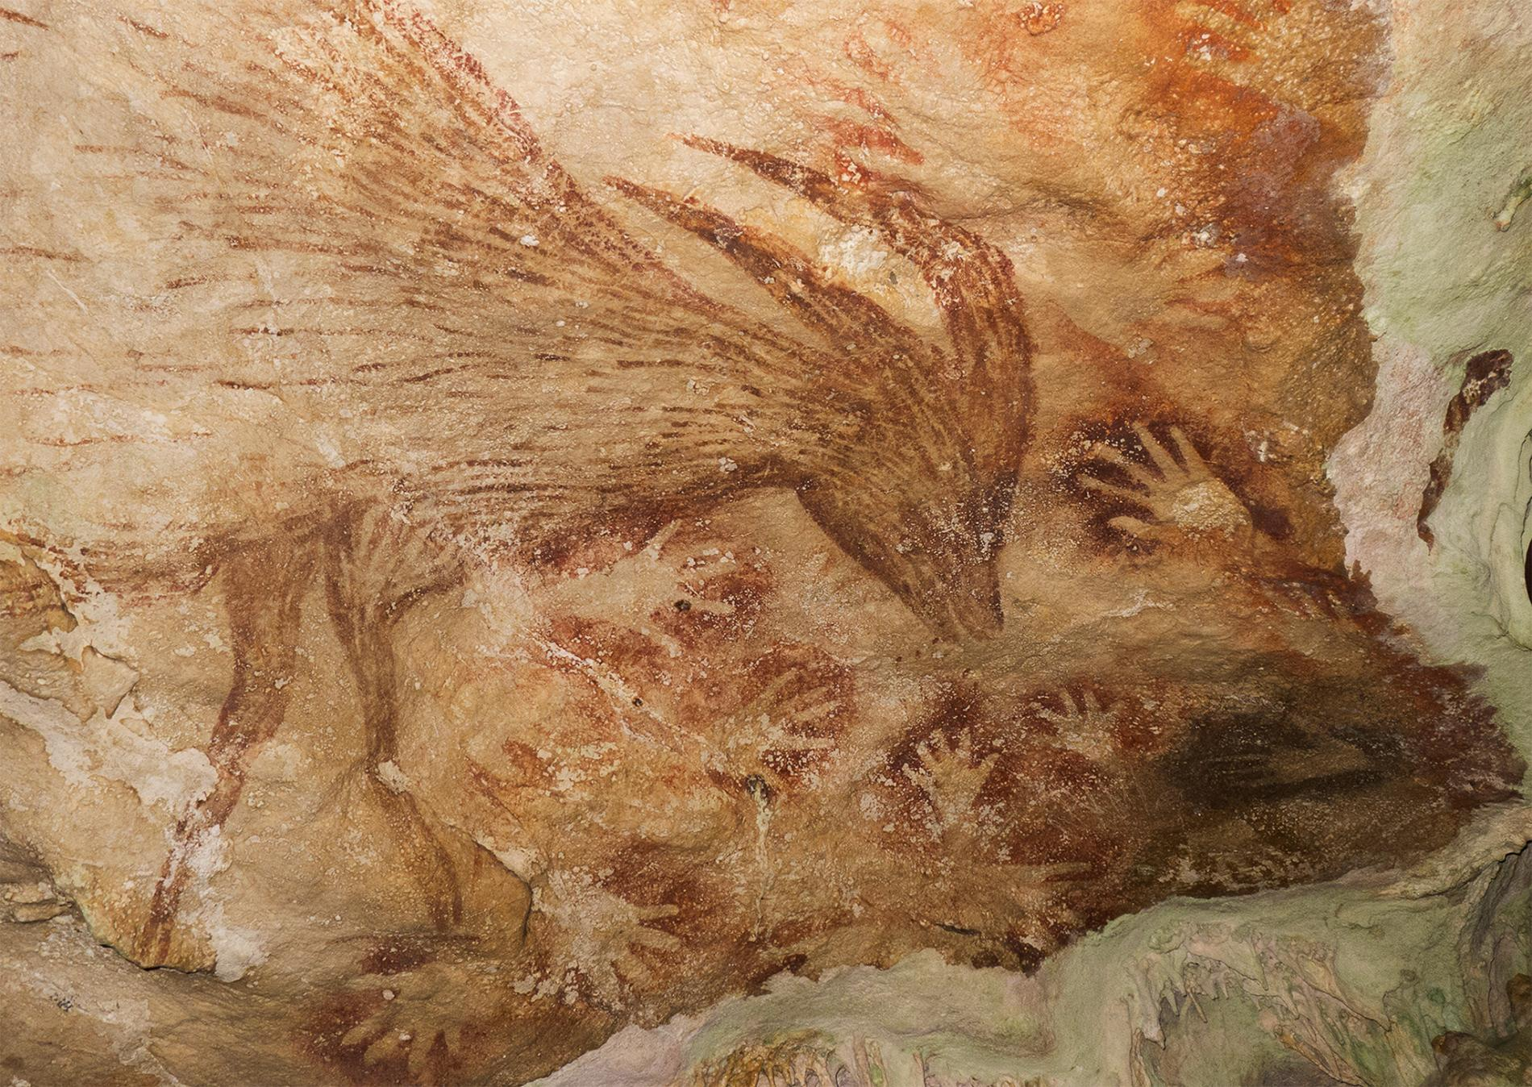
Sulawesi Cave Art (37,900 BC)

Slide 6
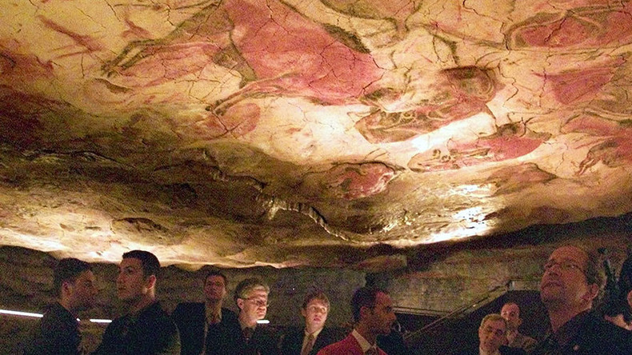
Altamira Cave (33,600 BC)

Slide 7
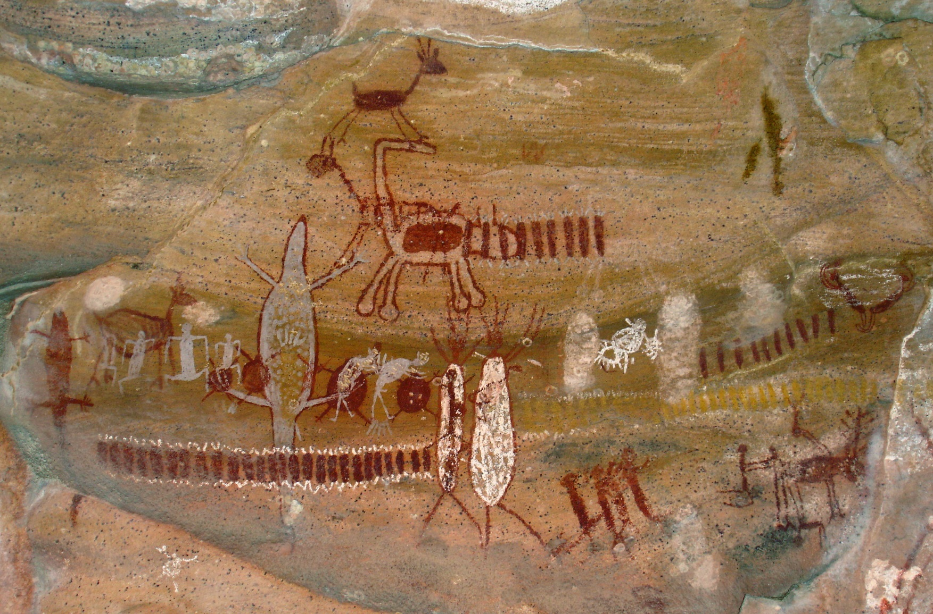
Serra da Capivara (23,000 BC)

Slide 8
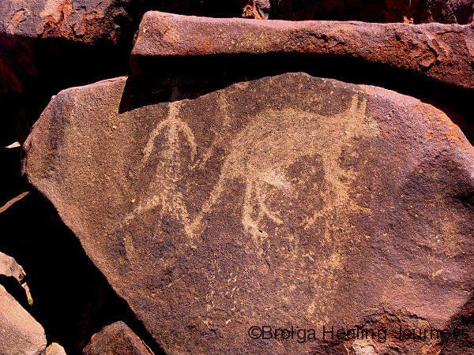
Burrup Peninsula (18,000BC)

Slide 9
Lascaux (17,000 BC)

Slide 10
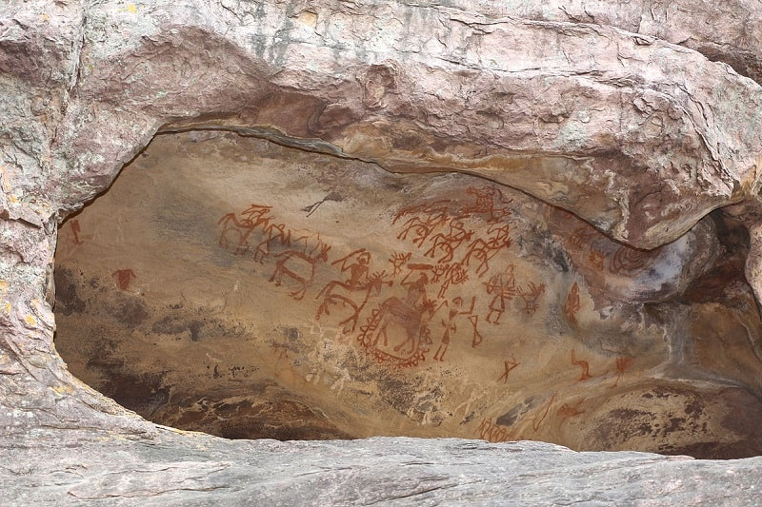
Bhimbetka (12,700 BC)

Slide 11
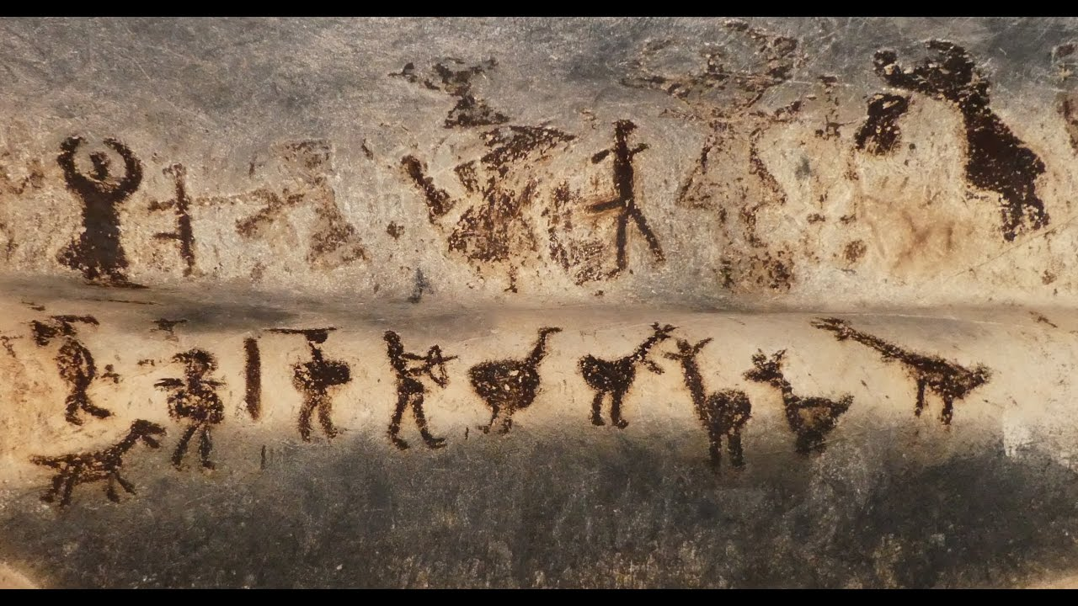
Magura Cave (6,000 BC)

Slide 12
Why?
Religious
Information
Acoustic

Slide 13
Petroglyphs

Slide 14
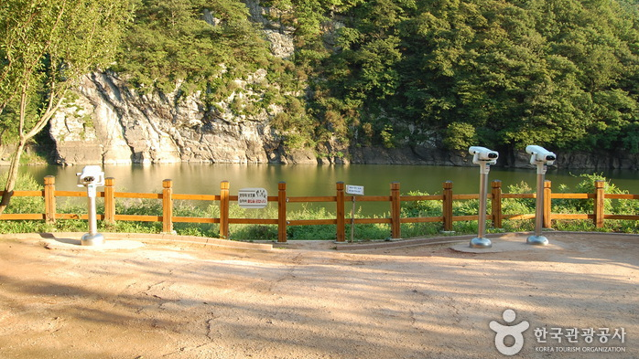
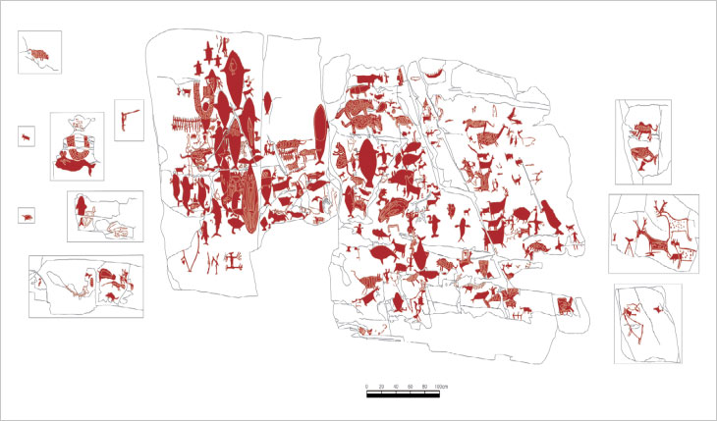

Slide 15
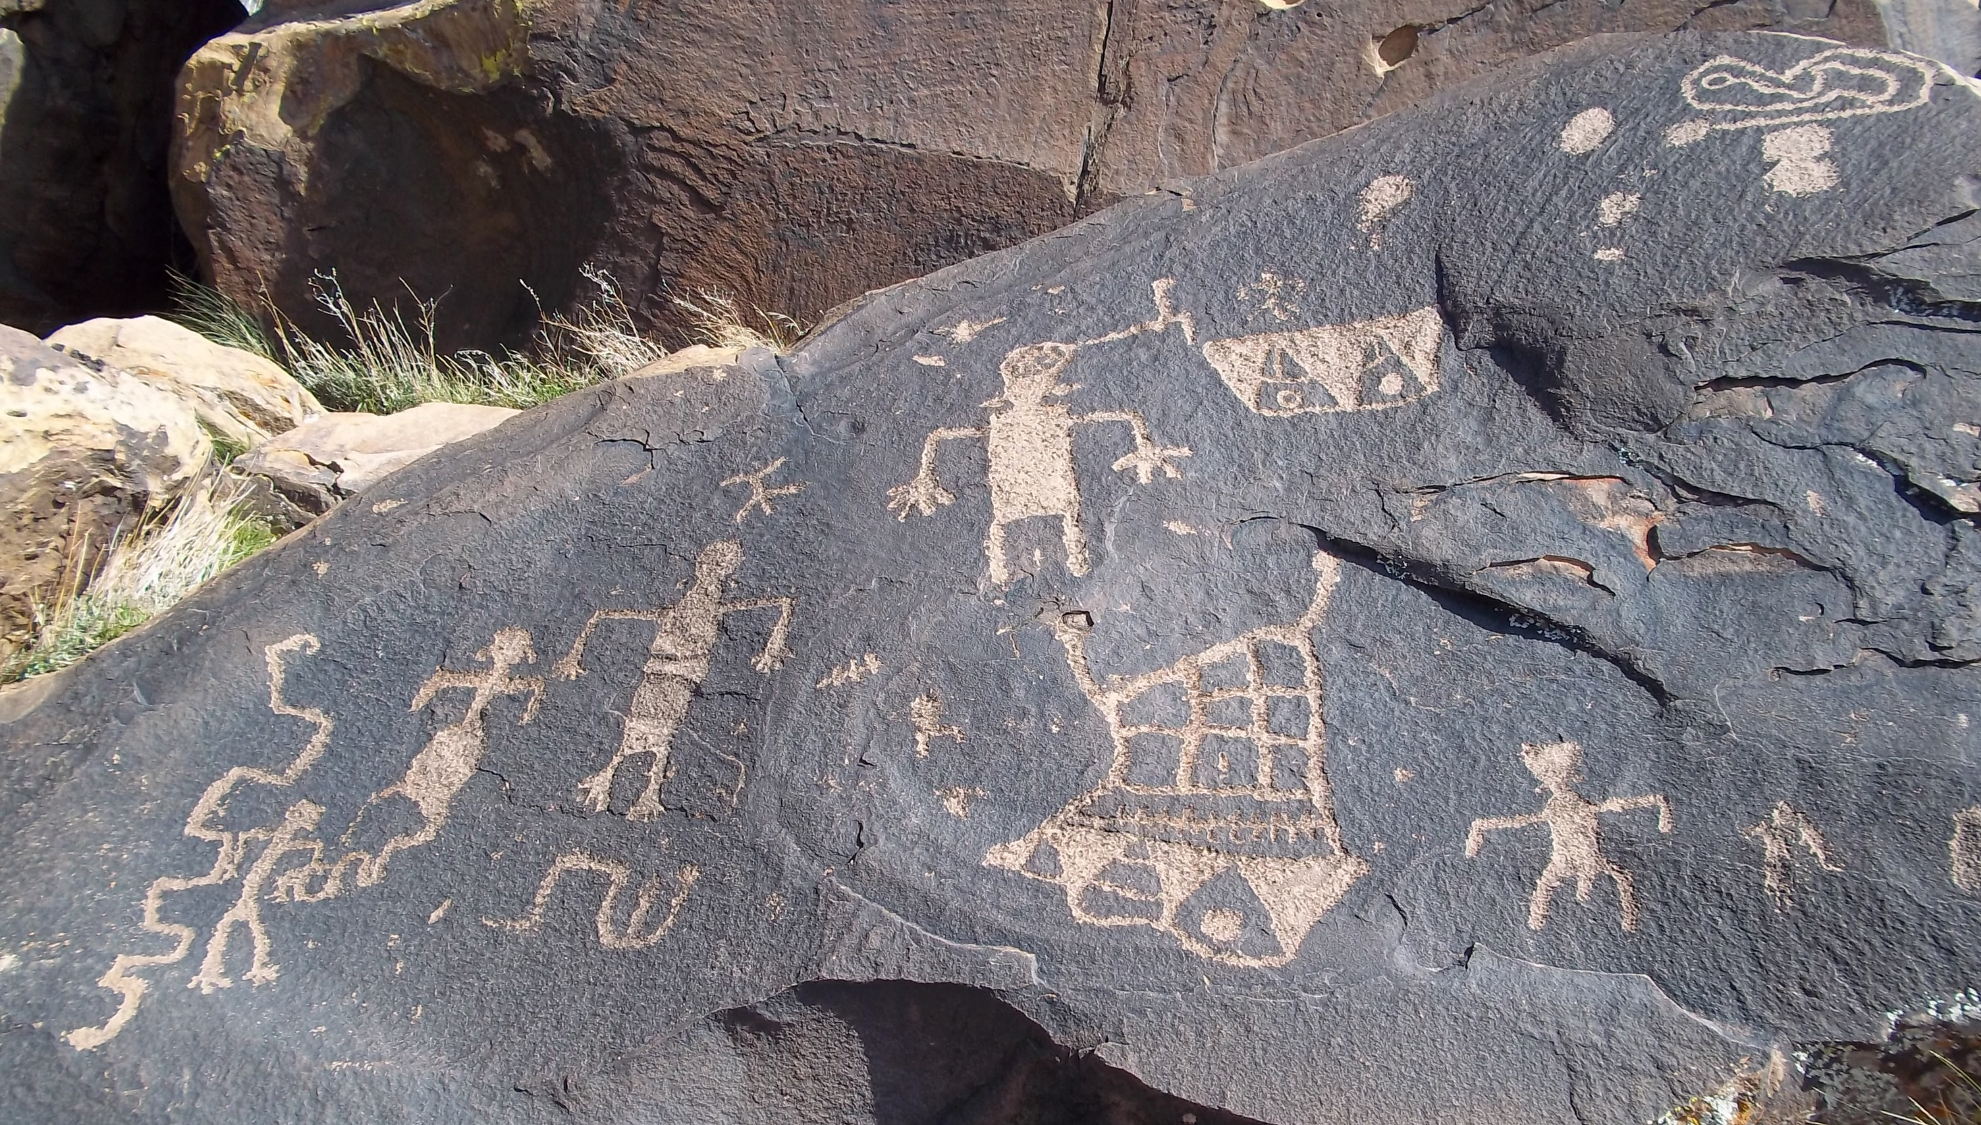

Slide 16
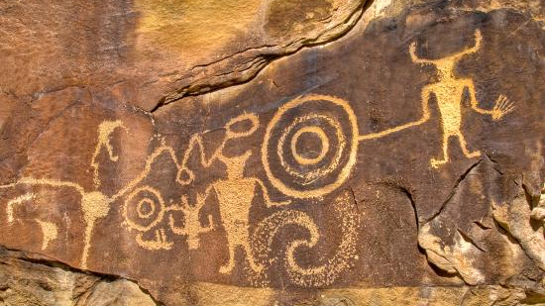

Slide 17
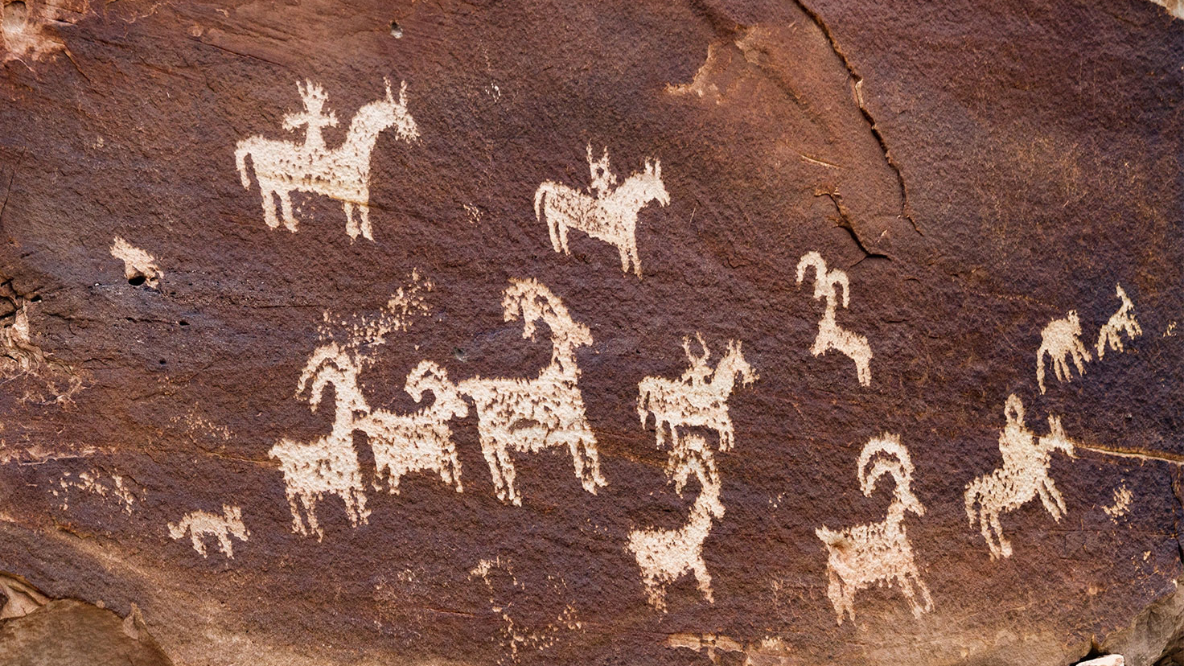

Slide 18
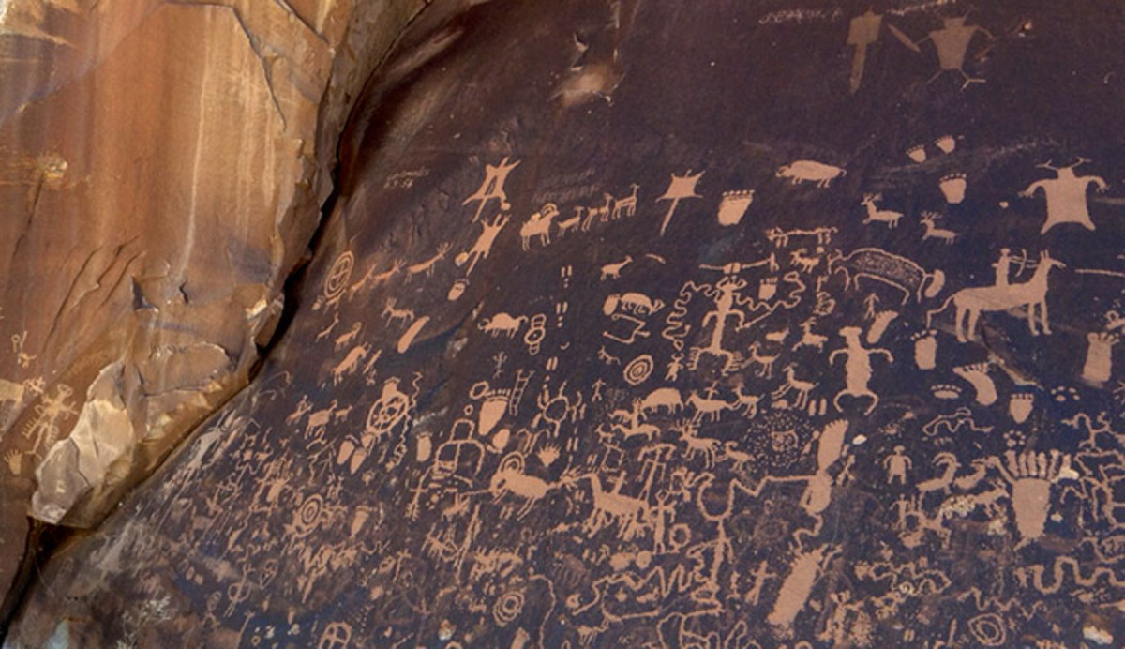

Slide 19
Pictogram
A petroglyph (petrogram) representing an idea.

Slide 20
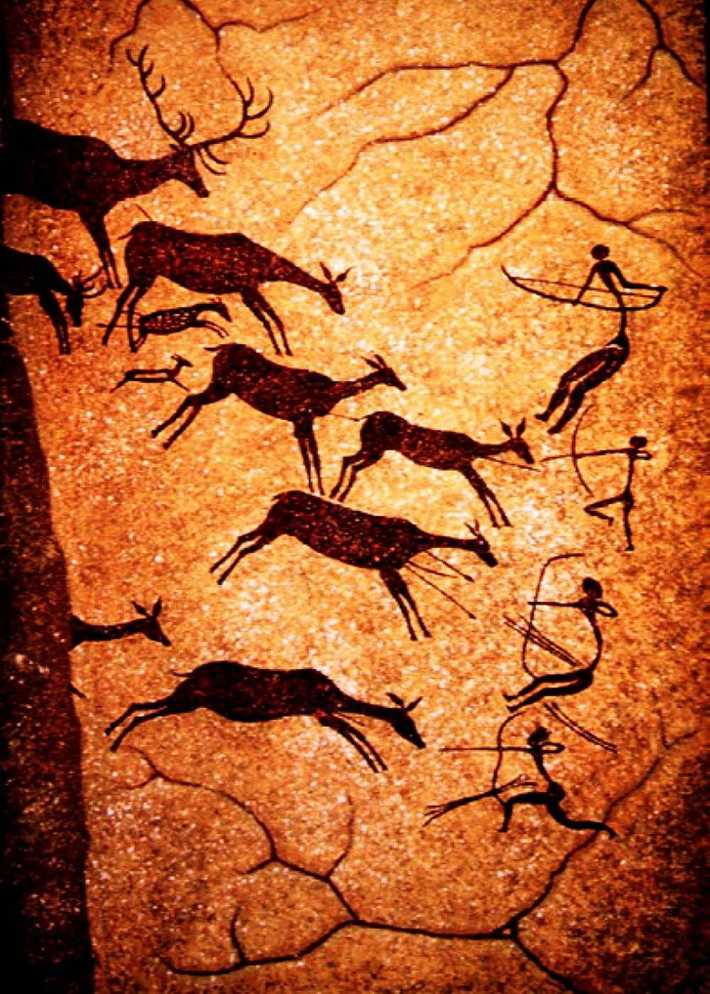
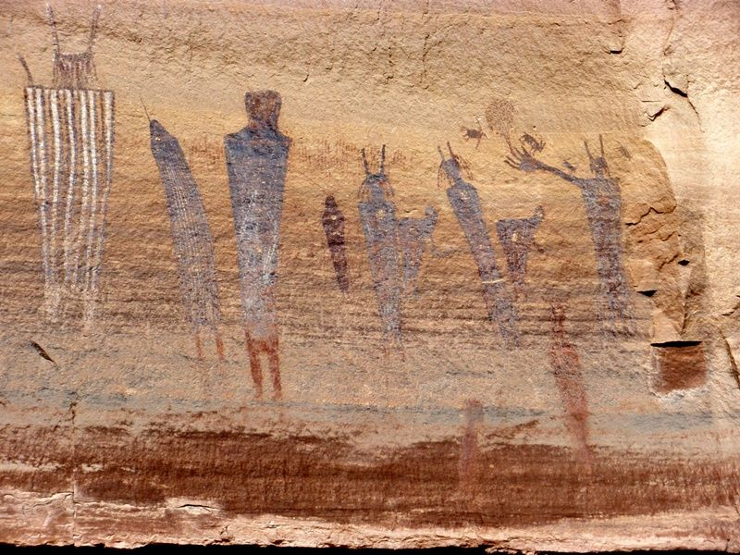
A scene

Slide 21
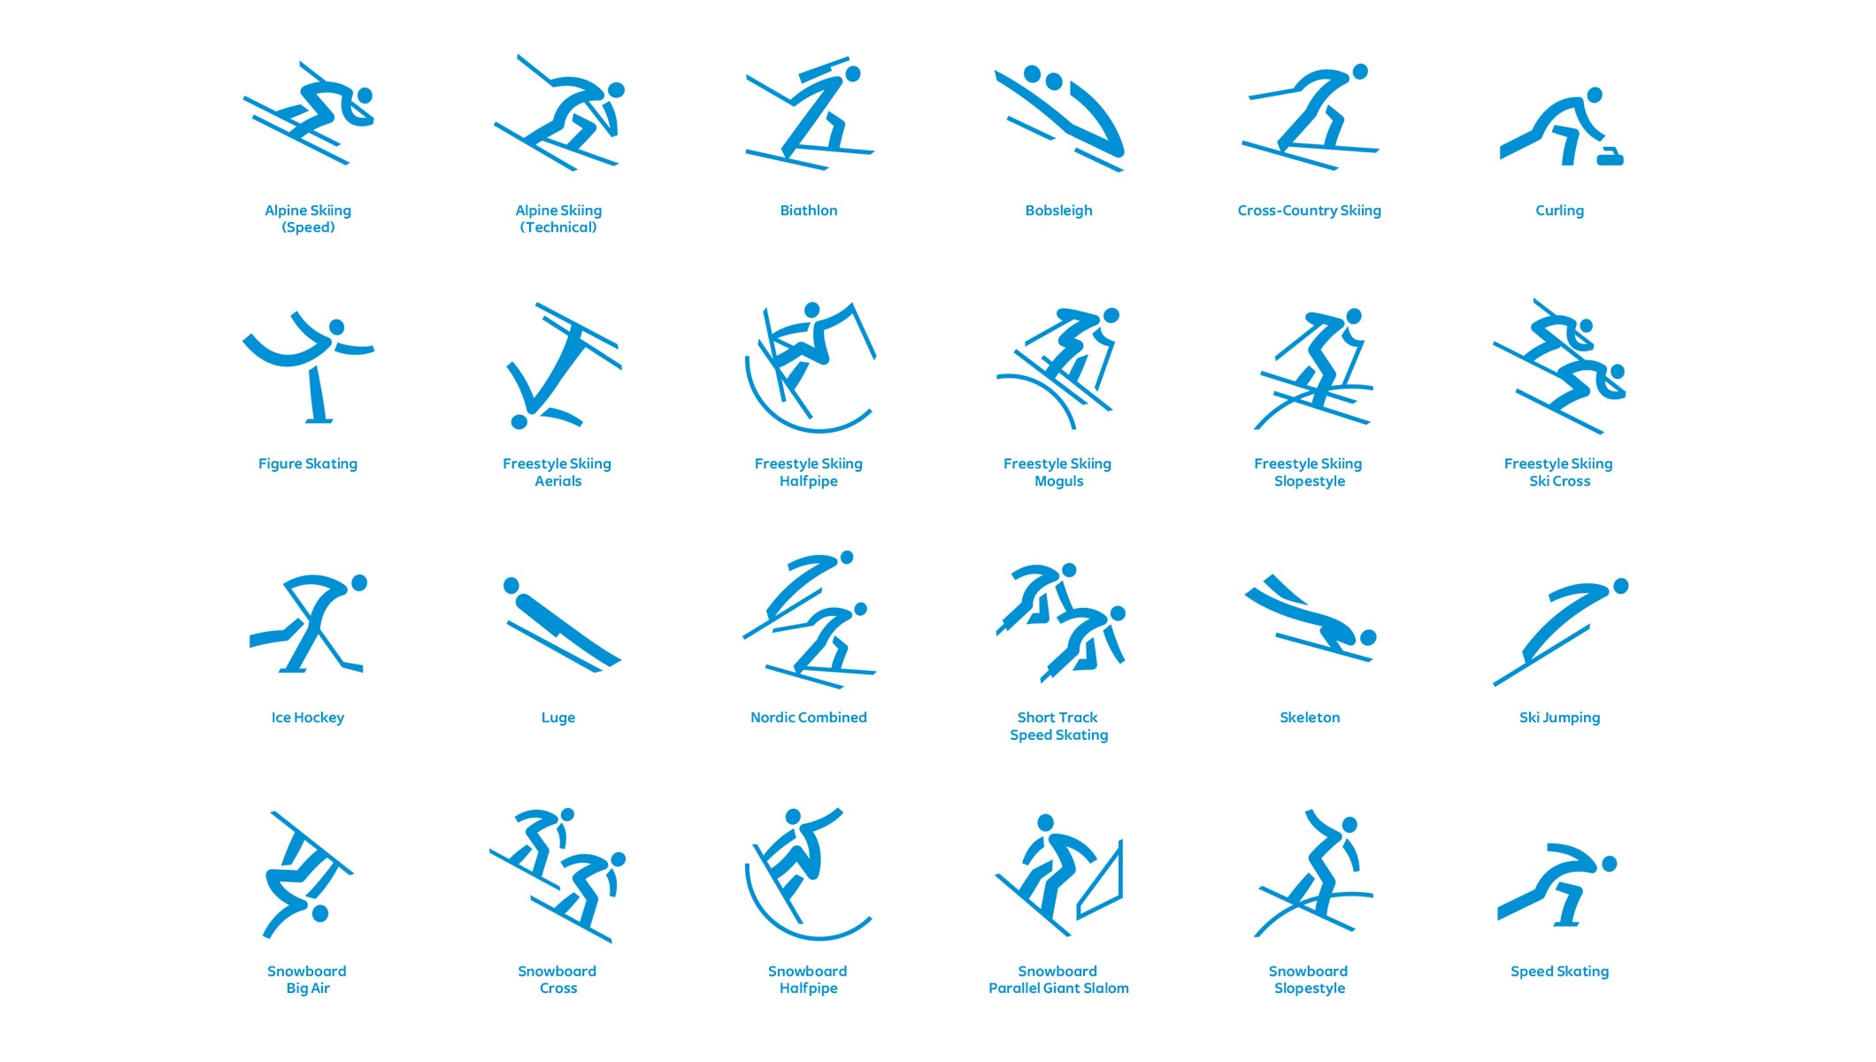

Slide 22
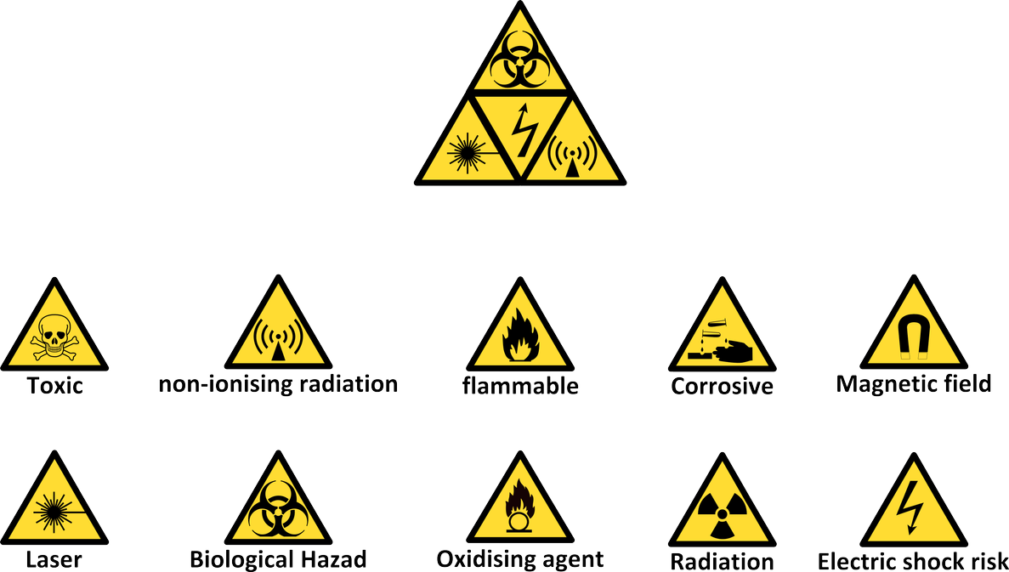

Slide 24
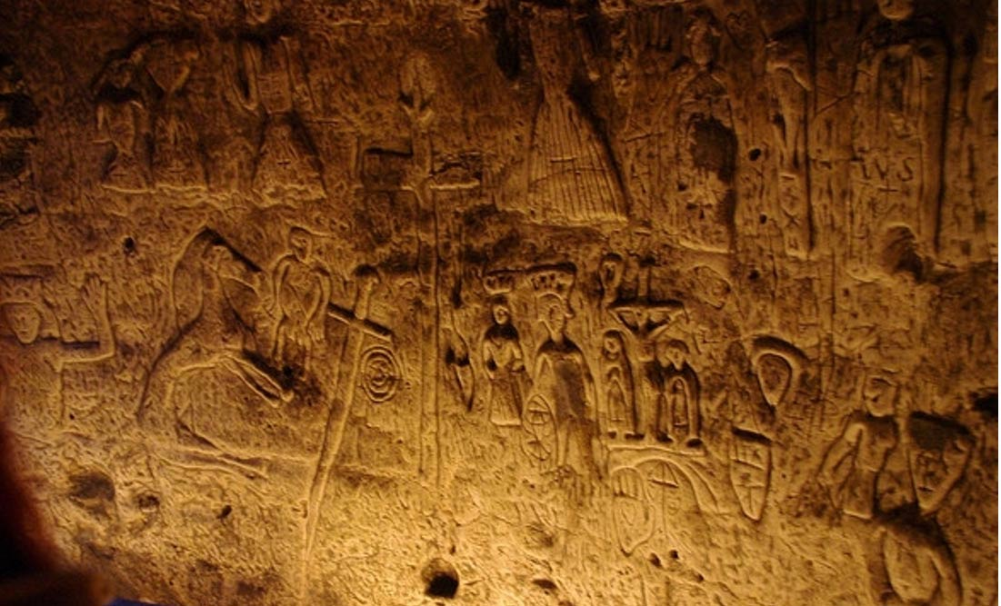
Ideograms

Slide 26
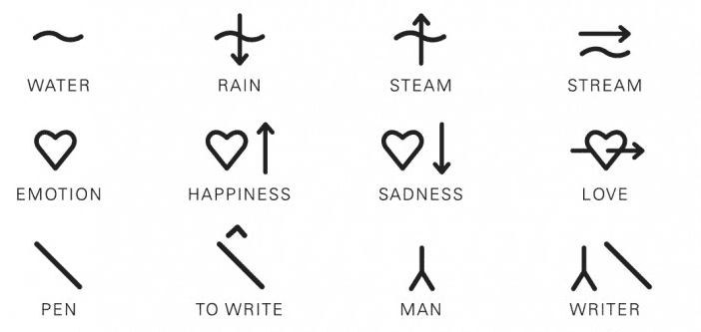
Ideograms
Symbols used to represent an idea or concept.

Slide 27
Create an Ideogram
He loves his mother.

Slide 28
Create an Ideogram
Write a simple sentence.
What ideas are present.
Design an ideogram to represent that idea. (Pictograms for nouns)

Slide 29
Create an Ideogram
How many symbols would you need?
120

Slide 30
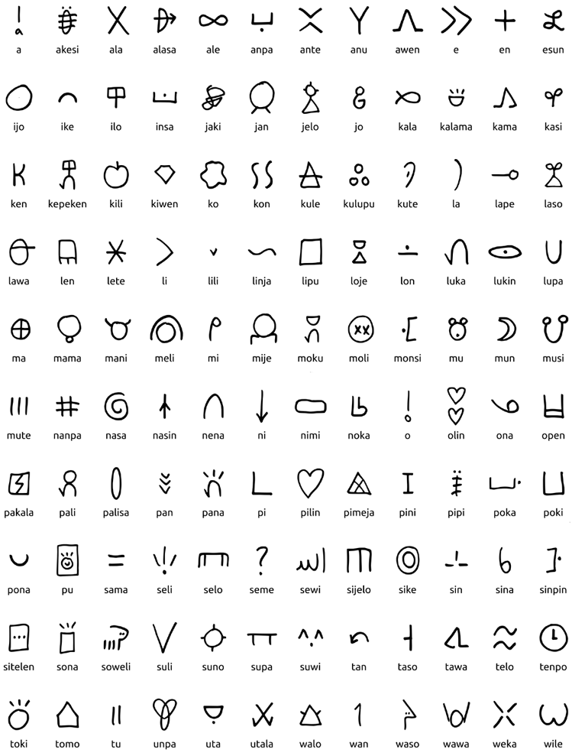
PONA:
cool
correct
fine
fix
friendly
good
great
hoorah
hurrah
improve
like
nice
peaceful
pleasing
positive
positivity
repair
right
simple
simplicity
simply
thank you
thanks
useful
well
yay
yay!
you're welcome
TOKI:
chat
communicate
communication
discourse
eloquent
grammatical
hello
hey
hi
jargon
language
lingo
linguistic
pronounce
say
speak
speech
talk
tell
think
tongue
verbal
https://www.youtube.com/watch?v=rIY28wOZCJQ

Slide 31
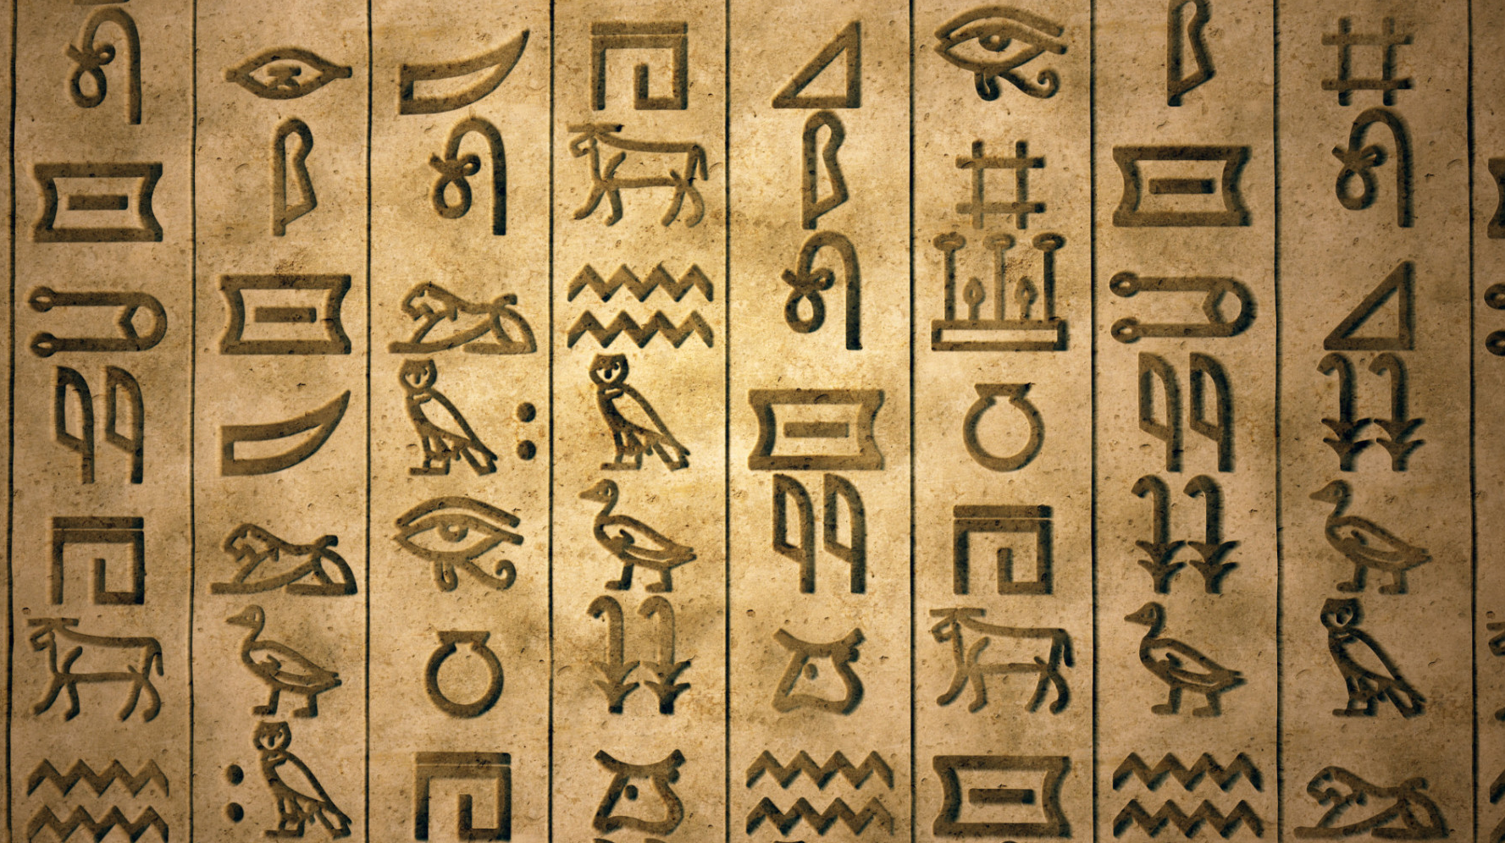
Logograms

Slide 32
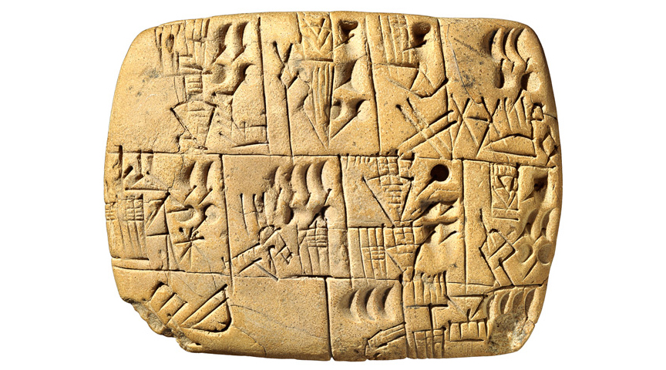
Logograms
A symbol that represents a word
or morpheme.

Slide 33
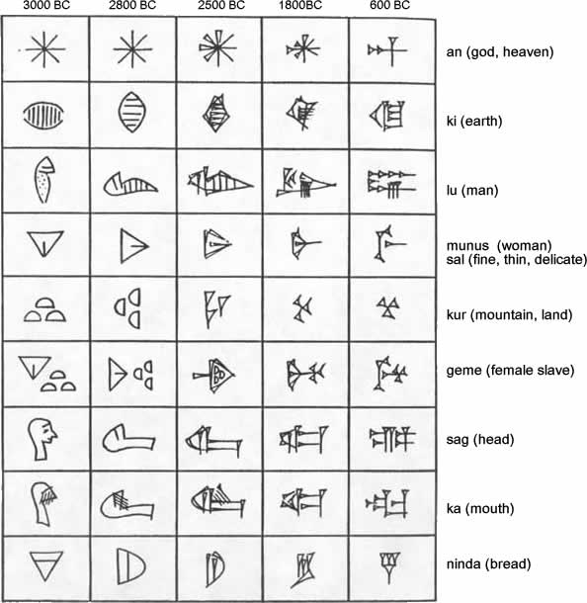
Cuneiform
Sumer (Sumerians)

Slide 34
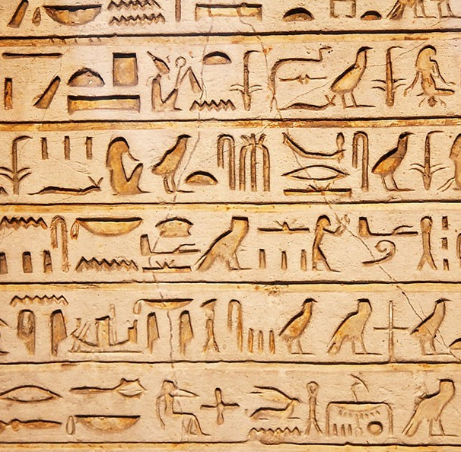
Hieroglyphs
Egypt (Egyptians)

Slide 35
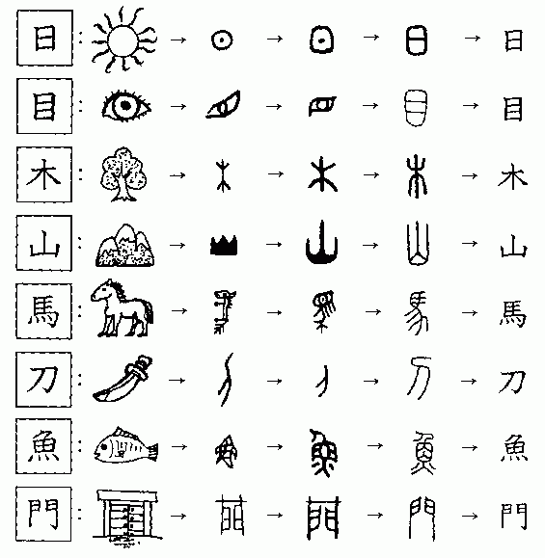
Chinese
China

Slide 36
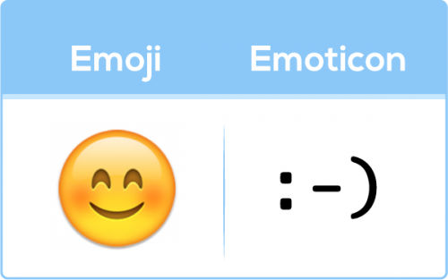
Emojis + Emoticons
Pictograms, logograms, petroglyphs, ideograms
Smiley Face (Invented by Carnegie Mellon in 1982)

Slide 37
Emoticons
How many can you guess?

Slide 38
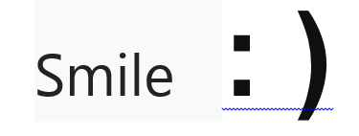
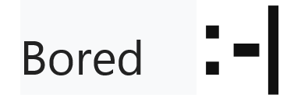

Slide 39
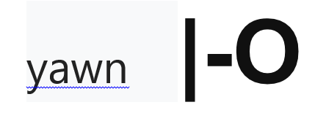

Slide 42
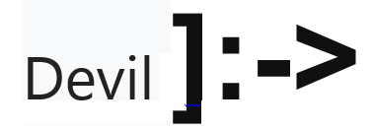

Slide 47
Emoticons
Why use emoticons?
Emoticons are used to show emotion in text.
It is difficult to understand the writers intention. There are no facial clues or body language to help.
Emoticons are usually added to the end of a sentence to provide context for the text.

Slide 48
Emoticons
You are crazy.
You are crazy :P

Slide 49
Emoticons
I will see you tomorrow.
I will see you tomorrow @}->--

Slide 50
Emoticons
Oh, you are a doctor?
Oh, you are a doctor? (@_@)

Slide 51
Text Message
Use your phones to send a message to another teacher (here).
Try using emoticons.

Slide 52
