Slide 1
What have you done?

Slide 2
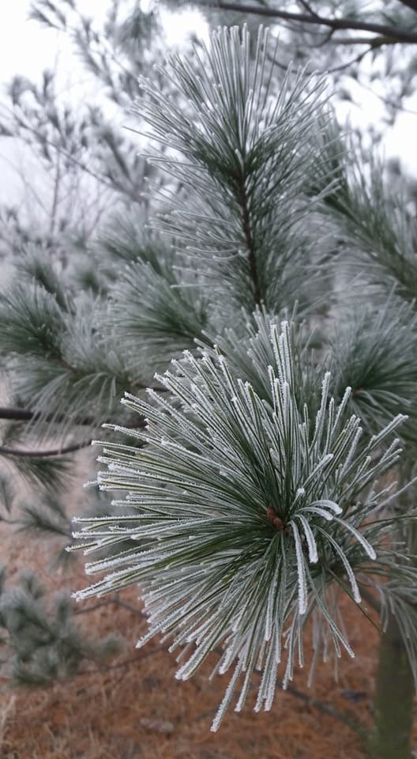
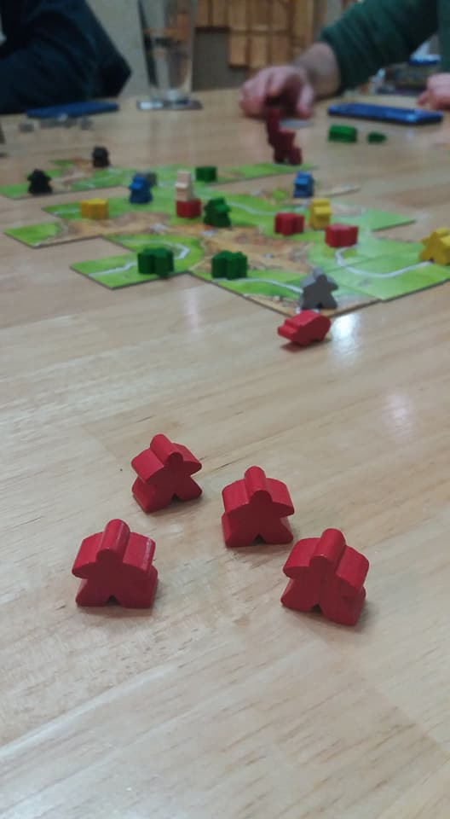
Vacation
How was your vacation?

Slide 3
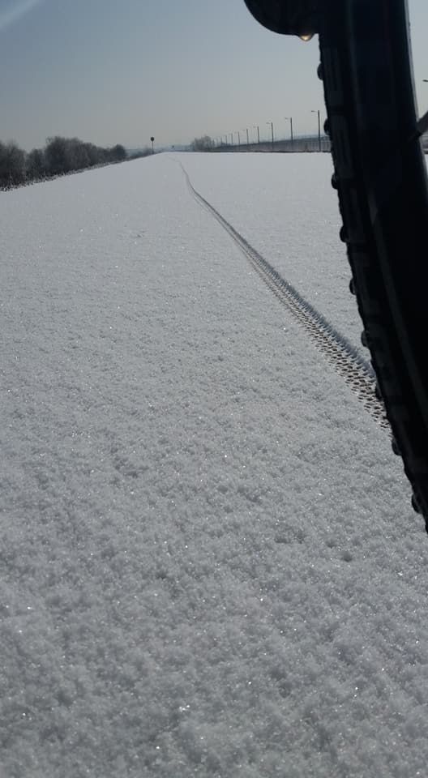
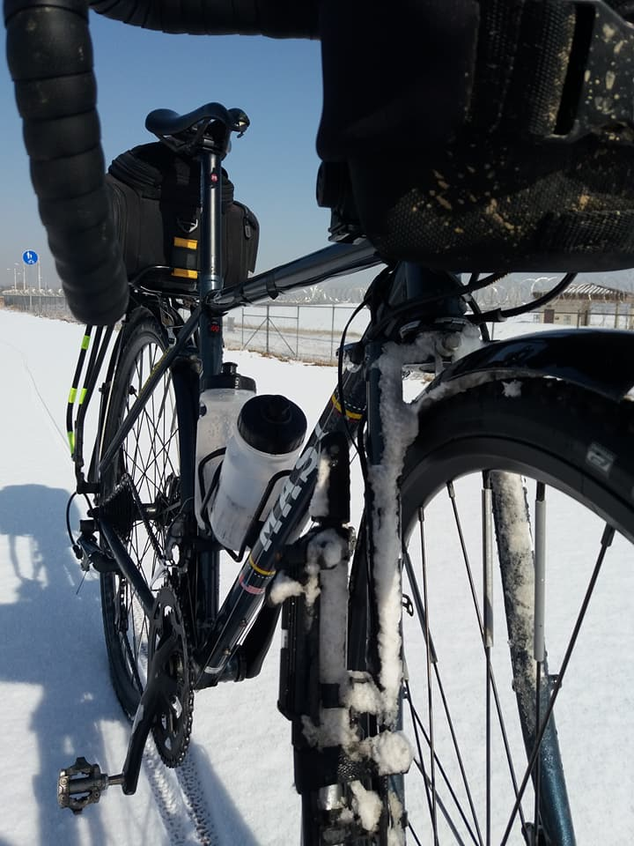
Vacation
What did you do?
What was the best part?

Slide 4
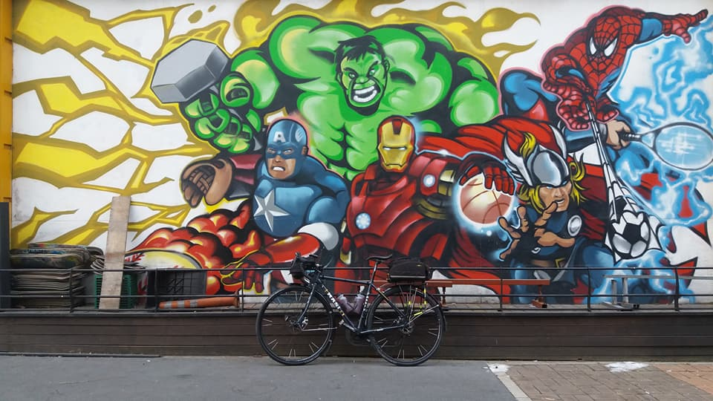

Slide 5
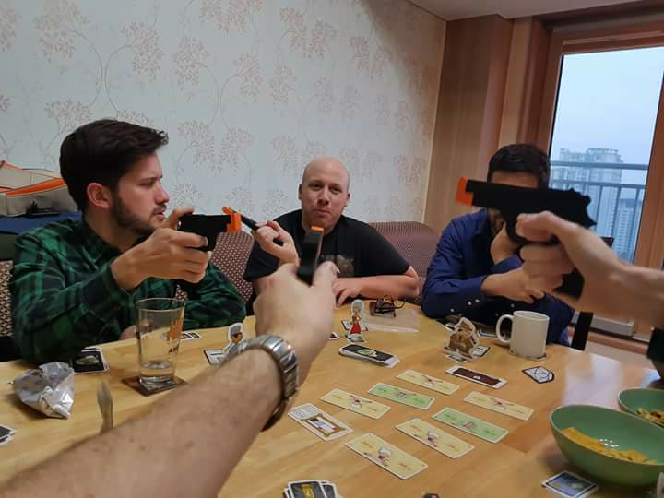
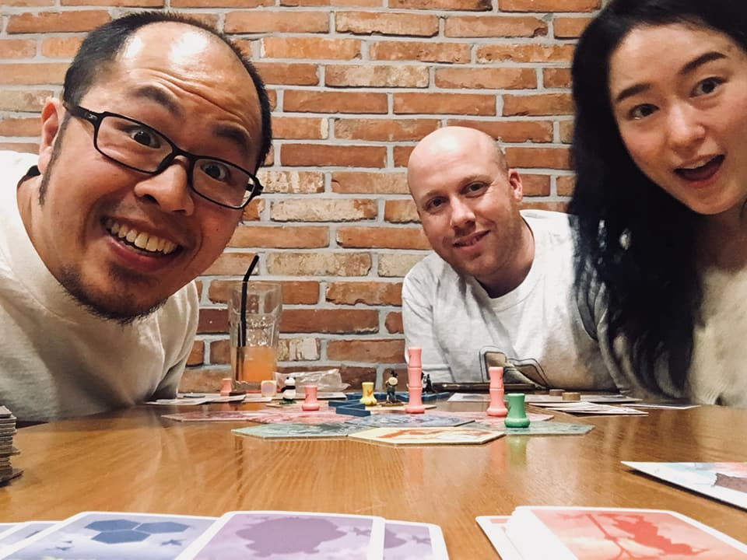
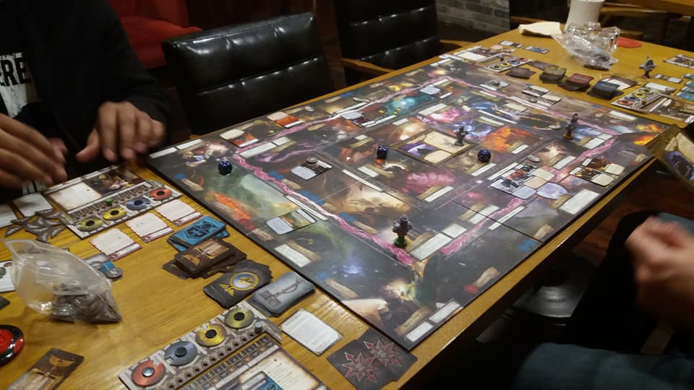
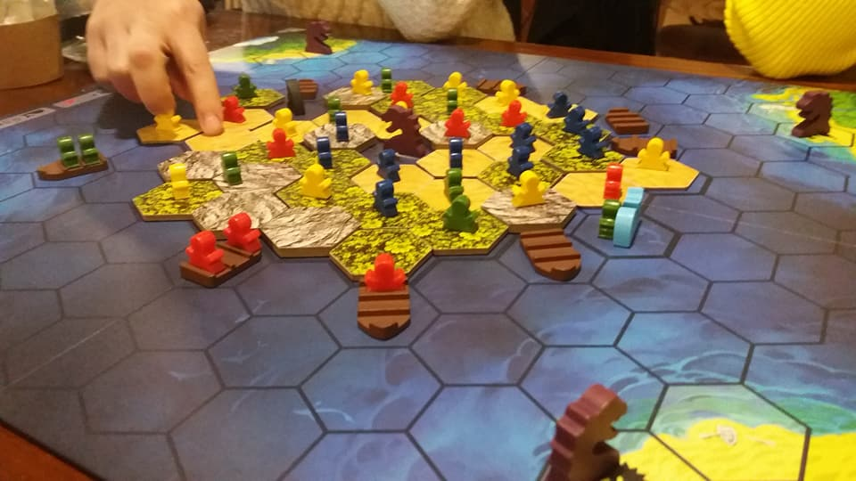
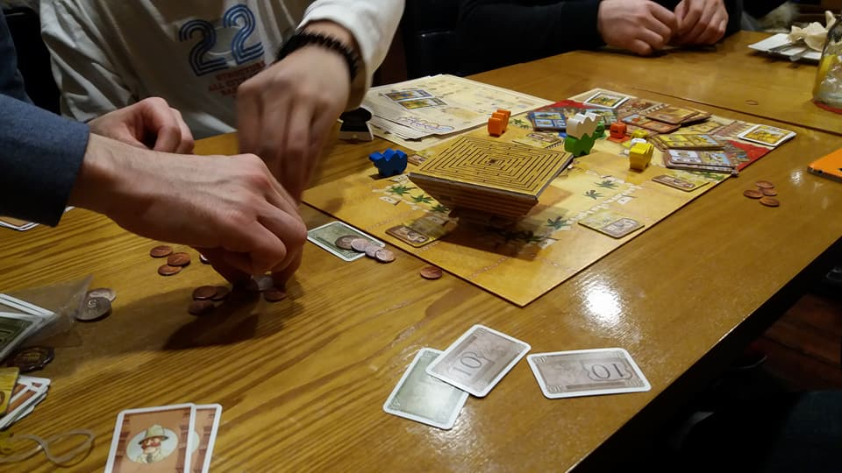
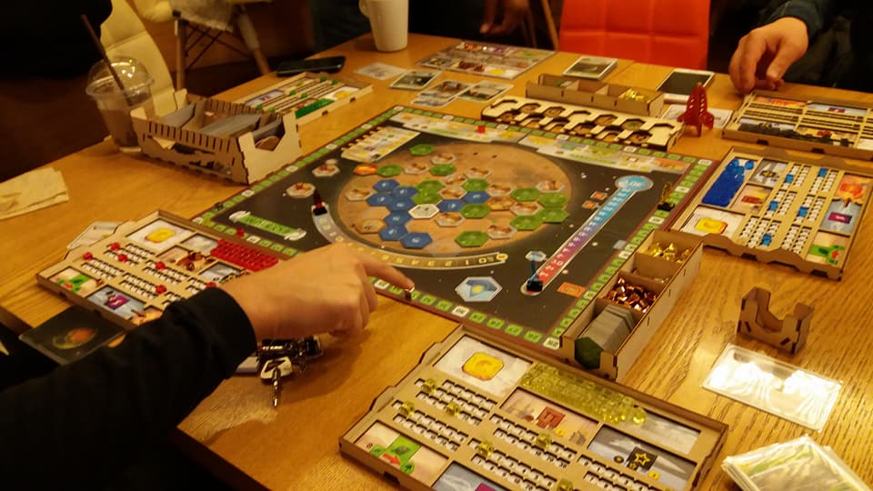

Slide 6
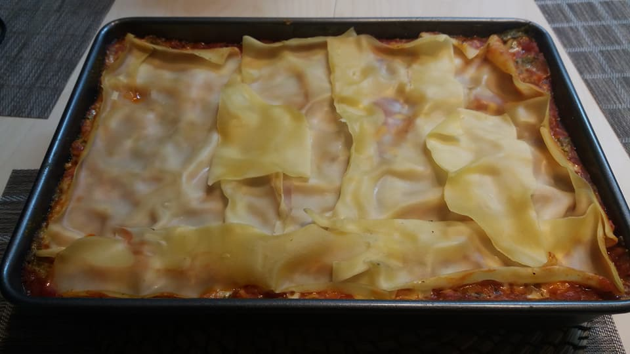
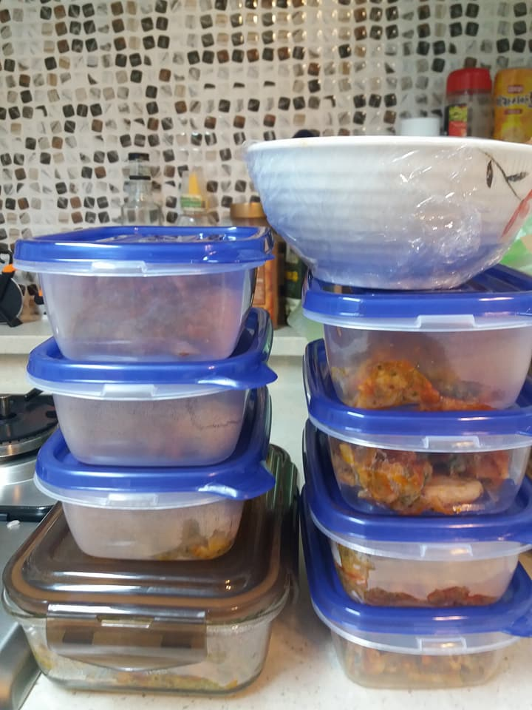
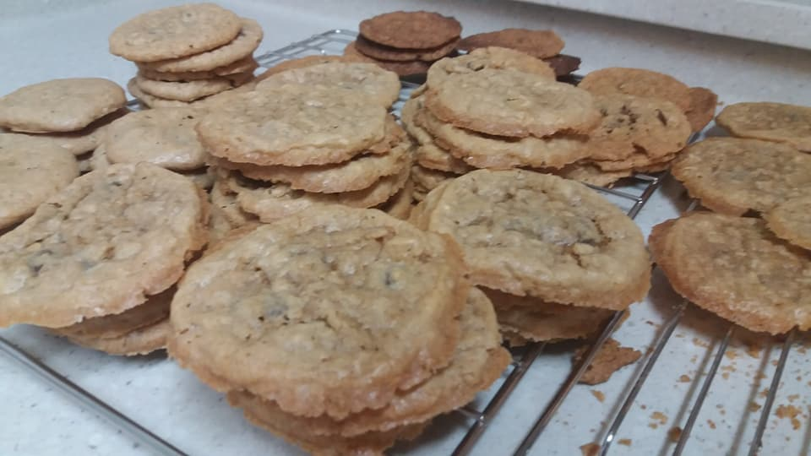

Slide 7
Vacation
Where did you go?

Slide 8
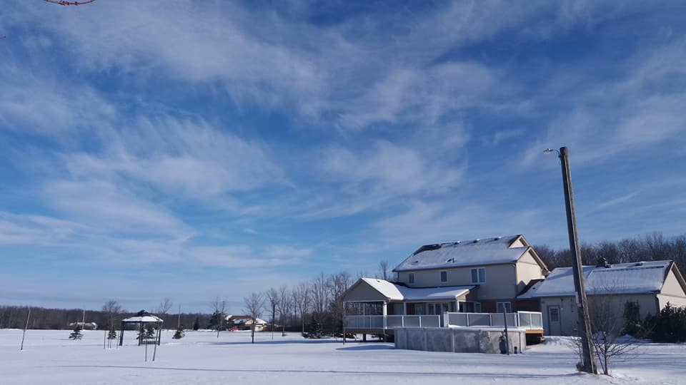

Slide 11
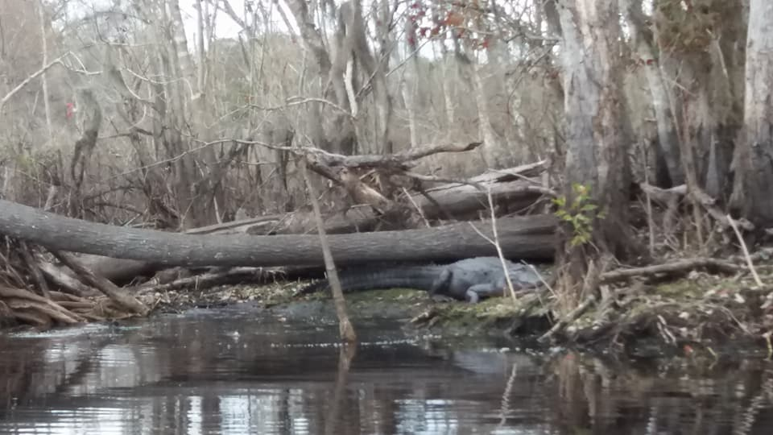
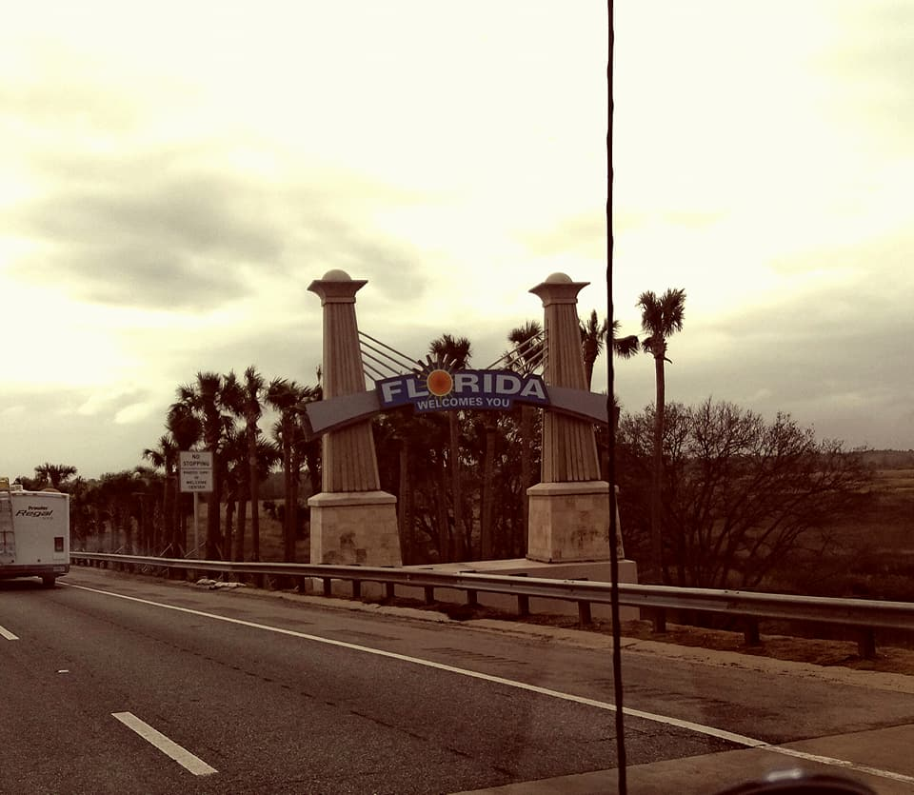

Slide 12
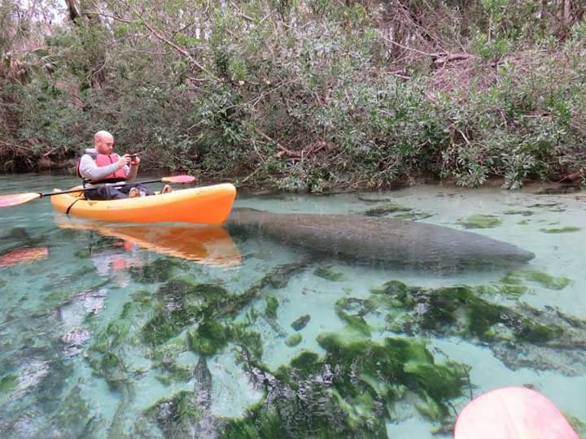

Slide 13
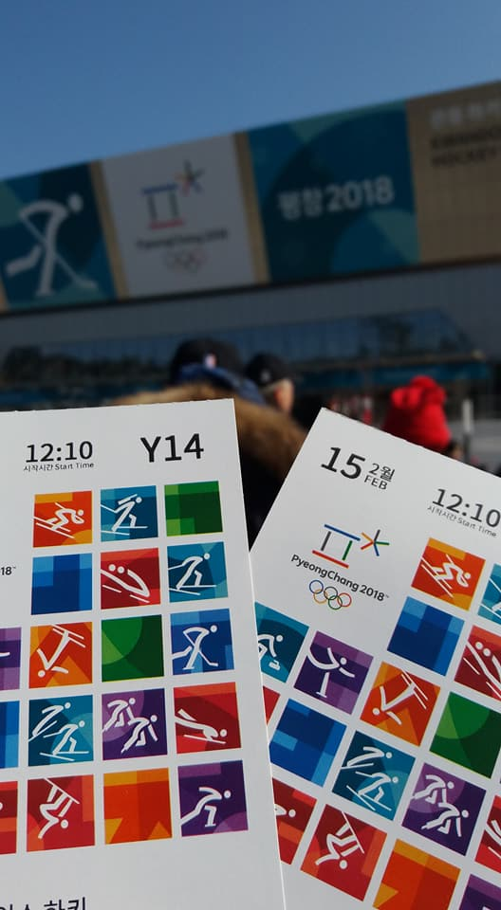
Vacation
Who saw the Olympics?

Slide 14
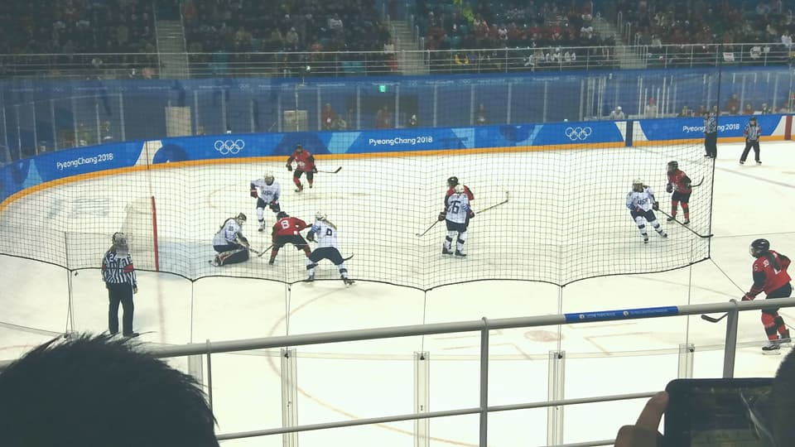

Slide 15
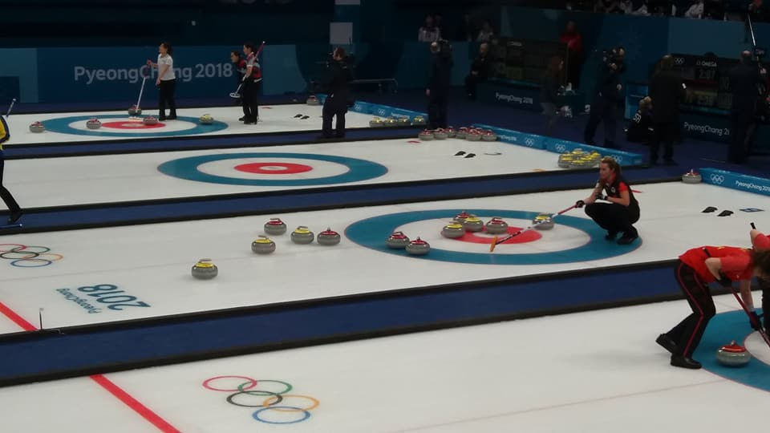

Slide 16
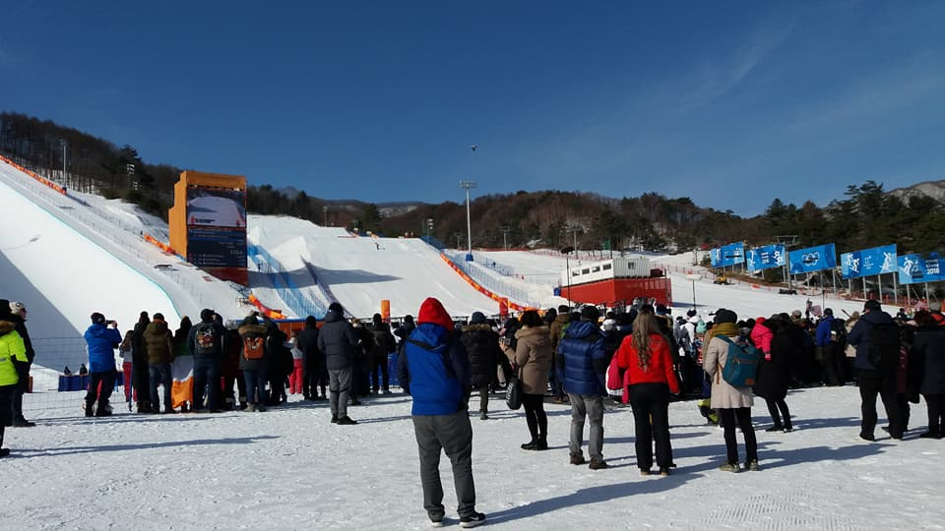

Slide 17
Present Perfect Tense
An action that started in the past, but continues (not finished).
An action but the time doesn’t matter.

Slide 18
Present Perfect Tense
How to make a sentence:
Present Perfect = _____ “to have” + past participle ___________.

Slide 19
Present Perfect Tense
How to make a sentence:
Present Perfect = _____ “to have” + past participle ___________.
To Have…
He
She
I
You
We
They
has
has
have
have
have
have

Slide 20
“I have (past tense) _______”
An action that started in the past, but continues (not finished).
Example:
I have worked here for three years.
I have studied English since I was 5 years old.

Slide 21
“I have (past tense) _______”
An action but the time doesn’t matter.
Example:
I have played volleyball.
I have eaten kangaroo.
ate?

Slide 22
(past participle) Eat Ate Eaten
Break
Choose
Come
Do
Feel
Get
Go
Broke
Chose
Came
Did
Felt
Got
Went
Broken
Chosen
Come
Done
Felt
Got / Gotten
Gone

Slide 23
(past participle) Eat Ate Eaten
Know
Run
See
Sing
Steal
Take
Wear
Write
Knew
Ran
Saw
Sang
Stole
Took
Wore
Wrote
Known
Run
Seen
Sung
Stolen
Taken
Worn
Written

Slide 24
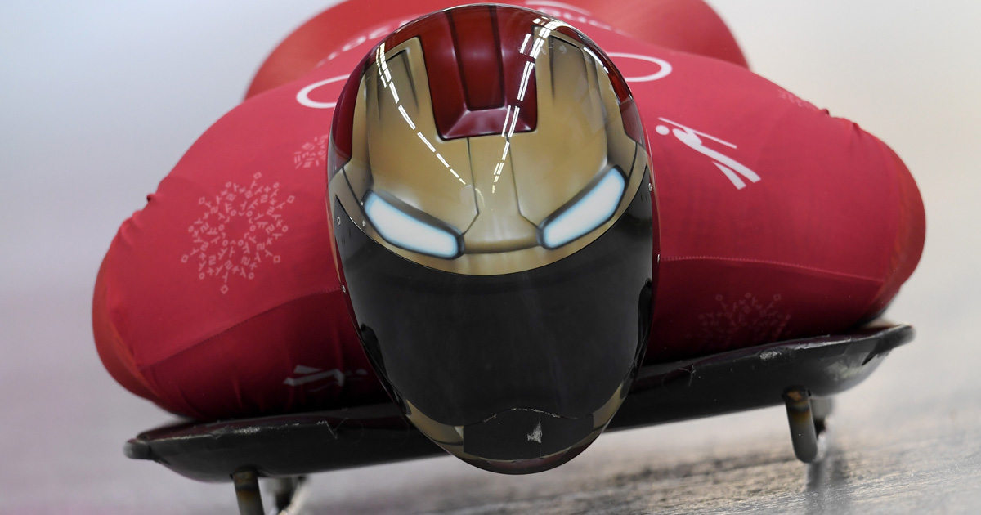
Yun Sung-bin:
He won a gold medal.
He has been to the Olympics before.
He has practiced skeleton since 2012.
In 2016, he received a Rookie Award at the 21st Korean Athletics Awards.

Slide 25
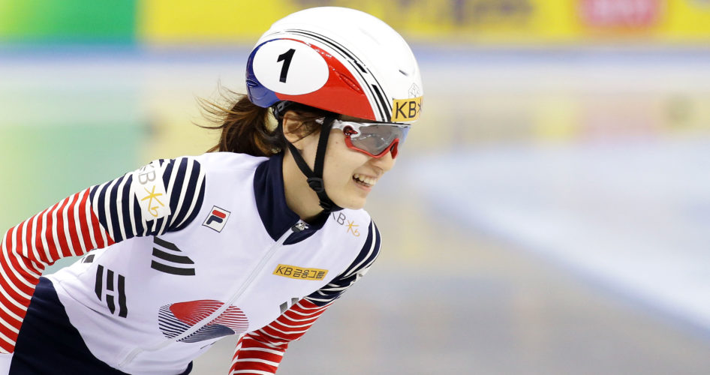
Choi Minjeong
1. She won a gold medal for ladies 1500m speed skating this year.
2. She has been skating since 2004.
In November 2016, she got the world record for 1500m speed skating.
3. In November 2016, she has gotten the world record for 1500m speed skating.
Choose the incorrect sentence:
4. She received the Top Player Award at the 2016 Korean Women's Sports Grand Awards

Slide 26
Team Corea
1. North and South Koreans played hockey together.
2. There has been players from other countries too.
There were players from other countries too.
3. Randi Griffin has been playing on the Korean hockey team since 2014.
Choose the incorrect sentence:
4. She was born in American, but naturalized to Korea in 2014.

Slide 27
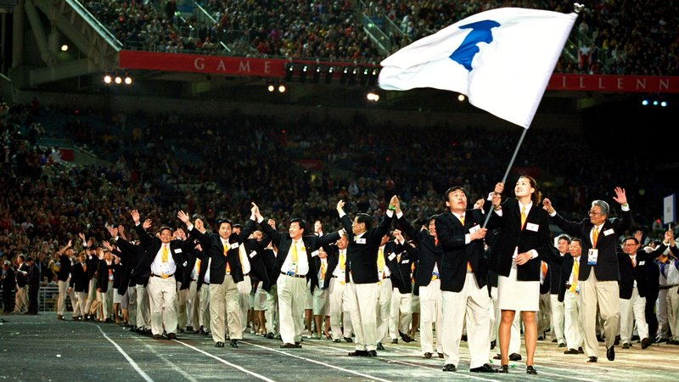
Team Corea
was
1. The unified Korean flag _______ used by the hockey team.
has been
2. It __________ used since 1991 any time North and South Korea compete together.
was
3. It ________ first used in the 1991 World Table Tennis Championships.
Choose the incorrect sentence:
4. The women’s team even __________ a gold medal at the championships.
won

Slide 28
What have you done?
Make teams
Each team will make some statements using “I have (past participle)…”
You will get points if you can say something that no other student has done.

Slide 29
What have you done? - Rules
Make a statement “I have ______ ______________.”
If its also true for you, put up your hand.
Count the points.
At the end, the lowest score wins.

