Slide 1
Past Perfect Tense
Had had…

Slide 2
Review
What is a Present Perfect Sentence?
How do we make that sentence?
When do we use that sentence?

Slide 3
Wolves Change Rivers
https://www.youtube.com/watch?v=ysa5OBhXz-Q

Slide 4
Past Perfect Tense
Something that happened in the past and something else happened after that.
Before / Until

Slide 5
Past Perfect Tense
Past Perfect Tense = ___ + “had” + (past participle)…
Examples:
Walk -> walked
Have -> had
Write -> written
Break -> broken
Forget -> forgotten

Slide 6
Practice
She ____ lived in South Africa for three years before she moved to England.
had

Slide 7
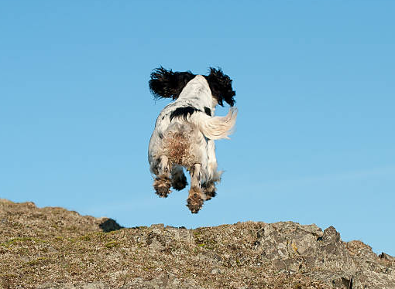
Practice
Before I knew it, my dog ____ run away.
had

Slide 8
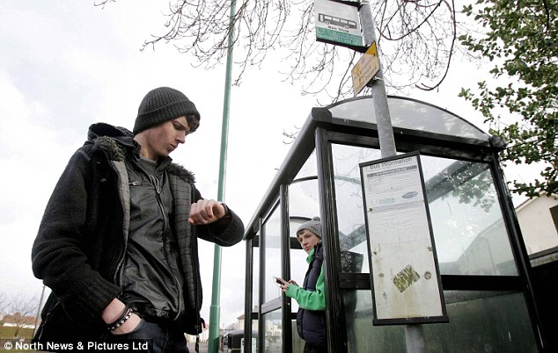
Practice
had waited
He _________ two hours before the bus finally came.
Wait

Slide 9
Practice
I didn’t say anything until she _________ talking.
had finished
Finish

Slide 10
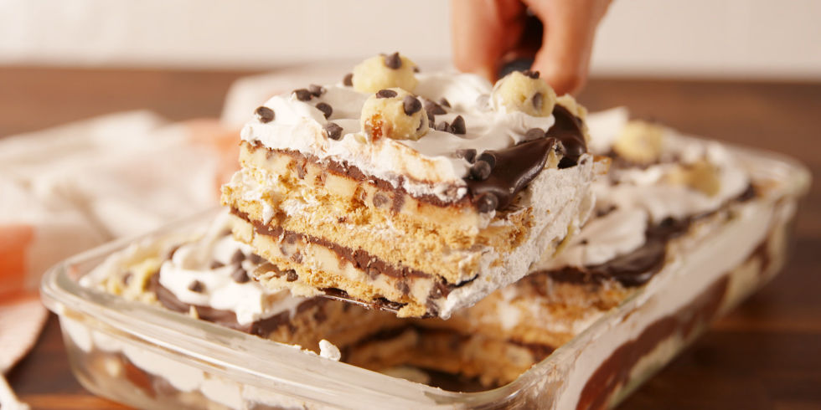
Practice
I _______ enough to eat, but I still ate dessert.
had had
Have

Slide 11
Practice
She (had / has) lived here since she was 10 years old.

Slide 12
Practice
He (had / has) lost his wallet a long time before going to the theater.

Slide 13
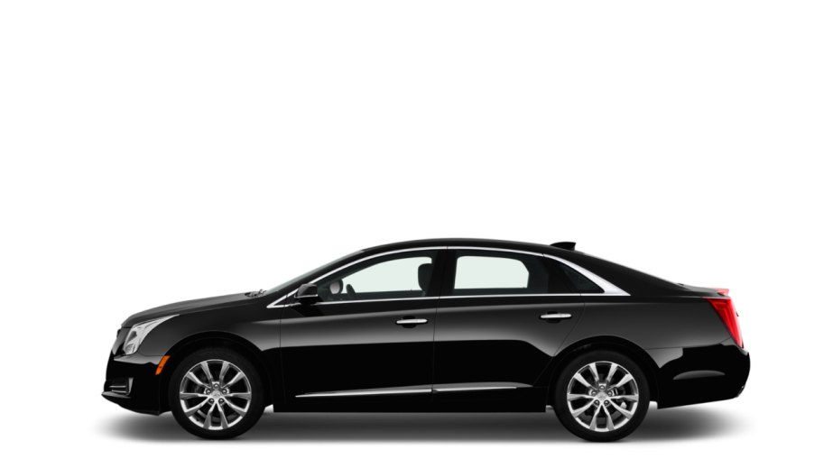
Practice
Until I turned 21, I (had / has) never driven a car.

Slide 14
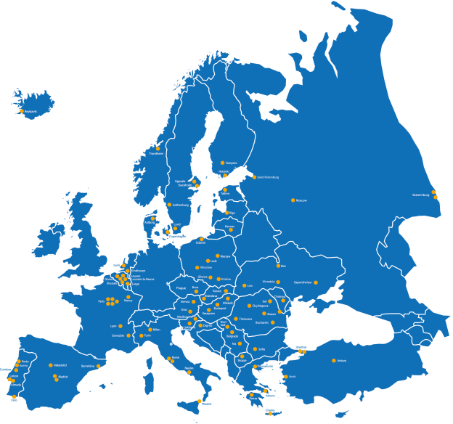
Practice
I (had / has / have) been to Europe.

Slide 15
Wolves of Yellowstone

Slide 16
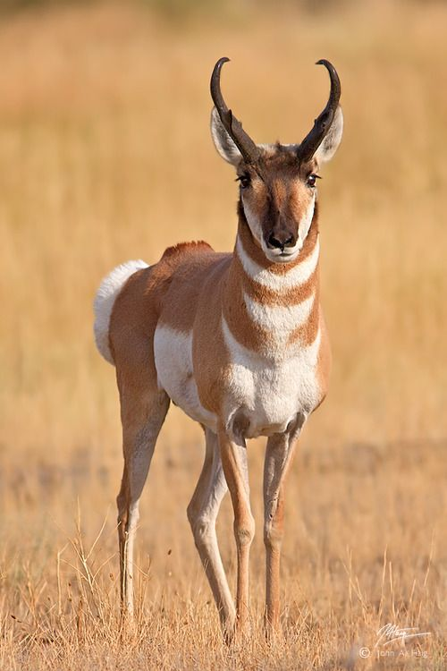
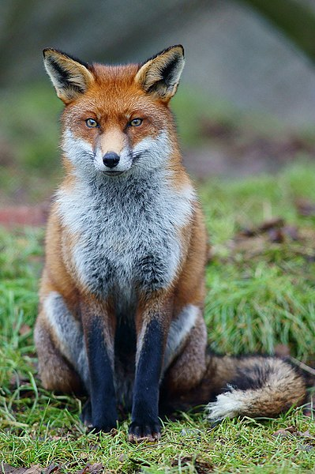
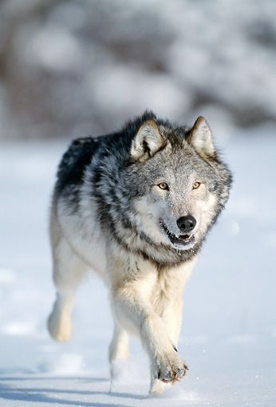
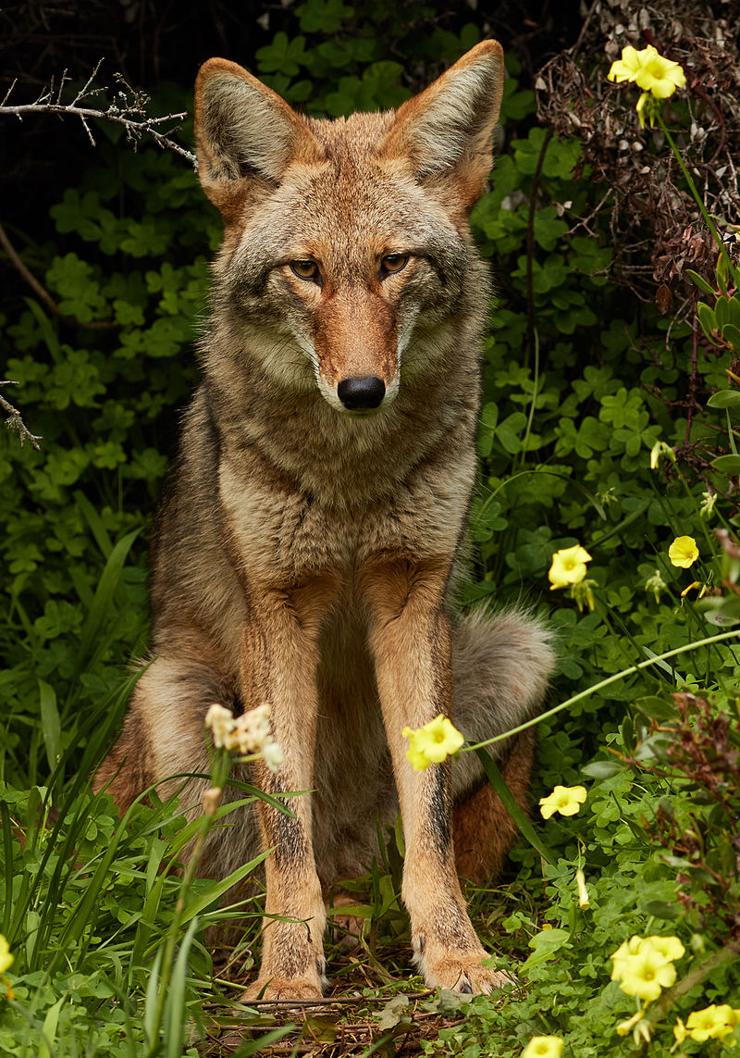
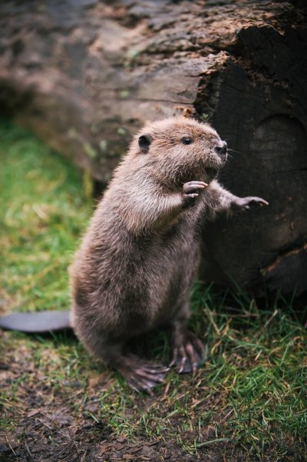
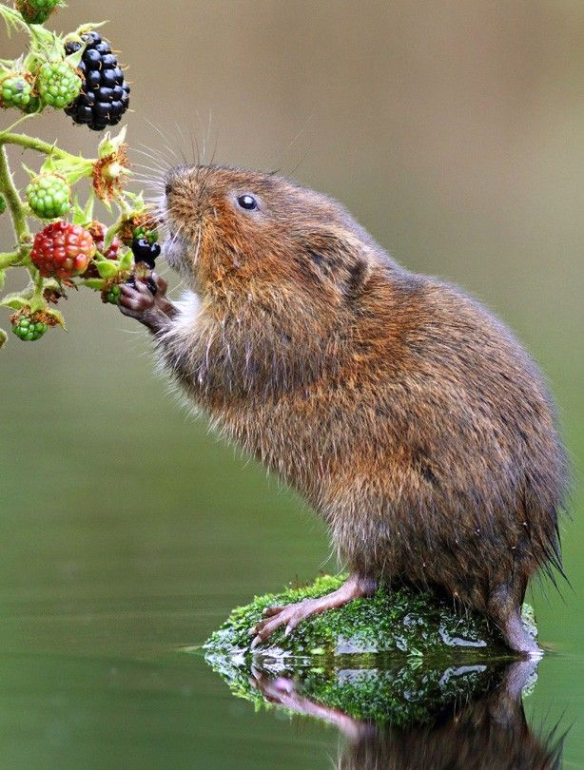
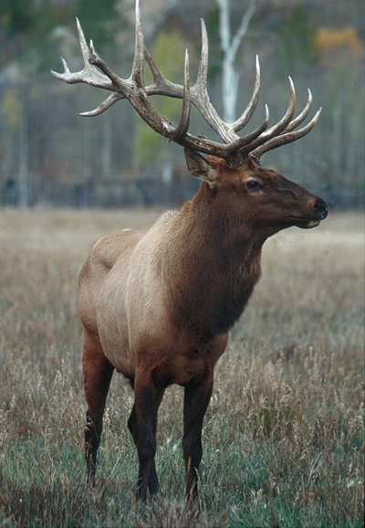
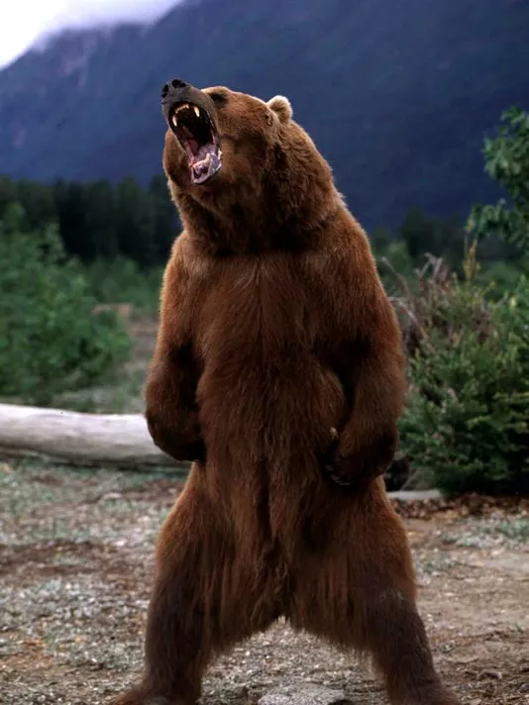
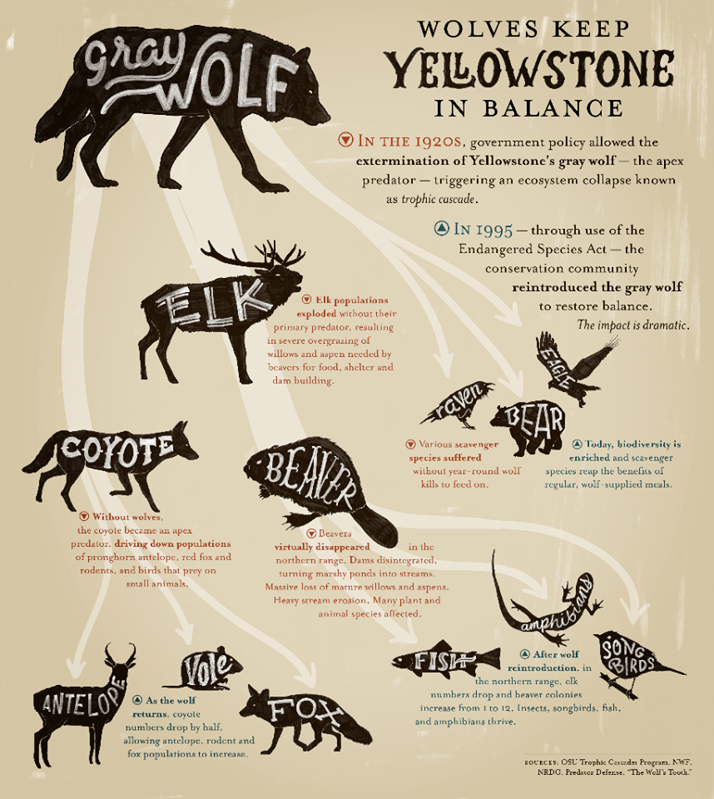
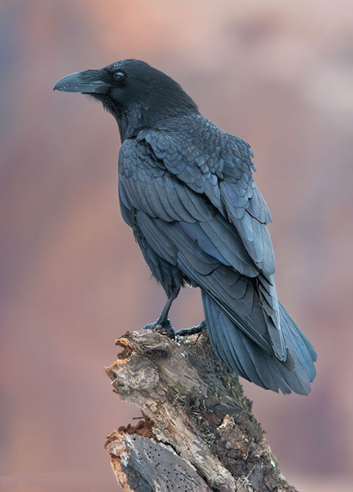

Slide 18
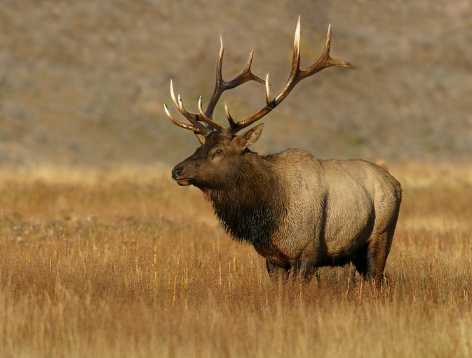
Who do you think eats elk?
Gray Wolves

Slide 19
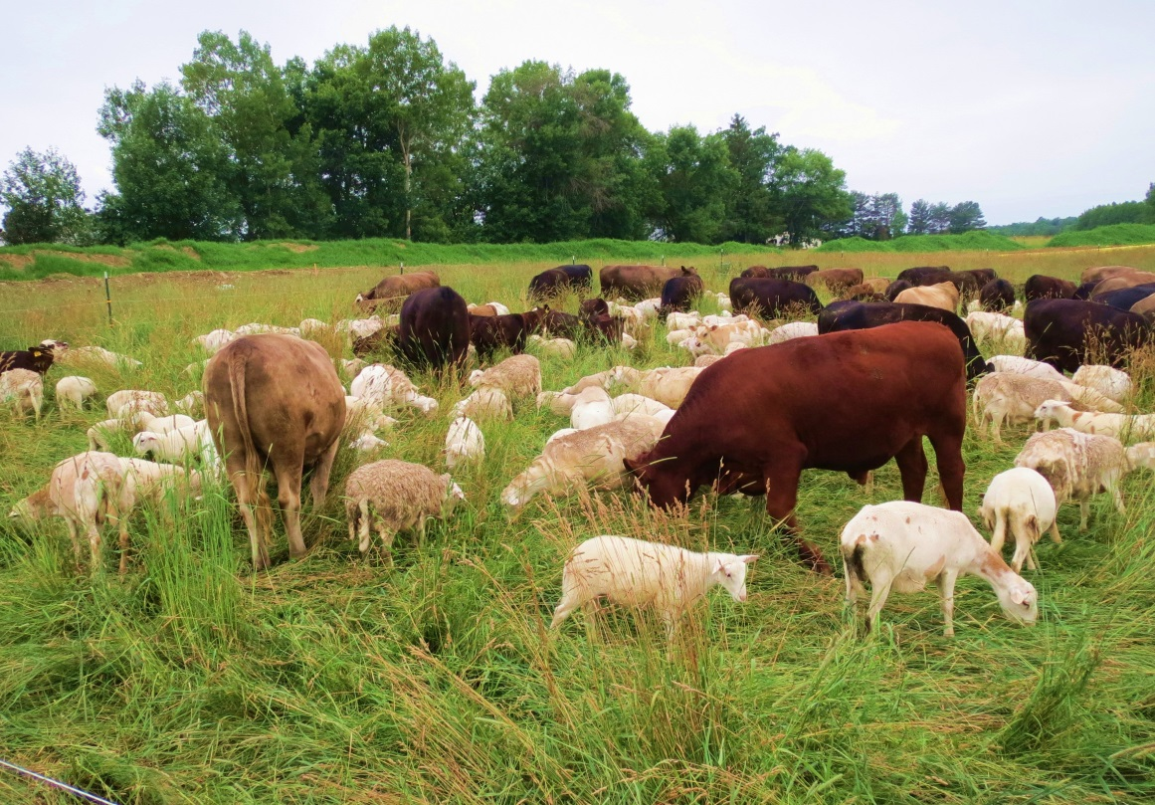
Who do you think ate farm animals?
Gray Wolves

Slide 20
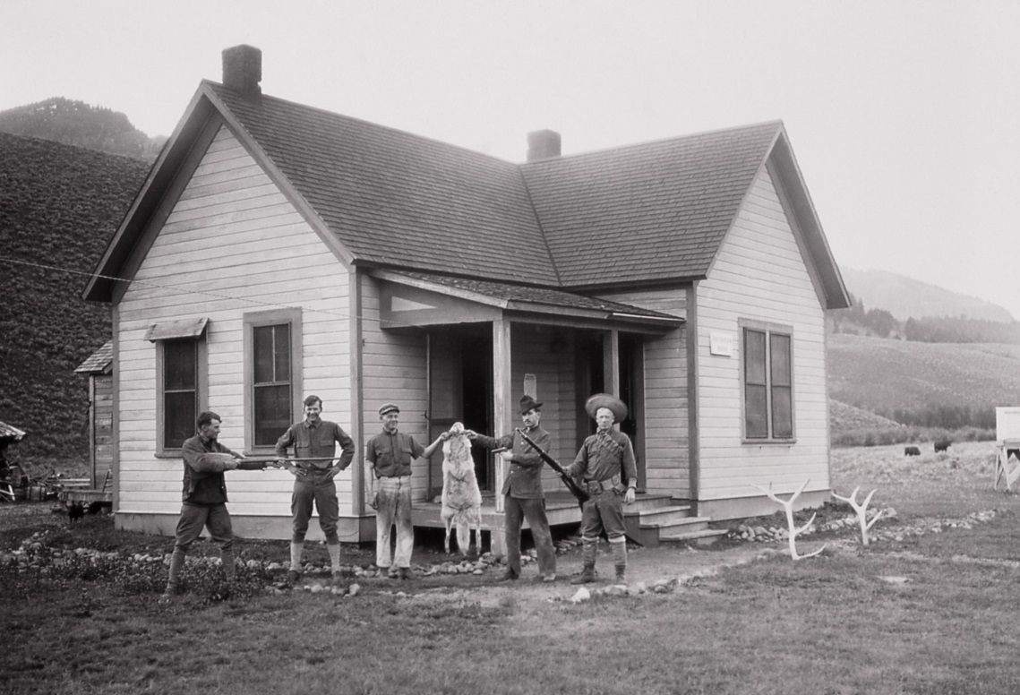
What do you think the farmers did?
They killed the Gray Wolves.

Slide 21
What would happen to the elk if gray wolves disappear?
There would be many elk.

Slide 22
Why would that be bad?
There would be many elk.

Slide 23
Then what would happen if you reintroduced gray wolves?
The gray wolves would eat the elk and the number of elk would decrease.

Slide 24
The Wolves of Yellowstone
By the early 1990s, gray wolves (A) had begun / have begun to disappear from Yellowstone National Park in the US, and this resulted in a growing elk population. The elk ate too many leaves from the trees, which reduced shade along the rivers and creeks. This caused water temperatures to increase and the populations of many fish species in the park (B) declined / had declined. To restore balance to Yellowstone’s ecosystem, sixty-six gray wolves from Canada were released into the park. As a result, the number of elk quickly dropped. Now, the ecosystem has returned to its natural balance. This story shows how crucial some species are for the health of an entire ecosystem. If we (C) respect / will respect all species equally, we’ll be able to continue to enjoy the natural world.

Slide 25
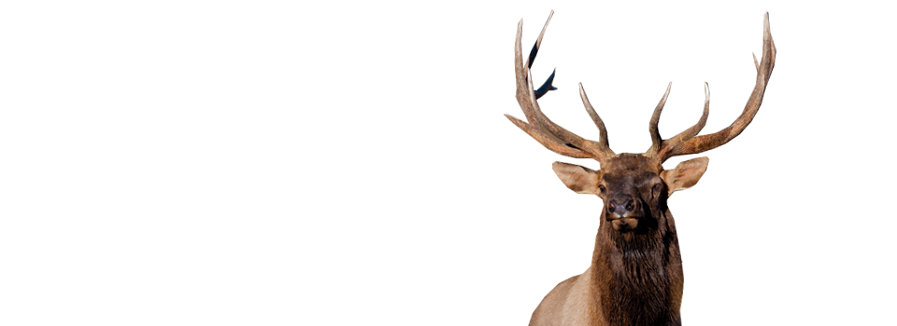
By the early 1990s, gray wolves (A) had begun / have begun to disappear from Yellowstone National Park in the US, and this resulted in a growing elk population.
By this time / Before this time…

Slide 26
What happened before the 1990s?
By the early 1990s, gray wolves (A) had begun / have begun to disappear from Yellowstone National Park in the US, and this resulted in a growing elk population.
Past perfect tense
- it happened before 1990s
- “had” + (past participle)

Slide 27
What happened before the 1990s?
By the early 1990s, gray wolves (A) had begun / have begun to disappear from Yellowstone National Park in the US, and this resulted in a growing elk population.
Where?
Yellowstone National Park

Slide 28
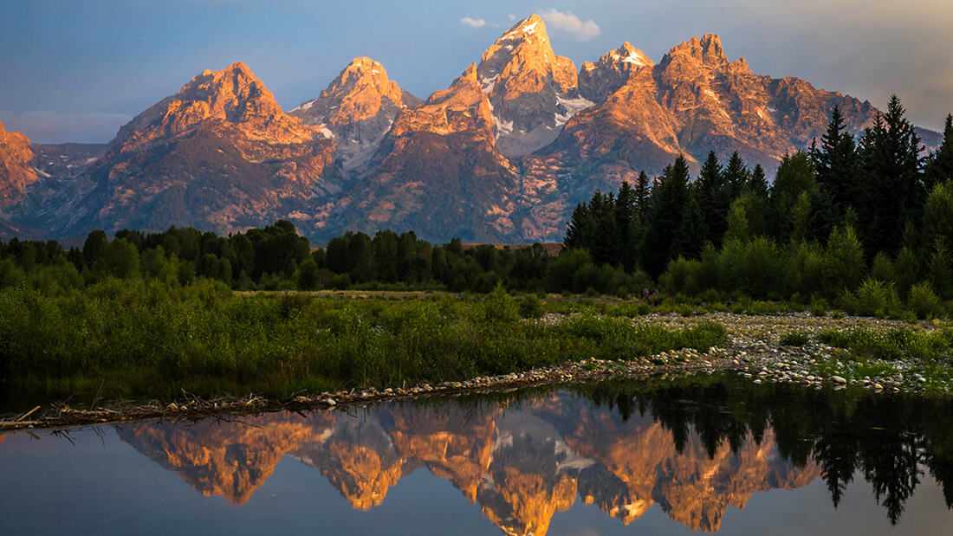

Slide 29
What was the result?
By the early 1990s, gray wolves (A) had begun / have begun to disappear from Yellowstone National Park in the US, and this resulted in a growing elk population.

Slide 30
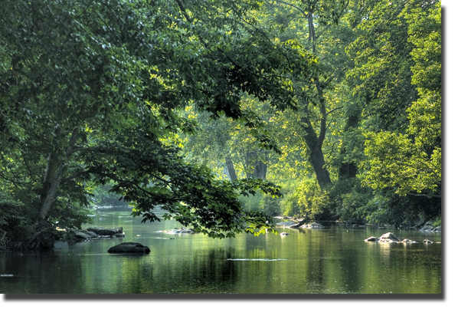
The elk ate too many leaves from the trees, which reduced shade along the rivers and creeks.

Slide 31
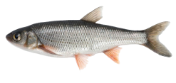
What caused it?
This caused water temperatures to increase and the populations of many fish species in the park (B) declined / had declined.
The elk ate the leaves…

Slide 32
What happened?
This caused water temperatures to increase and the populations of many fish species in the park (B) declined / had declined.

Slide 33
What happened ?
This caused water temperatures to increase and the populations of many fish species in the park (B) declined / had declined.

Slide 34
What happened?
This caused water temperatures to increase and the populations of many fish species in the park (B) declined / had declined.

Slide 35
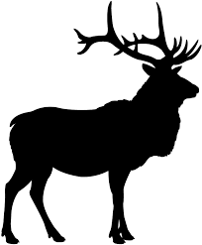
To restore balance to Yellowstone’s ecosystem, sixty-six gray wolves from Canada were released into the park.

Slide 36
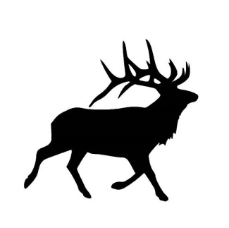
To restore balance to Yellowstone’s ecosystem, sixty-six gray wolves from Canada were released into the park.
As a result, the number of elk quickly dropped.

Slide 37
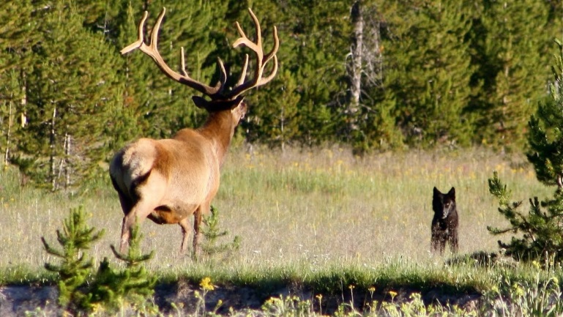
Now, the ecosystem has returned to its natural balance. This story shows how crucial some species are for the health of an entire ecosystem.

Slide 38
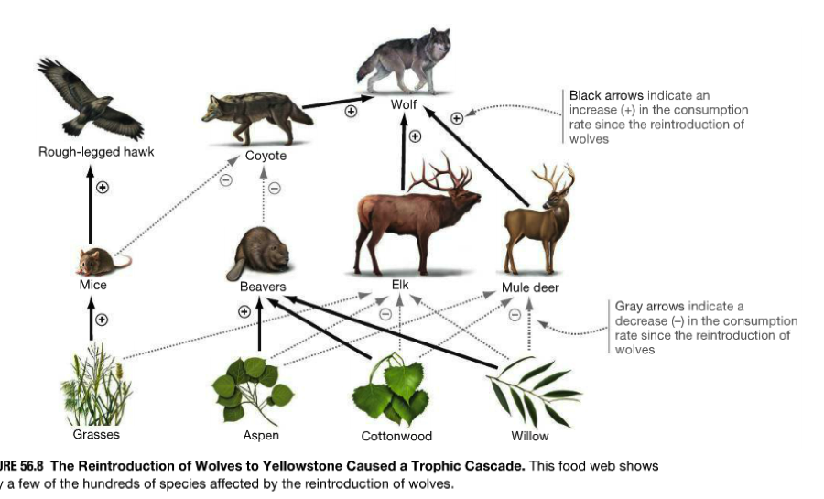
How can we respect all species?
If we (C) respect / will respect all species equally, we’ll be able to continue to enjoy the natural world.

Slide 39
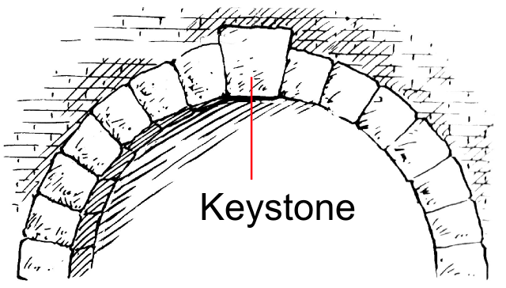
Keystone Species
Animals that are most important for their habitat (where they live)

Slide 40
Wolves Change Rivers #2
https://www.youtube.com/watch?v=JGcIp4YEKrc

Slide 41
Video Question
What are some keystone species?
Wolves of Yellowstone
Beavers
Elephants
Parrotfish

Slide 42
Ecosystem Balance
What if there are too many predators?

Slide 43
Ecosystem Balance
What if there are too many herbivores?

Slide 44
Ecosystem Balance Game
Fox – Rabbit - Grass

