Slide 1
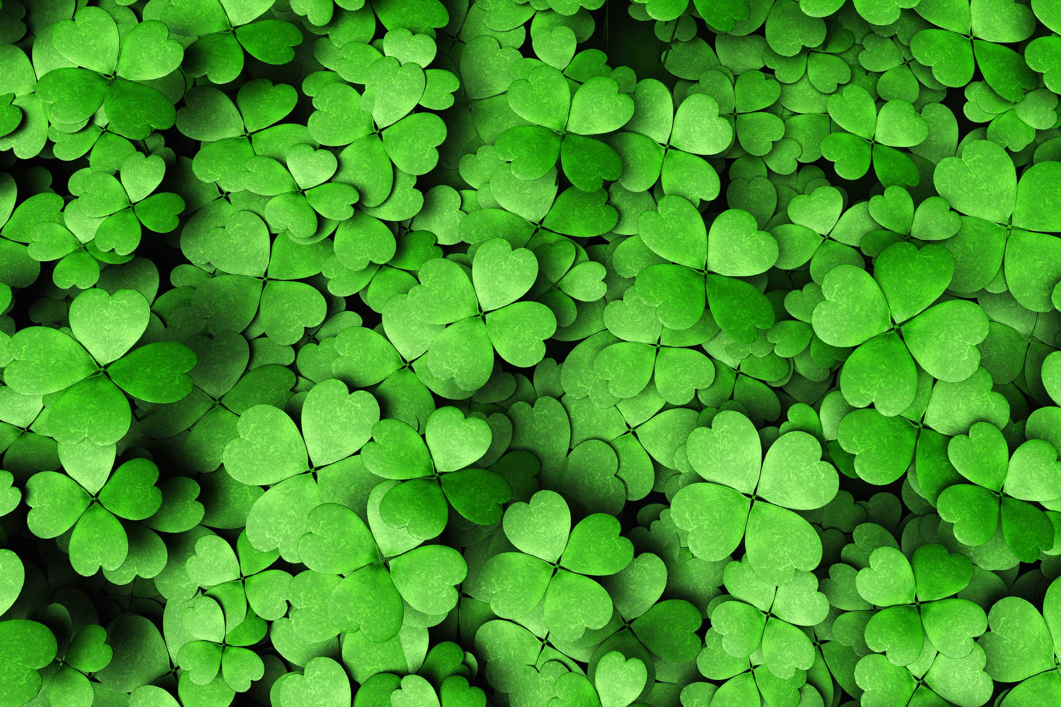
St. Patrick’s Day

Slide 2
St. Patrick’s Day

Slide 3
Where is it from?
Irish = Ireland

Slide 4
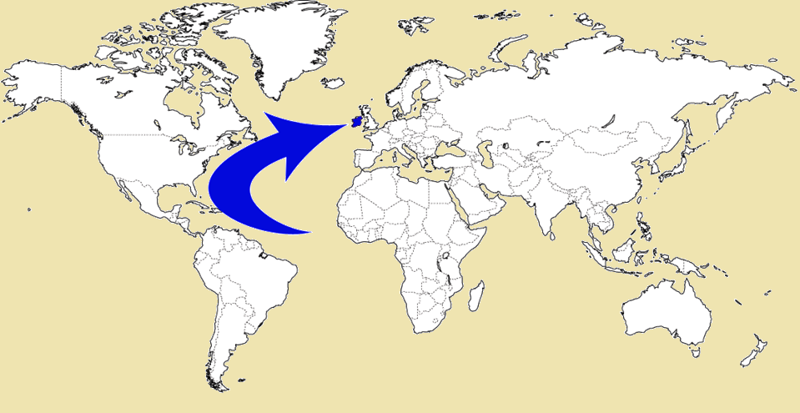
Irish = Ireland

Slide 5
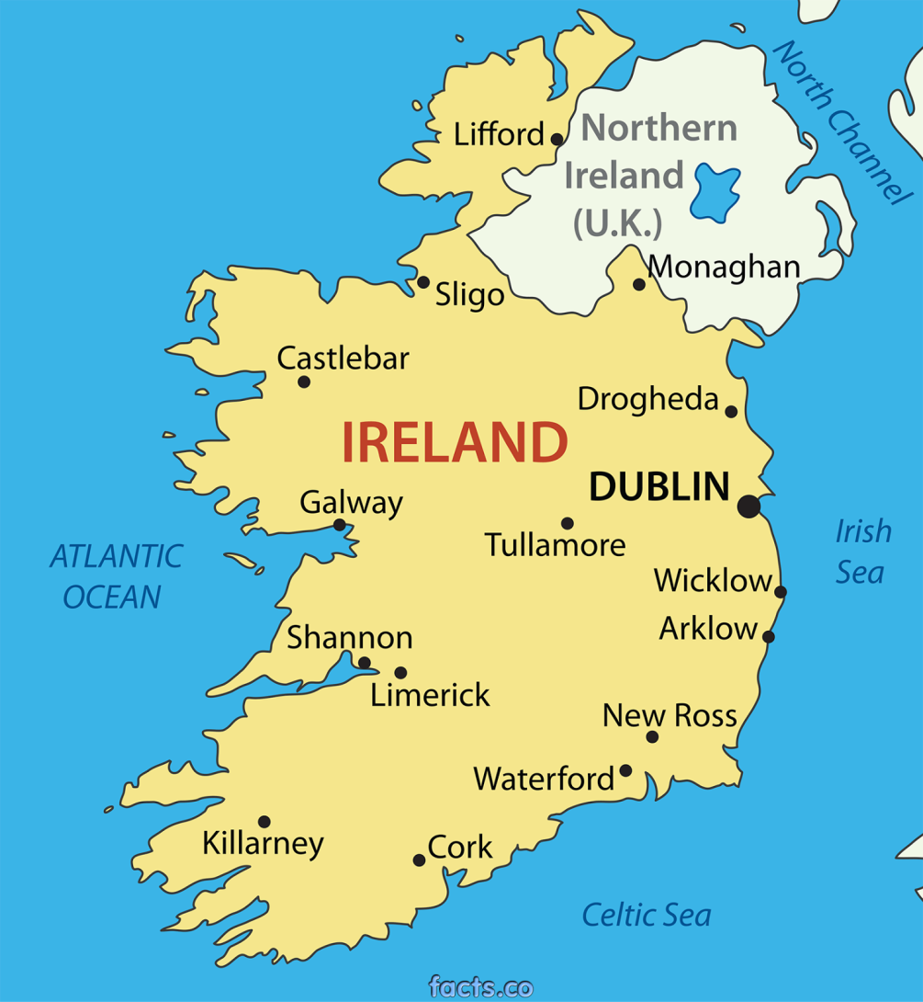
Irish = Ireland

Slide 6
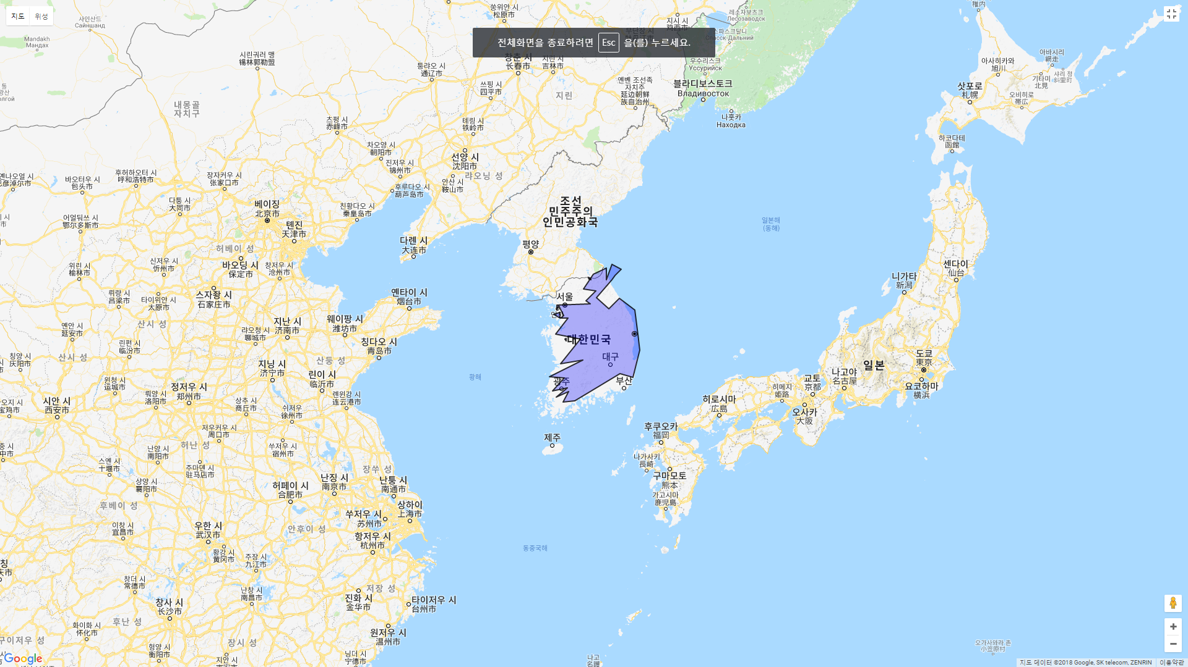
Population = 6,572,728

Slide 7
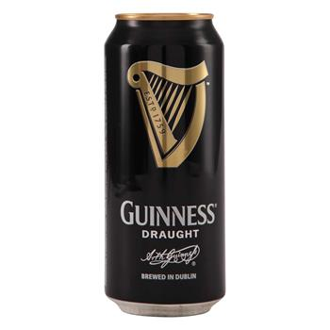
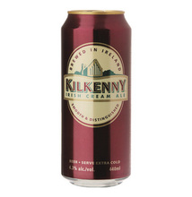
Irish Beer
The Irish consume on average 131.1 liters of beer per year - the 2nd highest per-capita consumption after the Czech Republic.

Slide 8
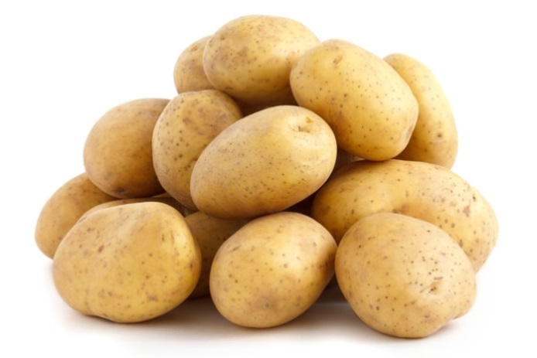
The Potato Famine
From 1845 – 1852, there was a potato disease called, “potato blight” destroyed much of the potatoes in Ireland.
The population fell 20 – 25% during this time due to death and emigration.

Slide 9
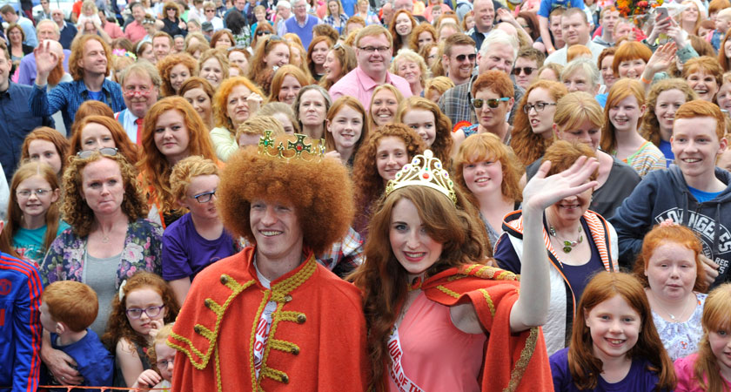

Slide 10
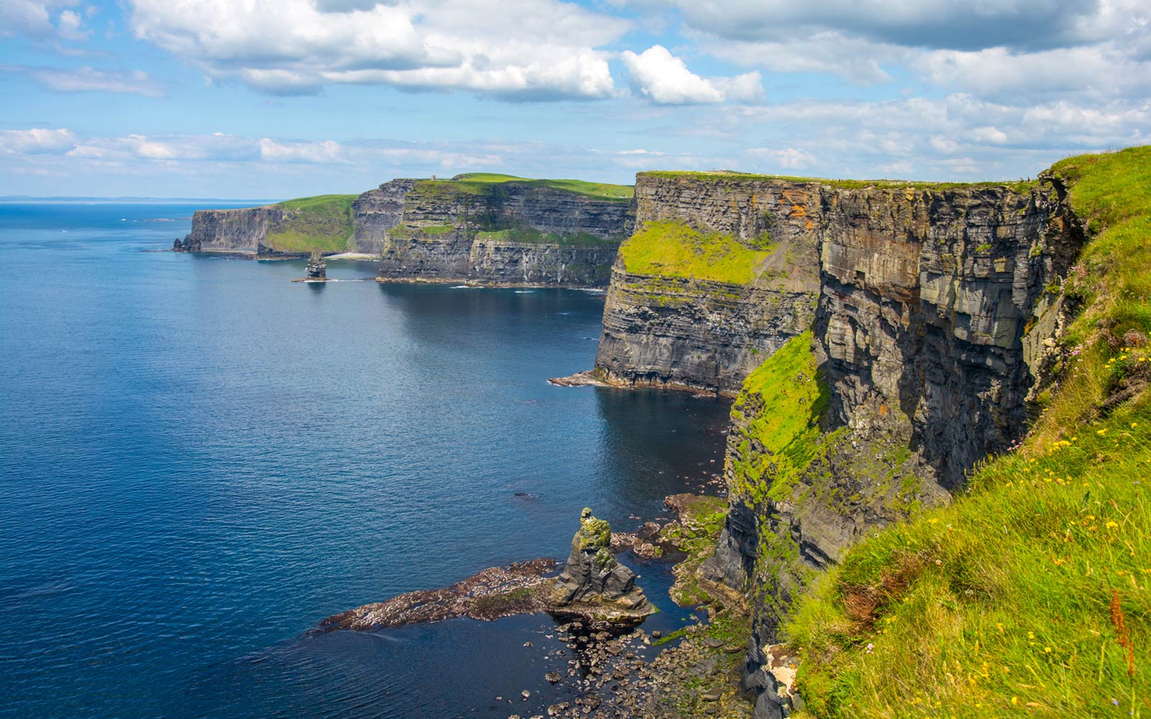
Cliffs of Moher

Slide 11
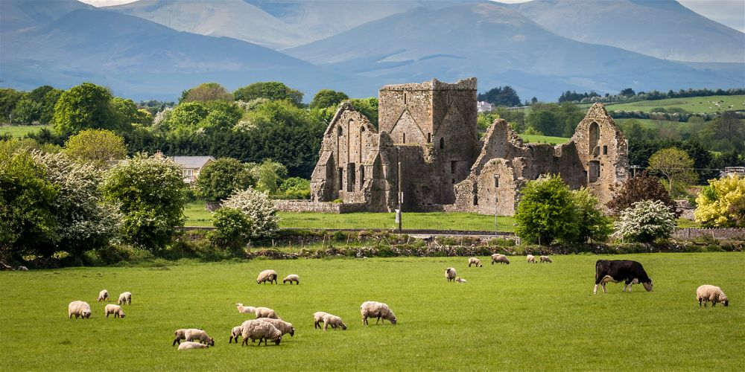

Slide 12
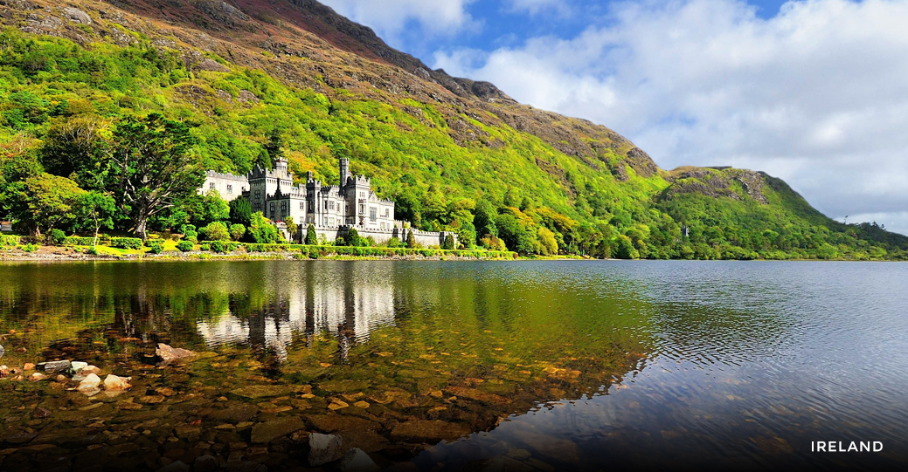

Slide 14
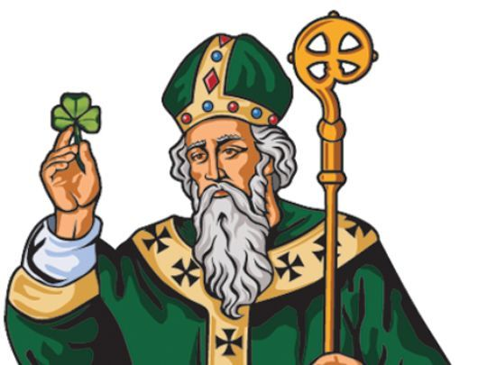
St. Patrick’s Day
Saint Patrick was a Christian missionary.
He is considered the patron saint of Ireland.

Slide 15
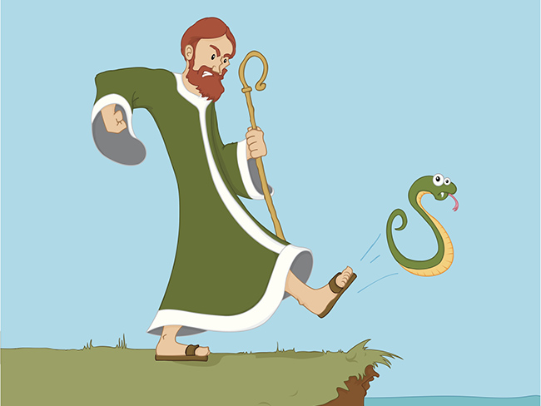
According to legend, he drove all of the snakes out of Ireland.

Slide 16
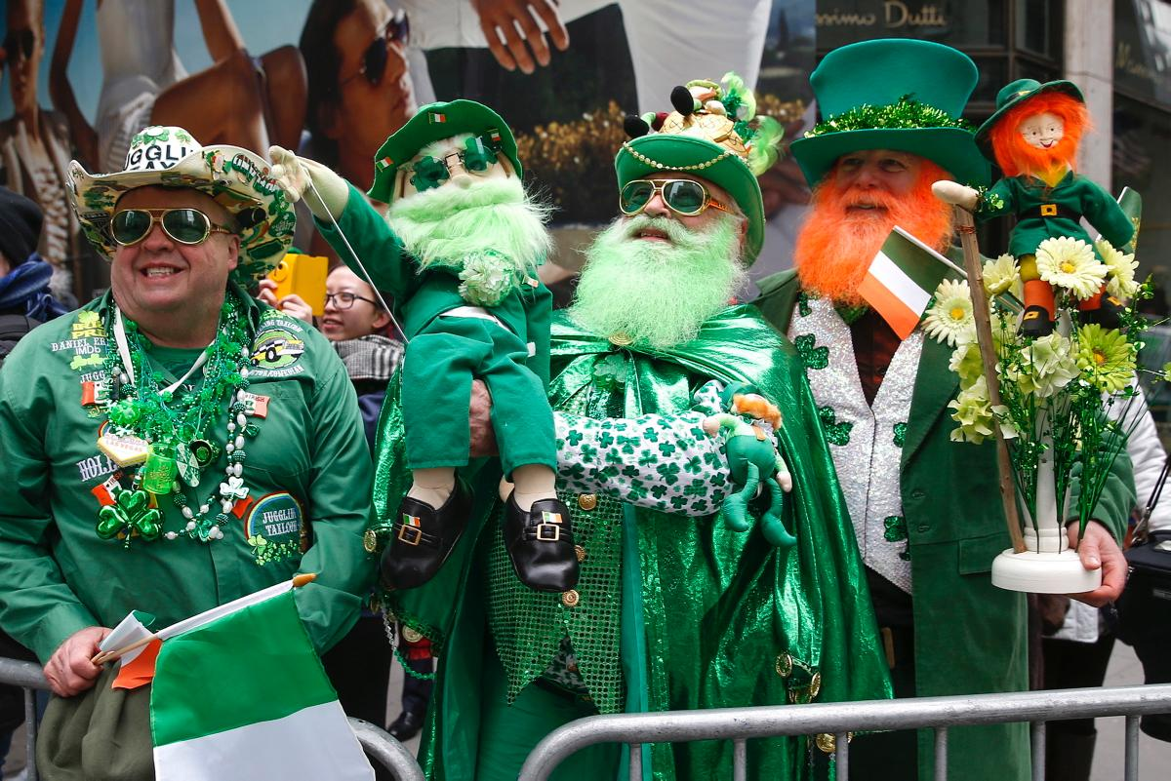
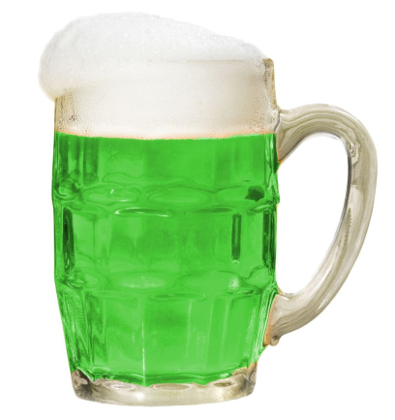
St. Patrick's Day Symbols

Slide 17
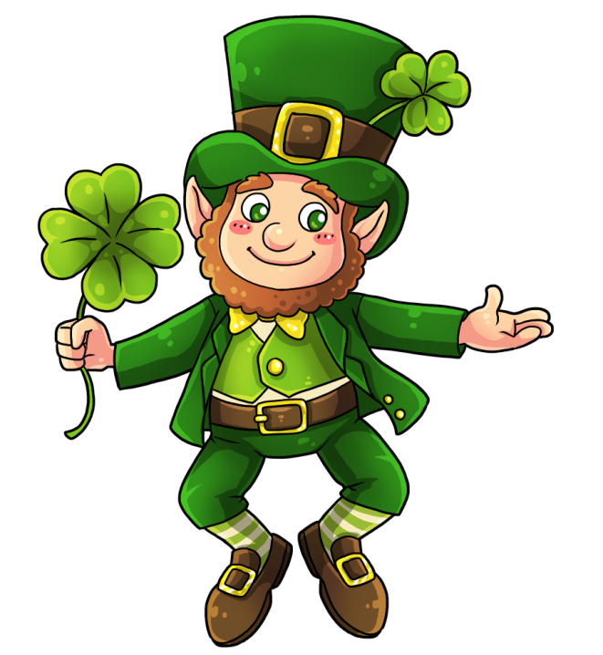
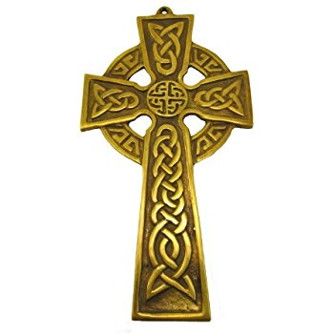
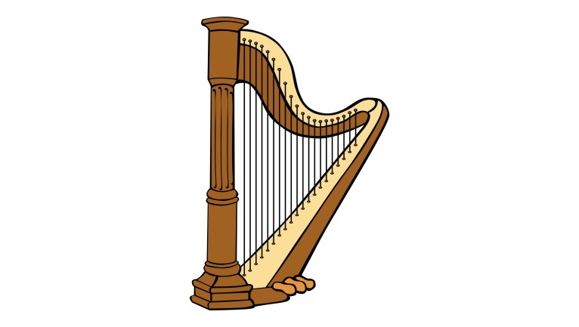
St. Patrick's Day Symbols
Shamrock
(clover)
4-Leaf Clover
Leprechaun
Celtic Cross
Harp

Slide 18
St. Patrick’s Day
Listen and choose the correct words
https://eslholidaylessons.com/03/saint_patricks_day.html

Slide 19
Saint Patrick's Day, March 17, is an annual (1) ____ of the patron saint of Ireland. It is a national holiday in Ireland, and millions of Irish people all over the world where there are Irish (2) ____ celebrate. Celebrations are based on all (3) ____ Irish and the color green. City authorities in Chicago even (4) ____ the city’s river green for this day. Many people wear green clothes, eat Irish food and drink the Irish drink Guinness, which many bars also try and dye green. There are also traditional St Patrick’s Day parades. The (5) ____ in Dublin is spread over five days and attracts half a million people. The New York parade is the largest, with two million spectators. Many people with (6) ____ Irish connections celebrate and declare themselves Irish for a day.
1. | (a) | celebrate | (b) | celebrations | (c) | celebration | (d) | celebrated
2. | (a) | communities | (b) | community | (c) | commune | (d) | communal
3. | (a) | thing | (b) | thingy | (c) | things | (d) | thingamy
4. | (a) | die | (b) | died | (c) | dyed | (d) | dye
5. | (a) | this | (b) | one | (c) | ones | (d) | that
6. | (a) | no | (b) | non | (c) | know | (d) | now

Slide 20
Saint Patrick was a Christian missionary. Some (7) ____ say he was born in England, while others believe he was Italian. Most agree he lived in the fifth century. When he was sixteen, he was captured and taken as a (8) ____ to Ireland. He lived as a slave for six years before (9) ____. He joined the church to train as a priest and became a missionary in the north and west of Ireland. Legend has it that Patrick (10) ____ all the snakes out of Ireland. There are many other legends about Patrick that have cemented him as a key part of Irish culture. March 17 is (11) ____ to be the date of his death. Unlike other saints, Patrick was never canonized by a Pope, although most Christian churches (12) ____ him as a “Saint in Heaven”.
7. | (a) | scholarly | (b) | scholars | (c) | scholar | (d) | school
8. | (a) | slavery | (b) | slaved | (c) | slave | (d) | slaving
9. | (a) | escaped | (b) | escapist | (c) | escape | (d) | escaping
10. | (a) | drive | (b) | drove | (c) | driven | (d) | driver
11. | (a) | belief | (b) | believer | (c) | believing | (d) | believed
12. | (a) | list | (b) | listing | (c) | lists | (d) | list of

Slide 21
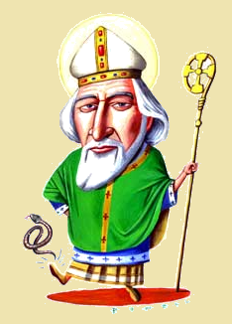
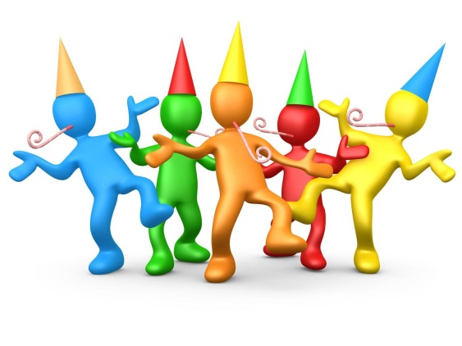
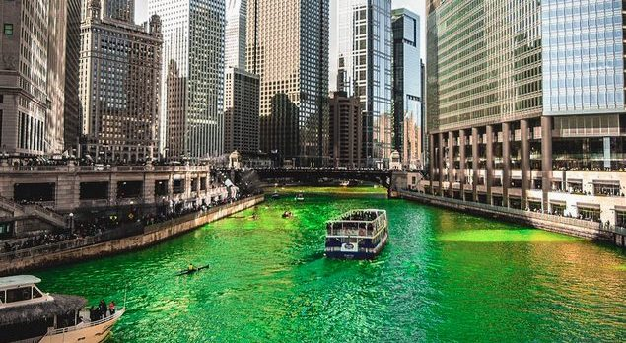
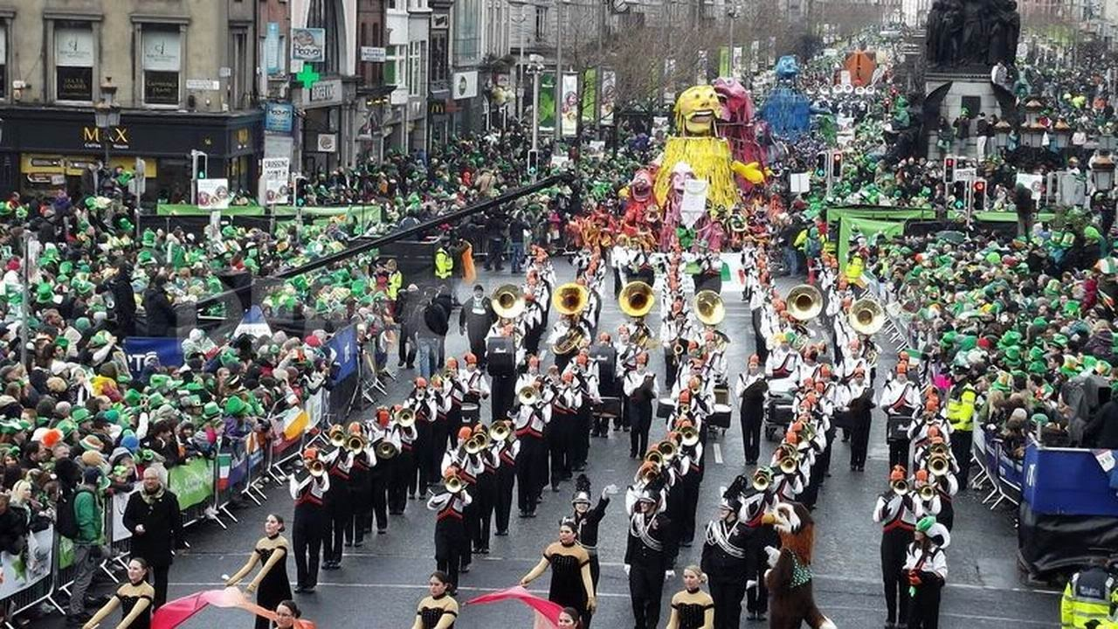
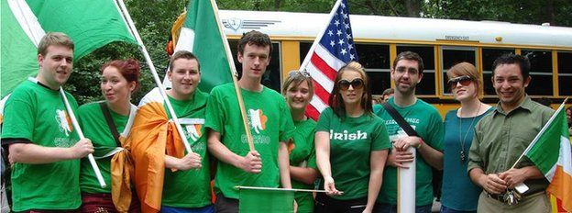
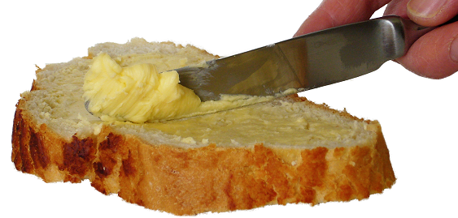
St. Patrick’s Day
Saint Patrick's Day, March 17th, is an annual celebration of the patron saint of Ireland. It is a national holiday in Ireland, and millions of Irish people all over the world where there are Irish communities celebrate. Celebrations are based on all things Irish and the color green. City authorities in Chicago even dye the city’s river green for this day. Many people wear green clothes, eat Irish food and drink the Irish drink Guinness, which many bars also try and dye green. There are also traditional St Patrick’s Day parades. The one in Dublin is spread over five days and attracts half a million people. The New York parade is the largest, with two million spectators. Many people with no Irish connections celebrate and declare themselves Irish for a day.
annual celebration
patron saint of Ireland
Irish communities
dye the city’s river green
St. Patrick’s Day parades
spread over five days
Irish connections
Irish for a day

Slide 22
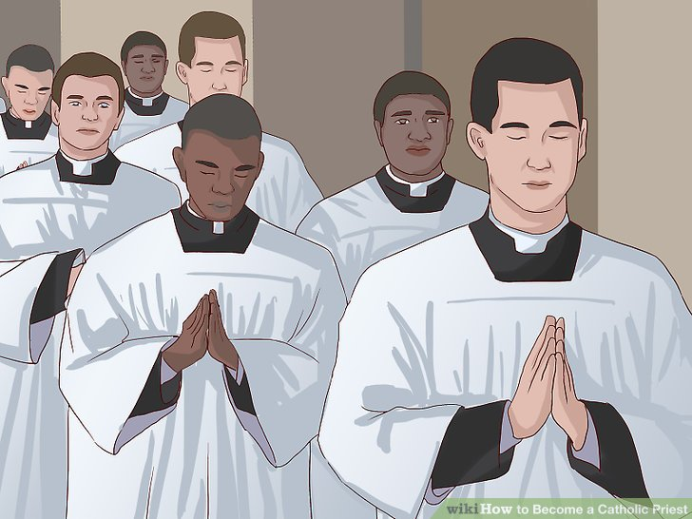
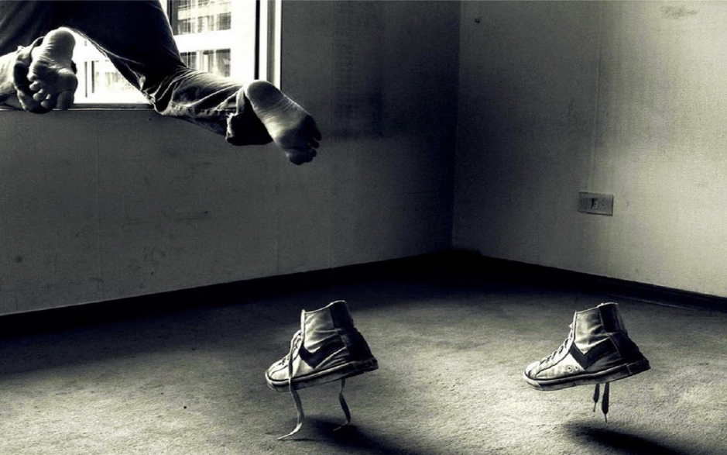
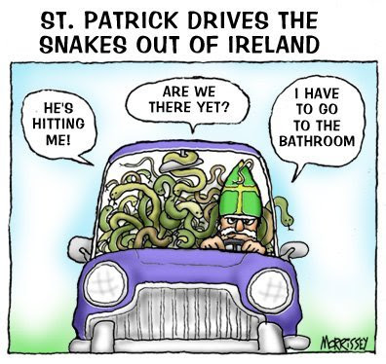
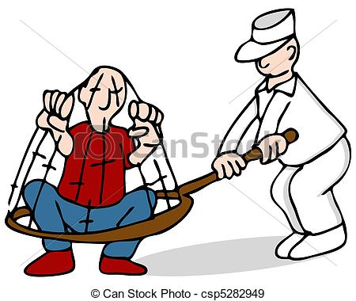
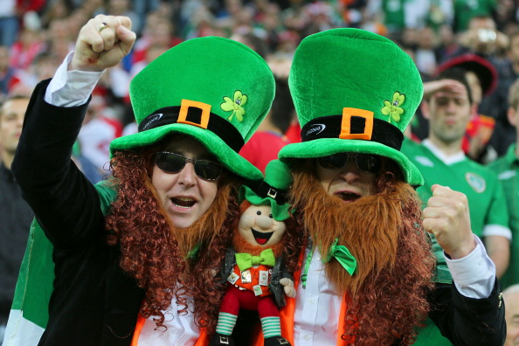
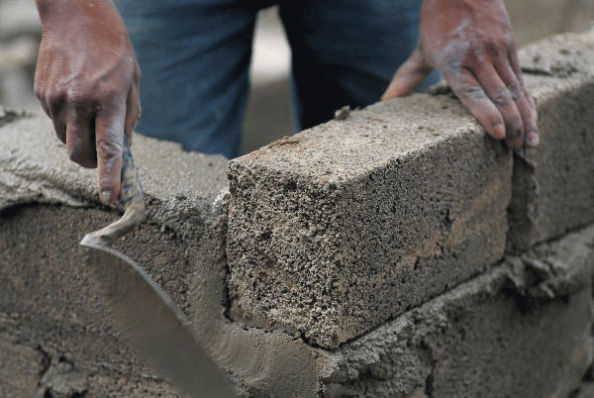
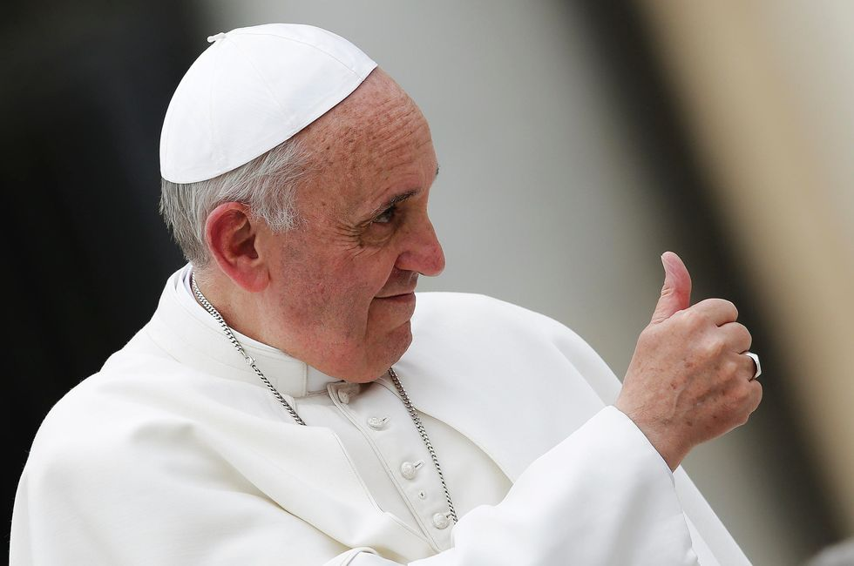
St. Patrick’s Day
1st century = 1-100
2nd century = 101–200
3rd century = 201-300
4th century = 301-400
5th century = 401-500
Saint Patrick was a Christian missionary. Some scholars say he was born in England, while others believe he was Italian. Most agree he lived in the fifth century. When he was sixteen, he was captured and taken as a slave to Ireland. He lived as a slave for six years before escaping. He joined the church to train as a priest and became a missionary in the north and west of Ireland. Legend has it that Patrick drove all the snakes out of Ireland. There are many other legends about Patrick that have cemented him as a key part of Irish culture. March 17 is believed to be the date of his death. Unlike other saints, Patrick was never canonized by a Pope, although most Christian churches list him as a “Saint in Heaven”.
Christian missionary
scholars
fifth century
captured and taken as a slave
escaping
train as a priest
drove all
cemented
key part of Irish culture
Patrick was never canonized

Slide 23
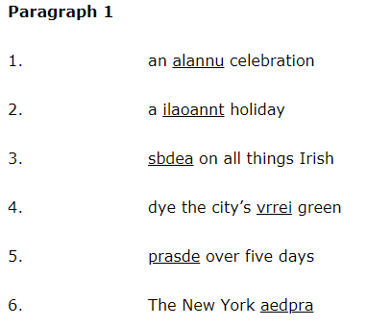
Unscramble
An annual celebration
Celebrate every year
A national holiday
They don’t go to work
Based on all things Irish
Everything is about Ireland
Dye the city’s river green
Change the color
Spread over 5 days
During 5 days
The New York parade
It’s the largest parade

Slide 24
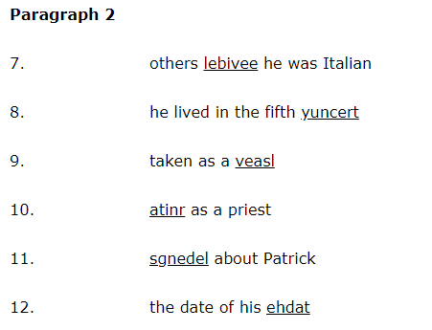
Unscramble
Others believe he was Italian
Other people think this
He lived in the fifth century
401 – 500 AD
Taken as a slave
Work with no pay
Train as a priest
Training, education
Legends about Patrick
Stories
The date of his death
When he died

Slide 25
When is St. Patrick's Day?
St. Patrick's Day is on March 17th.

Slide 26
Dates and Times
On, at, in…

Slide 27
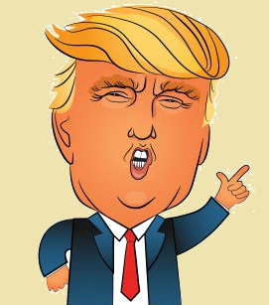
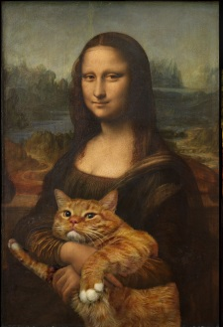
Years
In 1983, I was born.
Donald Trump became president in 2017.
Leonardo DaVinci started painting the Mona Lisa in 1503.
The first i-Phone was released in 2007.

Slide 28
Years
1983 =
2017 =
1503 =
2007 =
nineteen eighty-three.
Twenty seventeen.
fifteen “O” three.
two thousand and seven.

Slide 29
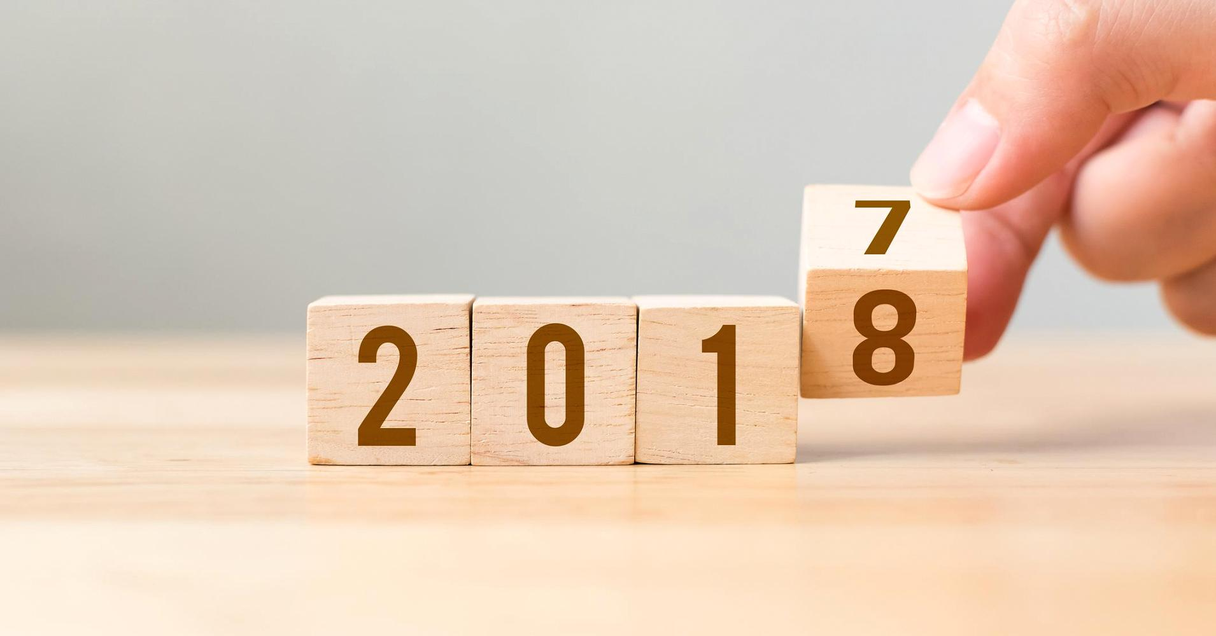
Years

Slide 30
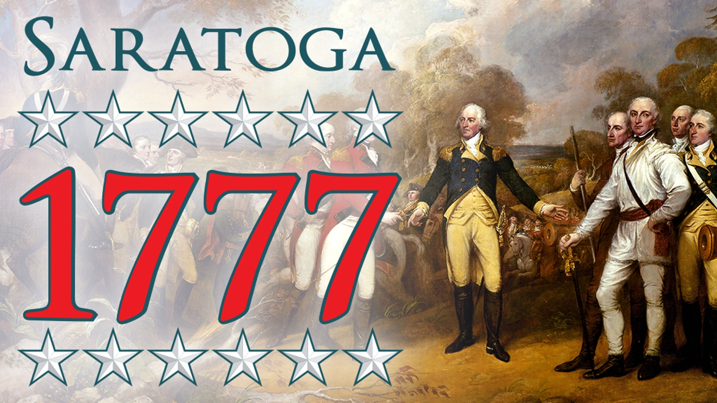

Slide 32
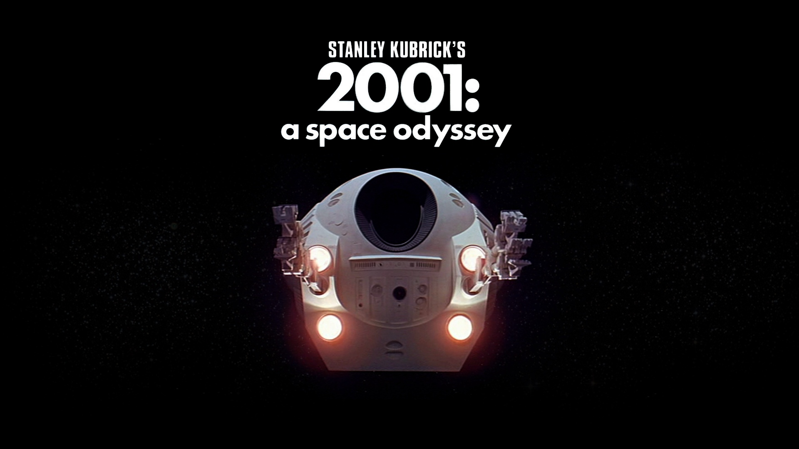

Slide 33
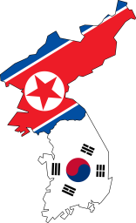
Months
The Pyeongchang Olympics were held in February.
The next Star Wars movie will be released in May.
The Korean Armistice Agreement (한국휴전협정) was signed in July, 1953.

Slide 34
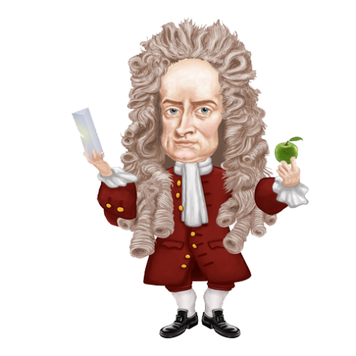
Day
On December 25th, we celebrate Christmas.
Isaac Newton was born on January 14th, 1643.
The official end to World War 2 was on September 2nd, 1945.

Slide 35
Time
We will meet for lunch at 11:30.
Remember, you need to wake up at 7am.
World War 1 ended on November 11th, 1918 at 11am.

Slide 36
When did I make this ppt?
Years =
Months =
Days =
Time =
in
in
on
at

Slide 37
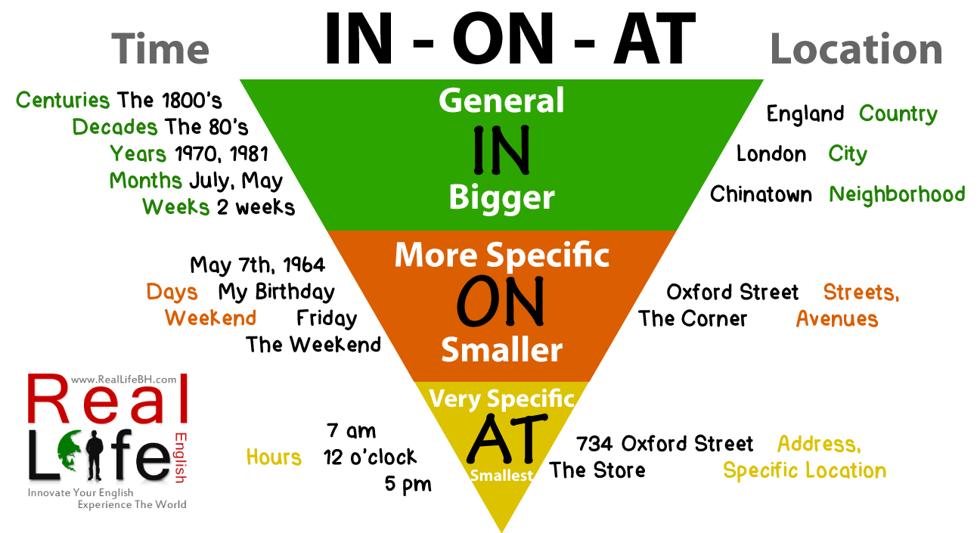

Slide 38
When is Valentines day?
Valentine's day is on February 14th.

Slide 39
When does class start?

Slide 40
When is your birthday?

Slide 41
When did you wake up?

Slide 42
When is lunch time?

Slide 43
When was King Sejong born?
(He was born in 1397)
(He was born on May 15th, 1397)

Slide 44
Magazine Search
Find a date…

Slide 45
Magazine Search
Using the magazine at the back, find an article that has a date / time.
Write down what happened at that time or on that day. (They won the Stanley Cup on May 2nd.)
Write as many as you want.

Slide 46
Magazine Search
Points
The closest to the date / time will get a candy.

Slide 47
Today

Slide 48
Noon

Slide 49
1900

Slide 50
Oldest Date

Slide 51
March 12

Slide 52
7:00pm

Slide 53
2010

Slide 54
Most Recent

Slide 55
Closest to current time

