Slide 1
Coulda, Woulda, Shoulda
Could, Would, Should

Slide 2
Should
Advice
Suggestions
조언
A: I feel sick.
B: You should see a doctor.
A: I am lonely.
B: You shouldn’t stay at home. You should join a sports team.

Slide 3
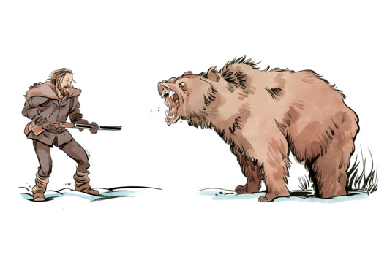
What should I do?

Slide 4
I’m so tired.

Slide 5
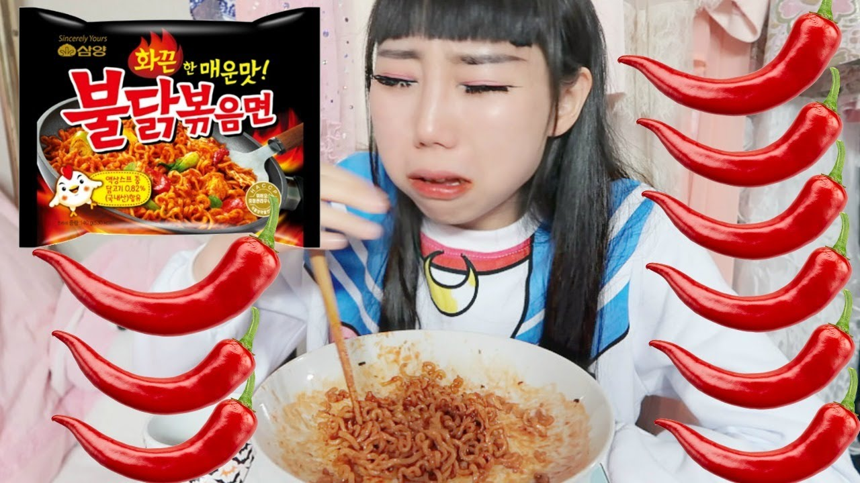
It’s too spicy.

Slide 6
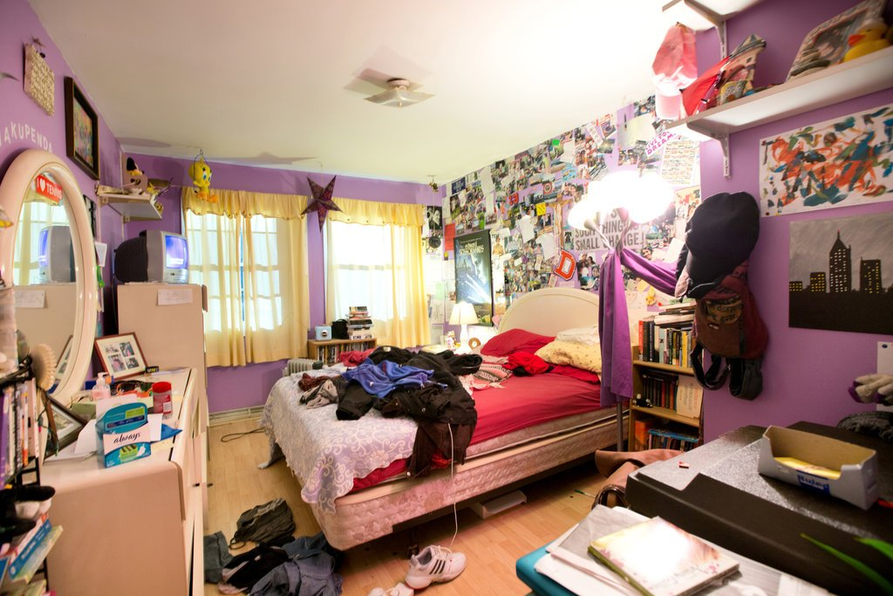
It’s my bedroom.

Slide 7
Could
Ability in the Past
(능력)
When I was younger, I could play all day.
I couldn’t find my glasses.

Slide 8
Could
Future Possibilities
We could go to noraebang together.
We could eat ddeokbokki or kimbap later.

Slide 9
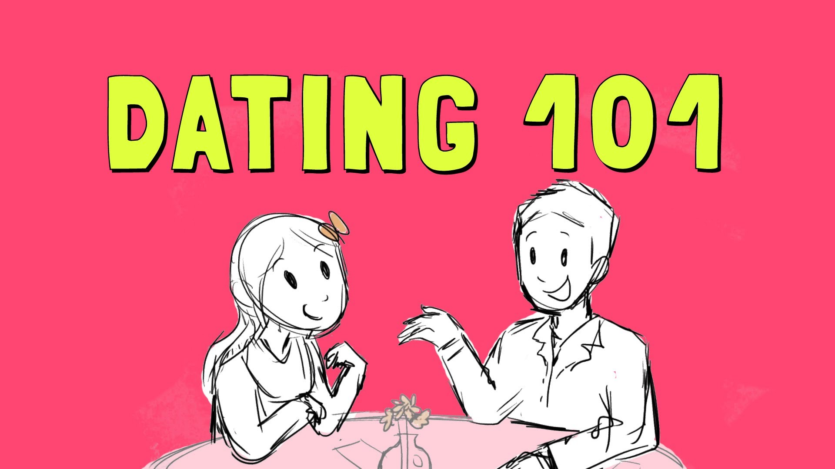

Slide 10
Would
Unlikely (situations)
Not Real (situations)
Would you rather eat rice or noodles?
If I had a car, I would drive to Jin-do.
I would like to meet Leonardo DiCaprio.

Slide 11
If I found gold,
_____________.

Slide 12
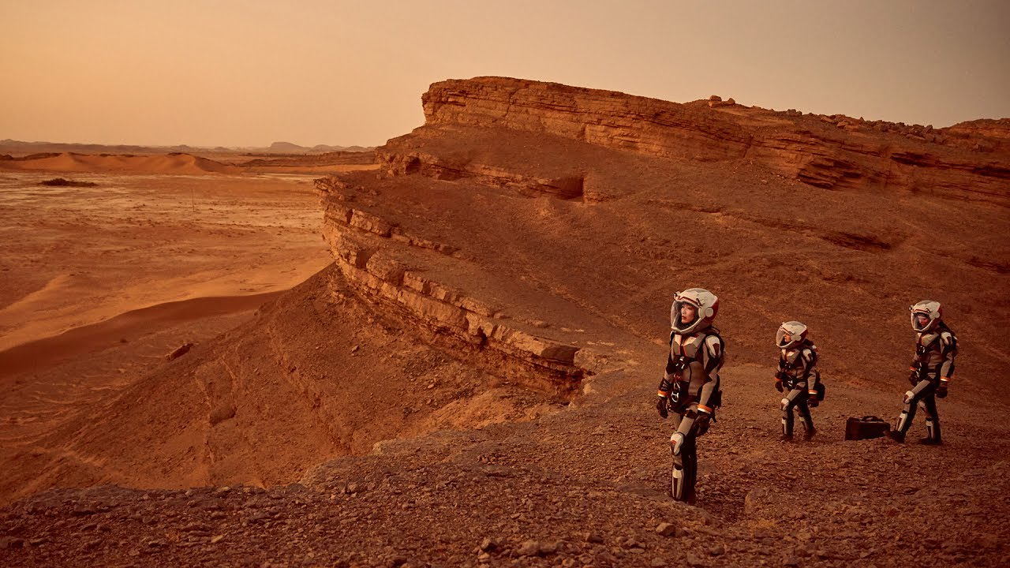
Me.

Slide 13
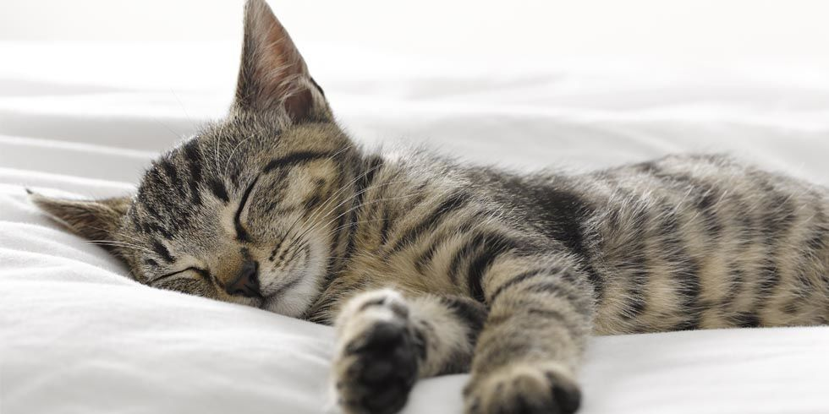

Slide 14
Polite (공손한)
Could
Would
Could = Polite request
Would = Polite offer
의뢰
제공

Slide 15
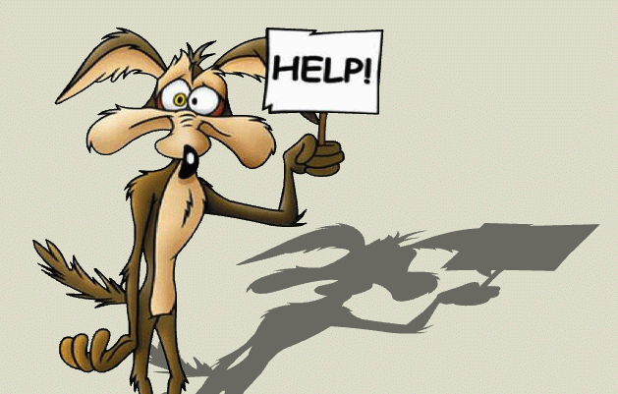
Could you help me?

Slide 16
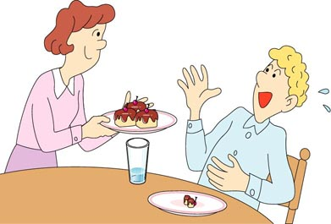
Would you like some more?
No thanks. I’m full

Slide 17
Would you sit down?

Slide 18
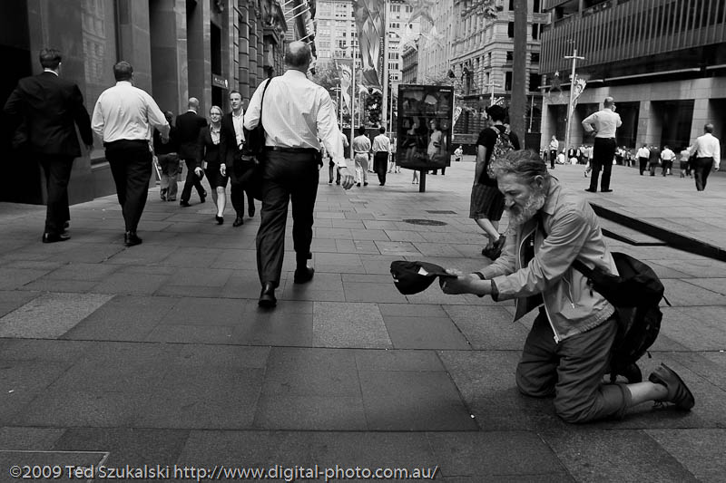
Could you give me some money?

Slide 19
Use the correct word
Would, could, should

Slide 20
What ___________ we do tonight?
should
We __________ watch a movie.
could
Would
___________ you like to go now?

Slide 21
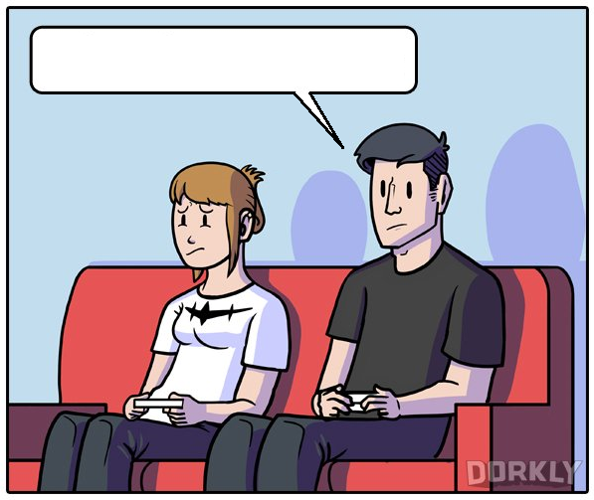
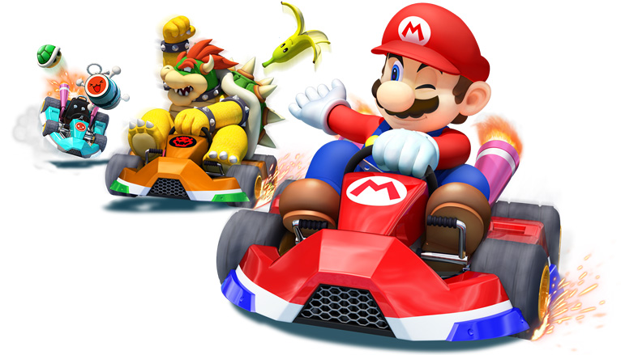
Would you like to play Mario Kart?

Slide 22
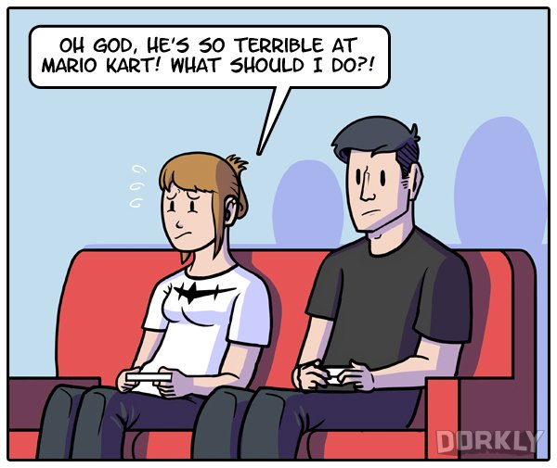

Slide 23
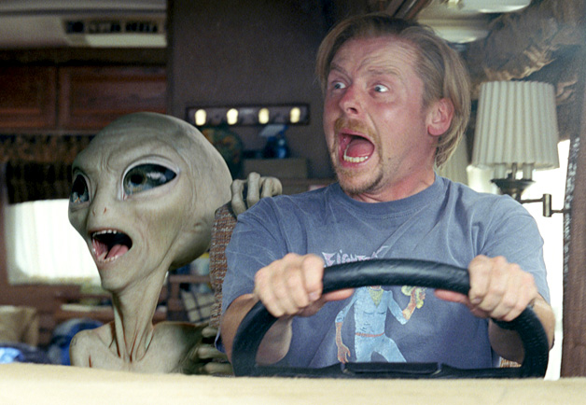
If I met an alien, I _______ scream.
would

Slide 24
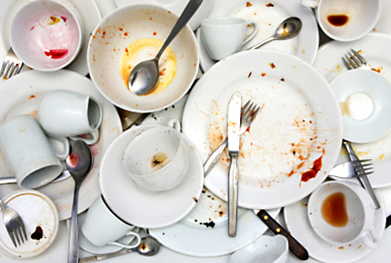
The dishes are dirty. I _________ wash the dishes.
should

Slide 25
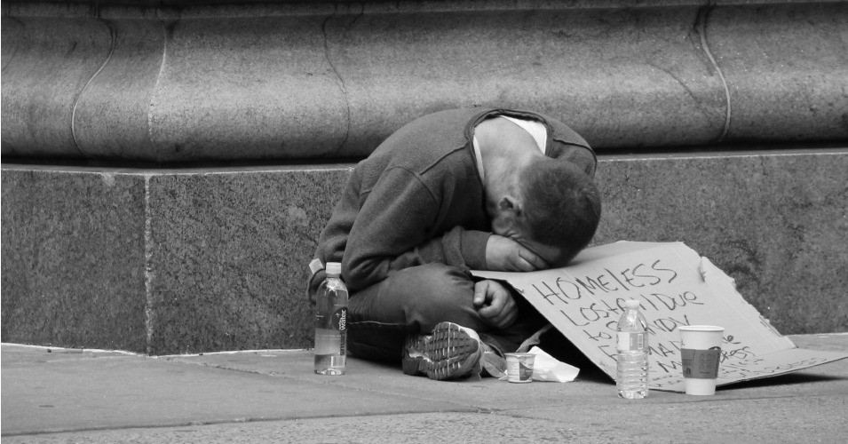
_______ you give me some food.
Could

Slide 26
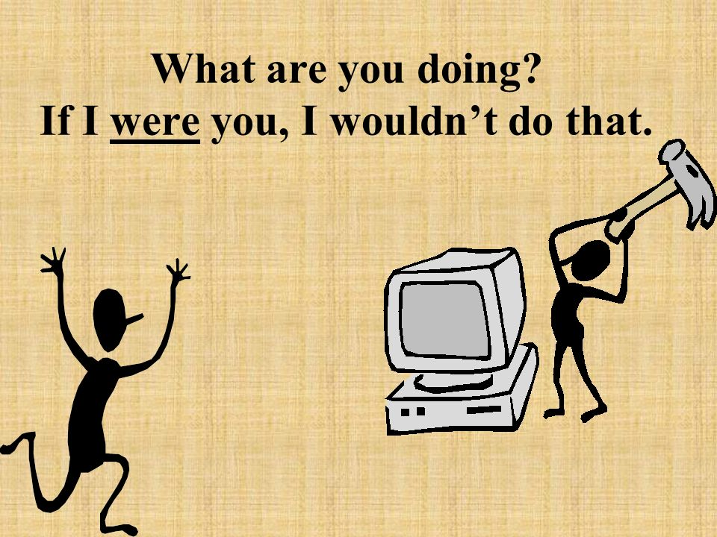

Slide 28
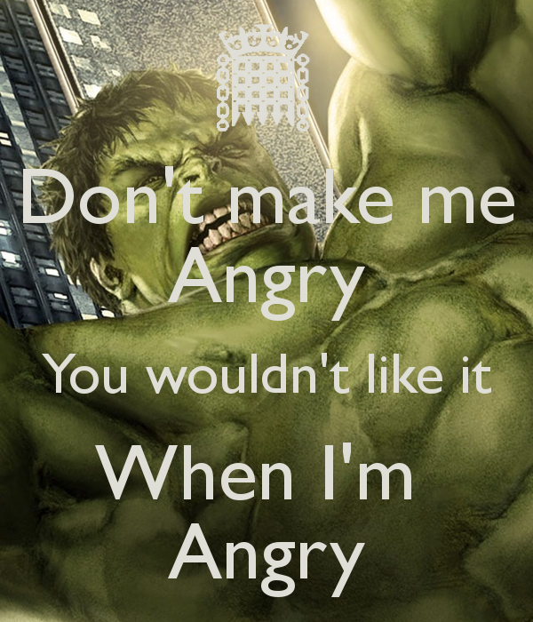

Slide 29
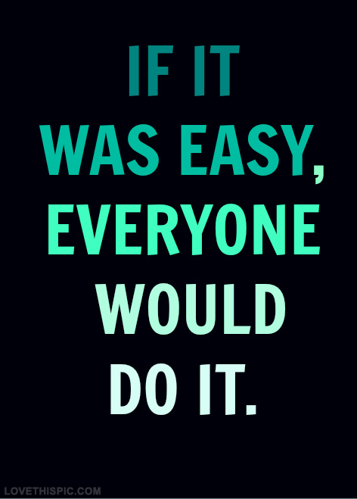

Slide 30
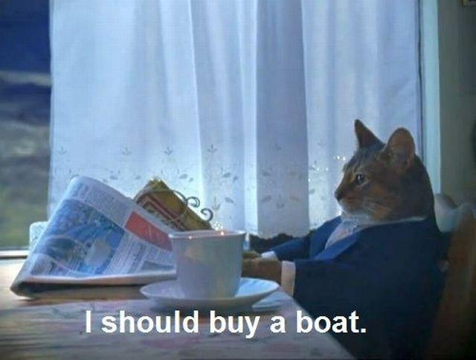

Slide 31
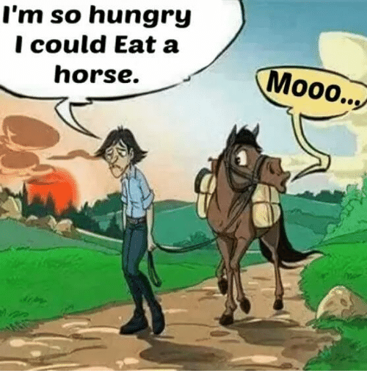

Slide 39
What Should I Do?
Circular Story

