Slide 1
What Should I Do?
Escape the Lab

Slide 2
As you are waking up, you can hear people around you talking. You decide to pretend to stay asleep so they wont know you are awake. It is difficult to understand what they are saying, but you hear “…security… What should we do?... Out… kill…” Your head hurts, but you can feel the strength coming back to your body. Where are you? How did you get here? How can you escape?
Open your eyes
Punch the air
Scream
Kick

Slide 3
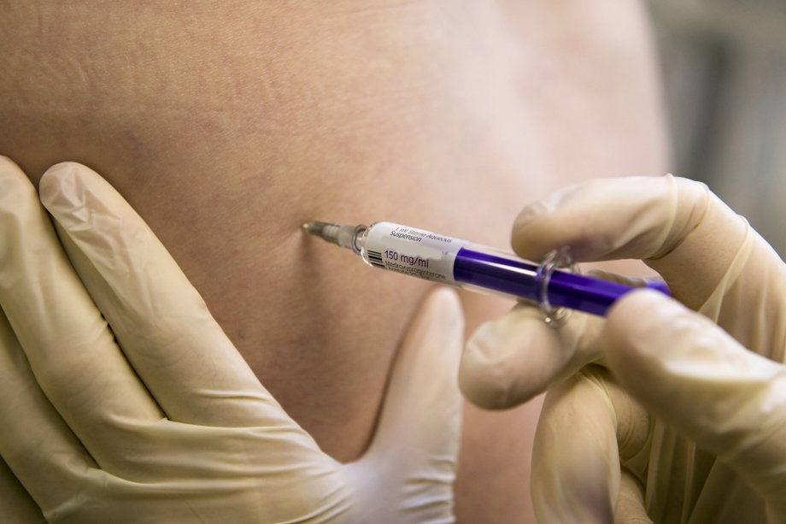
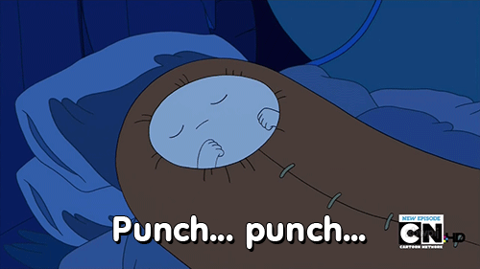
You throw caution to the air and punch nothing.
The men saw you punch.
They come over and inject you with a needle.
Everything goes black.

Slide 4
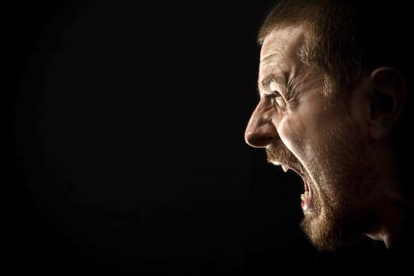
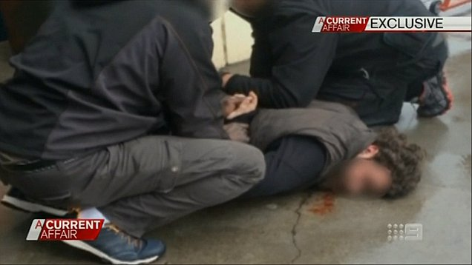
They rush over and hold you down.
Your screaming alerts the men.
They inject you with a needle and everything goes black.

Slide 5
Kick
Your kicking alerts the men.
They rush over and hold you down.
They inject you with a needle and everything goes black.
You throw caution to the air and punch nothing.
Everything goes black.
The men saw you punch.
They come over and inject you with a needle.

Slide 6
You slowly open your eyes.
You realize that you are on a table.
There is a bright light, but you can see two men in lab coats talking together in the corner.
As you look around, you see some tools on a table next to you.
Talk to the men
Stand up
Pretend to sleep
Kick

Slide 7
Talk to the men
You say, “Hello”
The men slowly walk over and say, “You’re not supposed to wake up yet.”
You feel a pinch on your arm and everything turns black.
You throw caution to the air and punch nothing.
Everything goes black.
The men saw you punch.
They come over and inject you with a needle.

Slide 8
Stand up
As soon as you stand up, the men rush over.
They are stronger than you, so they put you on the table.
You feel a pinch and everything goes black.
You throw caution to the air and punch nothing.
Everything goes black.
The men saw you punch.
They come over and inject you with a needle.

Slide 9
Kick
Your kicking alerts the men.
They rush over and hold you down.
They inject you with a needle and everything goes black.
You throw caution to the air and punch nothing.
Everything goes black.
The men saw you punch.
They come over and inject you with a needle.

Slide 10
You close your eyes.
You hear the feet get closer.
It sounds like one man picked up a tool.
The other man says, “It’s almost lunch time, lets wait until after we eat.”
Surprise attack
Talk to the men
Scream for help
Wait for them to leave

Slide 11
Surprise attack
You jump up and punch one of the men in the face.
He falls to the floor, but the other man grabs you.
He holds you long enough, until the other man stands up and helps to hold you down.
You feel a need go into you as everything goes black.
You throw caution to the air and punch nothing.
Everything goes black.
The men saw you punch.
They come over and inject you with a needle.

Slide 12
Talk to the men
You say, “Hello”
The men slowly walk over and say, “You’re not supposed to wake up yet.”
You feel a pinch on your arm and everything turns black.
You throw caution to the air and punch nothing.
Everything goes black.
The men saw you punch.
They come over and inject you with a needle.

Slide 13
Scream for help
Your screaming scares the men.
At first they jump back, but then they jump on you.
They inject you with a needle and everything goes black.
You throw caution to the air and punch nothing.
Everything goes black.
The men saw you punch.
They come over and inject you with a needle.

Slide 14
About 5 minutes later, you hear the door close.
You open your eyes and see that they are now gone.
You slowly sit up on the table and look around.
Explore lockers
Leave the room
Search Tools
Hide under the bed

Slide 15
Explore lockers
There is nothing in the lockers.
You throw caution to the air and punch nothing.
Everything goes black.
The men saw you punch.
They come over and inject you with a needle.

Slide 16
Search tools
There are some needles and knives in a tool kit.
It looks like they are used for surgery.
You throw caution to the air and punch nothing.
Everything goes black.
The men saw you punch.
They come over and inject you with a needle.

Slide 17
Hide under bed
You wait for 30 minutes, but nothing happens.
You know that the men will come back from lunch soon.
You throw caution to the air and punch nothing.
Everything goes black.
The men saw you punch.
They come over and inject you with a needle.

Slide 18
You slowly open the door and check to see if anyone is there.
You are surprised that no one is there.
But as soon as you step out of the door, the bright lights turn off and there are only soft red lights.
An alarm sounds.
Go back into the room
Go right
Try going into another room
Go left

Slide 19
Go back to the original room
The alarms are loud, men are coming.
You try to hide under the table, but they know where the alarm is coming from.
They find you quickly and shoot you with something. Everything turns black.
You throw caution to the air and punch nothing.
Everything goes black.
The men saw you punch.
They come over and inject you with a needle.

Slide 20
Go right
You start running right and the door swings open.
Two large men see you can run towards you.
But you fall, they catch you and everything goes black.
You throw caution to the air and punch nothing.
Everything goes black.
The men saw you punch.
They come over and inject you with a needle.

Slide 21
Go left
At the end of the hall there is a door.
You run towards it. Behind you, another door opens and two men run towards you.
You get to the door, but it is locked.
They catch you and start to choke you. Everything turns black.
You throw caution to the air and punch nothing.
Everything goes black.
The men saw you punch.
They come over and inject you with a needle.

Slide 22
You open the door to the room next to you.
There is another person there. They appear to be sleeping on a table similar to the one your were on.
Again, there are lockers and tools here too.
You can hear people coming.
Explore tools
Explore lockers
Hide under bed
Wake up patient

Slide 23
Explore Lockers
You find some clothes in the locker, but nothing else. There are many empty lockers.
As you are looking in the lockers, two men come into the room.
They shoot you with something and everything goes black.
You throw caution to the air and punch nothing.
Everything goes black.
The men saw you punch.
They come over and inject you with a needle.

Slide 24
Wake up patient
The patient seems to be sleeping very well.
You shake them, but they do not wake up.
As you are looking in the lockers, two men come into the room.
They shoot you with something and everything goes black.
You throw caution to the air and punch nothing.
Everything goes black.
The men saw you punch.
They come over and inject you with a needle.

Slide 25
Hide under bed
You slide under the bed and hope that they wont see you.
Unfortunately, that is the first place they check.
They grab you and everything goes black.
You throw caution to the air and punch nothing.
Everything goes black.
The men saw you punch.
They come over and inject you with a needle.

Slide 26
In the tools you find a knife. It’s sharp but small. There are also some need needles. The needles have some clear liquid in them.
You can hear them in your old room. They will check this room next.
Hide in the locker
Take the knife and hide in the locker
Inject yourself
Inject the other patient

Slide 27
Take the knife and hide in the locker.
The men come into the room.
The one says, “It looks like the knife is missing. He must be in here.”
They find your locker, open it and shoot you with something before you can stab them.
Everything goes black.
You throw caution to the air and punch nothing.
Everything goes black.
The men saw you punch.
They come over and inject you with a needle.

Slide 28
Inject yourself
Everything goes black.
You throw caution to the air and punch nothing.
Everything goes black.
The men saw you punch.
They come over and inject you with a needle.

Slide 29
Inject the patient
You squeeze the liquid into the man.
The heart rate monitor goes “beep, beep, beeeeeppp…”
The men outside hear it and come rushing over to the room.
As you are looking in the lockers, two men come into the room.
They shoot you with something and everything goes black.
You throw caution to the air and punch nothing.
Everything goes black.
The men saw you punch.
They come over and inject you with a needle.

Slide 30
The men enter the room.
You hear, “Everything looks fine. When will this one wake up?”
“Let’s check again in 15 minutes.”
You slowly exit the locker.
Take the knife
Take the needles
Chase after the men
Go back in the locker

Slide 31
Chase after the men
You made a big mistake.
The men turn around and tackle you to the ground.
Everything becomes dark.
You throw caution to the air and punch nothing.
Everything goes black.
The men saw you punch.
They come over and inject you with a needle.

Slide 32
Go back in the locker
You wait in the locker for another 30 minutes.
The men come back and realize where you are.
They catch you and give you an injection… Everything goes dark.
You throw caution to the air and punch nothing.
Everything goes black.
The men saw you punch.
They come over and inject you with a needle.

Slide 33
You take the needles and exit the room.
At the end of the hall, there is a door. You can see that there is a man leaning against it from the other side.
You slowly go up to the door and…
Stab the man with the needle
Knock on the door
Open the door
Talk to the man

Slide 34
open the door
As soon as you open the door, the man turns around and punches you
Everything goes dark.
You throw caution to the air and punch nothing.
Everything goes black.
The men saw you punch.
They come over and inject you with a needle.

Slide 35
Knock on the door
The man quickly turns around and hold the door.
He yells and two men come running from the other direction.
They catch you and push you to the ground.
Everything goes dark.
You throw caution to the air and punch nothing.
Everything goes black.
The men saw you punch.
They come over and inject you with a needle.

Slide 36
Talk to the man
You say, “Hello, can you let me out?”
He says, “ok” and lets you through the door.
But as soon as you come inside he injects you with something.
Everything does dark.
You throw caution to the air and punch nothing.
Everything goes black.
The men saw you punch.
They come over and inject you with a needle.

Slide 37
You take the knife and exit the room.
At the end of the hall, there is a door. You can see that there is a man leaning against it from the other side.
You slowly go up to the door and…
Stab the man with the knife
Knock on the door
Open the door
Talk to the man

Slide 38
Stab the man with the knife
You try stabbing him through the door, but there is no room. The key hole is too small.
The man hears you trying to stab him.
He yells to his friends.
They come and shoot you with something.
Everything goes dark.
You throw caution to the air and punch nothing.
Everything goes black.
The men saw you punch.
They come over and inject you with a needle.

Slide 39
Knock on the door
The man quickly turns around and hold the door.
He yells and two men come running from the other direction.
They catch you and push you to the ground.
Everything goes dark.
You throw caution to the air and punch nothing.
Everything goes black.
The men saw you punch.
They come over and inject you with a needle.

Slide 40
Open the door
As soon as you open the door, the man yells
You stab him, but the two other men come back.
They shoot you with something.
Everything goes dark.
You throw caution to the air and punch nothing.
Everything goes black.
The men saw you punch.
They come over and inject you with a needle.

Slide 41
Talk to the man
You say, “Hello, can you let me out?”
He says, “ok” and lets you through the door.
But as soon as you come inside he injects you with something.
Everything does dark.
You throw caution to the air and punch nothing.
Everything goes black.
The men saw you punch.
They come over and inject you with a needle.

Slide 42
The man falls to the ground. Everything is silent.
You open the door and see that no one is around.
The room looks like an office.
Search the desk
Jump out of the window
Open the last door
Search the man

Slide 43
Search the desk
There is nothing in the desk
You throw caution to the air and punch nothing.
Everything goes black.
The men saw you punch.
They come over and inject you with a needle.

Slide 44
Jump out of the window
You jump through the window, but you get cut.
As the blood pours out, everything becomes black.
You throw caution to the air and punch nothing.
Everything goes black.
The men saw you punch.
They come over and inject you with a needle.

Slide 45
Open the last door
You try opening the door, but it wont work.
You need to find a key.
You throw caution to the air and punch nothing.
Everything goes black.
The men saw you punch.
They come over and inject you with a needle.

Slide 46
You find an ID card that looks like a key card.
Search the desk
Jump out of the window
Open the last door

Slide 47
Search the desk
There is nothing in the desk
You throw caution to the air and punch nothing.
Everything goes black.
The men saw you punch.
They come over and inject you with a needle.

Slide 48
Jump out of the window
You jump through the window, but you get cut.
As the blood pours out, everything becomes black.
You throw caution to the air and punch nothing.
Everything goes black.
The men saw you punch.
They come over and inject you with a needle.

Slide 49
Congratulations!! You escaped the lab!

