Slide 1
Foot and Mouth Disease

Slide 2
Contagious Diseases
A disease that spreads easily and quickly.
Can you think of some?

Slide 3
Famous Examples:

Slide 4
Flu

Slide 5
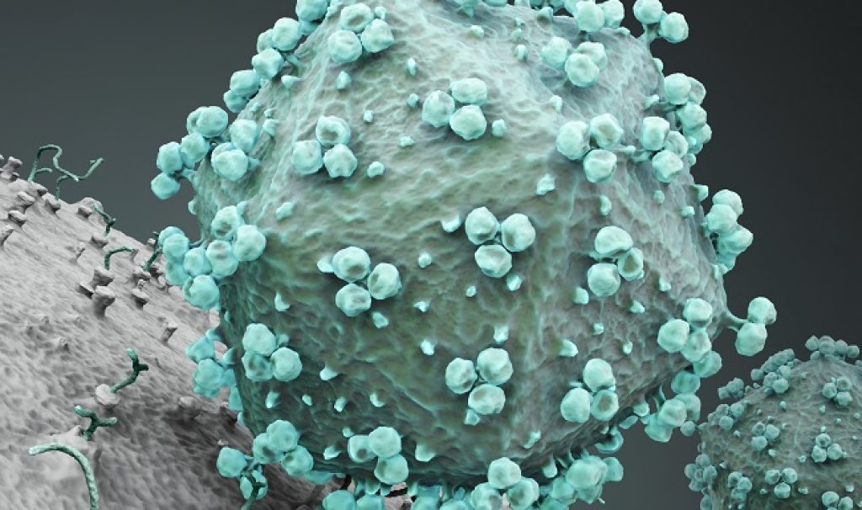
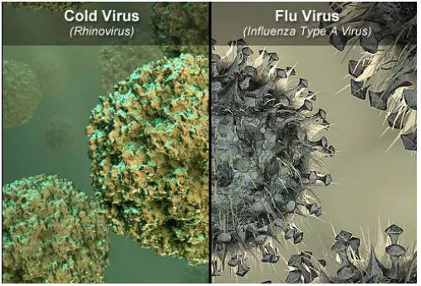
Common Cold

Slide 6
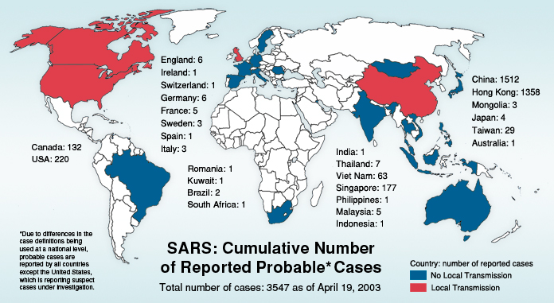

Slide 7
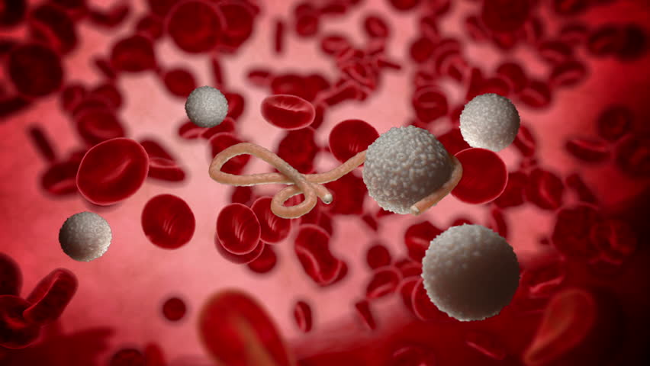
Ebola

Slide 8
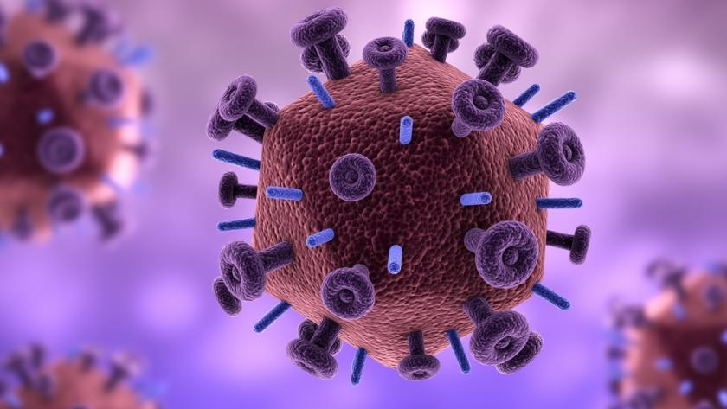
AIDS

Slide 9
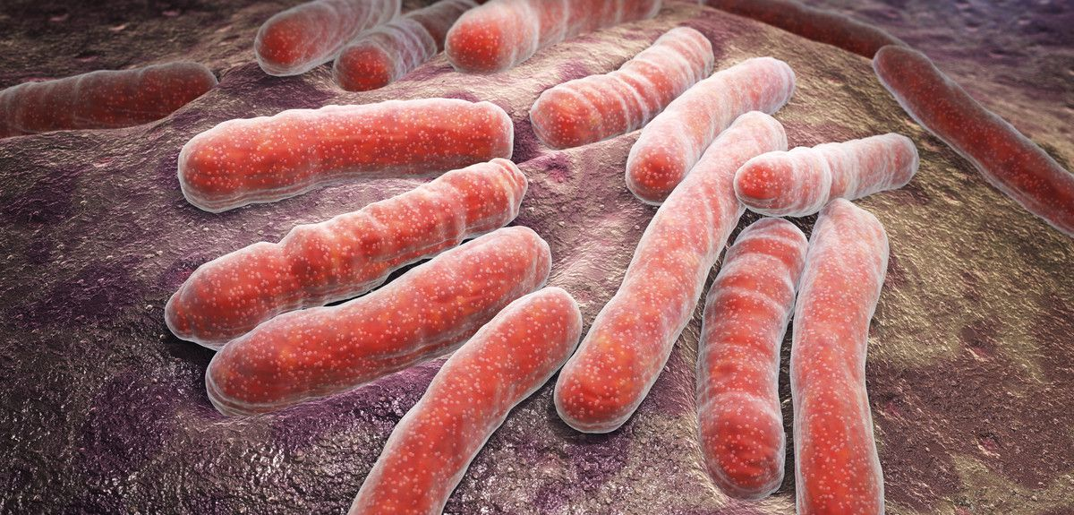
Tuberculosis

Slide 10
Bubonic Plague

Slide 11
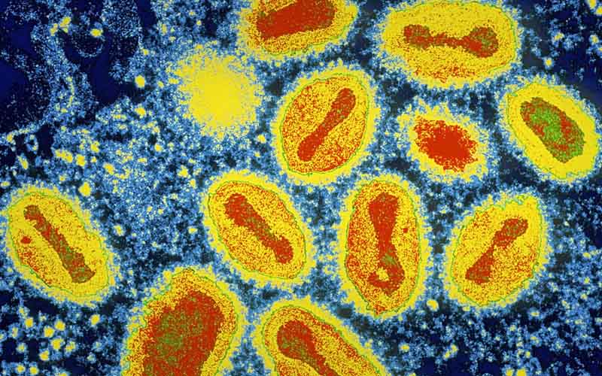
Smallpox

Slide 12
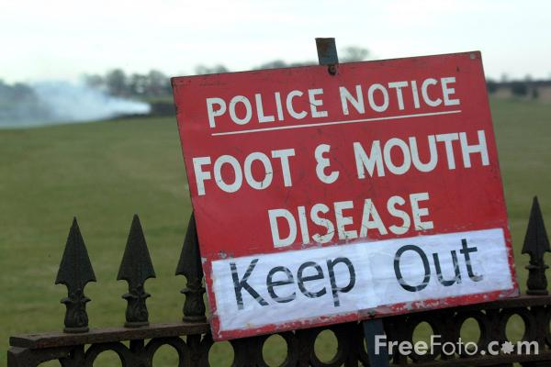

Slide 13
Contagious Diseases
What causes a disease?

Slide 14
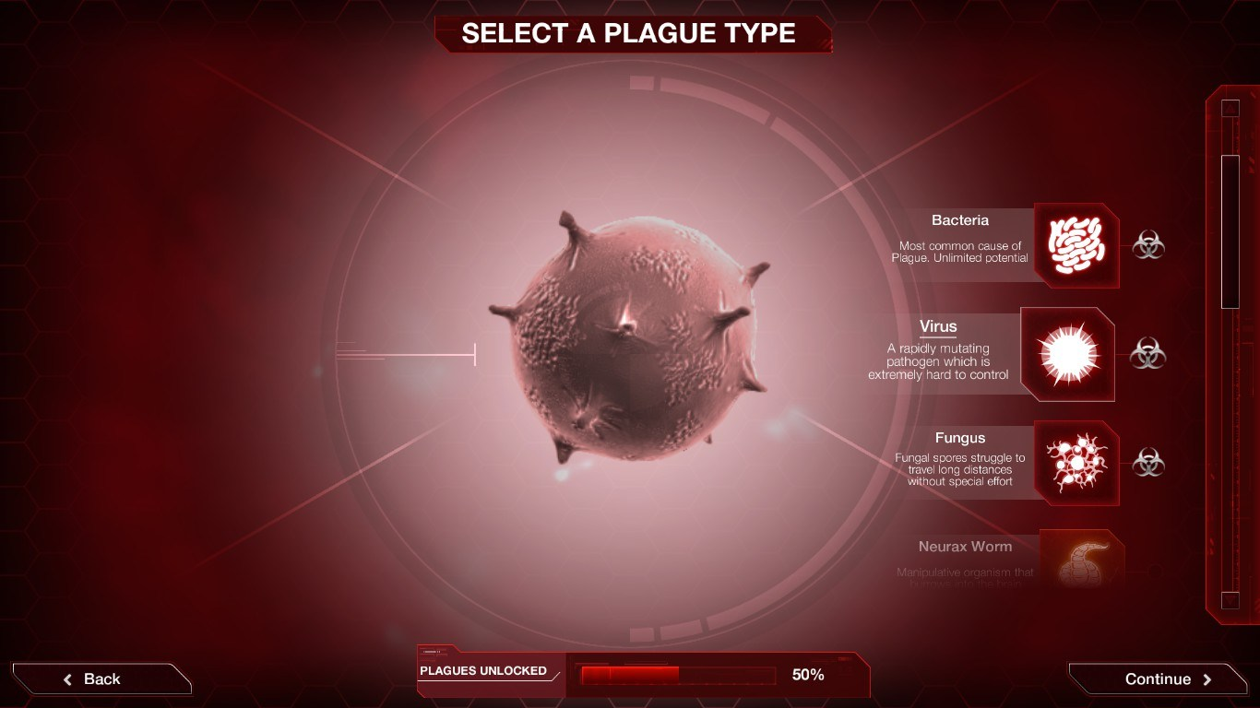
Virus

Slide 19
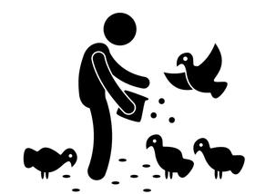
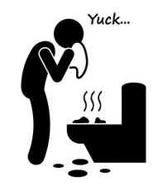
Contagious Diseases
How can a disease spread?
Exposure to other sick people
Sexual transmission
Touch
Animals
Sharing food
Poor sanitation
Sharing needles
Blood transfusion
Kissing

Slide 20
Foot-and-mouth disease, or FMD, is a highly contagious disease that affects animals with divided hooves, including pigs, sheep, and cows. FMD is caused by a virus that lives in the tissues of infected animals as well as in their breath, saliva, urine, and other excretions. Under the right conditions, the virus can survive for several months in the environment. Symptoms of the disease typically appear within 2 to 14 days after an animal has infected. The FMD virus is very difficult to prevent, because there are 7 known types and more than 60 subtypes, and immunity to one type or subtype does not protect an animal against another. Because of this, FMD is a major concern for animal farmers.

Slide 21
Foot-and-mouth disease, or FMD, is a highly contagious disease that affects animals with divided hooves, including pigs, sheep, and cows.
https://www.youtube.com/watch?time_continue=11&v=X0gI2QC27os

Slide 22
Foot-and-mouth disease, or FMD, is a highly contagious disease that affects animals with divided hooves, including pigs, sheep, and cows.

Slide 23
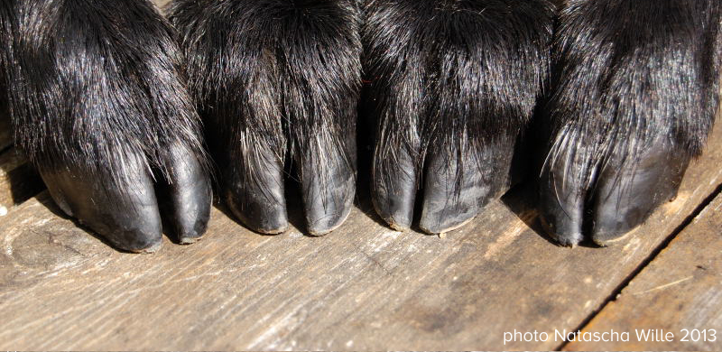
Foot-and-mouth disease, or FMD, is a highly contagious disease that affects animals with divided hooves, including pigs, sheep, and cows.

Slide 24
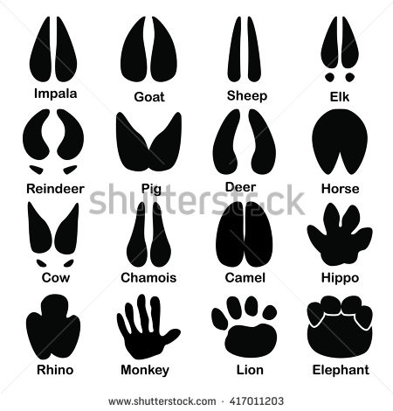
Foot-and-mouth disease, or FMD, is a highly contagious disease that affects animals with divided hooves, including pigs, sheep, and cows.

Slide 25
FMD is caused by a virus that lives in the tissues of infected animals as well as in their breath, saliva, urine, and other excretions.

Slide 26
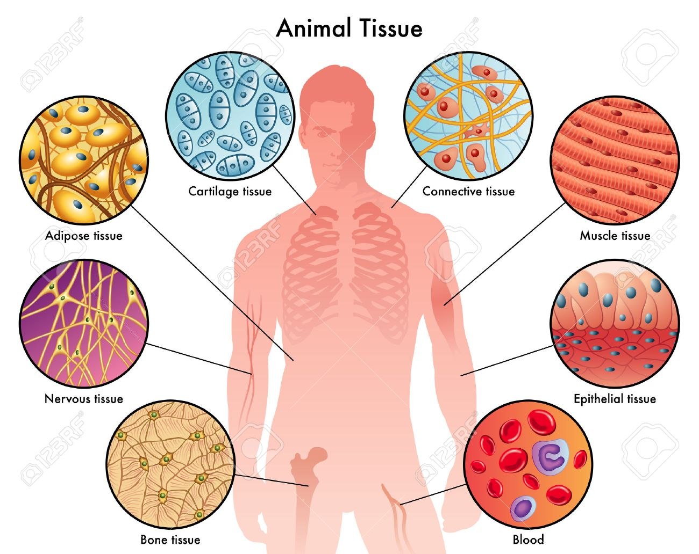
FMD is caused by a virus that lives in the tissues of infected animals as well as in their breath, saliva, urine, and other excretions.

Slide 27
FMD is caused by a virus that lives in the tissues of infected animals as well as in their breath, saliva, urine, and other excretions.
Infected = You have the disease

Slide 28
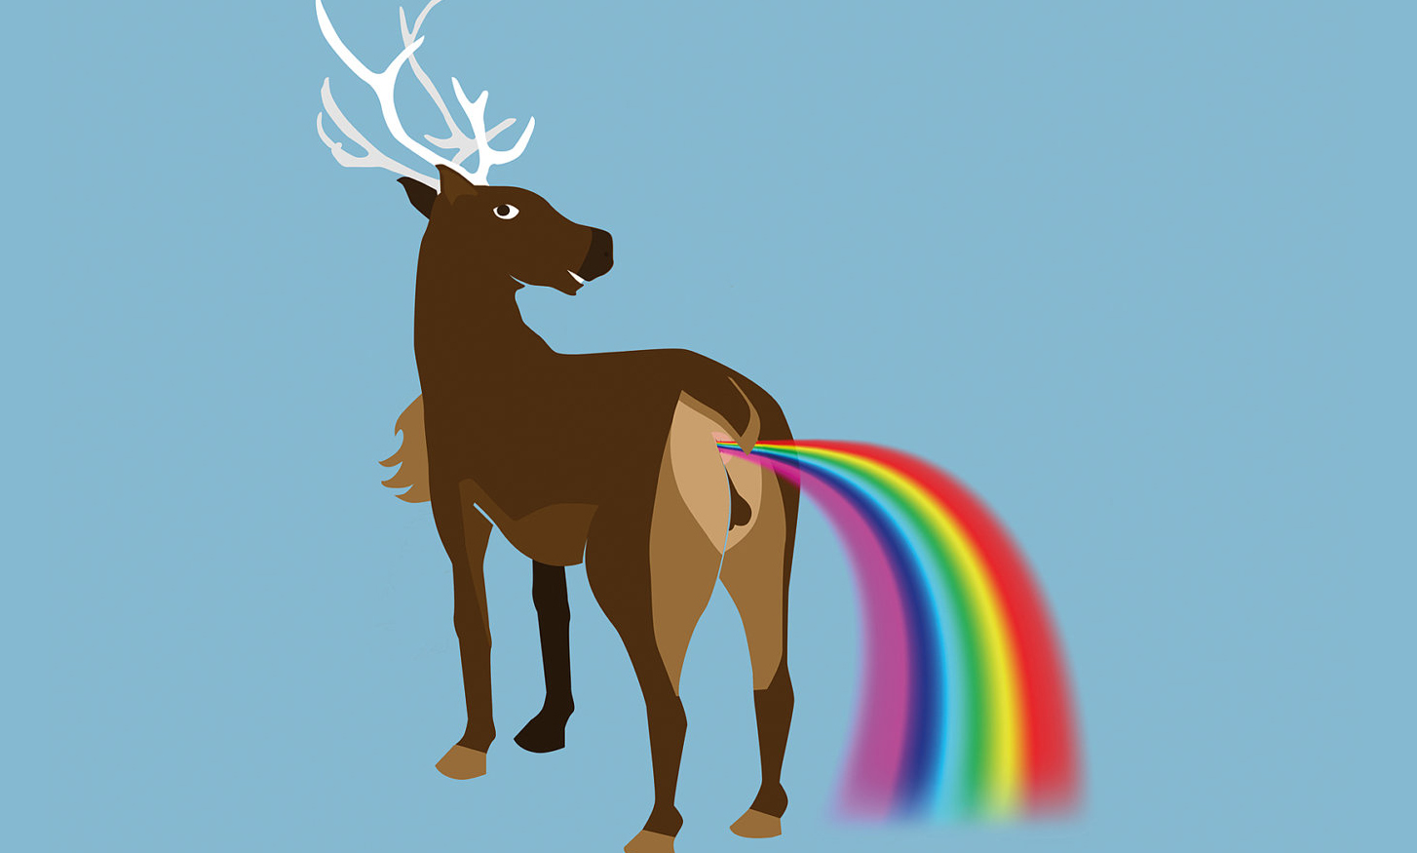
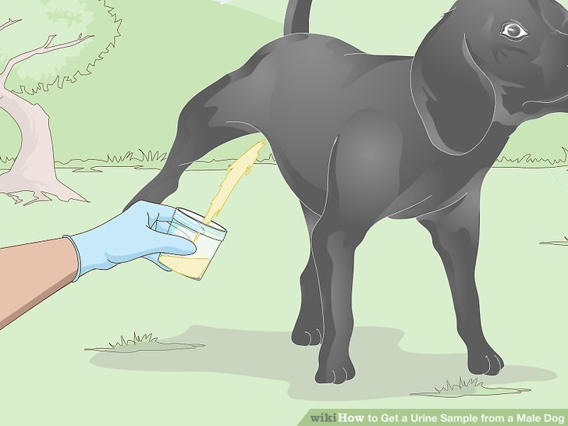
FMD is caused by a virus that lives in the tissues of infected animals as well as in their breath, saliva, urine, and other excretions.

Slide 29
Under the right conditions, the virus can survive for several months in the environment.

Slide 30
Under the right conditions, the virus can survive for several months in the environment.

Slide 31
Under the right conditions, the virus can survive for several months in the environment.
Several = 3 or 4

Slide 32
Under the right conditions, the virus can survive for several months in the environment.

Slide 33
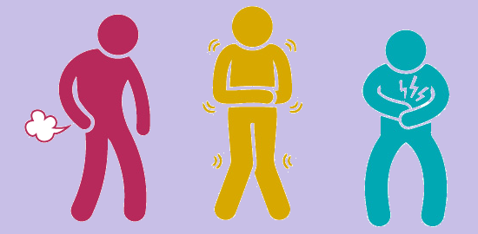
Symptoms of the disease typically appear within 2 to 14 days after an animal has infected.

Slide 34
Symptoms of the disease typically appear within 2 to 14 days after an animal has infected.
Typically = Usually
Appear = can see

Slide 35
Symptoms of the disease typically appear within 2 to 14 days after an animal has infected.
Starts before but is not finished ~ present perfect tense.
Present Perfect Tense = ______ “have / has” + past participle ________.

Slide 36
Symptoms of the disease typically appear within 2 to 14 days after an animal has been infected.
Starts before but is not finished ~ present perfect tense.
Present Perfect Tense = ______ “have / has” + past participle ________.

Slide 37
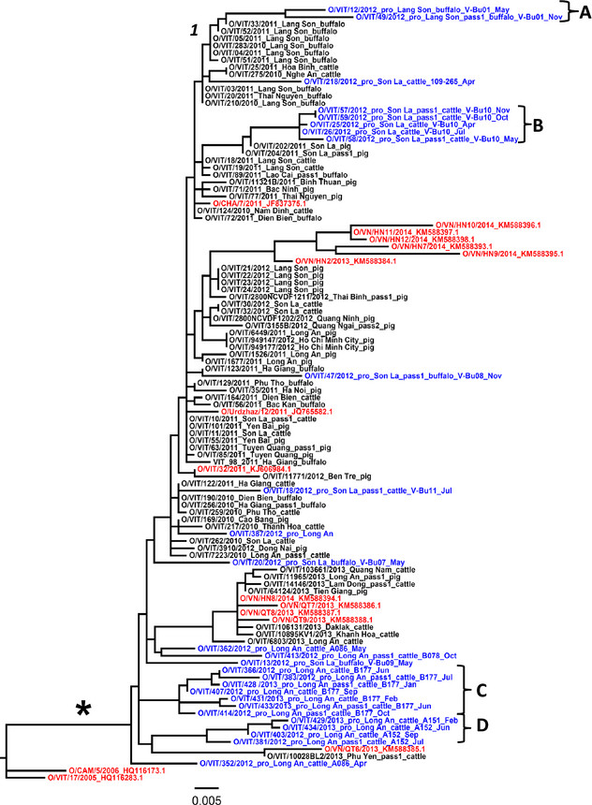
The FMD virus is very difficult to prevent, because there are 7 known types and more than 60 subtypes, and immunity to one type or subtype does not protect an animal against another.

Slide 38
The FMD virus is very difficult to prevent, because there are 7 known types and more than 60 subtypes, and immunity to one type or subtype does not protect an animal against another.
Immunity = can’t get sick from it

Slide 39
The FMD virus is very difficult to prevent, because there are 7 known types and more than 60 subtypes, and immunity to one type or subtype does not protect an animal against another.

Slide 40
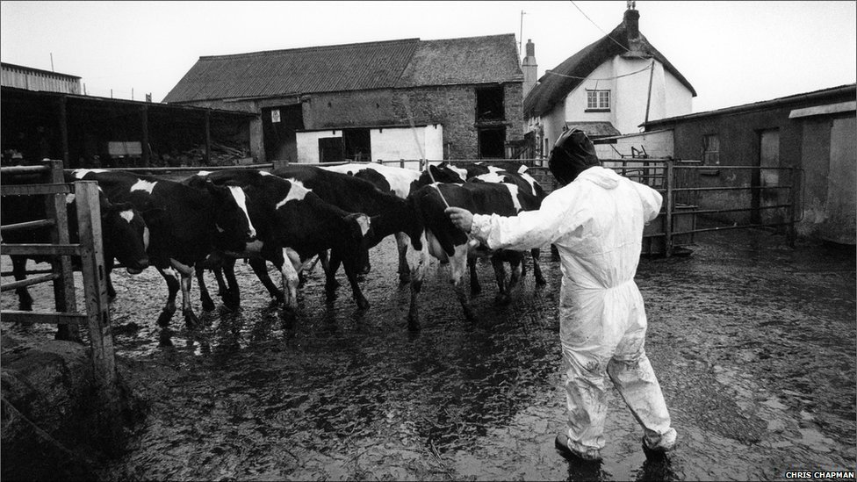
Because of this, FMD is a major concern for animal farmers.

Slide 41
Foot-and-mouth disease, or FMD, is a highly contagious disease that affects animals with divided hooves, including pigs, sheep, and cows. FMD is caused by a virus that lives in the tissues of infected animals as well as in their breath, saliva, urine, and other excretions. Under the right conditions, the virus can survive for several months in the environment. Symptoms of the disease typically appear within 2 to 14 days after an animal has infected. The FMD virus is very difficult to prevent, because there are 7 known types and more than 60 subtypes, and immunity to one type or subtype does not protect an animal against another. Because of this, FMD is a major concern for animal farmers.

Slide 42
Study of how disease spread

Slide 43
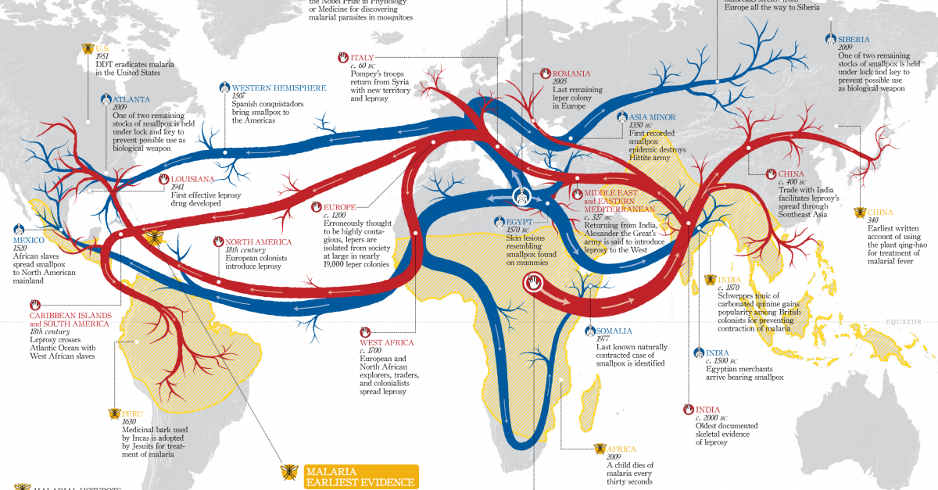
Epidemiology

Slide 44
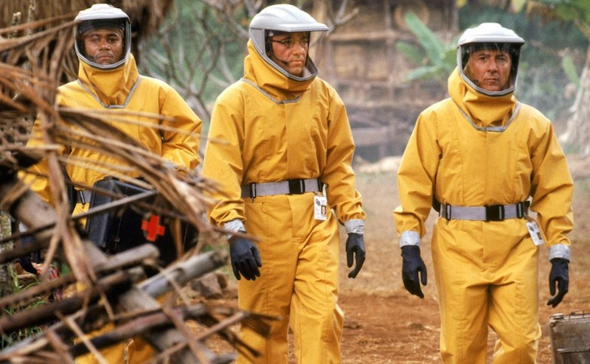
Outbreak

Slide 45
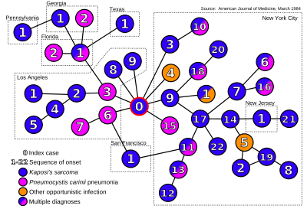
Patient 0

Slide 46
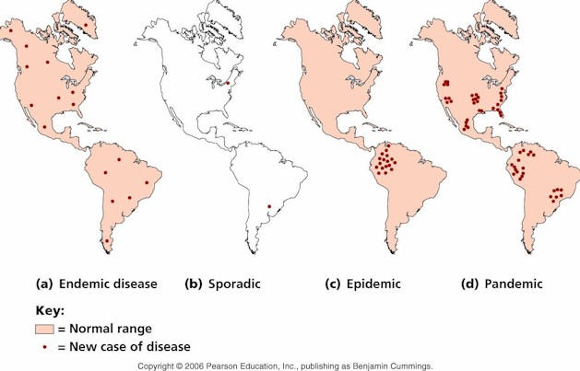

Slide 48
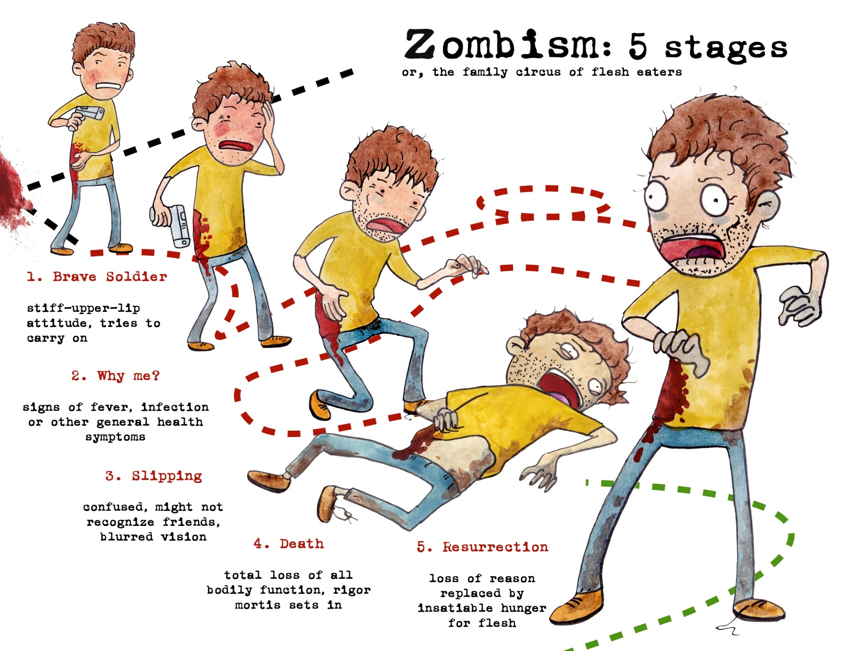

Slide 49
Zombie Parasites
https://www.youtube.com/watch?v=AgCQStTSMuk

Slide 50
Foot and Mouth
https://www.youtube.com/watch?v=PufTeIBNRJ4

