Slide 1
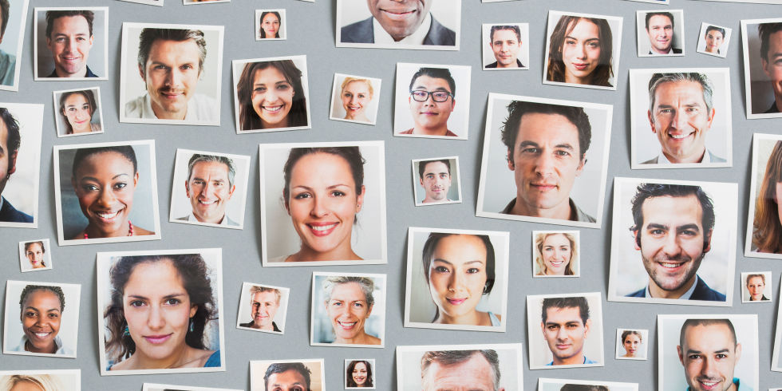
Face Blindness

Slide 2
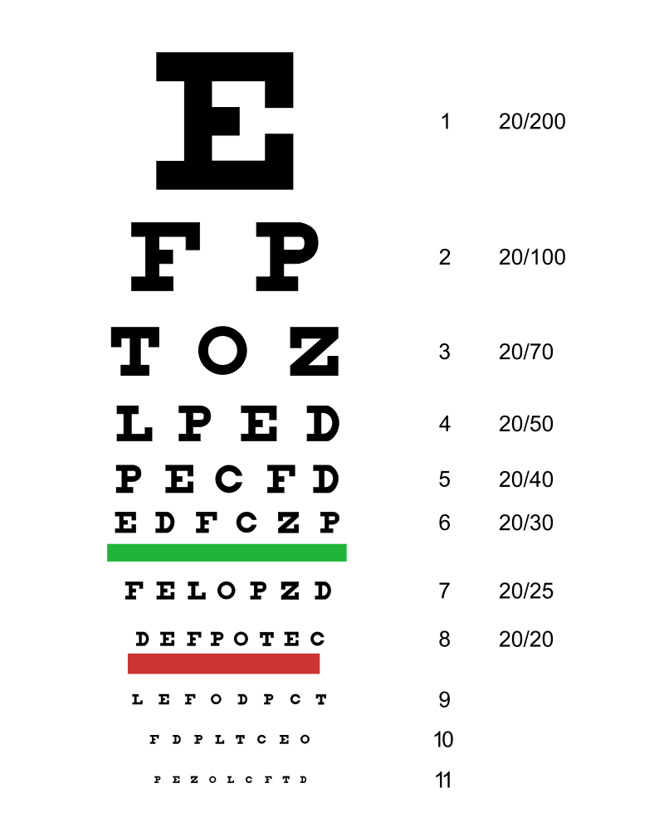
Eyesight

Slide 3
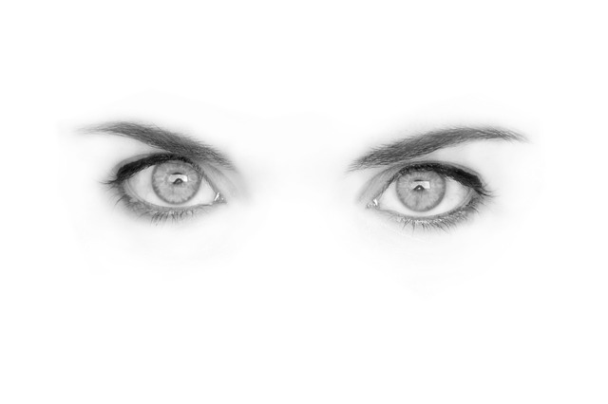
Eyesight
Perhaps 90% of the information we receive is from vision.
What would life be like without eyesight?

Slide 4
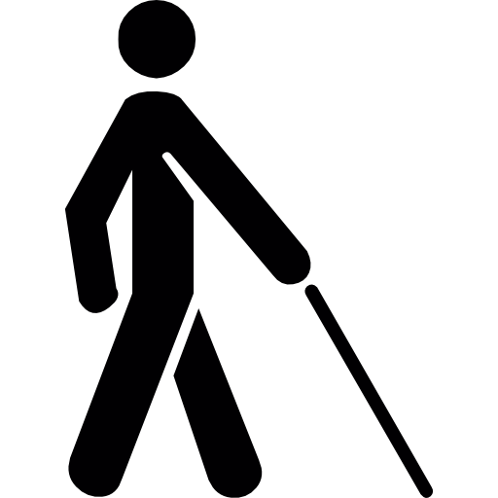
Blindness
36 million people are legally blind.
Other senses are increased.

Slide 5
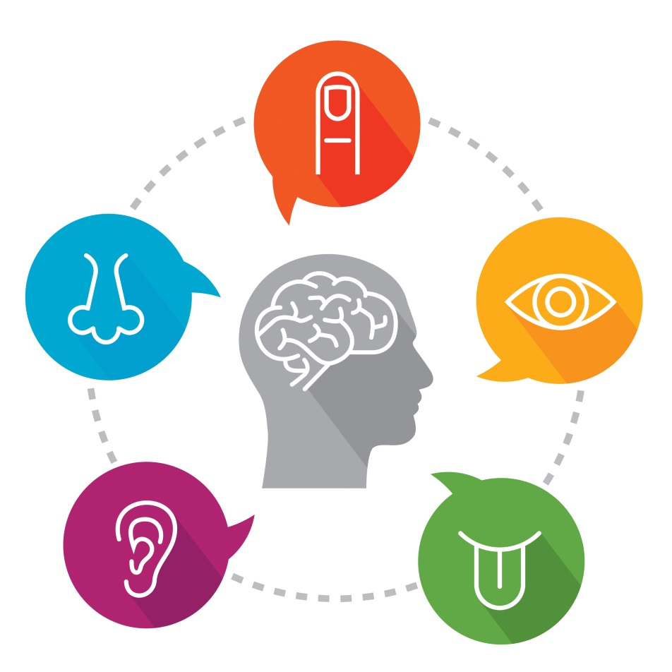
5 Main Senses:
Touch
Smell
Sight
Hearing
Taste

Slide 6
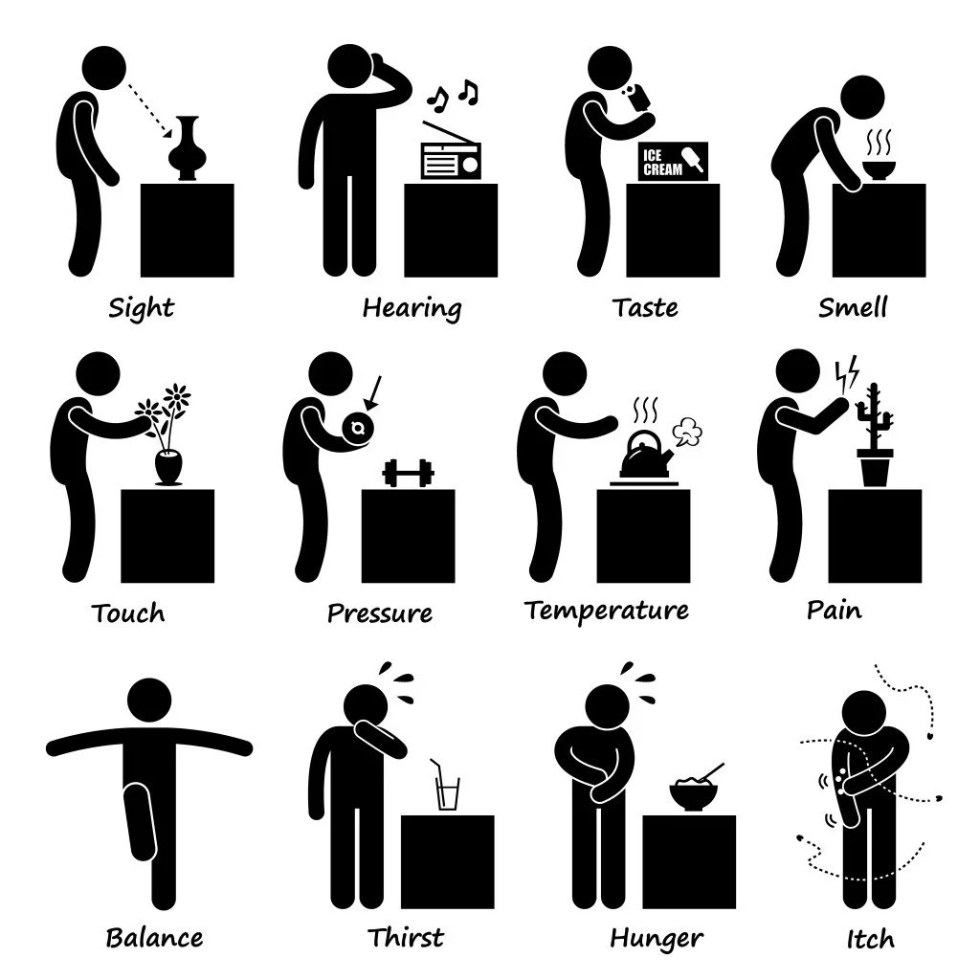
Other Senses

Slide 7
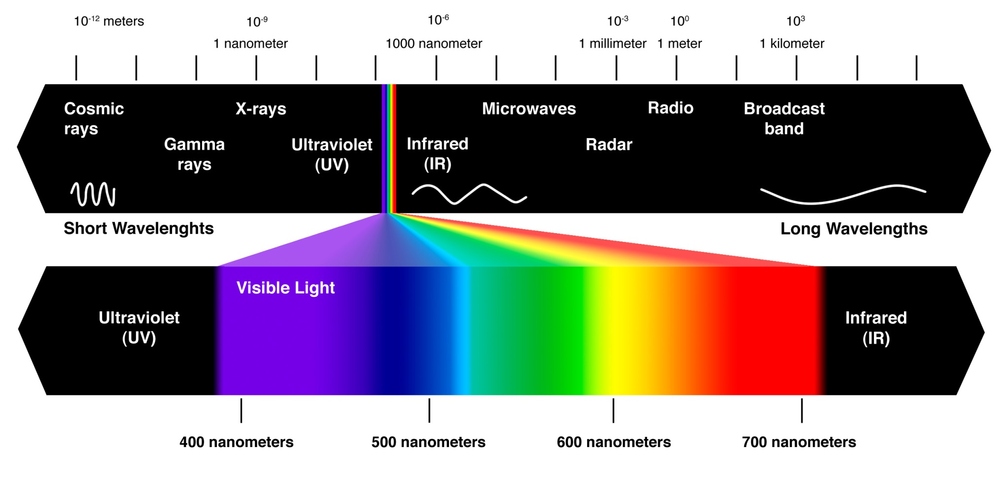
Ultraviolet / Infrared

Slide 8
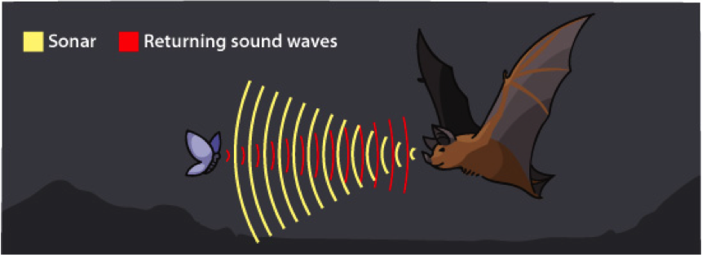
Echolocation
https://www.youtube.com/watch?v=A8lztr1tu4o (humans)

Slide 9
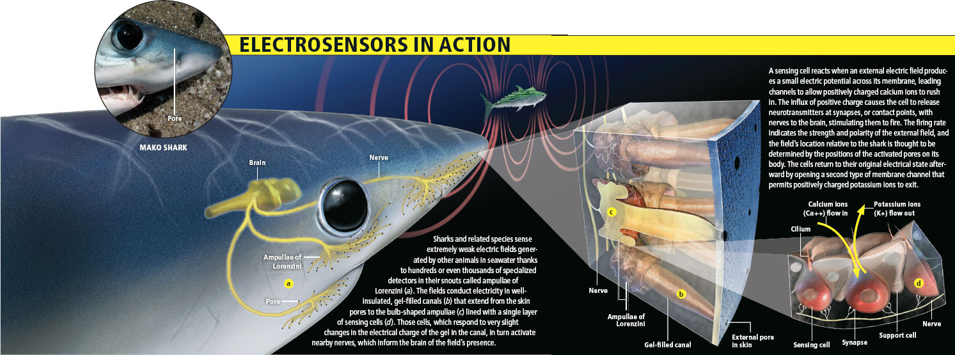
Electric Sense

Slide 10
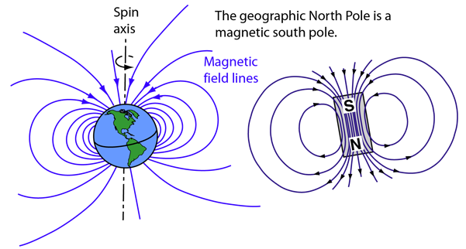
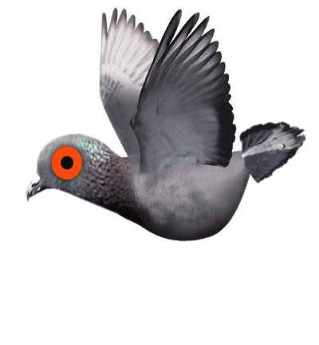
Magnetic Sense

Slide 11
Face blindness
Prosopagnosia, or face blindness is the inability to recognize familiar faces.
You may not be able to recognize your own face.

Slide 12
Face blindness
Face blindness makes it difficult for people to recognize the faces of others they have met before. In extreme cases, a person with face blindness may not even recognize family members. Furthermore, sufferers can’t easily imagine people’s appearance in their minds. Focusing on non-facial clues, such as hairstyles and voices, help them to recognize others. One problem often experienced by these people is the inability to distinguish one actor from another in movies, making it difficult to follow the plot. Face blindness often follows brain damage such as a stroke. Some cases, however, seem to be genetic.

Slide 13
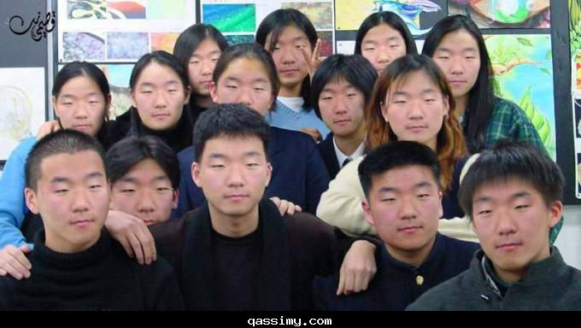
How does face blindness affect sufferers?
It is difficult to recognize faces of people they met before.

Slide 14
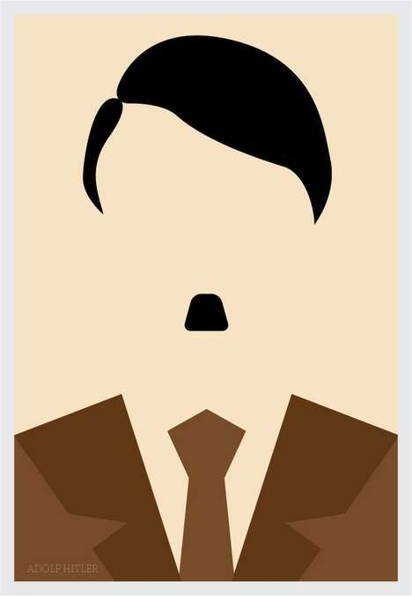
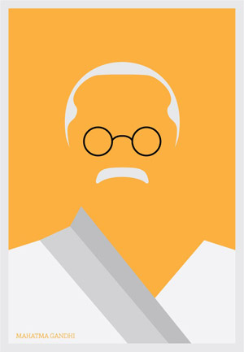
How can sufferers recognize people?
Hairstyles and voices

Slide 15
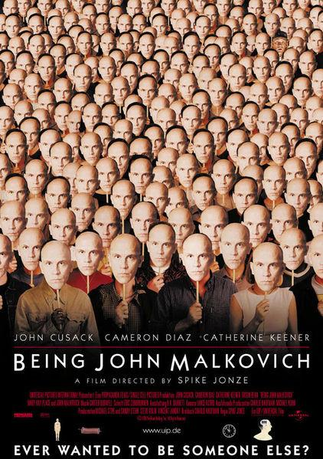
Why do sufferers have a difficult time following the plot of movies?
Can’t distinguish actors

Slide 16
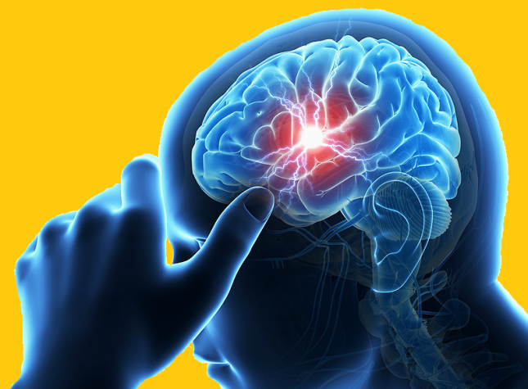
What is a common way to get face blindness?
Brain damage (stroke)

Slide 17
Can you spot the mistake?
Face blindness makes it difficult for people to recognize the faces of others they have met before. In extreme cases, a person with face blindness may not even recognize family members. Furthermore, sufferers can’t easily imagine people’s appearance in their minds. Focusing on non-facial clues, such as hairstyles and voices, help them to recognize others. One problem often experienced by these people is the inability to distinguish one actor from another in movies, making it difficult to follow the plot. Face blindness often follows brain damage such as a stroke. Some cases, however, seem to be genetic.

Slide 18
Can you spot the mistake?
Face blindness makes it difficult for people to recognize the faces of others they have met before. In extreme cases, a person with face blindness may not even recognize family members. Furthermore, sufferers can’t easily imagine people’s appearance in their minds. Focusing on non-facial clues, such as hairstyles and voices, help them to recognize others. One problem often experienced by these people is the inability to distinguish one actor from another in movies, making it difficult to follow the plot. Face blindness often follows brain damage such as a stroke. Some cases, however, seem to be genetic.
helps

Slide 19
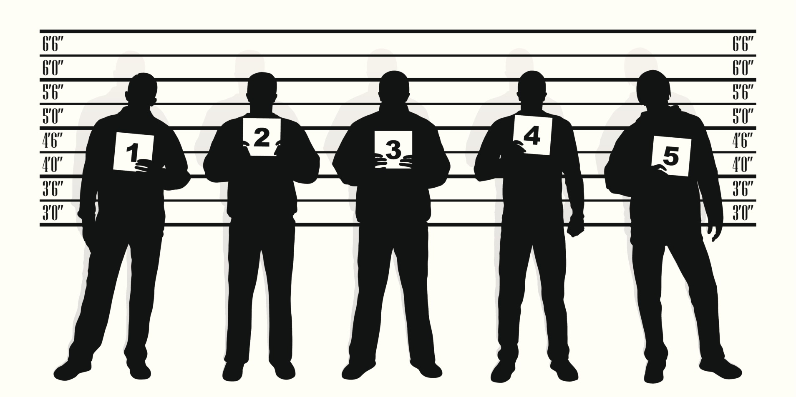
Police Lineup
https://www.youtube.com/watch?v=RWO2UQ4MW7U

Slide 20
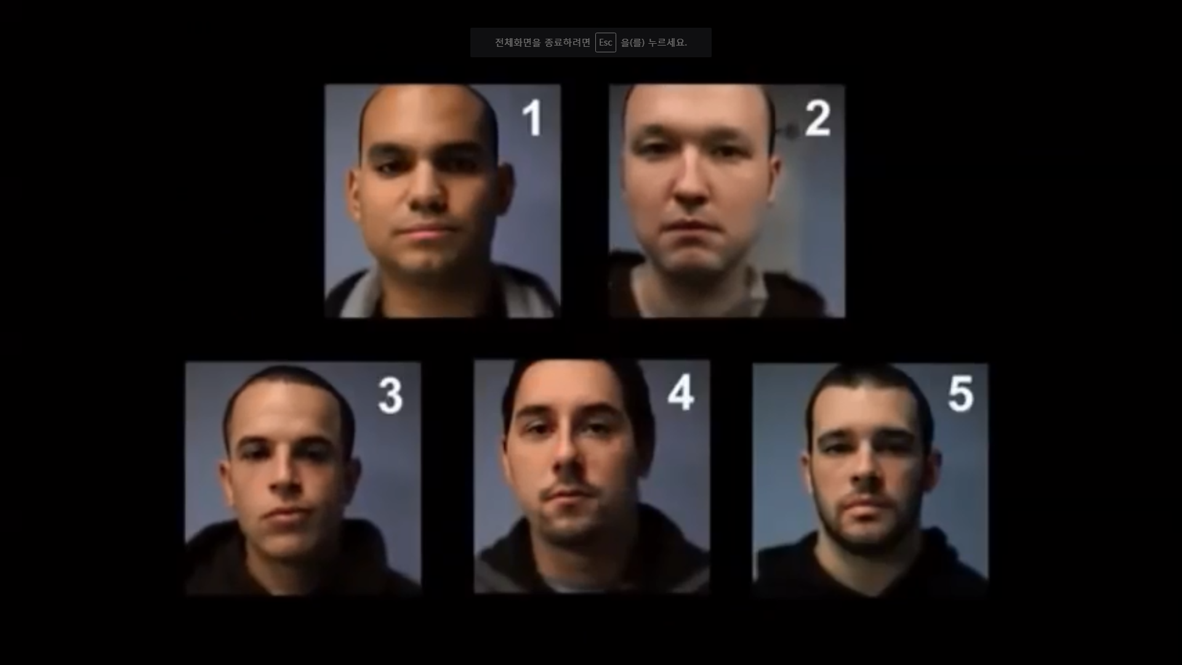

Slide 21
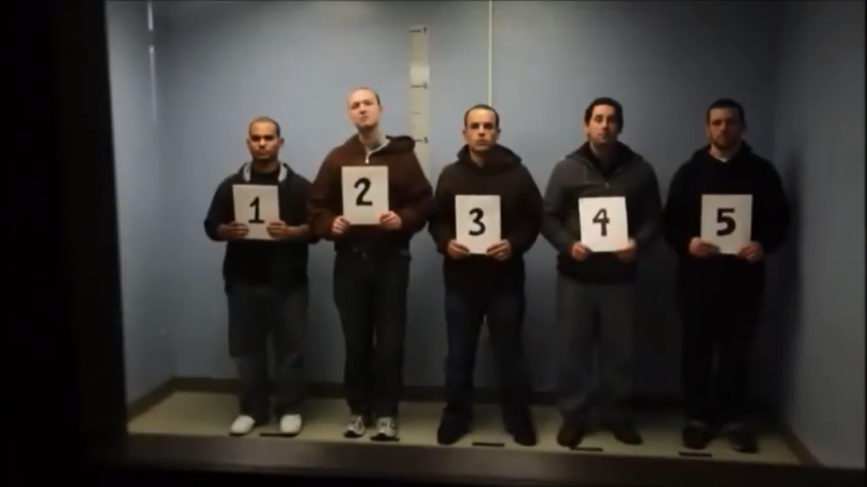
Who committed the crime?

Slide 22
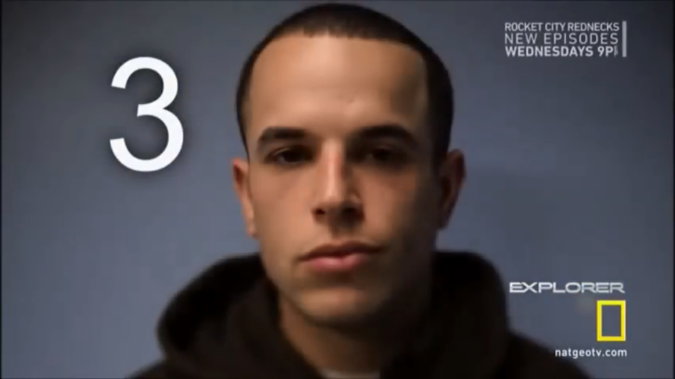
Reveal answer

Slide 23
Police Sketch Game
Describe the people.

