Slide 1
Police Sketch Artist

Slide 2
Rules:
Students work in pairs
One student will be the artist
Their back is to the TV
The other student is facing the TV and can see the picture.
For added complexity, allow students to see the picture for a limited time before describing the character. Click to the next screen, so they have to use their memory.
The artist must draw the picture on the TV by asking questions.
For example: “Is he wearing a hat?” “Does she have blue eyes?”
There is also a 3 minute timer for drawing
The other student can only answer in “yes” or “no.”
Switch the roles.

Slide 3
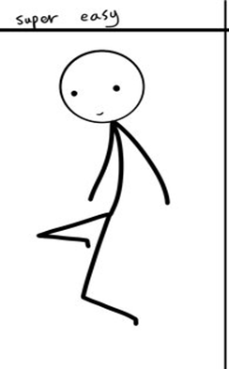
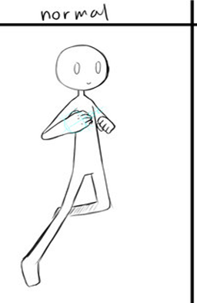
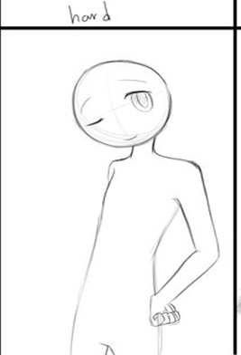
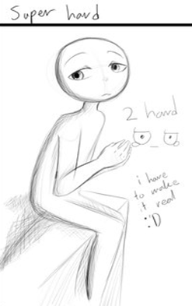
Choose a character:

Slide 4
Ready?

Slide 5
Click when you are ready to draw

Slide 6
Draw!
Time’s Up!
(Click to reveal answer)

Slide 7
Choose a new character:

Slide 8
Ready?

Slide 9
Click when you are ready to draw

Slide 10
Draw!
Time’s Up!
(Click to reveal answer)

Slide 11
Choose a new character:

Slide 12
Ready?

Slide 13
Click when you are ready to draw

Slide 14
Draw!
Time’s Up!
(Click to reveal answer)

Slide 15
Choose a new character:

Slide 16
Ready?

Slide 17
Click when you are ready to draw

Slide 18
Draw!
Time’s Up!
(Click to reveal answer)

Slide 19
Choose a new character:

Slide 20
Ready?

Slide 21
Click when you are ready to draw

Slide 22
Draw!
Time’s Up!
(Click to reveal answer)

Slide 23
Choose a new character:

Slide 24
Ready?

Slide 25
Click when you are ready to draw

Slide 26
Draw!
Time’s Up!
(Click to reveal answer)

Slide 27
Choose a new character:

Slide 28
Ready?

Slide 29
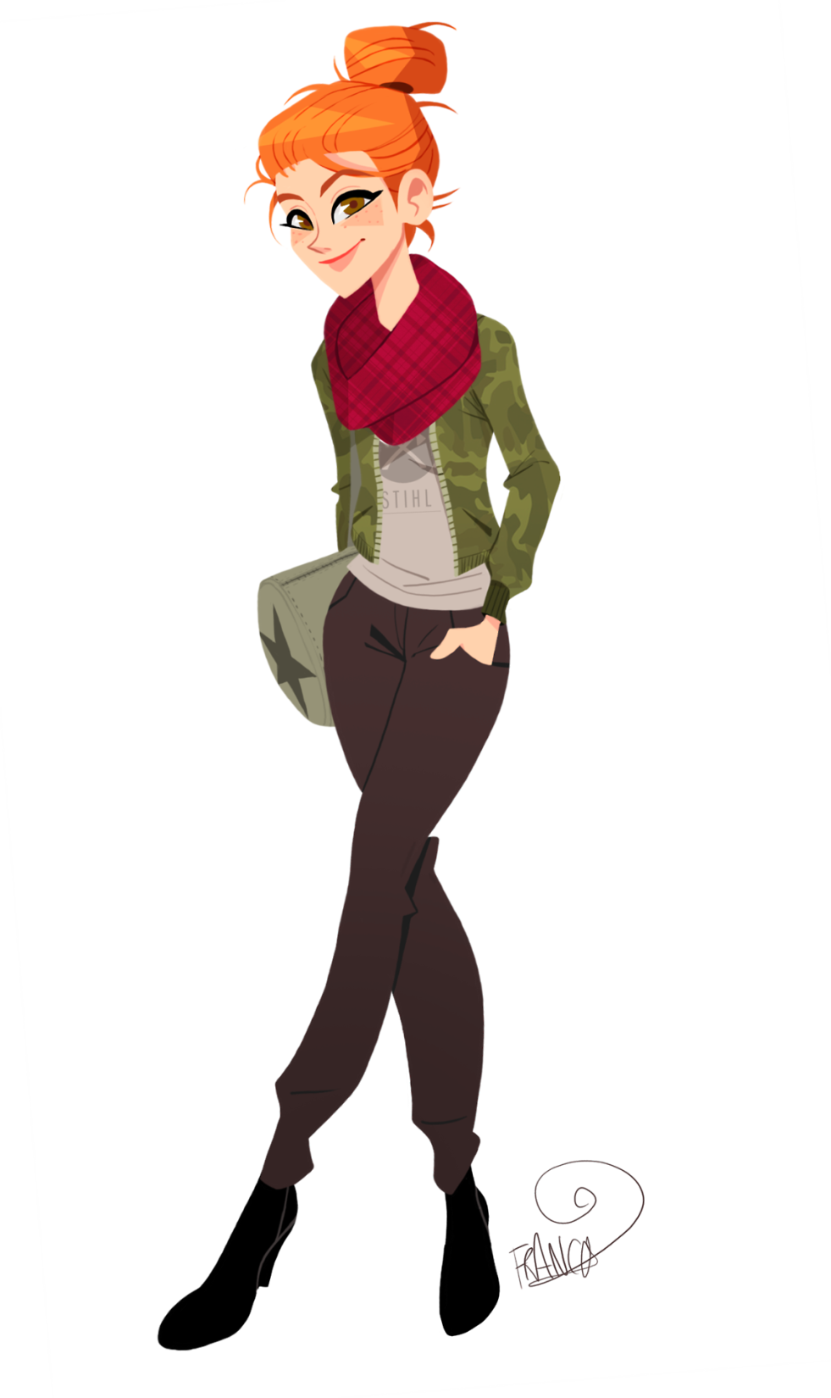
Click when you are ready to draw

Slide 30
Draw!
Time’s Up!
(Click to reveal answer)

Slide 31
Choose a new character:

Slide 32
Ready?

Slide 33
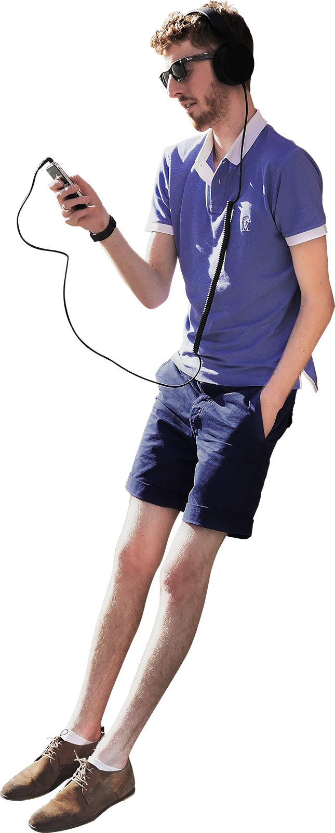
Click when you are ready to draw

Slide 34
Draw!
Time’s Up!
(Click to reveal answer)

Slide 35
Choose a new character:

Slide 36
Ready?

Slide 37
Click when you are ready to draw

Slide 38
Draw!
Time’s Up!
(Click to reveal answer)

Slide 39
Choose a new character:

Slide 40
Ready?

Slide 41
Click when you are ready to draw

Slide 42
Draw!
Time’s Up!
(Click to reveal answer)

Slide 43
Choose a new character:

