Slide 2
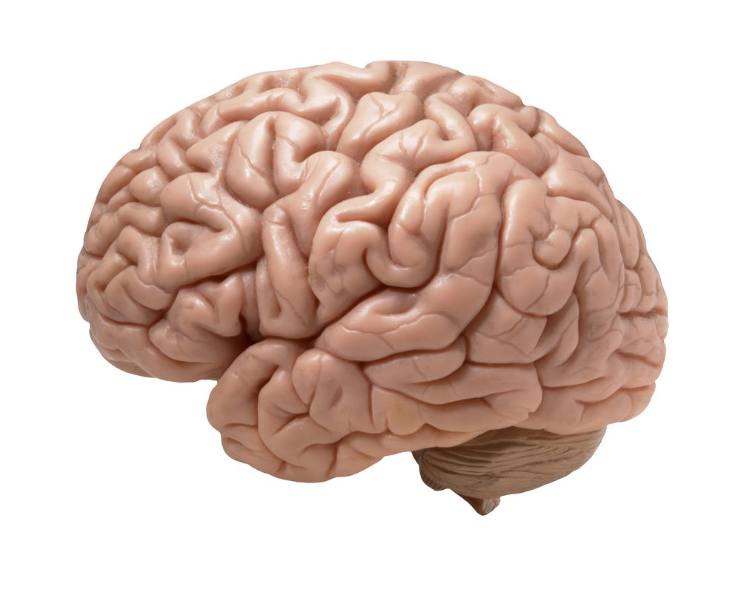
Brain Exercise

Slide 3
Is your brain getting enough exercise?

Slide 4
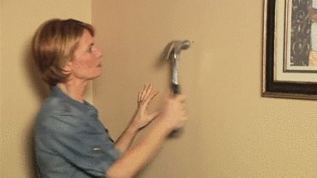

Slide 5
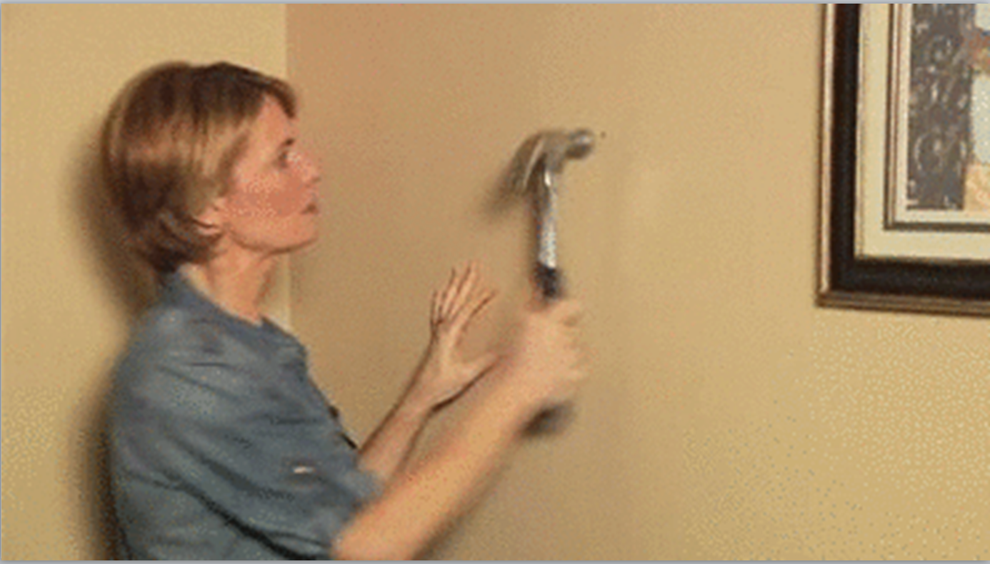
You may think you have difficulty to remember things because of dying brain cells, but the more likely reason is a simple lack of use.

Slide 6
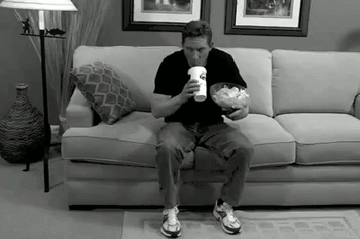

Slide 7
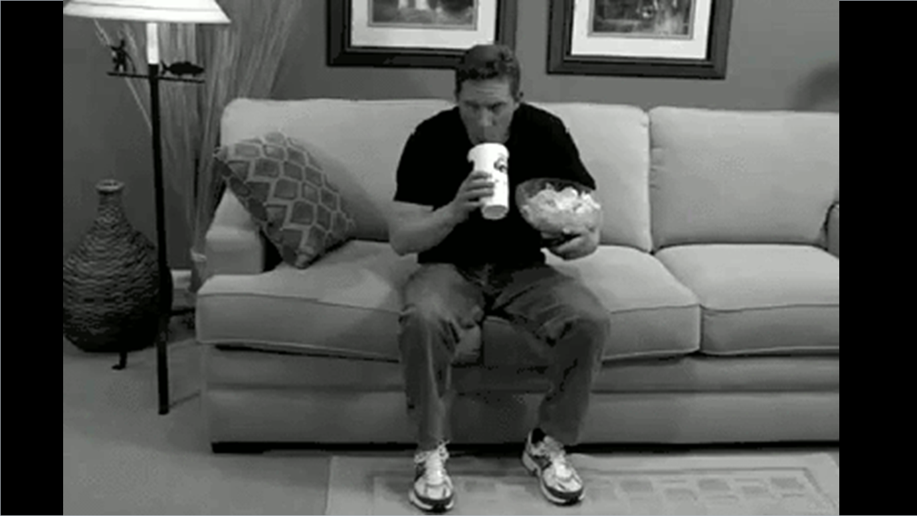
Studies have shown that our brains are in their prime between the ages of 40 and 60.

Slide 8
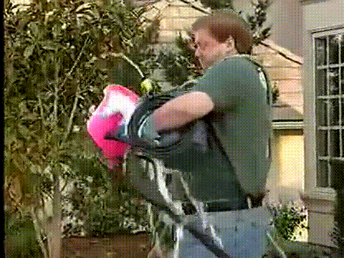

Slide 9
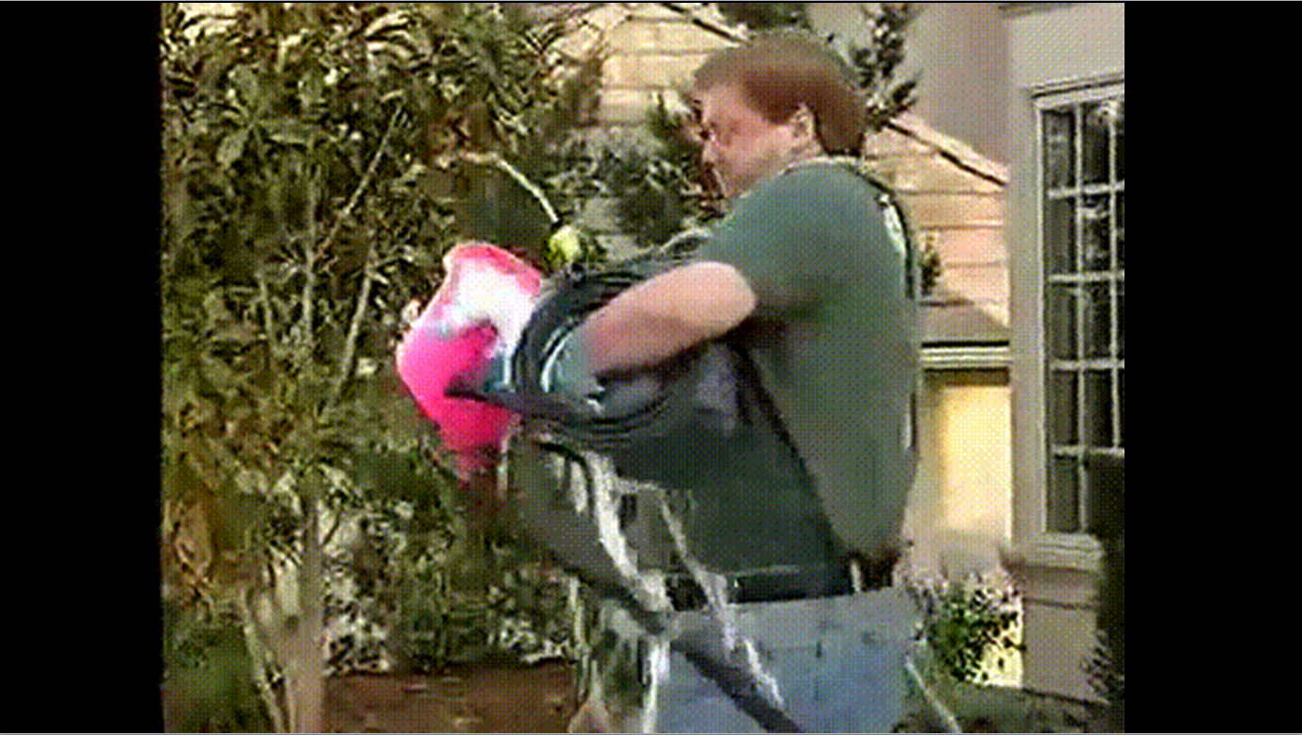
As a mature adult, you may not remember all the information you learned in school, but you’re in a better place to use what you have remembered.

Slide 10
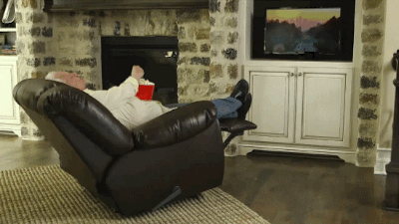

Slide 11
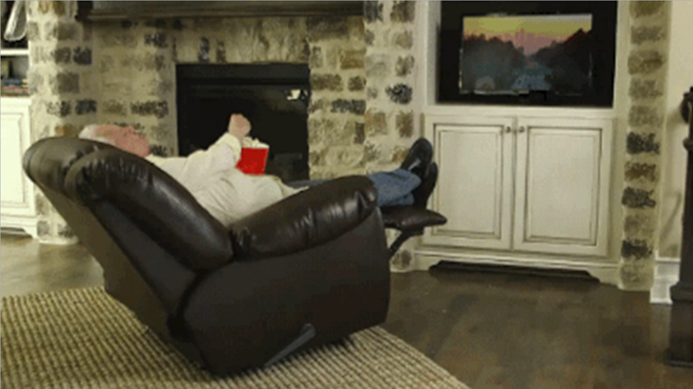
So why do some older people forget so many things?

Slide 12
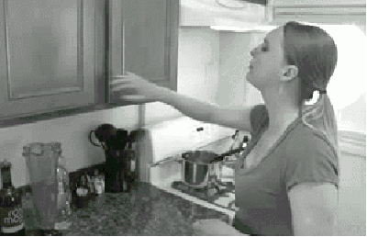

Slide 13
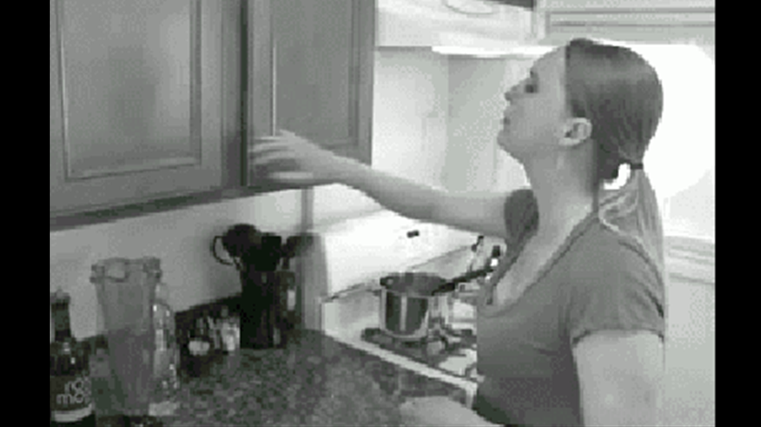
Like a muscle, the brain must be kept in shape.

Slide 14
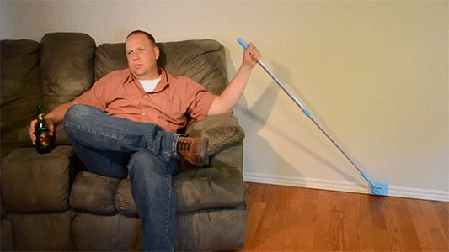

Slide 15
Stuck in a daily routine, it can become lazy and weak.

Slide 16
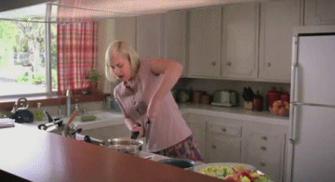

Slide 17
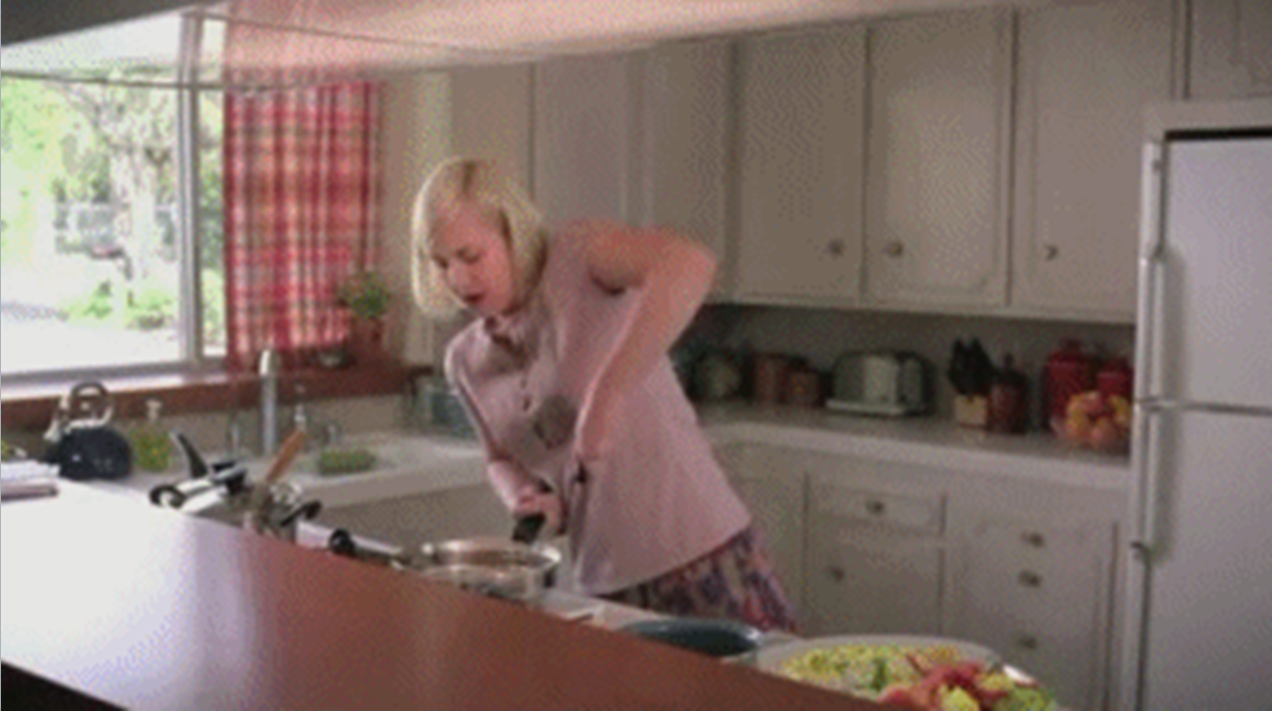
You can easily do this by stretching it with puzzles.

Slide 18
Questions

Slide 19
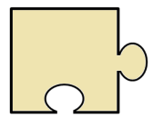
Why do you have a difficult time remembering things?
Lack of use

Slide 20
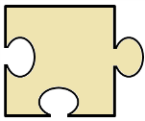
When is our brain in it’s prime?
Between 40 and 60 years old

Slide 21
Why do some people forget so many things?
Lazy and weak brain

Slide 22
How can you stretch your brain?
Puzzles

Slide 23
Brain Exercise
Is your brain getting enough exercise? You may think you have difficulty to remember things because of dying brain cells, but the more likely reason is a simple lack of use. Studies have shown that our brains are in their prime between the ages of 40 and 60. As a mature adult, you may not remember all the information you learned in school, but you’re in a better place to use what you have remembered. So why do some older people forget so many things? Like a muscle, the brain must be kept in shape. Stuck in a daily routine, it can become lazy and weak. Therefore, you must challenge it regularly to keep it healthy. You can easily do this by stretching it with puzzles.

Slide 24
Brain Exercise
Is your brain getting enough exercise? You may think you have difficulty to remember things because of dying brain cells, but the more likely reason is a simple lack of use. Studies have shown that our brains are in their prime between the ages of 40 and 60. As a mature adult, you may not remember all the information you learned in school, but you’re in a better place to use what you have remembered. So why do some older people forget so many things? Like a muscle, the brain must be kept in shape. Stuck in a daily routine, it can become lazy and weak. Therefore, you must challenge it regularly to keep it healthy. You can easily do this by stretching it with puzzles.
remembering

Slide 25
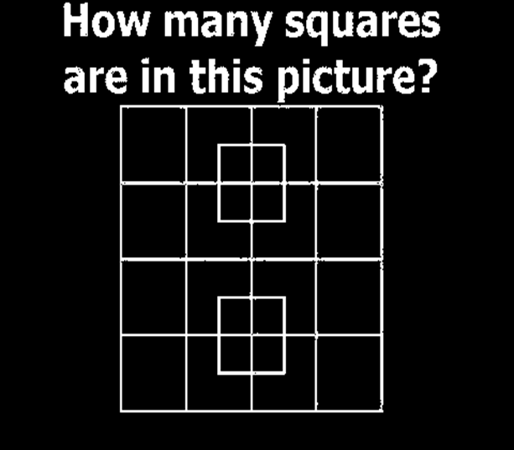

Slide 27
Riddles
And brain teasers

Slide 28
Riddle
1
Q: I am tall when I am young. I am short when I am old. What am I?
A: candle

Slide 29
Riddle
2
Q: What is at the end of the rainbow?
A: “w”

Slide 30
Riddle
3
Q: How many months have 28 days?
A: 12 (all of them).

Slide 31
Riddle
4
Q: Name 4 days of the week that start with “T”.
A: Tuesday, Thursday, Today, Tomorrow

Slide 32
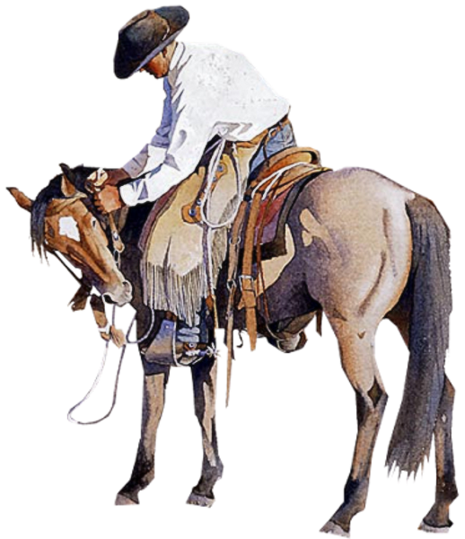
Riddle
5
Q: A cowboy rides into town on Friday. He stays 3 days and leaves on Friday.
How is it possible?
A: The horse’s name is Friday.

Slide 33
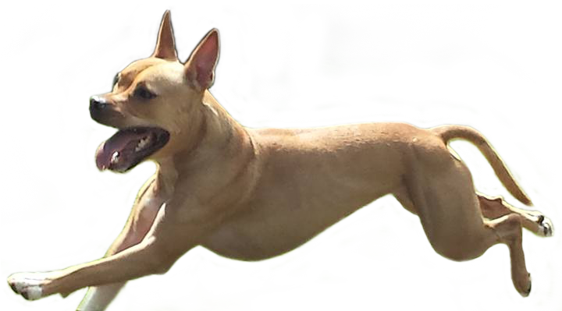
Riddle
6
Q: How far can a dog run into the forest?
A: Halfway (or he would be running out)

Slide 34
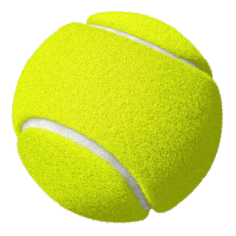
Riddle
7
Q: You throw a ball as hard as possible. It doesn’t bounce, but it comes back to you. Why?
A: You threw the ball straight up.

Slide 35
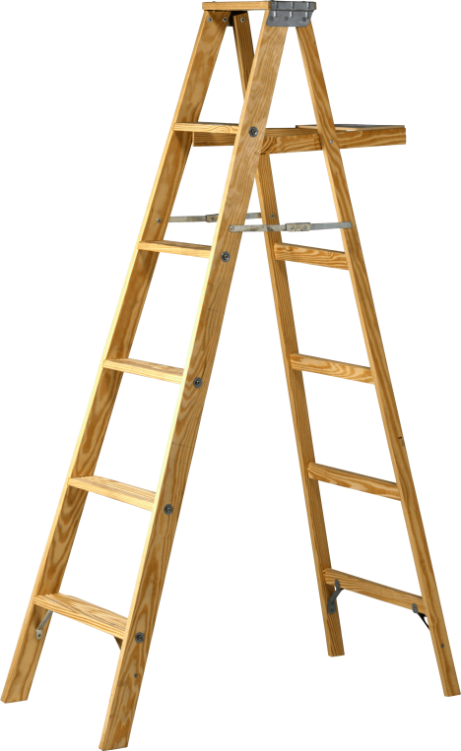
Riddle
8
Q: A boy falls off a 10m ladder, but he did not get hurt. Why?
A: He was on the bottom step.

Slide 36
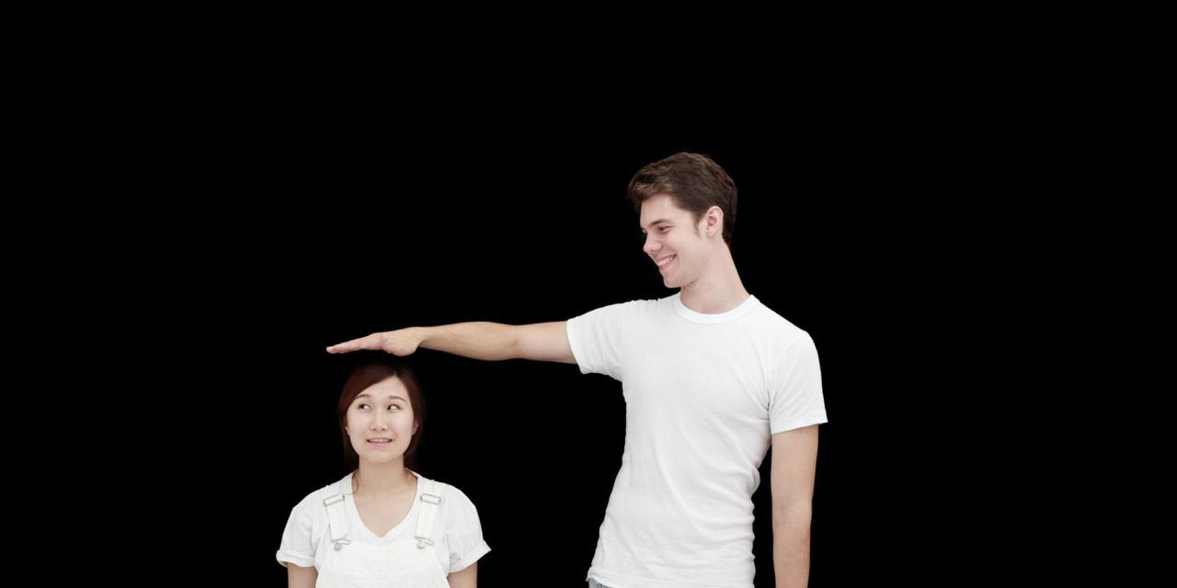
Riddle
9
Q: What word becomes shorter when you add two letters?
A: short

Slide 37
Riddle
10
Q: What belongs to you, but other people use it more than you?
A: Your name

Slide 38
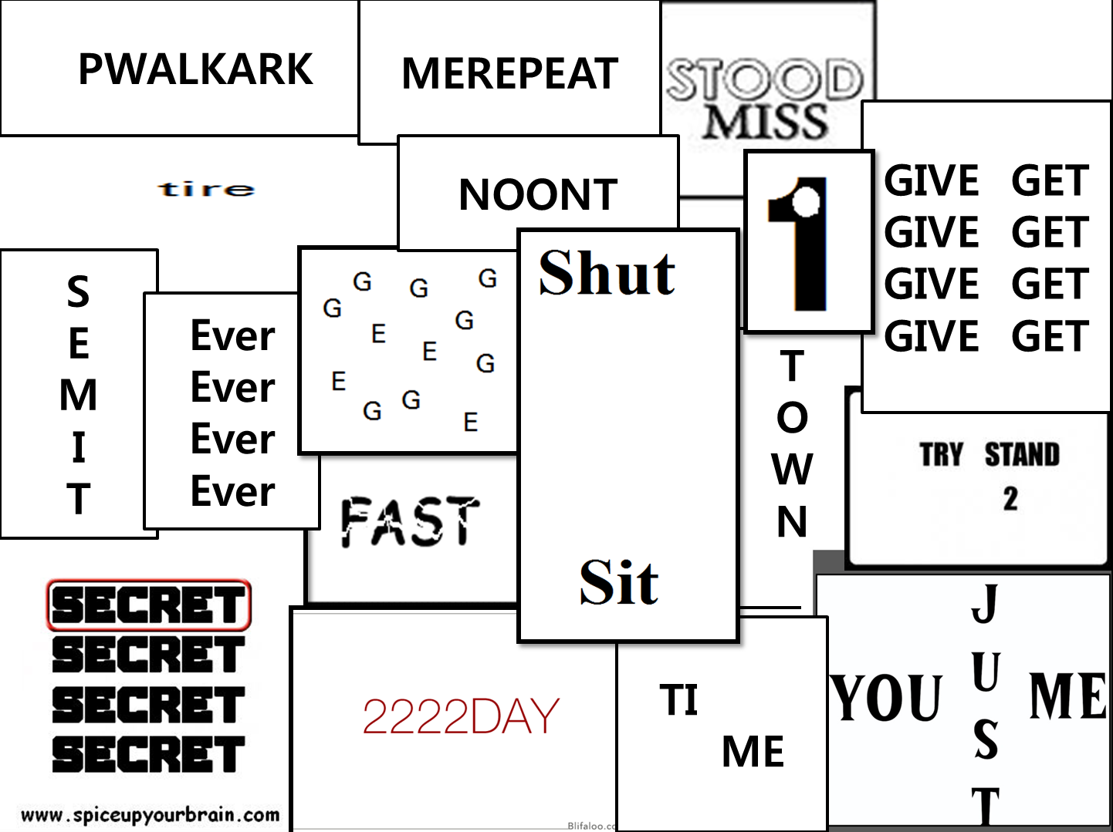

Slide 39
Parallel thinking
Yes, No, Irrelevant

Slide 40
Yes, No, Irrelevant
Read the story and ask questions.
I will answer; “Yes”, “No”, or “Irrelevant”
Try to find out what happened.

Slide 41
Gloves
A woman leaves home and makes three left turns. She returns home again. On the way she passed by five people with gloves. Who were they?
They are baseball players. She hit a homerun.
Answer

Slide 42
Jane
It’s a hot summer day. Jane is dead on the floor. There is water on the floor and she is naked.
What happened?
Jane is a fish.
The aquarium broke.
Answer

Slide 43
Ancient Invention
There is an ancient invention still used in some parts of the world. It lets you see through walls.
What is it?
A window.
Answer

Slide 44
Soccer Scores
There is a magician who says he knows the score of every soccer game before it starts. He is always right.
How is it possible?
The score before a game starts is 0-0.
Answer

Slide 45
The surgeon
A man and his son were rock climbing and they fell. The son was injured, so he went to the hospital. The surgeon said, “I can’t operate on this boy. He is my son!”
How is this possible?
The surgeon is his mother.
Answer

Slide 46
The trains
There is a bridge that only has one railroad going across it. There are two trains that are moving in opposite directions. They both cross the bridge, but never hit each other.
How is it possible?
They cross the bridge at different times.
Answer

Slide 47
The small Umbrella
Three people try to share a small umbrella. No one gets wet. Why?
It’s not raining.
Answer

Slide 48
Gloves
There is a small lake. A man walks across the lake. There is no bridge, but the man is not wet.
How is it possible?
The lake is frozen (walk on ice)
Answer

Slide 49
The 10th Floor
A woman lives on the 10th floor. At night she gets off on the seventh floor and walks to her apartment.
Why doesn’t she go to the 10th floor?
She is short. She can’t reach the 10th floor button.
Answer

Slide 50
An Unopened Backpack
A man is found dead in the desert. He is wearing an unopened backpack.
How did he die?
The backpack is his parachute.
Answer

