Slide 1
Evolution
And Woodpeckers

Slide 2
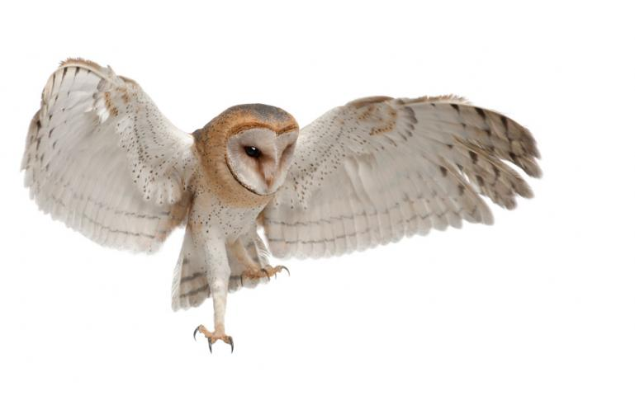
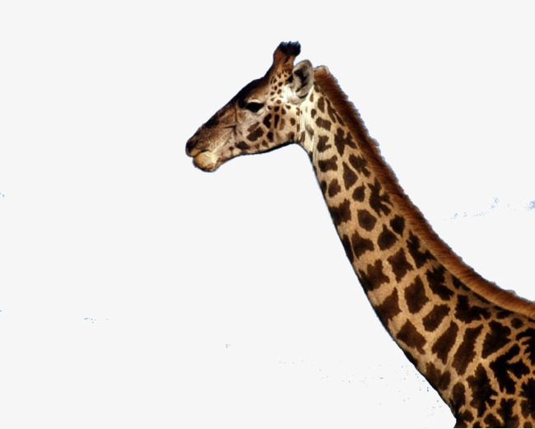
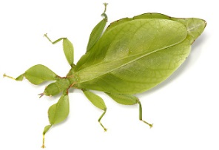
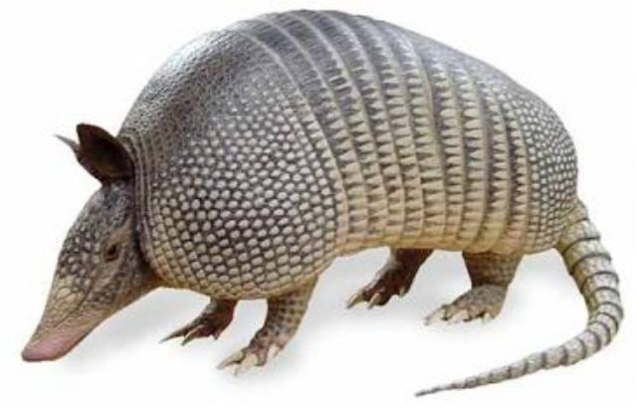
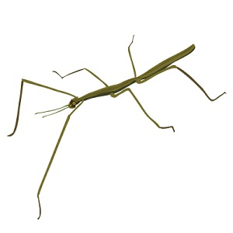
Evolution can explain many strange features in animals

Slide 3
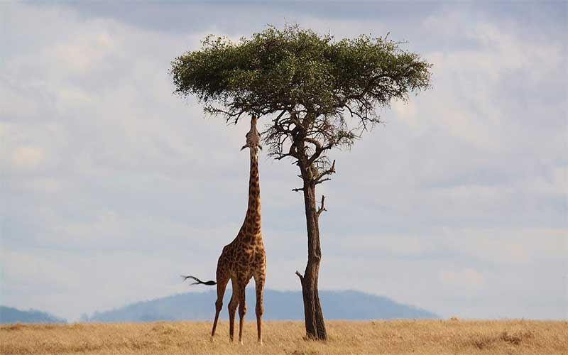
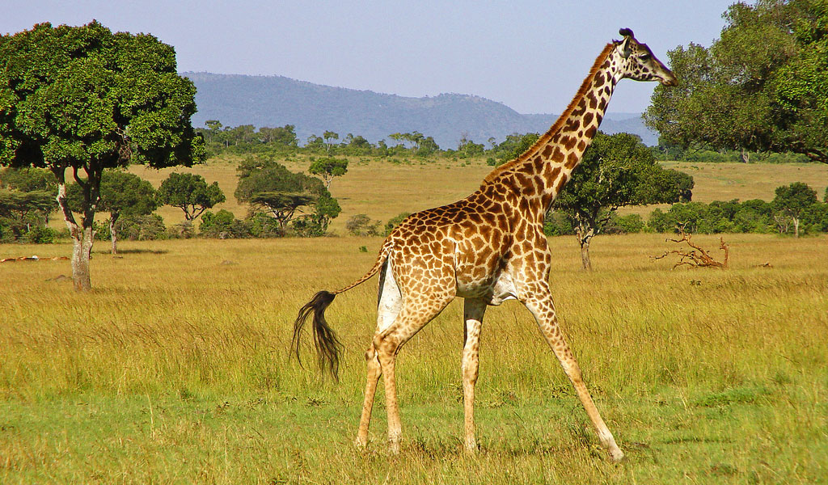
Why does the giraffe have a long neck?

Slide 4
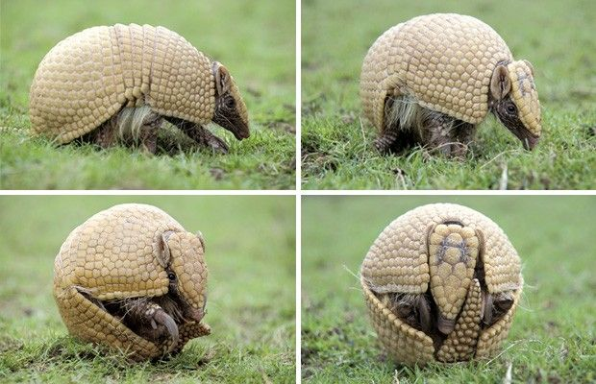
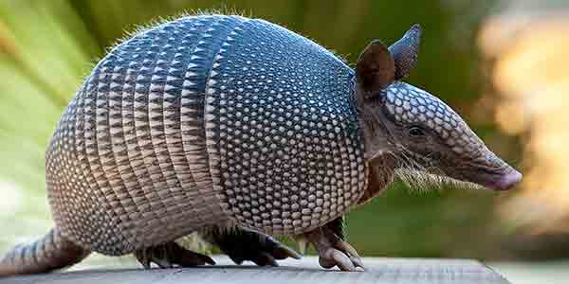
Why is armadillo skin hard?

Slide 5
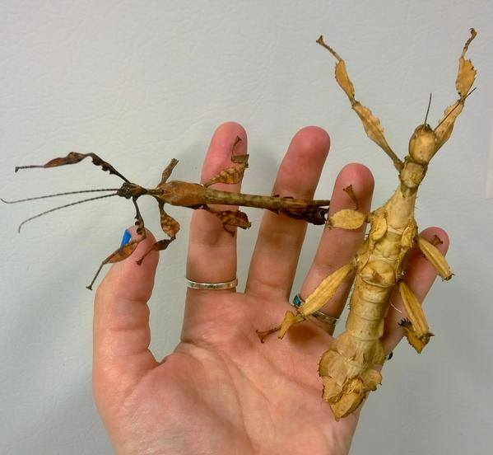
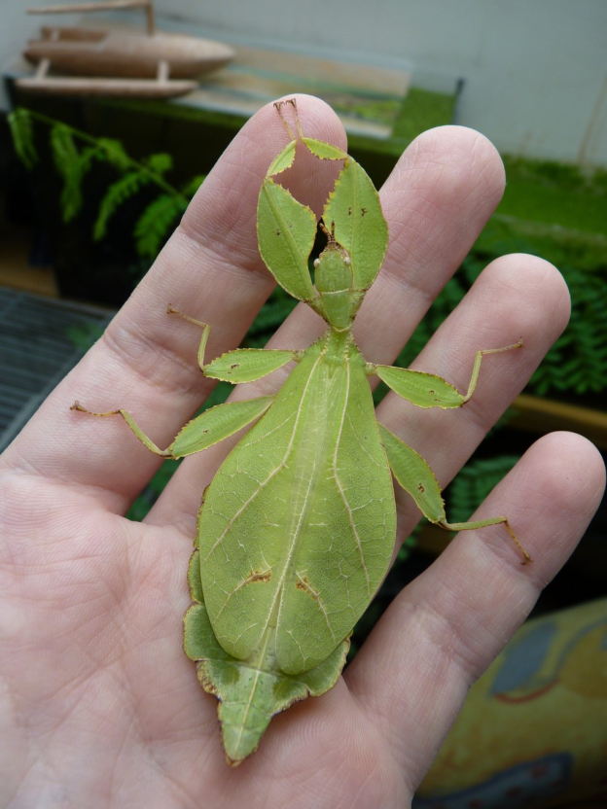
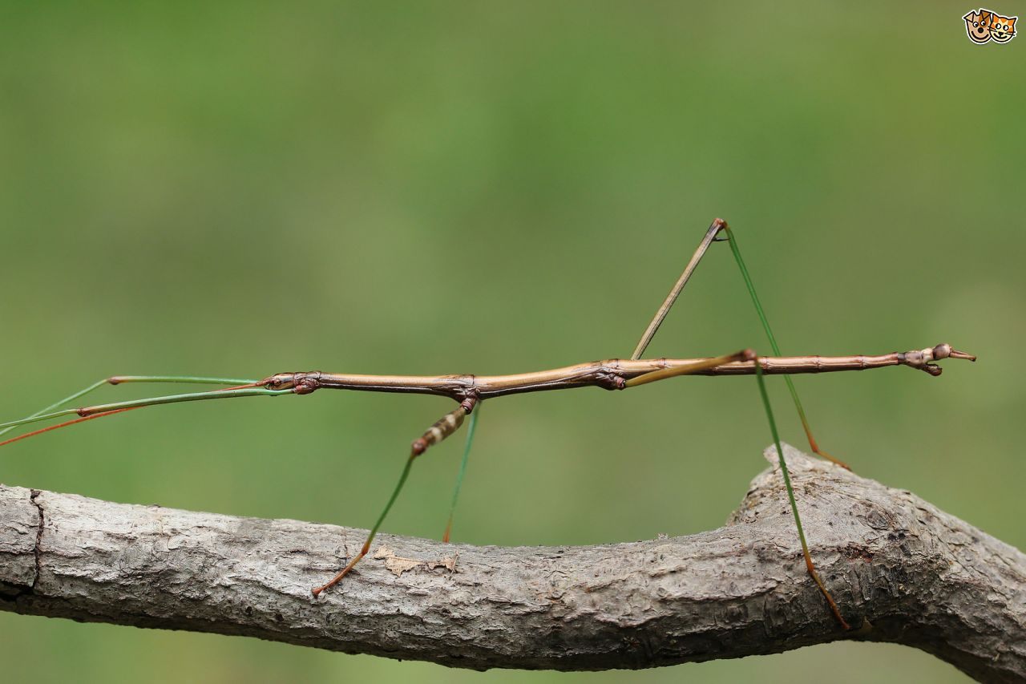
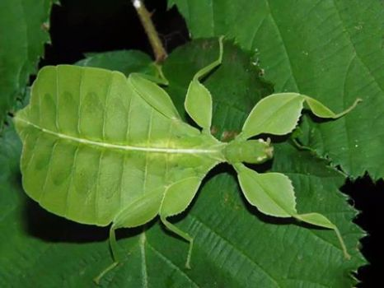
Why do these insects look like plants?

Slide 6
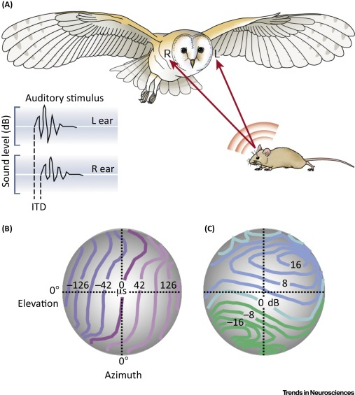
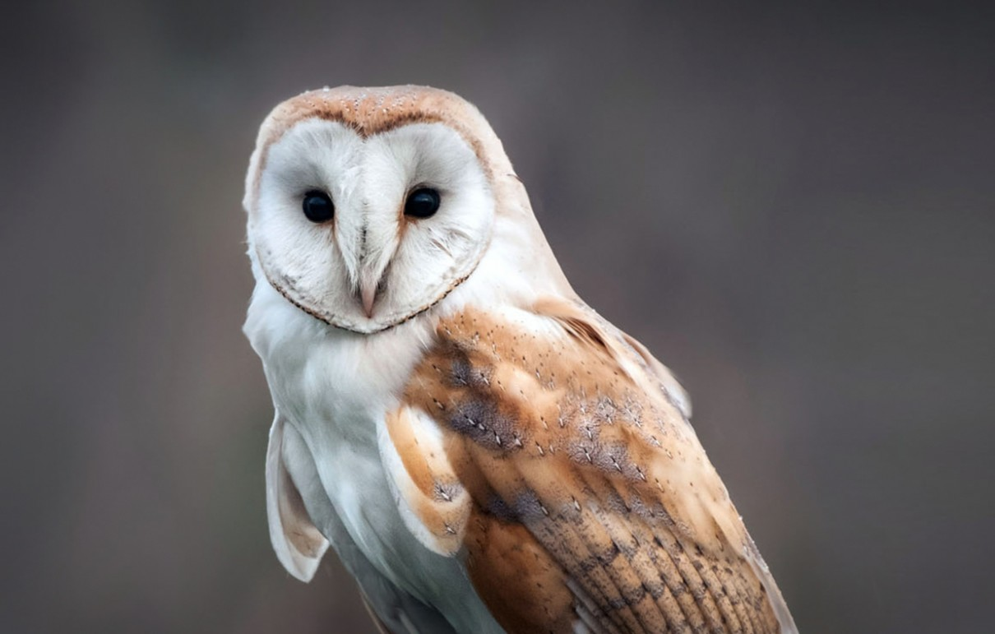
Why does a barn owl have a funny face?

Slide 7
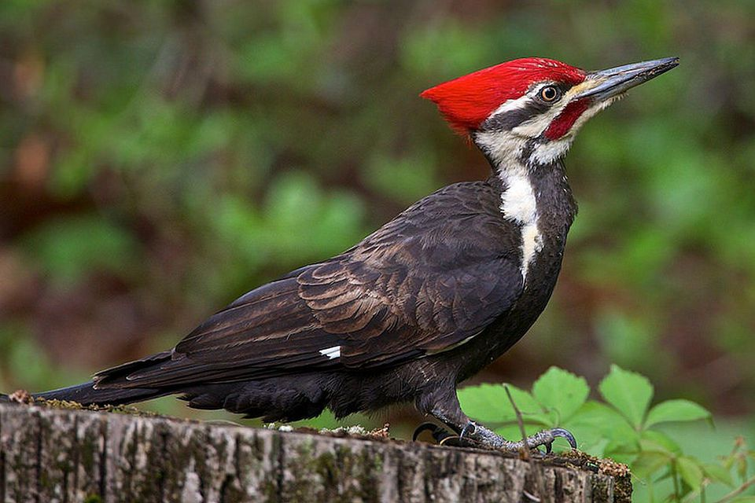
What is strange about woodpeckers?

Slide 8
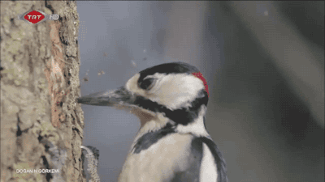

Slide 9
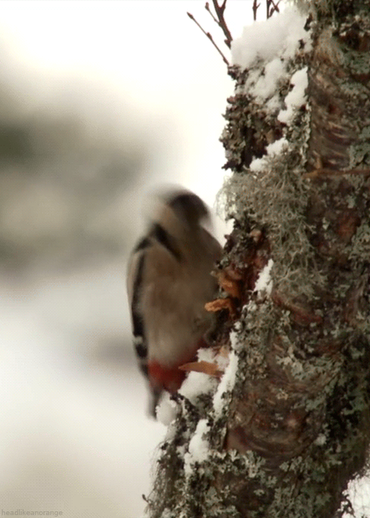
Woodpeckers spend their days banging their heads against trees. So why don’t they get headaches?

Slide 10
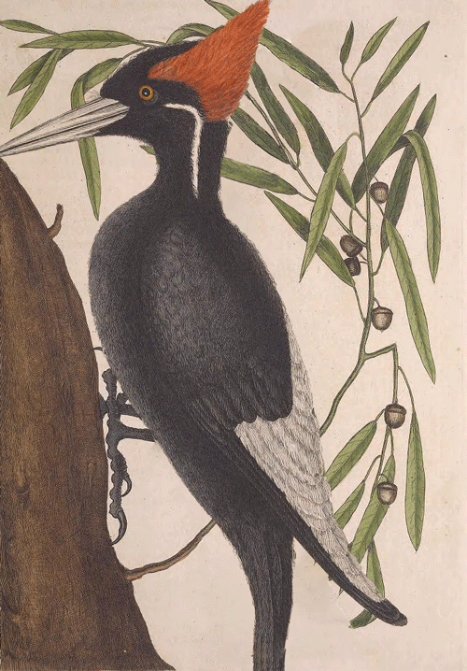
Research has shown that the impact of a woodpecker’s brain against its skull is spread over a relativity large surface area.

Slide 11
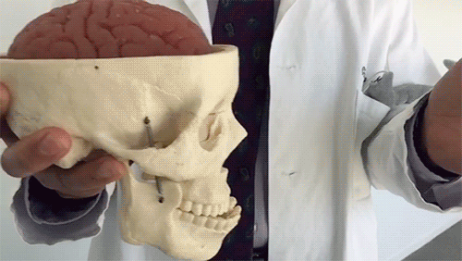
This makes the vulnerability of a woodpecker’s brain to injury very slight compared to those of a human brain.

Slide 12
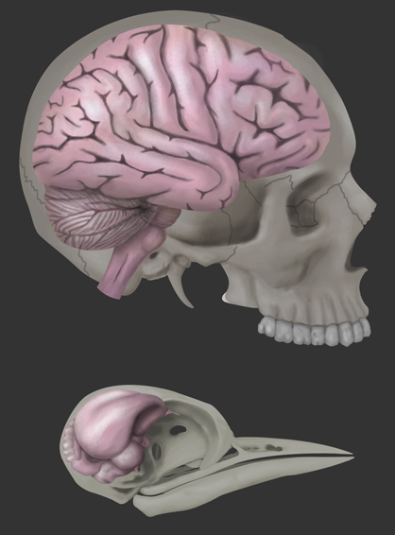
Furthermore, a woodpecker’s brain fits tightly inside it’s skull.

Slide 13
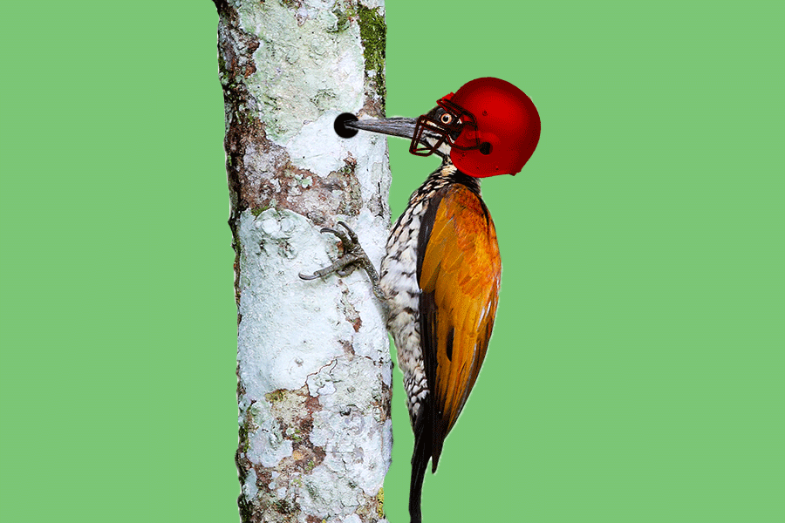
This allows for hardly any movement, and there is little risk of injury.

Slide 14
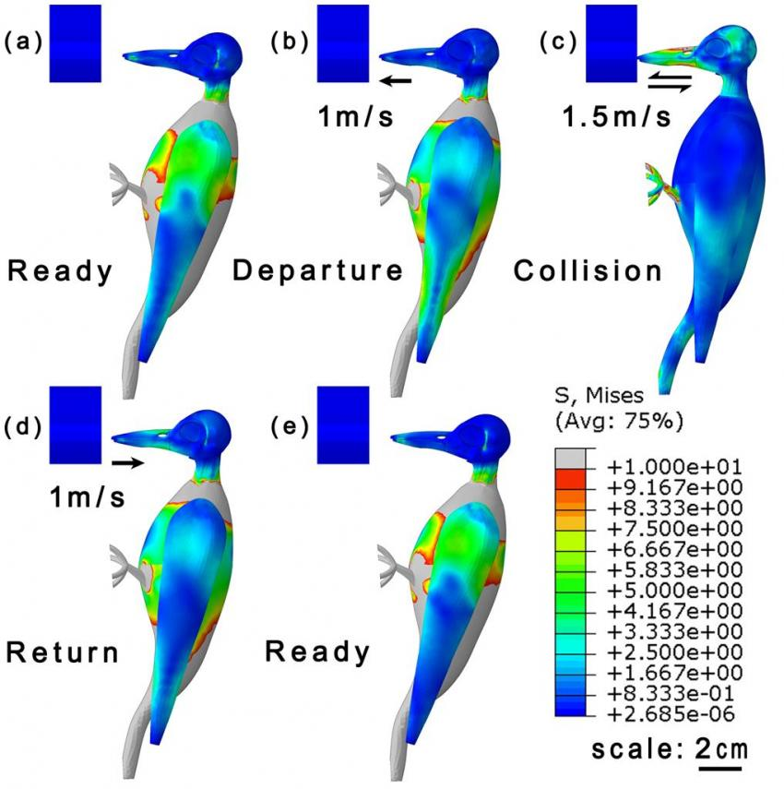
A woodpecker’s brain is also protected by the concentration of each impact on the areas of the skull that are the thickest.

Slide 15
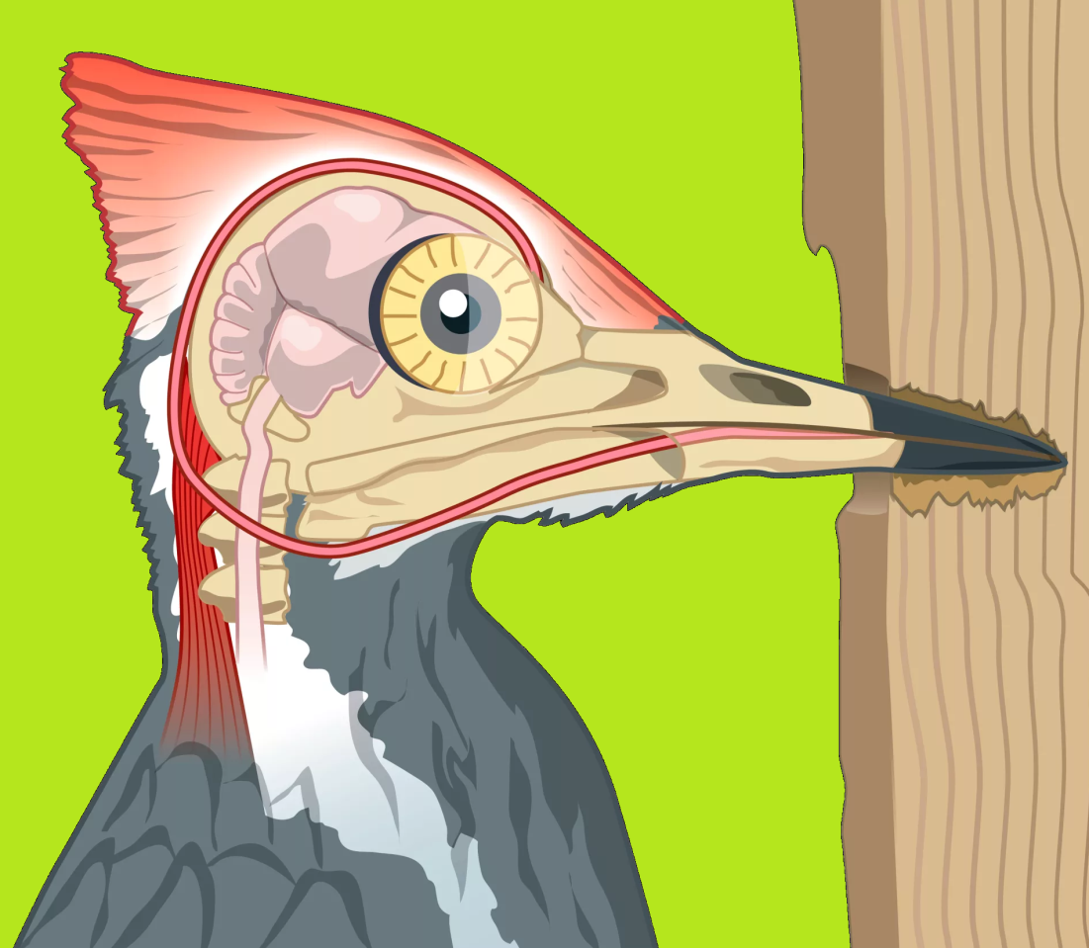
Consequently, much of the force that the woodpecker experiences is absorbed by its thick neck muscles rather than its brain.

Slide 16
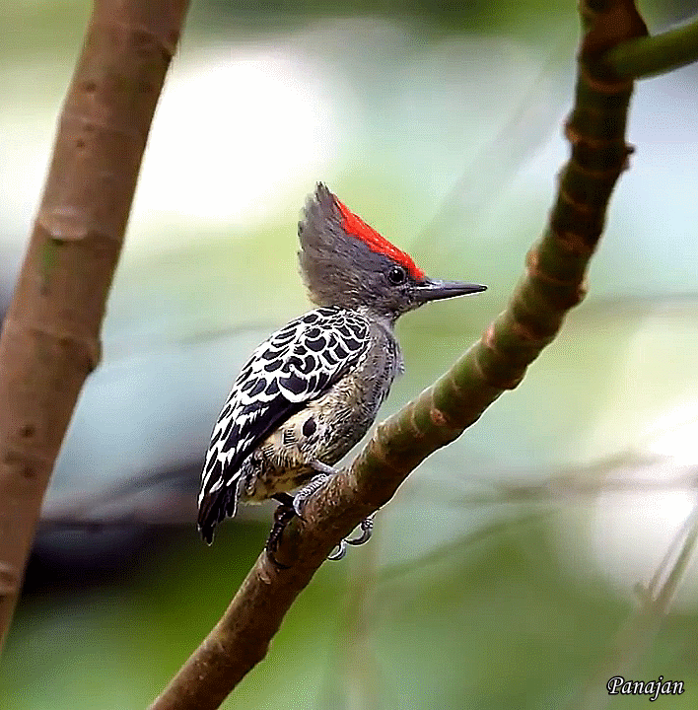

Slide 17
Did you understand?

Slide 18
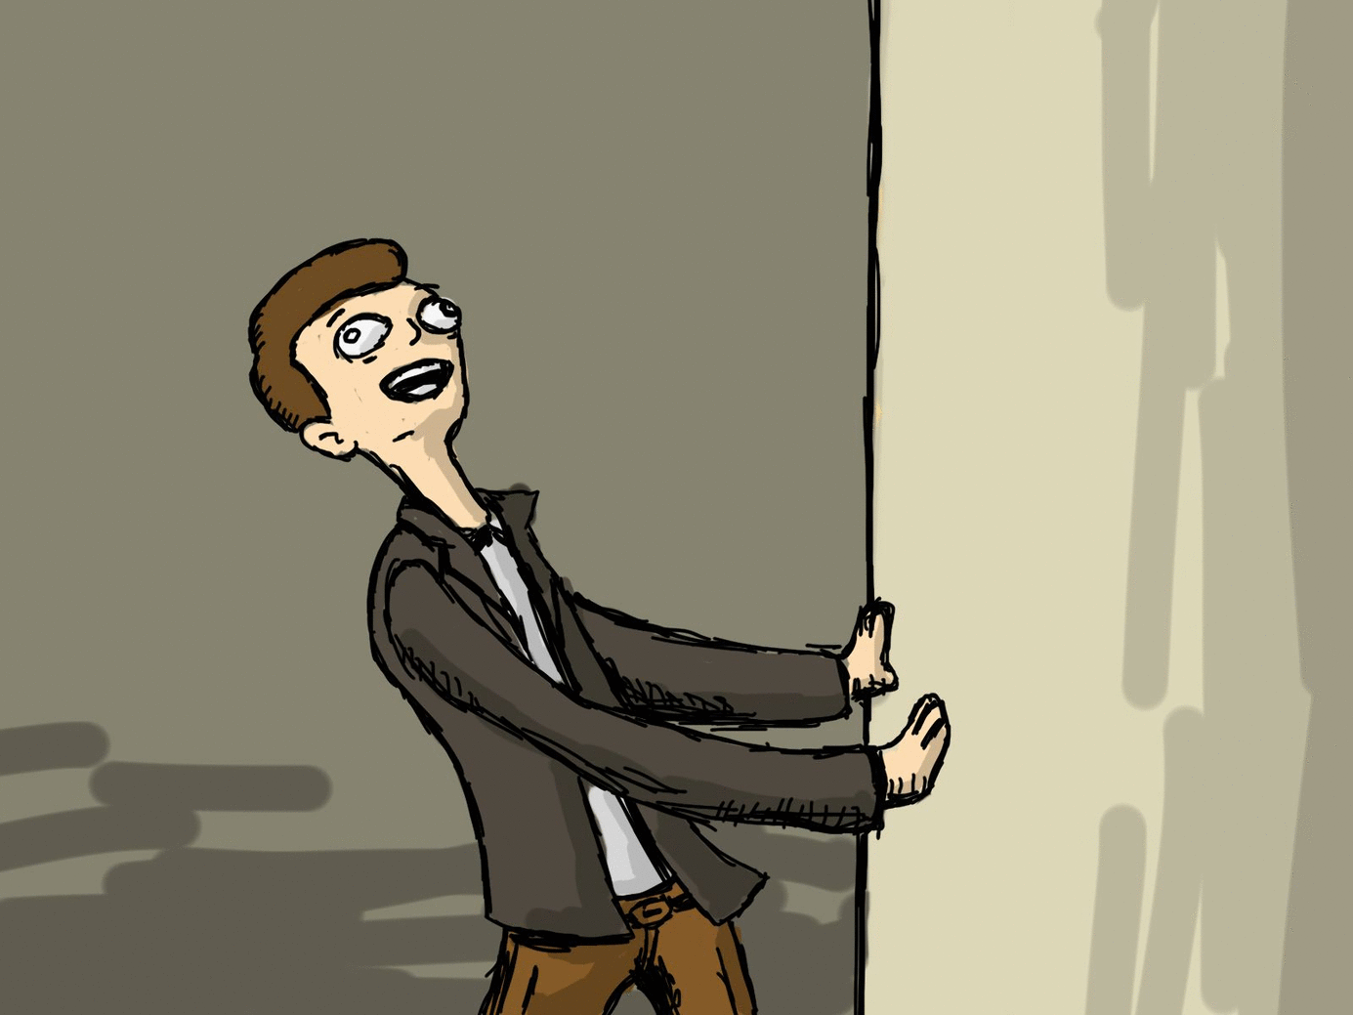

Slide 19
Let’s check:

Slide 20
Woodpeckers spend their days banging their heads against trees. So why don’t they get headaches?
What they do with time.

Slide 21
Woodpeckers spend their days banging their heads against trees. So why don’t they get headaches?
hitting their heads

Slide 22
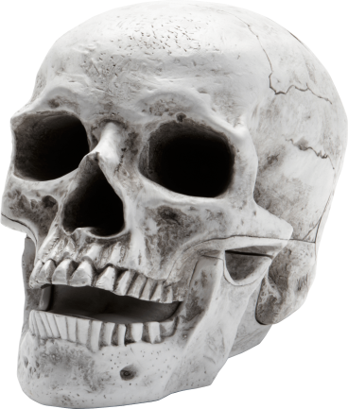
Research has shown that the impact of a woodpecker’s brain against its skull is spread over a relativity large surface area.
When it hits the skull

Slide 23
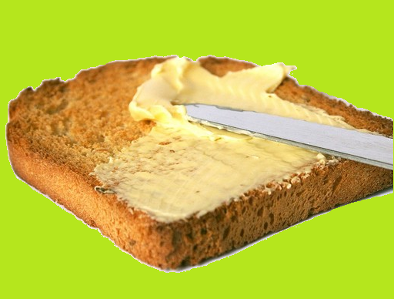
Research has shown that the impact of a woodpecker’s brain against its skull is spread over a relativity large surface area.
Apply in an even layer.

Slide 24
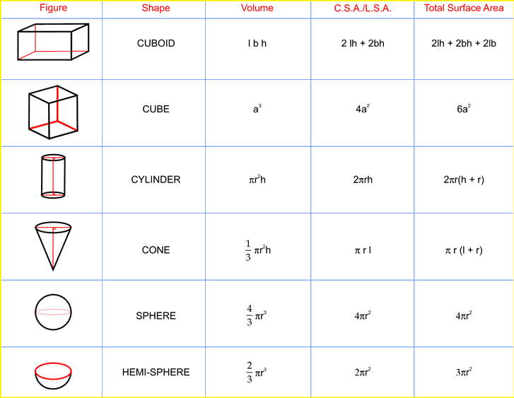
Research has shown that the impact of a woodpecker’s brain against its skull is spread over a relativity large surface area.
In relation to (compared to similar ones)

Slide 25
This makes the vulnerability of a woodpecker’s brain to injury very slight compared to those of a human brain.
How easily harmed.

Slide 26
This makes the vulnerability of a woodpecker’s brain to injury very slight compared to those of a human brain.
Just a little

Slide 27
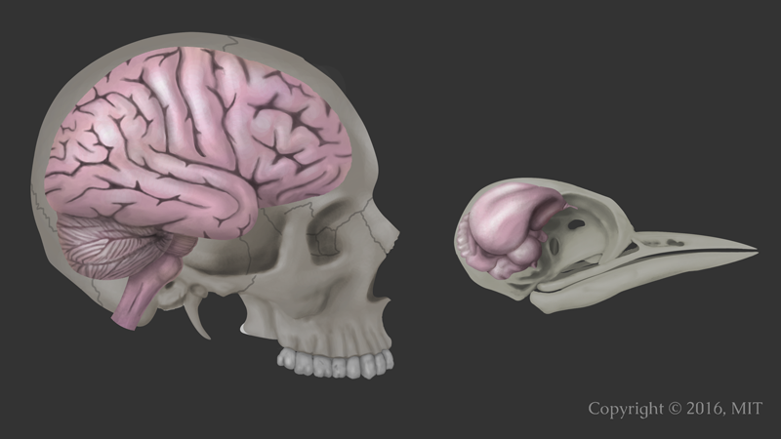
This makes the vulnerability of a woodpecker’s brain to injury very slight compared to those of a human brain.

Slide 28
Furthermore, a woodpecker’s brain fits tightly inside it’s skull.
More information

Slide 29
Furthermore, a woodpecker’s brain fits tightly inside it’s skull.

Slide 30
This allows for hardly any movement, and there is little risk of injury.
Result

Slide 31
This allows for hardly any movement, and there is little risk of injury.
doesn’t move

Slide 32
This allows for hardly any movement, and there is little risk of injury.
Probably wont be harmed.

Slide 33
A woodpecker’s brain is also protected by the concentration of each impact on the areas of the skull that are the thickest.
More in this area

Slide 34
A woodpecker’s brain is also protected by the concentration of each impact on the areas of the skull that are the thickest.
Stronger part

Slide 35
Consequently, much of the force that the woodpecker experiences is absorbed by its thick neck muscles rather than its brain.
Result

Slide 36
Consequently, much of the force that the woodpecker experiences is absorbed by its thick neck muscles rather than its brain.
Pressure
Feels

Slide 37
Consequently, much of the force that the woodpecker experiences is absorbed by its thick neck muscles rather than its brain.
Taken in by the neck

Slide 38
Headbangers
Woodpeckers spend their days banging their heads against trees. So why don’t they get headaches? Research has shown that the impact of a woodpecker’s brain against its skull is spread over a relativity large surface area. This makes the vulnerability of a woodpecker’s brain to injury very slight compared to those of a human brain. Furthermore, a woodpecker’s brain fits tightly inside it’s skull. This allows for hardly any movement, and there is little risk of injury. A woodpecker’s brain is also protected by the concentration of each impact on the areas of the skull that are the thickest. Consequently, much of the force that the woodpecker experiences is absorbed by its thick neck muscles rather than its brain.
That

Slide 39
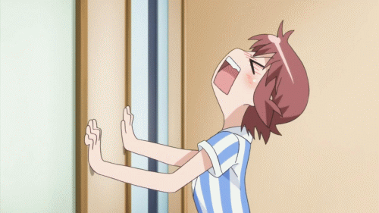

Slide 40
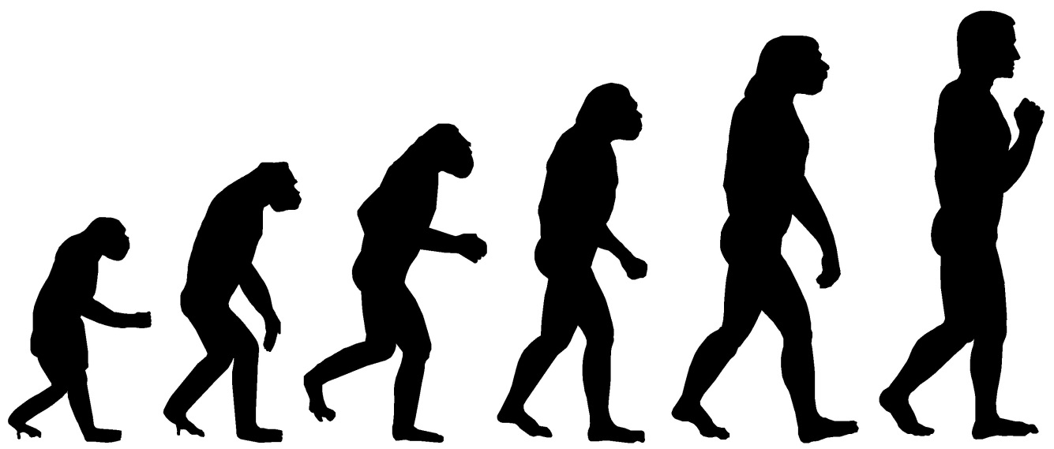
Evolutionary Process
How things change over time.

Slide 41
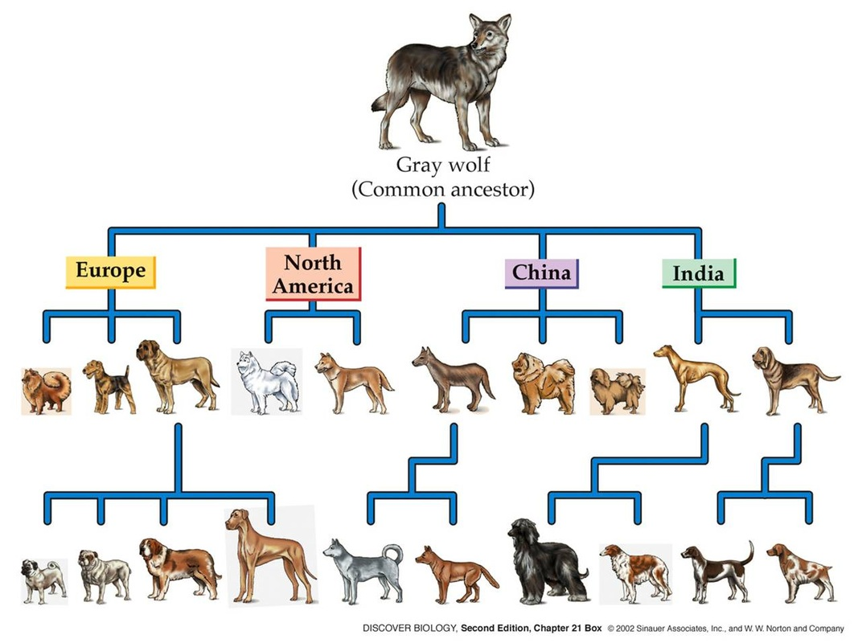

Slide 42
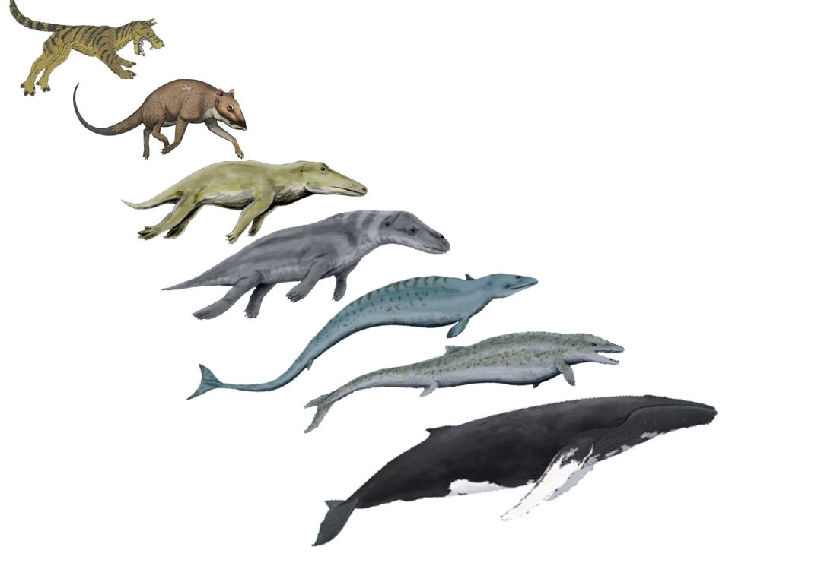

Slide 43
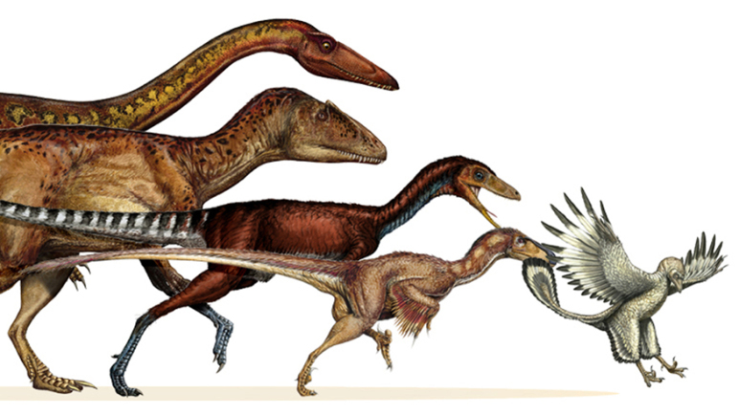

Slide 44
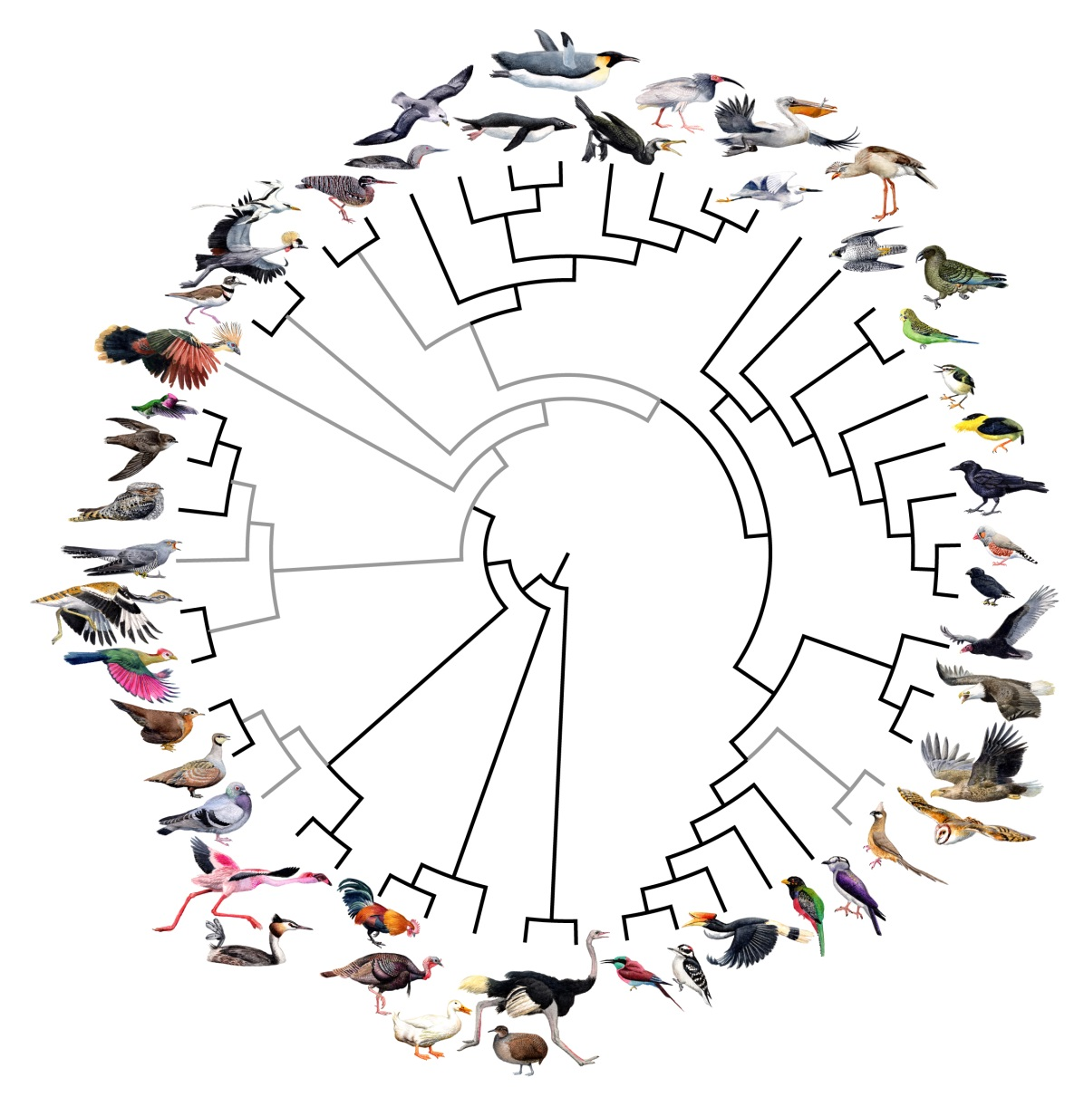

Slide 46
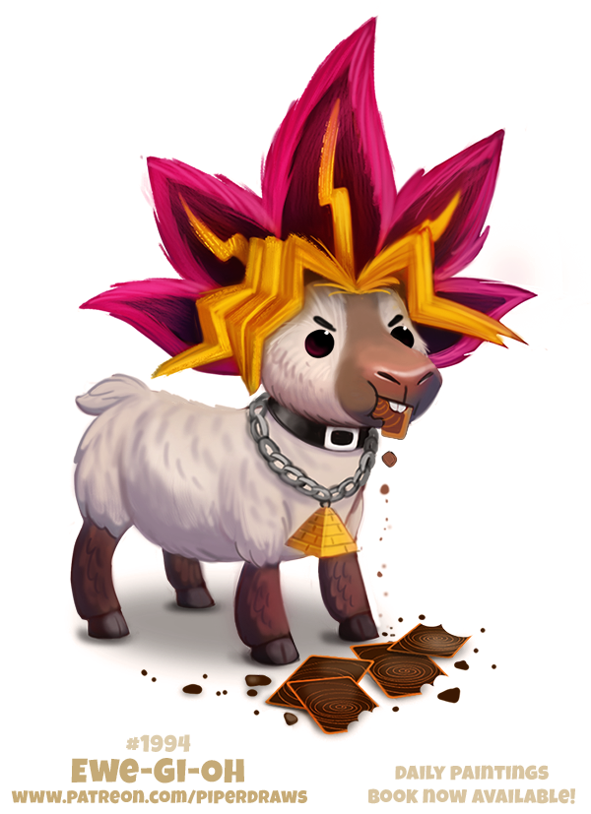
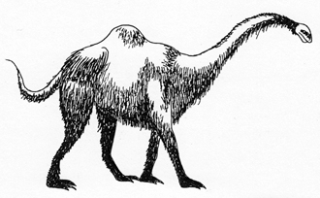
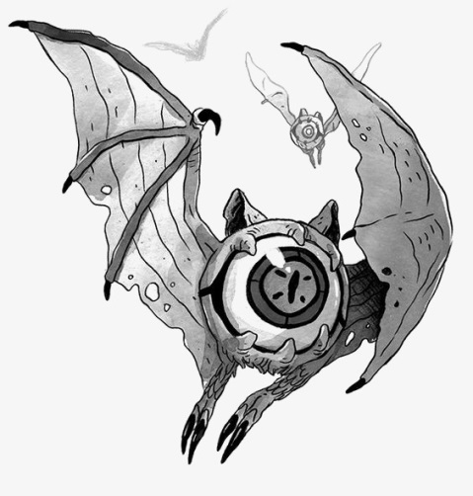
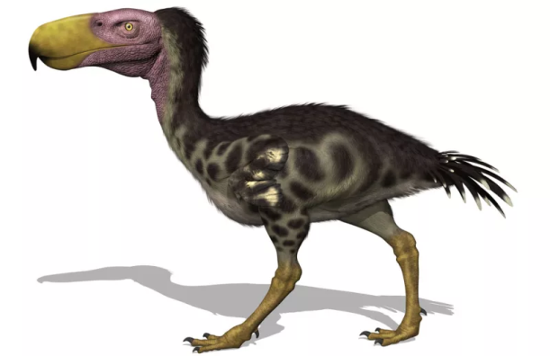
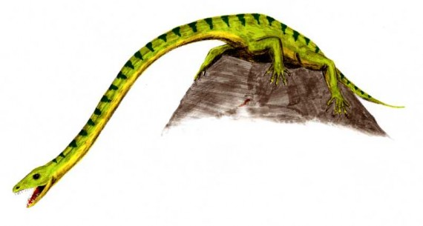
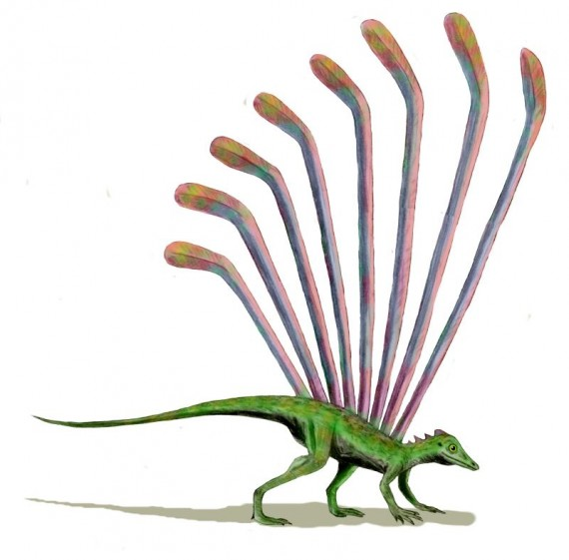
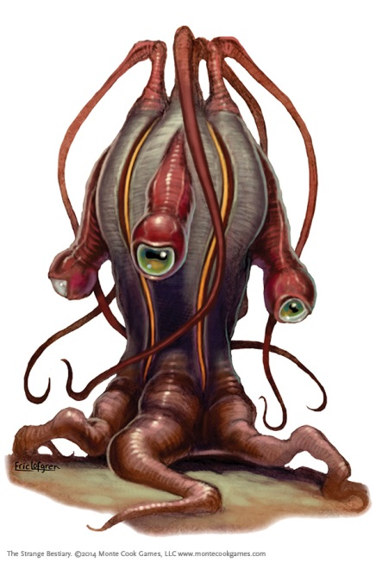
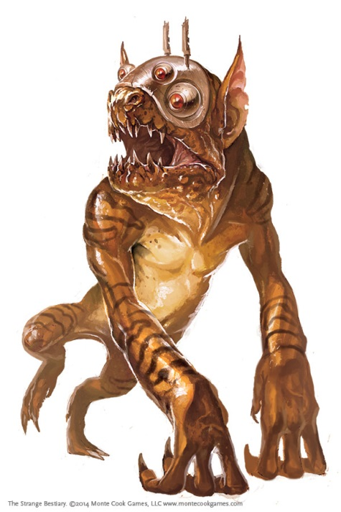
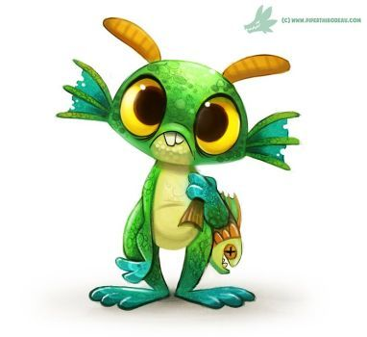
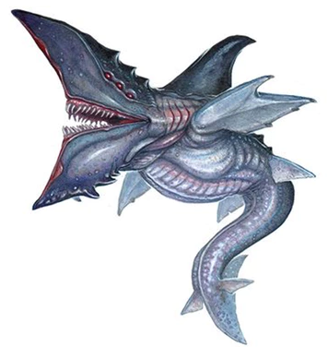
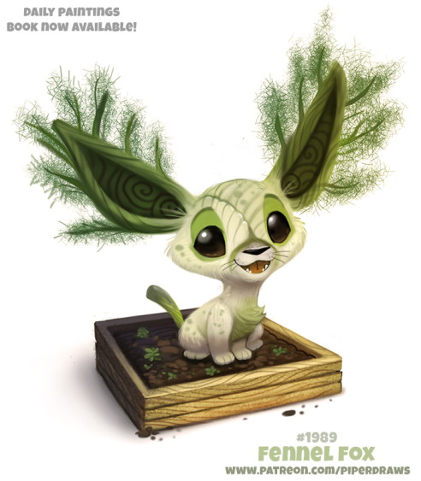
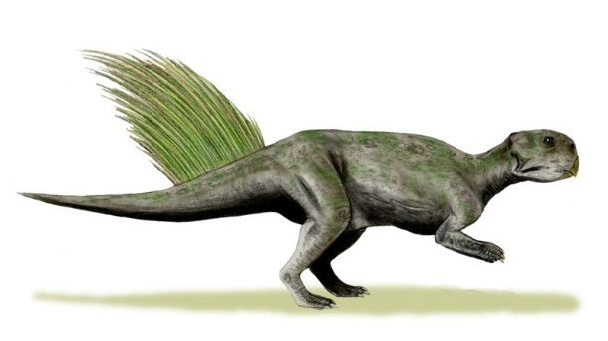
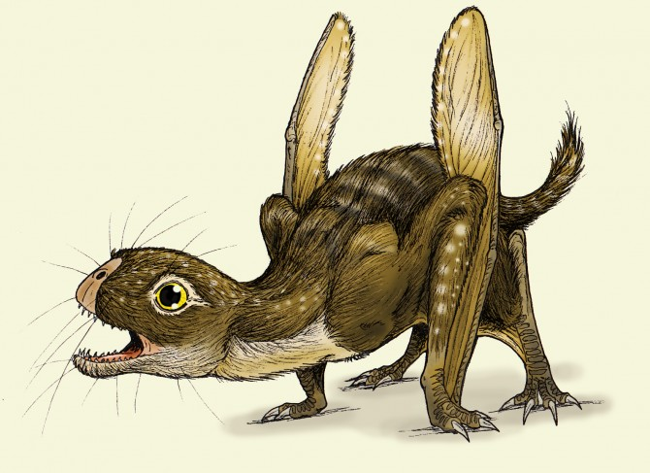

Slide 47
Game: picture evolution
Everyone starts with a paper.
When I say start, start drawing an animal.
After 10s, I will say switch and pass the paper to the next person.
After multiple times, we will stop.

Slide 48
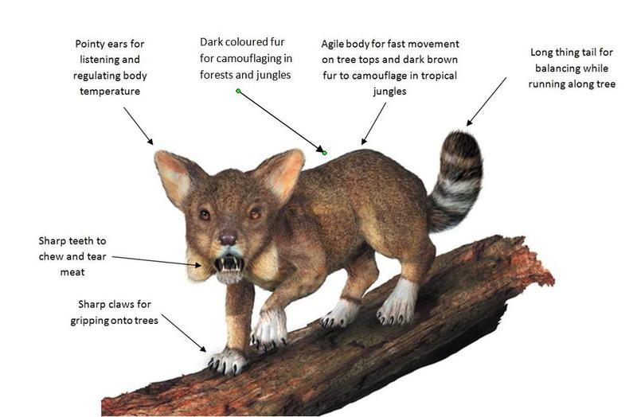

Slide 49
Game: picture evolution
Now, try to imagine why the animal might have evolved those characteristics.
Who would like to tell us about their creature.

