Slide 1
Communication Over Time

Slide 2
4 Basic Types of Communication
Tactile
Chemical
Visual
Auditory

Slide 3
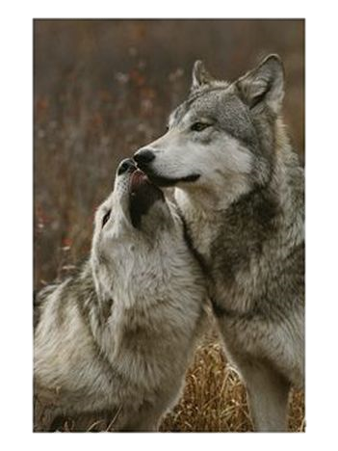
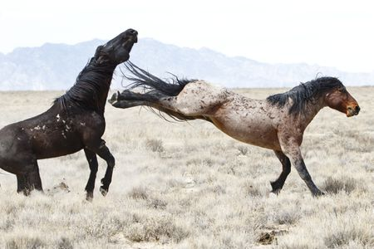
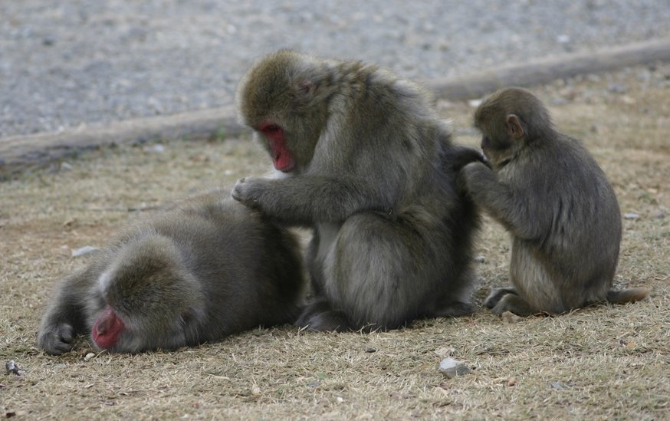
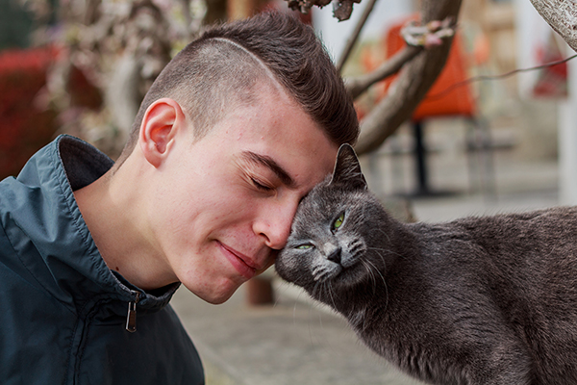
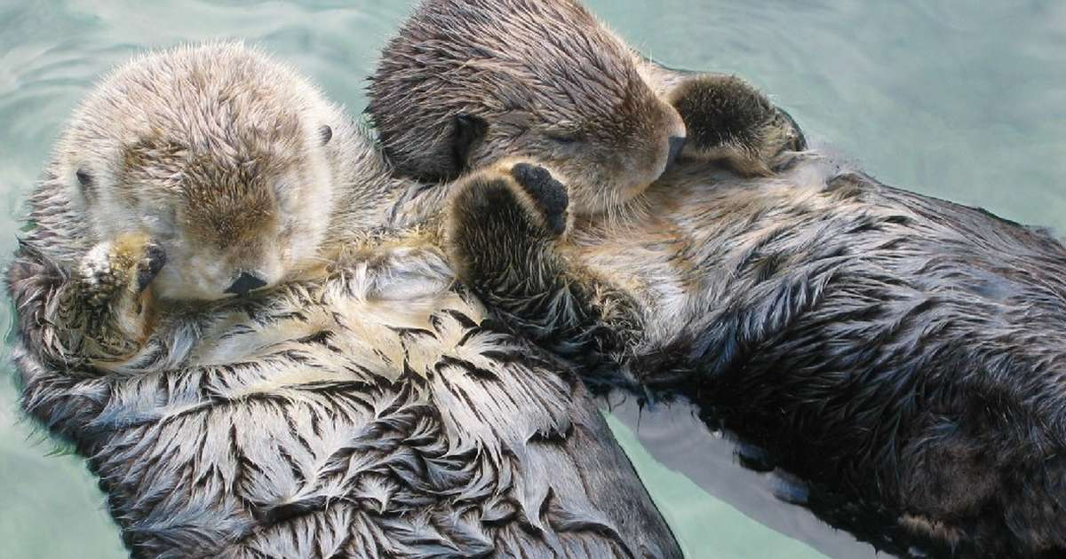
Tactile

Slide 4
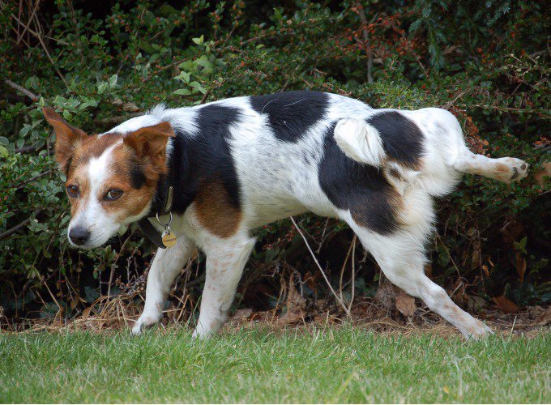
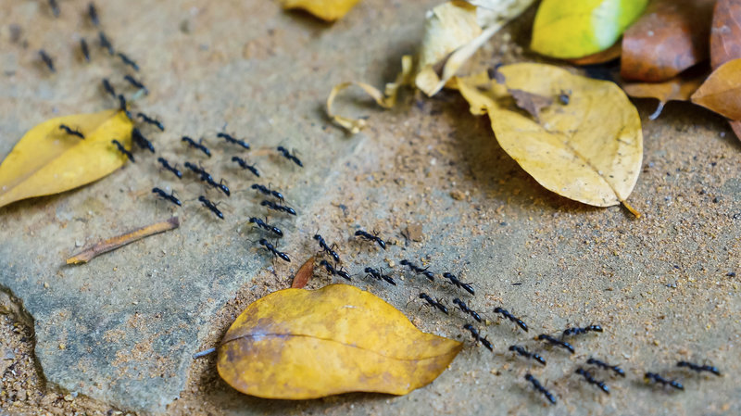
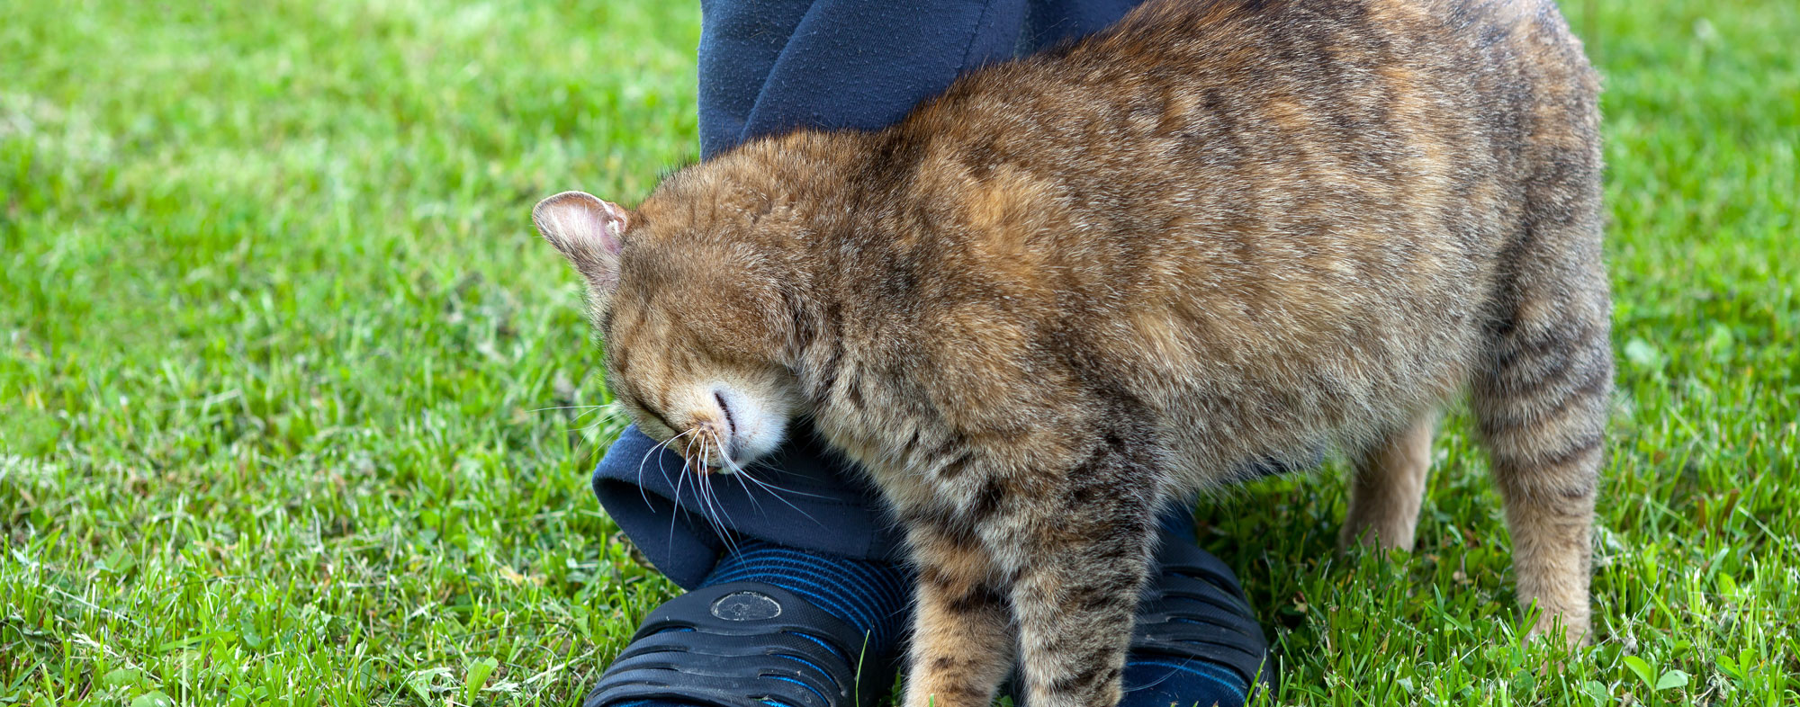
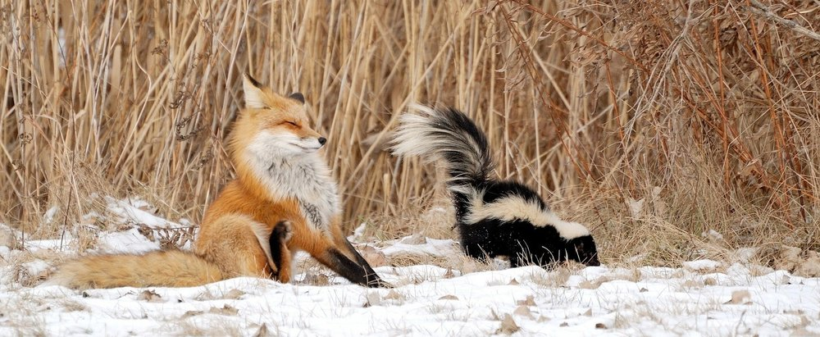
Chemical

Slide 5
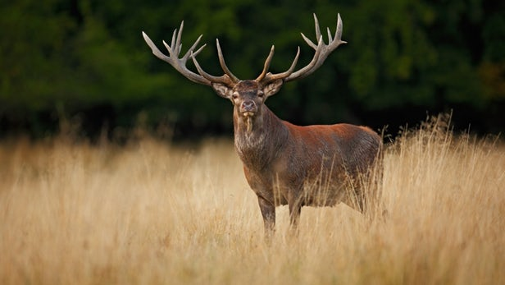
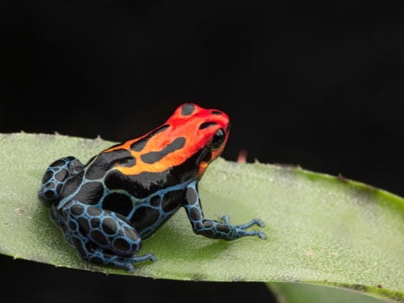
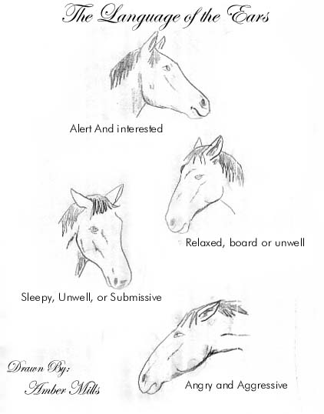
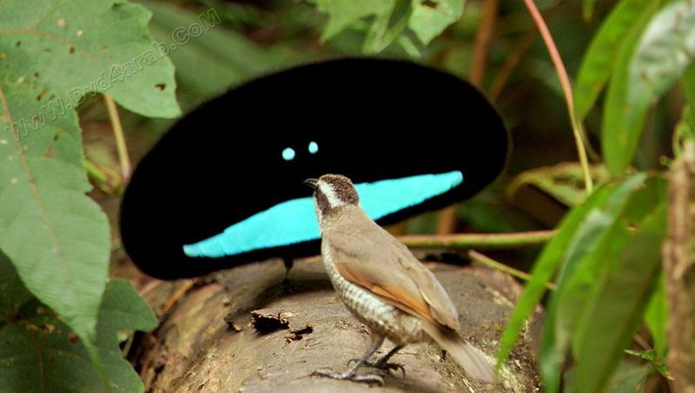
Visual

Slide 6
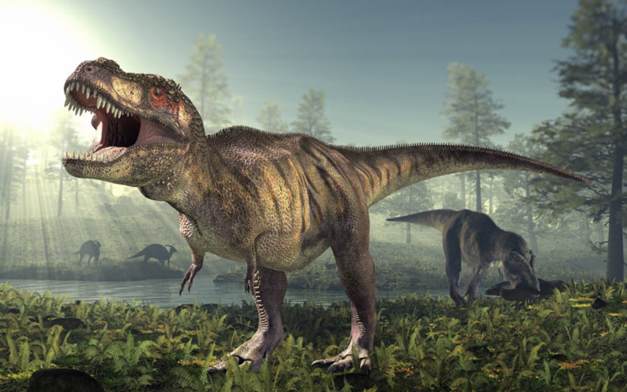
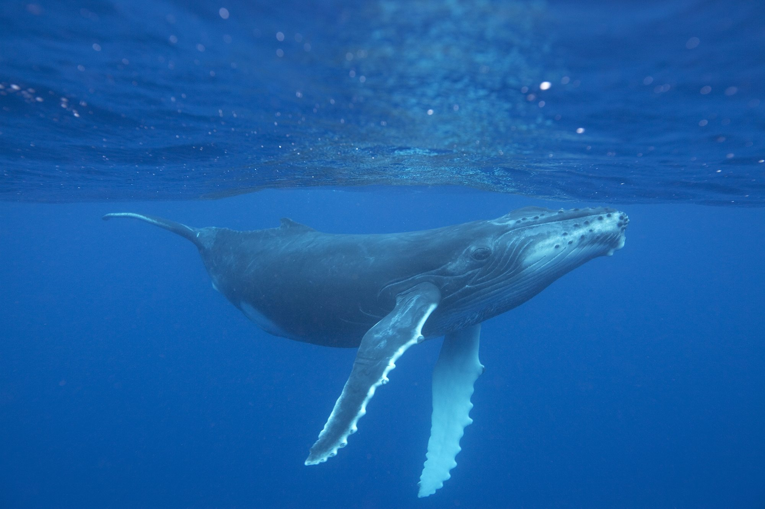
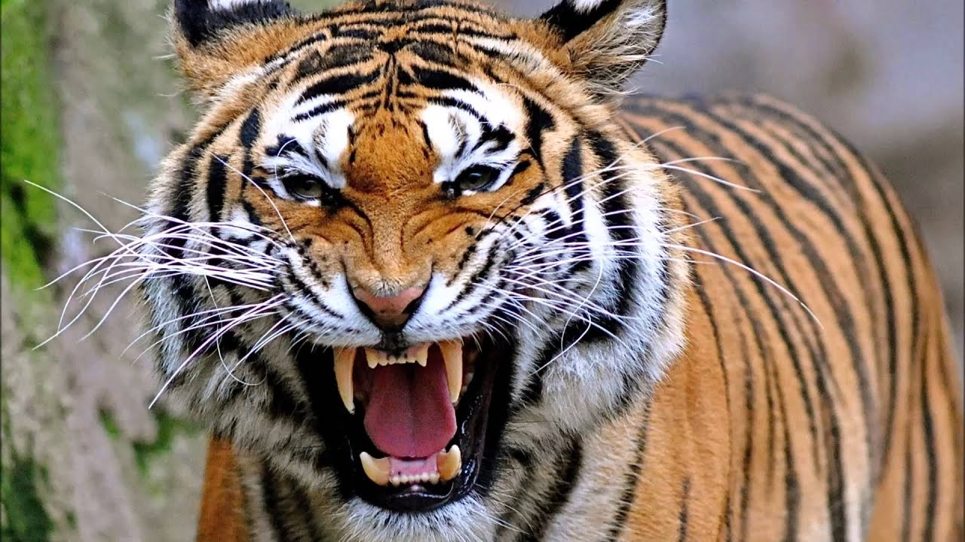
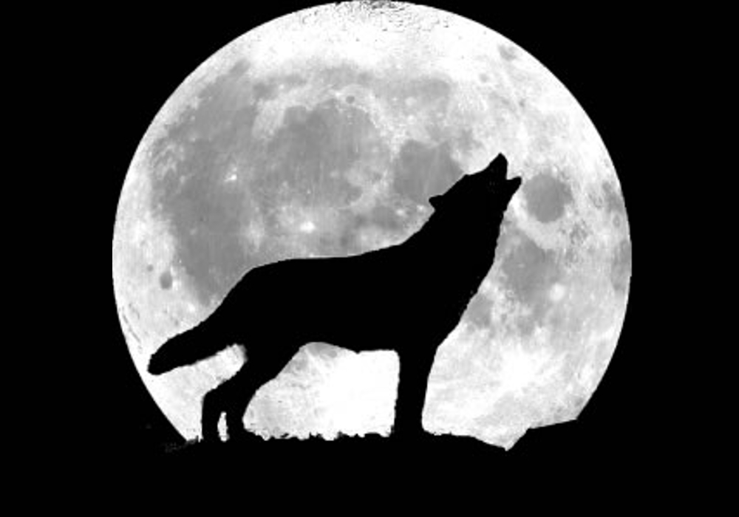
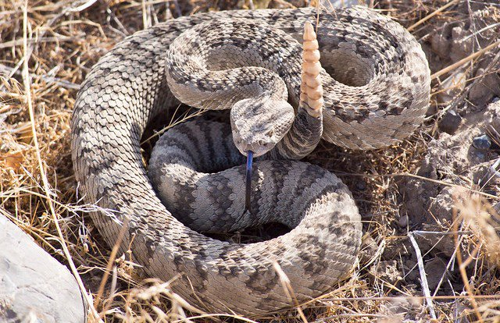
Auditory

Slide 7
Shouting

Slide 8
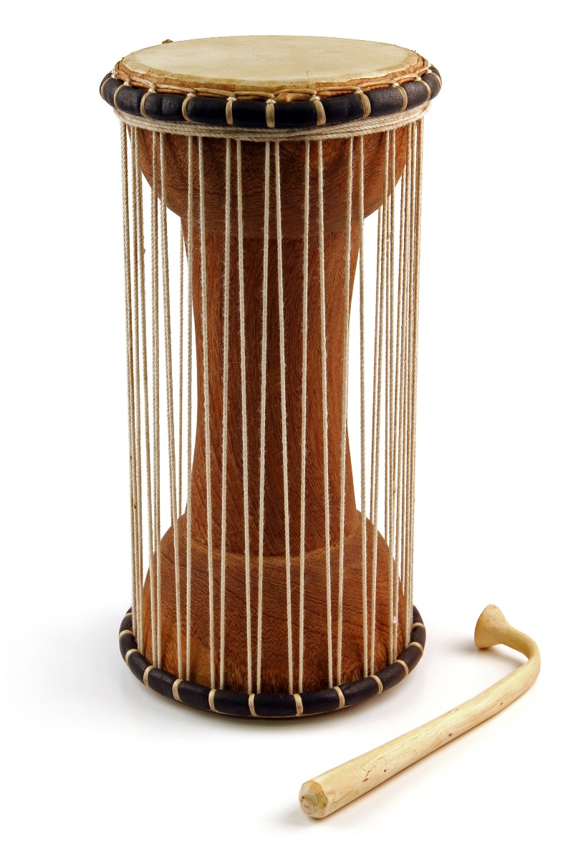
Talking Drums

Slide 9
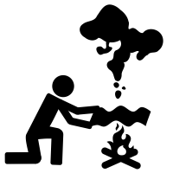
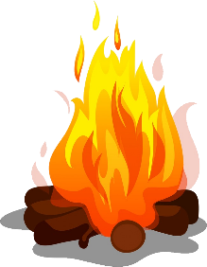
Signal fires

Slide 10
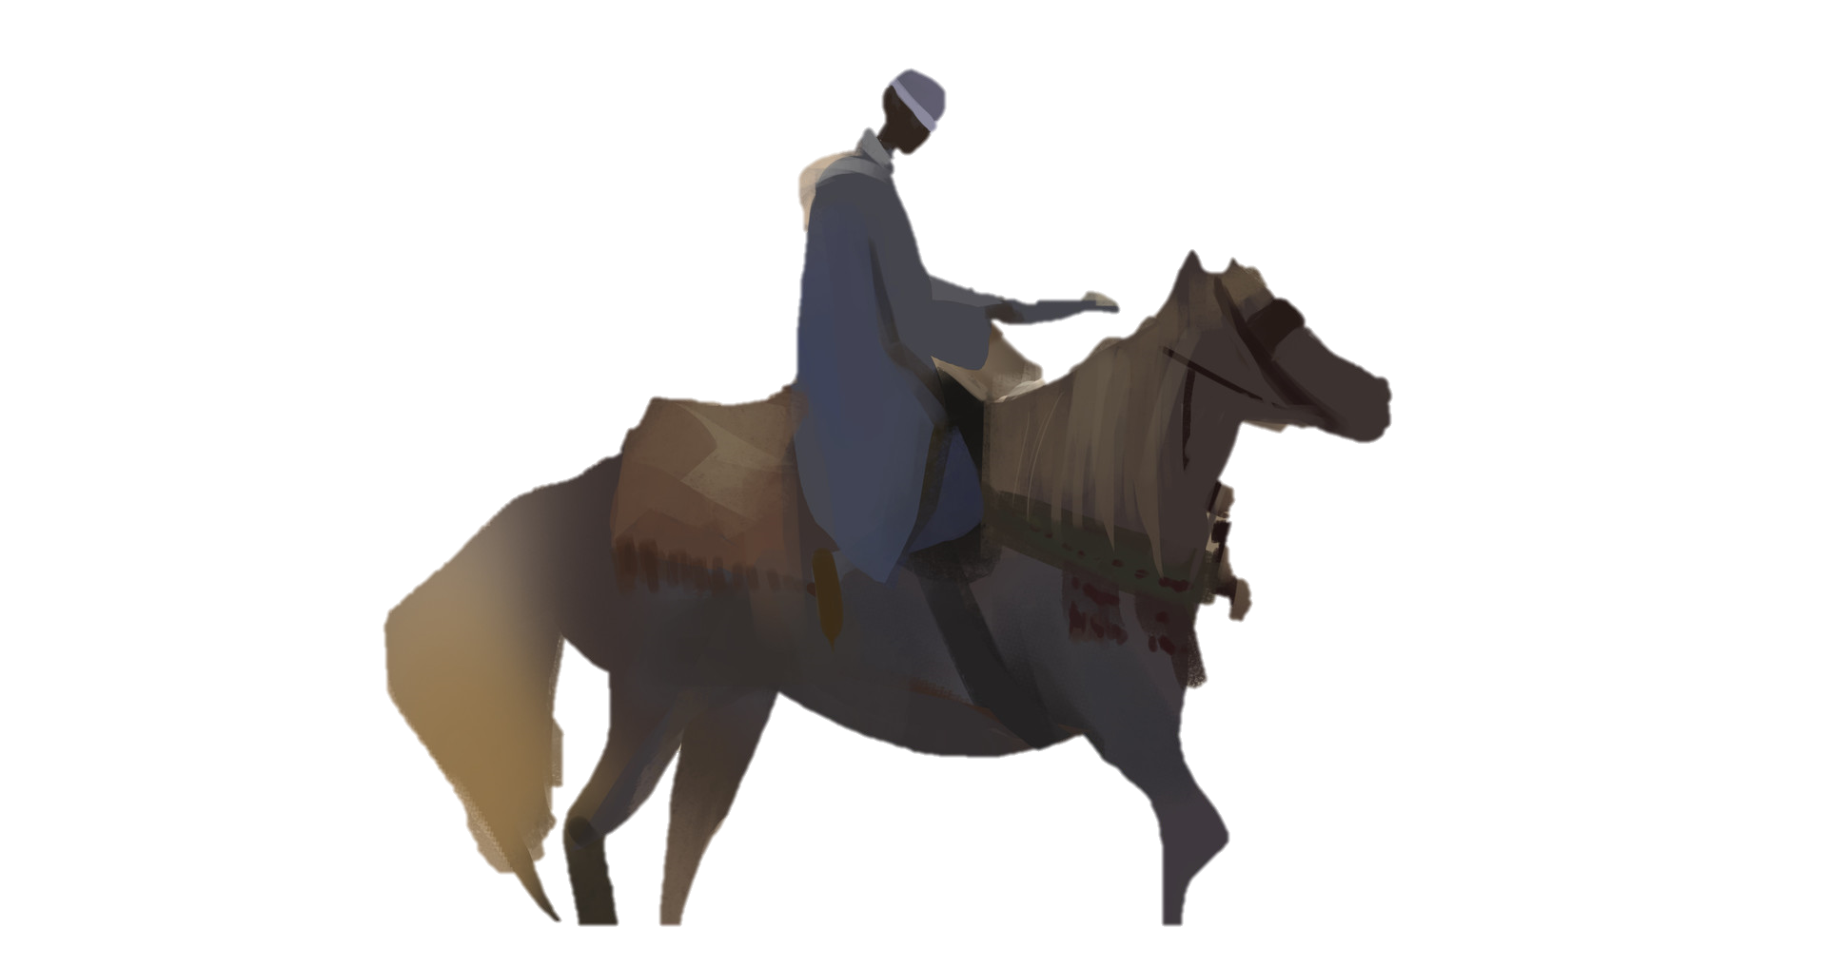
Letters

Slide 11
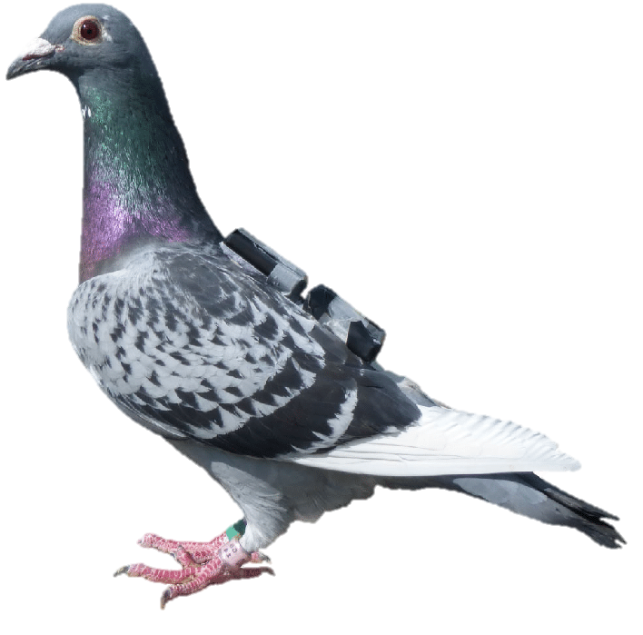
Homing Pigeons

Slide 12
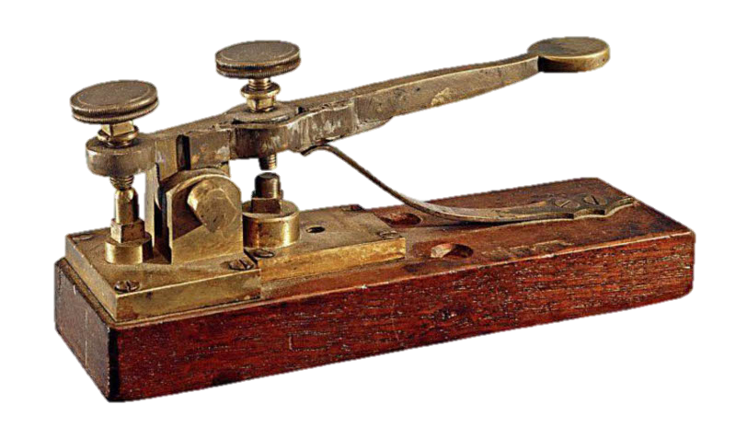
Telegraph

Slide 13
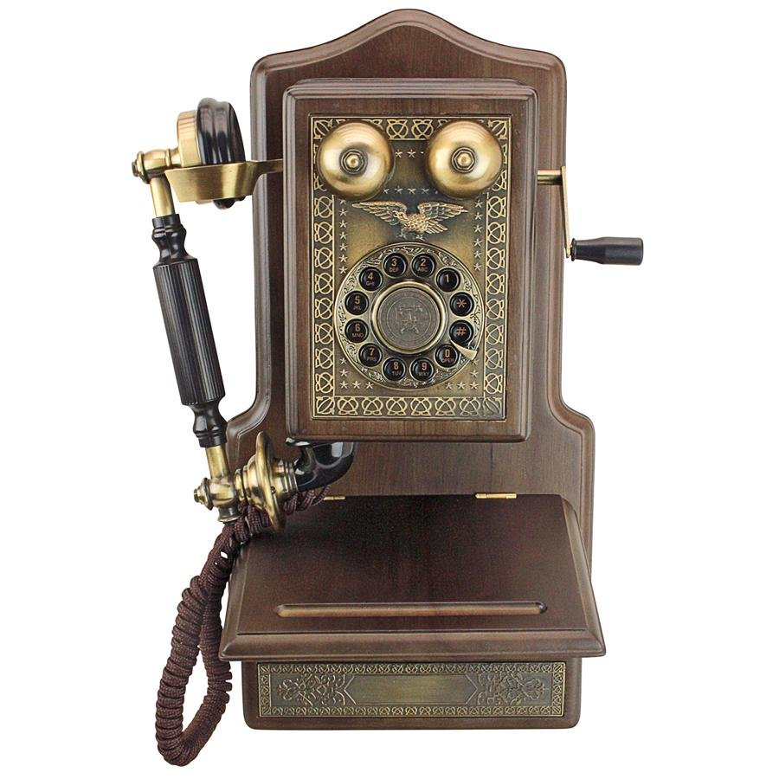
Telephone

Slide 14
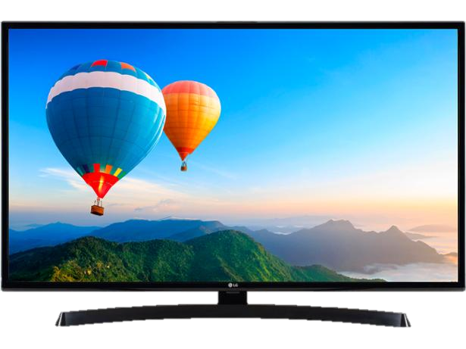
Television

Slide 15
Email

Slide 16
Internet

Slide 17
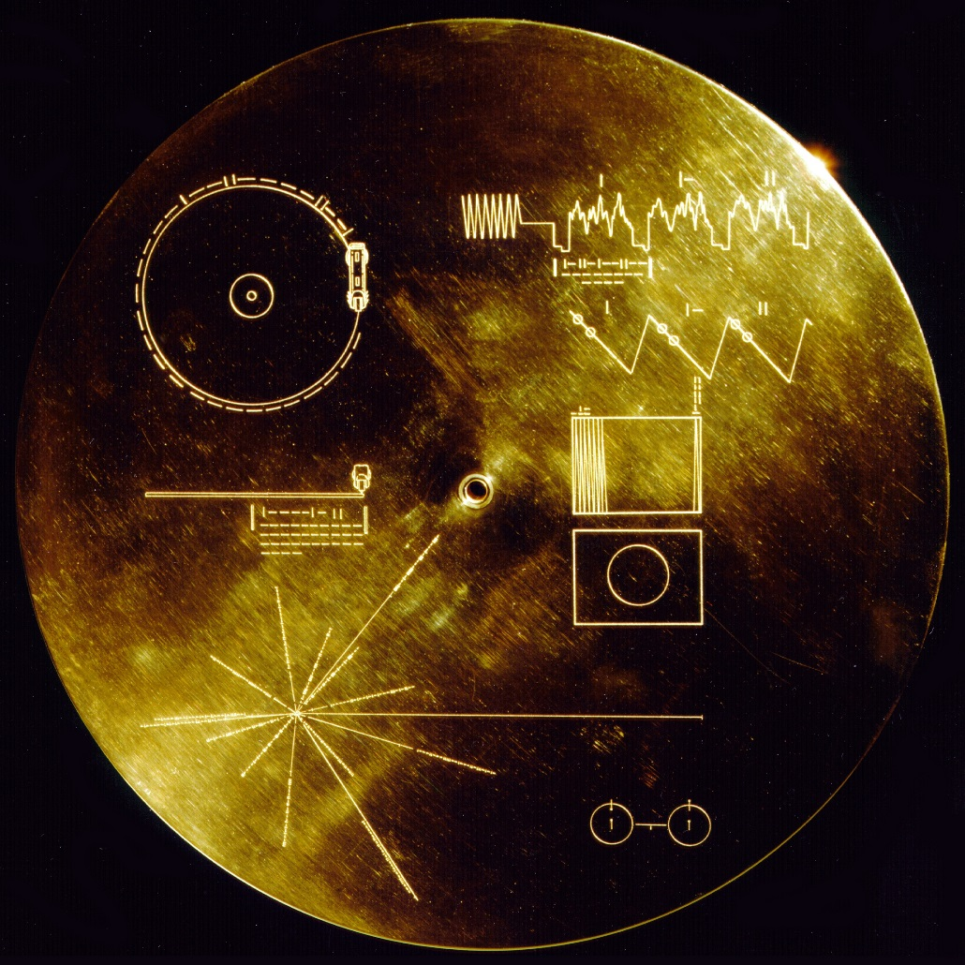
Communication Over Time
The Golden Record (pictures)
https://www.youtube.com/watch?v=NAN1kt4SG9E
The Golden Record (Sounds)
https://www.youtube.com/watch?v=Xz03_qQ2HBg (Music)
https://www.youtube.com/watch?v=bVgZIhotpSs (Greetings)
https://www.youtube.com/watch?v=tkxP-9BEc8E&t=296s (Sounds of Earth)

Slide 18
Communication Over Time
What are some important things that you would put on Golden Record 2019

Slide 19
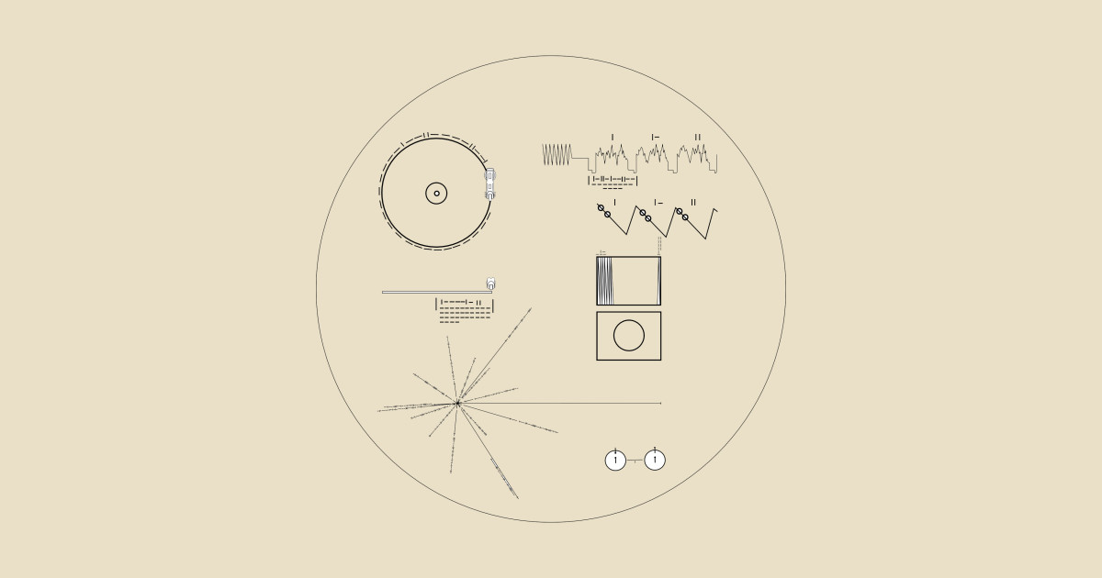

Slide 20
Time Immemorial

Slide 21
Time Immemorial
The beyond our memory. (Property Law: You owned it so long, you don’t have to prove HOW you got it)
Connected history

Slide 22
Time Immemorial
When?
Coronation of Richard I
July 6th, 1189

Slide 23
Within living memory
We don’t remember major cultural events before 5 years old
As people die, there will be no one left who remembers it.

Slide 24
Within living memory
Oldest Person alive: Kane Tanaka (Japan – January 2nd, 1903)
Oldest Person Ever: Jeanne Calment (France– 122 years, 164 days)

Slide 25
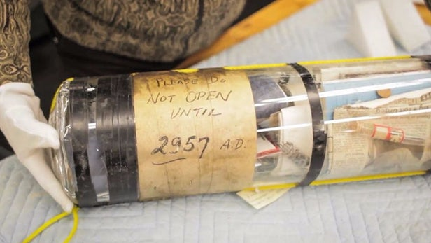
Communication Over Time
Write a letter to yourself
Read it on the last day.

