Slide 1
Personal Information
p. 10

Slide 2
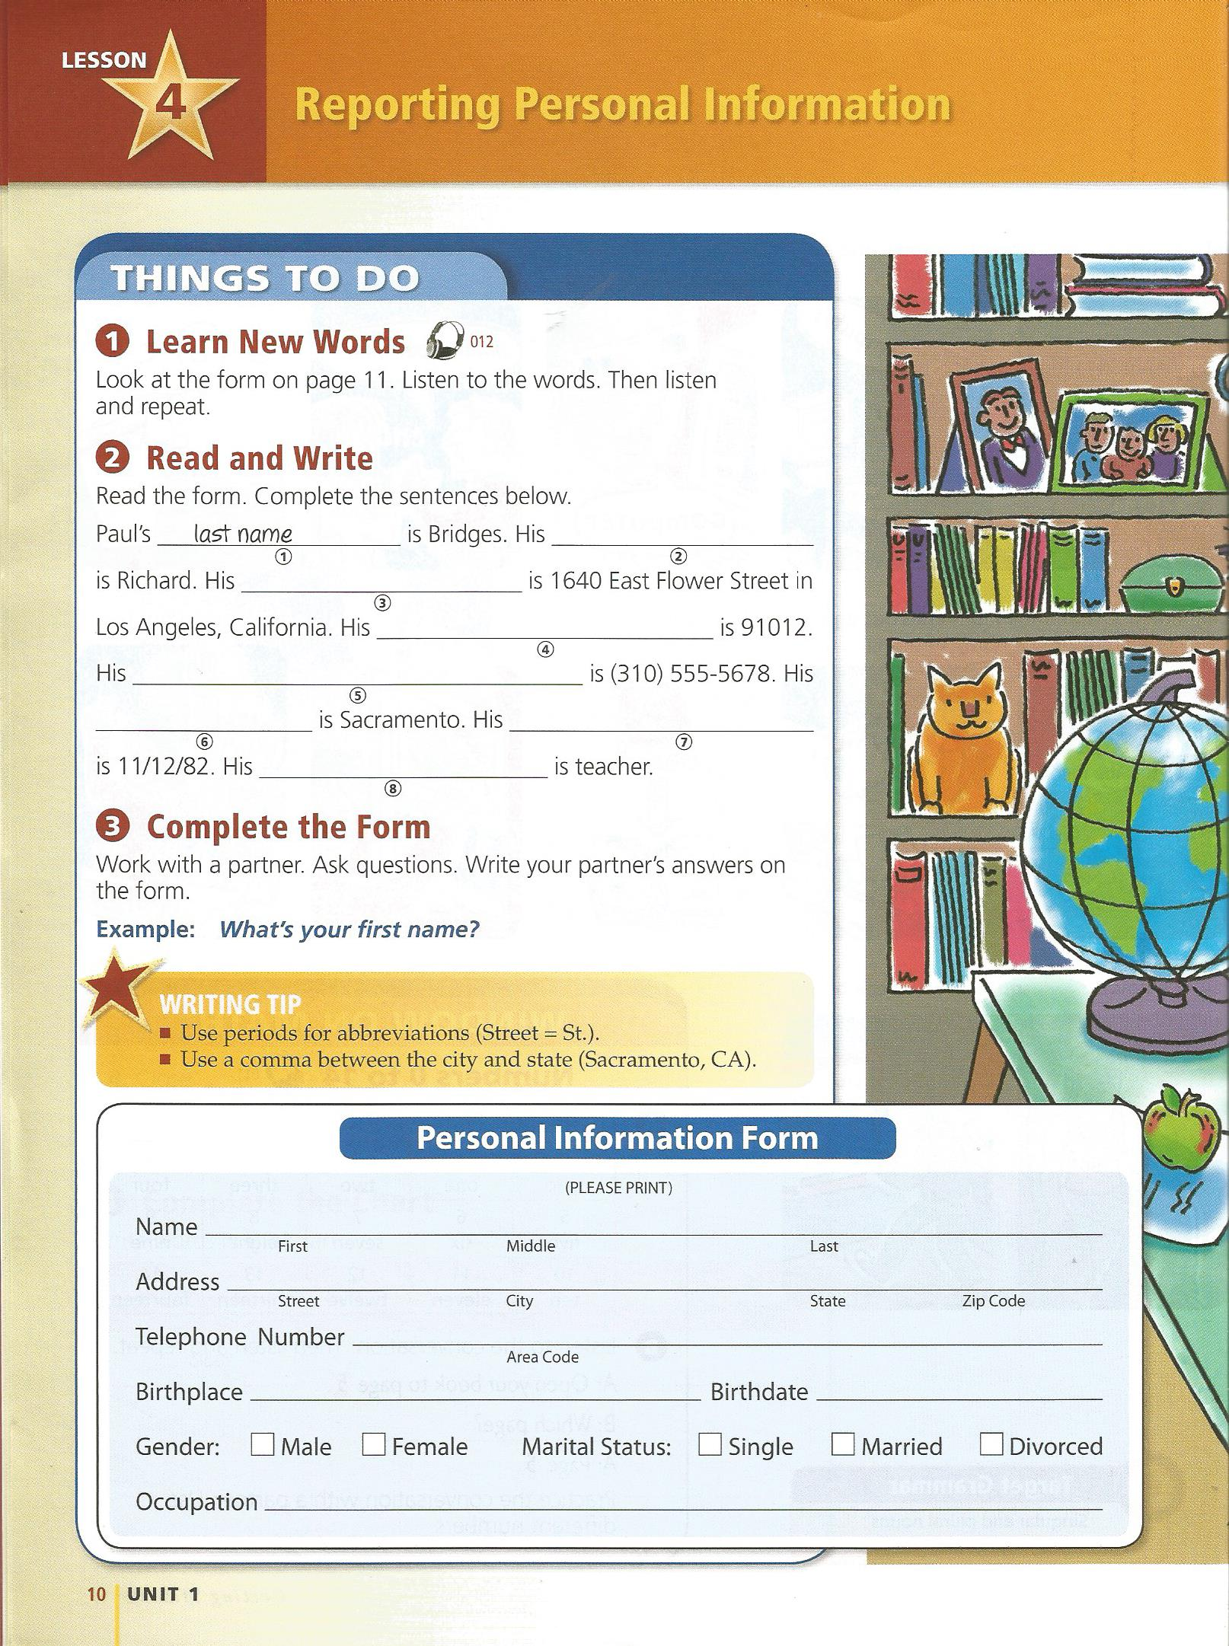
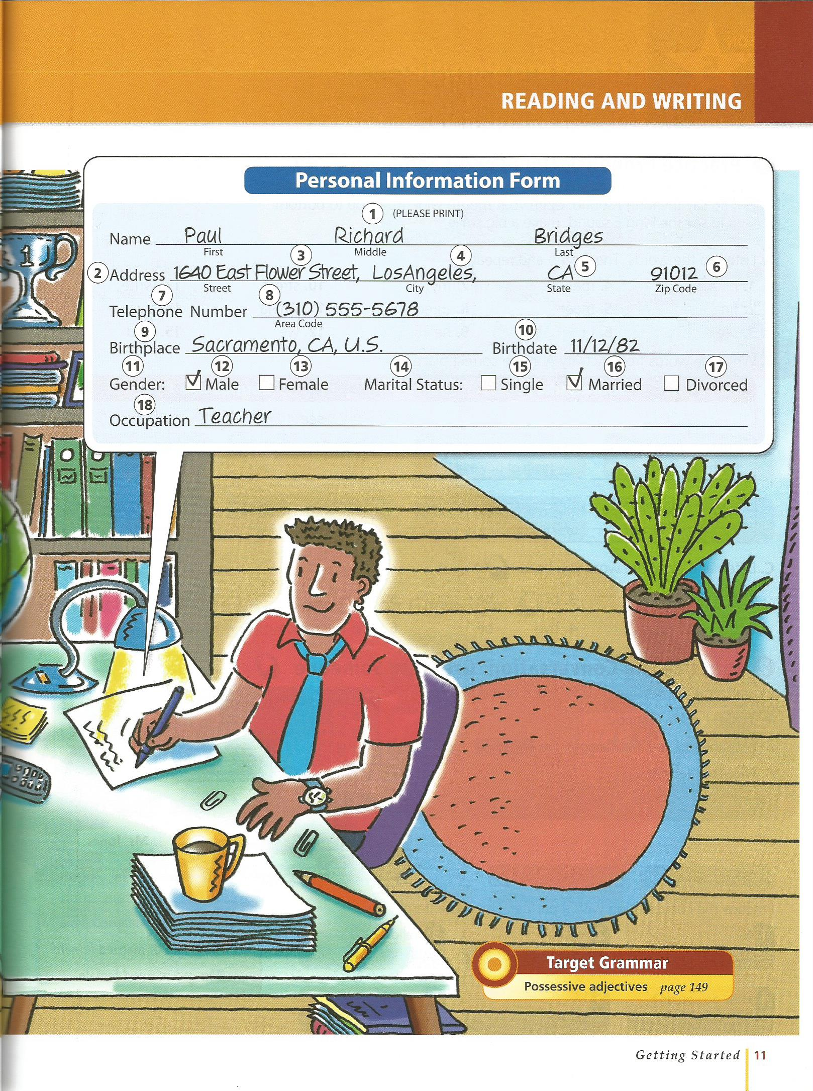

Slide 3
Address
Name
### Building name (apt. number)
Number, -dong, -gu, -si
South Korea (postal code)

Slide 4
Address
135-283 서울특별시 용산구 서초2동 1308-25 하나 아파트 9층 912호 박민호 선생님)

Slide 5
Postal Codes
300 Dong-gu
301 Jung-gu
302 Seo-gu
305 Yuseong-gu
306 Daedeok-gu

Slide 6
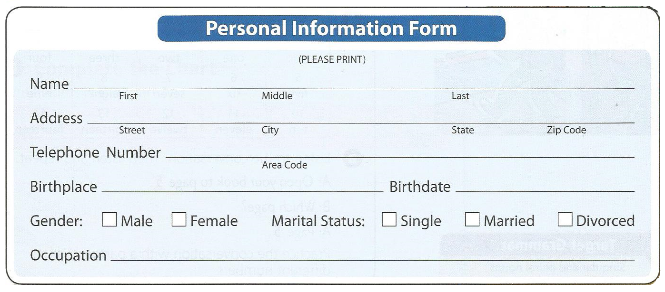
Fill out your information card:

Slide 7
Introduce a friend
Start by taking a card
Then introduce the person on the card.
Now that person will introduce the next card.

Slide 8
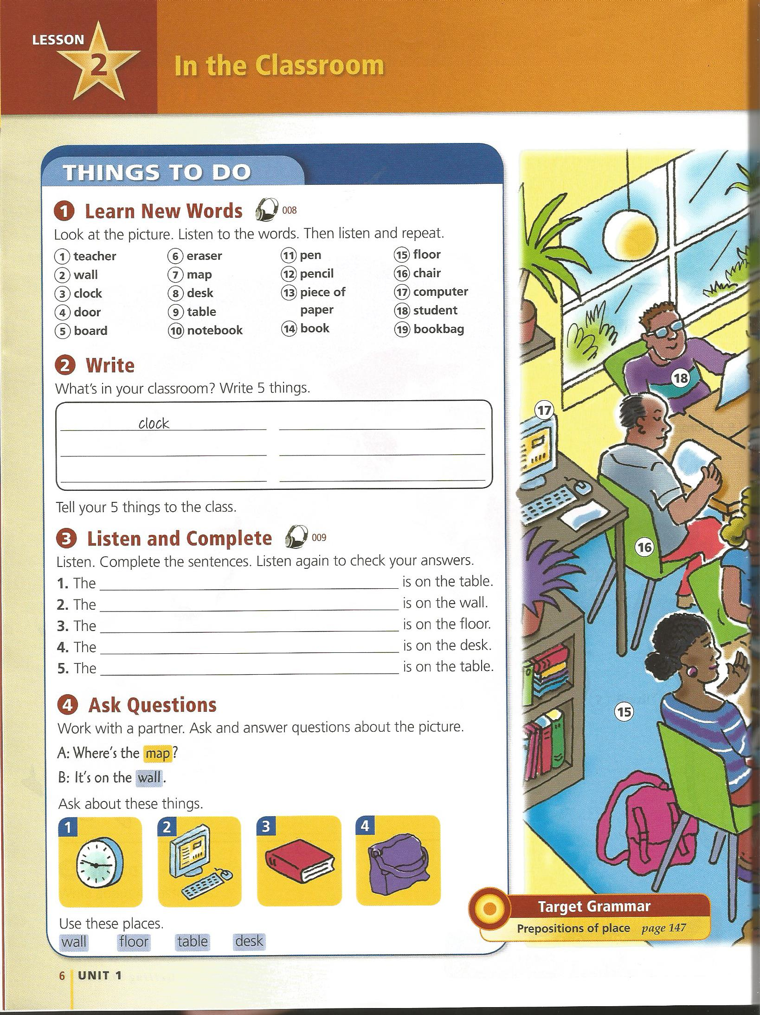
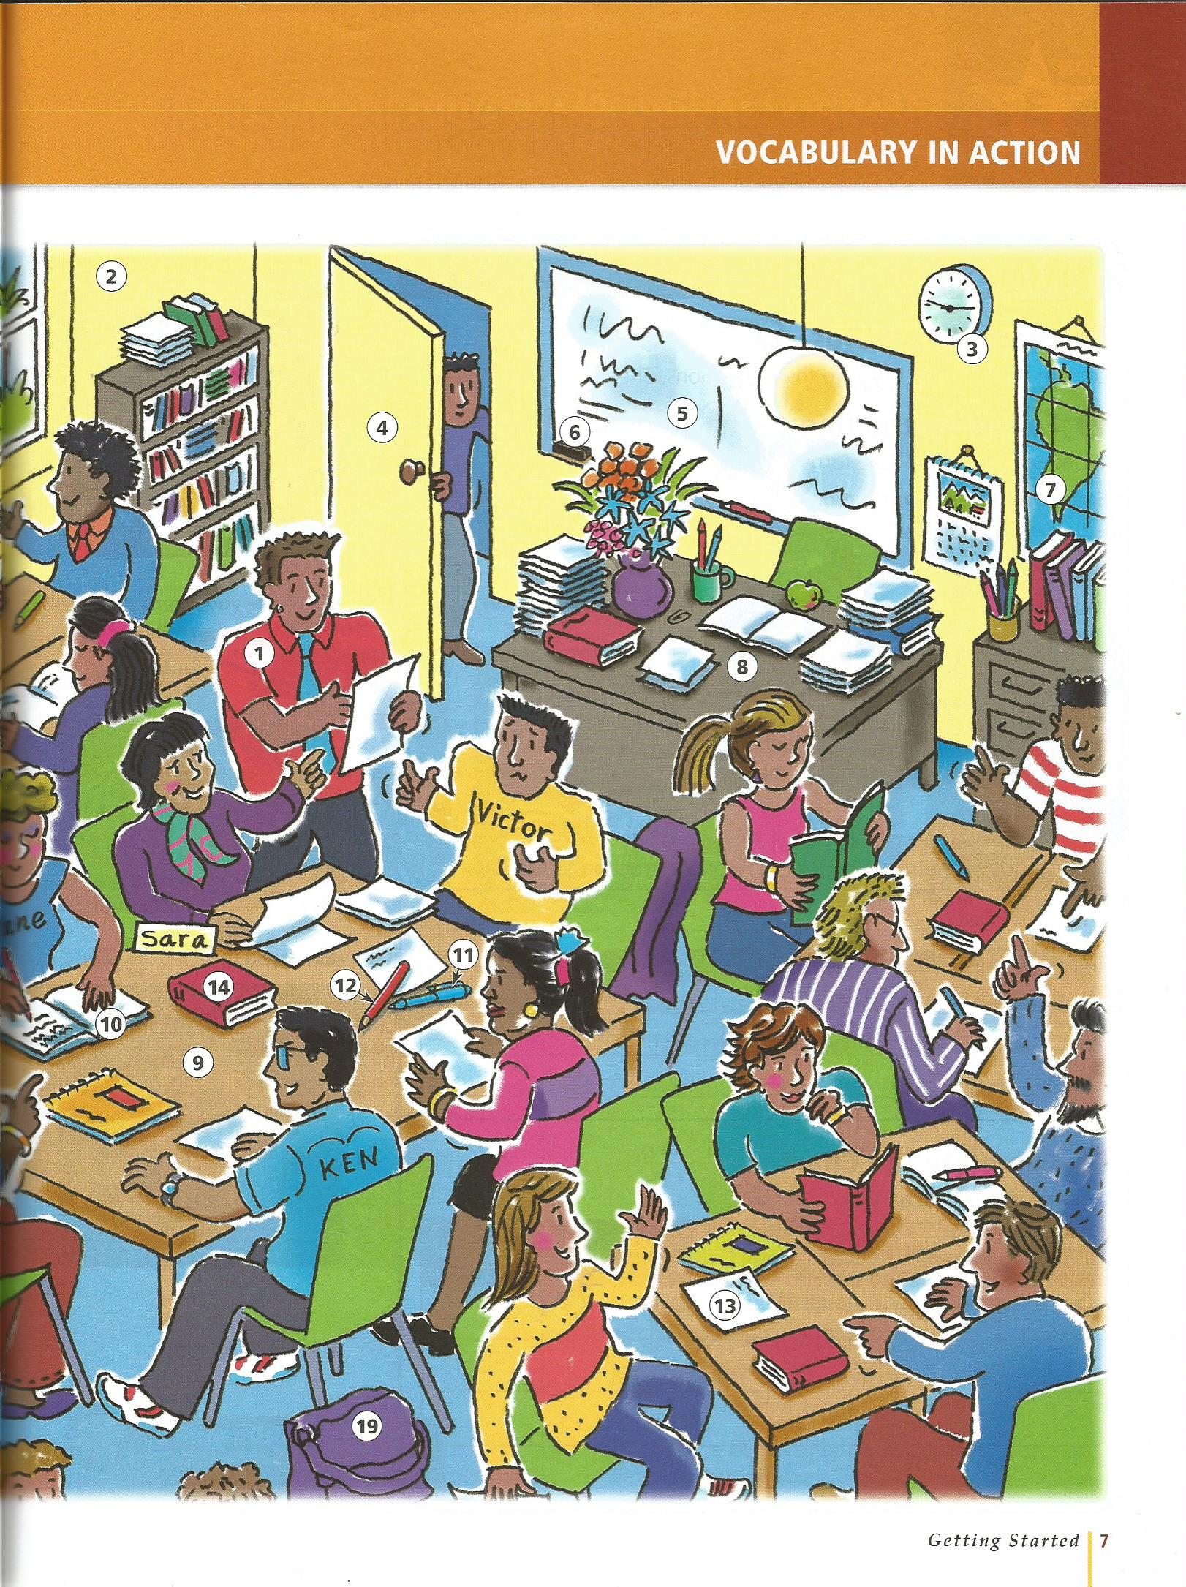
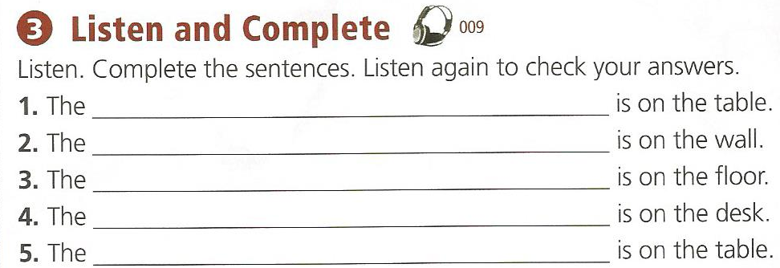

Slide 9
Whonu?

Slide 11
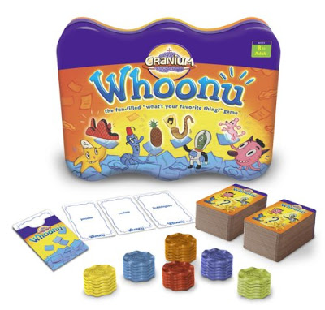

Slide 12
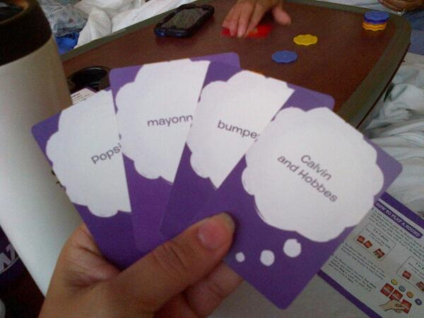

Slide 14
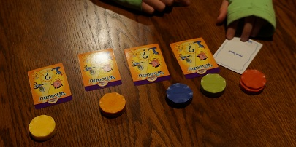

Slide 15
