Slide 1
Review

Slide 2
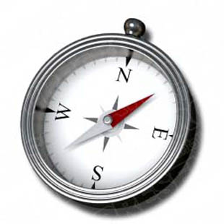

Slide 3
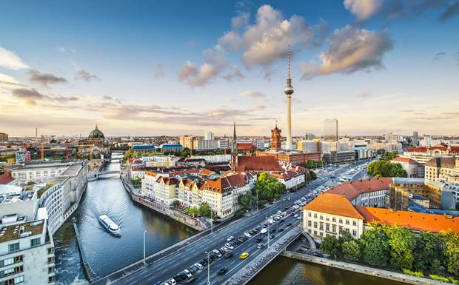
Berlin is the _____ ____ of Germany.

Slide 4
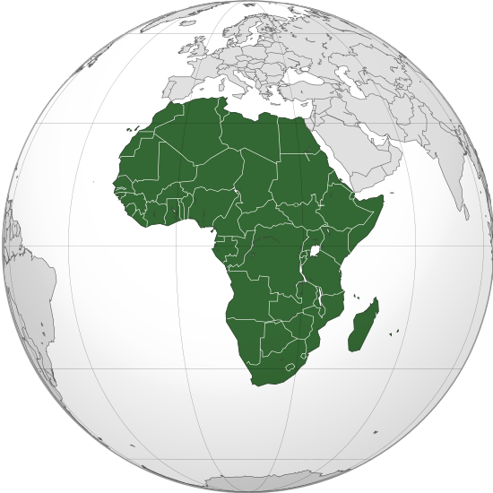
Madagascar is ______ of Africa.

Slide 5
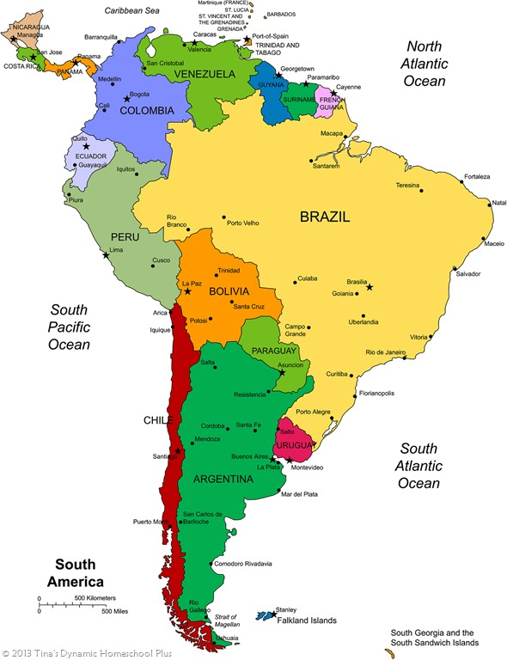
_______ is west of Argentina.

Slide 6
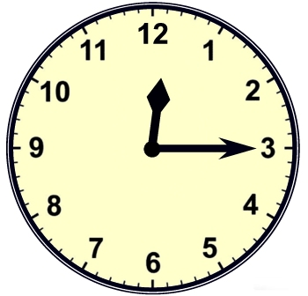

Slide 7
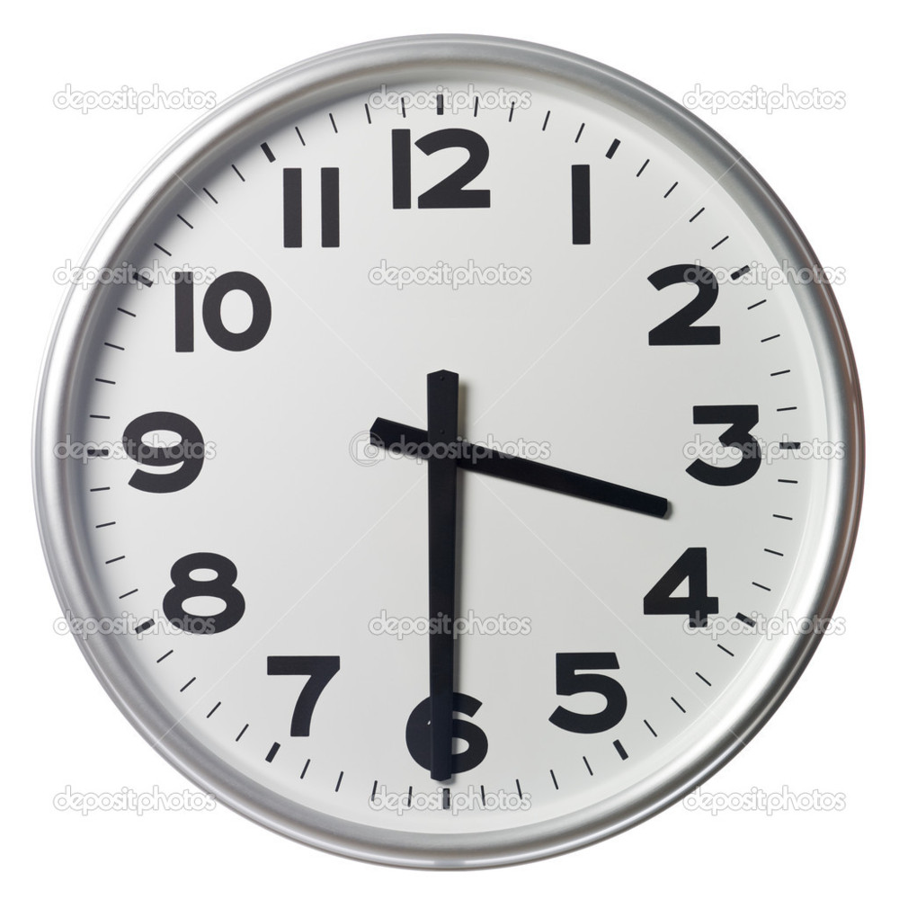

Slide 8
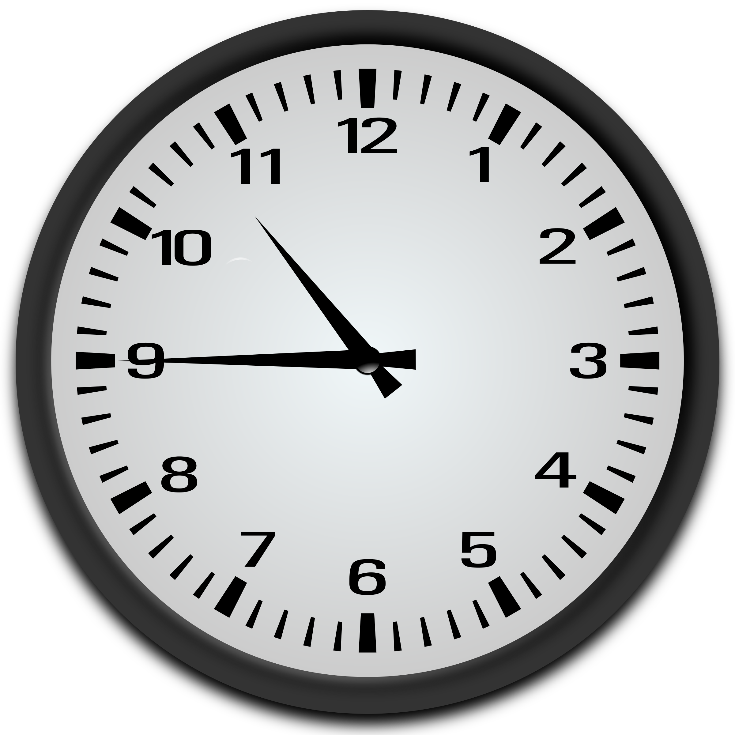

Slide 9
p. 40

Slide 10
Store Hours

Slide 11
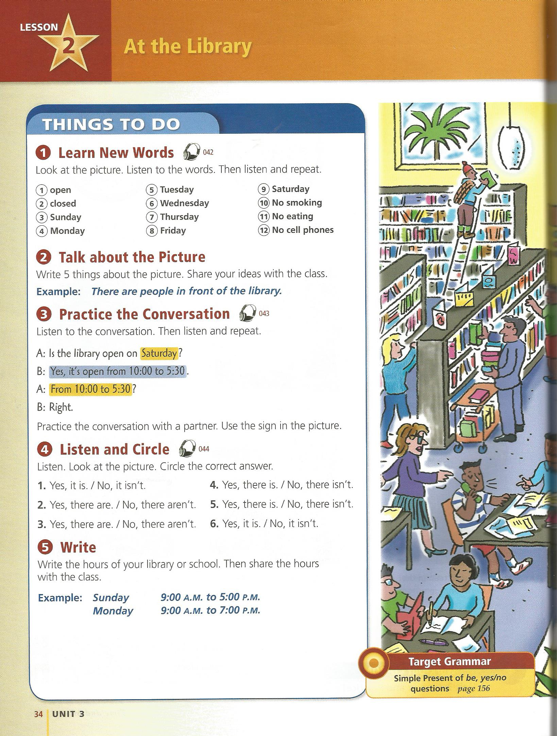
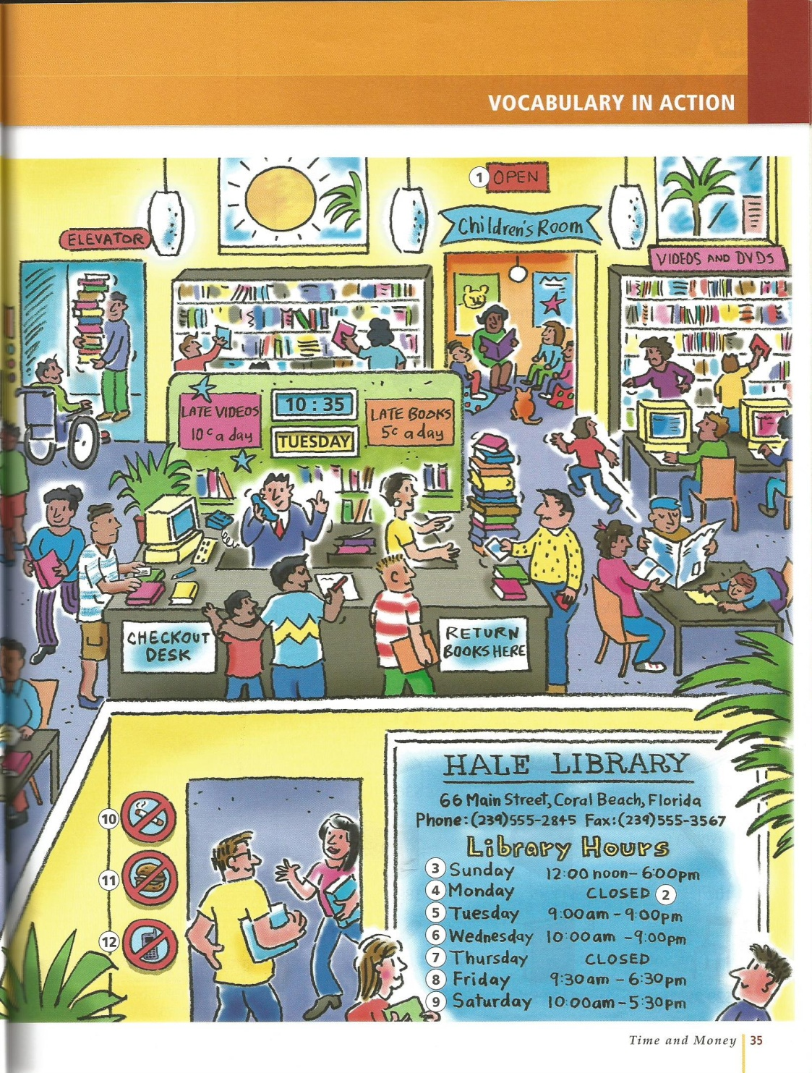

Slide 12
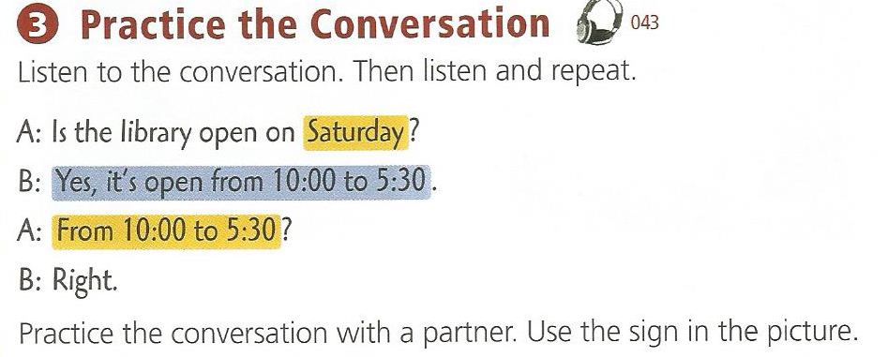
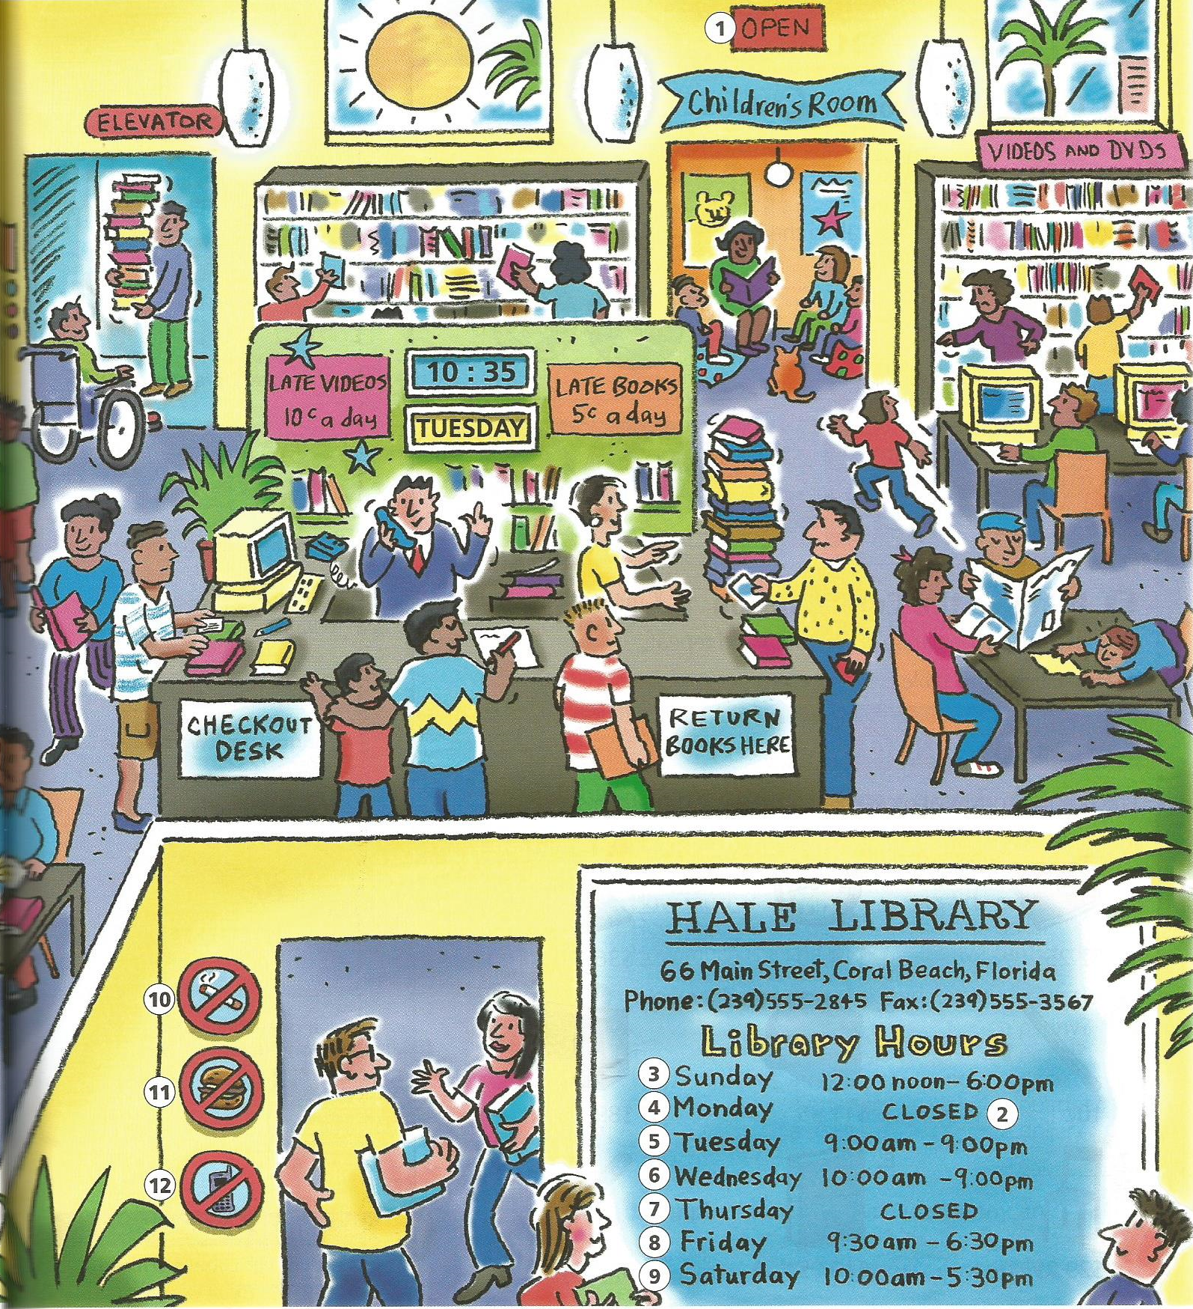

Slide 13
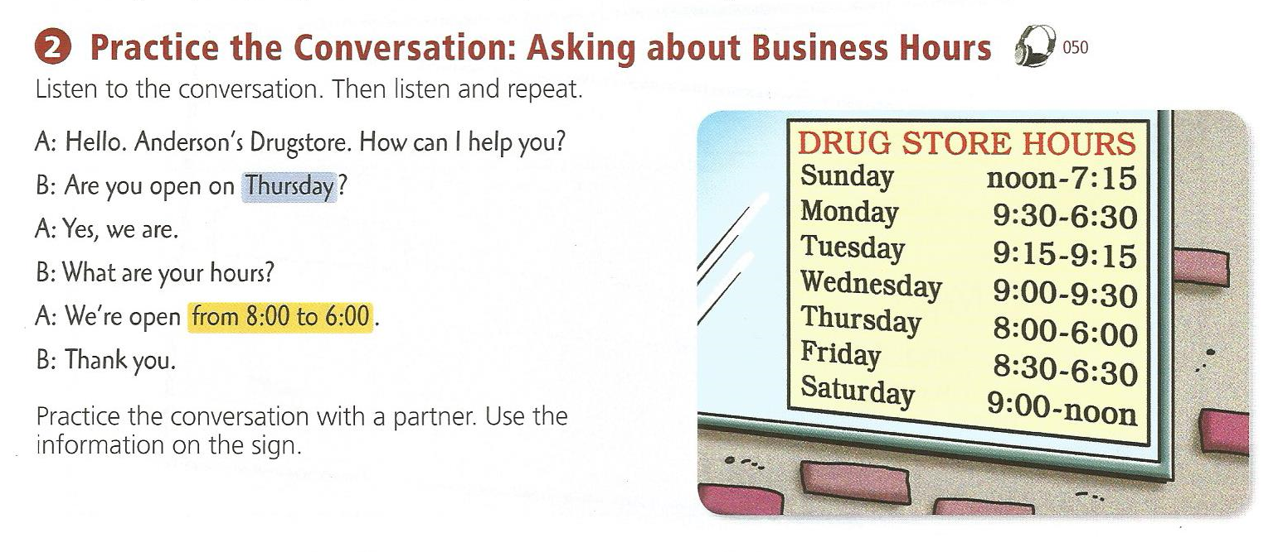
p. 40

Slide 14
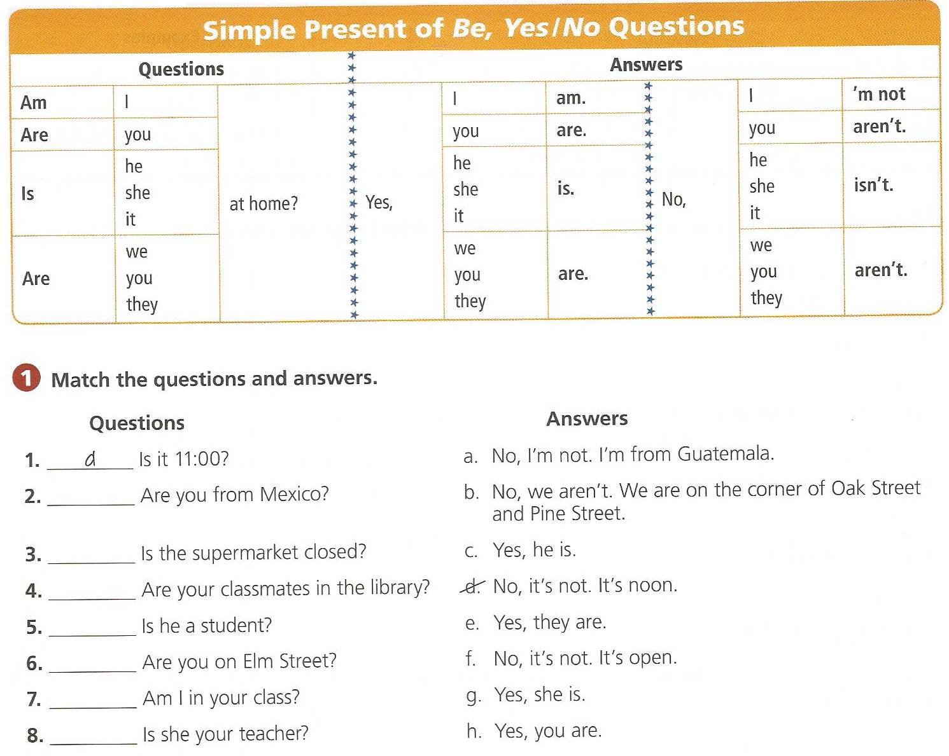
p.156

Slide 15
p.156 - 7

Slide 16
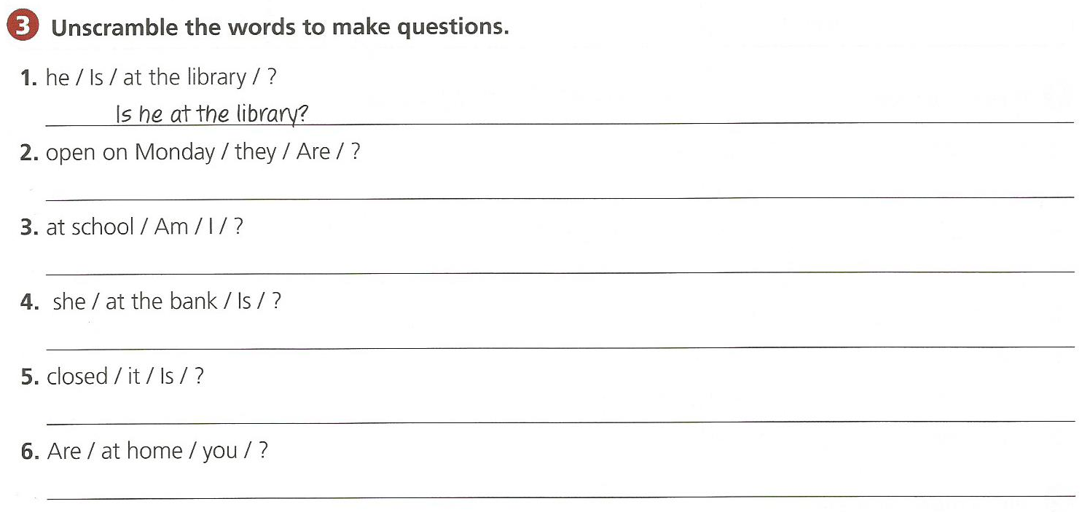
p. 157

Slide 17
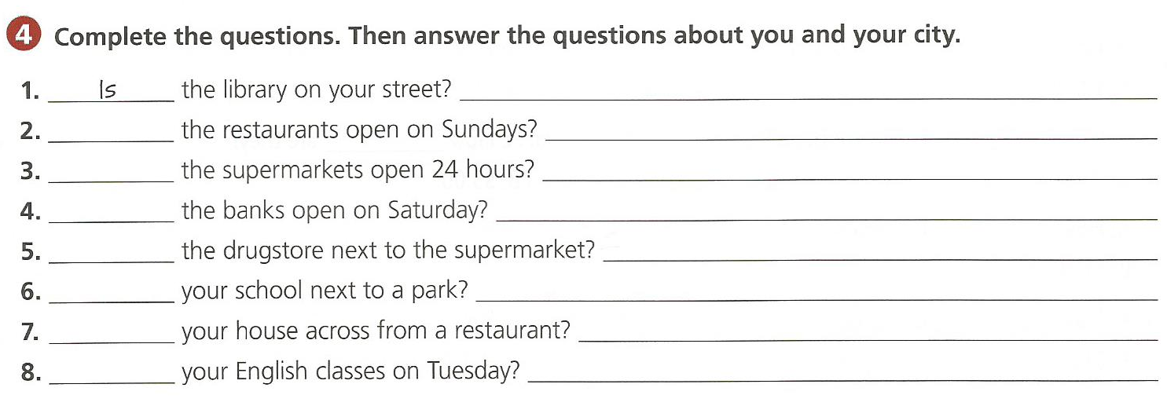
p. 157

Slide 18
Don’t Do That!

Slide 19
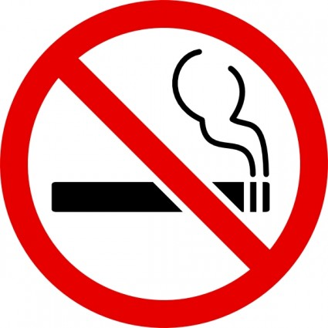
No Smoking / Don’t Smoke

Slide 20
No Eating / Don’t eat

Slide 21
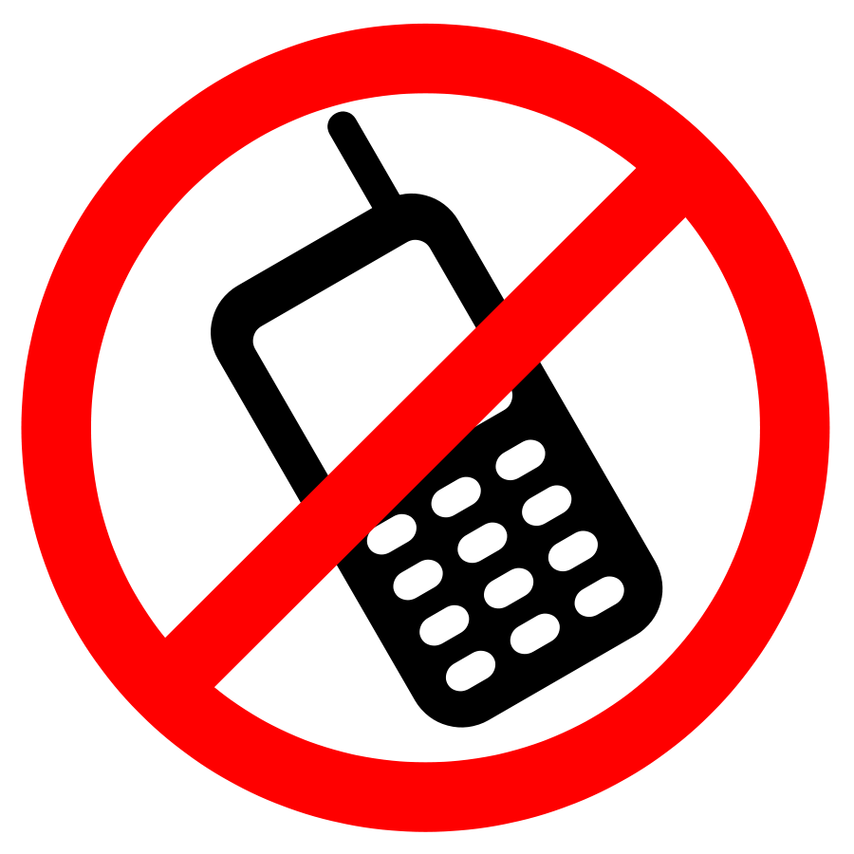
No cell phones / Don’t talk on phones

Slide 22
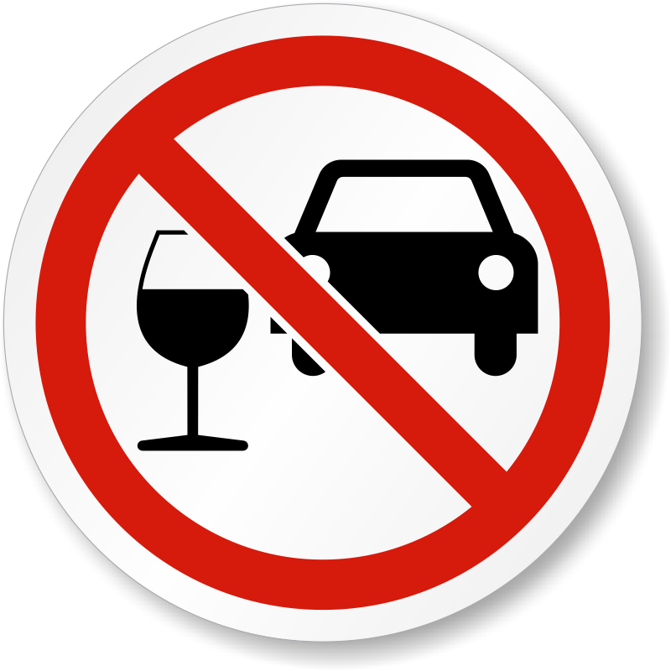
Don’t Drink and Drive

Slide 23
No photos / Don’t take Photos

Slide 24
No Dogs

Slide 25
No Aliens

Slide 26
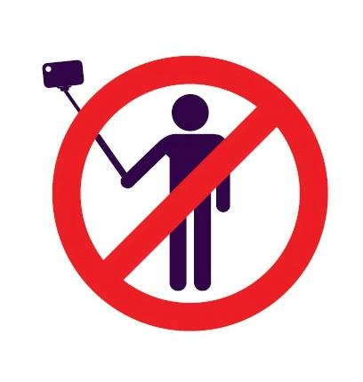
No Selfies / Don’t take your own picture

Slide 27
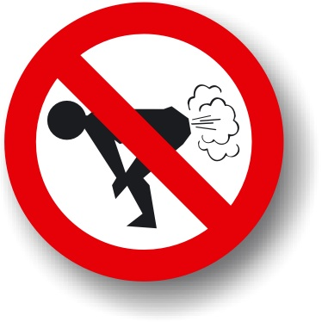
No Farting / Don’t Fart

Slide 28
Brainstorming Rules

Slide 29
School rules

Slide 30
Museum Rules

Slide 31
Park Rules

Slide 32
Airport Rules

