Slide 1
Lesson 12 - Money

Slide 2
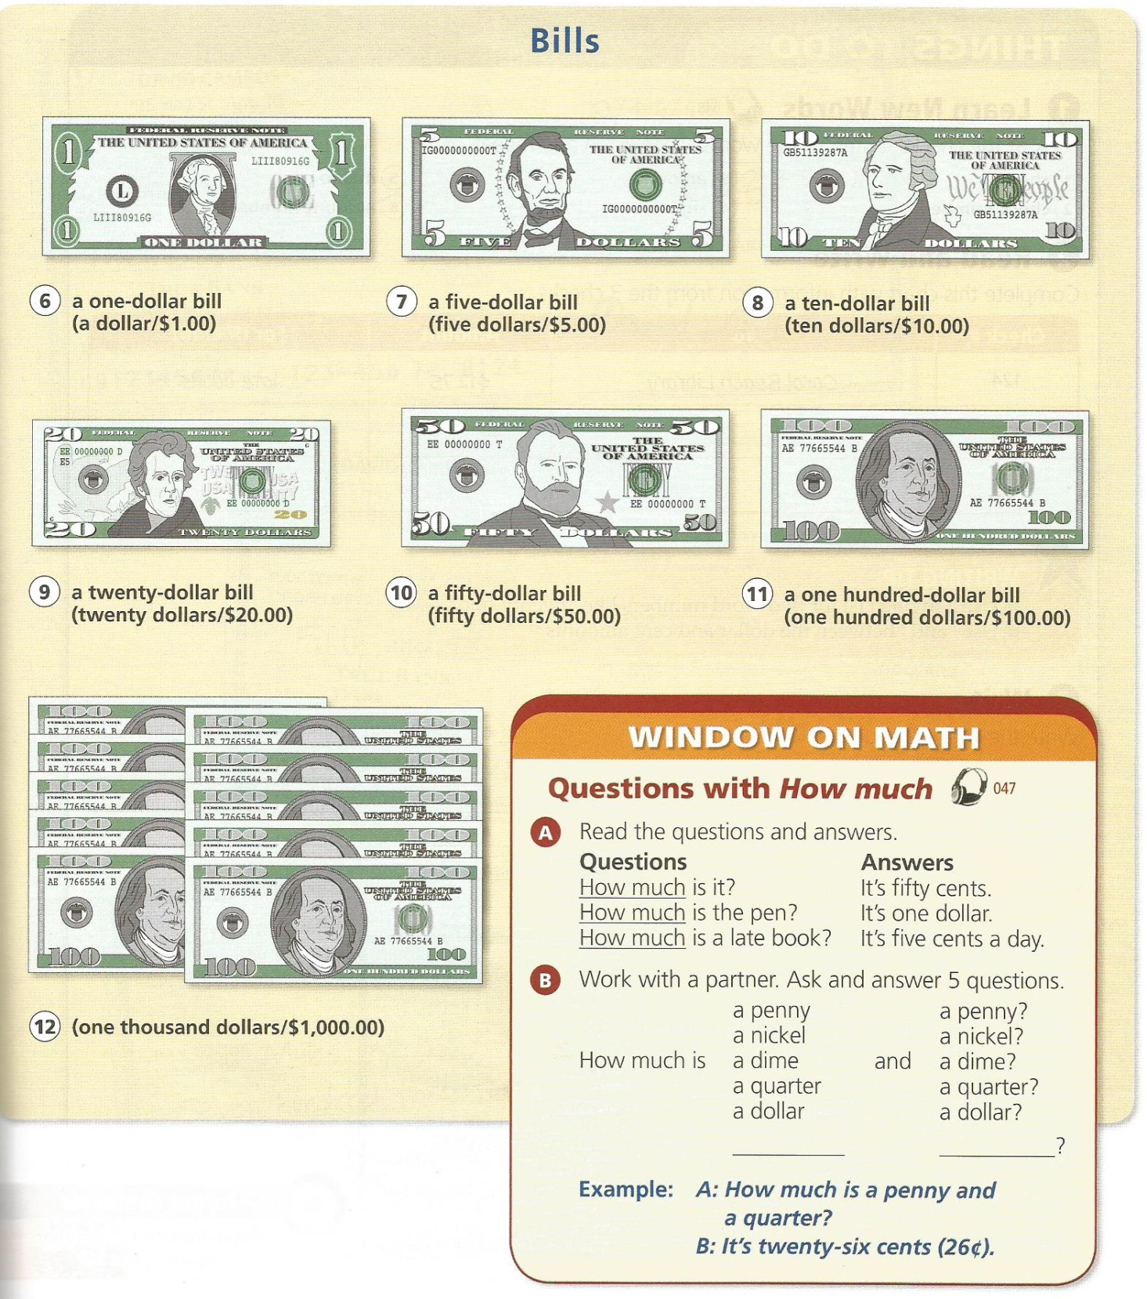

Slide 4
Riddle:
Two coins add up to 30 cents.
But, one coin is not a nickel.
How is this possible?

Slide 5
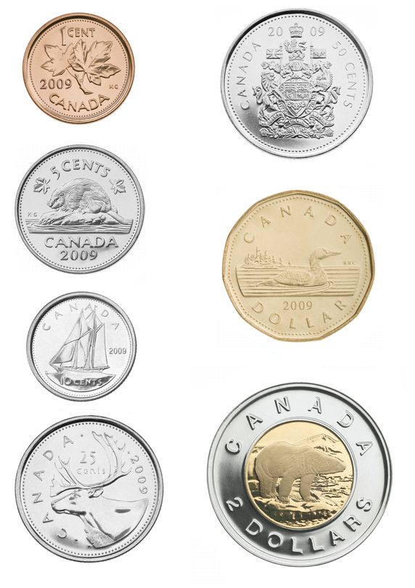
Canadian Coins

Slide 6
Finding Coins Game
First one to find the correct coin get a point.

Slide 7
Korean Coin

Slide 8
A penny from Canada

Slide 9
Japanese Money

Slide 10
Australian Money

Slide 11
A coin newer than 2010.

Slide 12
Loonie

Slide 13
100\ coin

Slide 14
A coin with a hole in it

Slide 15
A picture of Queen Elizabeth II

Slide 16
An American Dime

Slide 17
The Oldest Coin

Slide 18
An Australian 10 cents coin

Slide 19
A coin from before you were born.

Slide 20
A coin older than 1970

Slide 21
A Netherlands Coin

Slide 22
A New Zealand Coin

Slide 23
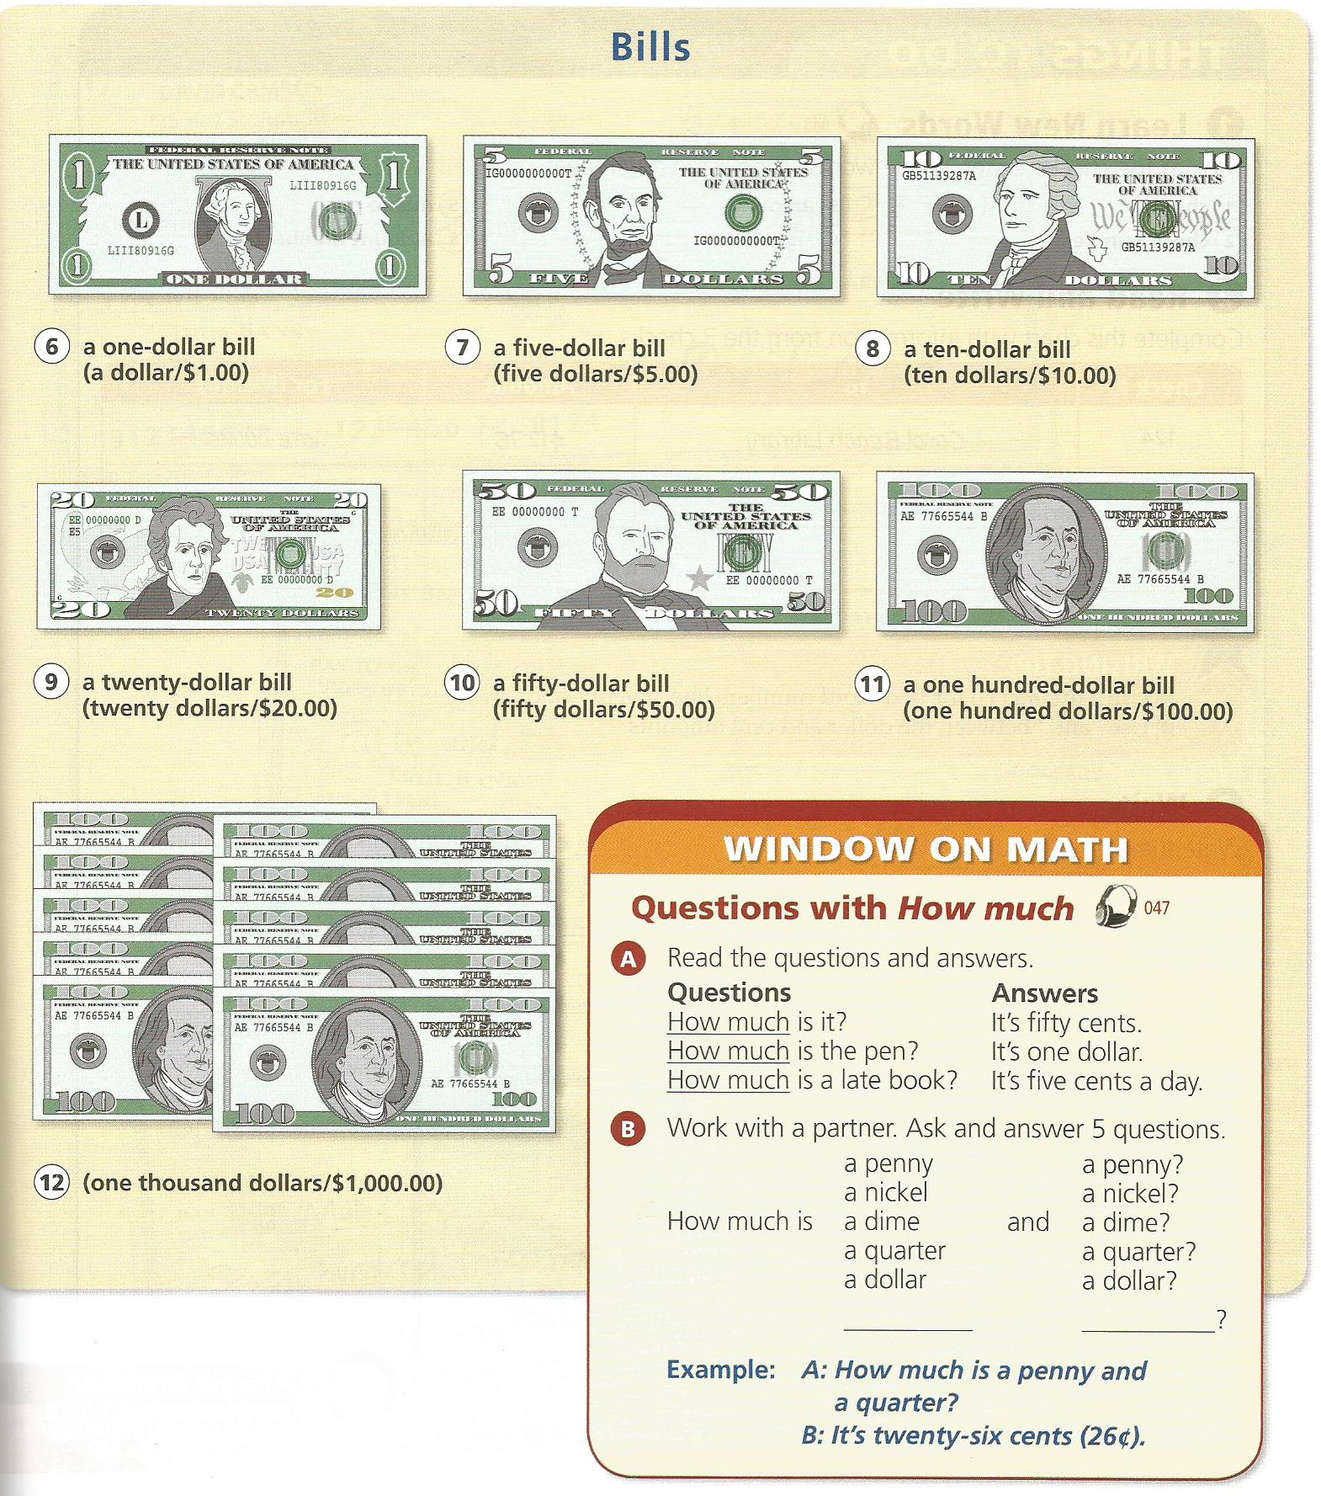
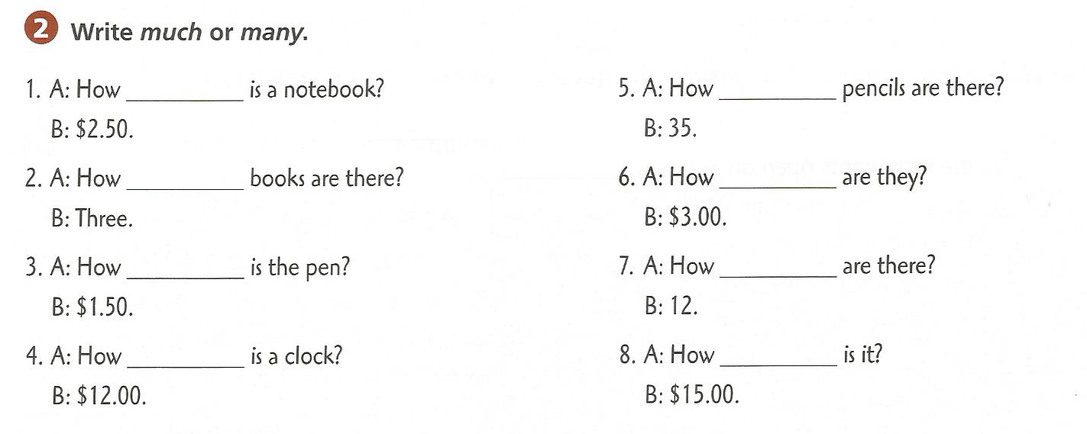

Slide 24
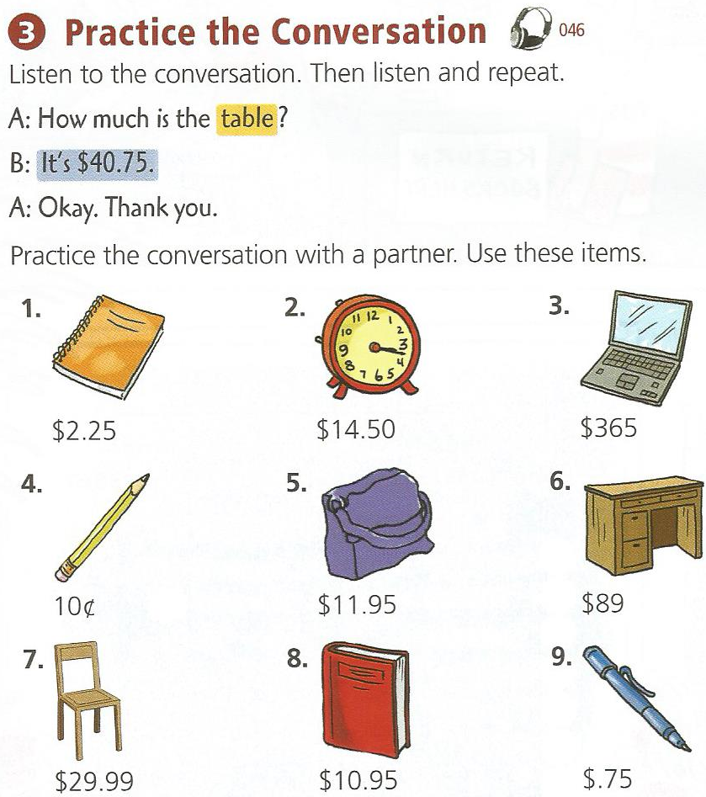

Slide 25
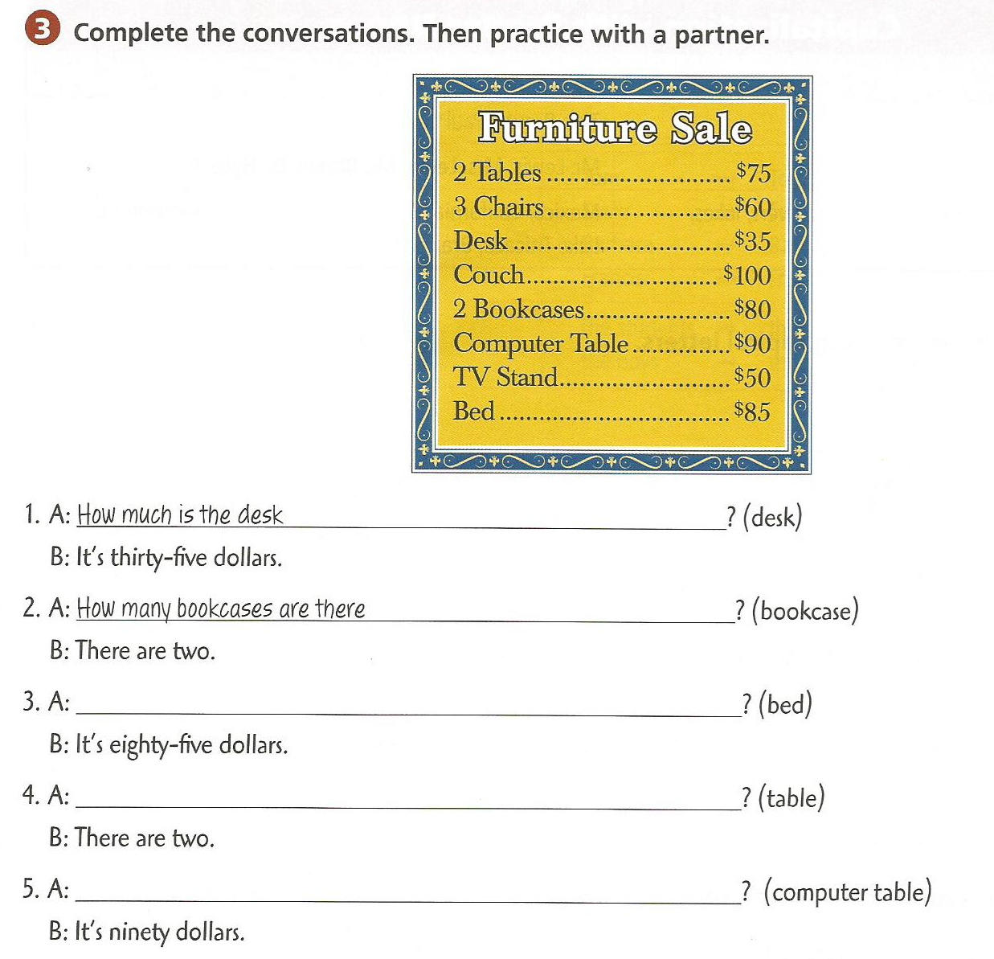
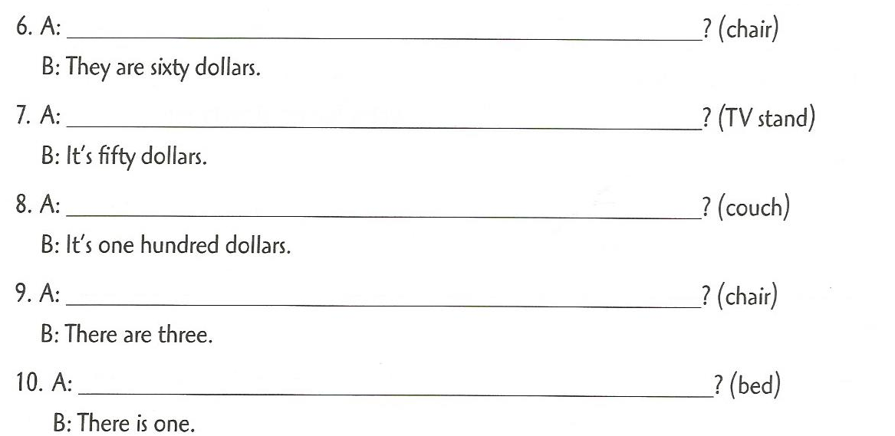

Slide 26
Sell Anything
Design a Product and sell it at an auction

Slide 27
Product:
Name
Purpose
Price

