Slide 1
Lesson 16 – Adjective Order

Slide 2
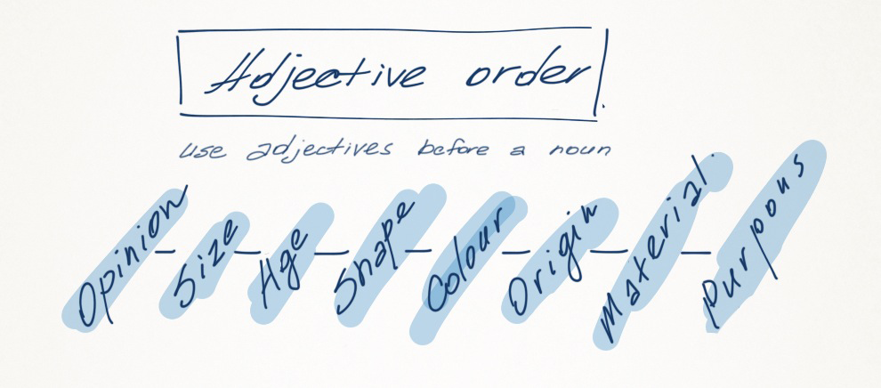

Slide 3

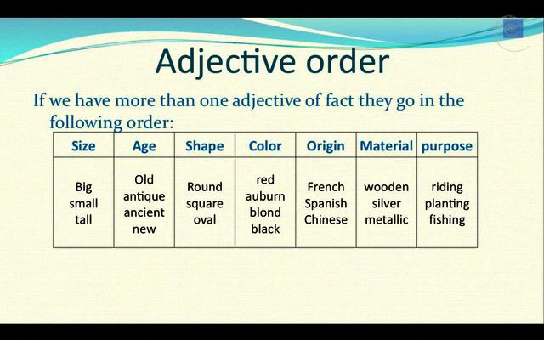

Slide 4

Opinion

Slide 5

Opinion
Best, Worst, Delicious, Beautiful, Horrible

Slide 6
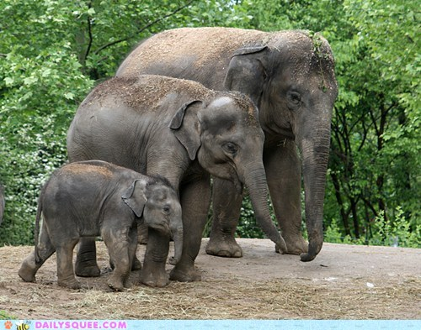
Size

Slide 7
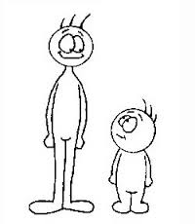


Slide 8
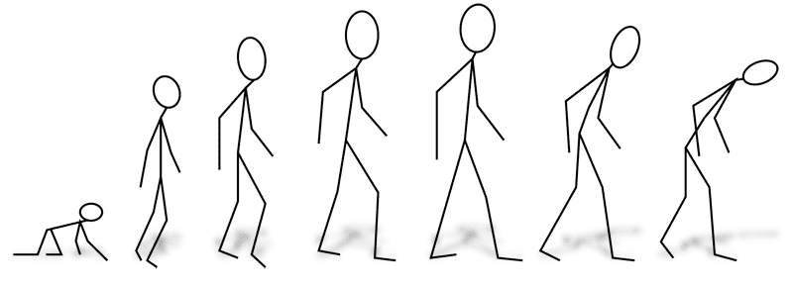
Age

Slide 9

Shape

Slide 10
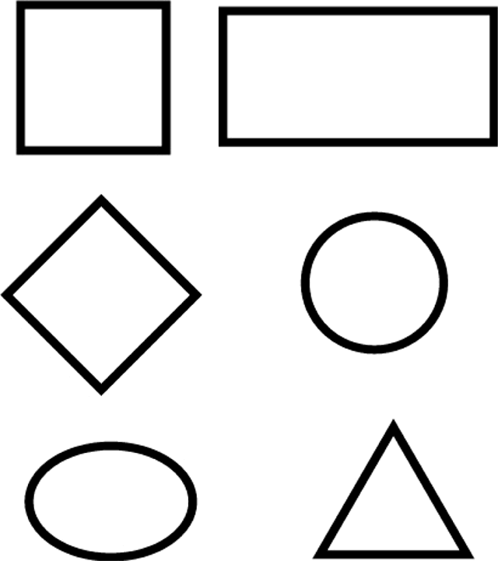
Shapes

Slide 11
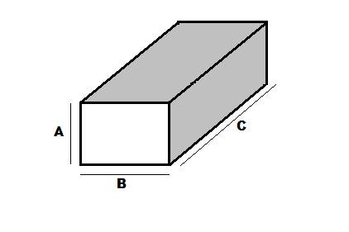
Rectangle = Rectangular

Slide 12
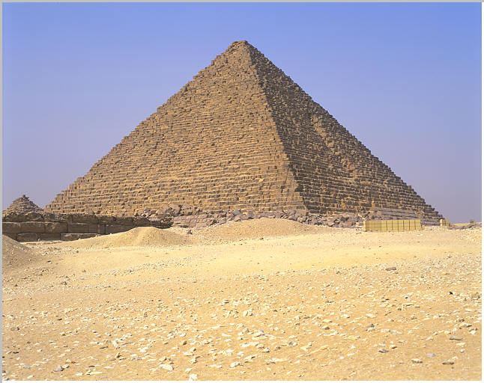
Triangle = Triangular

Slide 13
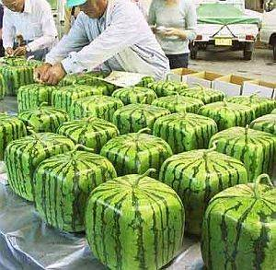
Square = Square

Slide 14
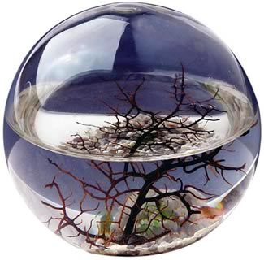
Circle = Round

Slide 15
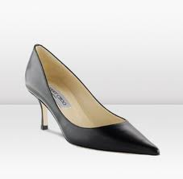
Pointy

Slide 16
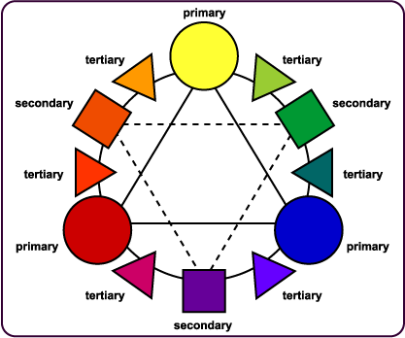

Slide 17

Color

Slide 18

Pink

Slide 19

Brown

Slide 20
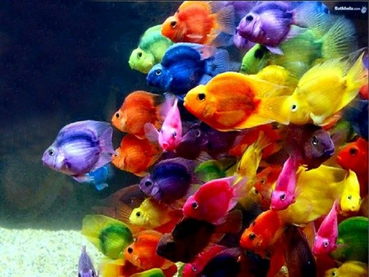
Colorful

Slide 21

Black

Slide 22
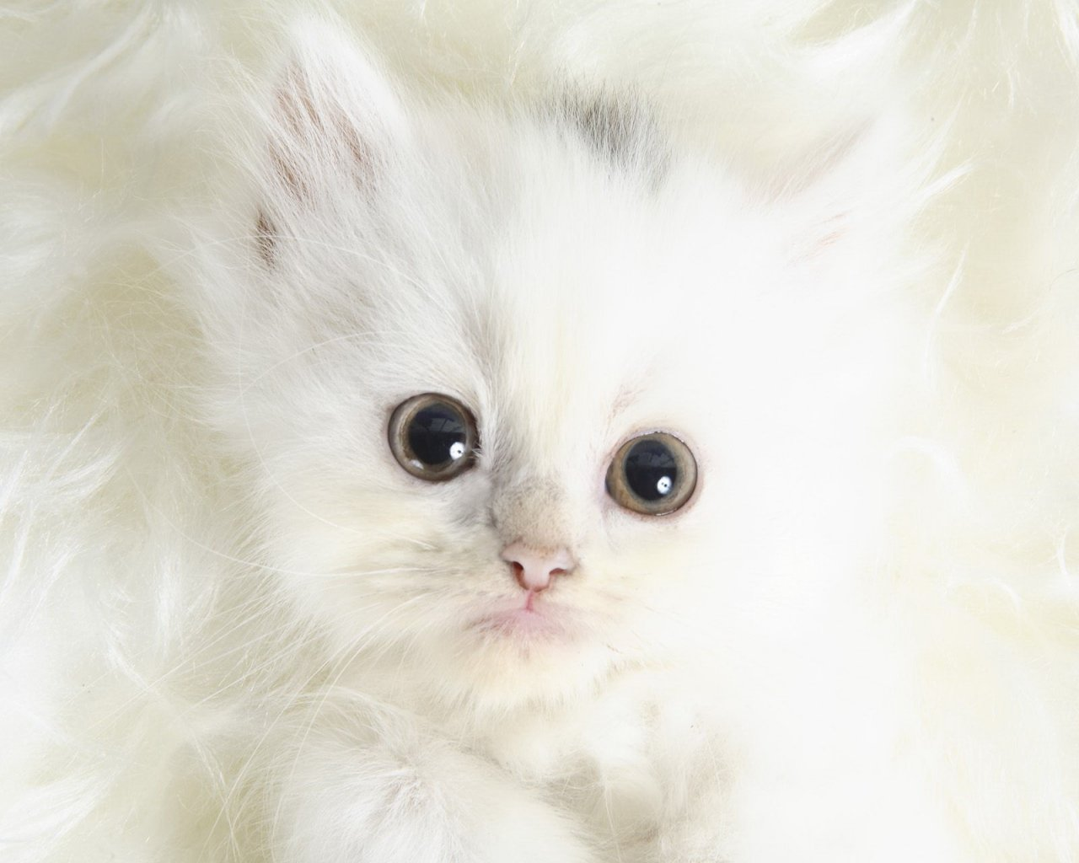
White

Slide 23

Grey

Slide 24
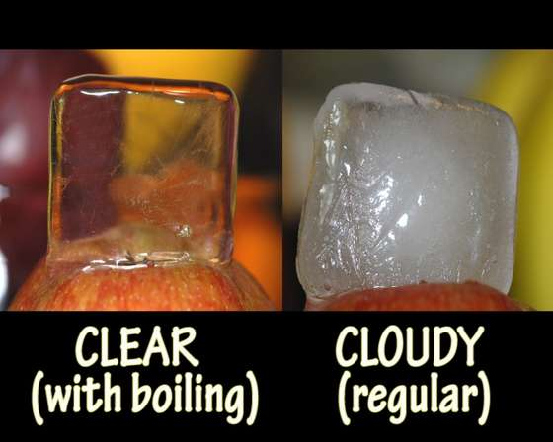

Slide 25
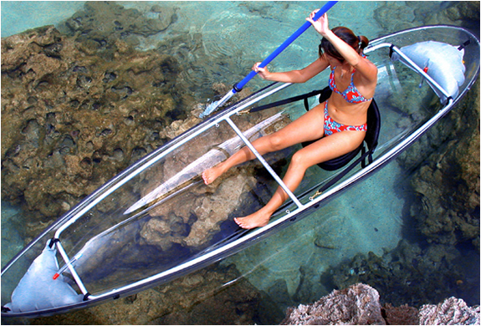
Clear

Slide 26

Origin

Slide 27
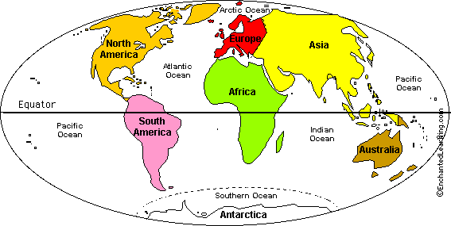

Slide 28
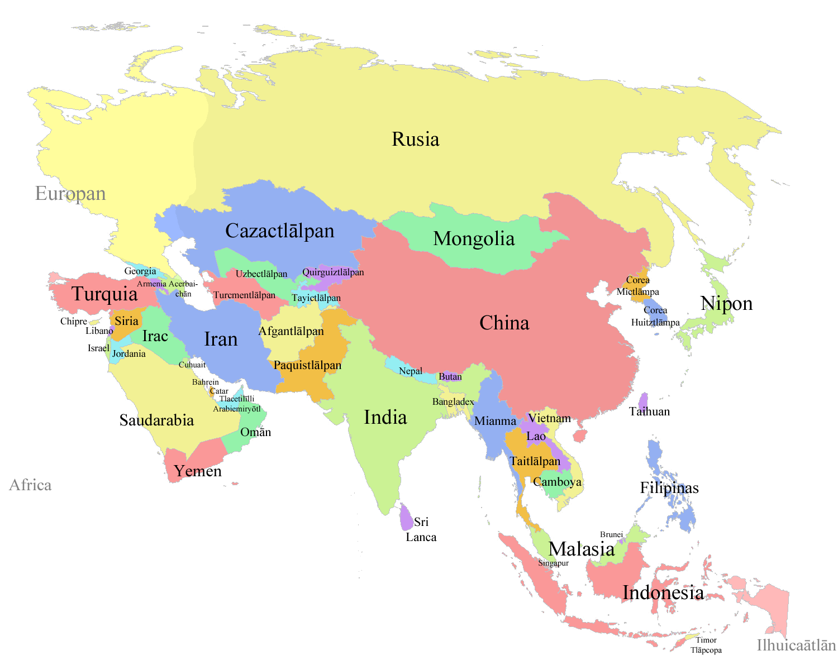
Asian

Slide 29
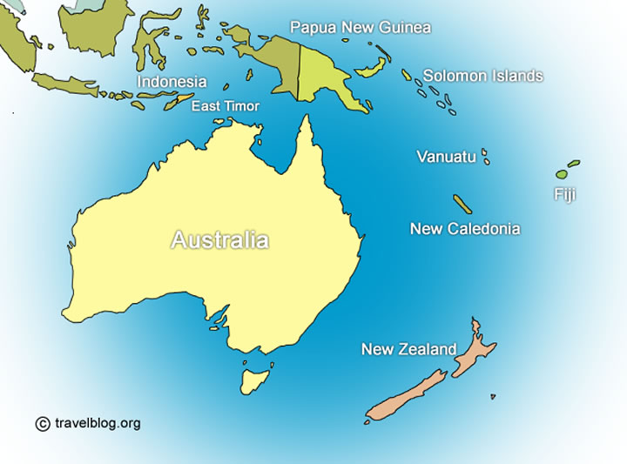
Australian

Slide 30
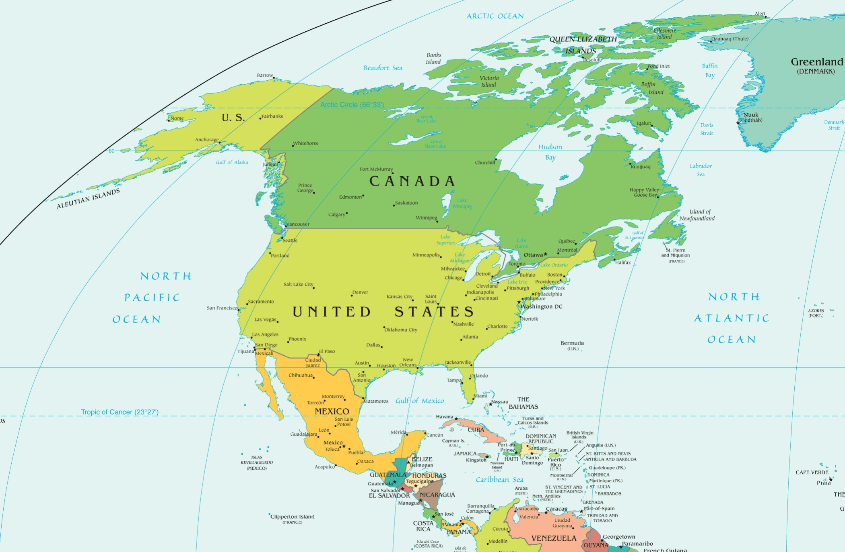
North American

Slide 31
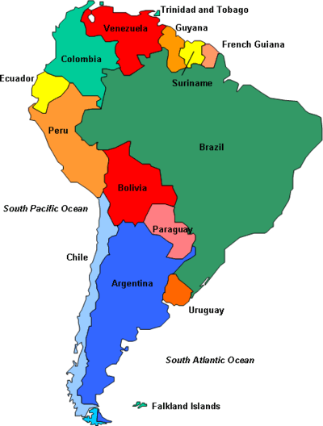
South American

Slide 32
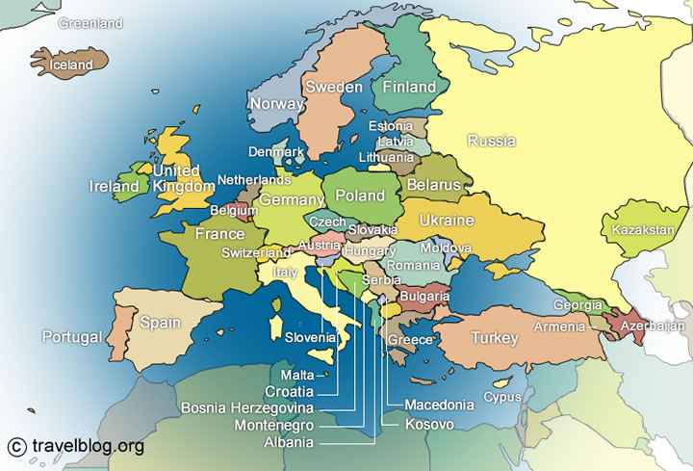
European

Slide 33
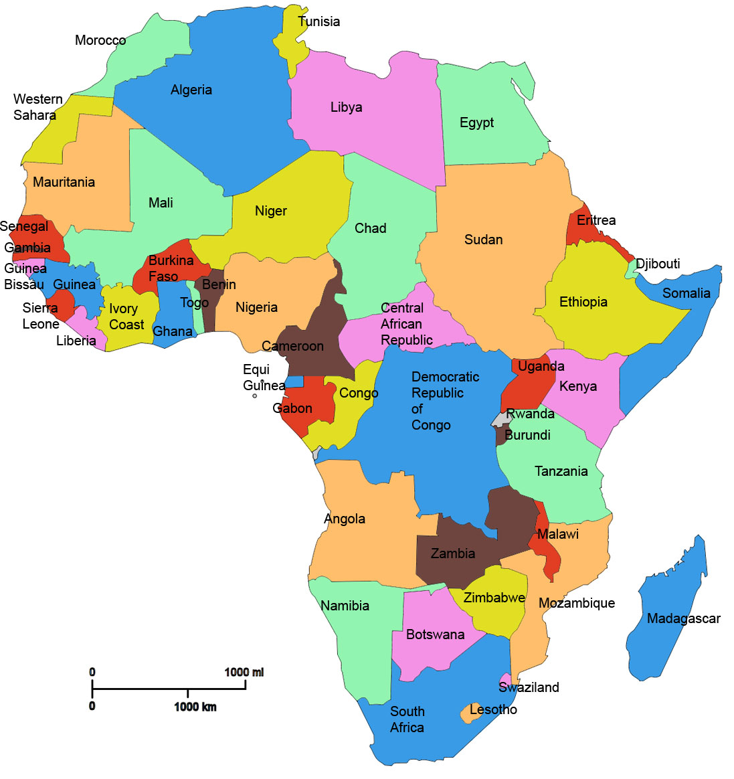
African

Slide 34

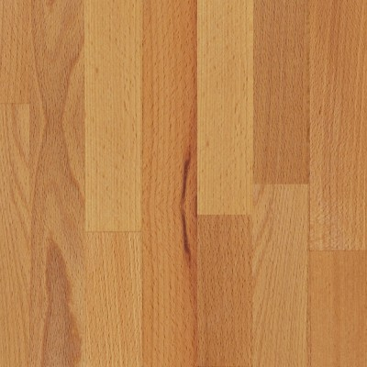
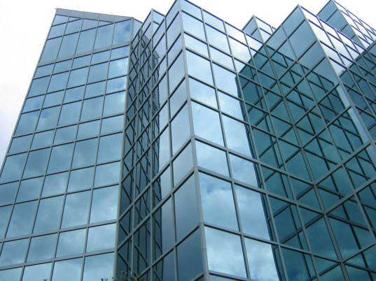
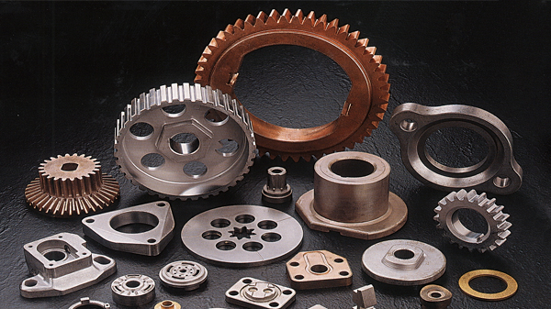
Material

Slide 35
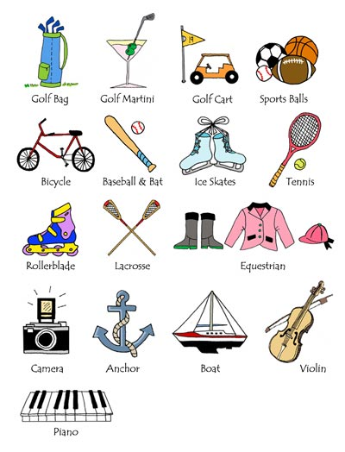
Purpose

Slide 36
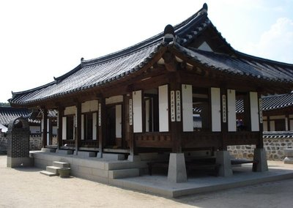
A hanok is an old, wooden, Korean house.
A hanok is a wooden, Korean, old house.

Slide 37
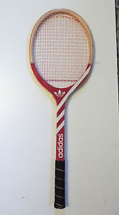
She uses a round, red wooden tennis racket.
She uses a tennis, round, red, wooden racket.

Slide 38
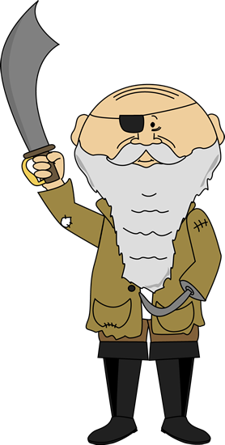
He was an ugly, tall, old, European Pirate
He was a tall, ugly, European, old pirate

Slide 39
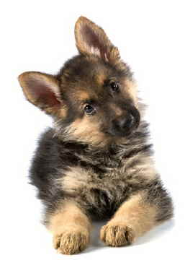
Look at that cute, tiny, young German Shepherd.
Look at that young, German, tiny, cute Shepherd

Slide 40
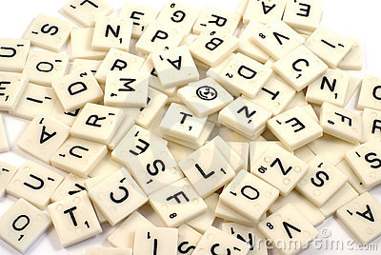
Letter and Adjective

Slide 41
Letters and Adjectives
One letter and a number of adjectives will be selected.
You must find the noun that makes sense.
First one gets the points.

Slide 42
Questions:

Slide 43

Opinion
Do you think it is ugly?
Is it beautiful?

Slide 44
Size
How big is it?
Is it small?

Slide 45
Age
How old is it?
Is it new?

Slide 46
Shape
What shape is it?
Is it pointy?
How many sides does it have?

Slide 47
Color
What color is it?
Is it blue?
  Is it light / dark blue?

Slide 48
Origin
Where is it from?
Is it Korean?

Slide 49
Material
What is it made from?
Is it plastic?
  Is it hard / soft?

Slide 50
Purpose
What is it used for?

Slide 51

Guessing Game
Ask questions to learn about the “noun”
Guess what it is.
Whoever guesses correctly gets to choose the next player.

Slide 52
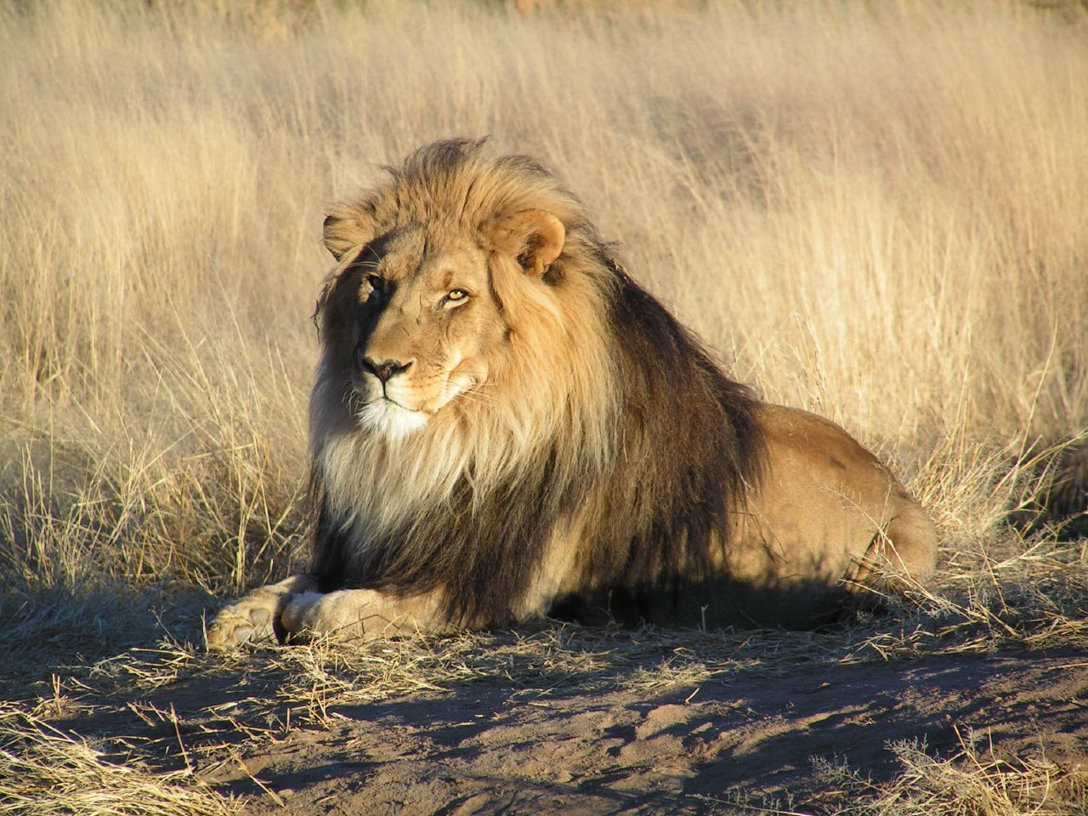

Slide 53


Slide 54
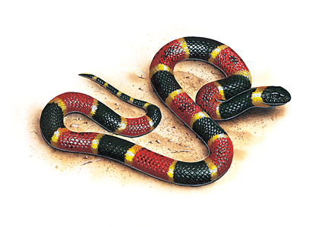

Slide 55
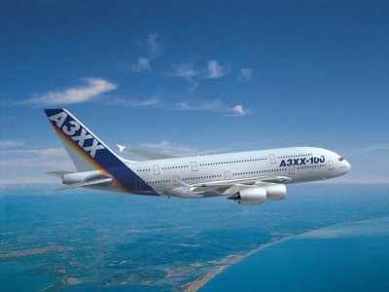

Slide 56
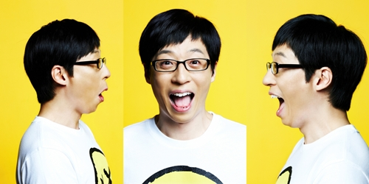

Slide 57


Slide 58
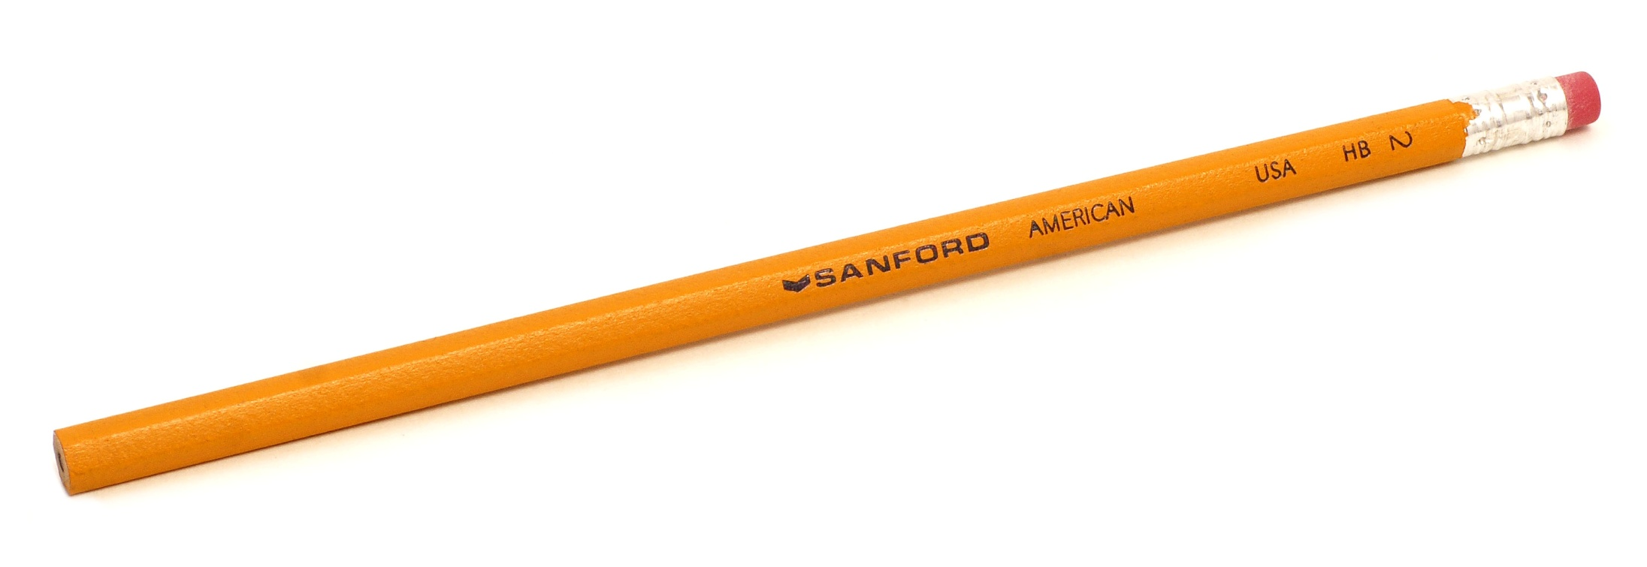

Slide 59
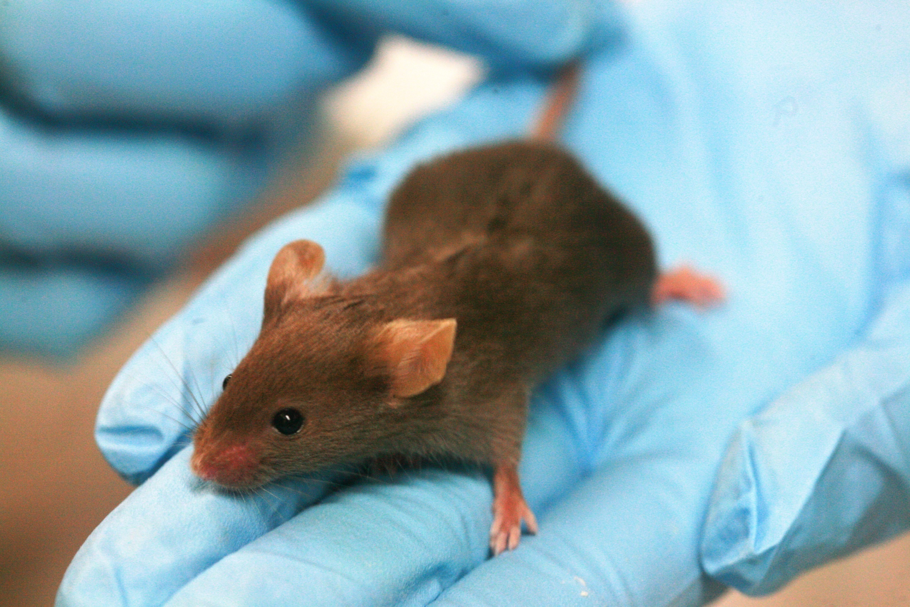

Slide 60
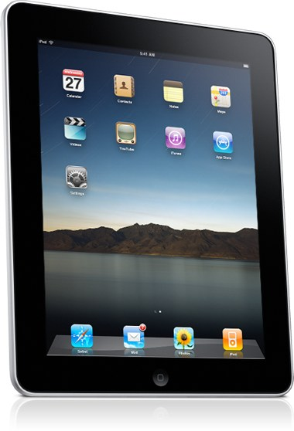

Slide 61
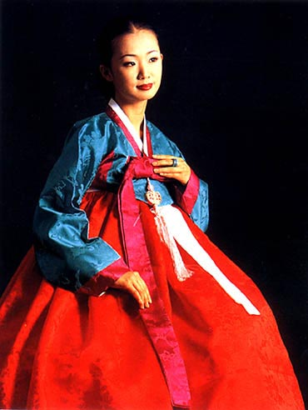


Slide 62


Slide 63
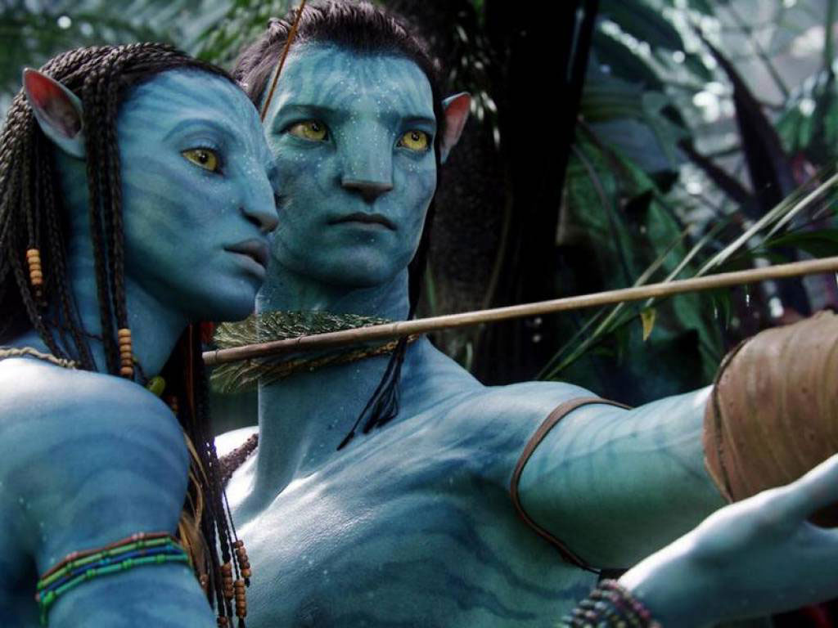

Slide 64
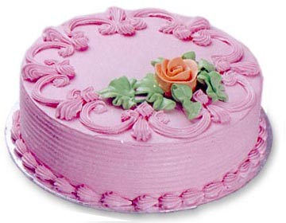

Slide 65
