Slide 1
Adjectives Again

Slide 2
What are the types of adjectives?
Opinion
Size
Age
Shape
Color
Origin
Material
Purpose

Slide 3
Questions:

Slide 4
Opinion
Do you think it is ugly?
Is it beautiful?

Slide 5
Size
How big is it?
Is it small?

Slide 6
Age
How old is it?
Is it new?

Slide 7
Shape
What shape is it?
Is it pointy?
How many sides does it have?

Slide 8
Color
What color is it?
Is it blue?
Is it light / dark blue?

Slide 9
Origin
Where is it from?
Is it Korean?

Slide 10
Material
What is it made from?
Is it plastic?
Is it hard / soft?

Slide 11
Purpose
What is it used for?

Slide 12
Guessing Game
Ask questions to learn about the “noun”
Guess what it is.
Whoever guesses correctly gets to choose the next player.

Slide 13
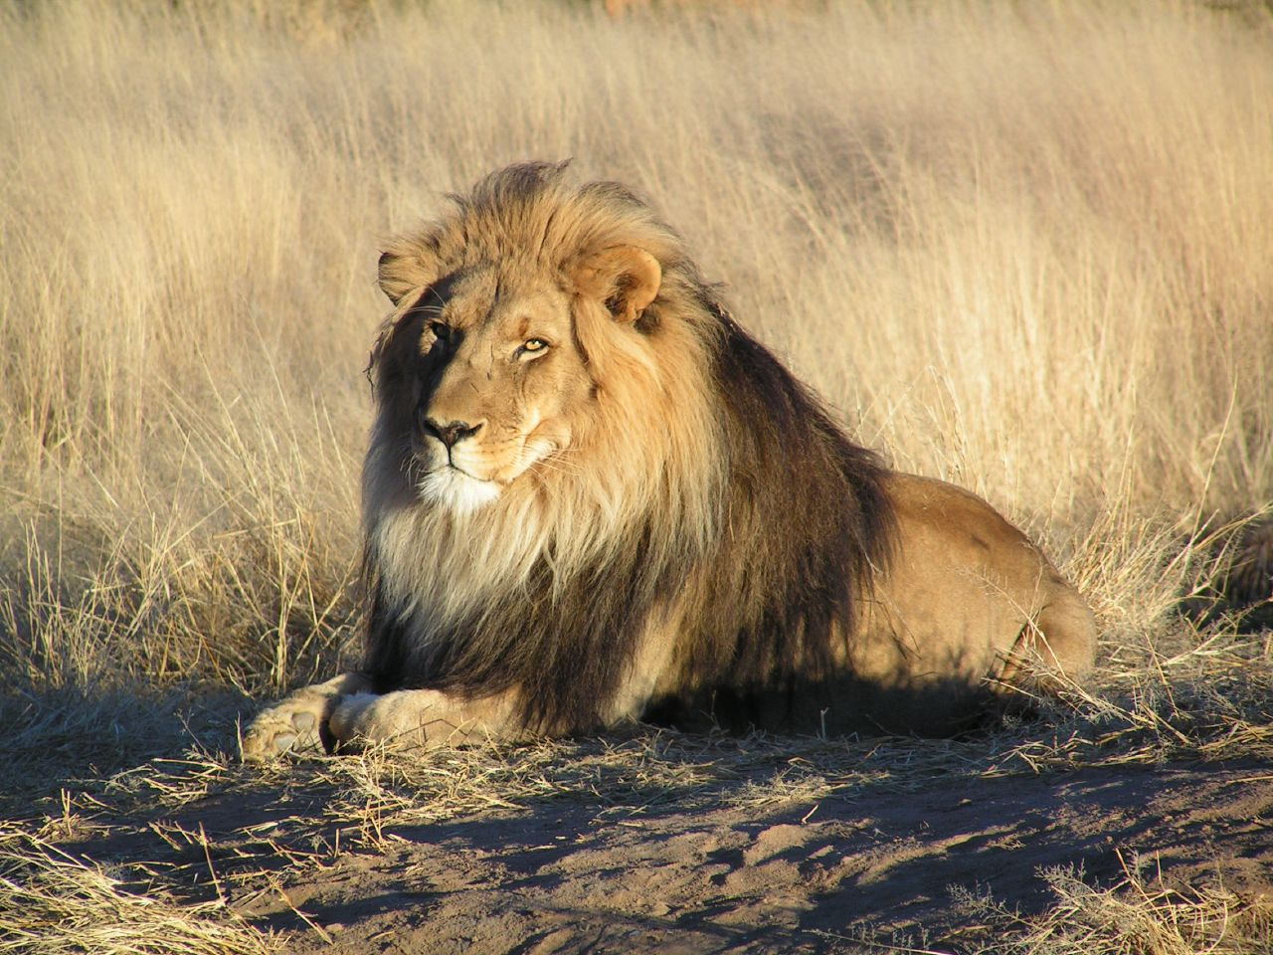

Slide 15
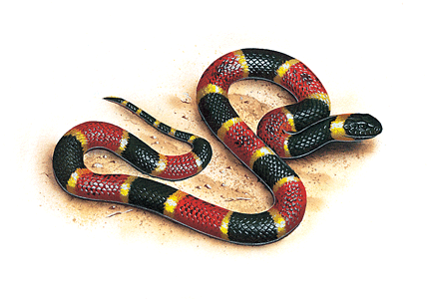

Slide 16
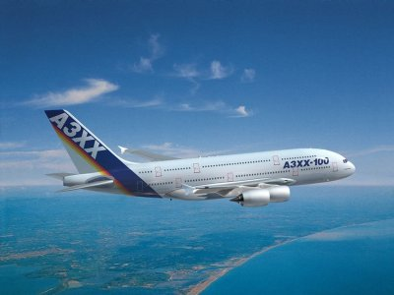

Slide 17
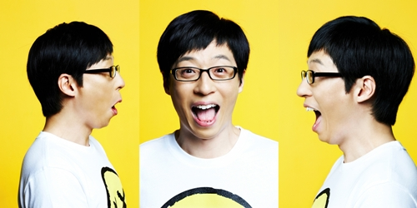

Slide 19
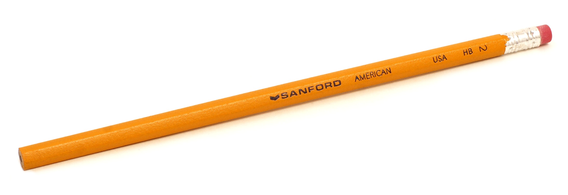

Slide 20
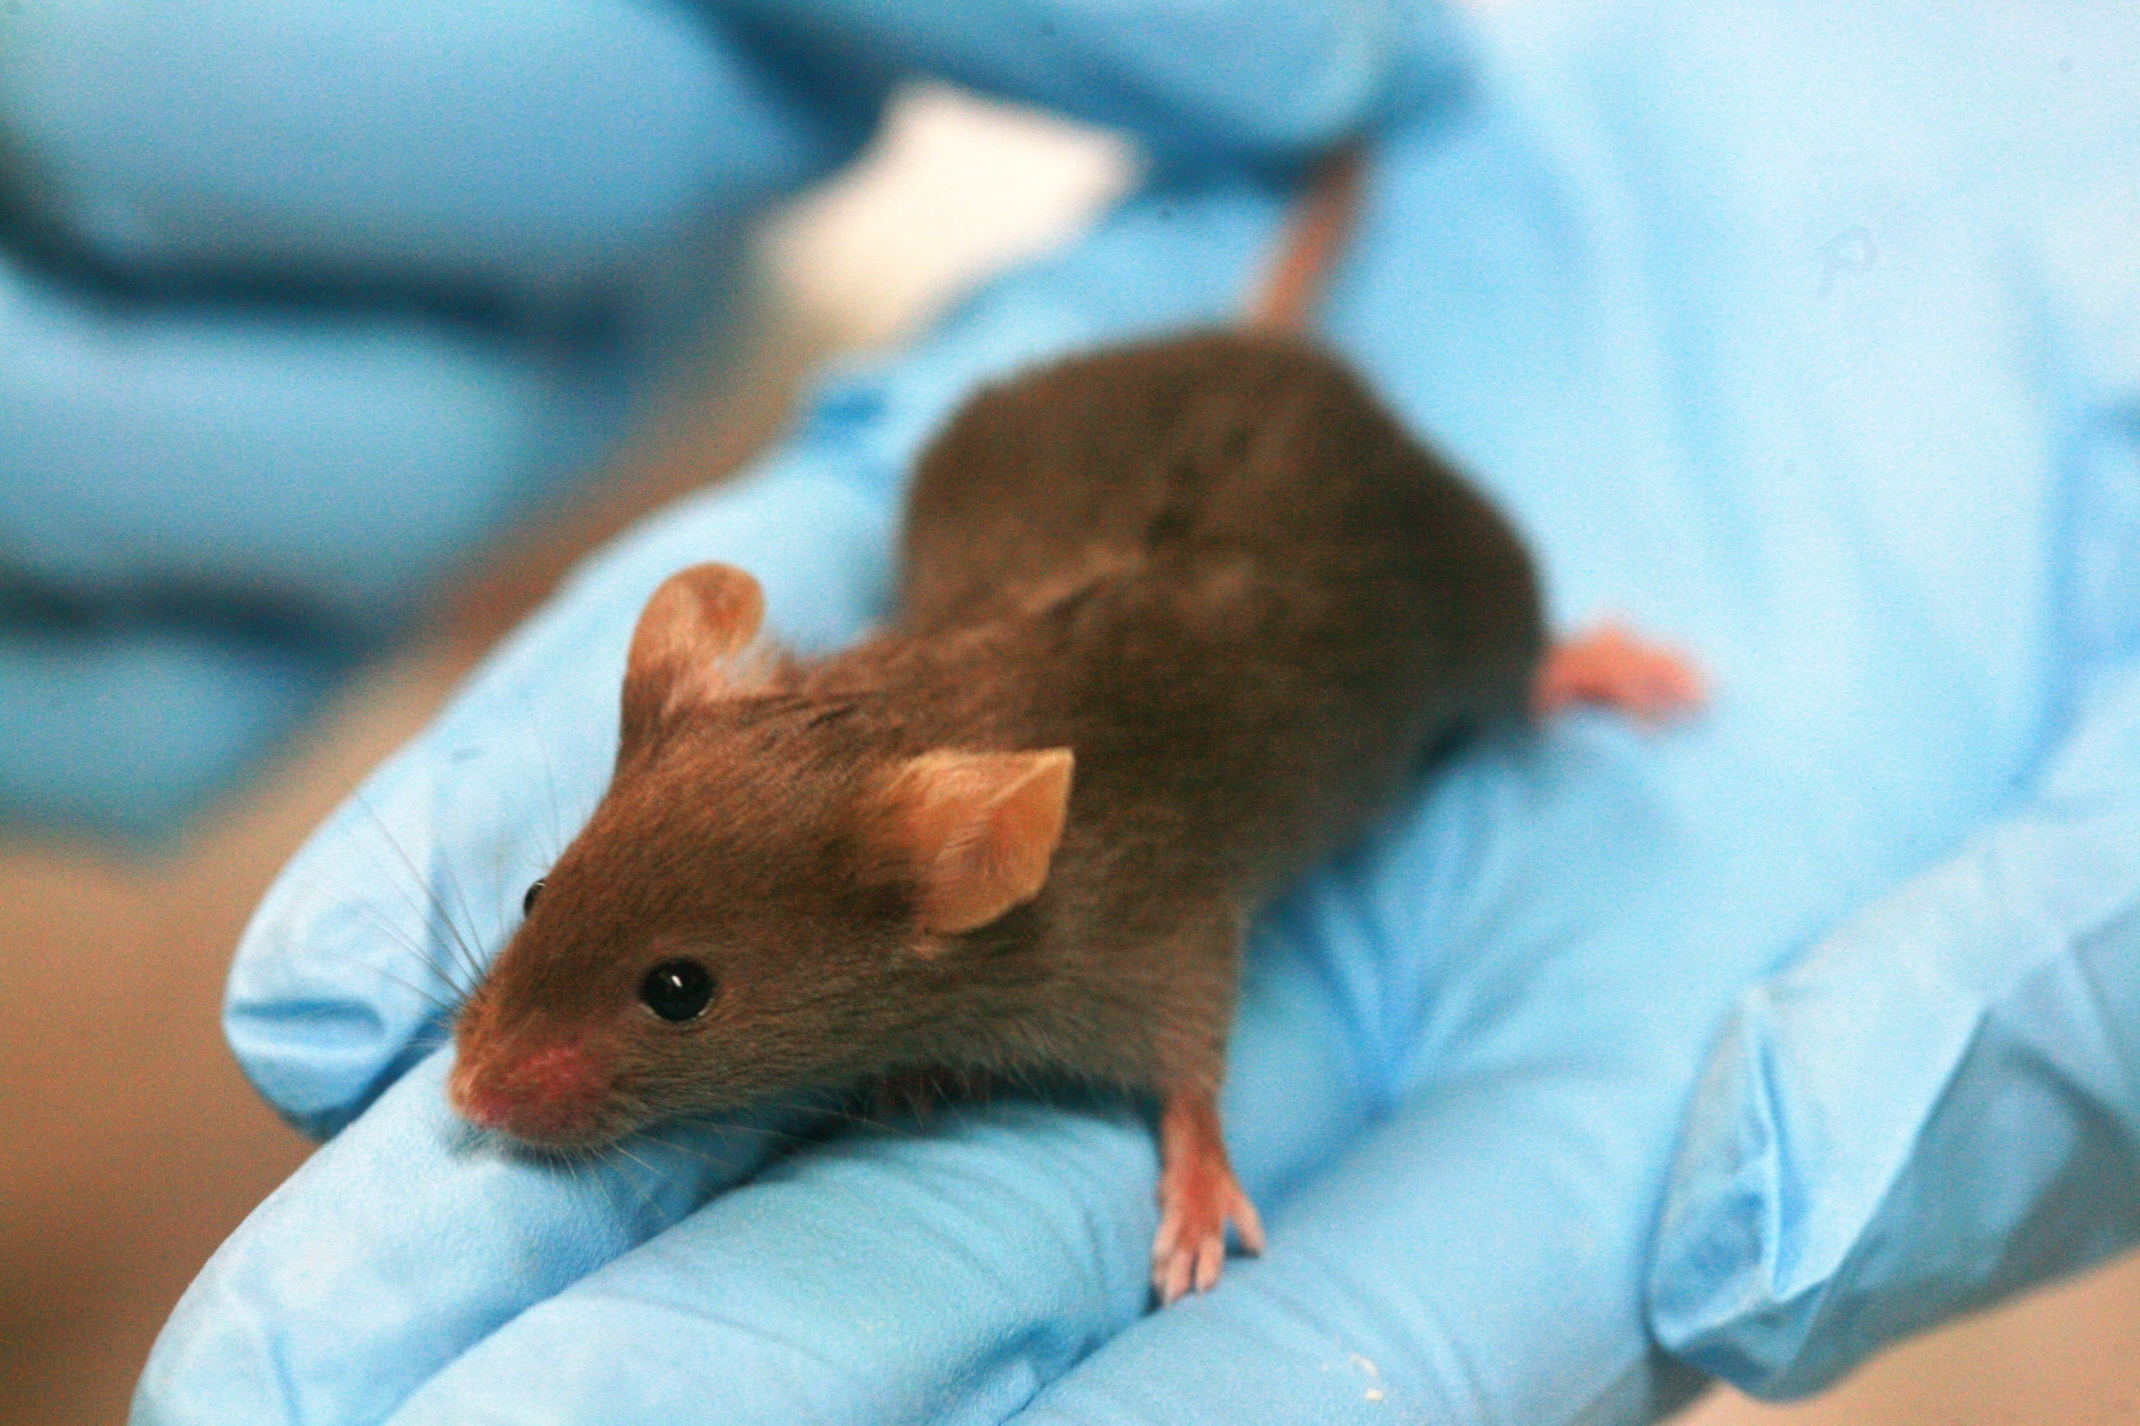

Slide 21
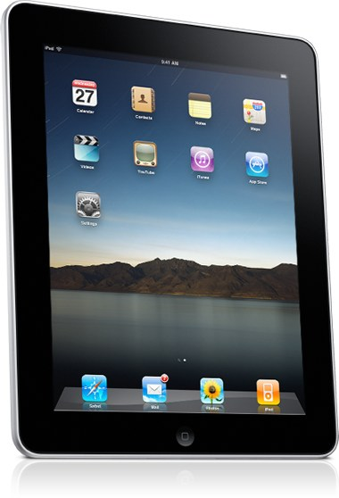

Slide 22
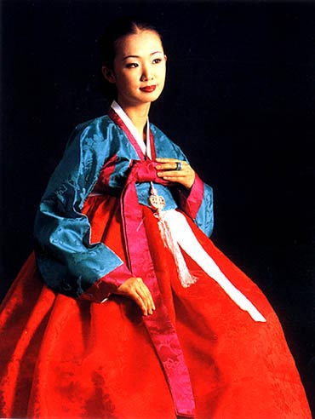

Slide 24
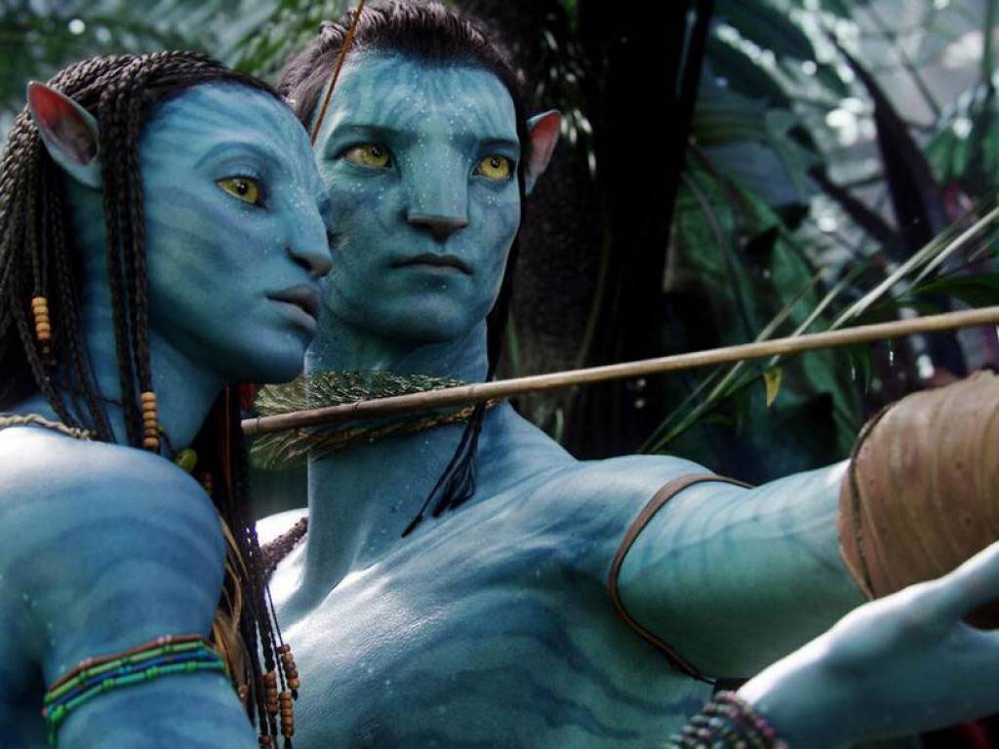

Slide 25
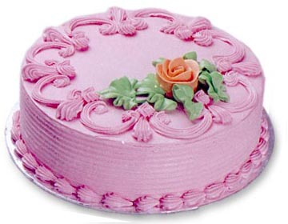

Slide 26
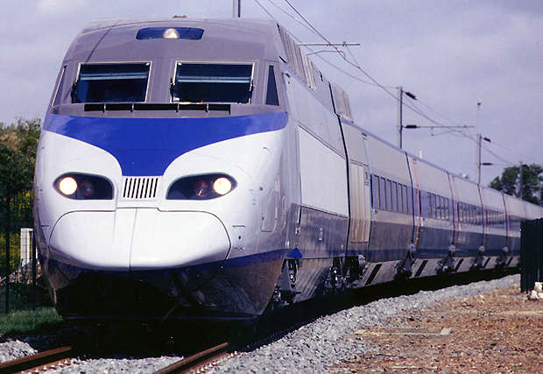

Slide 27
Scattergories
Write a word that goes with the adjectives and the letter.
*Same answers do not count*

