Slide 1
Types of Sentences

Slide 2
There are four types of sentences:
Declarative
Exclamatory
Interrogative
Imperative

Slide 3
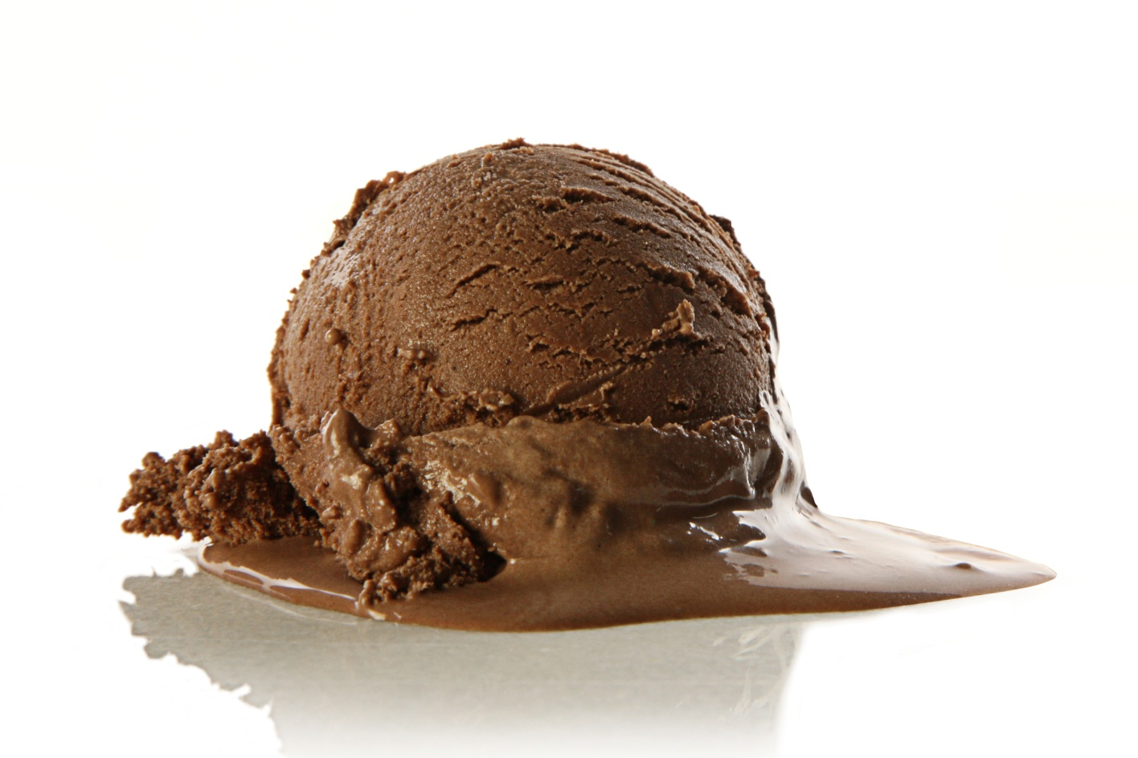
Declarative
A sentence that makes a statement.
It ends in a period.
Example:
  I like ice cream.

Slide 4
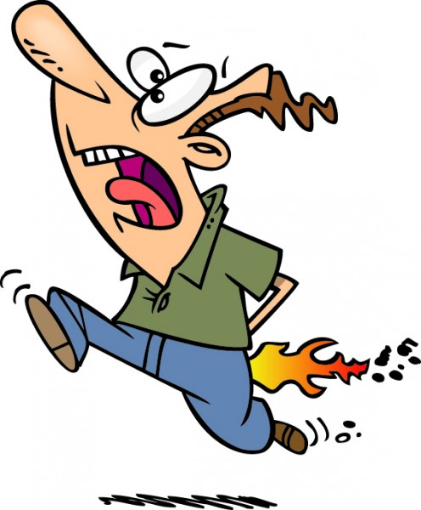
Exclamatory
Expresses a lot of emotion or excitement
It ends in an exclamation mark.
Example:
  I’m on fire!!!

Slide 5
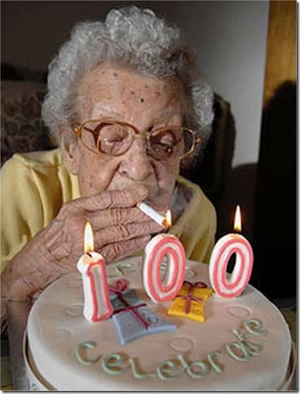
Interrogative
Asks a question.
Ends with a question mark.
Example:
  How old are you?

Slide 6
What kind of sentence is it?

Slide 7
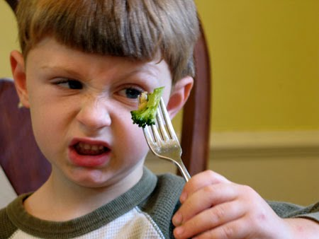
Interrogative
Do you like the food?

Slide 8
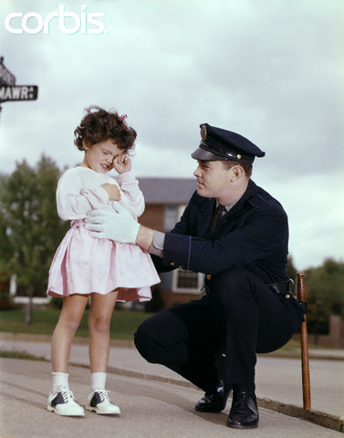
Declarative
The girl in the white jacket is lost.

Slide 9

Exclamatory
The bulldogs won the game in the last three minutes!

Slide 10

Declarative
I did not finish my homework.

Slide 11

Interrogative
Where is my science book?

Slide 12

Exclamatory
I got a perfect score on the test!

Slide 13
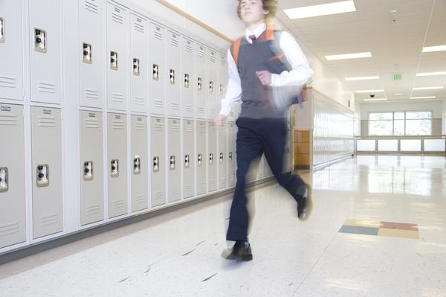
Interrogative
Why is Jake late for class?

Slide 14
Imperatives
p. 8

Slide 15

You must do this…!

Slide 16
What is a verb?

Slide 17
What is a verb?
Action words

Slide 18
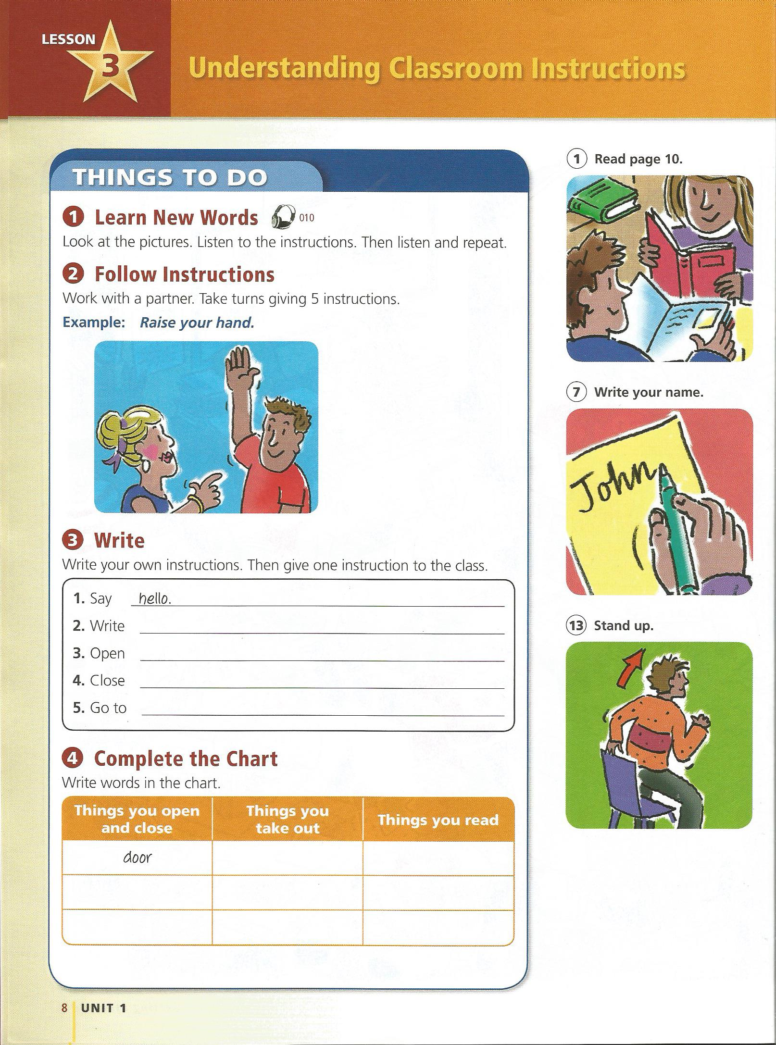
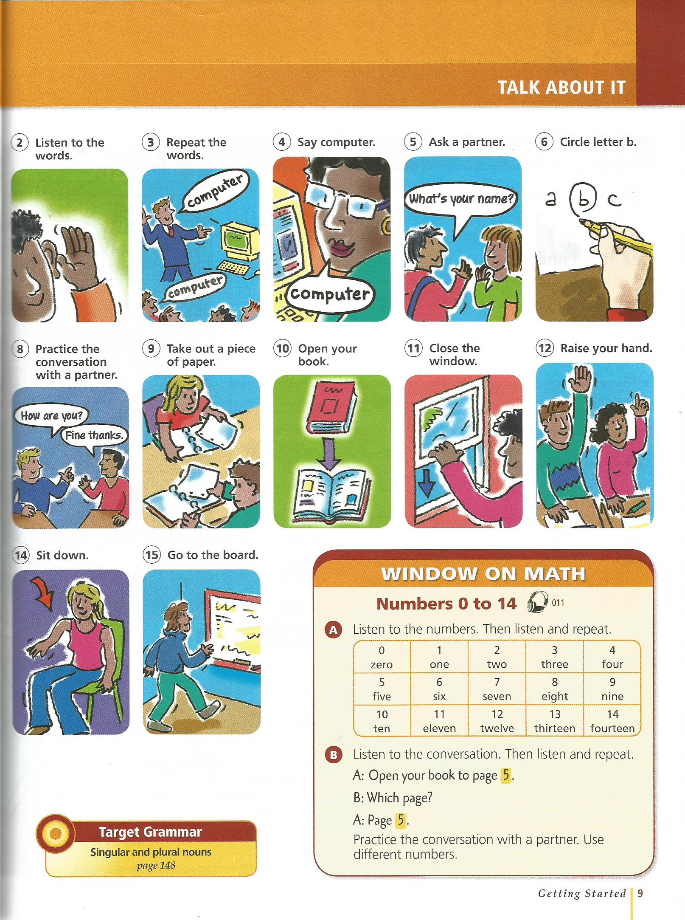
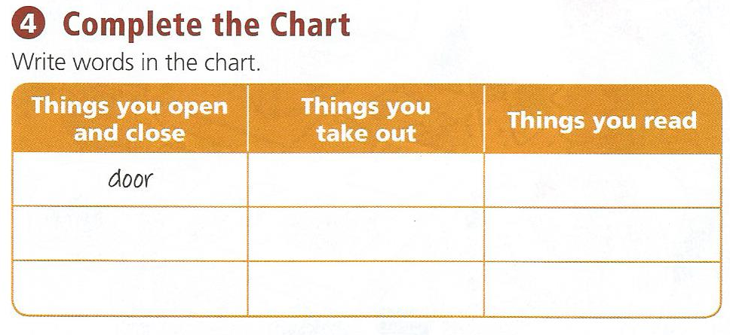
p.8

Slide 19
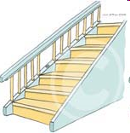
Don’t
Don’t smoke.
Don’t worry, be happy.

Slide 20

Be
Be quiet.
Be early to class.

Slide 21

Take
Take out the garbage.
Take a break.

Slide 22
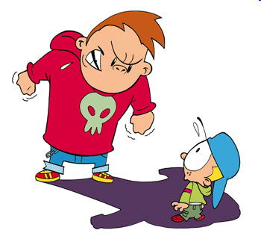
Give
Give me a candy.
Give me a break.

Slide 23
Go
Go away
Go to school

Slide 24
How to make a sentence...
Verb __________________.

Slide 25
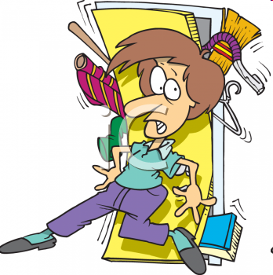
More examples
Open the door.
Close the window.
Run home.
Hurry up.

Slide 26
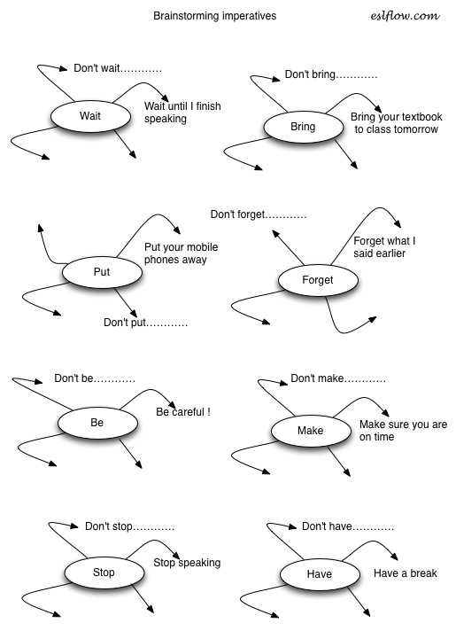

Slide 27
Change the Sentence into an Imperative.

Slide 28
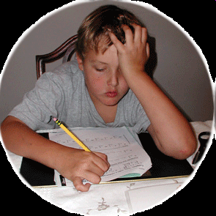
After school, you must do your homework.
Do your homework.

Slide 29
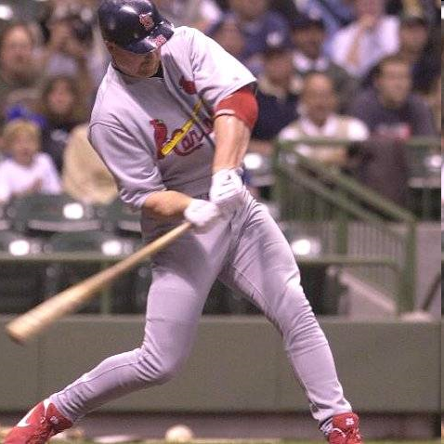
The player should hit the ball.
Hit the ball.

Slide 30

I want Pepsi.
Give me Pepsi.

Slide 31

The doctor told you to take your medicine.
Take your medicine.

Slide 32

You shouldn’t smoke.
Don’t smoke.

Slide 33
Create an imperative sentence:

Slide 34
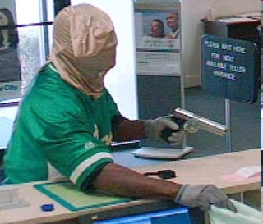
Give me money.

Slide 35
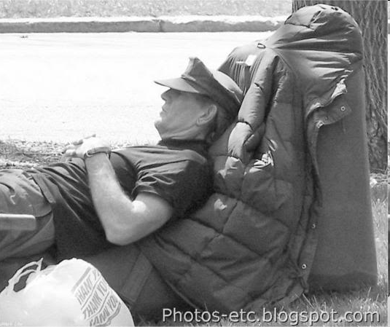
Take a break.

Slide 36

Don’t drink and drive.

Slide 37

Be happy.

Slide 38
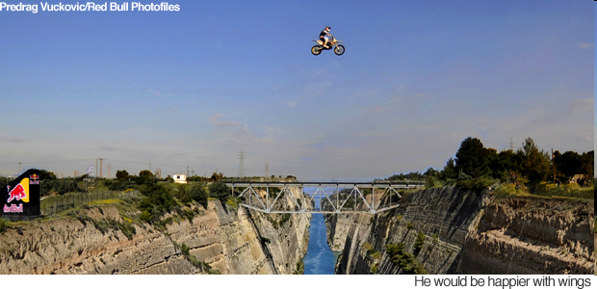
Jump over the river.

Slide 39

Don’t look at me.

Slide 40
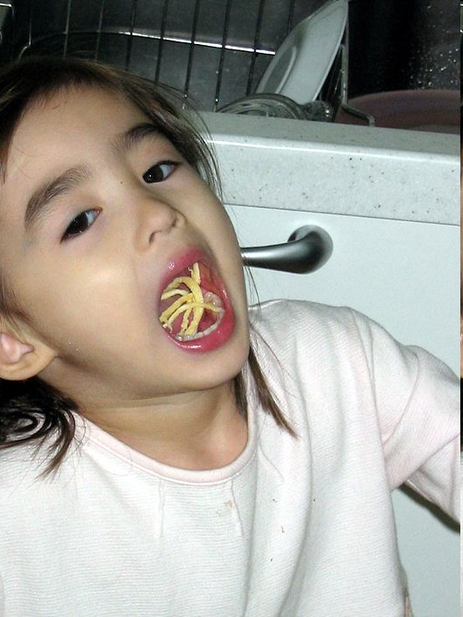
Don’t eat with your mouth open

Slide 41

Raise your hand.

Slide 42
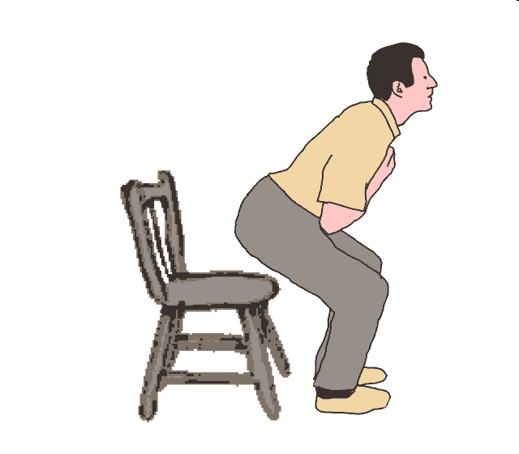
Sit Down

Slide 43

Listen.

Slide 44
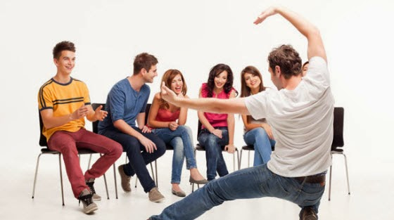
Game
Charades!

Slide 45

Be Quiet

Slide 46
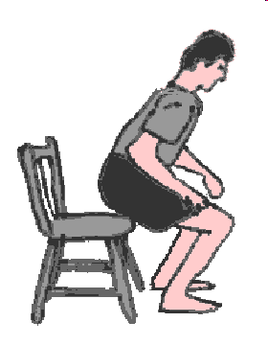
Sit down

Slide 47

Run!

Slide 48

Stop!

Slide 49
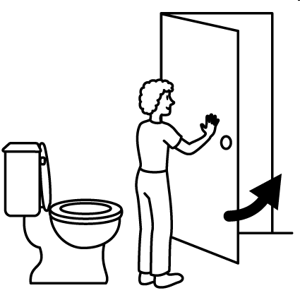
Close the door

Slide 50

Write your name.

Slide 51

Take a picture

Slide 52

Don’t smoke

Slide 53

Open your text book.

Slide 54

don’t cry

Slide 55
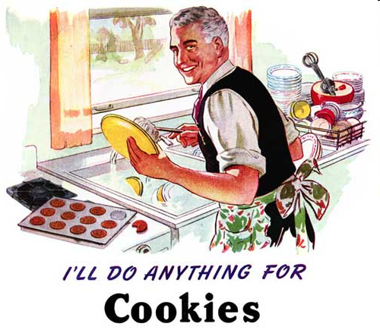
Wash the dishes

Slide 56
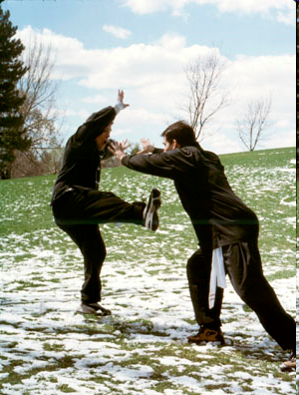
Go away

Slide 57

Do your homework

Slide 58
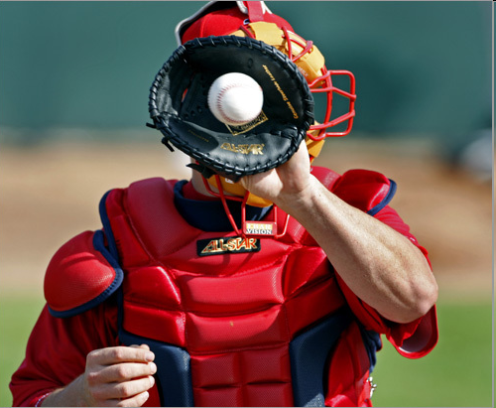
Catch the ball

Slide 59

Listen to the teacher

Slide 60

Close the book

Slide 61
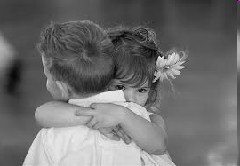
Hug a friend

Slide 62
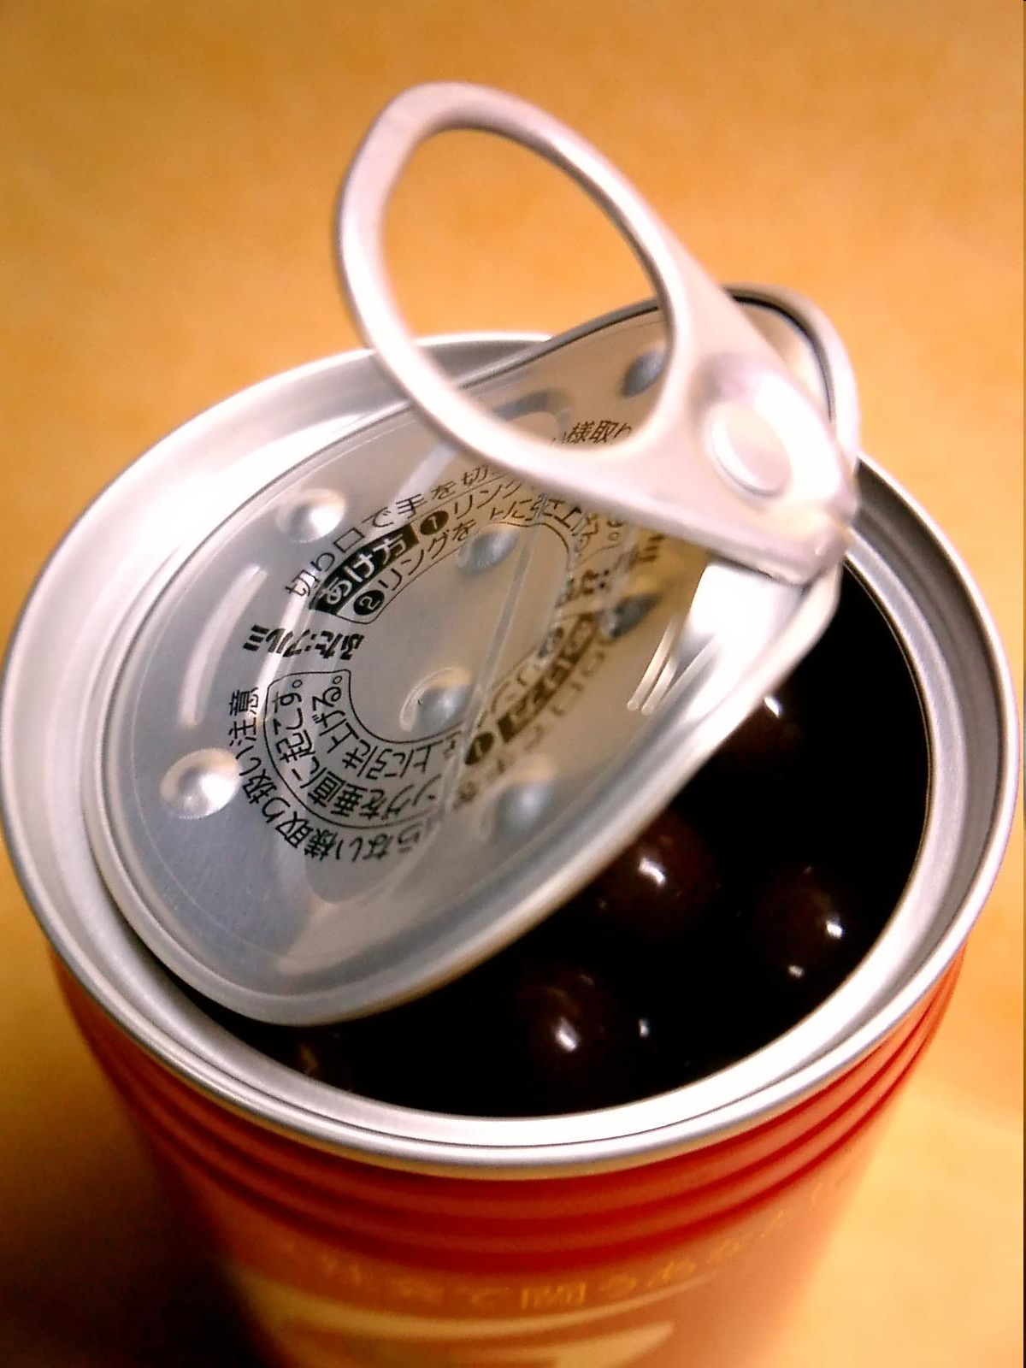
Open the can

Slide 63
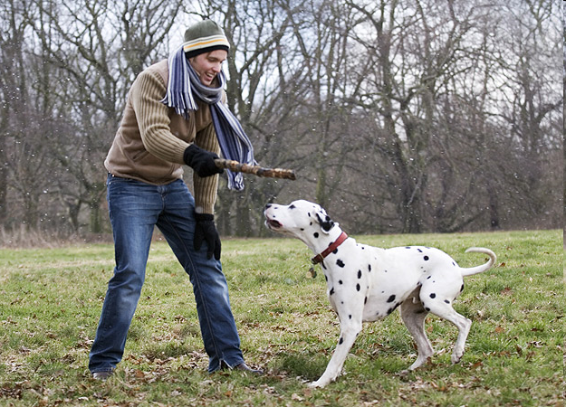
Play with the dog

Slide 64
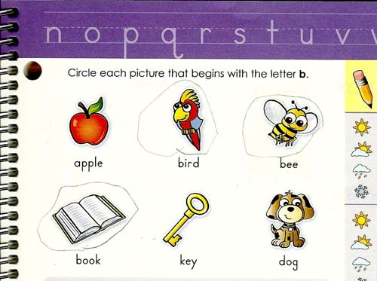
Circle the answer.

Slide 65
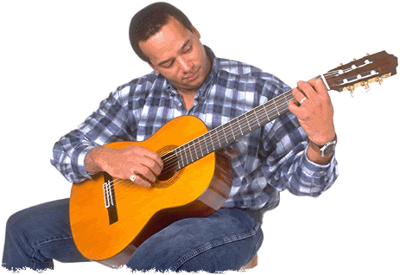
Play guitar

Slide 66
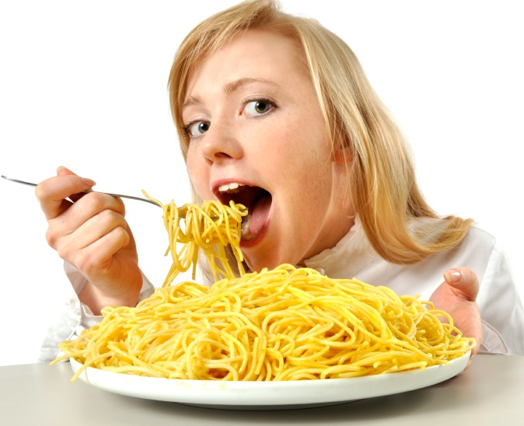
Eat your food.

Slide 67
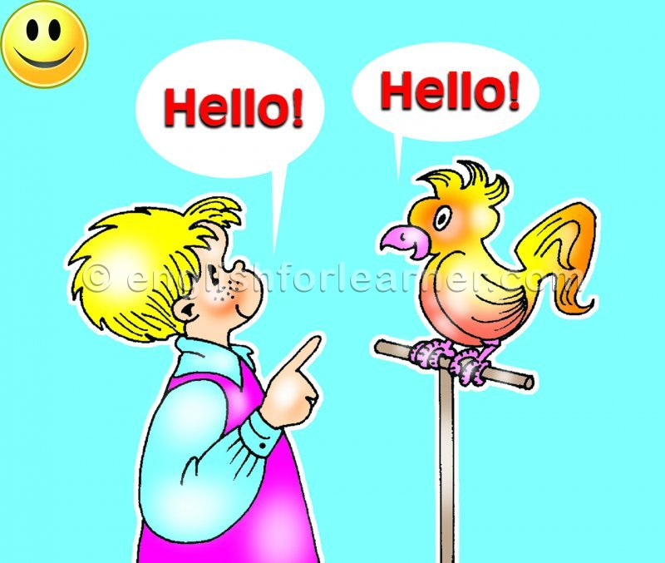
Repeat after me.

Slide 68

Hit the ball

Slide 69
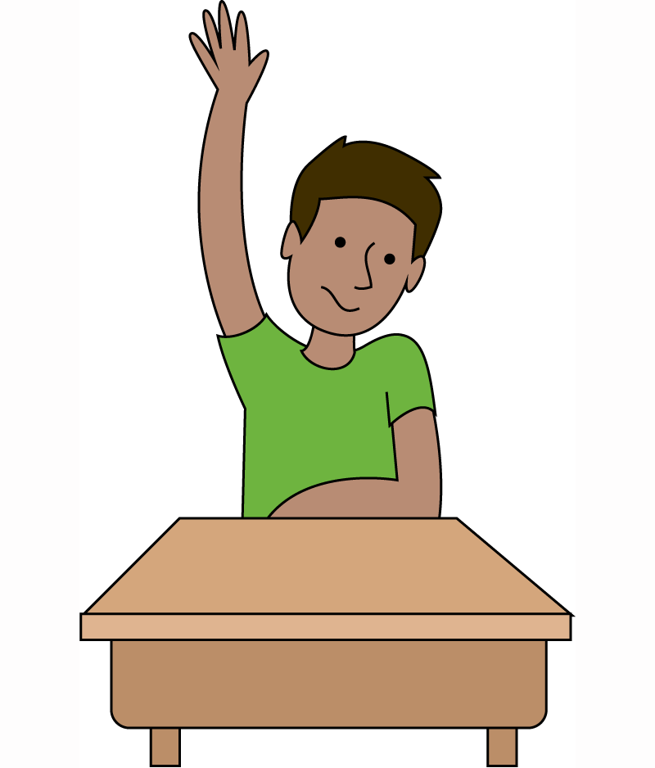
Raise your hand

Slide 70
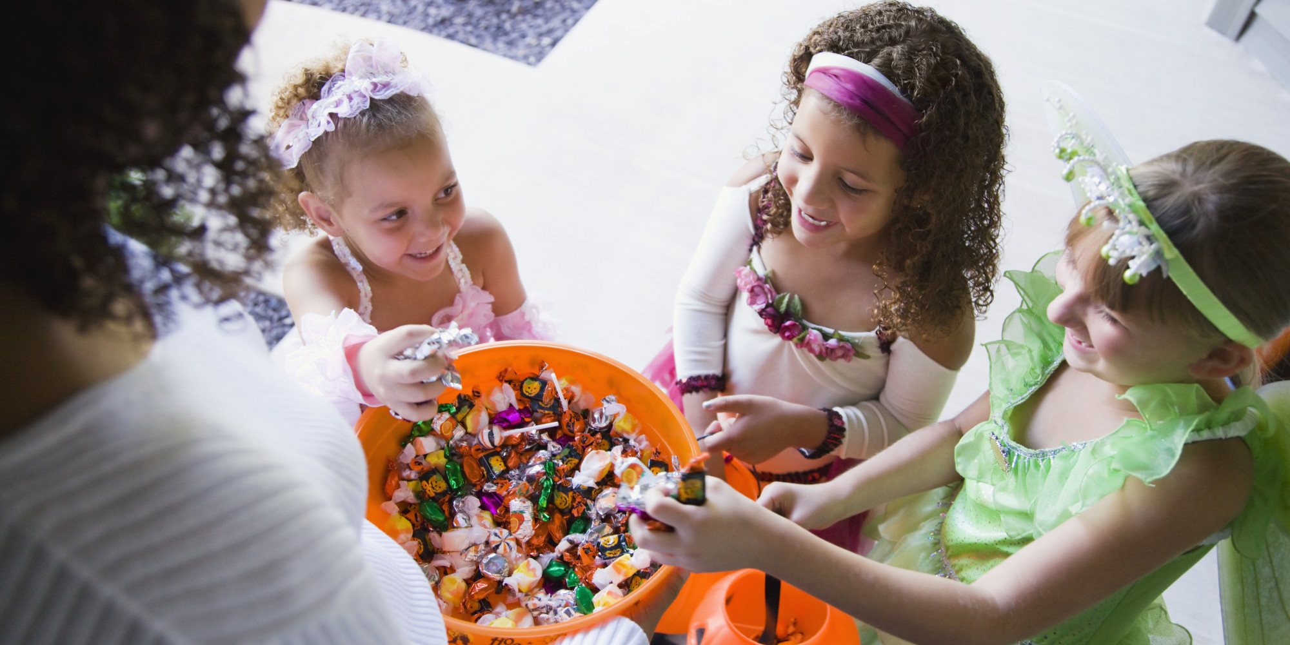
Give me a candy

Slide 71

Close the window.

Slide 72
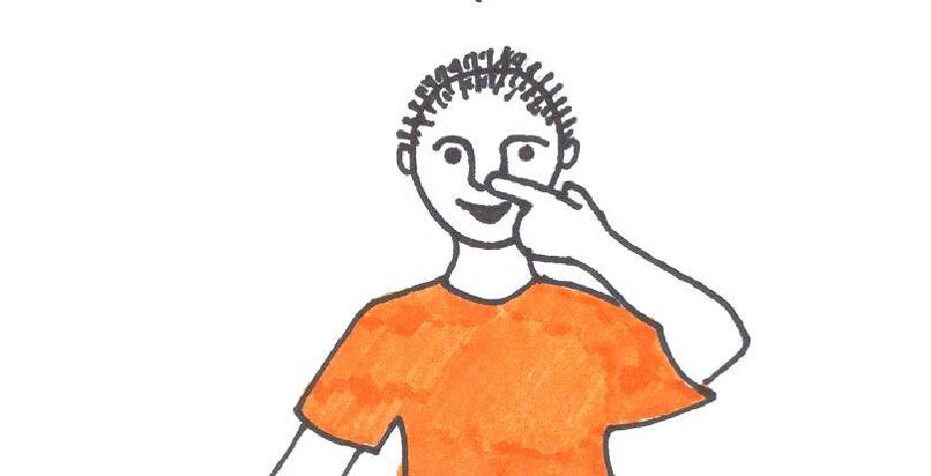
Touch your nose.

Slide 73
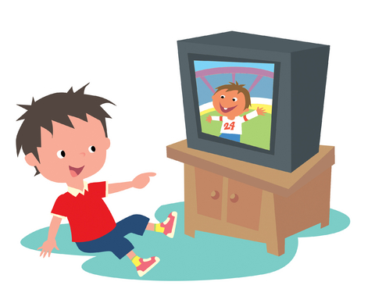
Watch TV

Slide 74

Smile!

Slide 75
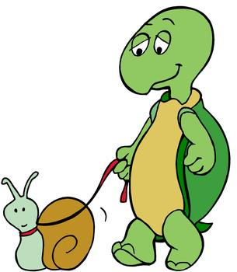
Walk slowly.

Slide 76
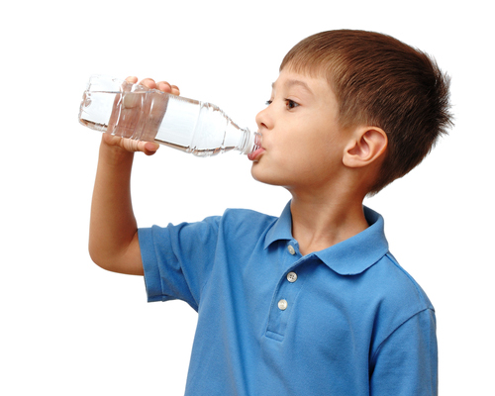
Drink water.

Slide 77

Help!

Slide 78
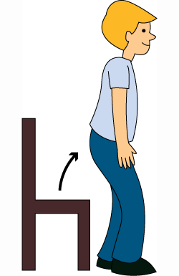
Stand up.

Slide 79

Shake hands.

Slide 80

Love everybody

Slide 81
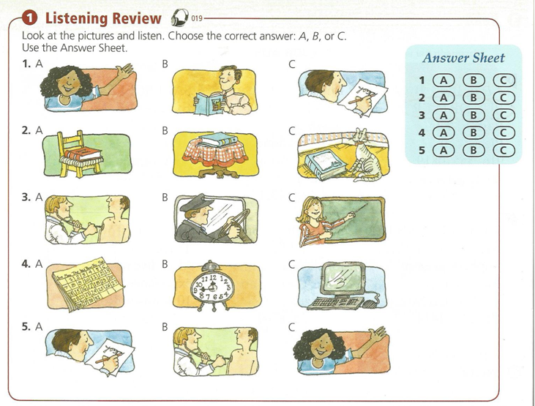

Slide 82
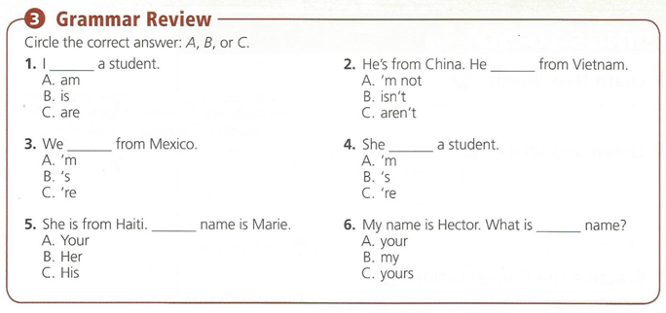

Slide 83
