Slide 1
Questions and Answers
Interrogative vs Declarative

Slide 2
What is an interrogative sentence?
Question

Slide 3
What is a declarative sentence?
Question

Slide 4
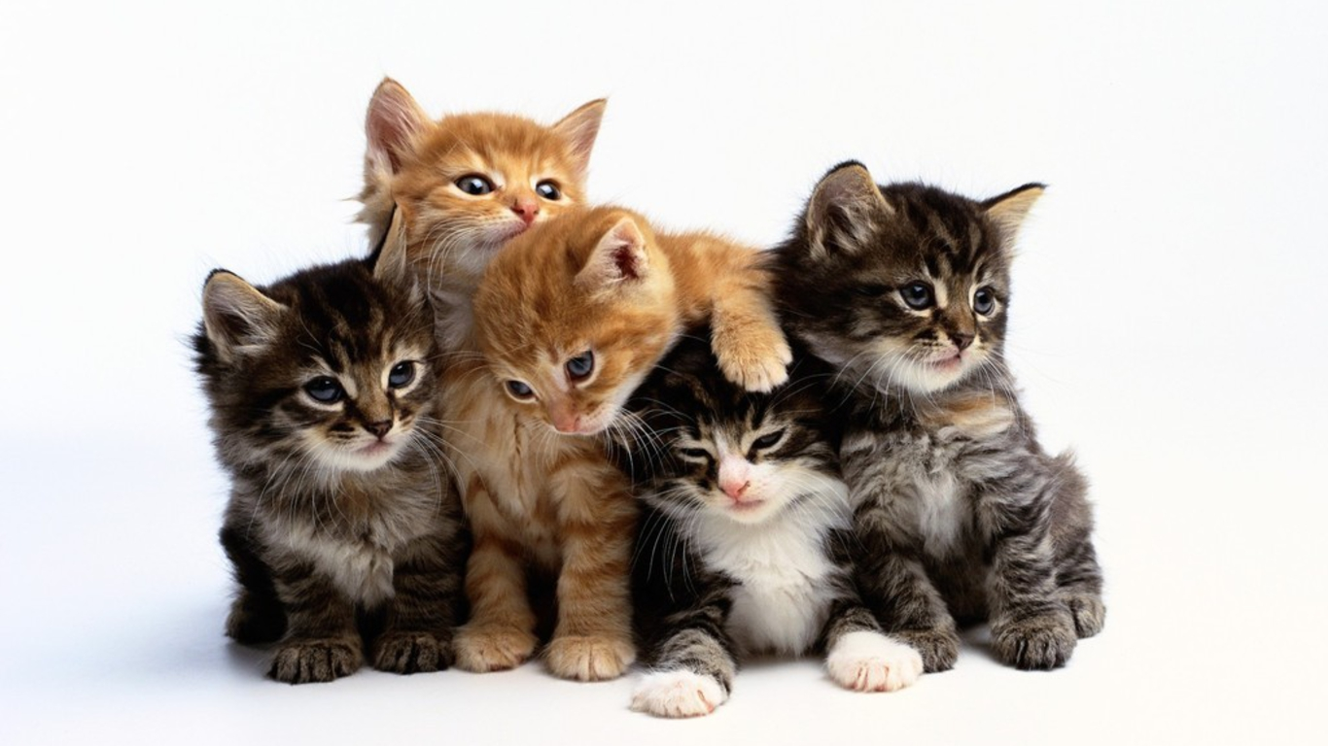
Making a Statement:
I like cats.

Slide 5
Making a Question:
Do you like cats?

Slide 6
I am → Are you
“Say, I am _________”
Point to someone and ask, “Are you?”

Slide 7
*Do you… *Did you

Slide 8
Change the sentences into Interrogative OR Declarative
I love bacon.
Do you know Tom Cruise?
I have a pen.
Have you been to Gangwon-do?
Are you smarter than a dolphin?
I ate ddeokbokki.

Slide 9
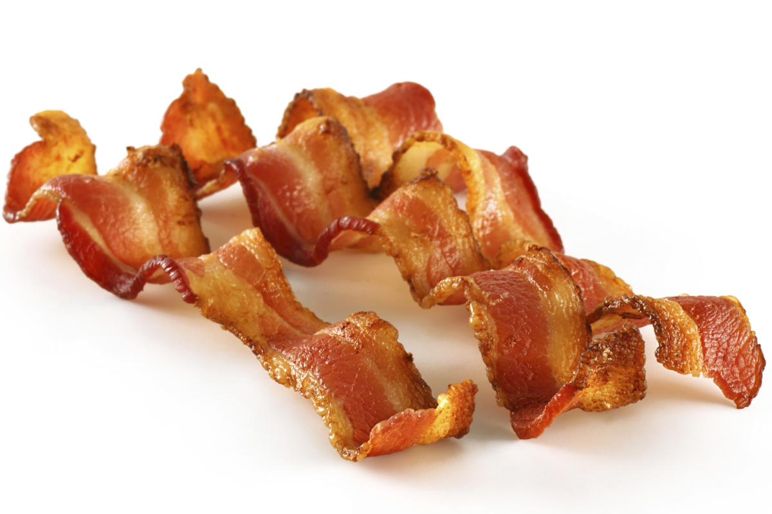
I love bacon.
Do you love bacon?

Slide 10
Do you know Tom Cruise?
Yes, I know Tom Cruise.
No, I don’t know Tom Cruise.

Slide 11
I have a pen.
Do you have a pen?

Slide 12
Have you been to Gangwon-do?
Yes, I have been to Gangwon-do.
No, I have not been to Gangwon-do.

Slide 13
Are you smarter than a dolphin?
Yes, I am smarter than a dolphin.
No, I am not smarter than a dolphin.

Slide 14
I ate ddeokbokki.
Did you eat ddeokbokki?

Slide 15
“Go Fish”
Try to get sets of cards
Each set is one point
Shuffle the cards and give 3 to each player.
Choose the first player.

Slide 16
“Go Fish”
Ask a question to one of the other players.
If the answer is “Yes…”, you can take their card and make a set.
If the answer is “No…”, it means you must take a card from the middle of the table.
The next player can then ask a question.

