Slide 1
Places
p.20

Slide 2
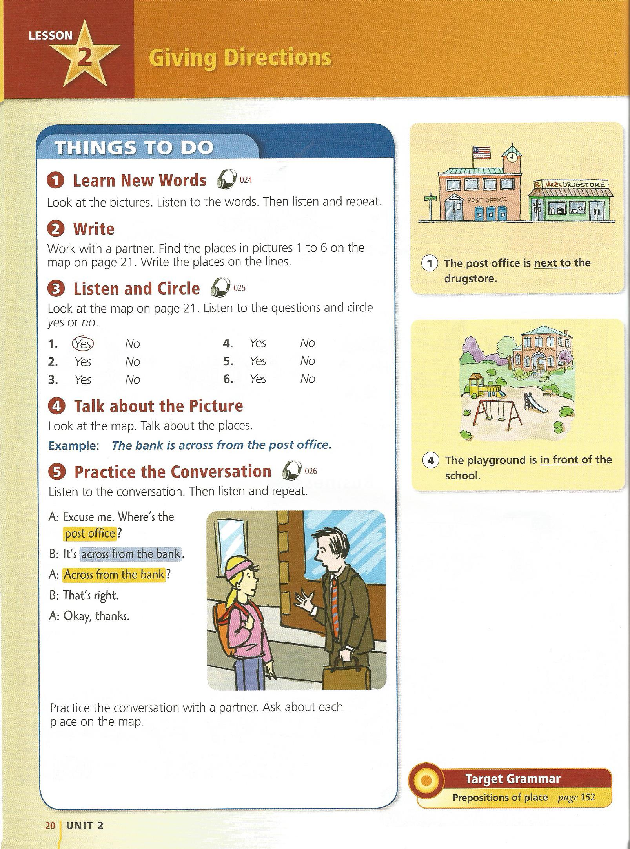
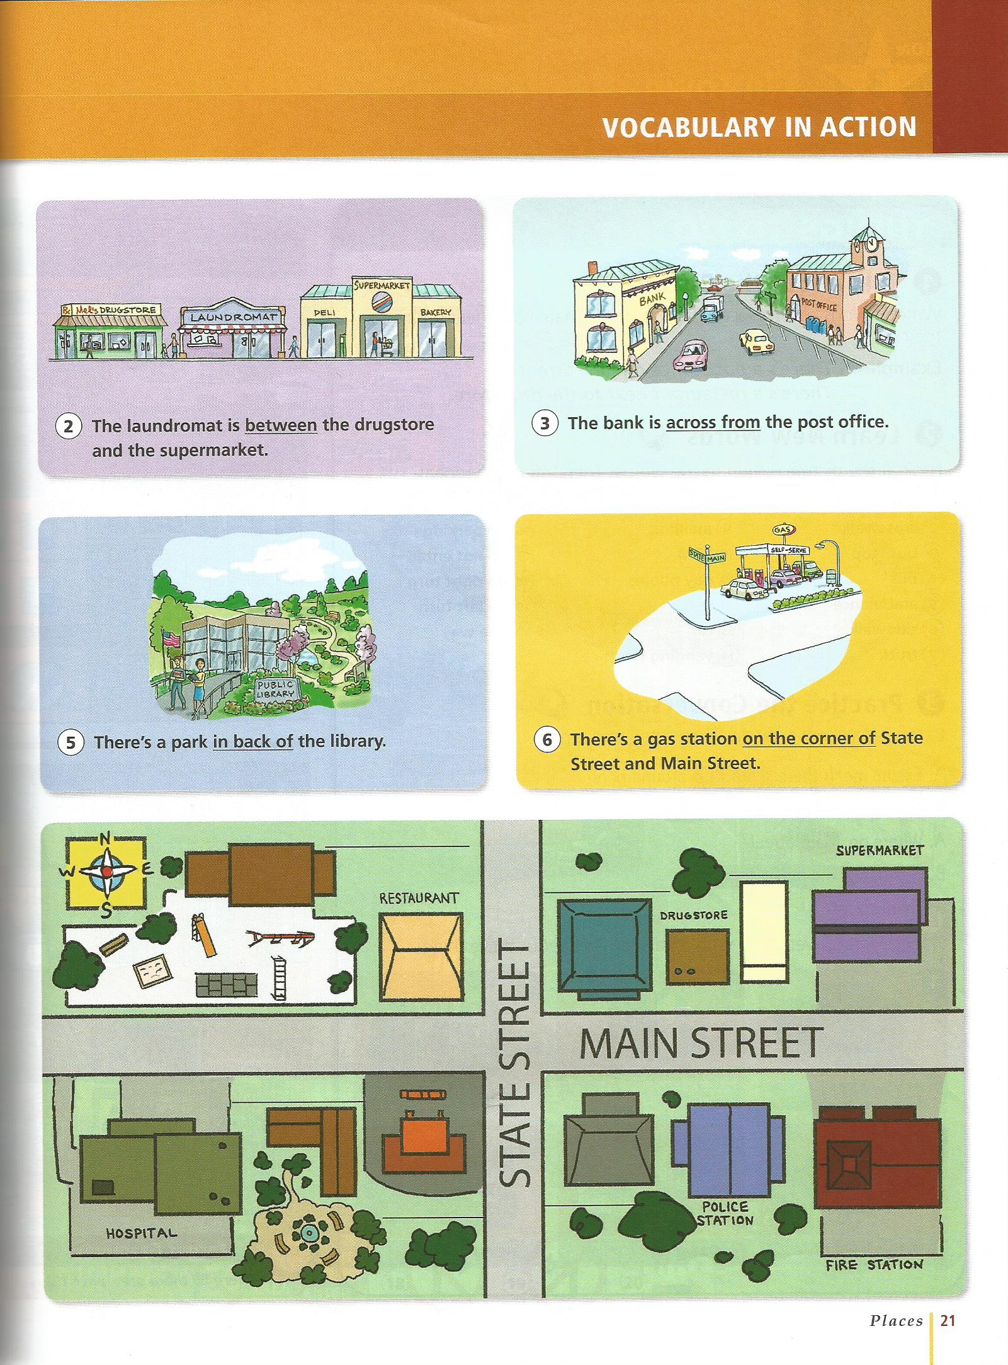

Slide 3
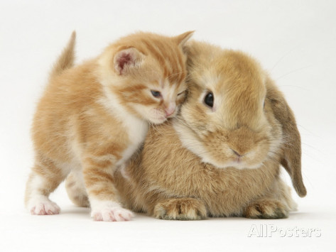
next to (beside)

Slide 4
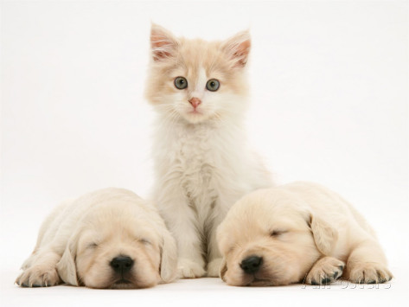
between

Slide 5
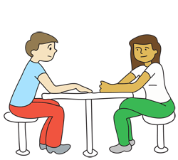
across from

Slide 6

in front of

Slide 7
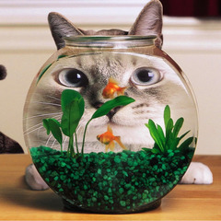
in back of (behind)

Slide 8
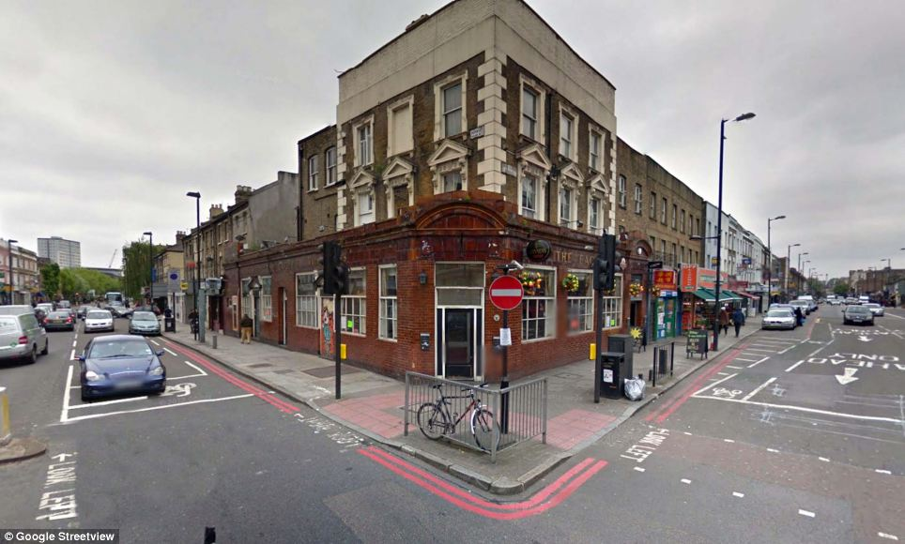
on the corner of

Slide 9
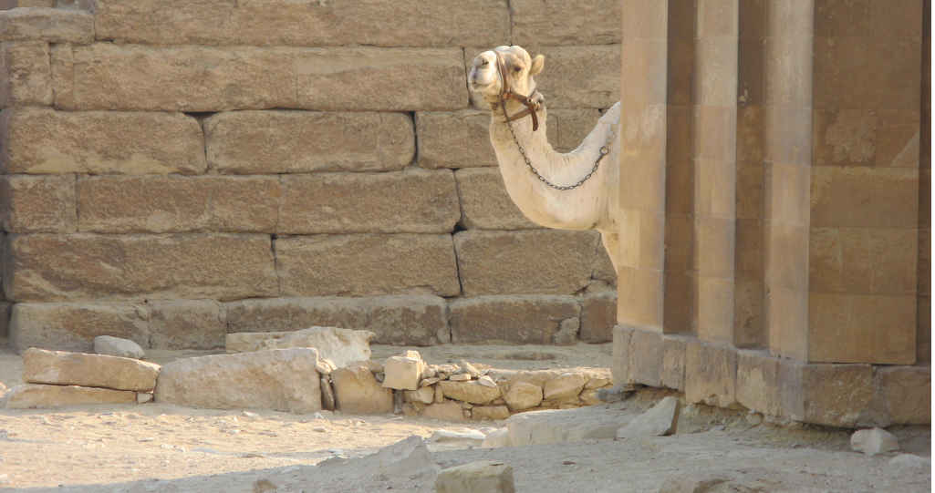
around the corner from

Slide 10
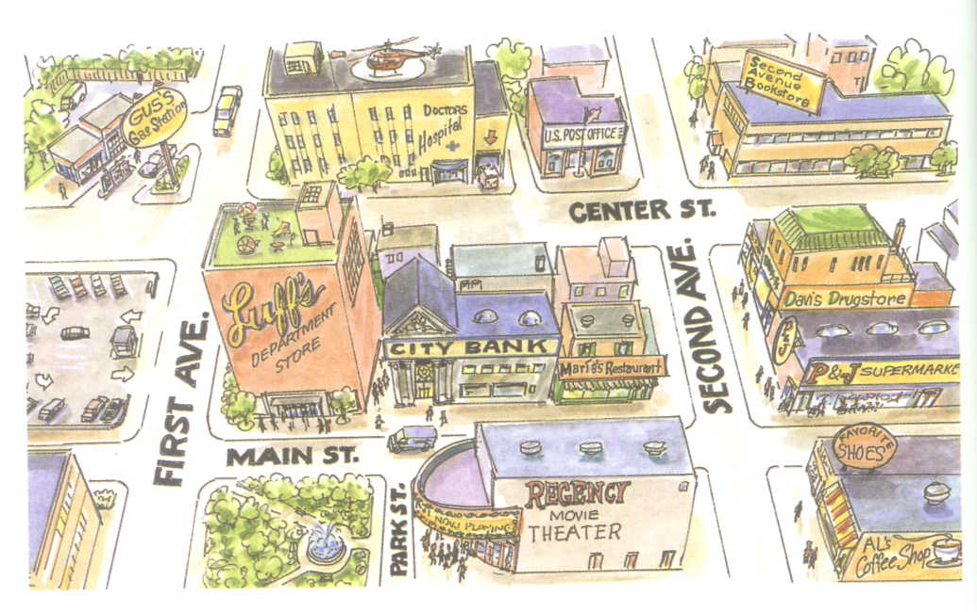

Slide 11
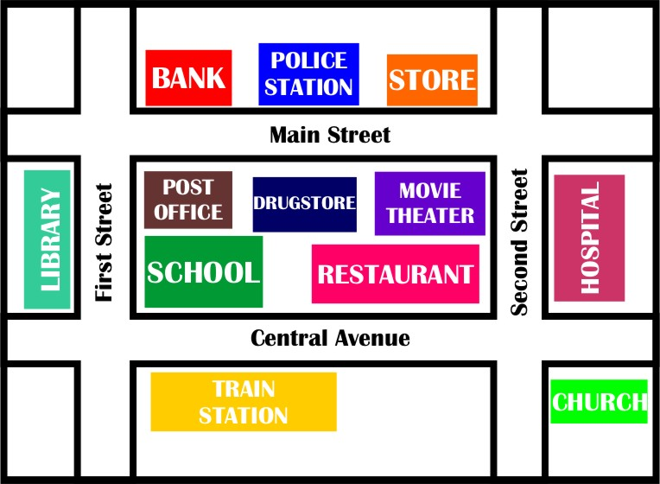

Slide 12
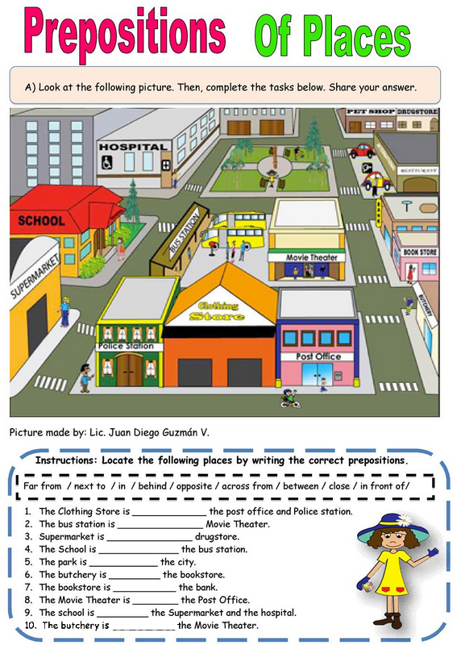

Slide 13
Where is it?
Use the clues to finish the map

Slide 14
The convenience store is behind the police station.
The community center is across from the restaurant and movie theater.
The service center is in back of the supermarket.
The pharmacy is on the corner of Time Ave. and Main St.
The restaurant is across from the service center.
The bank is across from the post office.
The internet Café is next to the bank.
The post office is in front of the gas station.
The park is across from the library.
The supermarket is across from the pharmacy.
The post office is next to the pharmacy.
Library is between the police station and the park.
Main St.
Community Center
Time Ave.
State Rd.

Slide 16
