Slide 1
Review

Slide 2
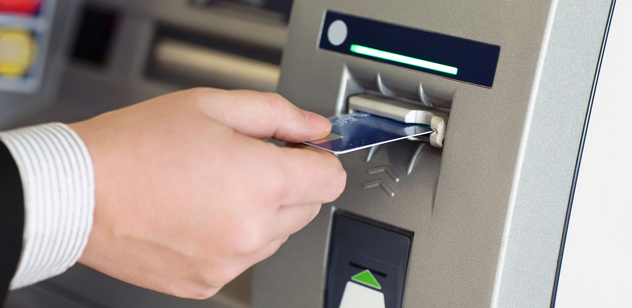
ATM

Slide 3
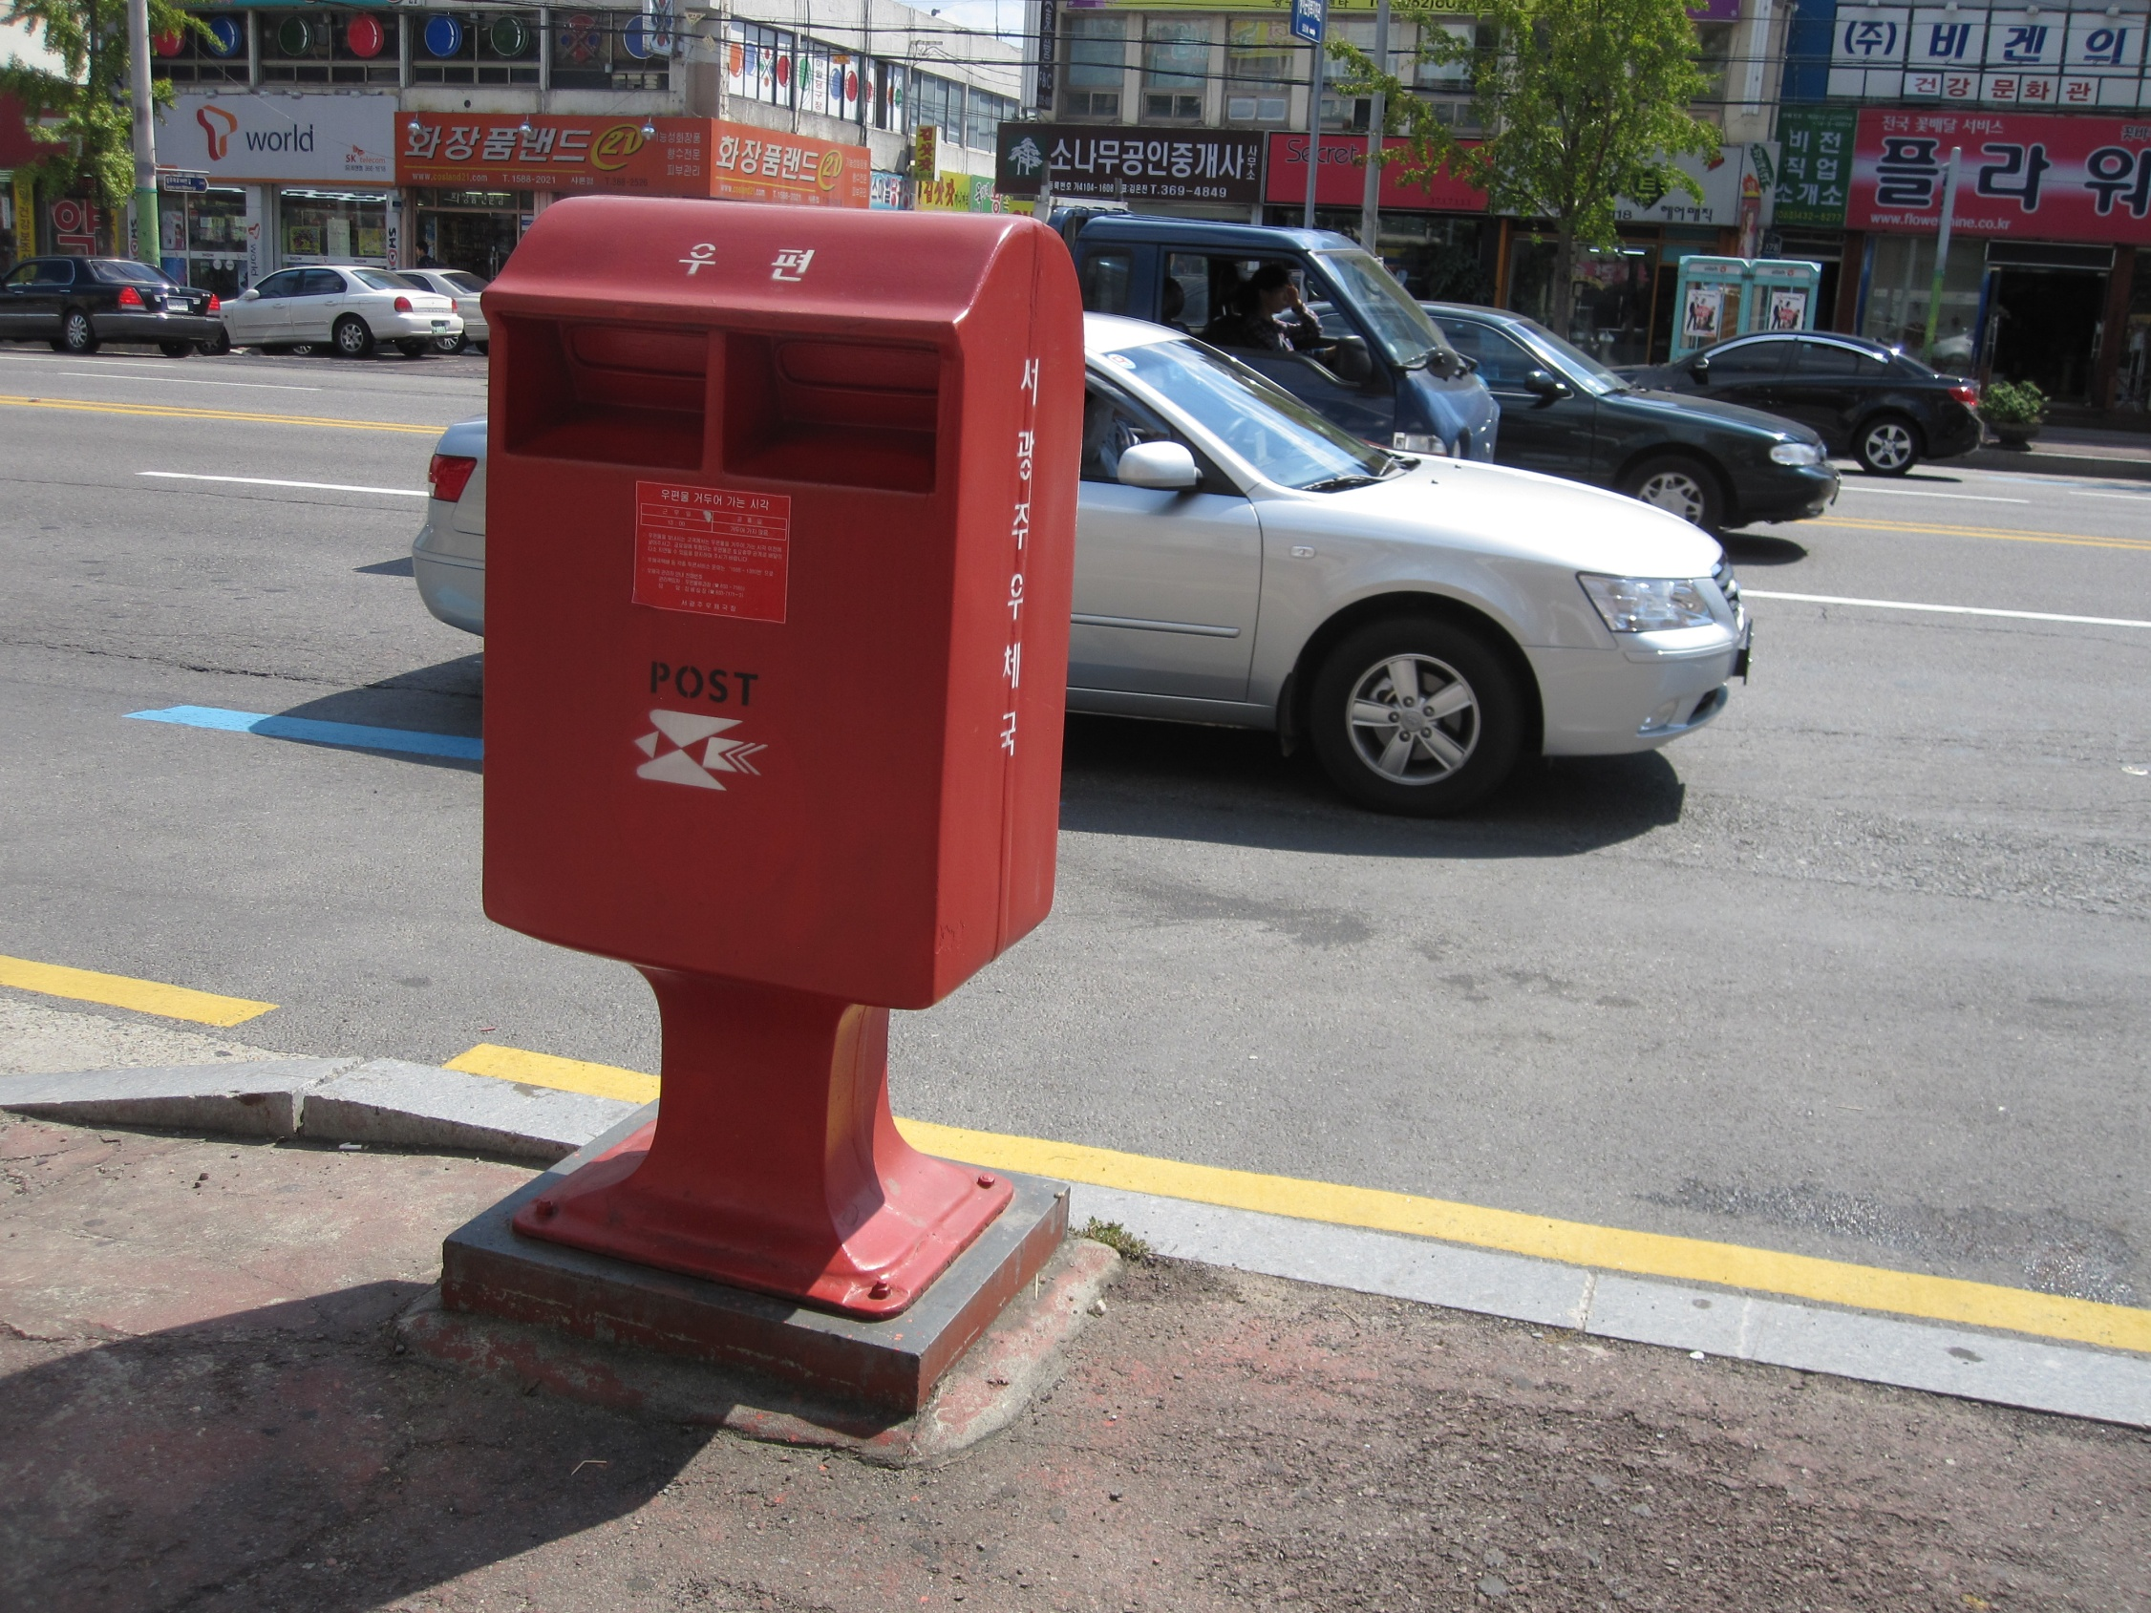
Mailbox

Slide 4
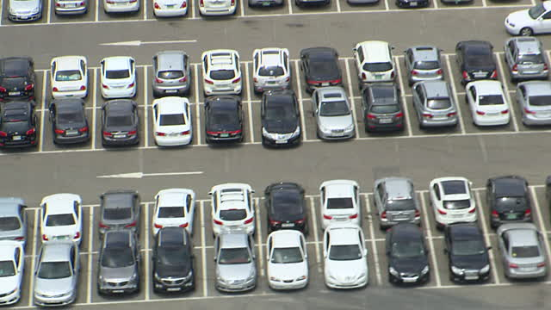
Parking Lot

Slide 5
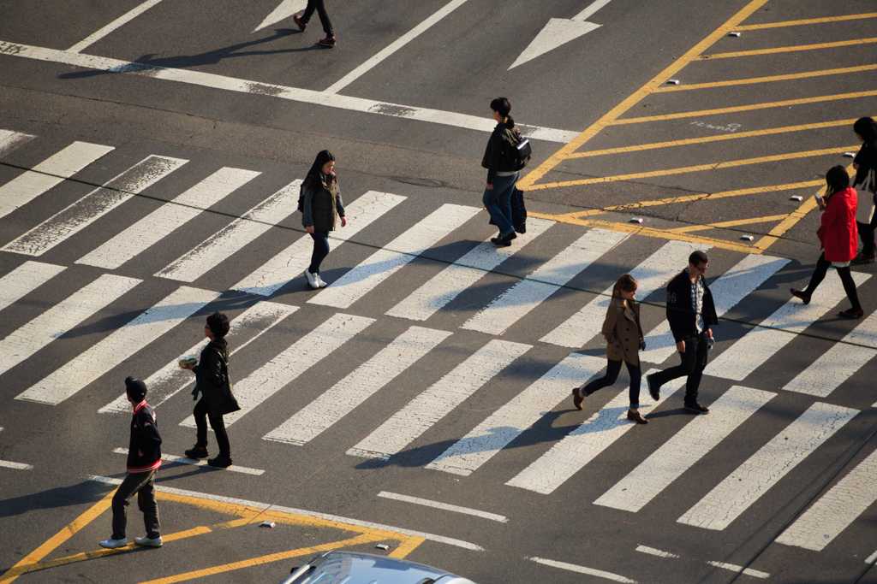
Crosswalk

Slide 6
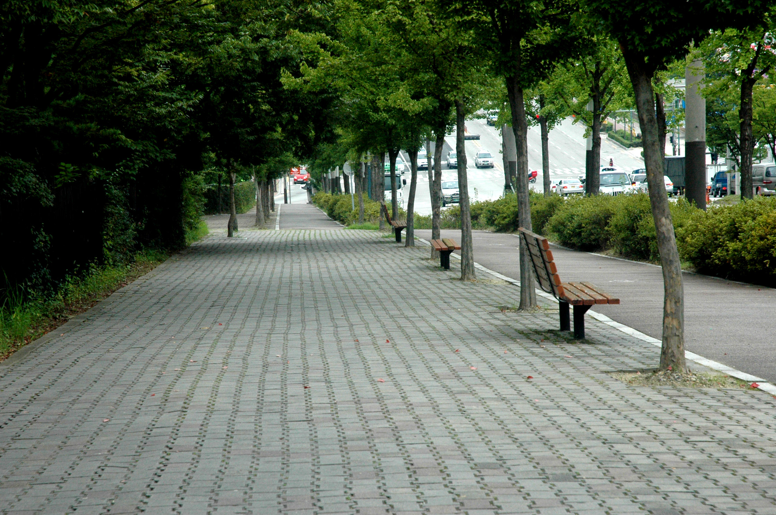
Sidewalk

Slide 7
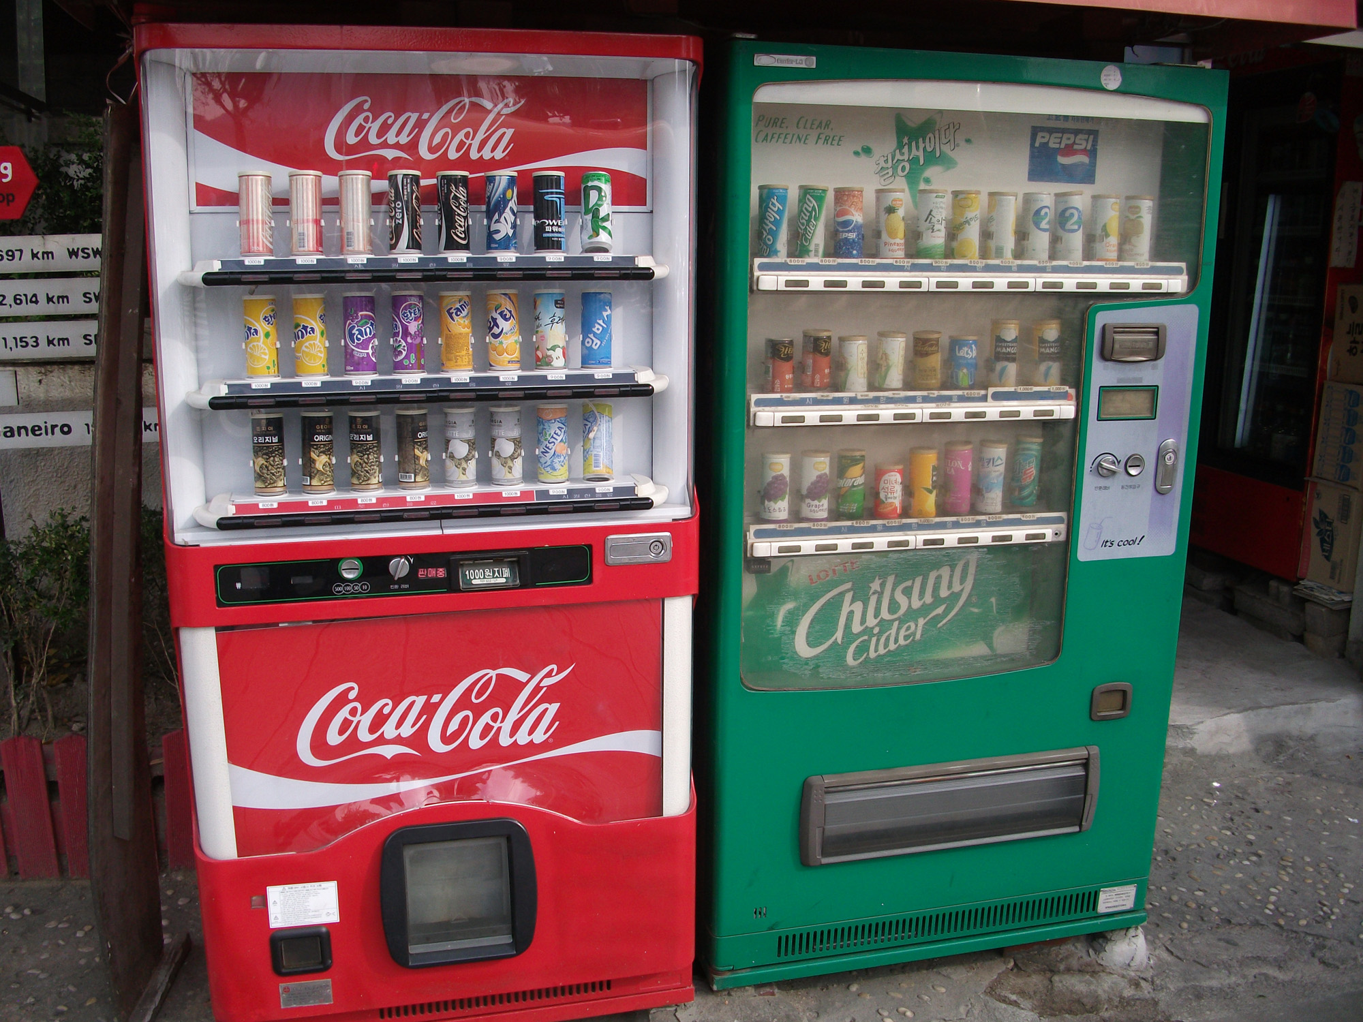
Vending Machine

Slide 8
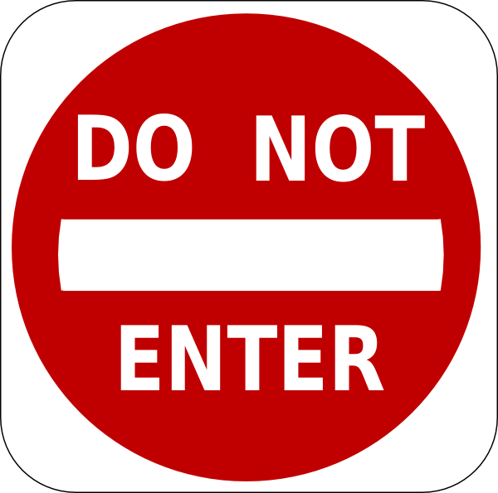

Slide 10
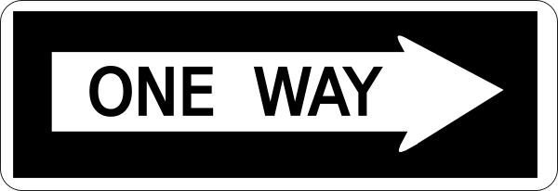

Slide 12
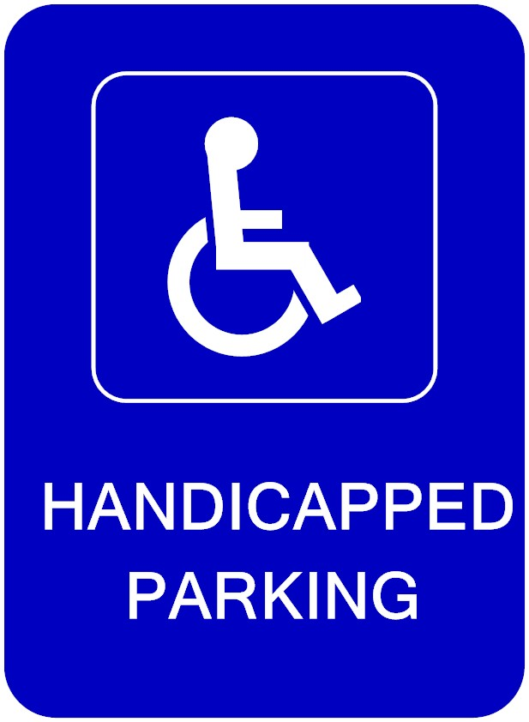

Slide 14
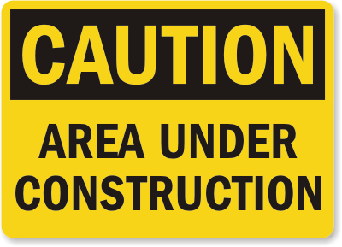

Slide 16
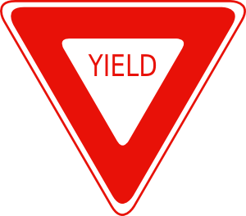

Slide 18
Maps
p. 24, 25, 155

Slide 19
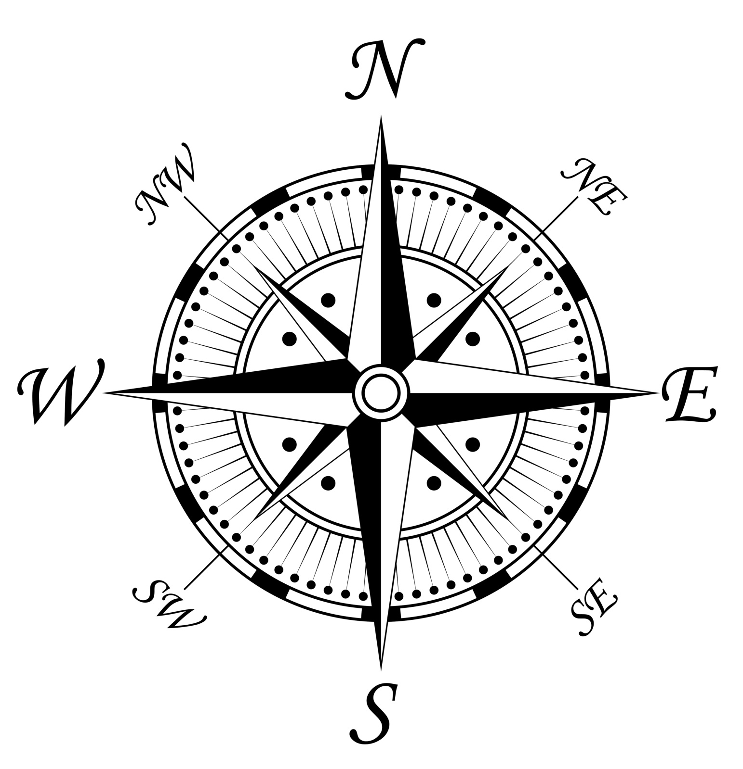

Slide 20
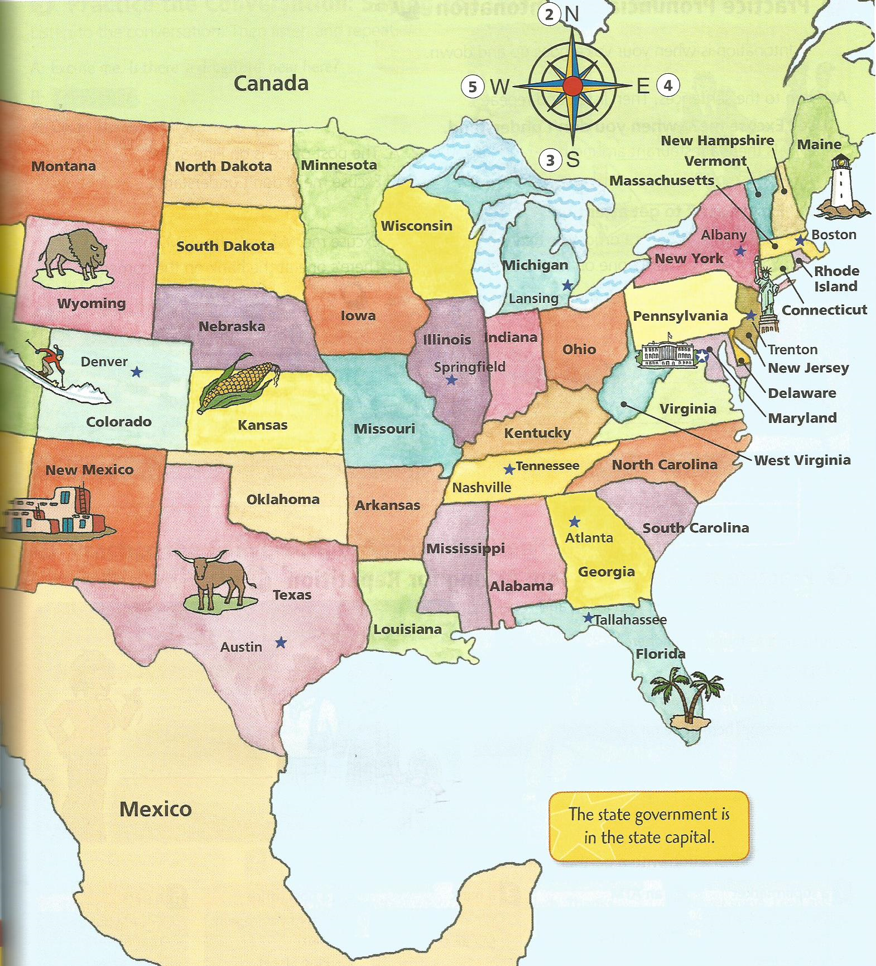
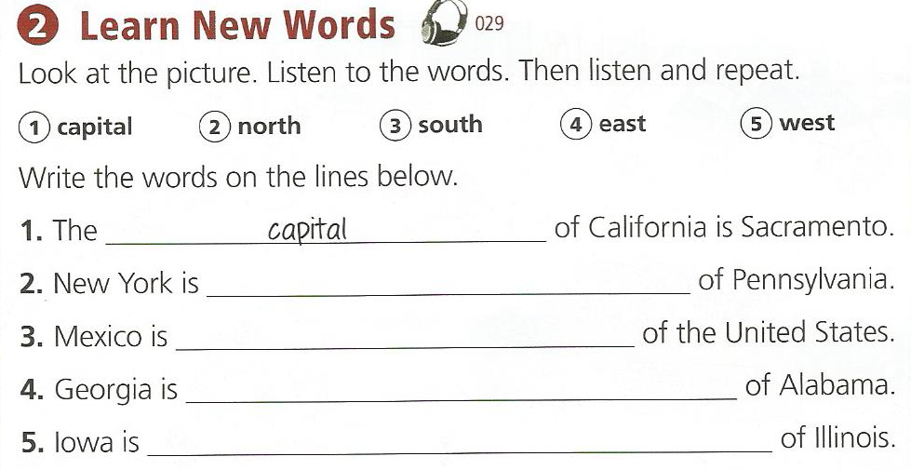
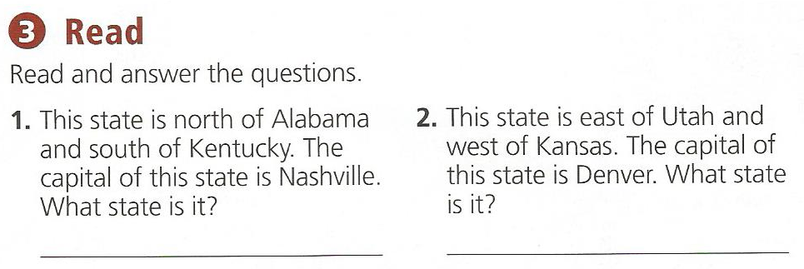
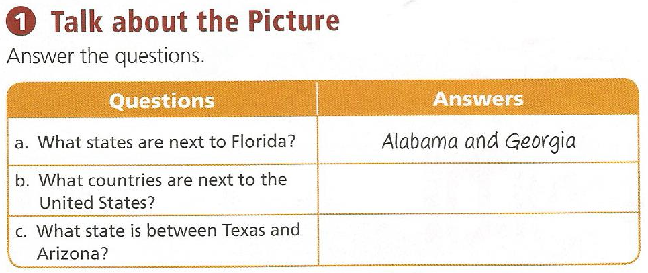

Slide 21
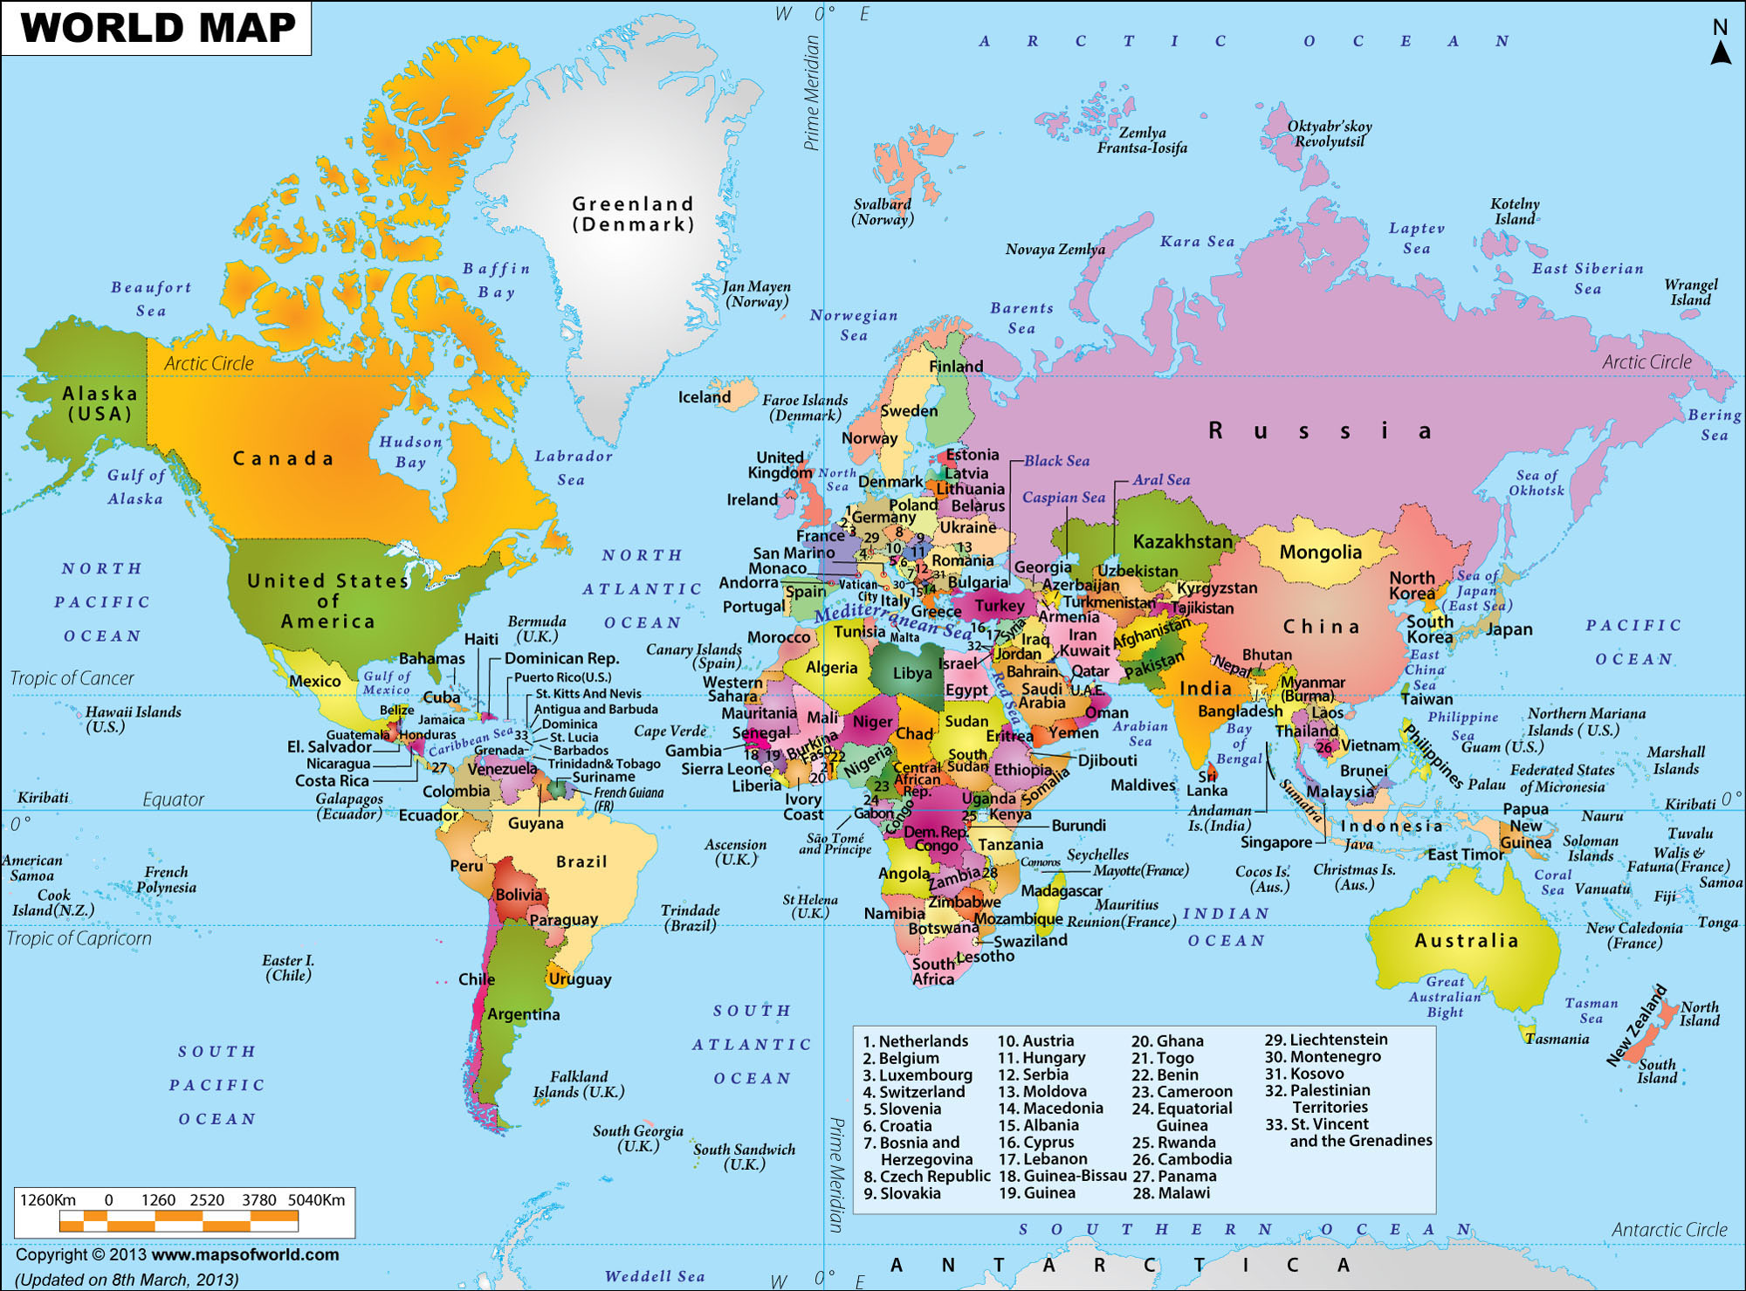

Slide 22
Capital Cities / Capital Letters
What is the capital city of Korea?
Seoul

Slide 23
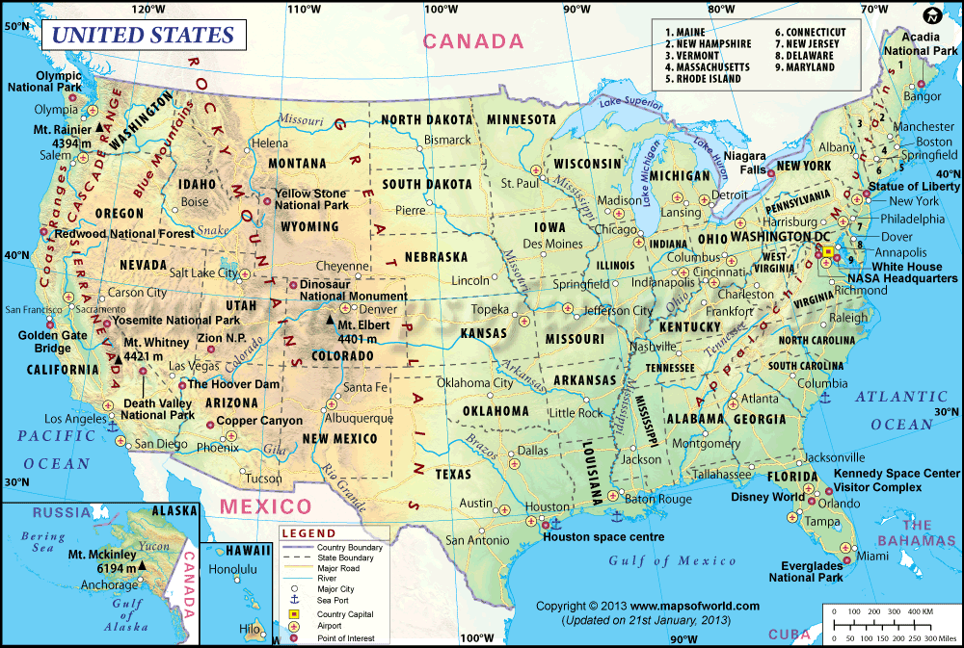
What is the capital city of USA?

Slide 24
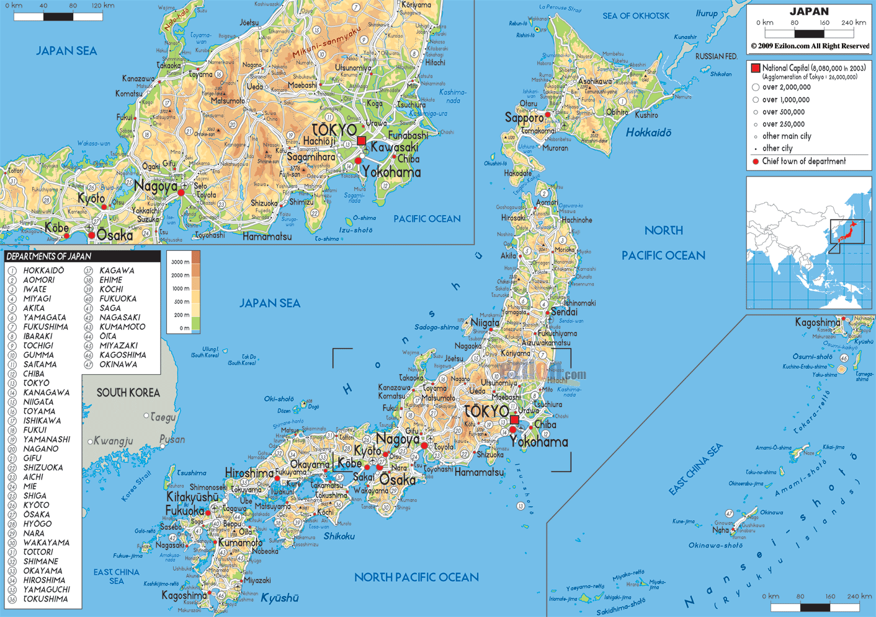
What is the capital city of Japan?

Slide 25
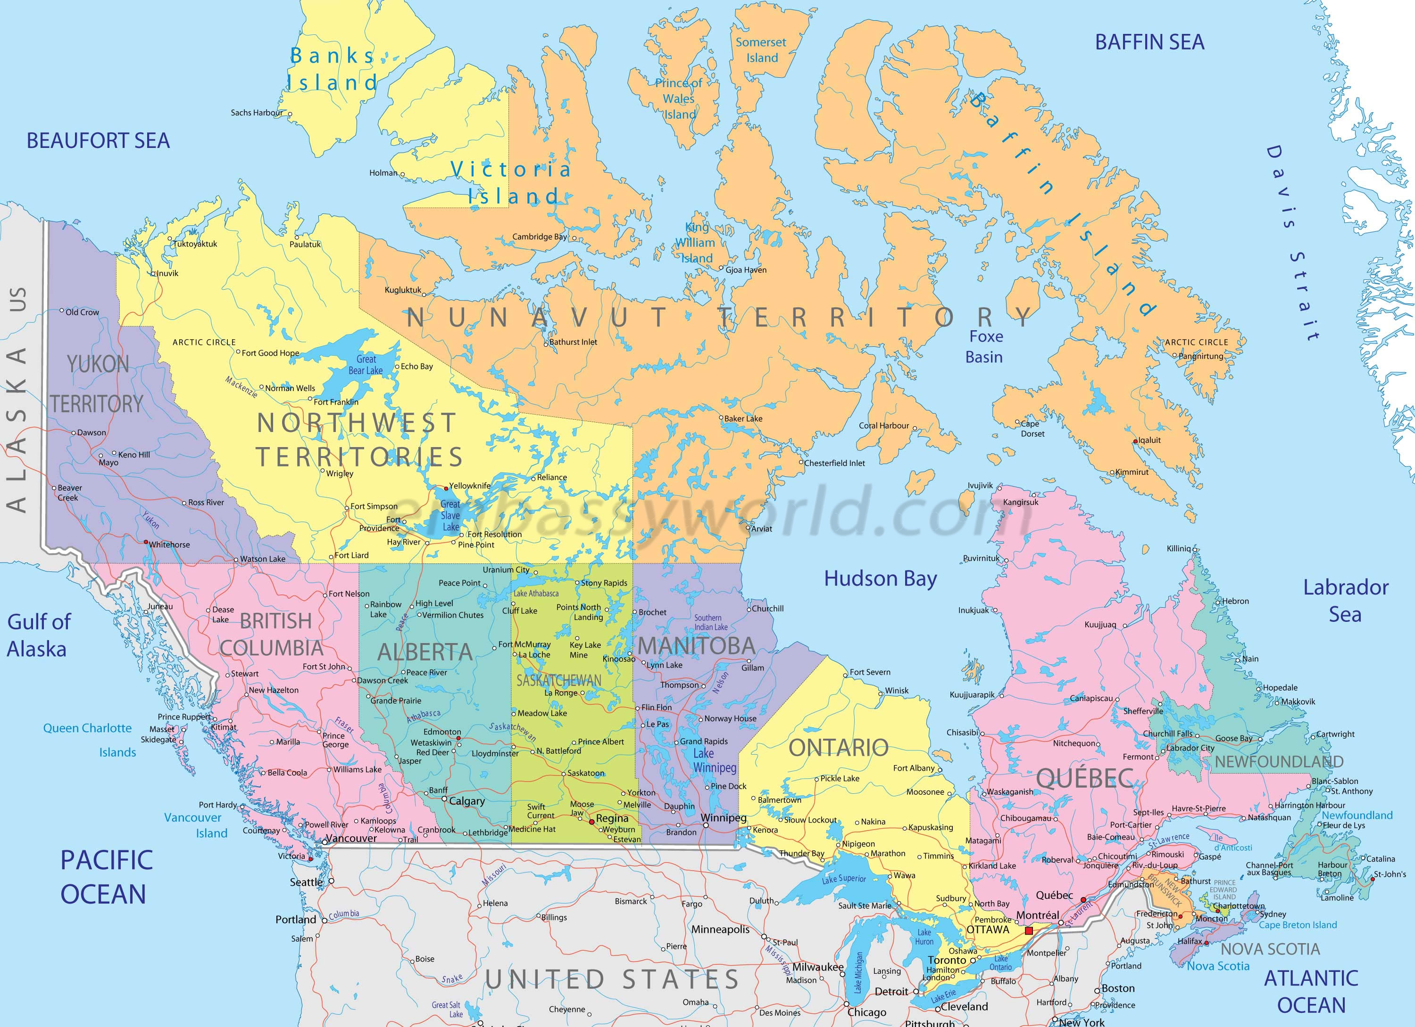
What is the capital city of France?

Slide 26
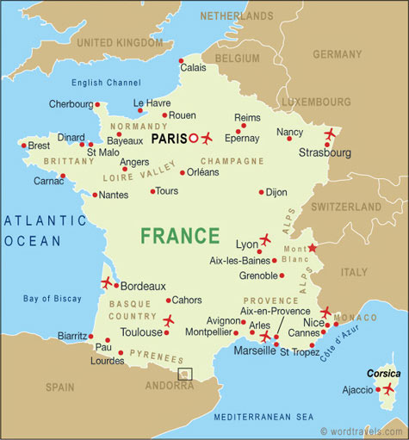
What is the capital city of Canada?

Slide 27
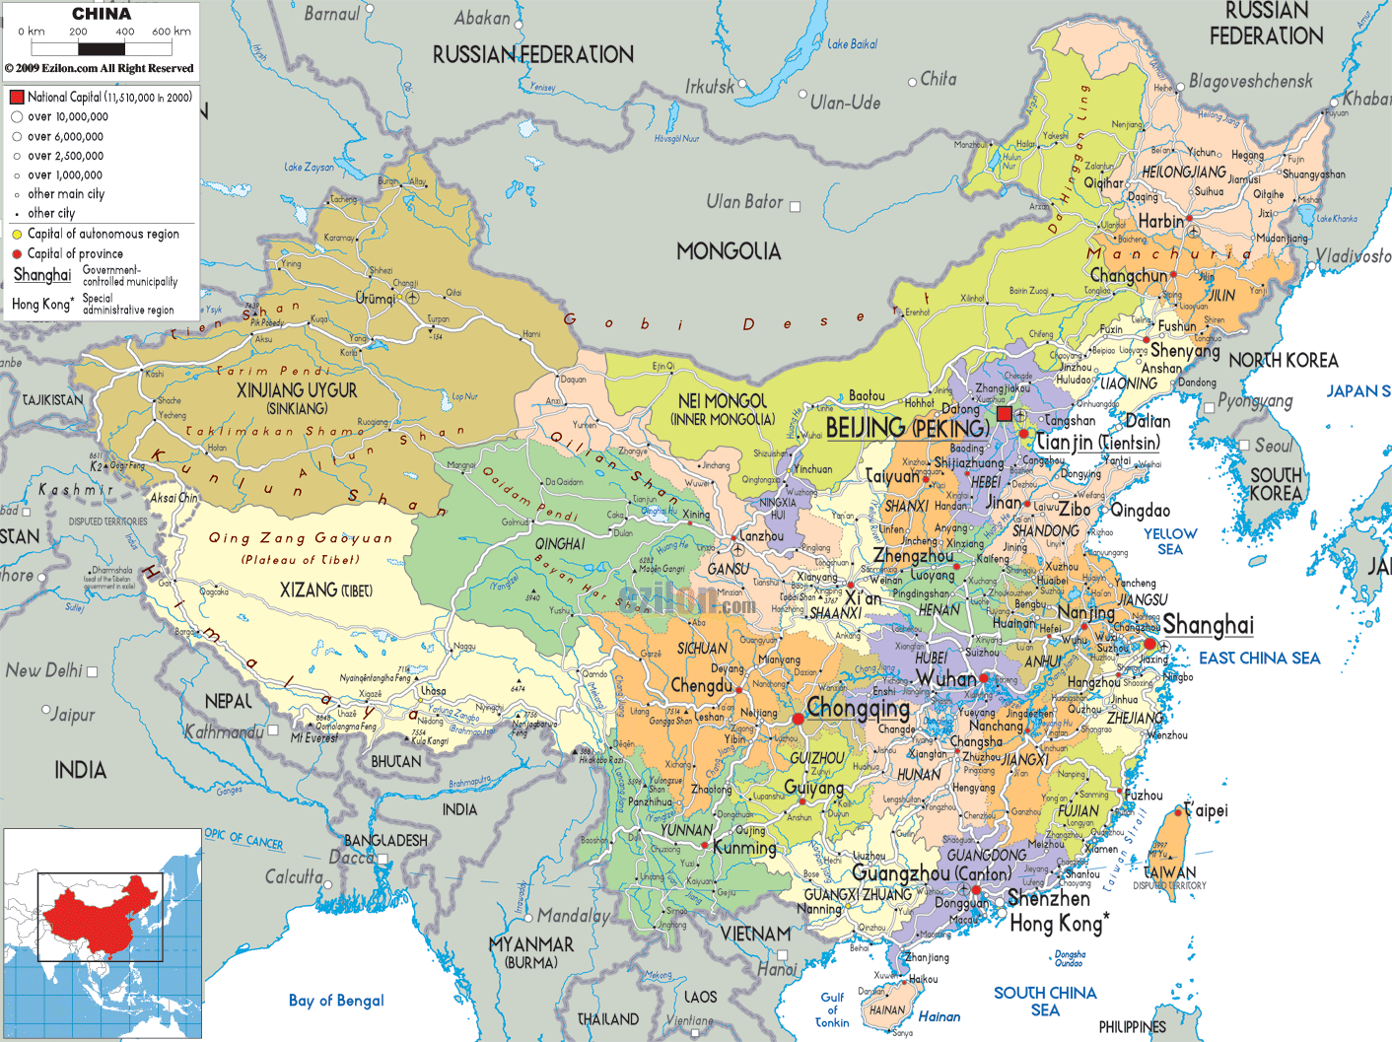
What is the capital city of China?

Slide 28
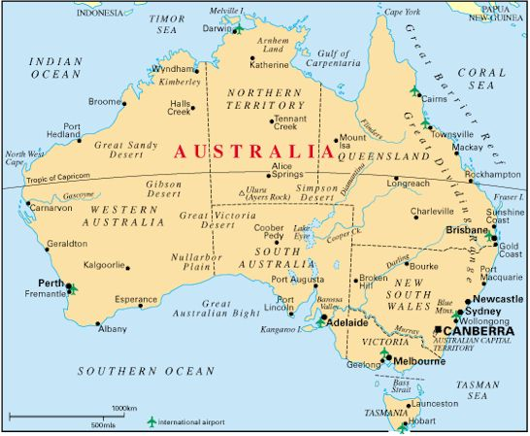
What is the capital city of Australia?

Slide 29
Missing Pieces Game
You can use your phone to help
Find the secret word by unscrambling the circled letters.

Slide 30
Capitalization and Punctuation

Slide 31
Country Quiz
http://www.jetpunk.com/quizzes/how-many-countries-can-you-name.php

