Slide 1
Review

Slide 2
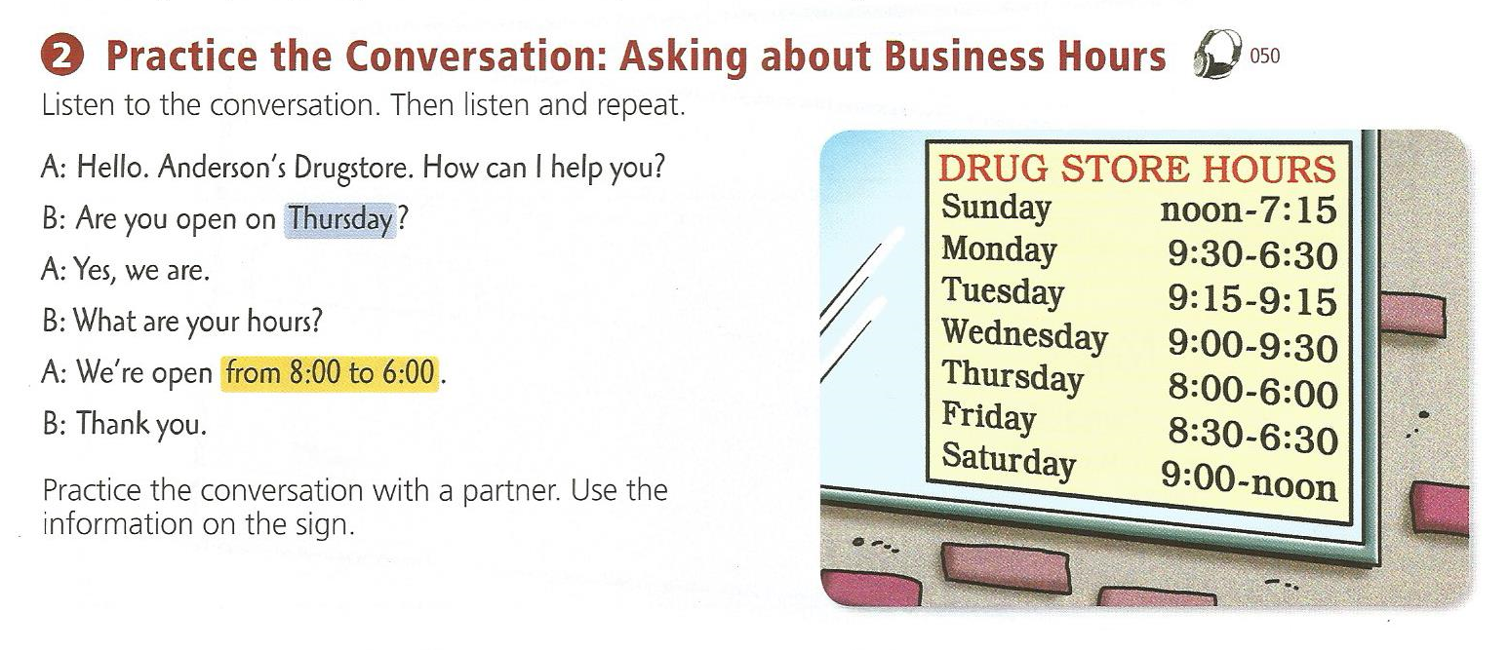

Slide 3
How much is: a nickel + a dime + a penny

Slide 4
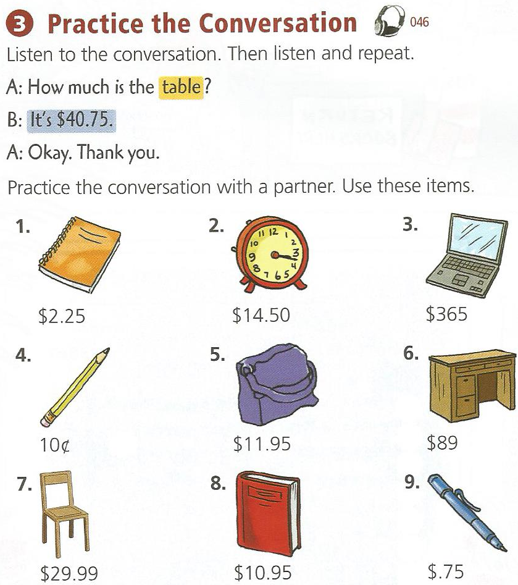

Slide 5
p. 44 - 45

Slide 6
p. 44 - 45

Slide 7
Lesson 13 – The Calendar
Ch.4

Slide 8
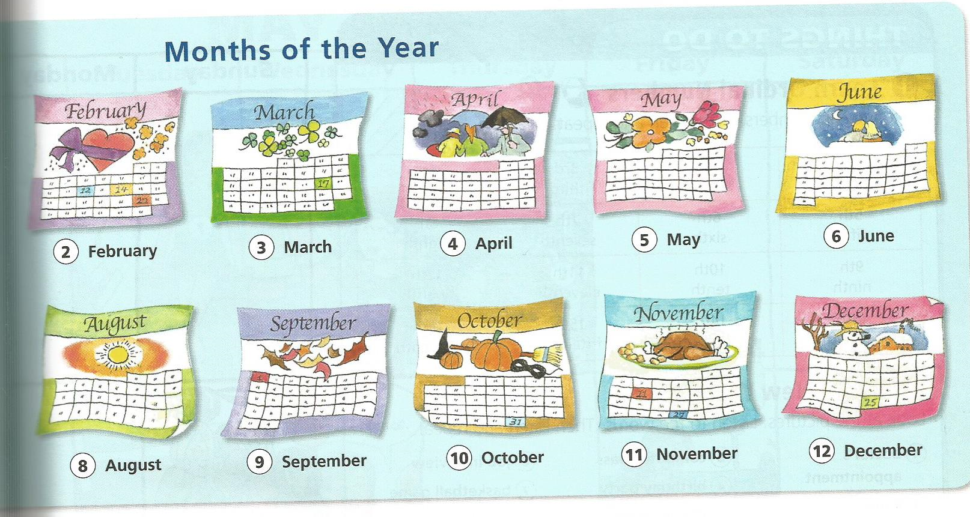
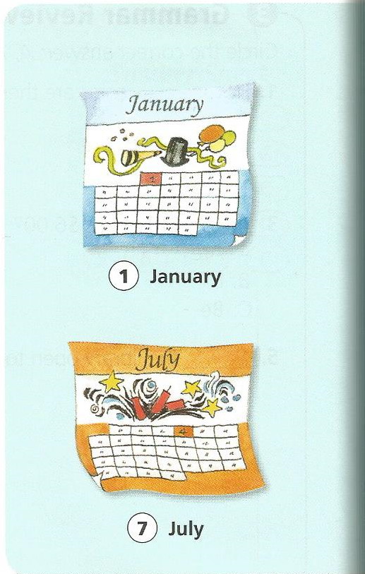
Months

Slide 9
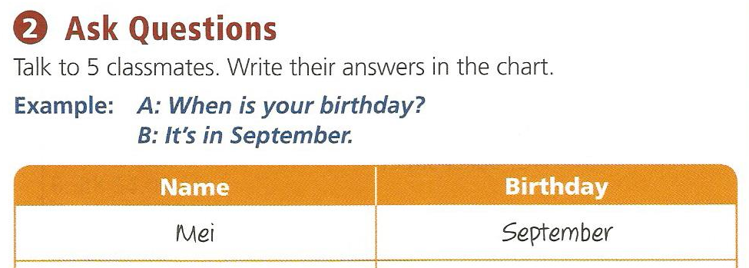
Months

Slide 10
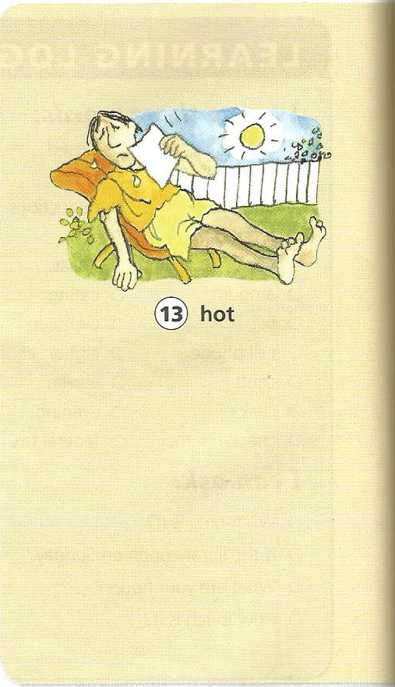
Weather

Slide 11
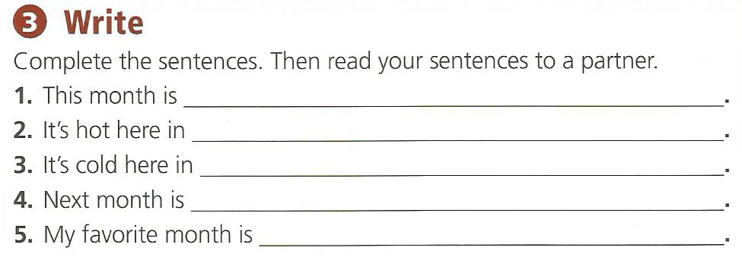
Weather

Slide 13
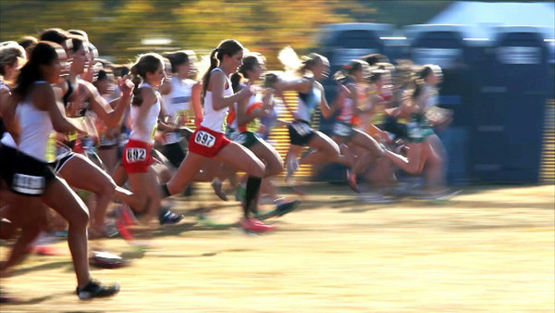
Ordinal Numbers
Order

Slide 14
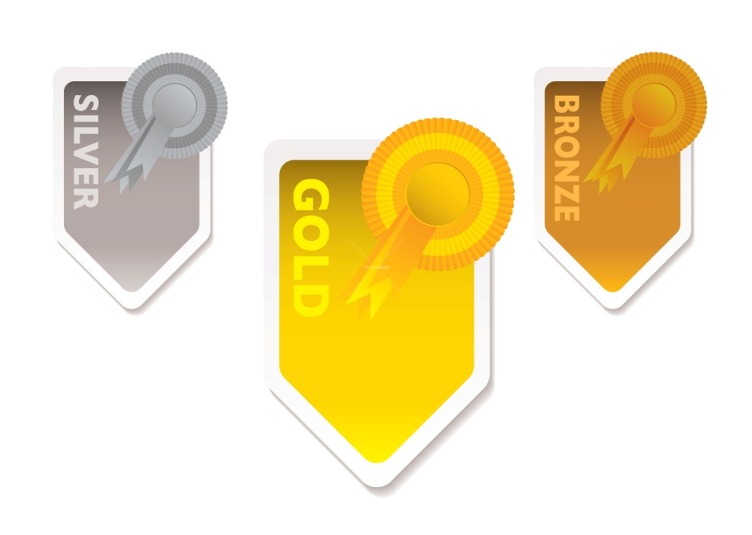
Order:
1st
2nd
3rd
4th
5th
6th
21st
22nd
23rd
24th
100th
234th

Slide 16
Order:
1st =
2^{nd =}
3^{rd =}
4^{th =}
5^{th =}
6th =
First
Second
Third
Fourth
Fifth
Sixth
21^{st =}
22^{nd =}
23^{rd =}
24^{th =}
100^{th =}
234th =
Twenty-first
Twenty-second
Twenty-third
Twenty-fourth
One Hundredth
Two hundred and thirty-fourth

Slide 17
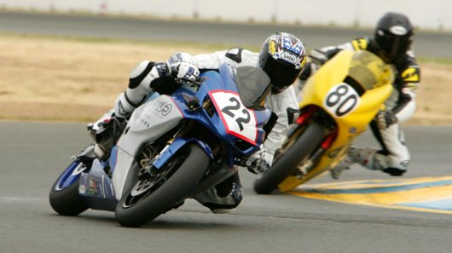
Who is in first?

Slide 18
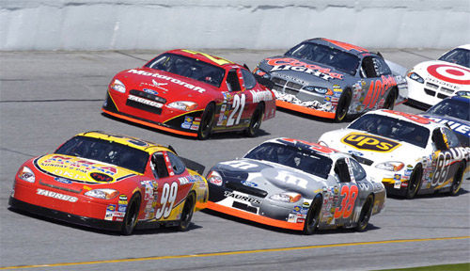
What position is he in?

Slide 19
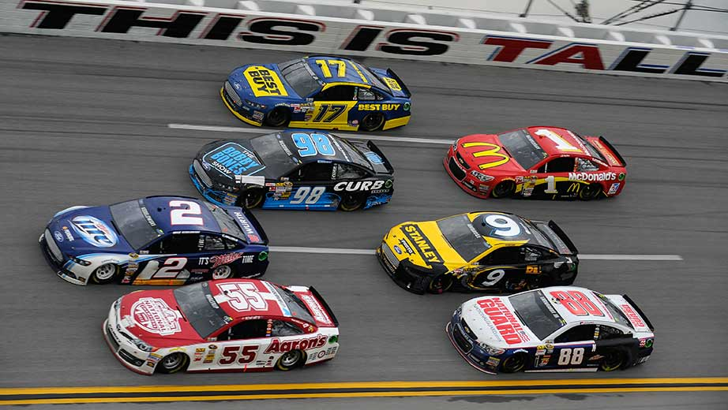
What position is he in?

Slide 20
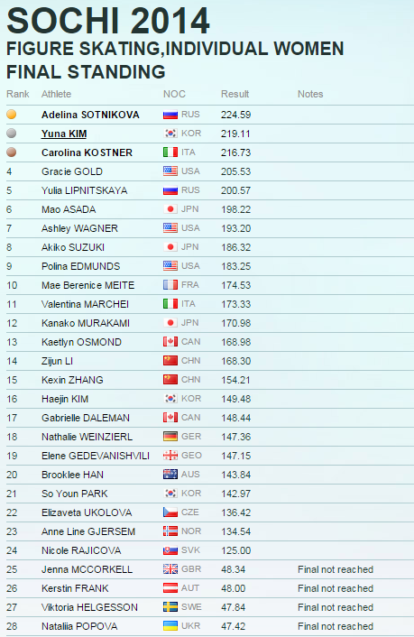
Who finished first?

Slide 21
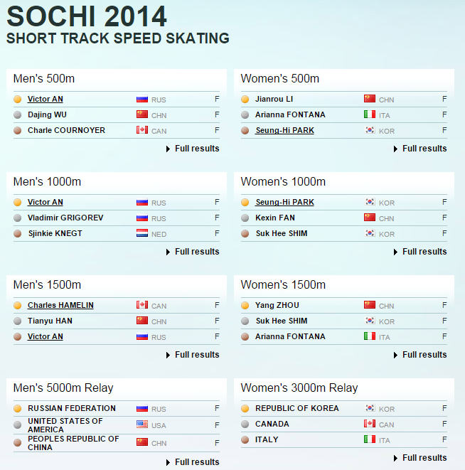

Slide 22
Betting Game
Who will finish first?

Slide 23
Betting Game Rules
You start with $10.
You can bet as much money as you want on as many players as you want.
If you are right, you win money
2 players = 1:1
3 players = 1:2
4 players = 1:3

Slide 24
Betting Game
https://www.youtube.com/watch?v=2QFXP8BxMME

Slide 25
Midgets vs Camel
https://www.youtube.com/watch?v=X8KdawFd874

Slide 26
Man vs Giraffe vs Zebra
https://www.youtube.com/watch?v=Y5QwYJoLUfE

Slide 27
Backwards Race – Man vs Car
https://www.youtube.com/watch?v=0olAvlNsWZI

Slide 28
Man vs Ostrich
https://www.youtube.com/watch?v=2WcMRpozO4s

Slide 29
Veyron vs Jet
https://www.youtube.com/watch?v=7NZ9X9A2efA

Slide 30
Usain Bolt vs Bus
https://www.youtube.com/watch?v=OHwU5Krd8l0

Slide 31
Mascot Race
https://www.youtube.com/watch?v=eCvrnn6Hi10

