Slide 1
Review

Slide 2
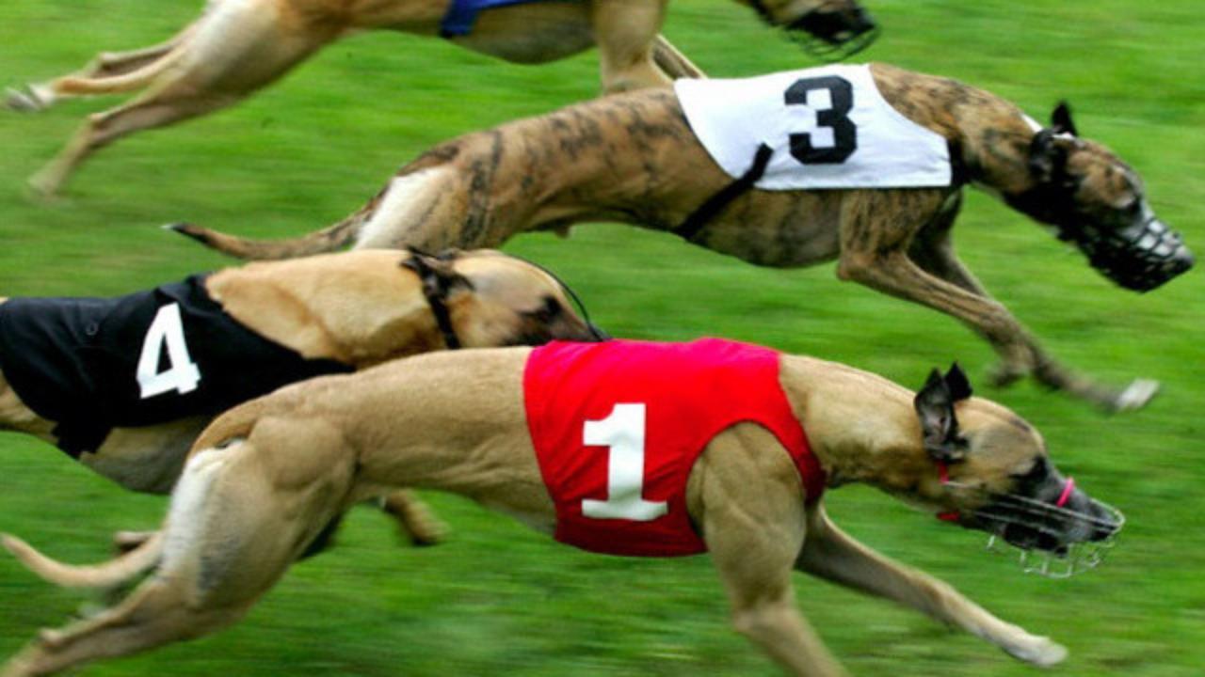
What position is he in?

Slide 3
Dates and Days
Monday
August 11, 2015

Slide 4
What day is it today?

Slide 5
What is an appointment?

Slide 6
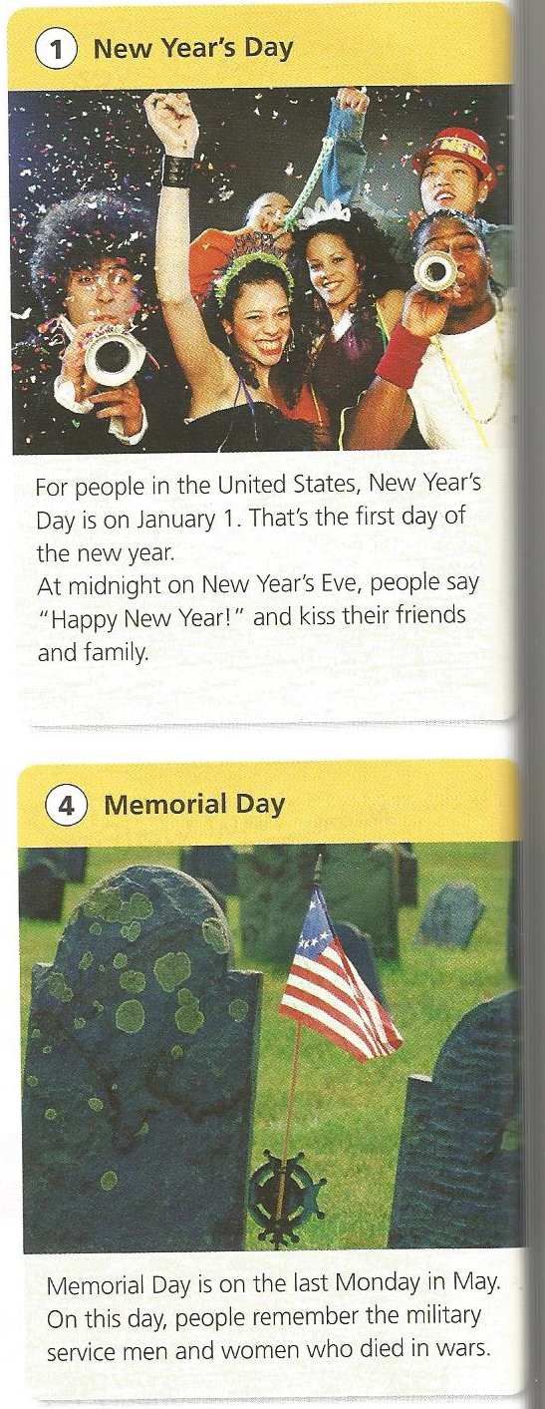
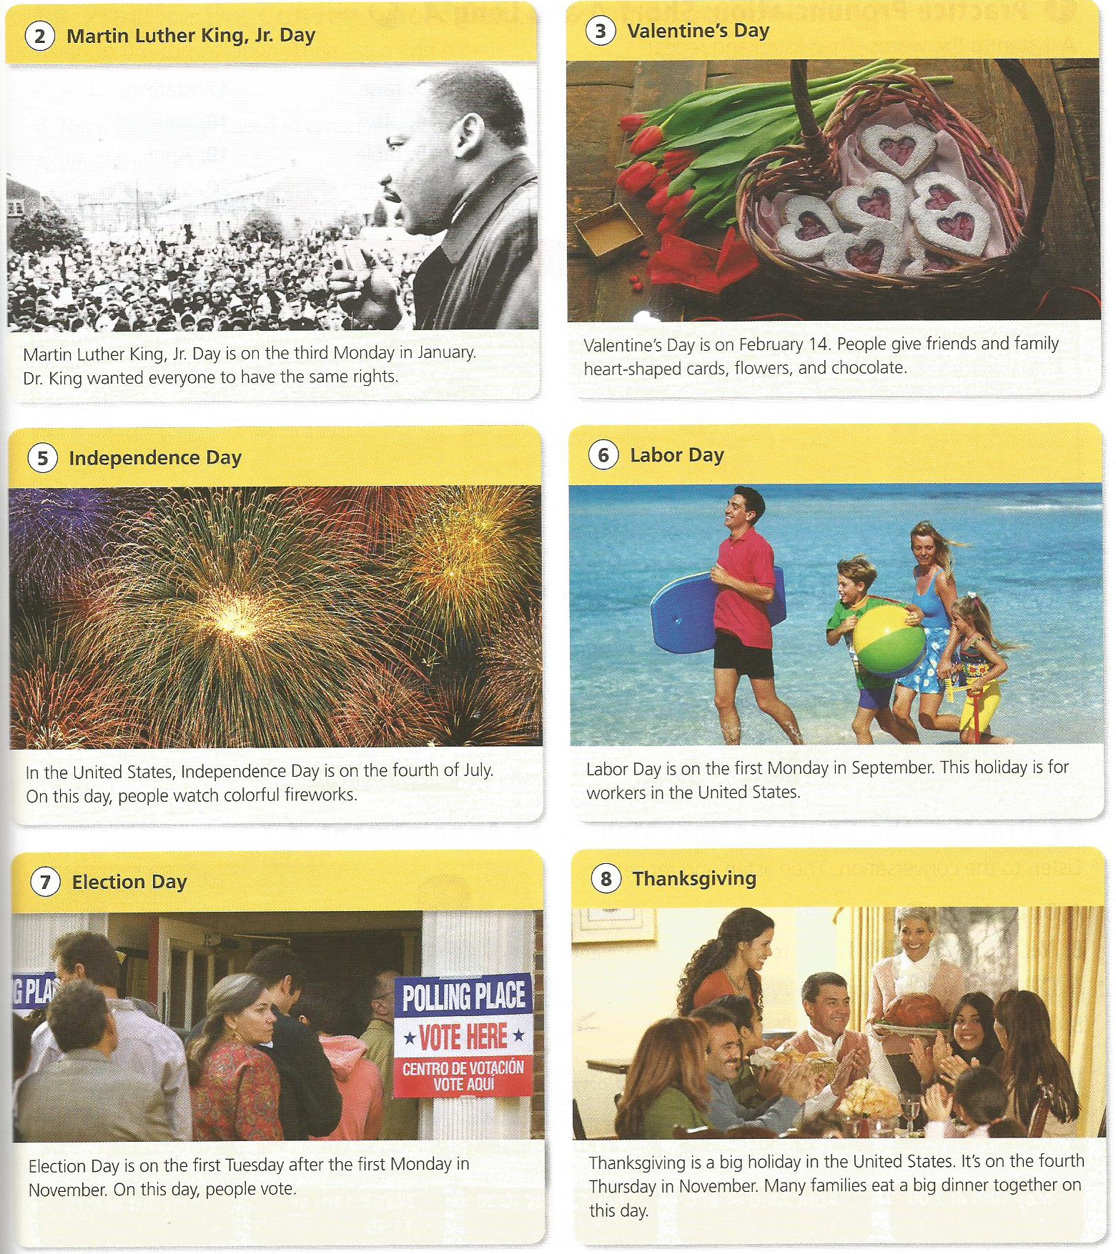
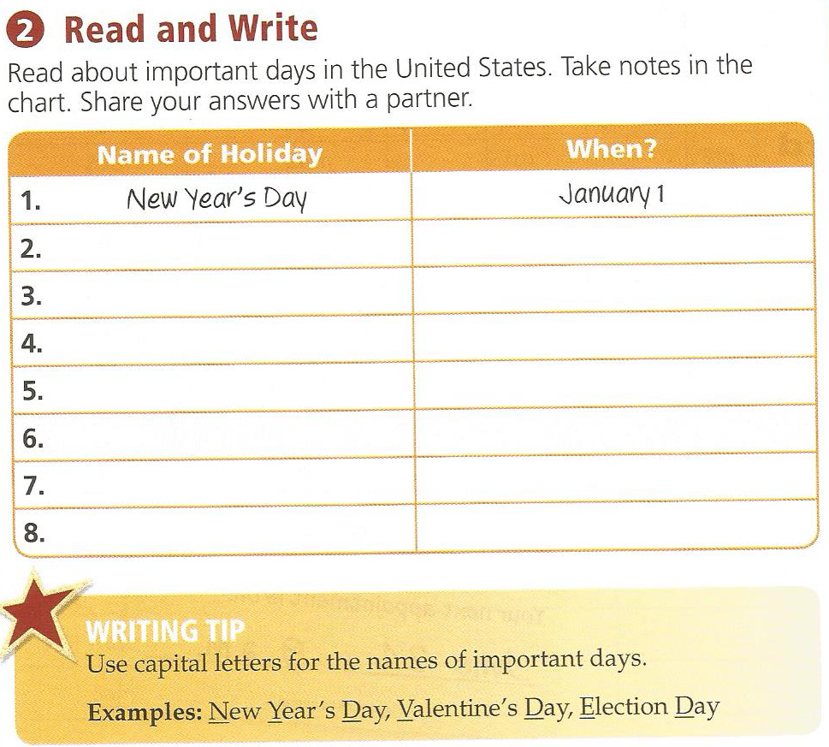

Slide 7
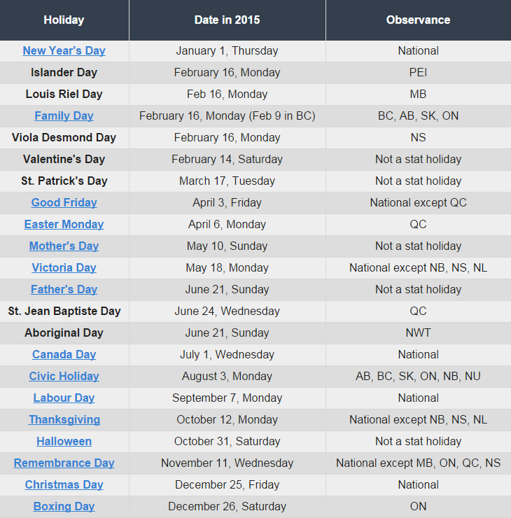
Holiday List

Slide 8
Holiday Calendar
Ask, “When is ____________?”
Answer, “It’s on ____(ordinals)____.”
Write it on your calendar.

Slide 9
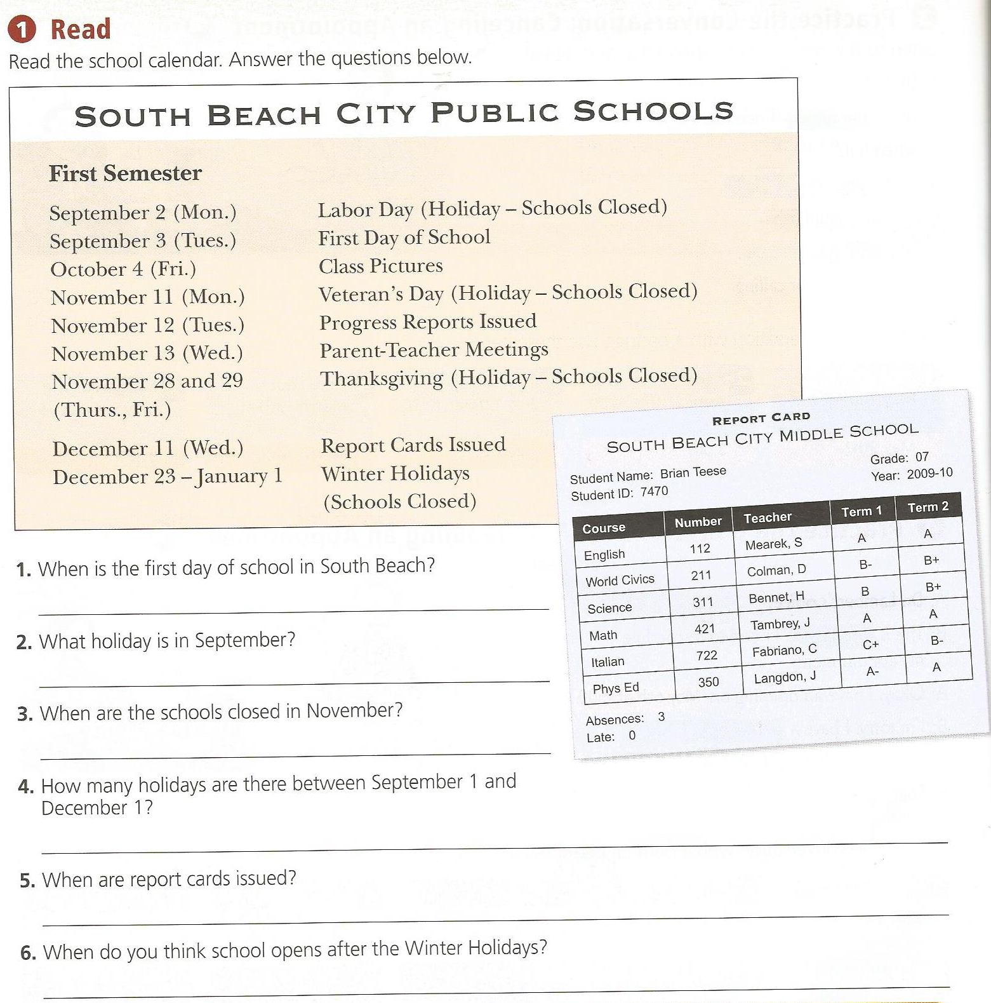
p.56

Slide 10
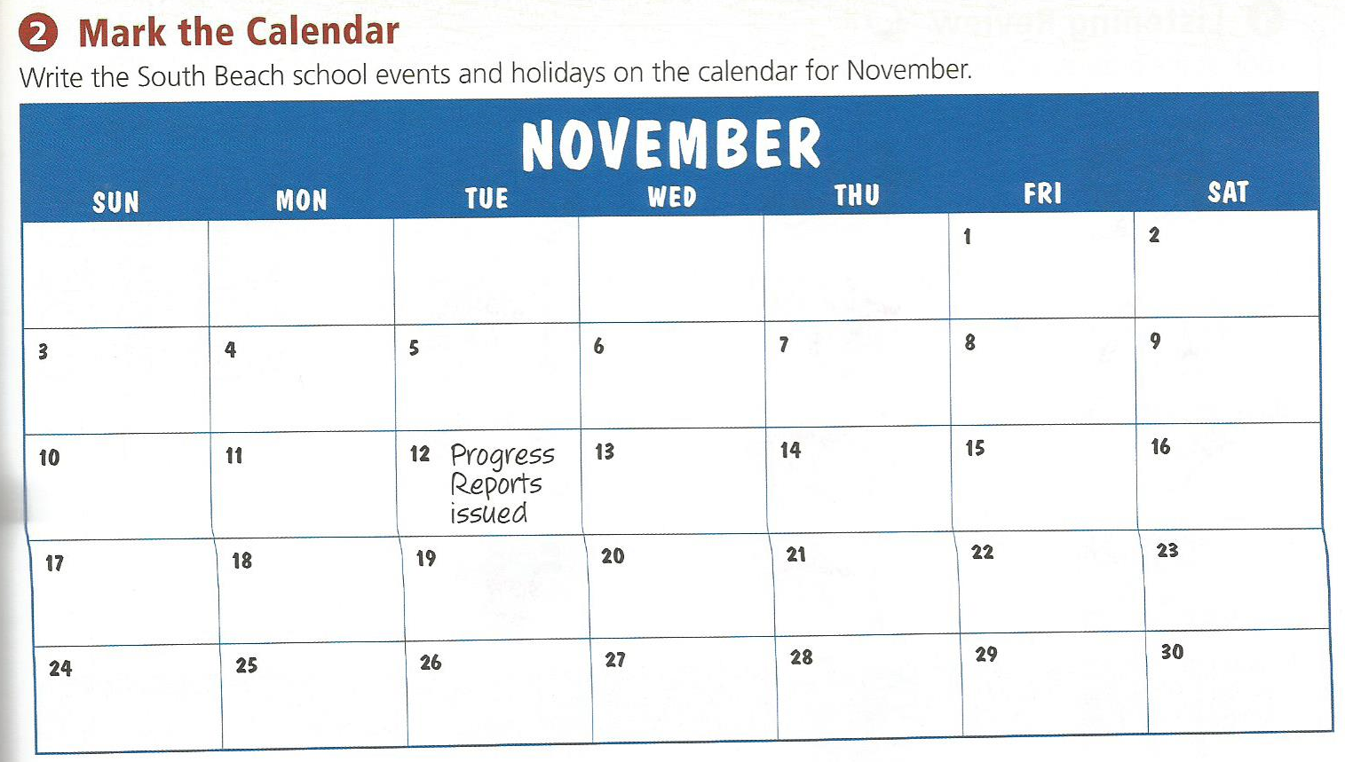
p.57

Slide 11
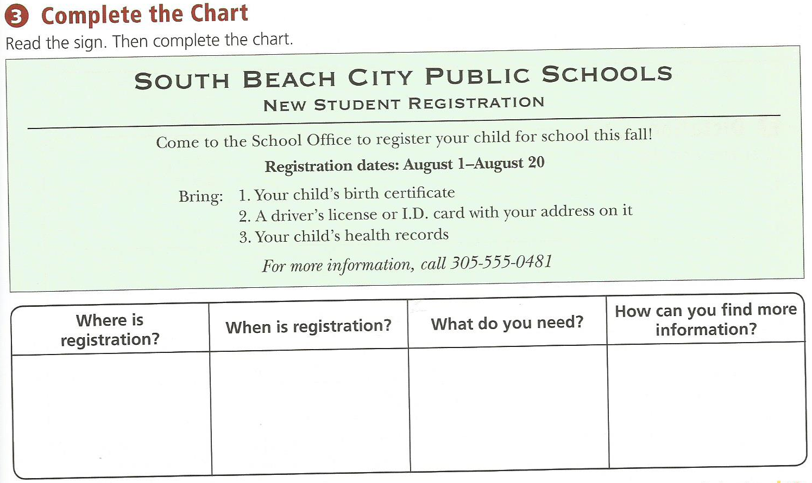
p.57

Slide 12
p.58

Slide 13
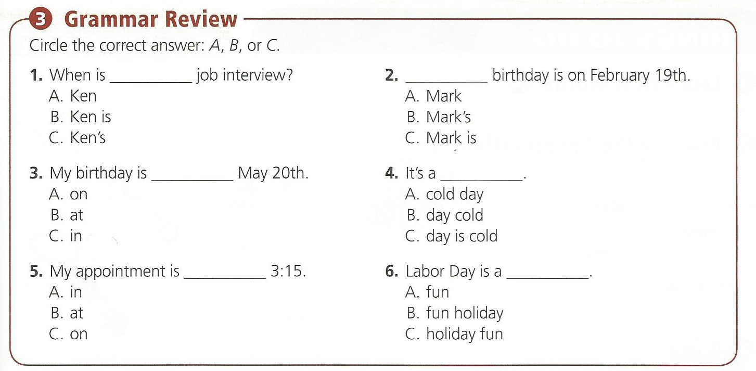
p.59

Slide 14
p. 164

Slide 16
Adjectives

Slide 17
Describe These Pictures:

Slide 18
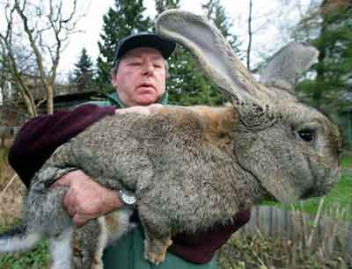

Slide 19
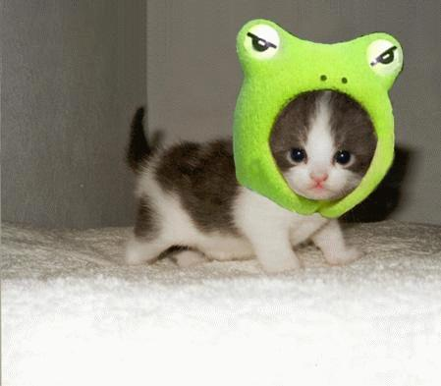

Slide 20
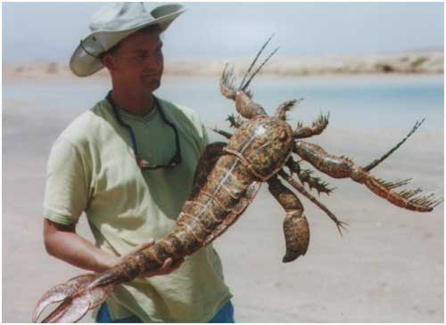

Slide 21
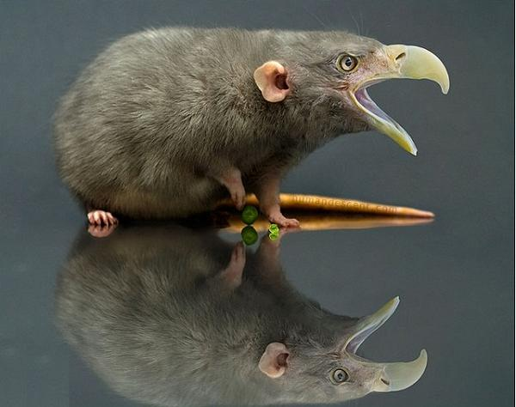

Slide 22
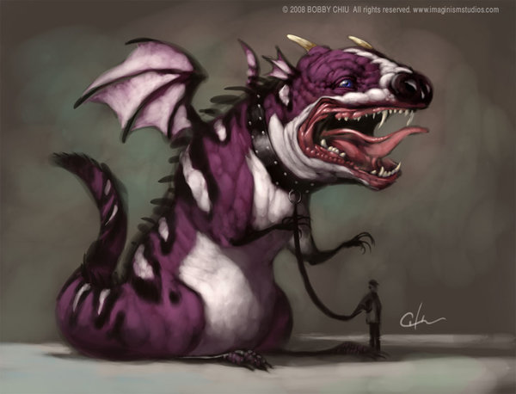

Slide 23
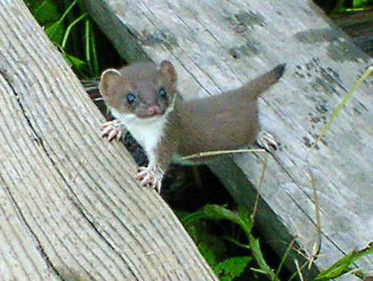

Slide 24
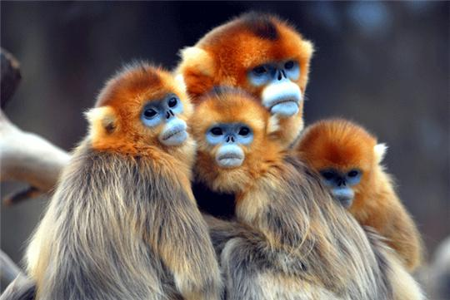

Slide 25
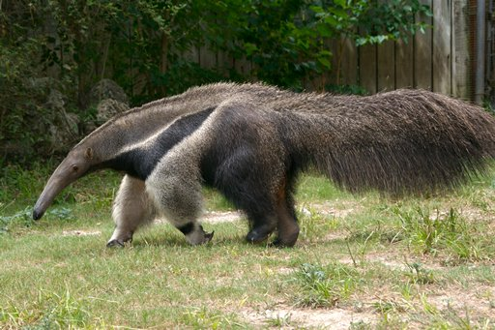
Ant eater

Slide 26
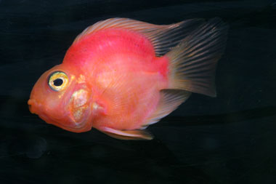
Parrot fish

Slide 27
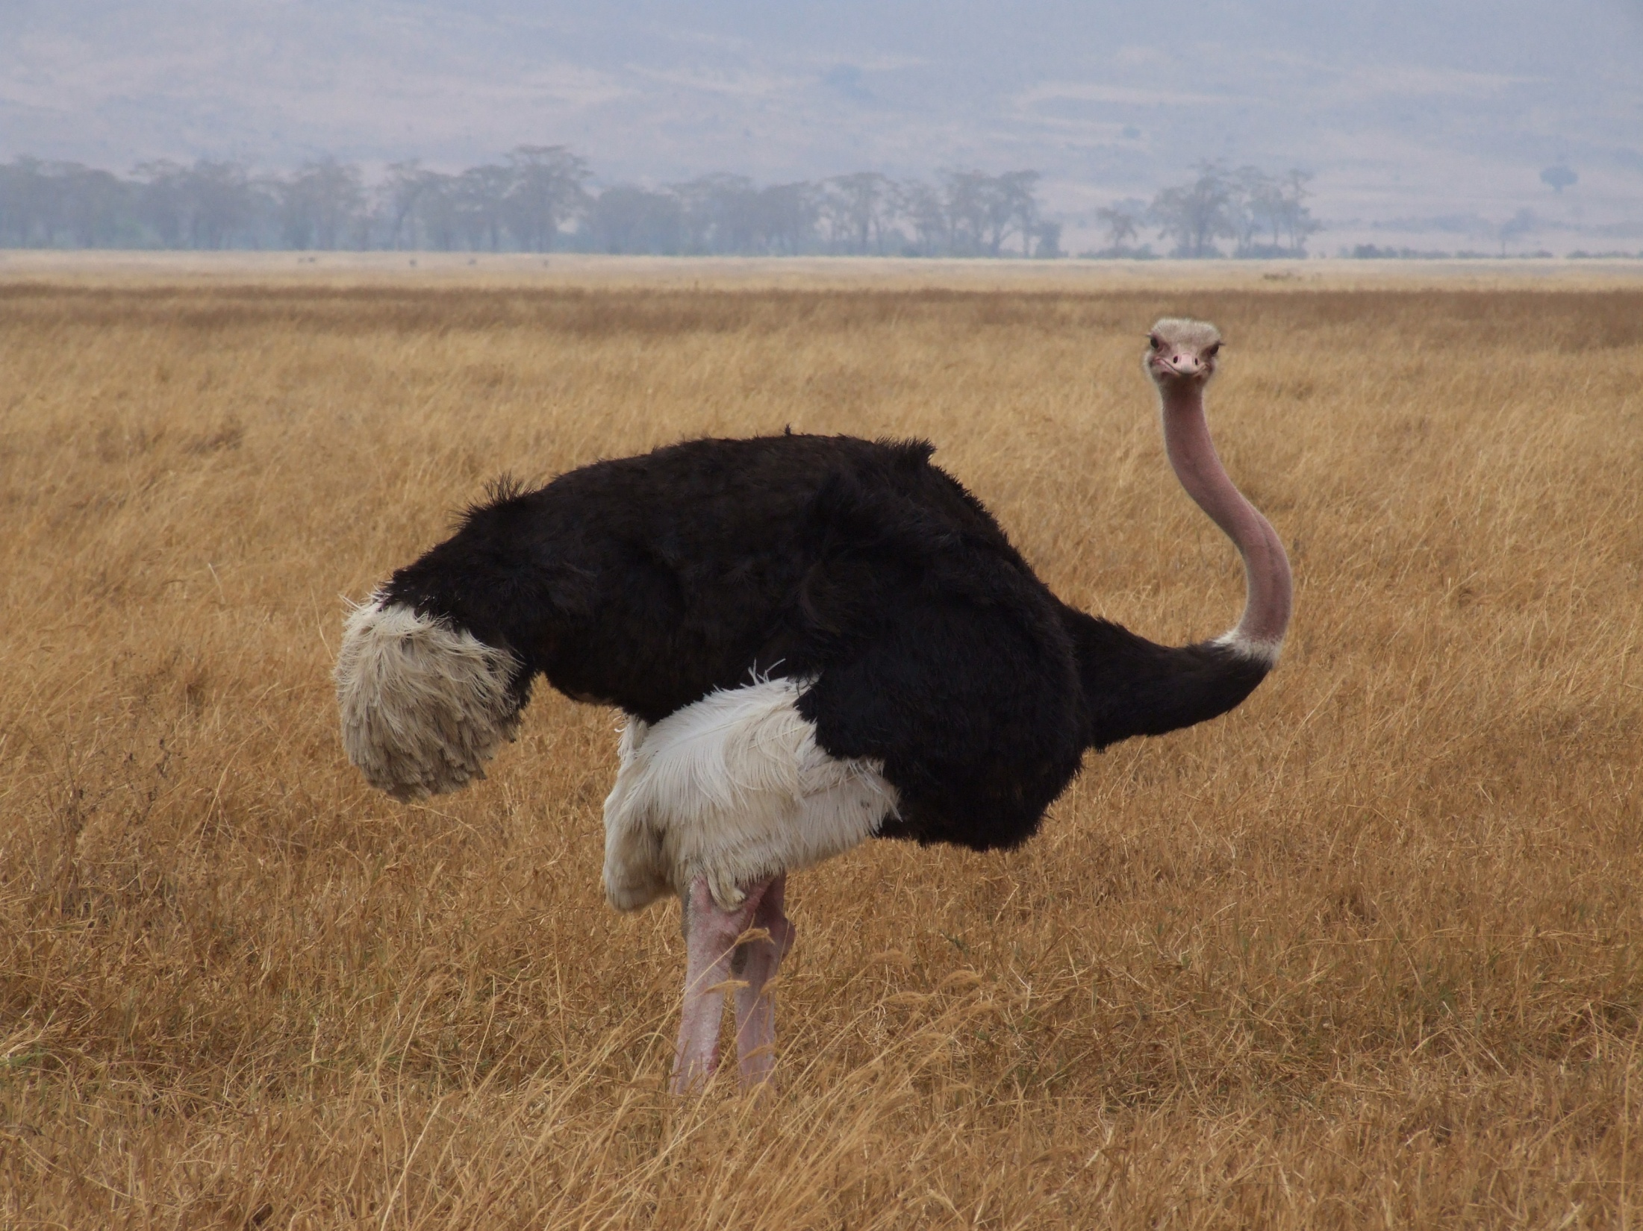
Ostrich

Slide 28
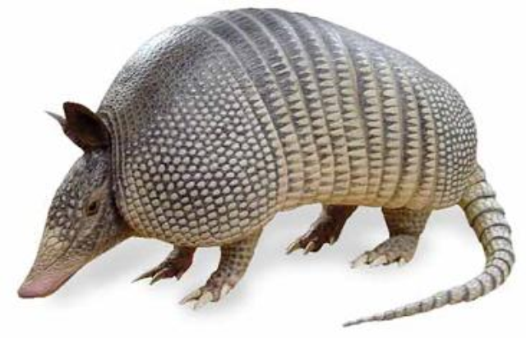
Armadillo

Slide 29
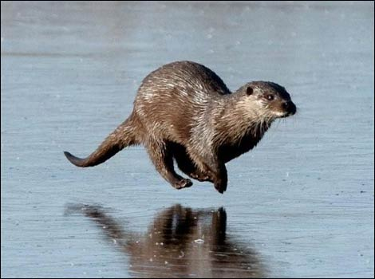
Otter

Slide 30
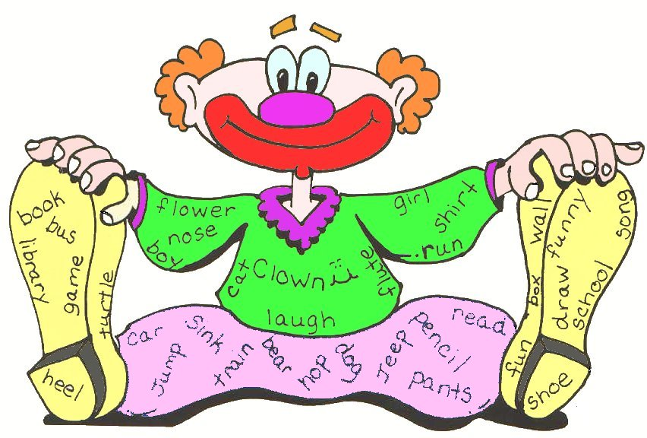
What is an adjective?
Describes a noun.
Noun = person, place, or thing.

Slide 31
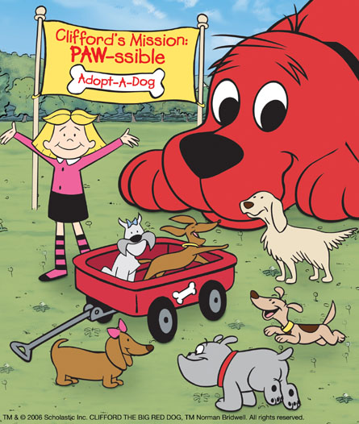
The big, red dog.

Slide 32
Find the adjective:

Slide 33
1. The man is an old, ugly, and grey man.
2. Be careful by the scary, and large house.
3. Where are the delicious candies that I ordered?

Slide 34
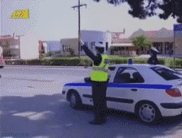
Good Job

Slide 35
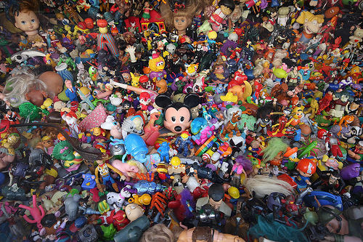
Eye Spy
Eye spy with my little eye, something that is...

