Slide 1
Prepositions of Place (review)
p. 152

Slide 3
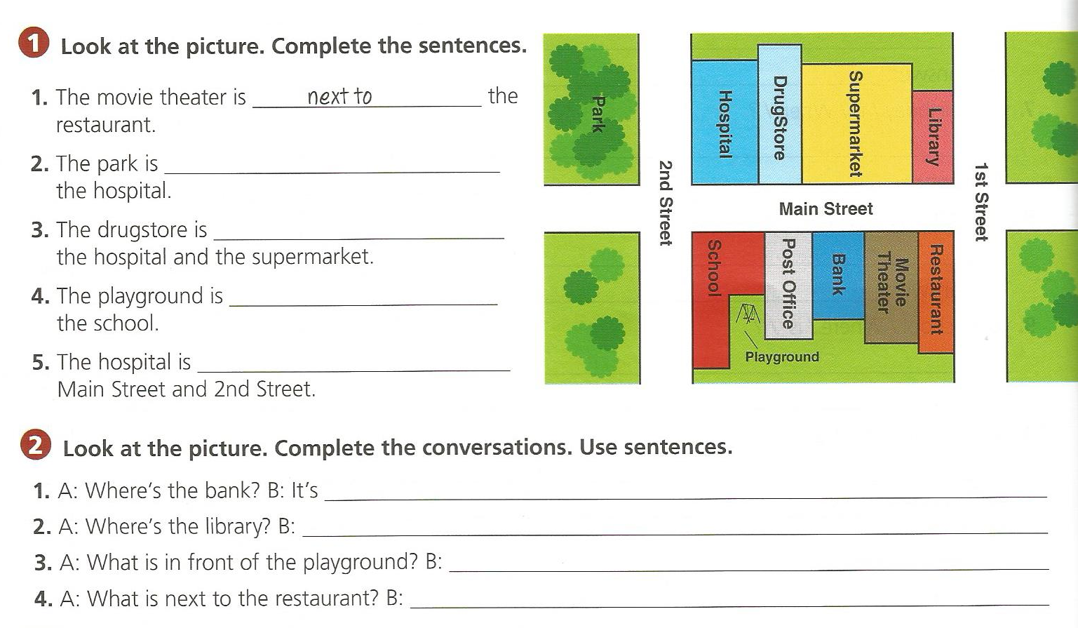

Slide 4
There is / There are
p. 153, 154

Slide 5
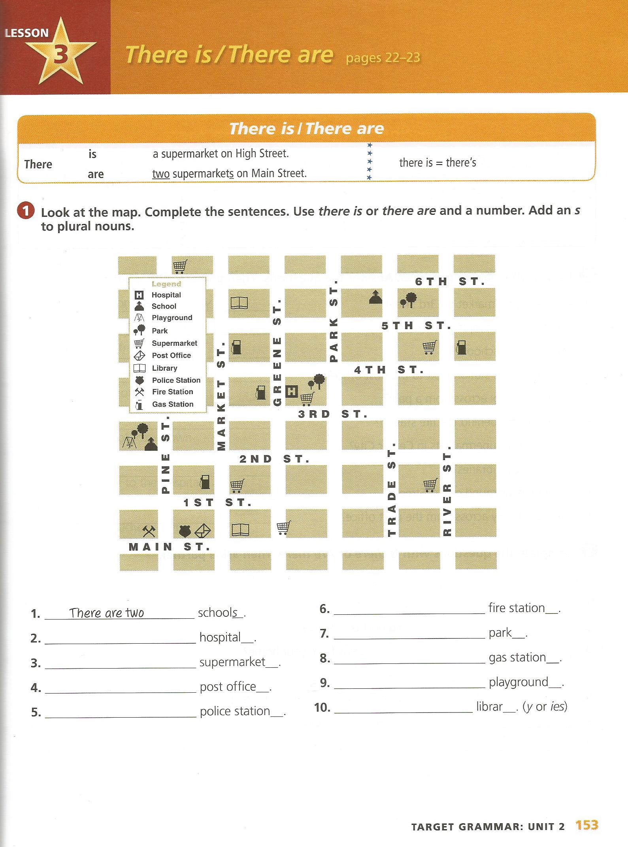

Slide 6
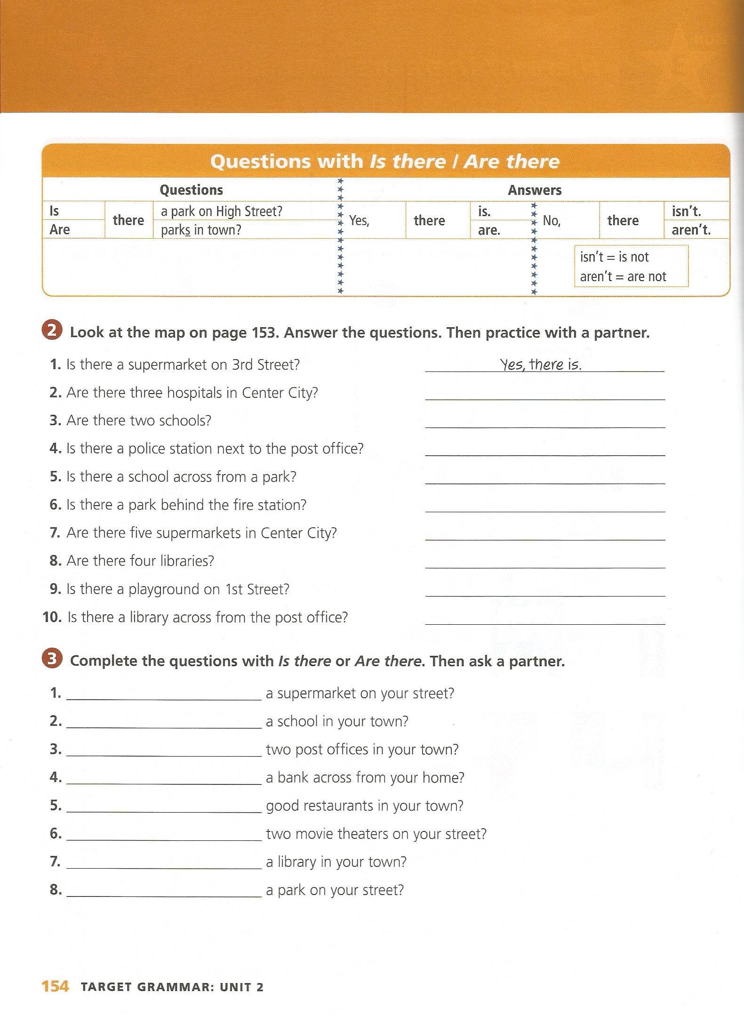
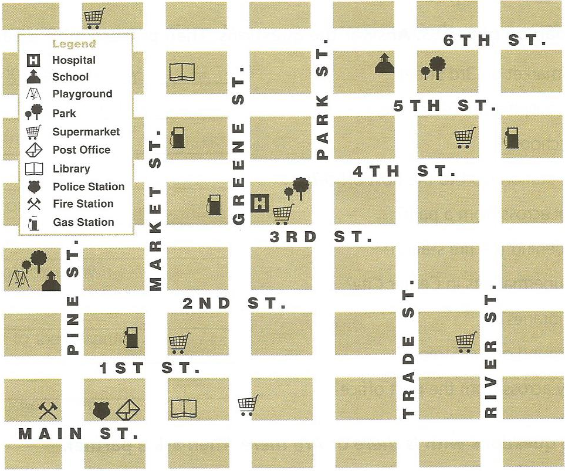
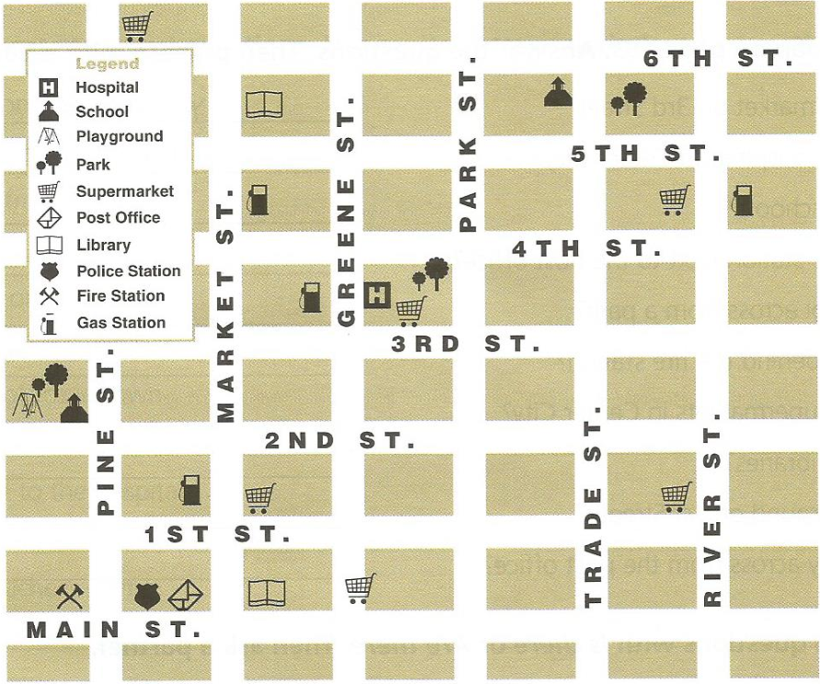

Slide 8
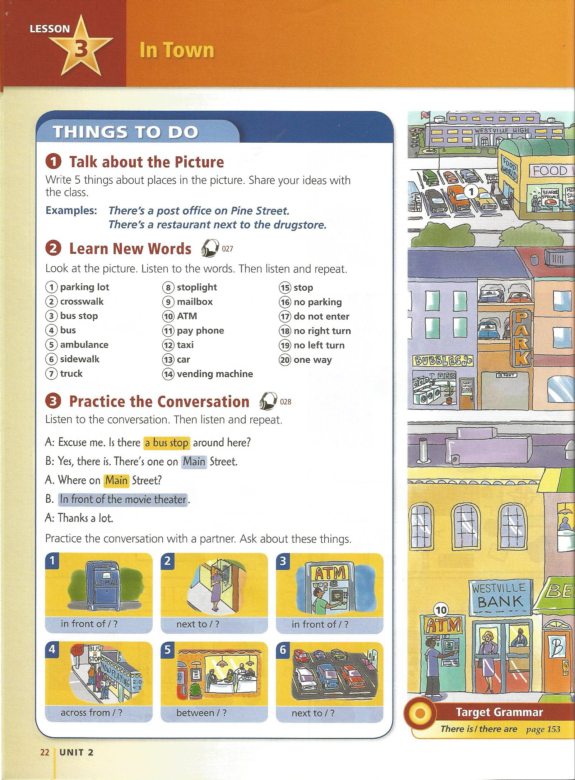
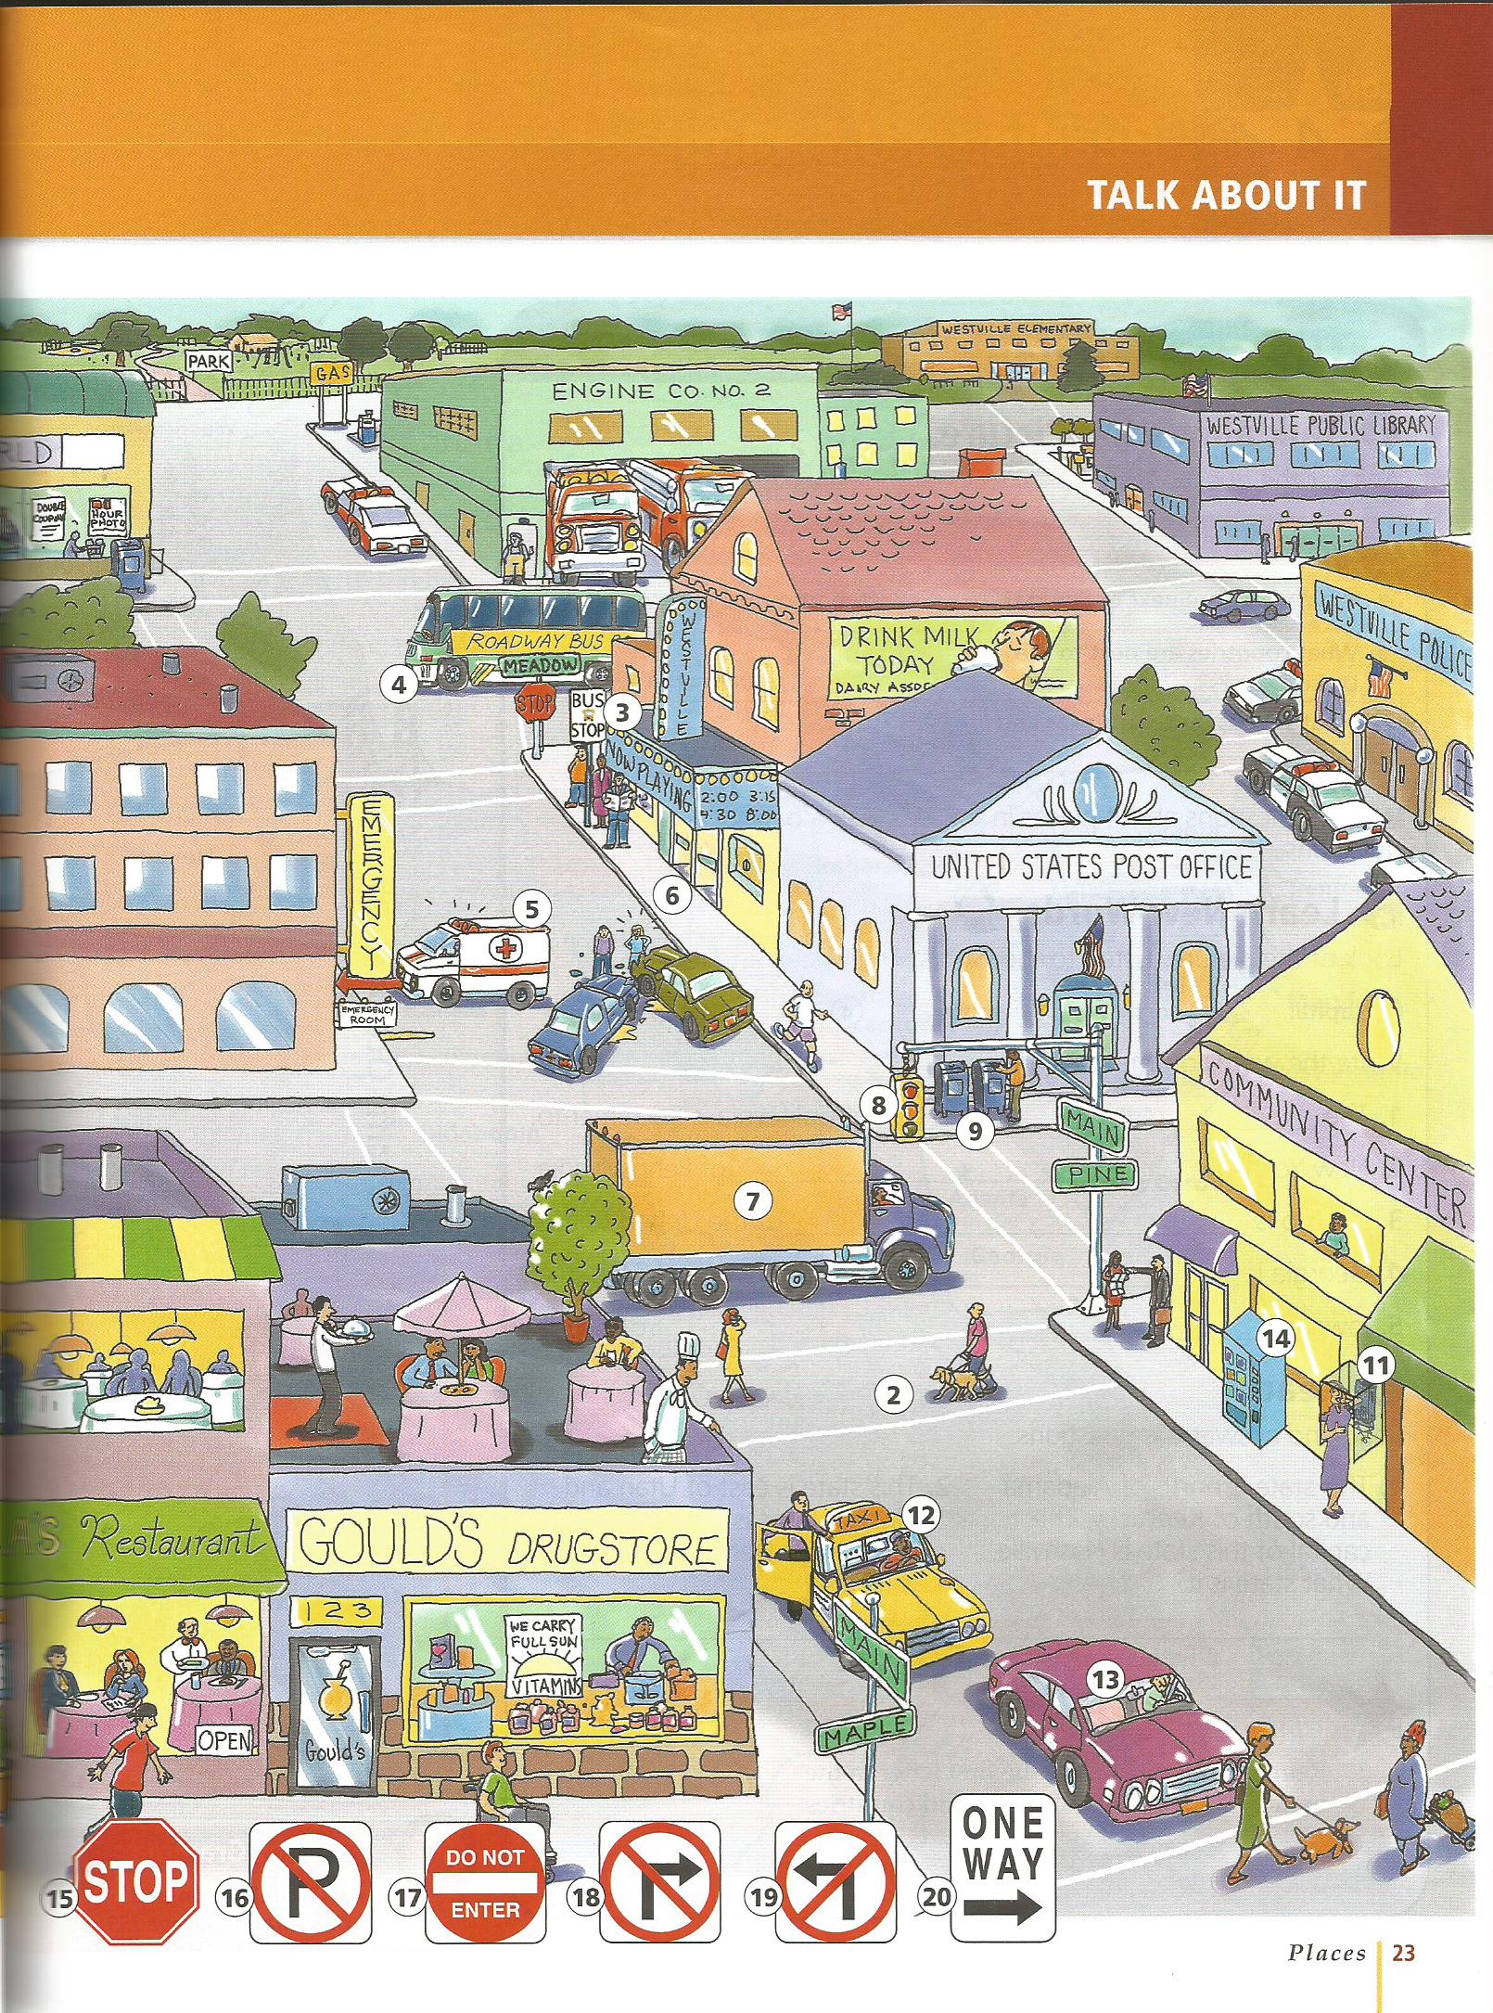
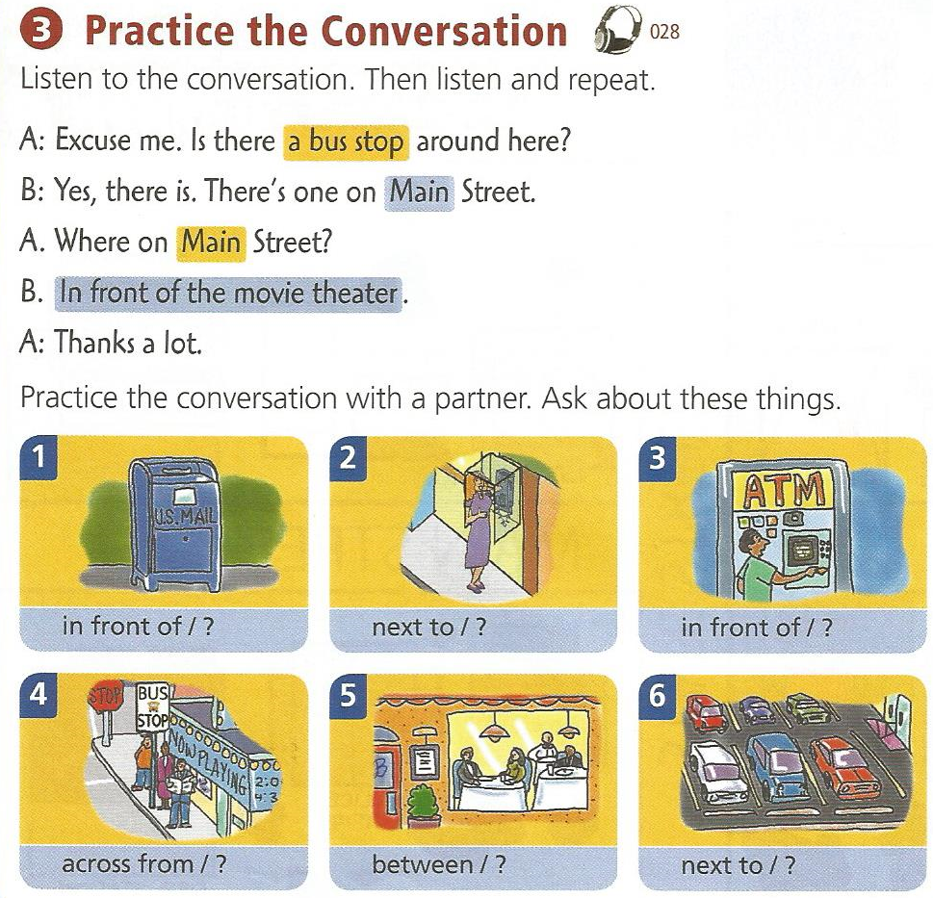

Slide 9
Day 3 – Signs

Slide 20
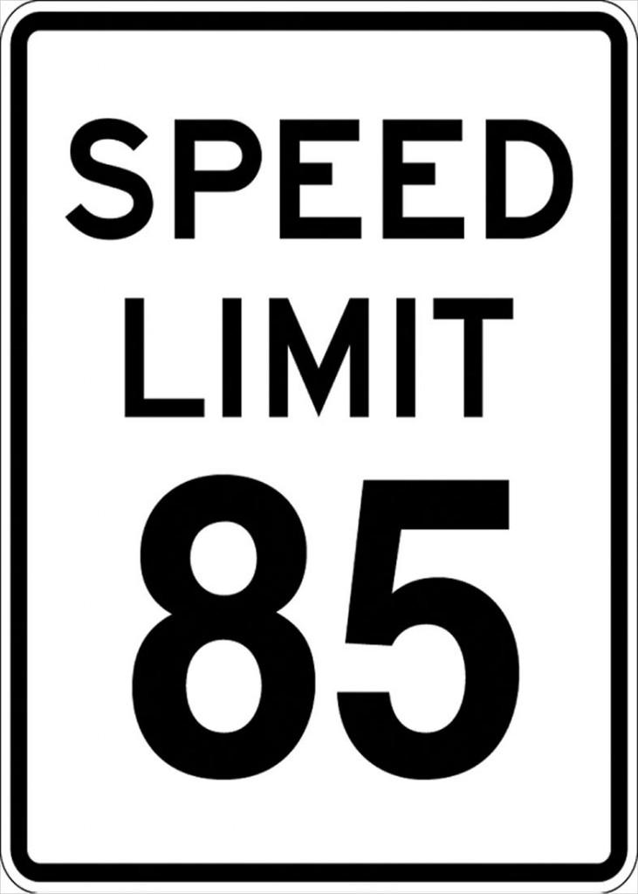

Slide 28
Caution Sign Game
Memory

Slide 29
Caution Crossword

Slide 30
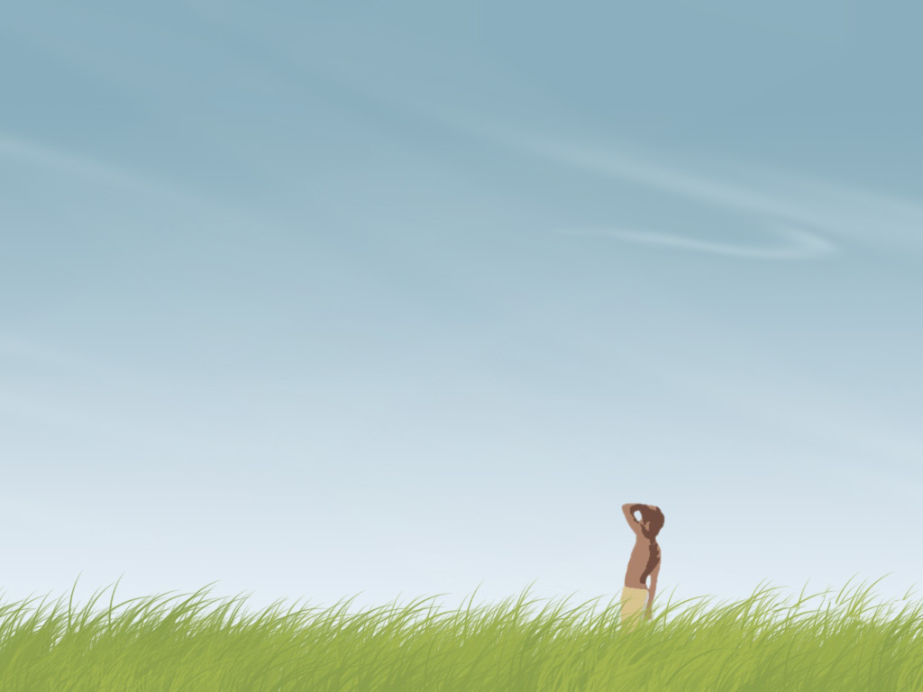
School ______
Zone

Slide 31
Dangerous electricity =
High Voltage

Slide 32
BOOM!! =
Explosive

Slide 33
People walking =
Pedestrian

Slide 34
Unidentified Flying Object =
UFO

Slide 35
Rocks going down =
Falling

Slide 36
=
Radiation

Slide 37
If there is a dangerous dog =
Beware

Slide 38
Do not drink or eat this =
Poison

Slide 39
Going across the road =
Crossing

Slide 40
Young people =
Children

Slide 41
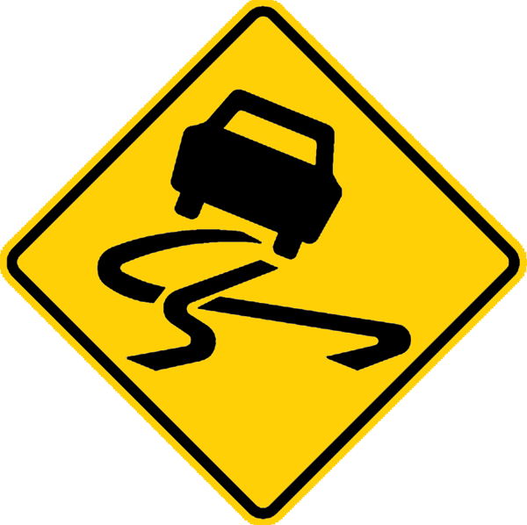
Ice is ________.
Slippery

Slide 42
Stop sign _______
Ahead

Slide 43
Wind from left or right =
Cross Wind

Slide 44
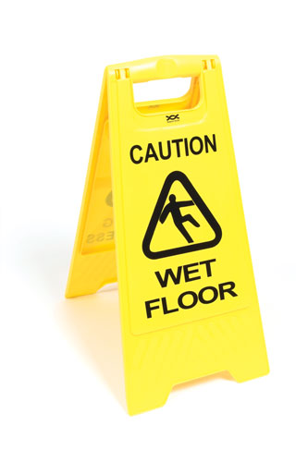
Something with water on it =
Wet

Slide 45
People making or working =
Construction

Slide 46
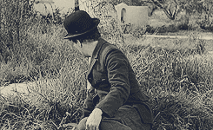

Slide 47
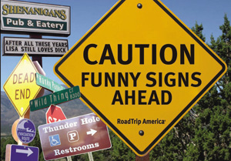

Slide 48
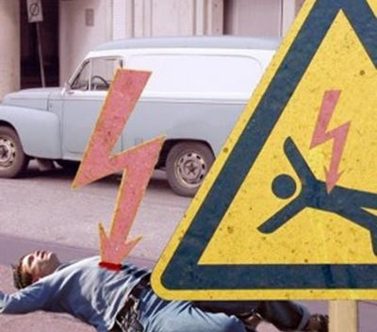

Slide 49
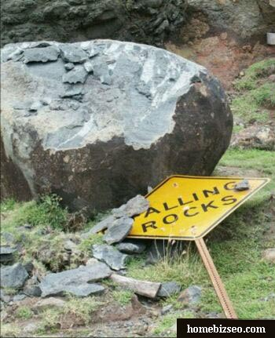
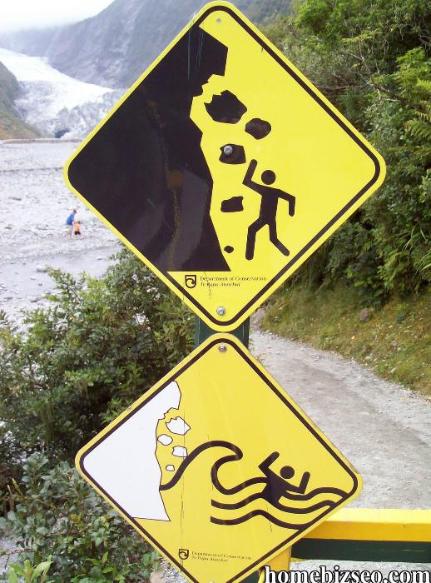

Slide 50
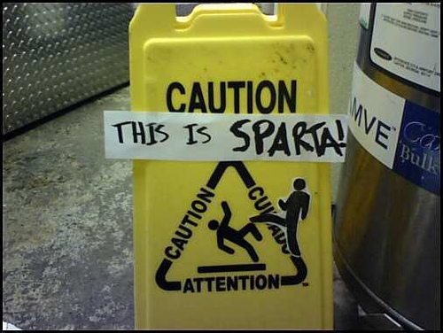

Slide 51
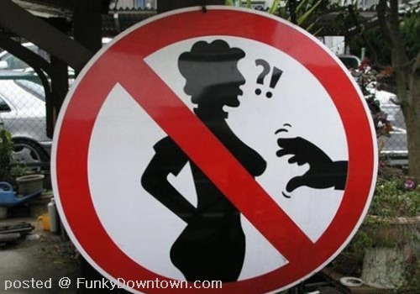

Slide 52
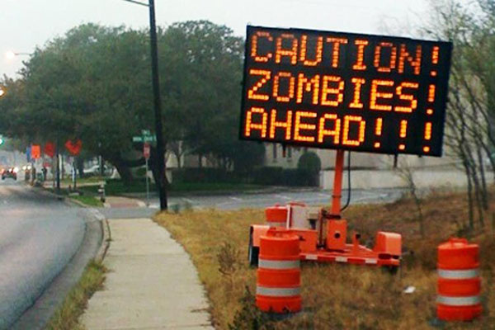

Slide 53
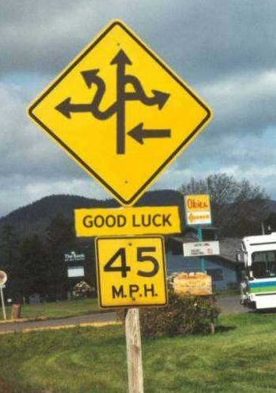
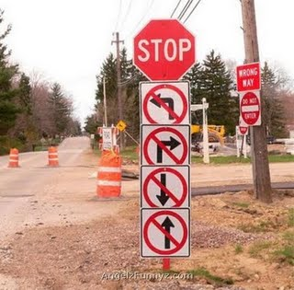

Slide 54
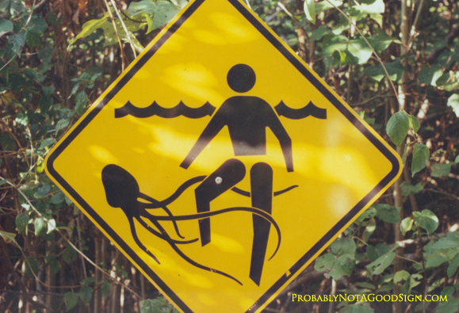

Slide 55
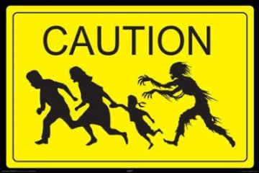

Slide 56
Make Your Own funny Caution Sign

Slide 57
Stop
Caution
Go

