Slide 1
Beyond England

Slide 2
Which Countries Speak English
Brainstorm English speaking countries
(official or de facto)

Slide 3
Which Countries Speak English
India
United States
Pakistan
Nigeria
Bangladesh
Ethiopia
Philippines
United Kingdom
South Africa
Tanzania
Myanmar
Kenya
Uganda
Sudan
Canada
Malaysia
Ghana
Nepal
Cameroon
Australia
Sri Lanka
Malawi
Zambia
Zimbabwe
Rwanda
Burundi
South Sudan
Jordan
UAE
Papua New Guinea
Israel
Sierra Leone
Singapore
Liberia
Ireland
New Zealand
Kuwait
Eritrea
Jamaica
Qatar
Namibia
Botswana
Lesotho
Bahrain

Slide 4
Which Countries Speak English
Trinidad and Tobago
Mauritius
Cyprus
Swaziland
Fiji
Guyana
Solomon Islands
Maldives
Malta
Brunei
Belize
Bahamas
Vanuatu
Barbados
Samoa
Saint Lucia
Kiribati
Grenada
Saint Vincent and the Grenadines
Tonga
Seychelles
Antigua and Barbuda
Dominica
Marshall Islands
Saint Kitts and Nevis
Palau
Cook Islands
Tuvalu
Nauru
Niue

Slide 5
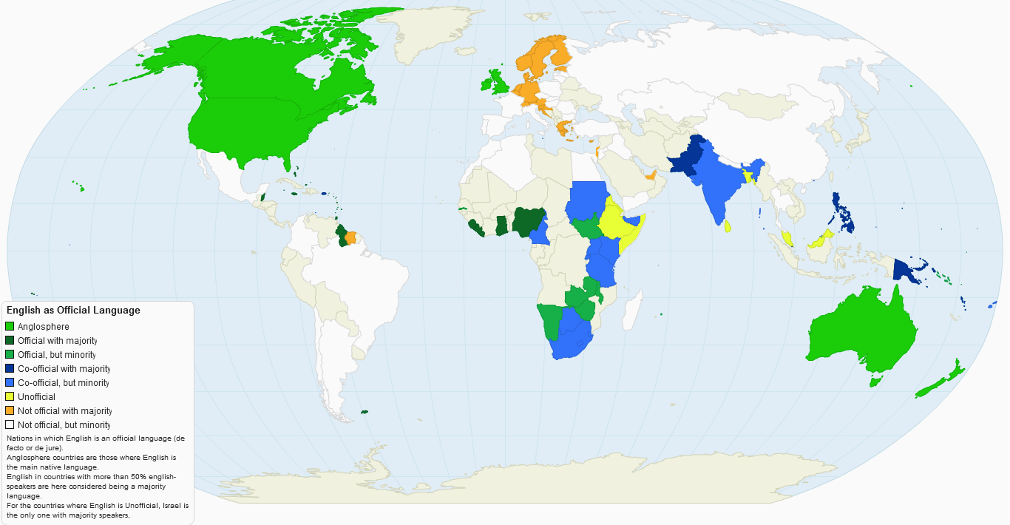

Slide 6
% of Native Speakers

Slide 7
United Kingdom
92.2%

Slide 8
New Zealand
90.1%

Slide 9
Ireland
87.1%

Slide 10
United States of America
78.9%

Slide 11
Australia
77.7%

Slide 12
Canada
56.0%

Slide 13
Singapore
36.9%

Slide 14
South Africa
8.3%

Slide 15
British Colonies
The sun never sets on the British Empire

Slide 16
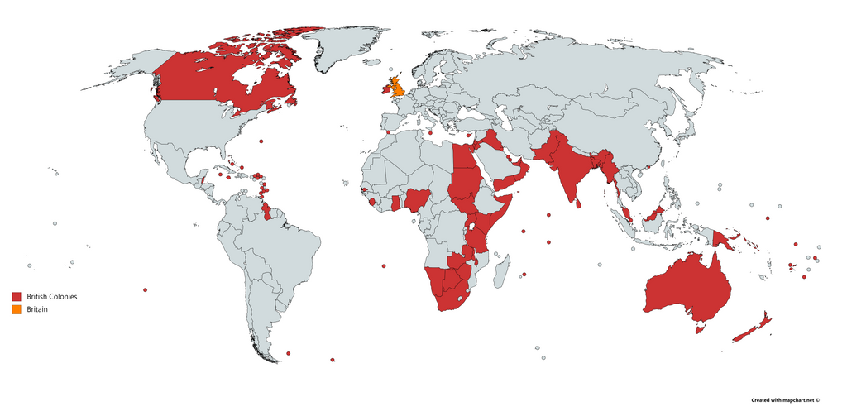

Slide 17
American vs British

Slide 18
Change the British spelling to American:
Neighbour
Centre
Licence
Apologise
Oestrogen
Travelling
Tyre
Flavour
Storey
Fibre
Defence
Connexion*
Aeon
Faeces
Organize
Prise
Paralyse
Dialogue
Jewellery
Learnt
Sceptic
Likeable
Axe
Cosy
Doughnut
Grey

Slide 19
Neighbour
Neighbor

Slide 20
Centre
Center

Slide 21
Licence
License

Slide 22
Apologise
Apologize

Slide 23
Oestrogen
Estrogen

Slide 24
Travelling
Traveling

Slide 25
Tyre
Tire

Slide 26
Flavour
Flavor

Slide 27
Storey
Story

Slide 28
Fibre
Fiber

Slide 29
Defence
Defense

Slide 30
Connexion
Connection

Slide 31
Aeon
Eon

Slide 32
Faeces
Feces

Slide 33
Organise
Organize

Slide 34
Prise
Prize

Slide 35
Paralyse
Paralyze

Slide 36
Dialogue
Dialog

Slide 37
Jewellery
Jewelry

Slide 38
Learnt
Learned

Slide 39
Sceptic
Skeptic

Slide 40
Likeable
Likable

Slide 41
Axe
Ax

Slide 42
Cosy
Cozy

Slide 43
Doughnut
Donut

Slide 44
Grey
Gray

Slide 45
American Influence
Does the sun ever set on America?

Slide 46
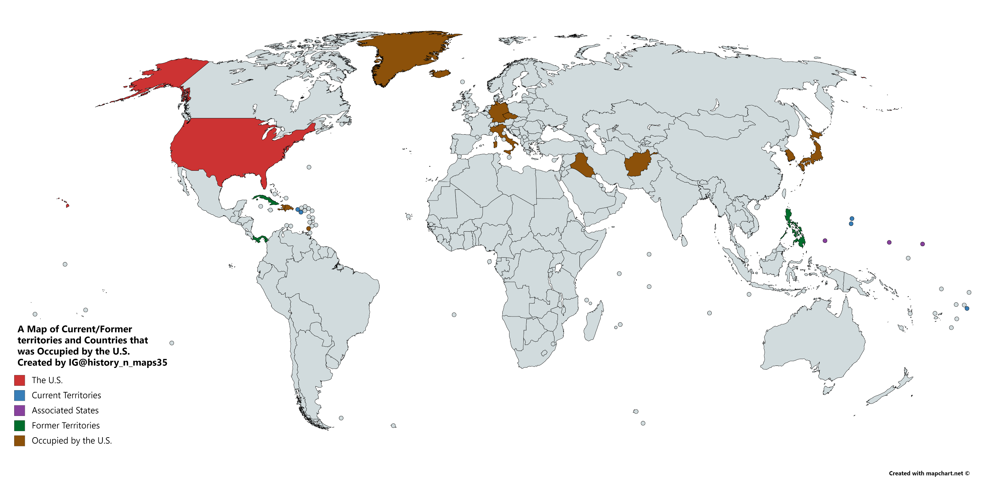

Slide 47
Additional Influence
American Political System
American English
American Media

Slide 48
American-English History

Slide 49
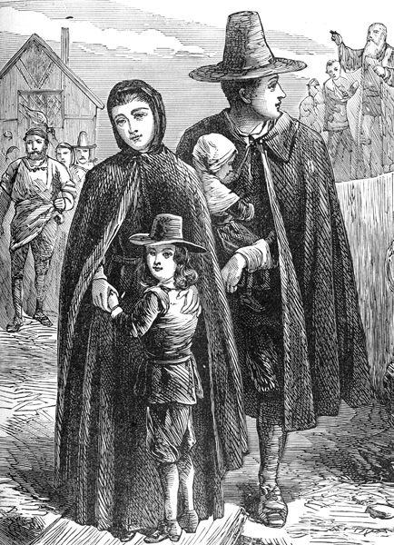
Puritans
First settlers
England
Religious
Squanto Story

Slide 50
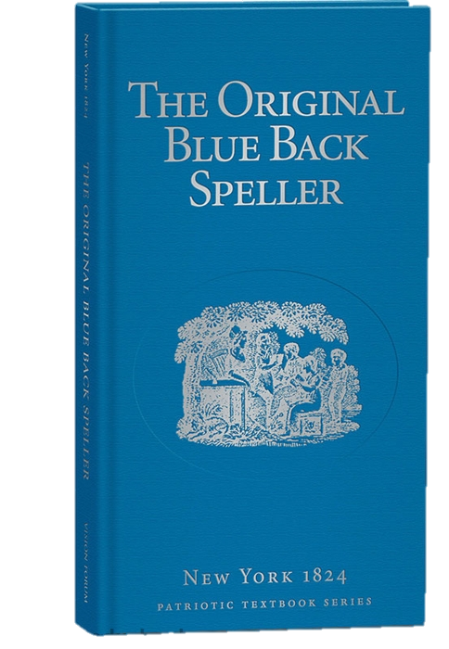
Blueback Speller
Top seller
Non-regional accents

Slide 51
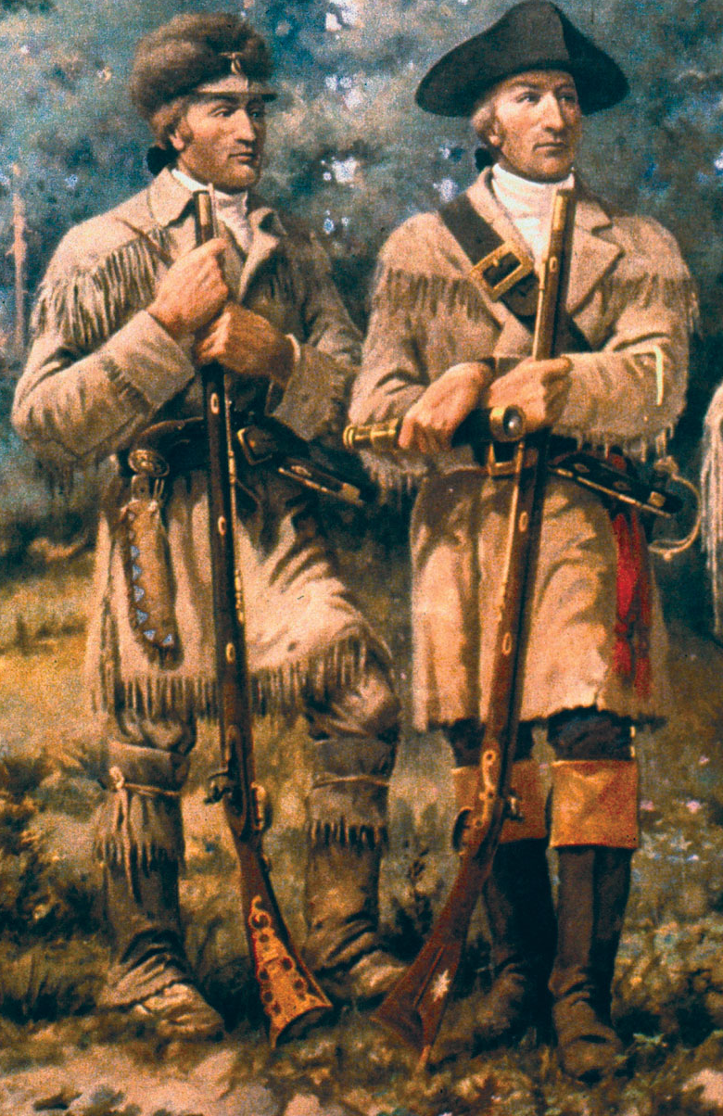
Lewis and Clark
Louisiana Purchase (1803)
Find a passage to the West
Nature
Similar to England
Native borrowings
Descriptive names

Slide 52
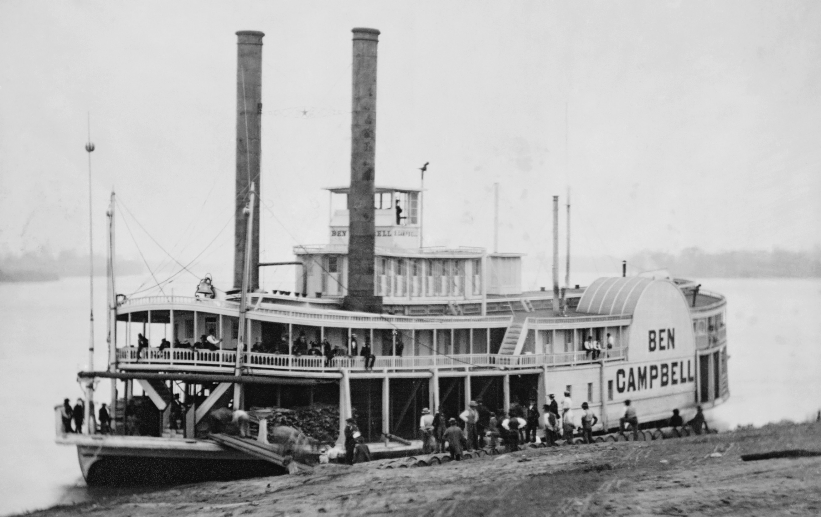
Riverboat Gamblers
To be continued…

Slide 53
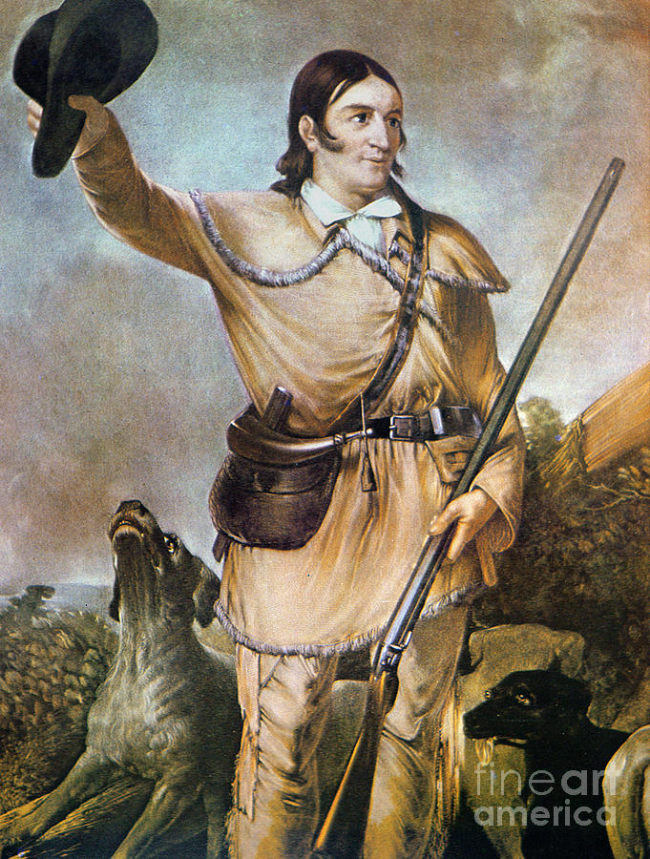
Davy Crockett
Tall tales
“When he talked, he made the forest shake.”

Slide 54
Slaves
Brought African words and traditions
Uneducated
Liberia

Slide 55
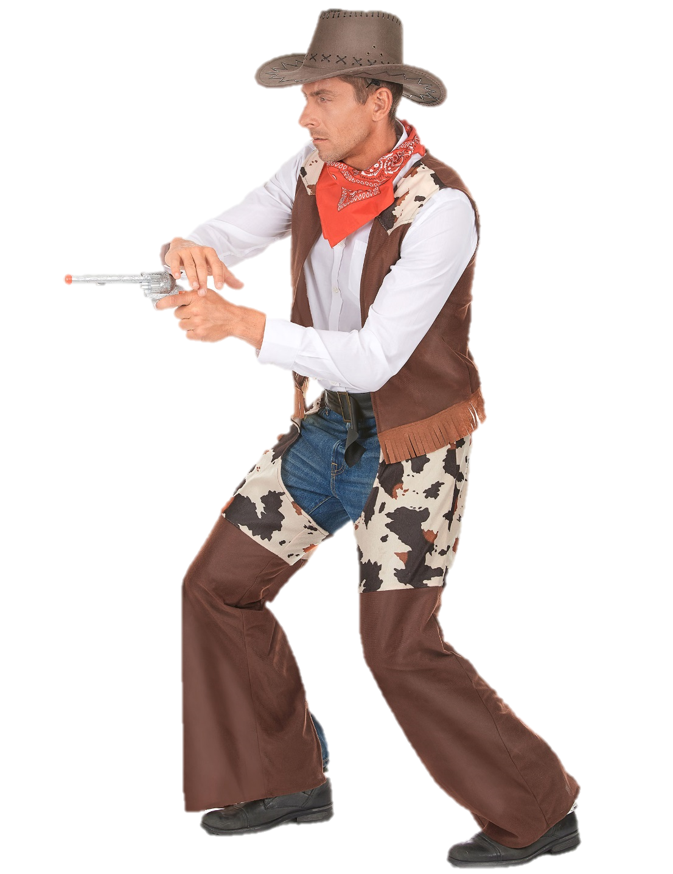
Other Influence
Gold Rush
Cowboys

